Slide 1
Regulatory Update
FDA SDTCG 4.3,
Data Standards Catalog
Antje Simon, Parexel
25 September 2019, 29th CDISC DACH UG Meeting, Eschborn

Slide 2
Agenda
FDA Study Data Technical Conformance Guide v4.3 updates (compared to v4.2.1)
FDA Data Standards Catalog v6.1 (09-09-2019)

Slide 3
FDA Technical Conformance Guide
Changes from version 4.2.1 to 4.3

Slide 4
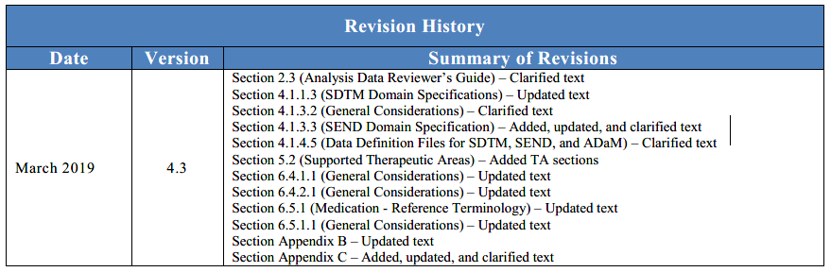
Revision History
FDA Study Data Technical Conformance Guide 4.3 (March 2019)
    Note: version 4.2.1 was backdated to “December 2018” in the Revision History.
    Version date in 4.2.1 is “January 2019”
https://www.fda.gov/media/122913/download

Slide 5
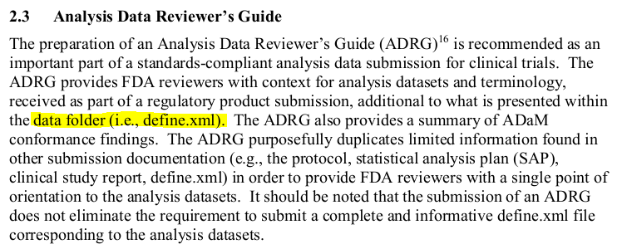
FDA SDTCG changes 4.2.1 → 4.3
Section 2.3 (Analysis Data Reviewer’s Guide)
  Small clarification
    Wording in 4.2.1: “… the data definition folder (i.e., define.xml) …”
FDA SDTCG v. 4.3 page 5

Slide 6
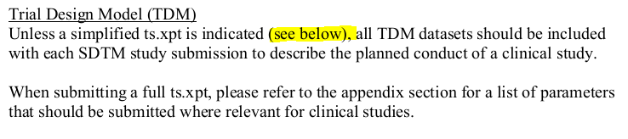
FDA SDTCG changes 4.2.1 → 4.3
Section 4.1.1.3 (SDTM Domain Specifications)
  Small clarification
    Wording in 4.2.1: “…(see section 7.3) …”
    (… but there was no section 7.3 in TCG 4.2.1)
    The paragraph about use of a simplified TS was already removed in 4.2.1.
    Thus “see below” does not refer to anything.
FDA SDTCG v. 4.3 page 12

Slide 7
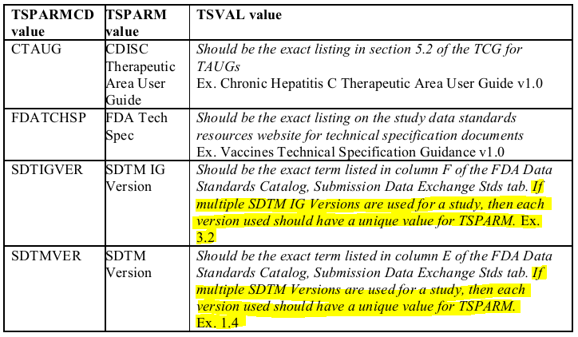
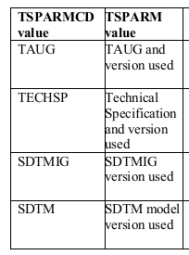
FDA SDTCG changes 4.2.1 → 4.3
Section 4.1.1.3 (SDTM Domain Specifications)
  Type of change: Clarified text
    Wording in 4.2.1: “…(see section 7.3) …”
    … but there was no section 7.3 in TCG 4.2.1
    TSPARMCDs/TSPARMs about applicable specifications changed
    Instruction about use of multiple SDTM versions added
  TSPARM(CD) in TCG 4.2.1:
FDA SDTCG v. 4.3 page 12

Slide 8

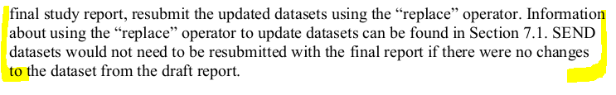
FDA SDTCG changes 4.2.1 → 4.3
Section 4.1.3.2 (General Considerations) – in 4.1.3 SEND
  New paragraph regarding CDER submission of SEND datasets (and re-submission)
FDA SDTCG v. 4.3 page 16/17

Slide 9
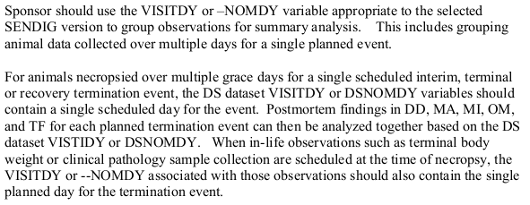
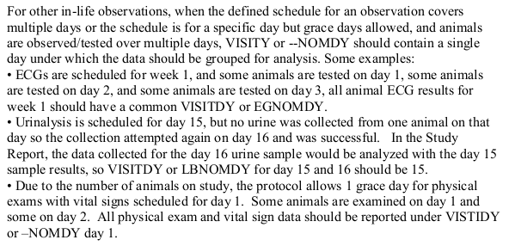
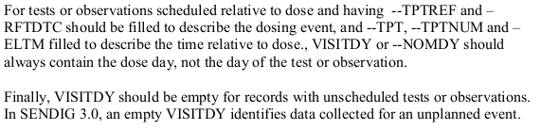
FDA SDTCG changes 4.2.1 → 4.3
Section 4.1.3.2 (General Considerations) – in 4.1.3 SEND
  Extended section about use of
  VISITDY, --NOMDY
    More examples
    Clear guidance that
    “VISITDY or --NOMDY should always contain
    the dose day, not the day of the test or observation.”
FDA SDTCG v. 4.3 page 17

Slide 10
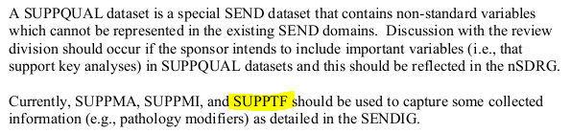
FDA SDTCG changes 4.2.1 → 4.3
Section 4.1.3.3 (SEND Domain Specification) – in 4.1.3 SEND
  List of domains extended
    SUPPTF (Supplemental Qualifiers for Tumor Findings) added
FDA SDTCG v. 4.3 page 18

Slide 11

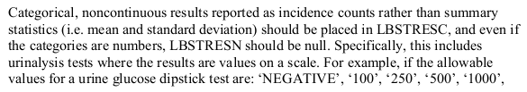
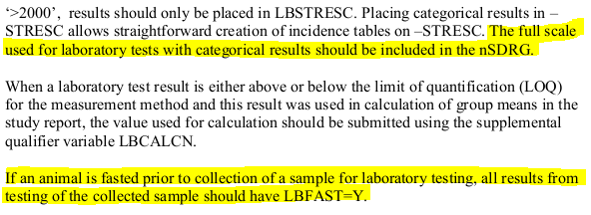
FDA SDTCG changes 4.2.1 → 4.3
Section 4.1.3.3 (SEND Domain Specification) – in 4.1.3 SEND
  Guidance for LB amended
    NEW: Explain categorical results in nSDRG
    NEW: Use LBFAST for fasting status
FDA SDTCG v. 4.3 page 19

Slide 12
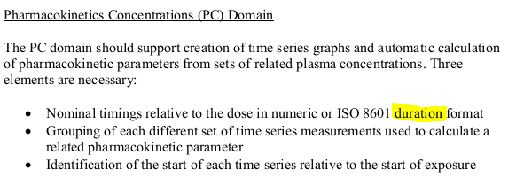
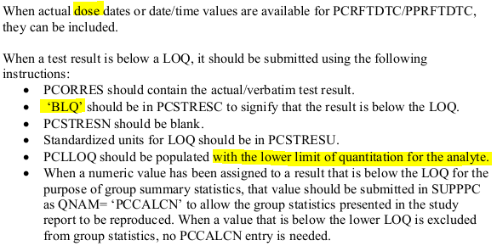
FDA SDTCG changes 4.2.1 → 4.3
Section 4.1.3.3 (SEND Domain Specification) – in 4.1.3 SEND
  …
  Small clarifications
  Wording in 4.2.1:
    “… ISO 8601 format …” (“duration” added)
    Wording in 4.2.1: “… actual dates …” (“dose” added)
    Wording in 4.2.1: “The value of ‘BLQ’ should be in PCSTRESC …”
    “… with the lower limit of quantitation for the analyte.” added
FDA SDTCG v. 4.3 page 19

Slide 13


FDA SDTCG changes 4.2.1 → 4.3
Section 4.1.3.3 (SEND Domain Specification) – in 4.1.3 SEND
  Reference to simplified TS removed
  Guidance for abbreviations added
FDA SDTCG v. 4.3 page 20

Slide 14
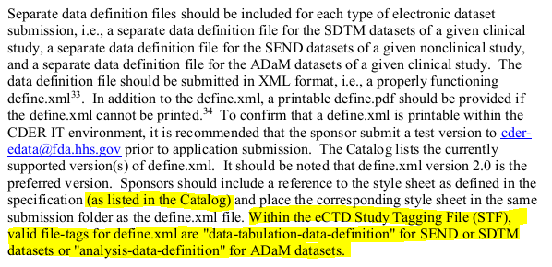
FDA SDTCG changes 4.2.1 → 4.3
Section 4.1.4.5 (Data Definition Files for SDTM, SEND, and ADaM)
    Clarification added
    Guidance for eCTD STF
FDA SDTCG v. 4.3 page 22

Slide 15
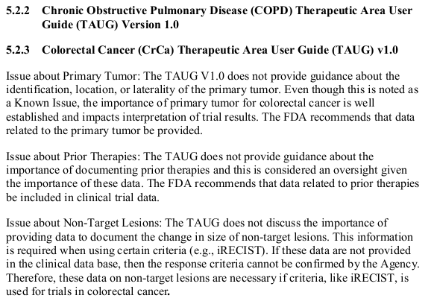
FDA SDTCG changes 4.2.1 → 4.3
Section 5.2 (Supported Therapeutic Areas)
  New TAUGs added
    COPD version v1.0
    Colorectal Cancer v1.0
    Huntington’s Disease v1.0
    TAUGs are listed in alphabetical order => section numbers of the other TAUGs changed
FDA SDTCG v. 4.3 page 24-26
Notes:
List of all TAUGs in the TCG with previous section numbers
5.2.1 Chronic Hepatitis C Therapeutic Area User Guide v1.0
5.2.2 Chronic Obstructive Pulmonary Disease (COPD) Therapeutic Area User Guide (TAUG) Version 1.0 -> NEW
5.2.3 Colorectal Cancer (CrCa) Therapeutic Area User Guide (TAUG) v1.0 -> NEW
5.2.4 Dyslipidemia Therapeutic Area User Guide v1.0 -> was section 5.2.2
5.2.5 Diabetes Therapeutic Area User Guide v1.0 – Supplement for ADaM -> was section 5.2.3
5.2.6 Diabetic Kidney Disease Therapeutic Area User Guide v1.0 -> was section 5.2.4
5.2.7 Duchenne Muscular Dystrophy Therapeutic Area User Guide v1.0 -> was section 5.2.5
5.2.8 Ebola Therapeutic Area User Guide v1.0 -> was section 5.2.6
5.2.9 Huntington’s Disease Therapeutic Area User Guide v1.0 -> NEW
5.2.10 Influenza Therapeutic Area User Guide v1.1 -> was section 5.2.7
5.2.11 Kidney Transplant Therapeutic Area User Guide v1.0 -> was section 5.2.8
5.2.12 Major Depressive Disorder Therapeutic Area User Guide v1.0 -> was section 5.2.9
5.2.13 Malaria Therapeutic Area User Guide v1.0 -> was section 5.2.10
5.2.14 Prostate Cancer Therapeutic Area User Guide v1.0 -> was section 5.2.11
5.2.15 QT Studies Therapeutic Area User Guide v1.0 -> was section 5.2.12
5.2.16 Rheumatoid Arthritis Therapeutic Area User Guide v1.0 -> was section 5.2.13
5.2.17 Schizophrenia Therapeutic Area User Guide v1.1 -> was section 5.2.14
5.2.18 Traumatic Brain Injury Therapeutic Area User Guide v1.0 -> was section 5.2.15
5.2.19 Tuberculosis Therapeutic Area User Guide v2.0 -> was section 5.2.16
5.2.20 Vaccines Therapeutic Area User Guide v1.1 -> was section 5.2.17
5.2.21 Virology Therapeutic Area User Guide v2.1 -> was section 5.2.18

Slide 16
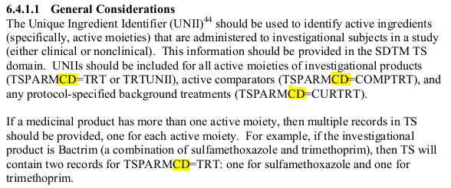
FDA SDTCG changes 4.2.1 → 4.3
Section 6.4.1.1 (General Considerations) – in 6.4.1 FDA Unique Ingredient Identifier
    Correction: variable name “TSPARM” was used in 4.2.1 but it should be “TSPARMCD”
FDA SDTCG v. 4.3 page 30

Slide 17
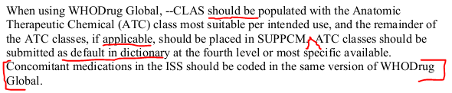
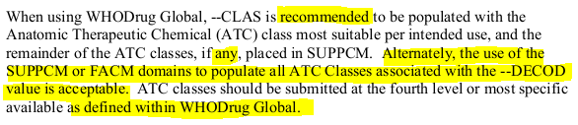
FDA SDTCG changes 4.2.1 → 4.3
Section 6.4.2.1 (General Considerations) – in 6.4.2 WHODrug Global
TCG 4.2.1 TCG 4.3
    ATC coding
    Use of --CLAS for intended use with other classes in SUPPCM was the only option per TCG 4.2.1
    Alternative added in 4.3: Use SUPPCM or FACM for all ATC classes.
    Guidance about medications in ISS removed
FDA SDTCG v. 4.3 page 31

Slide 18
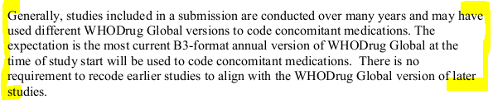
FDA SDTCG changes 4.2.1 → 4.3
Section 6.4.2.1 (General Considerations) – in 6.4.2 WHODrug Global
    New paragraph about required dictionary version and re-coding.
FDA SDTCG v. 4.3 page 31

Slide 19
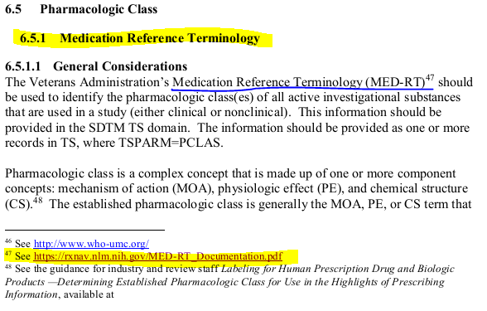
FDA SDTCG changes 4.2.1 → 4.3
Section 6.5.1 (Medication - Reference Terminology)
  Corrections for consistency of an “incomplete” update in 4.2
    Reference to “National Drug File” updated to “Medication Reference Terminology” in section header and Footnote/link.
      This change was already made in the 6.5.1.1 text (update from TCG 4.1 to 4.2)
      MED-RT is a replacement and successor to NDF-RT.
FDA SDTCG v. 4.3 page 31

Slide 20
FDA SDTCG changes 4.2.1 → 4.3
Appendix B: Trial Summary (TS) Parameters for Submission – Clinical
  NEW parameter
        SSTDTC (Study Start Date)
  CHANGE to recently added parameters about specs versions:
        TAUG (v4.2.1) is now CTAUG (CDISC Therapeutic Area User Guide)
        TECHSP (v4.2.1) is now FDATCHSP (FDA Technical Specification)
        SDTM (v4.2.1) is now SDTMVER (SDTM Version)
        SDTMIG (v4.2.1) is now SDTIGVER (SDTM IGVersion)
  Note about multiple versions added for SDTMVER and SDTIGVER
      “If multiple SDTM Versions are used for a study the every version should be listed on each row.”
  Column TSPARM updated to the Submission Value of TSPARM CT
  (v4.2.1 showed the CDISC Synonym)
FDA SDTCG v. 4.3 page 44-46
Notes:
STTDTC already in TSPARMCD CT (added years ago)
Changed parameters with old TSPARMs
CTAUG (CDISC Therapeutic Area User Guide), Previously TAUG (Title and version of TAUG used for study data)
FDATCHSP (FDA Technical Specification), Previously TECHSP (Title and version of Tech Spec used for study data)
SDTMVER (SDTM Version), Previously SDTM (Version of SDTM model used)
SDTIGVER (SDTM IGVersion), Previously SDTMIG (Version of SDTM Implemtation Guide used)
Note “…the every version should be listed on each row” is very, very confusing.
Corresponding note in in section 4.1.1.3 “If multiple SDTM IG Versions are used for a study, then each version used should have a unique value for TSPARM. “

Slide 21
FDA SDTCG changes 4.2.1 → 4.3
Appendix C: Trial Summary (TS) Parameters for Submission – Nonclinical
  NEW parameters
        INTSAC (Time to Interim Sacrifice)
        RECSAC (Recovery Sacrifice Period)
  REMOVED parameters
        WATER (Drinking Water)
  “FDA Desired” condition added for AGE and AGETXT (only one is required)
  Column TSPARM updated to the Submission Value of TSPARM CT
  (v4.2.1 showed the CDISC Synonym)
FDA SDTCG v. 4.3 page 47-48

Slide 22
FDA SDTCG changes 4.2.1 → 4.3
Summary of changes
  A few small clarifications here and there (no change to requirements)
  A few clarifications that are new requirements
  SDTM TSPARM(CD) names updated (they were introduced in 4.2)
  List of SEND TSPARM(CD) extended
  3 additional TAUGs supported
  Alternative way to report ATC classes
FDA SDTCG v. 4.3 page 47-48

Slide 23
FDA Data Standards Catalog
v6.1 (09-09-2019)

Slide 24
FDA Data Standards Catalog v6.1 (09-09-2019)
SDTM
define.xml
Supported Version | Supported Implementation Guide Version | FDA Center(s) | Date Support Begins (MM/DD/YYYY) | Date Support Ends (MM/DD/YYYY) | Date Requirement Begins (MM/DD/YYYY) | Date Requirement Ends
1.2 | 3.1.2 | CDER, CBER | 30-10-2009 | 03/15/2019 [1] 03/15/2020 [2] | 12/17/2016 [1] 12/17/2017 [2] | 03/15/2019 [1] 03/15/2020 [2]
1.2 | Version 3.1.2 Amendment 1 | CDER, CBER | 08-07-2013 | 03/15/2019 [1] 03/15/2020 [2] | 12/17/2016 [1] 12/17/2017 [2] | 03/15/2019 [1] 03/15/2020 [2]
1.3 | 3.1.3 | CDER, CBER | 12-01-2012 |  | 12/17/2016 [1] 12/17/2017 [2]
1.4 | 3.2 | CDER, CBER | 08-17-2015 |  | 03/15/2018 [1] 03/15/2019 [2]
Supported Version | Supported Implementation Guide Version | FDA Center(s) | Date Support Begins (MM/DD/YYYY) | Date Support Ends (MM/DD/YYYY) | Date Requirement Begins (MM/DD/YYYY) | Date Requirement Ends
2.0 | N/A | CDER, CBER | 08-07-2013 |  | 12/17/2016 [1] 12/17/2017 [2]
https://www.fda.gov/media/122913/download

Slide 25
FDA Data Standards Catalog v6.1 (09-09-2019)
ADaM
SEND
Supported Version | Supported Implementation Guide Version | FDA Center(s) | Date Support Begins (MM/DD/YYYY) | Date Support Ends (MM/DD/YYYY) | Date Requirement Begins (MM/DD/YYYY) | Date Requirement Ends
2.1 | 1.0 | CDER, CBER | Ongoing | 03/15/2019 [1] 03/15/2020 [2] | 12/17/2016 [1] 12/17/2017 [2] | 03/15/2019 [1] 03/15/2020 [2]
2.1 | 1.1 | CDER, CBER | 03-15-2018 |  | 03/15/2019 [1] 03/15/2020 [2]
Supported Version | Supported Implementation Guide Version | FDA Center(s) | Date Support Begins (MM/DD/YYYY) | Date Support Ends (MM/DD/YYYY) | Date Requirement Begins (MM/DD/YYYY) | Date Requirement Ends
1.2 | 3.0 | CDER | 06-13-2011 | 03/15/2019 [1] 03/15/2020 [2] | 12/17/2016 [1] 12/17/2017 [2] | 03/15/2019 [1] 03/15/2020 [2]
1.5 | 3.1 | CDER | 08-21-2017 |  | 3/15/2019 [1] 3/15/2020 [2]
https://www.fda.gov/media/122913/download

Slide 26
Thank you

