Slide 1
CDISC UG 25-Sep-2019
SDTM IG v3.3
6.3.10 Findings I (Morphology/Physiology Domains Subgroup)

Slide 2
6.3.10 Findings I (Morphology/Physiology Domains)
CV: Cardiovascular System Findings
MK: Muscoloskeletal System Findings
NV: Nervous System Findings

Slide 3
CV: Cardiovascular System Findings
A domain for morphological and physiological findings related to the
cardiovascular system, including the
heart, blood vessels, lymphatic vessels
Assumptions:
This domain is used to represent results and findings of cardiovascular diagnostic procedures. Information about the conduct of the procedure(s), if collected, is submitted in the Procedure Domain (PR).
Any identifiers, timing variables, or findings general observation class qualifiers may be added to the CV domain, but the following Qualifiers would generally not be used in CV: MODIFY, BODSYS, FAST, ORNRLO, ORNRHI, TNRLO, STNRHI, and LOINC.

Slide 4
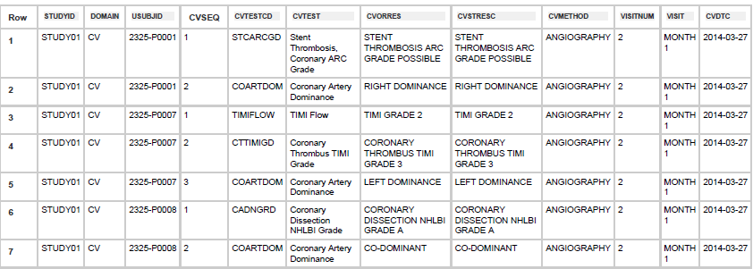
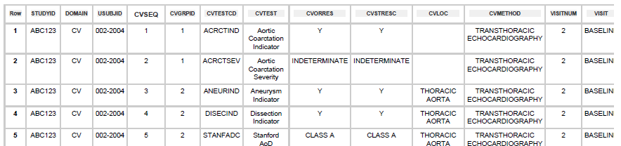
CV: Cardiovascular System Findings – Examples

Slide 5
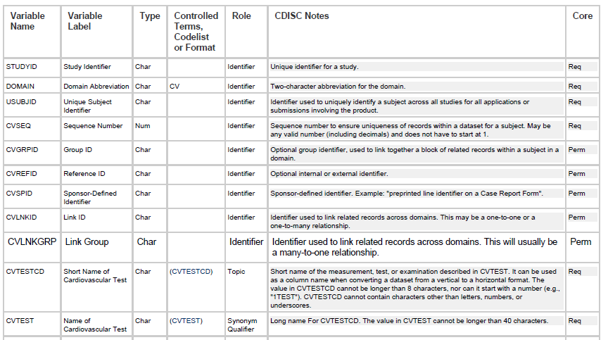
CV: Cardiovascular System Findings - Variables

Slide 6
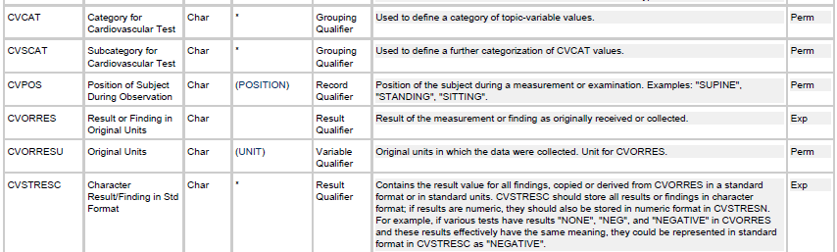
CV: Cardiovascular System Findings – Variables II

Slide 7
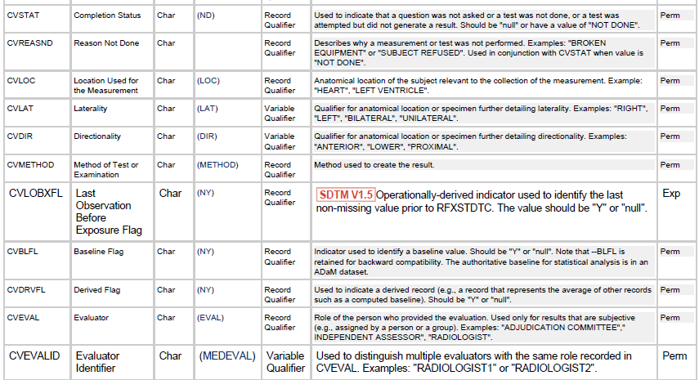
CV: Cardiovascular System Findings – Variables III

Slide 8
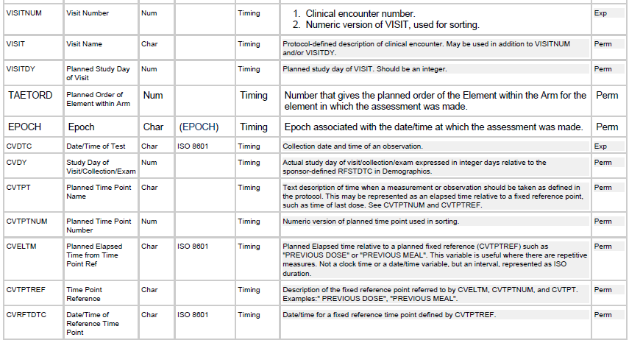
CV: Cardiovascular System Findings – Variables IV

Slide 9
MK: Musculoskeletal System Findings
Musculoskeletal System Findings:
A domain for morphological and physiological findings related to the system of muscles, tendons, ligaments, bones, joints and associated tissues
Assumptions:
This domain should not be used for oncology data related to the musculoskeletal system (e.g., bone lesions). Such data should be placed in the appropriate oncology domains: TU, TR, and/or RS.
Musculoskeletal assessment examples that may have results represented in the MK domain include the following:morphology/physiology observations such as
swollen/tender joint count, limb movement, and strength/grip measurements.
Note that --BLFL is retained for backward compatibility. The authoritative baseline flag for statistical analysis is in an ADaM dataset.
Any Identifier variables, Timing variables, or Findings general-observation-class qualifiers may be added to the MK domain, but the following qualifiers would generally not be used in MK:
--MODIFY, --BODSYS,--LOINC, --TOX, --TOXGR,--FAST, --ORNRLO, --ORNRHI, –STNRLO, --STNRHI,--ORREF,–STREFC, --STREFN

Slide 10
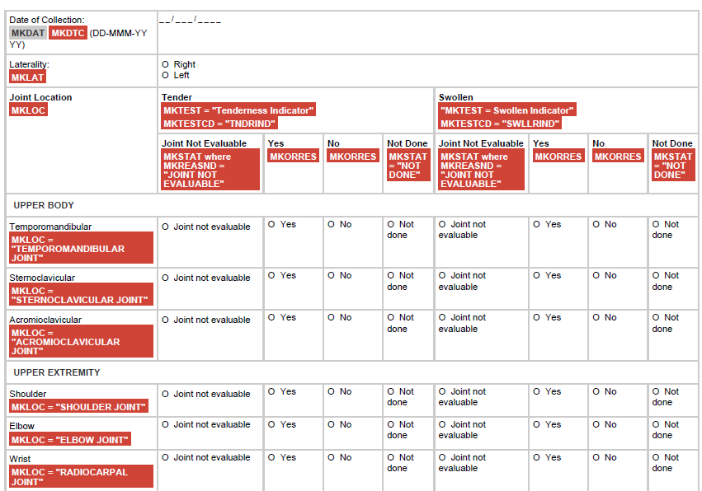
MK: Musculoskeletal System Findings – Examples

Slide 11

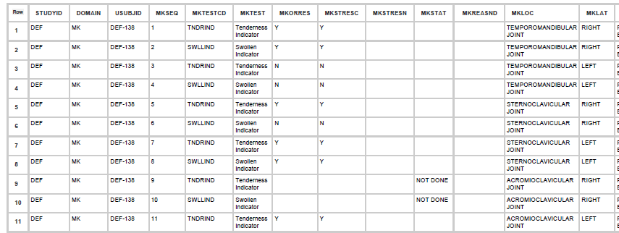
MK: Musculoskeletal System Findings – Examples

Slide 12
NV - Nervous System Findings
Nervous System Findings
A domain for morphological and physiological findings related to the nervous system based on neurological examinations or procedures, involving the brain, spinal cord, the cranial and spinal nerves, autonomic ganglia, and plexuses.
Assumptions:
Methods of assessment for nervous system findings may include
nerve conduction studies, EEG, EMG, and imaging.
Any Identifier variables, Timing variables, or Findings general observation class Qualifiers may be added to the NV domain, but the following Qualifiers would not generally be used in NV:
--MODIFY, --BODSYS,--LOINC, --TOX,--TOXGR

Slide 13
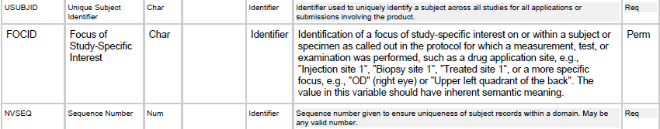
NV - Nervous System Findings – special variables
After USUBJID/before NVSEQ:
--POS does not exist in NV
(‘SITTING’, ’SUPINE’) is not used here

Slide 14
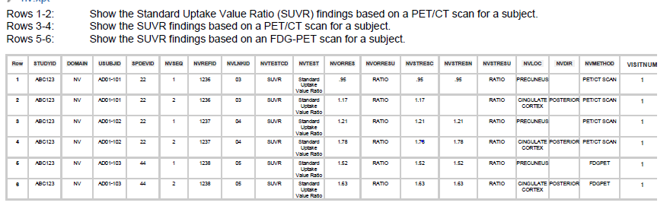
NV - Nervous System Findings - Examples

Slide 15
6.3.10 Findings I (Morphology/Physiology Domains)
QUESTIONS ???
COMMENTS ???
THANKS for your attention ☺

