Slide 1
German CDISC UN 25-Sep-2019
SDTM IG v3.3
5.4 SM, 7.3.3 TM - Disease Milestones

Slide 2
Disease Milestone
Event or activity that can be anticipated in the course of a disease, trigger collection of data
Timing not controlled by the study schedule
Examples: Diagnosis of a disease, AE of interest
For Study: Types defined in TM-Trial Disease Milestones
For subject: Times of occurrence in SM-Subject Disease Milestones, structure similar to SV and SE
Not used if a study does not have milestones

Slide 3
Disease Milestone Naming
Instances are given names at subject level
TM:
  MIDSTYPE=character string
SM:
  MIDSTYPE=character string
  MIDS=short form of character string + sequence number
Findings, intervention or events class records:
  MIDS=short form of character string + sequence number

Slide 4
Disease Milestone Timing
SM: SMSTDTC/SMENDTC, SMSTDY/SMENDY
  Date/time of disease milestone, study day
Related Domains: MIDS, RELMIDS, MIDSDTC
  MIDS: populated with name of milestone (anchor)
    Similar to --TPTREF
  RELMIDS: temporal relationship between observation and milestone named in MIDS (not study schedule)
    Currently no CT, example: IMMEDIATELY BEFORE, DURING
    Similar to --ELTM
  MIDSDTC: --DTC for finding or --STDTC for event
    Similar to --RFTDTC

Slide 5
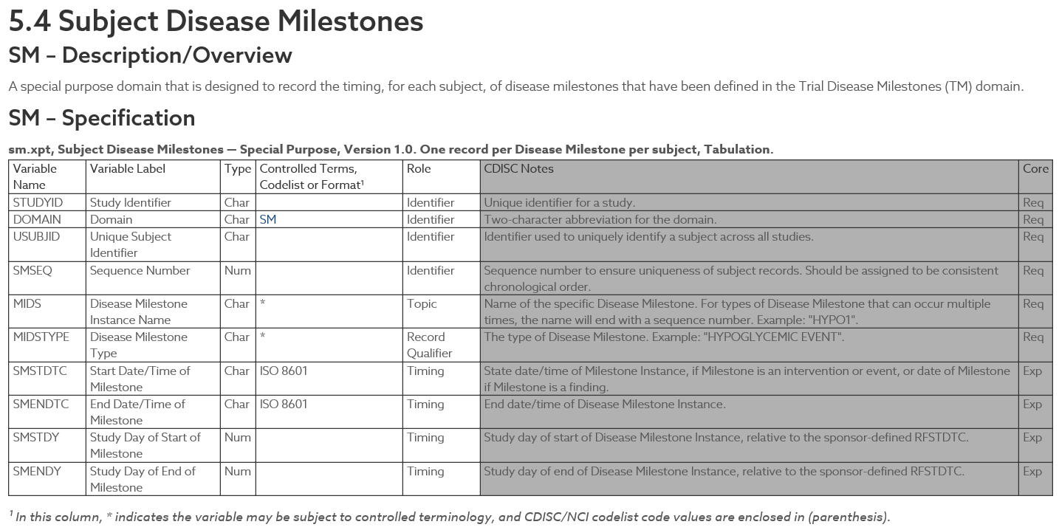
Special Purpose Domains – 5 SM

Slide 6
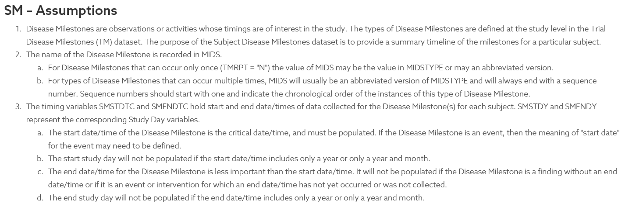
Special Purpose Domains – 5 SM

Slide 7
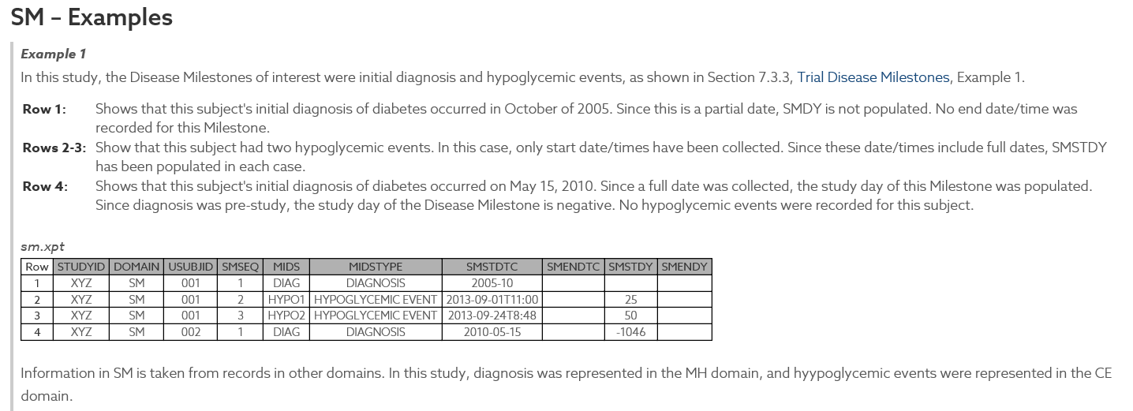
Special Purpose Domains – 5 SM

Slide 8
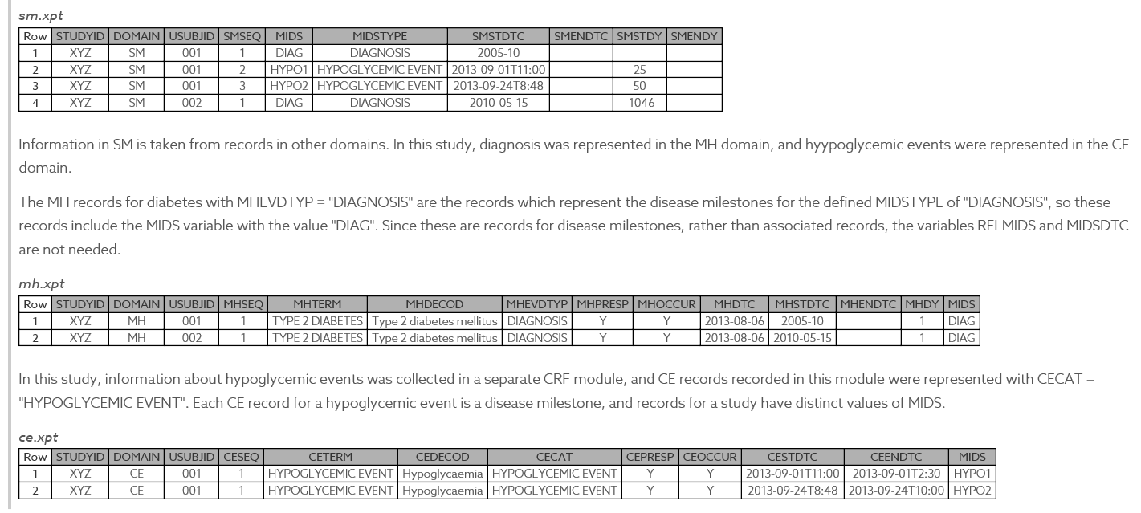
Special Purpose Domains – 5 SM

Slide 9
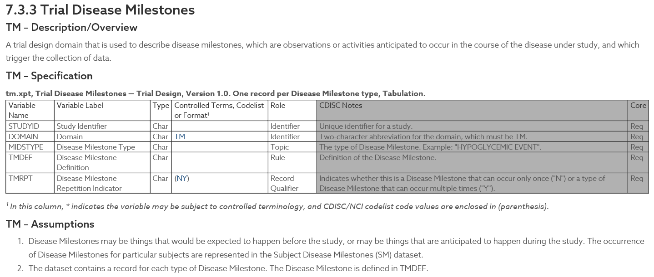
Special Purpose Domains – 7 TM

Slide 10
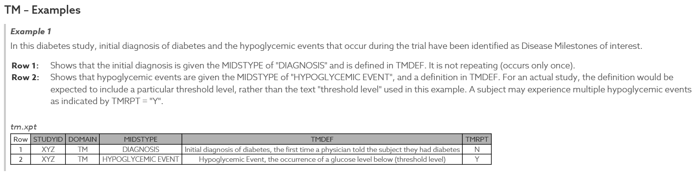
Special Purpose Domains – 7 TM

Slide 11
Things to note
Timing related to milestone, not to study schedule
If study without milestones, then disease milestone timing variables may not be included in other domains
If milestone=event or intervention, some data triggered by the milestone may be modeled as FA.
  RELMIDS then related to subject of question in finding,
  not when question was asked
MIDS to link observations associated with a milestone
  Similar to VISITNUM to link observations collected at a visit
  advantage over RELREC as nature of relationship is included
  RELREC not needed when milestones are defined

Slide 12
Reference
CDISC SDTM IG 3.3
https://www.cdisc.org/standards/foundational/sdtmig/sdtmig-v3-3#Subject+Disease+Milestones

Slide 13
Questions
Sabine Erbslöh
Associate Director Statistical Programming
Helfmann-Park 10
D-65760 Eschborn, Germany
DIRECT: +49 6196-7709-263
mailto: serbsloeh@Clinipace.com

