Slide 1
First Experiences with the
CDISC Library API and
RESTful Web Services
Jozef Aerts
XML4Pharma
CDISC German Speaking USER GROUP
September 2019

Slide 2
What is the CDISC Library API ?
It is a huge metadata repository (MDR) ultimately containing almost all of the CDISC standards
Machine-readable
Queryable using RESTful web services

Slide 3
What are RESTful Web Services ?
What is an API ?
RESTful web services are services running over the internet (usually HTTP/HTTPS)
GET / POST / PUT / POST / DELETE
Return structured information formatted as XML, JSON, RDT-Turtle, …
Can usually be tested in the browser, but are meant to be used by applications
The API describes the available methods and how to run them

Slide 4
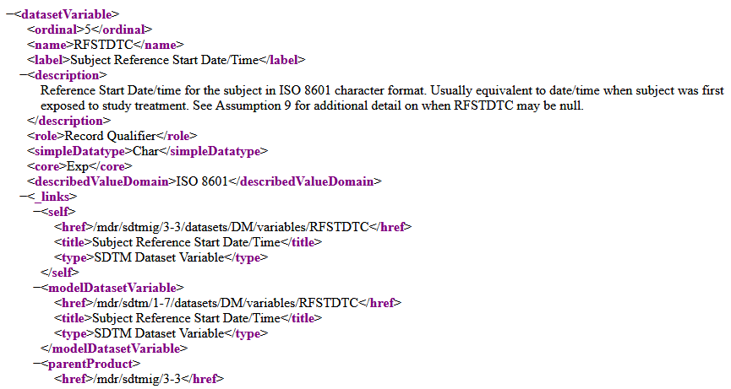
Example in browser
https://library.cdisc.org/api/mdr/sdtmig/3-3/datasets/DM/variables/RFSTDTC

Slide 5
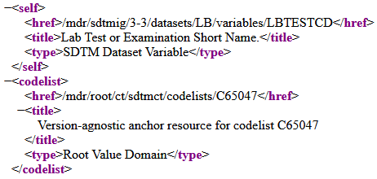

HATEAOS principles
Response contains links to parent and child and related information
Example: LB - LBTESTCD (SDTM-IG 3.3)

Slide 6
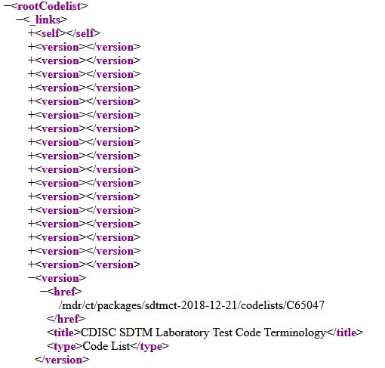
HATEAOS principles
LBTESTCD Codelist
CodeLists have … versions

Slide 7
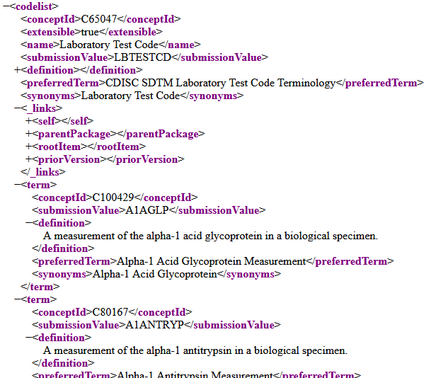
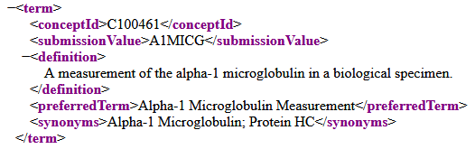
HATEAOS principles
LBTESTCD Codelist 2018-12-21
CodeLists versions have
… terms

Slide 8
What is currently covered ?
Controlled Terminology
CDASH
CDASH-IG
SDTM
SDTM-IG
SEND-IG
ADaM
Coming: TAUGs (Therapeutic Area User Guides)

Slide 9
Implementation in Software
RESTful web services are extremely easy to implement in modern software
"How to" examples for different computer languages on the Wiki:
https://wiki.cdisc.org/display/LIBSUPRT/Getting+Started%3A+Programmatically+connect+to+CDISC+Library+API
  Python
  SAS
  Java
  Coming: XSLT, XQuery

Slide 10
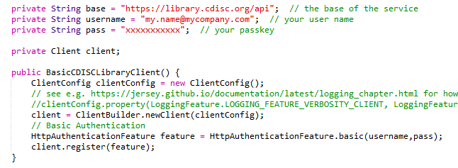
Implementation in Software: Java
(Using Jersey-2 libraries)
CDISC Library requires "Basic Authentication"
  This needs to be taken into account in applications

Slide 11
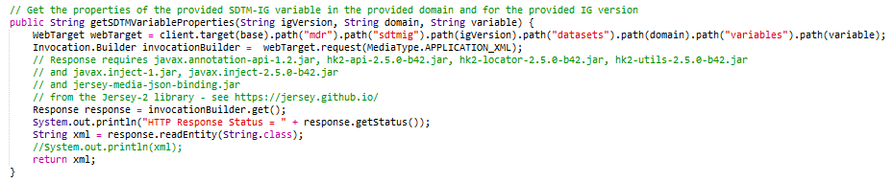
Implementation in Software: Java
(Using Jersey-2 libraries)
Example: get SDTM Variable Properties, with parameters
"IG-version", "domain", "variable"

Slide 12
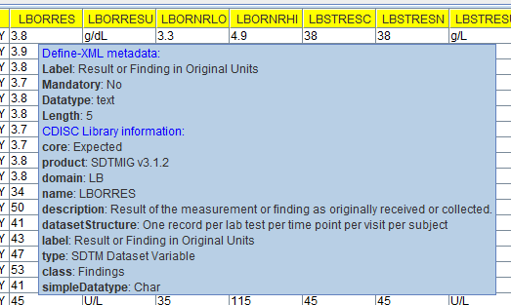
Implementation in Software: Java
Example: "Smart Submission Dataset Viewer"

Slide 13
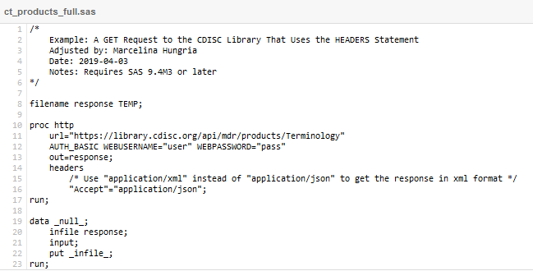
Implementation in Software: SAS

Slide 14
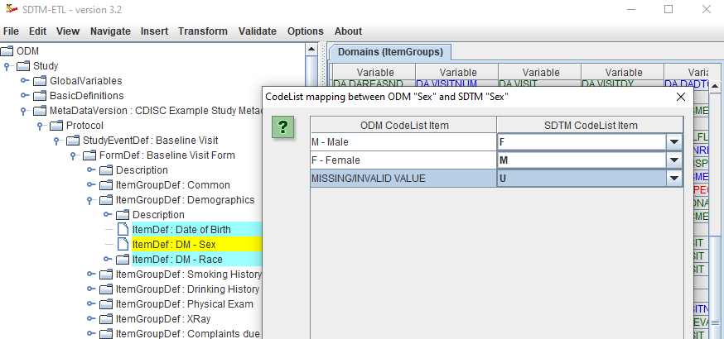
Implementation in XSLT
Mapping Software "SDTM-ETL" uses XSLT to execute the mappings
CDISC ODM
(e.g. from EDC)
Mapping Instructions
(XSLT)
Mapping Instructions
(propriety language)
Wizards
SDTM / SEND
(CDISC Dataset-XML)
SDTM / SEND
(outdated XPT)

Slide 15
Implementation in Software: XSLT
Problem:
XSLT very well supports RESTful web services
But does not well support "Basic Authentication"
Most used Java-Library for XSLT "Saxon" however allows to write XSLT extensions so that "Basic Authentication" can be applied
We are currently implementing this into the "SDTM-ETL" mapping software

Slide 16
Implementation in Software: XQuery
"Open Rules for CDISC Standards" initiative uses XQuery for expressing CDISC, FDA and PMDA validation rules
Thousands of rules available at:
http://xml4pharmaserver.com/OpenRulesForCDISCStandards/
  Including latest FDA-SDTM-2019 rules
XQuery very well supports RESTful web services
but does not well support "Basic Authentication"
This will be solved in near feature as W3C wants to add Authentication mechanisms to the XSLT/XQuery standard

Slide 17
"Search" function in CDISC Library API
New is a "search" function in the CDISC Library API
  https://wiki.cdisc.org/display/LIBSUPRT/Search
This functionality is extremely powerful, but a bit more complicated to use
Example: "Search for LBTESTCD" in the scope of the "LB" domain and the IG-version "3.3":
https://library.cdisc.org/api/mdr/search?q=LBTESTCD&domain=LB&product=SDTMIG%20v3.3
Currently only a JSON implementation is available

Slide 18
Other experiences with the CDISC Library
Speed: acceptable (0.5 - several seconds)
  Remedy: cache results
Bandwidth: 1.5-3 GB per month
  But extra bandwidth available at low cost
  Remedy: cache results
API documentation: very good
(Technical) Support by CDISC: very good

Slide 19
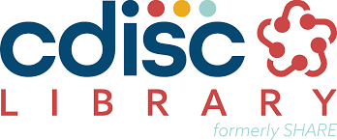
The CDISC Library
The CDISC Single Source of Truth

