Slide 1
Clinipace WLAN Guest Access
GUEST
Password: A1b2c3d4e5

Slide 2

Welcome to the 29th Meeting
German CDISC UN
Company logo placeholder
25-Sep-2019, Clinipace Eschborn

Slide 3







Ready for a CRO That Values Performance Over Promises?
At Clinipace, it’s personal.
Notes:
At Clinipace we’re a step above the rest because we truly provide the personal experience to not just make a promise to guide you through the trial, but to use our experience, our drive and our flexibility, to provide you with a simple partnership that believes in performance over promises. Any foreseen challenge is a challenge we accept with you.
At Clinipace ---it’s personal.

Slide 4
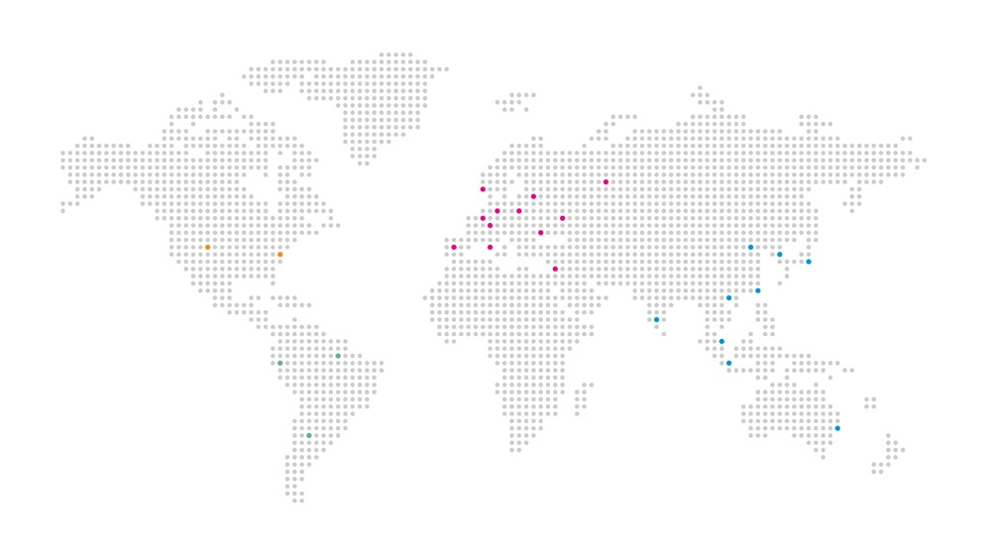
Clinipace Overview
NORTH AMERICA
EUROPE
United States
Czech Republic
France
Germany
Israel
Italy
Poland
Romania
Russia
Spain
Switzerland
Ukraine
United Kingdom
Global expertise and experience to plan and execute trials of any size.
  800+ employees
  Commitment to quality and delivery
  Hands on executive and scientific leadership
Clarity Stack™ – state of the art IT systems and data visualization
Regulatory consulting expertise
SOUTH AMERICA
ASIA-PACIFIC
Argentina
Brazil
Peru
Australia
China
Hong Kong
India
Japan
Malaysia
Singapore
South Korea
Taiwan
Notes:
With a team of 800 experts in more than 40 countries, we are the right size for any study. We can help you conduct successful multinational studies by gaining operational proficiencies and ensuring consistency across local regulatory requirements, treatment landscapes and varying standard of care. We have applied our personal approach to more than 1,500 contract research and 1,500 regulatory drug or medical device development projects worldwide – carrying the flexibility to optimize your clinical development protocols, meet aggressive timelines, execute regulatory strategies and complete high-quality trials in a variety of therapeutic areas.

Slide 5

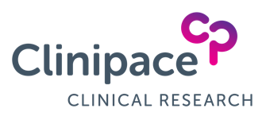




Expertise for Your Whole Trial.
We Will
DELIVER IT.
Clinical
Development
Regulatory
Affairs
Clinical
Analytics

Slide 6

Global Clinical Analytics
Finding Quality Information in the Details
Biostatistics and Statistical Programming
Clinical data management
Clinical staffing solutions
Clinical technology
150+ employees within GCA, continual growth
Notes:
Clinical Analytics: Finding Quality Information in the Details
The success of your trial relies heavily on your ability to answer questions that help you improve patient outcomes and cut costs. Our biostatistics and statistical programming team uses our industry-leading Clarity Stack technology solution to maximize the value in your clinical research data. We equip you to get the most out of your trial data for a successful trial at any phase, in any therapeutic, around the world.
Biostatistics and Statistical Programming
Clinical Technology
Clinical Data Management
Clinical Staffing Solutions

Slide 7

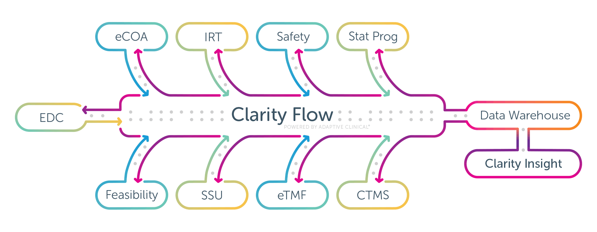
Clinical Technology – Clarity Stack™
Continuous Flow of Integrated Information
Notes:
Clarity Flow, powered by Adaptive Clinical, improves clinical trial operations through interoperability, helping you make more informed decisions, improve compliance and identify issues faster. With Clarity Stack clinical technologies, you will be able to see how your trial is progressing against plan and how your patient data is performing.
Key benefits
Agnostic compatibility, so you can choose to use industry-leading technology from our trusted partners or your existing systems
Information surveillance via dashboards for easy analysis and interpretation
Additional convenience for obtaining information by way of your smart devices (tablet, smartphone, etc.)
Real-time data reporting that delivers the most up-to-date information on study status, refreshed within a few minutes from time of source entry
Standardized data relationships with flexible, easy implementation

