Slide 1
Introduction to ADaM and “What’s new” in ADaM
Italian CDISC UN Day - Milan 27th October 2017
Silvia Faini
Principal Statistical Programmer
CROS NT - Verona

Slide 2
ADaM Purpose
Why are standards needed in analysis datasets?
  support an efficient generation
  allow analysis replication
  support the review of analysis results
This is the aim of CDISC Analysis Data Model (ADaM):
  provide a framework to statistical programmers and statisticians that enables analysis of the data;
  allowing reviewers and other recipients of the data to have a clear understanding of the data’s lineage from collection to analysis to results.

Slide 3
ADaM Motivation
The marketing approval process for regulated human health products often includes the submission of data from clinical trials to the regulatory agencies, currently:
  FDA and PMDA require CDISC standards
  EMA and China FDA recommend CDISC standards
For CDISC ADaM the following crucial items provide a roadmap for the reviewer:
  ADaM Compliant Datasets
  Define.xml
  Analysis Data Reviewer’s Guide (ADRG):
    This document is mandatory and its contents integrate the information provided in define.xml and other document.
    A template, completing instructions and sample files created by a CSS/PhUSE working group http://www.phusewiki.org/wiki/index.php?title=Analysis_Data_Reviewer%27s_Guide

Slide 4
ADaM Fundamental Principles
Analysis datasets and their associated metadata must:
  facilitate clear and unambiguous communication
  provide traceability between the analysis data and its source data (ultimately SDTM)
  be readily useable by commonly available software tools (XPT, XML)
Analysis datasets must:
  be accompanied by metadata
  be analysis-ready → “one proc away”
Focus

Slide 5
ADaM Metadata
Metadata are a key component of ADaM, help to document, are one of the 2 levels of traceability
Define.xml is the document which provides the 4 components of the ADaM metadata:
  Analysis datasets metadata
  Analysis variable metadata
  Parameter value-level metadata
  Analysis Results Metadata (ARM)
Analysis variable

Slide 6
ADaM Traceability 1/2
Metadata traceability enables the user to understand the relationship:
  of the analysis variable to its source dataset and variable and is required for ADaM compliance;
  but also between an analysis result (e.g., a p-value) and analysis dataset.
  How? By describing the algorithm used or steps taken to derive or populate an analysis value from its immediate predecessor.
Data point traceability enables the user to go directly to the specific predecessor record(s):
  When? Implemented if practically feasible.
  How? By providing clear links in the data (e.g. use of SRCDOM, SRCVAR, SRCSEQ variables) to the specific data values used as input for an analysis value.

Slide 7
ADaM Traceability 2/2
When traceability is successfully implemented, reviewers are able to identify:
  information that exists in the submitted SDTM study tabulation data
  information that is derived or imputed within the ADaM analysis dataset
  the method used to create derived or imputed data
  information used for analyses, in contrast to information that is not used for analyses yet is included to support traceability or future analysis

Slide 8
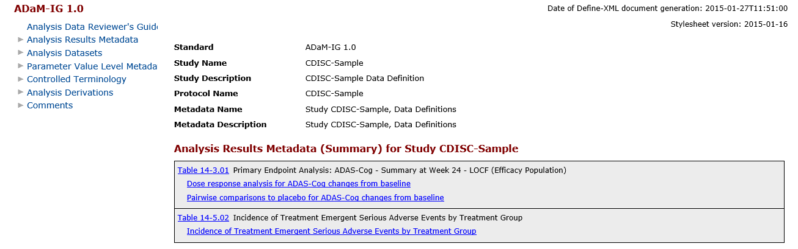
ADaM Define.xml

Slide 9
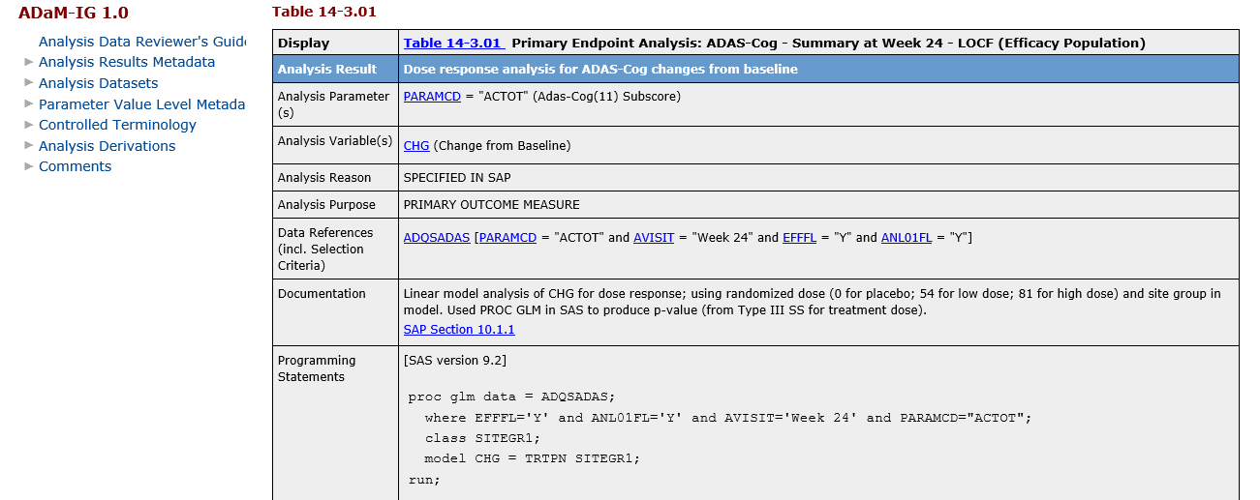
ADaM Define.xml

Slide 10
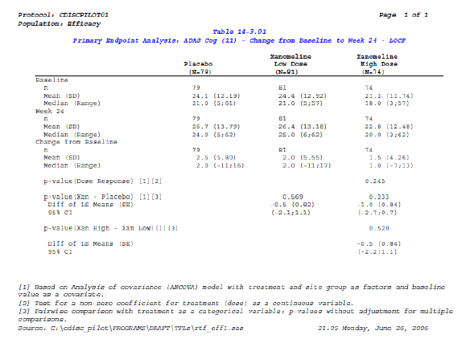
ADaM Define.xml

Slide 11
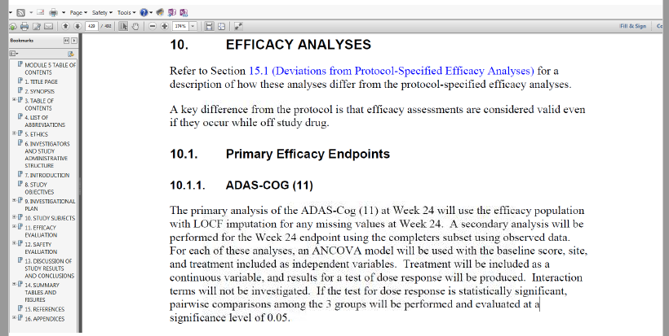
ADaM Define.xml

Slide 12
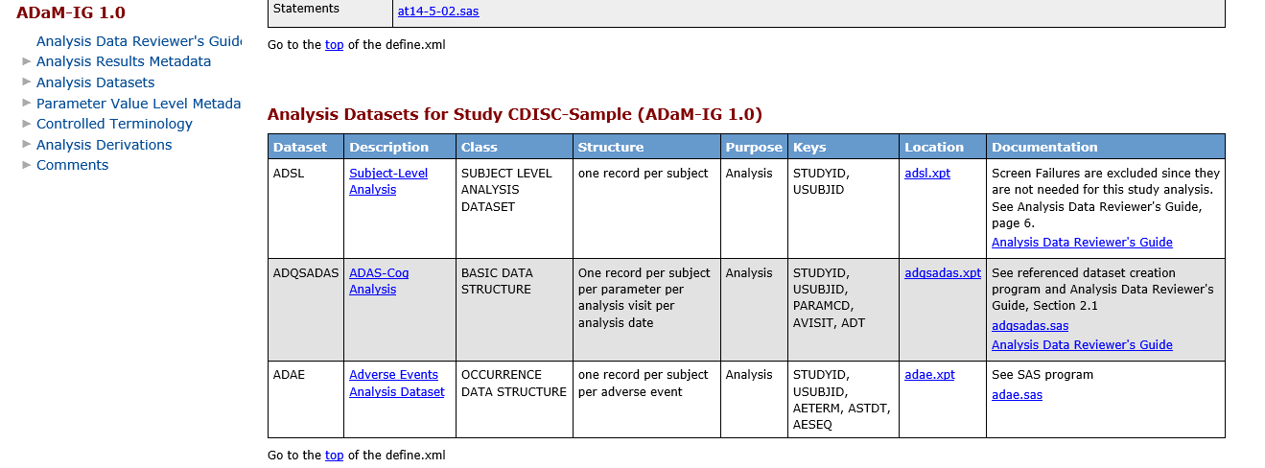
ADaM Define.xml

Slide 13
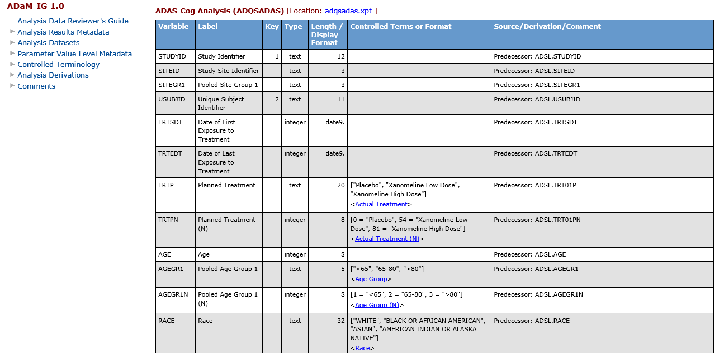
ADaM Define.xml
Analysis variable metadata

Slide 14
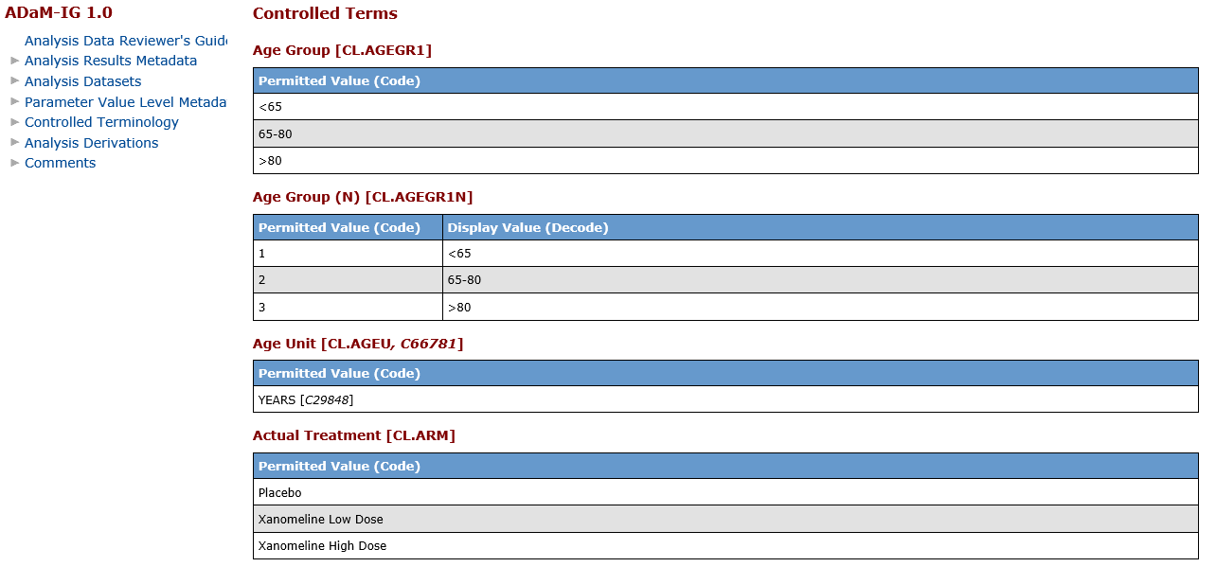
ADaM Define.xml
Analysis variable metadata

Slide 15
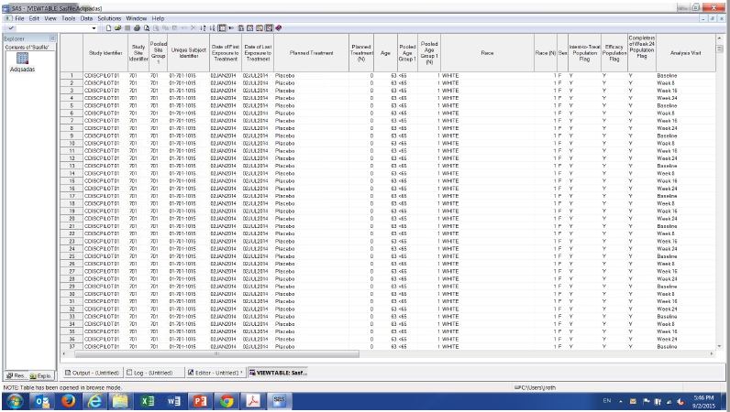
ADaM Define.xml

Slide 16
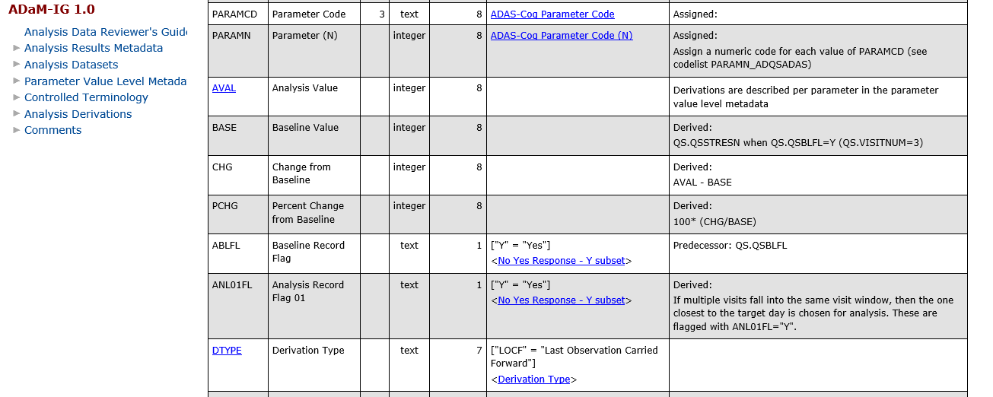
ADaM Define.xml

Slide 17
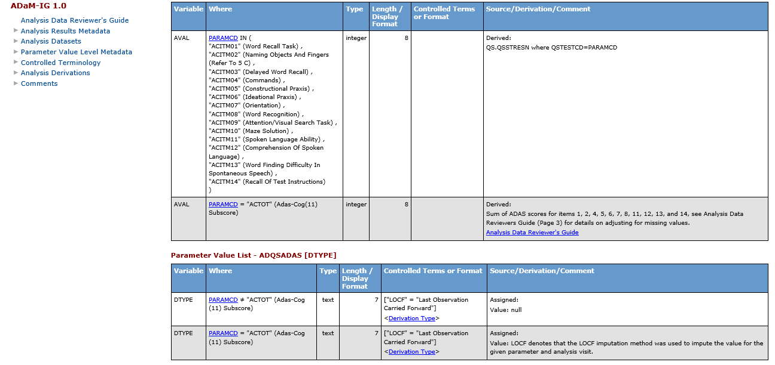
ADaM Define.xml

Slide 18
ADaM References
ADaM Document | Date Published
Analysis Data Model (ADaM) v2.1 | December 2009
Analysis Data Model Implementation Guide (ADaMIG) v1.1* | February 2016
ADaM Examples in Commonly Used Statistical Analysis Methods v1.0 | December 2011
The ADaM Basic Data Structure for Time-to-Event Analyses v1.0 | May 2012
ADaM Data Structure for Adverse Event Analysis v1.0** | May 2012
ADaM Structure for Occurrence Data (OCCDS) v1.0 | February 2016
CDISC ADaM Validation Checks v1.3 | March 2015
Define-XML v2.0 | March 2013
Analysis Results Metadata Specification for Define-XML Version 2 v1.0 | January 2015
*Enhancement of ADaMIG v1.0 **Superseded by OCCDS v1.0

Slide 19
ADaM Implementation 1/2
Analysis datasets must:
  include a subject-level analysis dataset named “ADSL”
  consist of the optimum number of analysis datasets needed and have enough self-sufficiency to allow analysis and review with little or no additional programming or data processing
  be named using the convention “ADxxxxxx”
  use ADaM standard variable names and naming conventions when available
  maintain the values and attributes of SDTM variables if copied into analysis datasets without renaming (i.e., adhere to the “same name, same meaning, same values” principle of harmonization)
  apply naming conventions for datasets and variables consistently across studies within a given submission and across multiple submissions for a product

Slide 20
ADaM Implementation 2/2
From ADaMIG v1.1 and OCCDS v1.0 there are 3 defined structures
Subject Level Structure (ADSL)
  Reserved dataset name ‘ADSL’
  One record per subject, regardless of study design
Basic Data Structure (BDS)
  Designed with the majority of analysis files in mind
  One or more records per subject per analysis parameter, per analysis time point (if applicable)
Occurrence Data Structure (OCCDS)
  Designed specifically for counting occurrences
  More general version of the old ADAE document

Slide 21
ADSL 1/2
ADSL contains required variables such as subject-level population flags, planned and actual treatment variables, demographic information, randomization factors, subgrouping variables, and important dates.
ADSL contains also other subject-level variables that are important in describing a subject’s experience in the trial, e.g.: Baseline characteristics, Numeric equivalents of flags, Stratification variables, Treatment duration and compliance variables, Other key visit dates and durations, Protocol specific event information, such as death/survival
This structure allows merging with any other dataset, including ADaM and SDTM datasets. ADSL is a source for subject-level variables used in other ADaM datasets, such as population flags and treatment variables.
It should be noted that there is no requirement that every ADSL variable be copied into a BDS dataset.

Slide 22
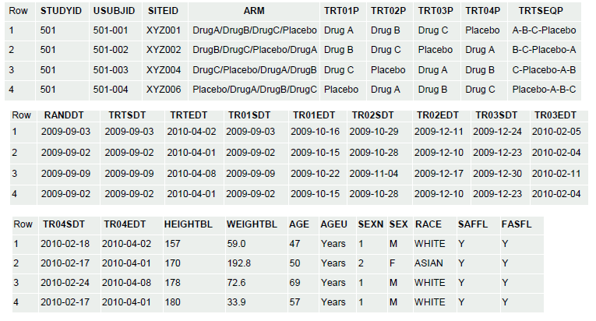
ADSL 2/2

Slide 23
Basic Data Structure 1/2
A record in an ADaM dataset can represent an observed (e.g. predecessor in SDTM), derived (e.g. total score of a questionnaire), or imputed (e.g. LOCF) value required for analysis.
  A data value may be derived from any combination of SDTM and/or ADaM datasets.
The BDS is flexible in that additional rows and columns can be added to support the analyses and provide traceability.
In a study there is often more than one ADaM dataset that follows the BDS. The capability of adding rows and columns does not mean that everything should be forced into a single ADaM dataset. The optimum number of ADaM datasets should be designed for a study, as discussed in the ADaM model document.

Slide 24
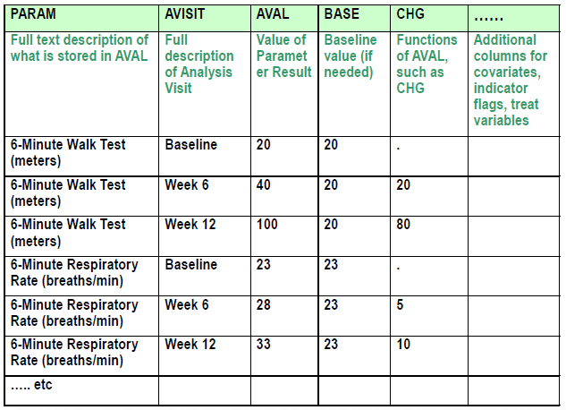
Basic Data Structure 2/2

Slide 25
Occurrence Data Structure 1/4
Developed specifically for occurrence analysis: the counting of subjects with a given record or term
Standard analyses of:
  Adverse Events
  Concomitant Medications
  Medical History
Other possible use cases:
  Clinical Events, Procedures, Substance Use
  Protocol violations
  Inclusion/exclusion criteria occurrences
  … and other uses depending on the analysis need

Slide 26
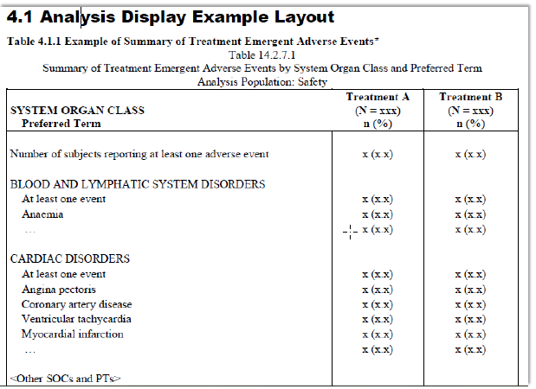
Occurrence Data Structure 2/4
Example of analysis needs – Adverse Events

Slide 27
Occurrence Data Structure 3/4
Three Rules for OCCDS Use:
1. There is no need for AVAL or AVALC.
  There are typically one or more records for each occurrence assessment
2. Occurrence is (often) coded via a dictionary
  Typically includes a well-structured hierarchy of categories and terminology
  Re-mapping this hierarchy to BDS variables PARAM and generic *CAT variables would lose the structure and meaning of the dictionary
3. Data content is typically not modified for analysis
  There is no need for analysis versions of the variables that hold the dictionary hierarchy or category terms

Slide 28
Occurrence Data Structure 4/4
Determining When to Use OCCDS:
  Many (but not all) SDTM events and interventions class data are often analyzed as occurrences and thus should use OCCDS
    Note: exposure data (EX) is often best analyzed with BDS, creating multiple analysis parameters
    Lab events is an example of a findings SDTM class data analyzed as occurrences with OCCDS
  OCCDS is not designed for all categorical data
    Example: questionnaire responses would never be mapped to a hierarchical dictionary, fit nicely in BDS, and should not use OCCDS
Choice of ADaM dataset structure always depends on analysis need

Slide 29
What’s new?
Basically ADaMIG v1.1 and OCCDS v1.0
  Notable Enhancements in ADaMIG v1.1 in comparison to ADaMIG v1.0
  OCCDS v1.0 versus ADAE v1.0
Therapeutic Area User Guide (TAUG)

Slide 30
Notable Enhancements in ADaMIG v1.1
Main emphasis: clarification of ADaMIG 1.0 throughout the document
Useful new variables (e.g. AGEGRy - Pooled Age Group y)
Clarified ADaM vs non-ADaM analysis datasets: to prevent confusion for non-ADaM use as two-letter prefix "AX"
Tables of variable name fragments (e.g. FL, DT, CHG, GRy, FU)
Length of copied SDTM variables can be reduced to maximum length of actual values to optimize file size (e.g. remove trailing blanks)
New w-index in variable names
PARAM is the only variable that describes AVAL or AVALC. Qualifiers are not allowed. ADaM BDS is different from a SDTM Finding domain
Expanded SRCDOM to allow ADaM dataset names, SRCSEQ to refer to new variable ASEQ

Slide 31
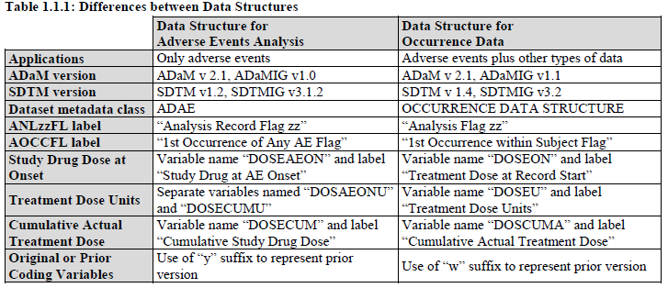
OCCDS vs ADAE
OCCDS added variables not applicable to AEs
  Example: WHO-Drug hierarchy

Slide 32

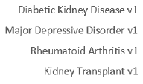

Therapeutic Area User Guide (TAUG)
ADaM
Terminology
SDTM
CDASH
ADaM

