Slide 1
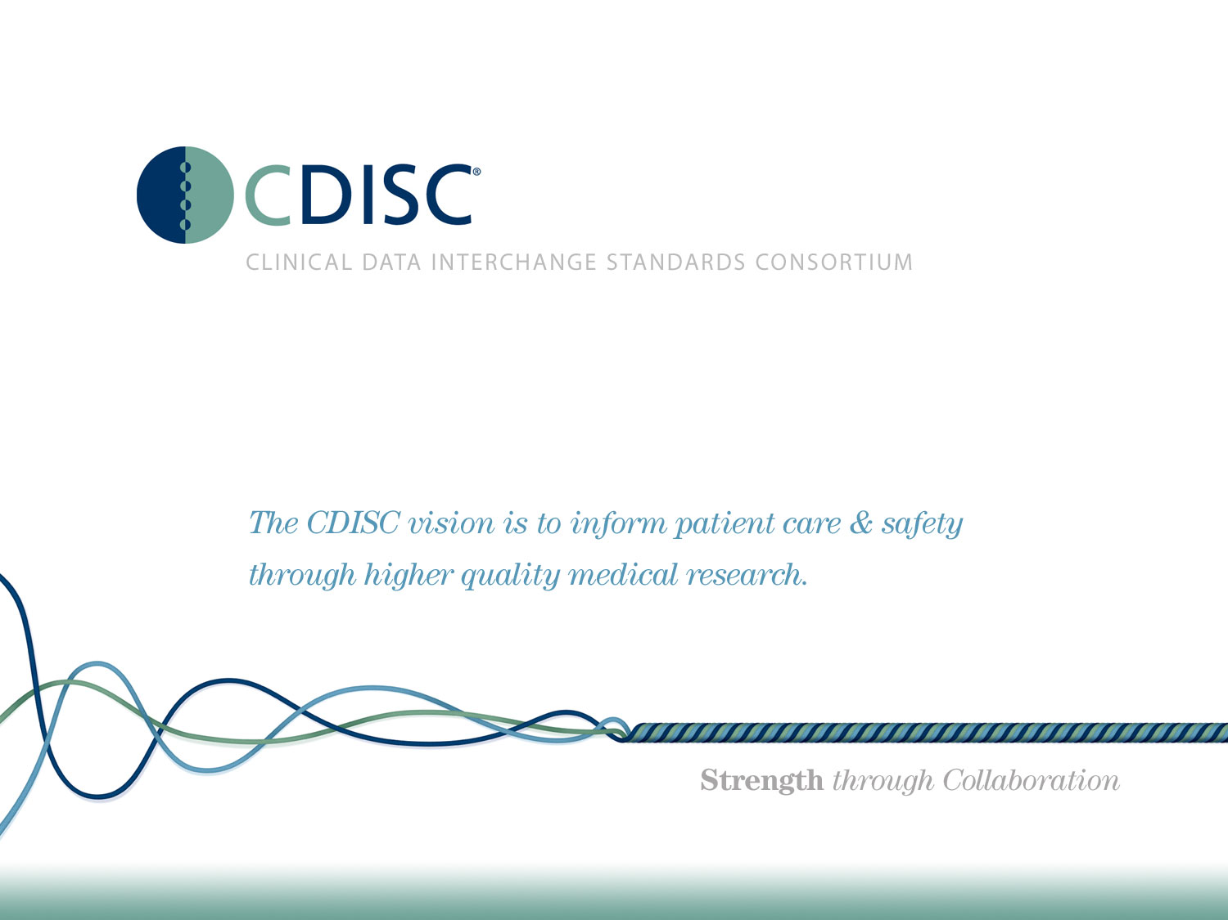

Slide 2
CDISC Italian UN Aggiornamento/Attività
CDISC Italian User Network Day
27 Ottobre 2017
Angelo Tinazzi (Cytel) - Silvia Faini (CROS NT)
E3C members

Slide 3
Agenda
Risposte Questionario Partecipanti
CDISC in a Nutshell
CDISC Italian User Network v2.0
CDISC News

Slide 4
Risposte Questionario Partecipanti

Slide 5
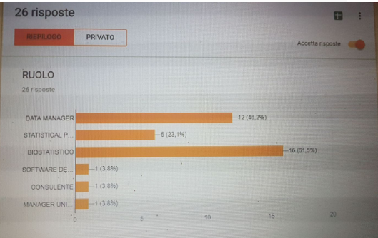
Risposte Questionario Partecipanti
1. Ruolo

Slide 6
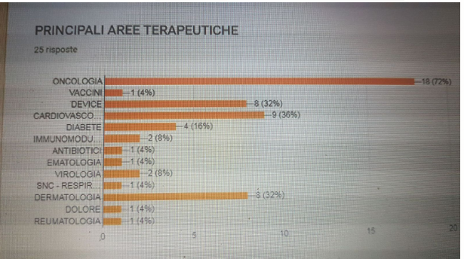
Risposte Questionario Partecipanti
2. Principali Aree Terapeutiche

Slide 7
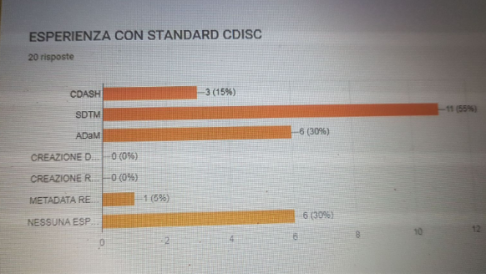
Risposte Questionario Partecipanti
3. Esperienza con Standard CDISC

Slide 8
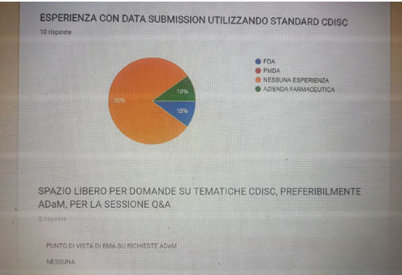
Risposte Questionario Partecipanti
4. Esperienza con data submission utilizzando standard CDISC (es. FDA Integrated of Safety Summary)

Slide 9
CDISC in a Nutshell

Slide 10
CDISC in a Nutshell
CDISC is a global, open, multidisciplinary, non-profit organization that has established standards to support the acquisition, exchange, submission and archive of clinical research data and metadata.
The CDISC mission is to develop and support global, platform-independent data standards that enable information system interoperability to improve medical research and related areas of healthcare.
Metadata is….
  data about data
  information about data
  information about information

Slide 11
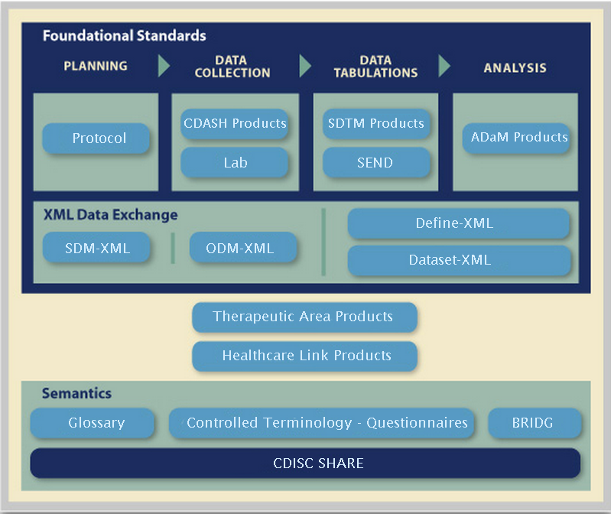
CDISC in a Nutshell
Notes:
ADaM: The ADaM defines the standards to support the creation and submission of analysis datasets and results. Dataset structure, metadata concepts, and practical examples are addressed in the ADaM documents.
BRIDG: The Biomedical Research Integrated Domain Group (BRIDG) Model is a domain analysis model representing protocol-driven biomedical/clinical research. It was developed to provide an overarching model that could readily be understood by domain experts and would provide the basis for harmonization among standards within the clinical research domain and between biomedical/clinical research and healthcare. 3 important streams: CDISC, NCI, HL7.
CDISC started constructing a Domain Analysis Model to support harmonization of their models as well as with HL7.
The NCI's caBIG initiative joined the CDISC BRIDG efforts to construct a structured protocol representation and to achieve interoperability among clinical trials research in cancer
The BRIDG model was been adopted by the HL7 RCRIM Technical Committee as the RCRIM Domain Analysis Model and is being implemented at NCI.
CDASH: CDASH Version 1.1 was developed via CDISC’s consensus-based standards development process. It describes the basic recommended (minimal) data collection fields for 18 domains, including common header fields, and demographic, adverse events, and other safety domains that are common to all therapeutic areas and phases of clinical research. CDASH V 1.1also includes implementation recommendations and best practice guidelines, regulatory references and other information on the CDASH project.
Define-XML / Metadata: This subteam supports the standard for providing Case Report Tabulations Data Definitions in an XML format for submission to regulatory authorities (e.g., FDA). The XML schema used to define the expected structure for these XML files is based on an extension to the CDISC Operational Data Model (ODM).
LAB: The LAB model is a data standard to support the exchange of data between a central laboratory and a recipient of the data. The model defines how to capture information about the laboratory in addition to the assay results.
ODM: The Operational Data Model (ODM) is designed to facilitate the archive and interchange of the metadata and data for clinical research, its power being fully unleashed when data are collected from multiple sources.
PRM: The scope of this model includes protocol content including Study Design, Eligibility Criteria, and the requirements from the ClinicalTrials.gov and World Health Organization (WHO) registries. The model focuses on the characteristics of a study and the definition and association of activities within the protocols, including "arms" and "epochs".
SDTM/SDS: The SDS team creates and updates the Study Data Tabulation Model (SDTM), which defines a standard structure for study data tabulations that are to be submitted as part of a product application
SEND: The SENDIG is intended to guide the organization, structure, and format of standard nonclinical tabulation datasets for interchange between organizations such as sponsors and CROs and for submission to the US FDA.
SHARE: CDISC SHARE is a global, accessible electronic library, which through advanced technology, enables standardized data element definitions and richer metadata that can be used in software applications and research studies to improve biomedical research and its link with healthcare. SHARE metadata is envisioned to help find, understand and use clinical metadata efficiently.
TDM : Trial Design Model defines domains that capture information about the study design but do not contain subject data. Inclusion/Exclusion, Trial Arms, Elements and Visits, and Summary information about the trial are included.
Terminology: The Terminology subteam supports the files used to define standard language used in CDISC submissions. Approved terminology is maintained and distributed as part of NCI Thesaurus and is available for download at the NCI website.

Slide 12
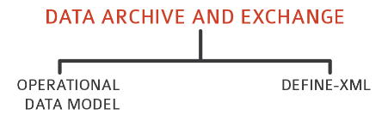
CDISC in a Nutshell
Planning
Data Collection
Data Tabulations
Data Analysis
Protocol
CDASH
SDTM
ADaM
Study
Design
LAB
SEND
NCI CT

Slide 13


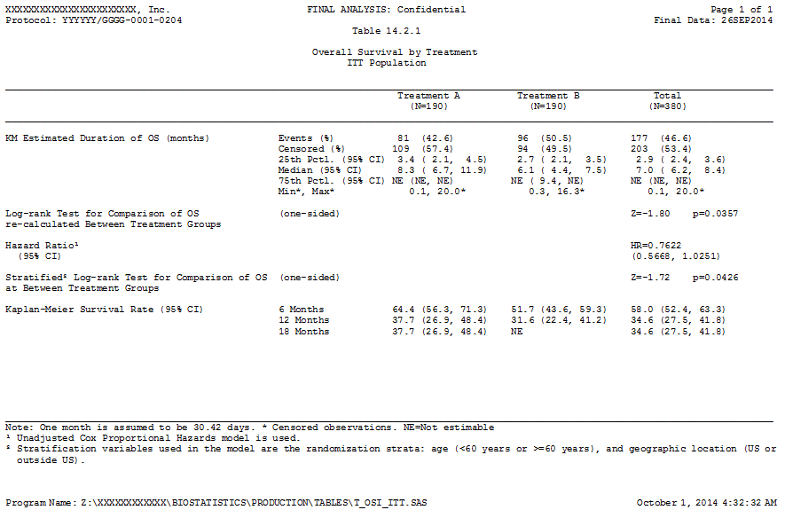
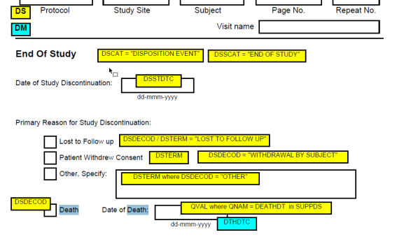
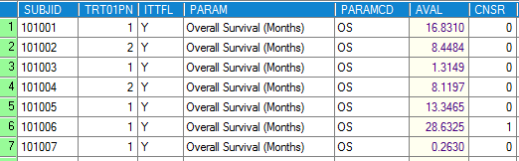

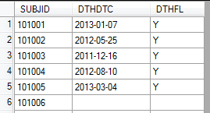
CDISC in a Nutshell – End to End
Primary Overall Survival Analysis
aCRF
ADTTE
SDTM define.xml
ADaM define.xml
DM

Slide 14

CDISC in a Nutshell – What is not covering CDISC?
CDISC do not define any standards supporting outputs development (standards template)
Check PhUSE initiative “Standards Analysis and Code Sharing”
http://www.phuse.eu/standard-analyses-code-sharing

Slide 15
CDISC in a Nutshell – Why use standards
Data from all companies will be in the same structure
Regulatory reviewers will have more time to review the data because they spend less time learning the data structure
Data can more easily be combined across companies and by therapeutic area
Supports Regulatory Agencies (i.e. FDA) larger vision of warehouse repository

Slide 16
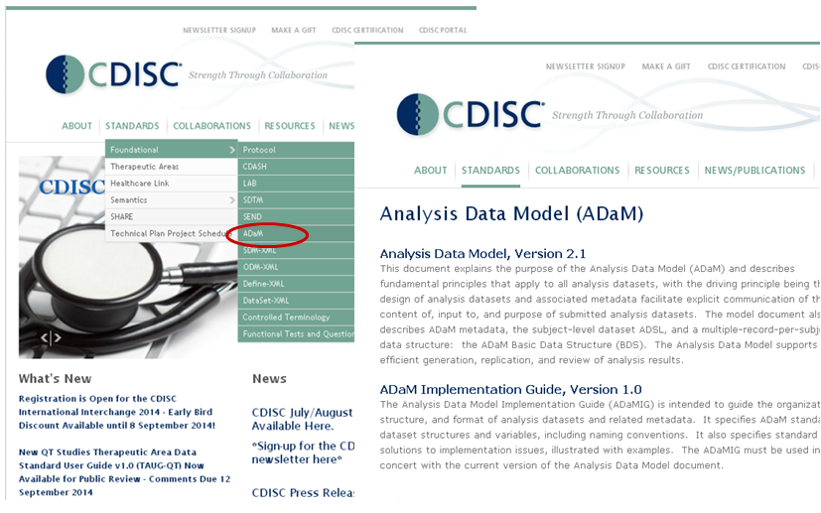
CDISC in a Nutshell – Access Resources www.cdisc.org

Slide 17
CDISC in a Nutshell – FDA (USA)
Studies with a study start date of 2016-12-17 (24 months after the original publication date of the binding guidance) must use the appropriate FDA-supported standards, formats, and terminologies specified in the Data Standards Catalog
For NDAs and some BLAs
For CDER and CBER
Includes ADaM
ADaM is the only analysis data standard mentioned in the catalog

Slide 18
CDISC in a Nutshell – PMDA (Japan)
PMDA is the Japanese authority over drug and device submissions.
April 27, 2015 released “Technical Conformance Guide on Electronic Study Data Submissions” which asks for CDISC data including ADaM. Can receive submissions in 2016, but will be required in 2020.
PMDA has its own data standards catalog, and technical conformance guide. The PMDA also has ADaM study data validation rules where the FDA hasn’t defined these yet.

Slide 19
CDISC in a Nutshell – Regulatory Requirements i.e. FDA
http://www.fda.gov/ForIndustry/DataStandards/StudyDataStandards
FDA Standards Catalog
  Exchange Format
    i.e. SAS XPT, XML, PDF, ASCII
  Regulatory Applications
    Electronic Common Technical Document (eCTD)
  Data Exchange Format
  SDTM, ADAM (Clinical Study Datasets)
  Define.xml (Study Data Definition)
  Terminology Standards
  CDISC Controlled Terminology
  MedDRA, WHO-DD
CDISC Metadata Submission Guidelines

Slide 20
CDISC in a Nutshell – Regulatory Requirements i.e. FDA (cont..and more)
Portable Document Format (PDF) Specifications
Use of fonts, colors
PDF properties
eCTD Specifications for Validation Criteria
i.e. Filename
  lowercase, letters, digits and ‘-’ (hyphen)
  Max 64 chars
Technical Rejection Criteria
  SDTM TS, DM mandatory
  ADSL mandatory for ADaM package

Slide 21
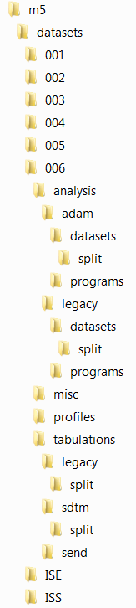
CDISC in a Nutshell – Regulatory Requirements – eCTD m5 folder
ADaM Analysis Datasets and Programs
Non ADaM Analysis Datasets and Programs
Other datasets i.e. look-up datasets
Non-SDTM Tabulation Datasets
SDTM Tabulation Datasets
ISS/ISE Pooling Folders
Electronic Commot Technical Document Specifications - http://estri.ich.org/eCTD/eCTD_Specification_v3_2_2.pdf
FDA Data Technical Conformance Guide - http://www.fda.gov/downloads/ForIndustry/DataStandards/StudyDataStandards/UCM384744.pdf

Slide 22
CDISC Italian User Network v2.0

Slide 23

Italian CDISC User Network 2.0
V2.0 Dal 2015
~ 40 members Mailing List
2 F2F Meetings
8 TC 1hr meeting
19

Slide 24
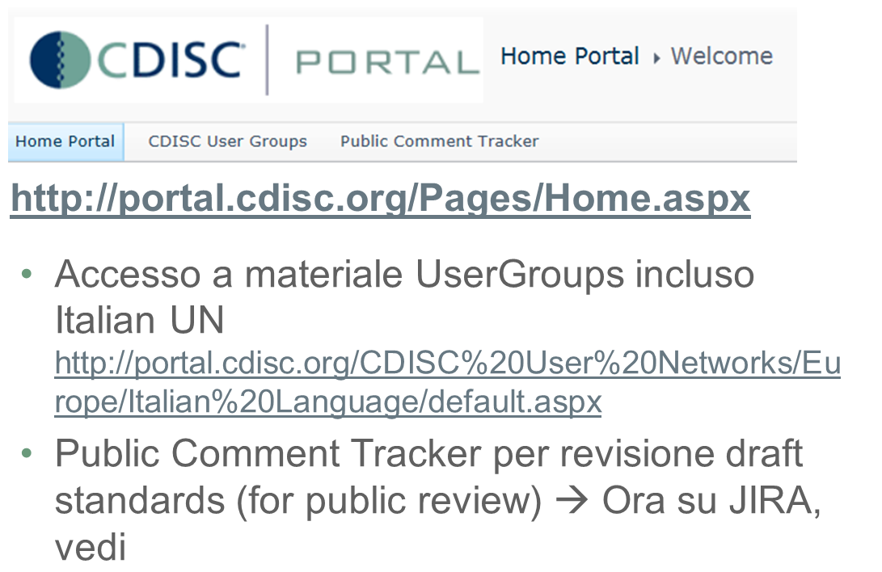
Italian CDISC User Network 2.0
Creare ‘profili’ sul sito CDISC

Slide 25
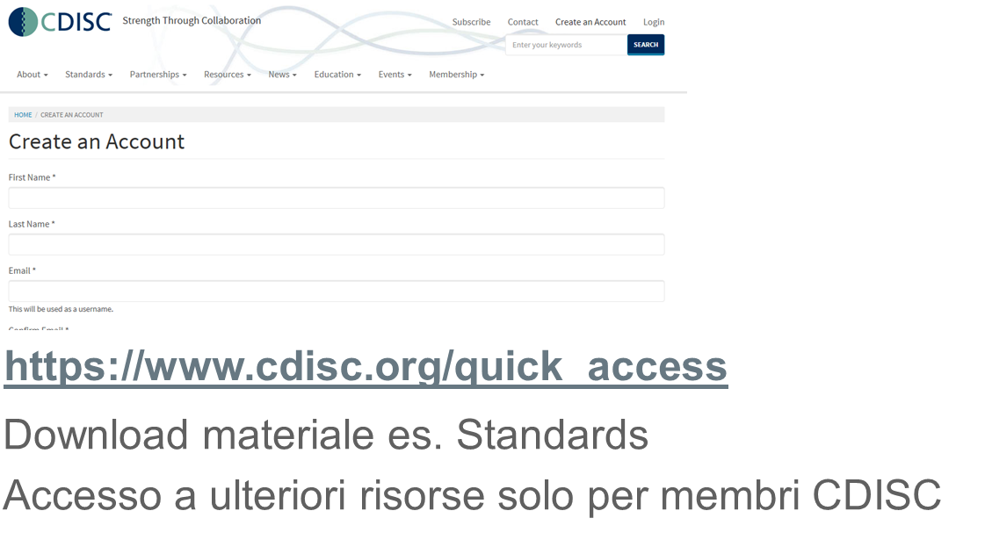
Italian CDISC User Network 2.0
Creare ‘profili’ sul sito CDISC (cont)

Slide 26
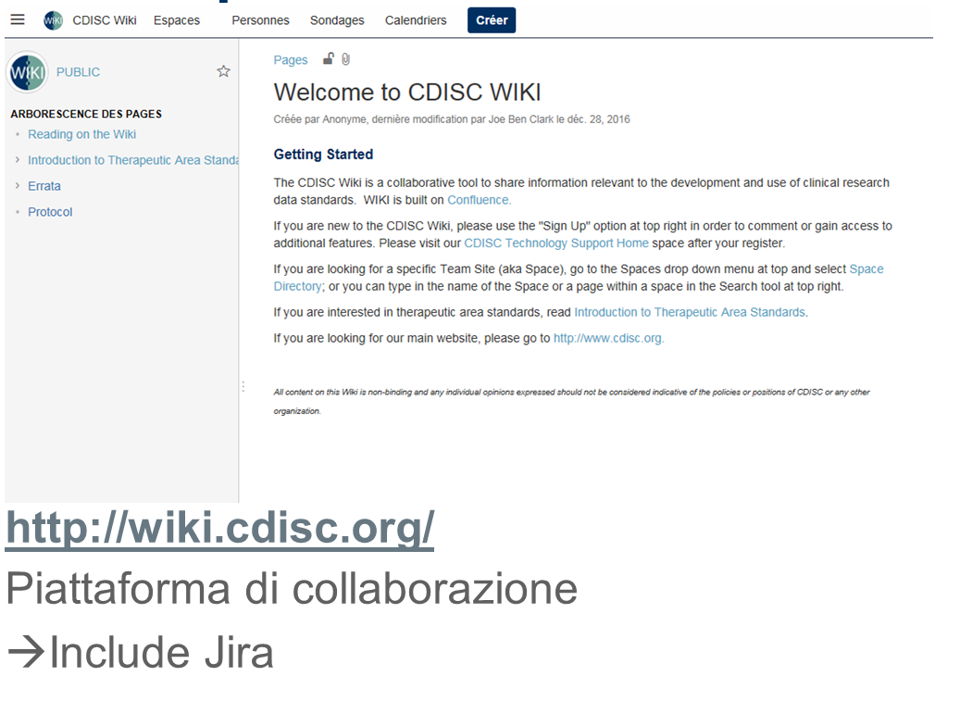
Italian CDISC User Network 2.0
Creare ‘profili’ sul sito CDISC (cont)

Slide 27
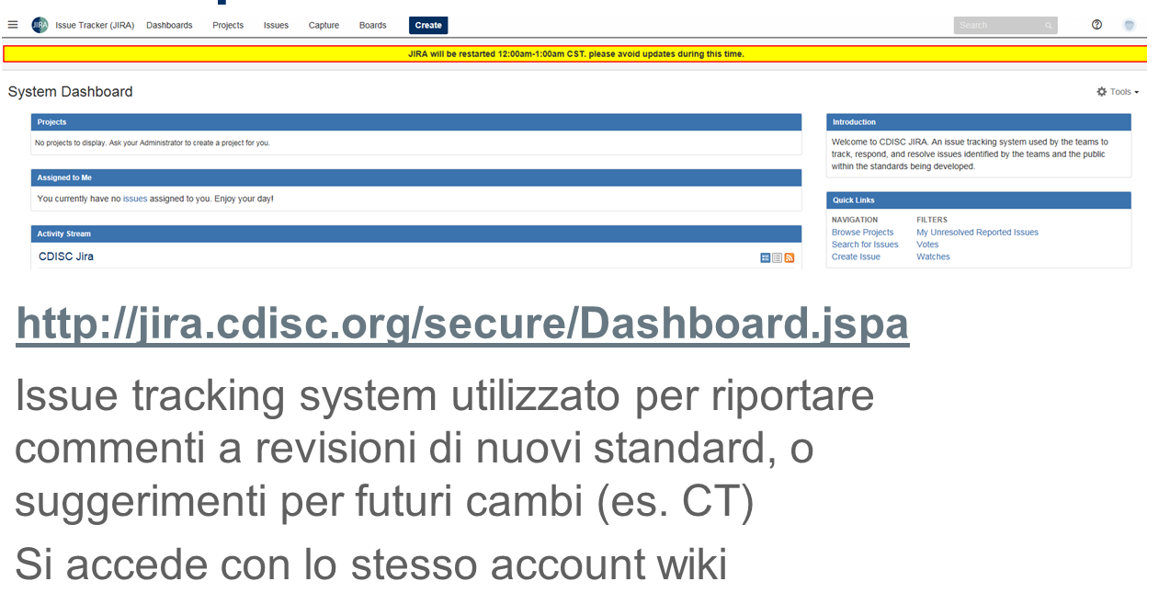
Italian CDISC User Network 2.0
Creare ‘profili’ sul sito CDISC (cont)

Slide 28
CDISC News

Slide 29
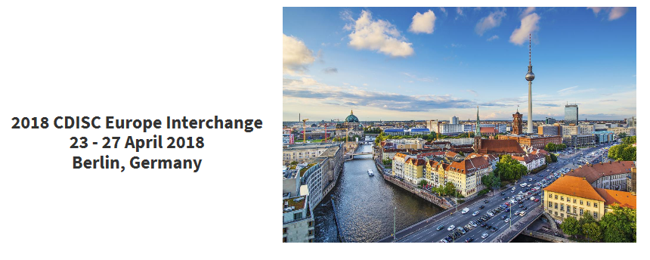
CDISC News

Slide 30
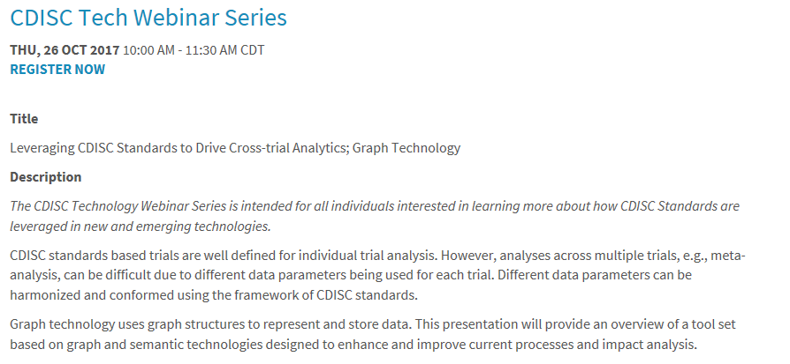
CDISC News https://www.cdisc.org/events/education/webinars
Next CDISC Webinars

Slide 31
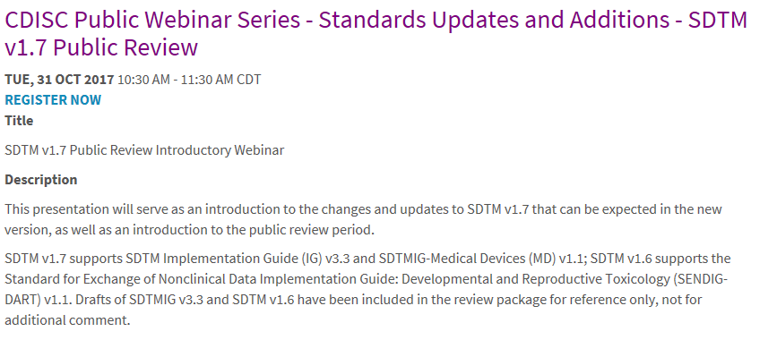
CDISC News https://www.cdisc.org/events/education/webinars
Next CDISC Webinars (cont)

Slide 32
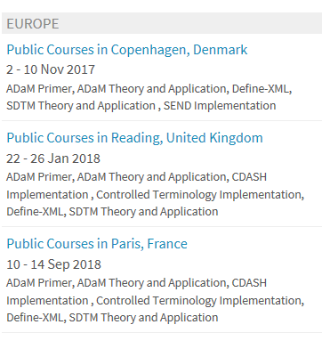

CDISC News https://www.cdisc.org/education/public-courses
Next Public Trainings

Slide 33
CDISC News
Standards
Standard | Release Date
SDTMIG v3.2 Conformance Rules | 2017-01-27
CDASH Model v1.0 & CDASHIG v2.0 | 2017-09-20
Therapeutic Area User Guides: Schizophrenia v1.1, (May 3, 2017) Prostate Ca v1 (Jul 10, 2017), Virology v2.1, (Aug 9, 2017) and Influenza v 1.1 (Aug 3, 2017), Vaccines V1.0 (Oct 3, 2017)
Controlled Terminology Packages: P29 (31 Mar), 30 (30 Jun), 31 (29 Sep), 32 (Planned 22 Dec 2017)
SDTMIG v3.3 and SDTM v1.7 | Planned
Notes:
ePublishing CDASH by the 20th – announce this.
3.3 and disposition events - still working on it.
DART – Developmental and Reproductive Toxicology.
Standard
Release Date
SDTMIG v3.2 Conformance Rules
2017-01-27
BRIDG 5.0
2017-02-01
BRIDG 5.0.1
2017-09-07
CDASH Model v1.0 & CDASHIG v2.0 (1st HTML!)
2017-09-20
SENDIG-DART - Final Version
This month!
Therapeutic Area User Guides: Schizophrenia v1.1, (May 3, 2017) Prostate Ca v1 (Jul 10, 2017), Virology v2.1, (Aug 9, 2017) and Influenza v 1.1 (Aug 3, 2017), Vaccines V1.0 (Oct 3, 2017)
Controlled Terminology Packages:
P29 (31 Mar), 30 (30 Jun), 31 (29 Sep), 32 (Planned 22 Dec 2017)
SENDIG-DART and SDTM v1.6
Planned
SDTMIG v3.3 and SDTM v1.7
Planned

Slide 34
CDISC News
Standards – Out of Public Review
Standard | Review Period Ends
Controlled Terminology P32 | 2017-10-13
Japanese Translation of SDTMIG v3.2 | 2017-10-20
CDISC RDF Reference Guide v1.1 | 2017-10-30
Huntington’s Disease v134 | 2017-11-11
Post Traumatic Stress Disorder v1 | 2017-11-13
CDISC SHARE API 2.0 | 2017-11-30
Notes:
Il Resource Description Framework (RDF) è lo strumento base proposto da W3C per la codifica, lo scambio e il riutilizzo di metadati strutturati e consente l'interoperabilità semantica tra applicazioni che condividono le informazioni sul Web
CDISC SHARE is a suite of tools and services, the cornerstone of which is a metadata repository, that supports the development, governance, publishing, and consumption of the CDISC standards in human and machine-readable formats. CDISC SHARE provides members with machine-readable electronic versions of CDISC standards and is a cornerstone of the CDISC roadmap.
RESTful web service to programmatically retrieve CDISC standards’ metadata from CDISC SHARE to support process automation

Slide 35
CDISC News
Standards …… e ADaM? Su cosa sta lavorando l’ADaM Team?
ADaM Ig 1.2
ADaM to support Integration
Traceability in ADaM
ADaM Oncology

Slide 36
CDISC News - PhUSE Working Groups http://www.phuse.eu/optimizing-data-standards
Optimizing the Use of Data Standards
Analysis Data Reviewer’s Guide (ADRG)
Study Data Reviewers Guide (SDRG)
Nonclinical SDRG Package
Best Practices for Data Collection Instructions
Best Practices for Metadata Documentation

Slide 37
CDISC News - PhUSE Working Groups http://www.phuse.eu/optimizing-data-standards
Optimizing the Use of Data Standards (cont)
Clinical Legacy Data Conversion Plan & Report
Data Reviewer’s Guide in XML
Define-XML V2.0 Completion Guidelines & Style Sheet Recommendations
Pooling WHO Drug B3 Format
SDTM ADaM Implementation FAQ

Slide 38
CDISC News - PhUSE Working Groups http://www.phuse.eu/optimizing-data-standards
Optimizing the Use of Data Standards (cont)
Standardizing Data Within the Inspection Site Selection Process
Study Data Standardization Plan (SDSP)

Slide 39
CDISC News – Use of LOINC
Goal: make recommendations to support the Mar 2018 mandate
Membership: CDISC, FDA, NIH and Regenstrief
Deliverable: Recommendations Document by late 2017
http://www.xml4pharma.com/publications/Use_of_LOINC_UCUM_in_SDTM_and_SEND.pdf
Notes:
LOINC FDA regulation is coming soon.
Currently about ~40% of 155 companies survey collect LOINCs from any source.
75% of 22 companies surveyed are collecting LOINC on clinical research studies.

