Slide 1
SDTM aCRF Guideline Workgroup
Status Summary
Markus Stoll

Slide 2
aCRF Guideline Workgroup – Status Summary
aCRF Guideline Recap + Status

Slide 3
Recap – „aCRF Guideline“ PhUSE Poster
PhUSE EU Connect 2018: 04-07th Nov 2018, Frankfurt/Main
Poster „aCRF Guideline“ presented by Workgroup Members Stefanie Sturm and Christina Paul
High setup efforts for Poster+Paper Audience feedback lower than expected
Authors + Presenters on PhUSE Conference
Christina Paul, | Stefanie Sturm, | (Eva Bervar)

Slide 4
aCRF Guideline Status
Planned Content…
 | V1.0 publication shifted to end 1st half 2019 focussing on Recommendations/requirements for aCRF TOC – Table of Content Format(s) for annotations Examples, Caveats + Best Practice Approach
 | Outlook for next Version(s): Other Special Cases Constraints for programmatic Quality Checks

Slide 5
New DACH UN wiki
Status and Feedback Collection
Markus Stoll

Slide 6
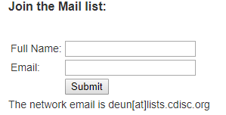
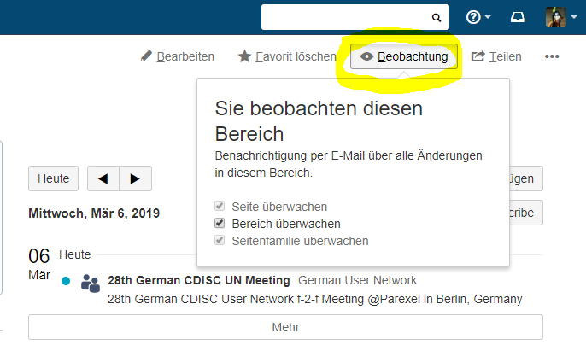
New DACH User Network wiki
CDISC wiki: https://wiki.cdisc.org/display/DEUUG/German+User+Network+Home
Mailing List on Portal Homepage:
Status end of Jan/2019: 56 registrees
Caveat:
Message Forward by Mailing List Server is filtered (rules unknown!).
-> Risk that important messages might get delayed or blocked!
Alternative: (requires wiki registration)
-> „Watch“ / „Beobachten“ function on wiki pages

Slide 7
Thank You
          Markus Stoll
          CDISC Data Standards and Governance Subject Matter Expert
          emailto:m@rkus-stoll.de

