Slide 1
Changes in FDA technical Conformance Guide v4.2/4.2.1
06. März 2019, German User Group Meeting, Marion Friebel

Slide 2
Definition
This Study Data Technical Conformance Guide provides specification, recommendations and general considerations on how to submit standardized study data using FDA–support
The guide is separated in the same sections as before:

Slide 3
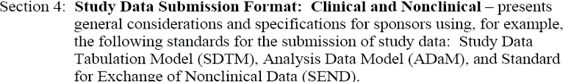

Definition - continue

Slide 4
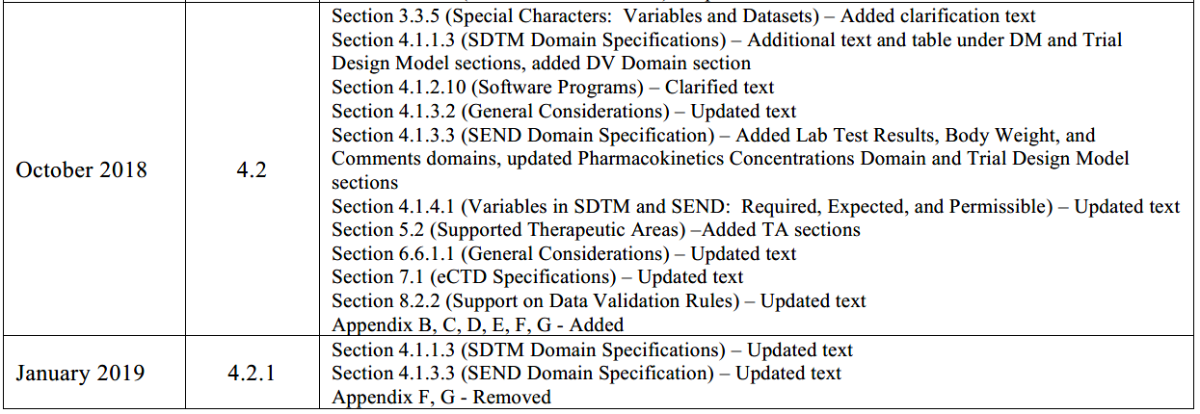
Updates 4.2 and 4.2.1

Slide 5
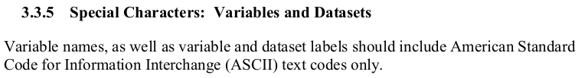
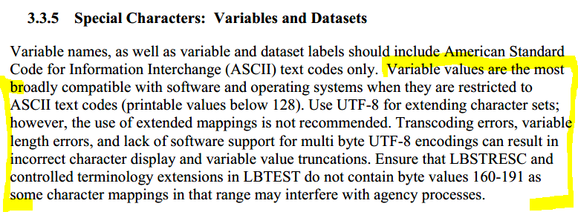
Changes from guide v4.1 to Guide v4.2 (released October 2018) –Updates in section 3.3.5 v4.1:
V4.2:

Slide 6
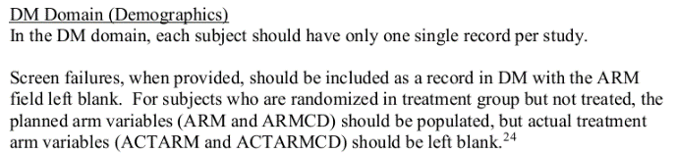
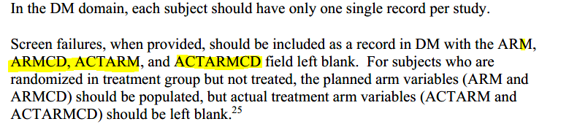
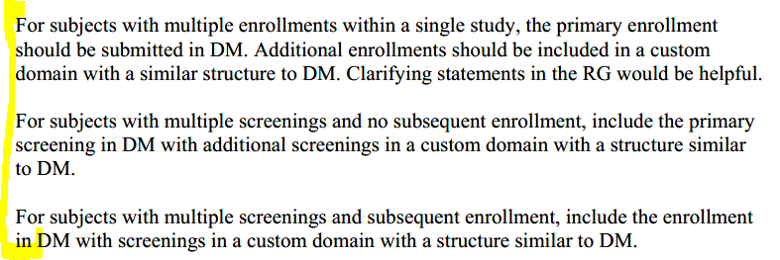
Changes from guide v4.1 to Guide v4.2 (released October 2018) –Updates in section 4.1.1.3 v4.1:
V4.2:

Slide 7
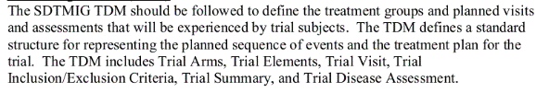
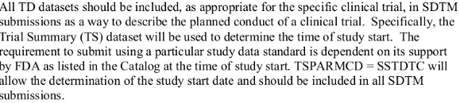

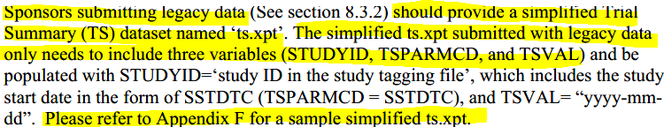
Updates in section 4.1.1.3- Continuous v4.1:
V4.2:
Notes:
Difference between ongoing study and legacy study . For ongoing clinical studies the appendix B is required. For legacy studies the appendix F should be used. Appendix F removed in Conformance guide version 4.2.1

Slide 8
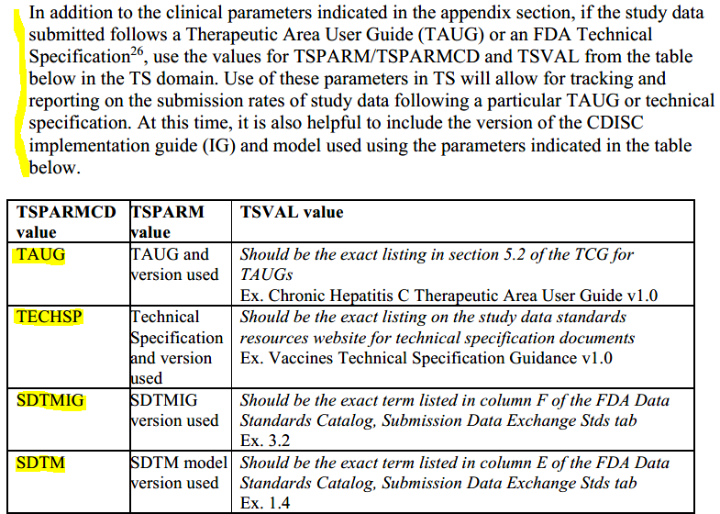
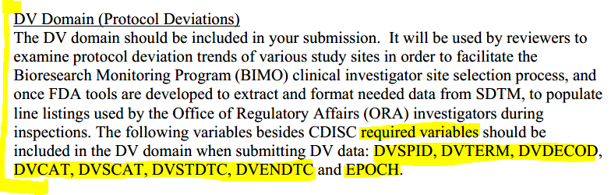
Updates in section 4.1.1.3- Continuous v4.2:
Notes:
TAUG and TECHSP are not in the referenced appendix but relevant if TAUGs are uses, DV section complete new in the conformance guide version 4.2

Slide 9
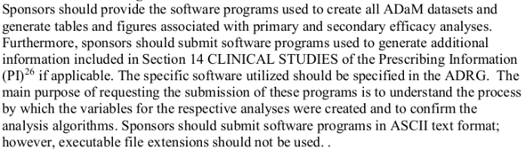
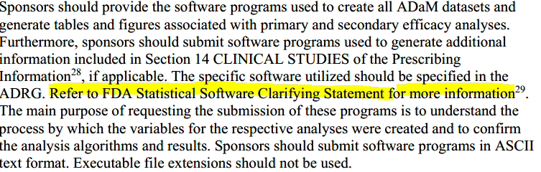
Changes from guide v4.1 to Guide v4.2 (released October 2018) –Updates in section 4.1.1.3 v4.1:
v4.2:

Slide 10
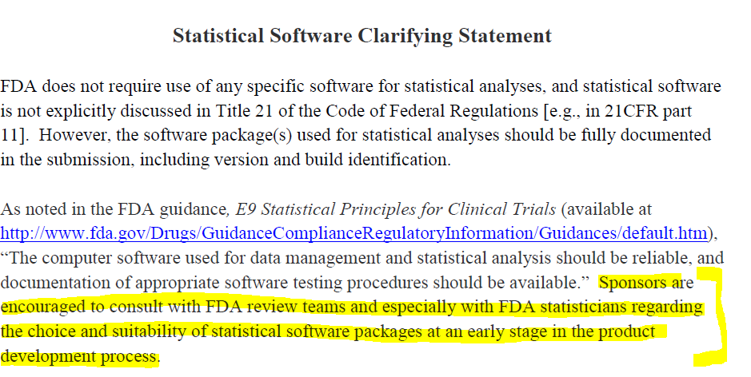
Updates in section 4.1.2.10- Continuous
Notes:
Value of the link

Slide 11
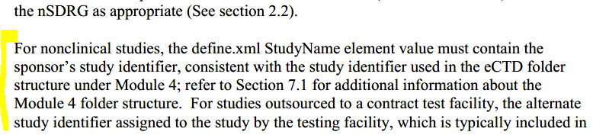
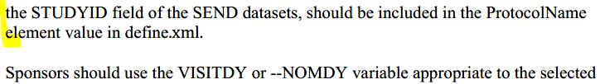
Changes from guide v4.1 to Guide v4.2 (released October 2018) –Updates in section 4.1.3.2
V4.1:
V4.2:
Notes:
Passage added for nonclinical studies

Slide 12
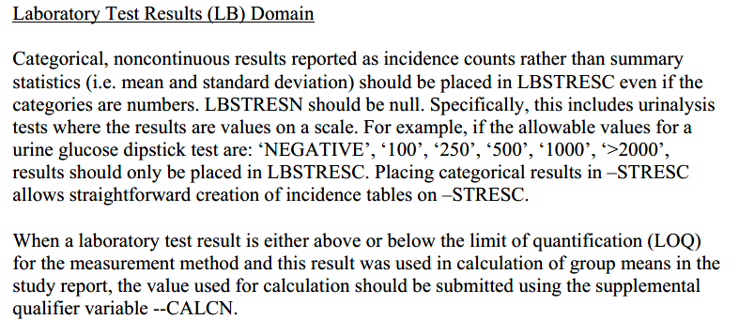
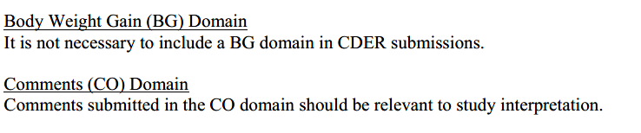
Changes from guide v4.1 to Guide v4.2 (released October 2018) –Updates in section 4.1.3.3
V4.1:
No Laboratory Test Result ~, Body Weight ~ or comments section available
V4.2:

Slide 13
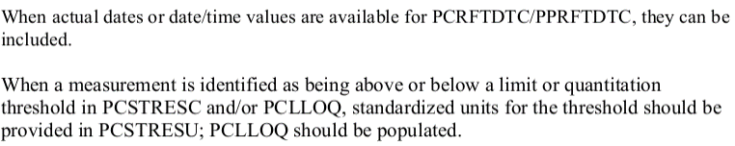
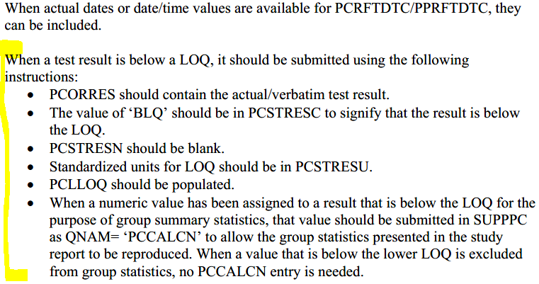
Updates in section 4.1.3.3 - Continuous.
V4.1:
V4.2:
Notes:
More instruction added for PCORRES / PCSTRESC / PCSTRESN for SEND studies

Slide 14
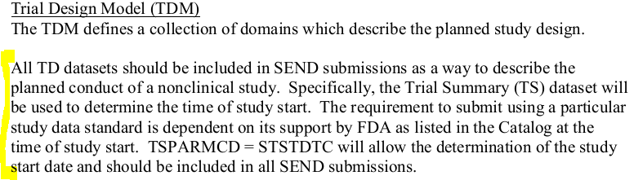
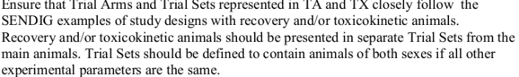
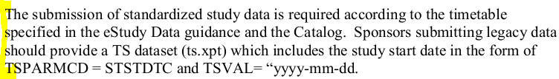
Updates in section 4.1.3.3 - Continuous.
V4.1:
V4.2:
Notes:
Yellow marked text is deleted in version 4.2 but an hint to the appendix added

Slide 15
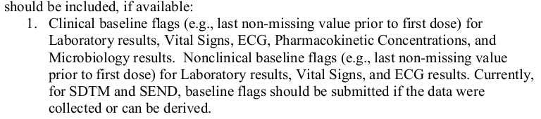
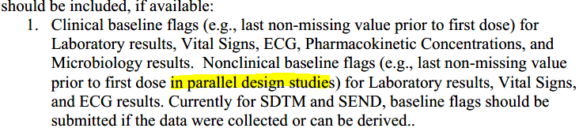
Changes from guide v4.1 to Guide v4.2 (released October 2018) –Updates in section 4.1.4.1
V4.1:
V4.2:
Notes:
Minor clarification

Slide 16
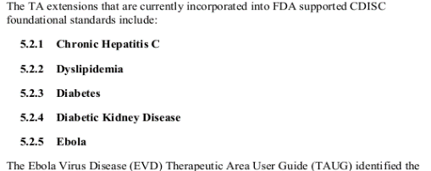
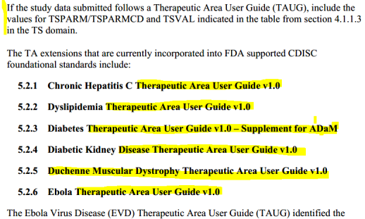
Changes from guide v4.1 to Guide v4.2 (released October 2018) –Updates in section 5.2.
V4.1:
V4.2:
Notes:
1 new TAUG was added, draft version not mentioned anymore, before it was not clear

Slide 17
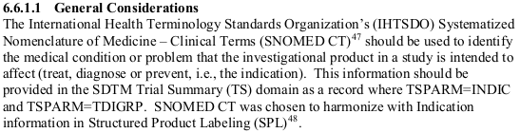
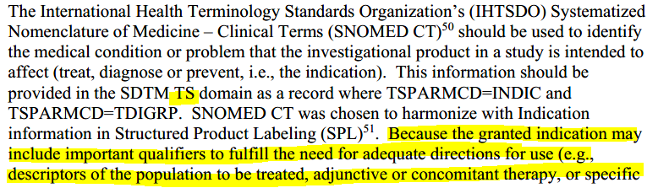
Changes from guide v4.1 to Guide v4.2 (released October 2018) –Updates in section 6.6.1.1
V4.1:
V4.2:

Slide 18
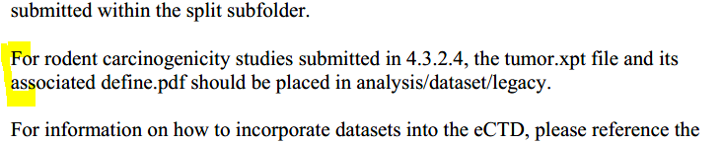

Changes from guide v4.1 to Guide v4.2 (released October 2018) –Updates in section 7.1
V4.1:
V4.2:

Slide 19
Changes from guide v4.1 to Guide v4.2.1 (released January 2019) –Updates in section 7.3
V4.1: not available
V4.2.1: not available

Slide 20
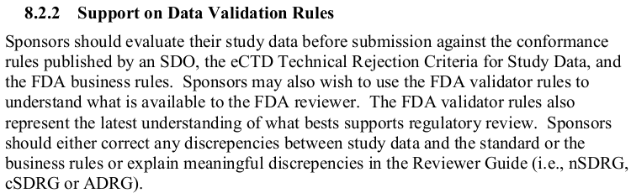
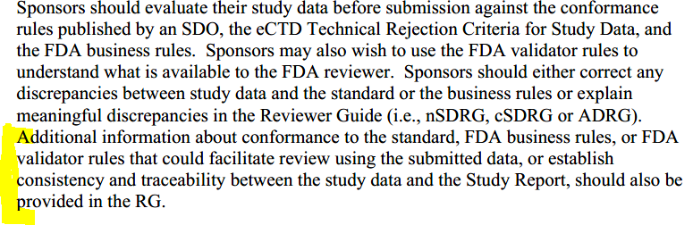
Changes from guide v4.1 to Guide v4.2 (released October 2018) –Updates in section 8.8.2.
V4.1:
V4.2:
Notes:
Important!!!

Slide 21
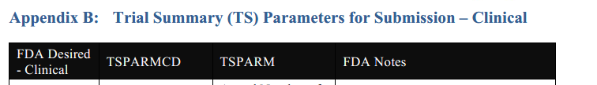
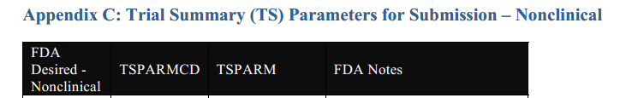
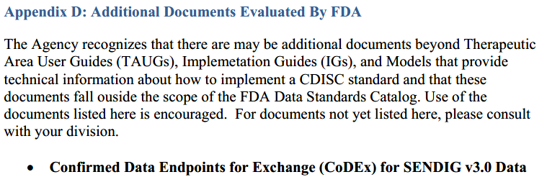
Changes from guide v4.1 to Guide v4.2 (released October 2018) – Appendix.
No appendix available
V4.1:
V4.2:

Slide 22
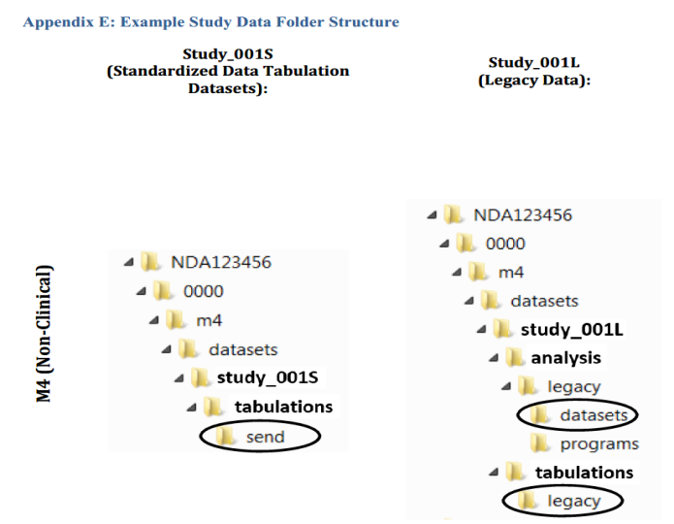
Appendix- Continuous
No appendix available
V4.1:
V4.2:

Slide 23
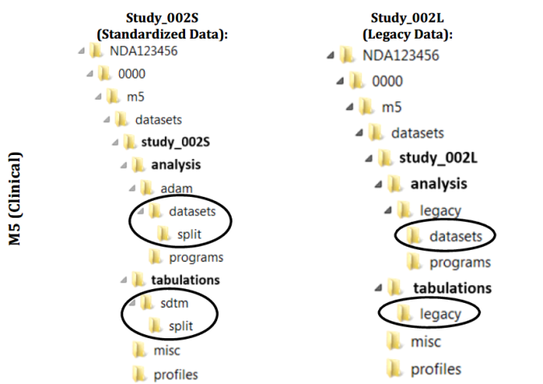
Appendix- Continuous
No appendix available
V4.1:
V4.2:

Slide 24
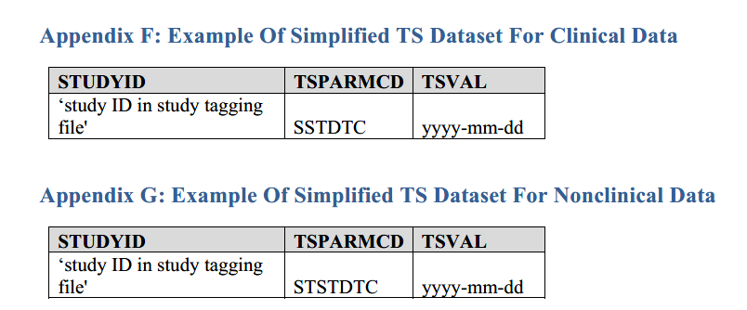
Appendix- Continuous
No appendix available
V4.1:
V4.2:

