Slide 1
CDISC related PhUSE Working Groups Deliverables
German CDISC User Network Meeting
Parexel International GmbH, Berlin
06-Mar-2019
Hasan Kantarci
HMS Analytical Software GmbH
Otto-Volger-Straße 3c
65843 Sulzbach

Slide 2
CDISC related PhUSE Working Groups Deliverables
Which stylesheet we currently use for define.xml:
  Stylesheet from Define-XML v2.0 package
  Stylesheet from ARM v1.0 for Define-XML v2.0 package
  Stylesheet from PhUSE Define-XML v2.0 stylesheet Recommendation Working Group
  Customized version
  Do not now

Slide 3
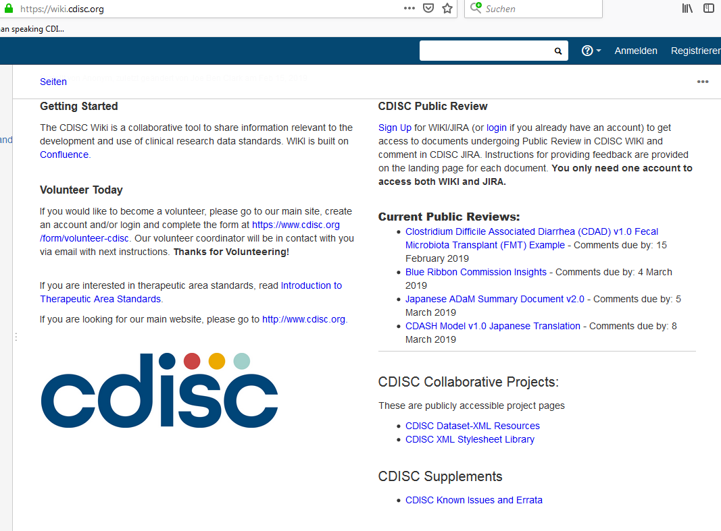
CDISC related PhUSE Working Groups Deliverables
New Define-XML Stylesheet
Can be found on the CDISC wiki page: https://wiki.cdisc.org/
Notes:
CDISC stylesheet library

Slide 4
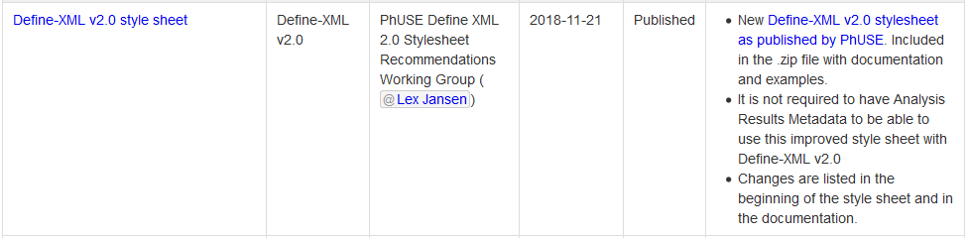
CDISC related PhUSE Working Groups Deliverables
New Define-XML Stylesheet
Notes:
Stylesheet from PhUSE Define-XML v2.0 stylesheet Recommendation Working Group - (for future usage with Define-XML v2.1)

Slide 5

CDISC related PhUSE Working Groups Deliverables
New Define-XML Stylesheet
Stylesheet documentation
  Overview what stylesheet shows and how it can be customised
  Uses special style for printing purposes
  Describes common issues, usage of the 5 stylesheet parameters (comments, VLM display).
  Additional metadata Info in header
Metadata Description attribute is optional, it is shown only in case it is present within the Define-XML document.
Notes:
(Printing functionality cannot be used to create define.pdf.
Provide printable define.pdf if define.xml cannot be printed.
Recommended: submit define.xml test version to cder-edata@fda.hhs.gov prior to application submission to check if it is printable in the CDER IT environment)
Stylesheet documentation.

Slide 6
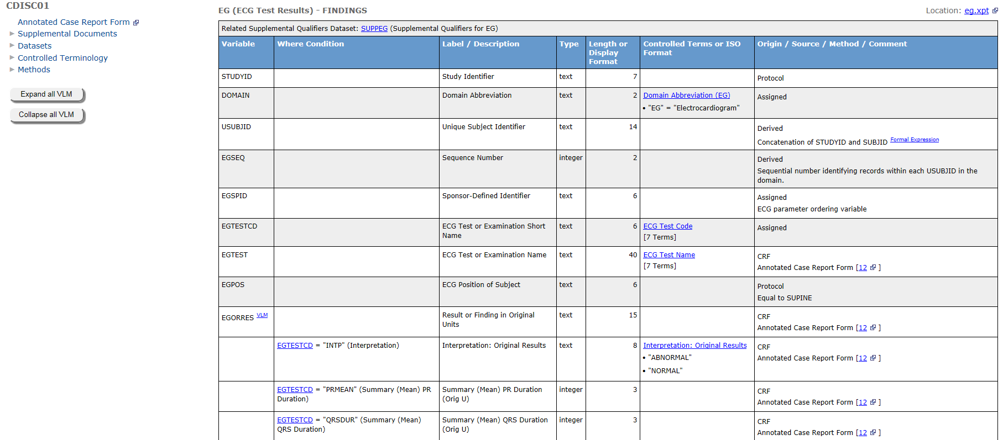
CDISC related PhUSE Working Groups Deliverables
New Define-XML Stylesheet
displayMethodsTable (0/1)
displayCommentsTable (0/1)
CodeListItemDisplay
displayPrefix (0/1)
[Origin] Derived
[Method] …
[Comment] …
displayLengthDFormatSD (0/1): 1 → 8 [2] : 5.2 Length [SignificantDigits] : Display Format
Notes:
New VLM ein/ausblenden: Kein eigener Menüpunkt, sondern jetzt auf-/zuklappbar.
Comments Domain ein/ausblenden
Controlled terms – Ausprägungen (default bis 5 alle anzeigen. >5 Anzahl eingeben. Durch „Schalter“ Anzahl änderbar.
CodeListItemDisplay
The number of codelist items which is displayed in the " Controlled Terms or
Format " column of the dataset view is controlled by the nCodeListItemDisplay
parameter. By default it is set to 5 and only codelists with 5 or less codes are
shown with values in this column. In case a codelist has more than
nCodeListItemDisplay items, it will be shown as
[XX Terms] in that column.
displayMethodsTable (0/1)
By default all algorithms are shown in a separate Methods table, which includes all of the
methods described in the Define-XML document. This parameter allows to control whether this
table is displayed or not.
displayCommentsTable (0/1)
By default comments are not shown in a separate Comments table, which includes all
comments described in the Define-XML document. This parameter allows to control whether this
table is displayed or not.
displayPrefix (0/1)
The " Origin/Source/Method/Comment " column combines different Define-XML attributes and
elements. By setting this parameter to 1, prefixes [Comment], [Method], [Origin] will be
displayed alongside with the descriptions, allowing to identify where it came from.
displayLengthDFormatSD (0/1)
When there is a format attribute provided, it will be shown in the " Length or Display Forma t"
column, otherwise only the length will be shown in this column. When this parameter is set to 1,
name of the column will be changed to " Length [SignificantDigits] : Display Format " and all of
the corresponding attributes, when present in the Define-XML document, will be shown in this
column.

Slide 7
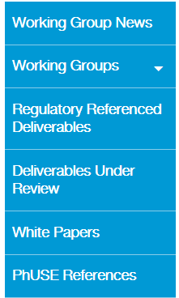
CDISC related PhUSE Working Groups Deliverables
PhUSE page
https://www.phuse.eu/phuse-working-groups
https://www.phuse.eu/css-deliverables
https://www.phuse.eu/cs-deliverables-under-review
https://www.phuse.eu/white-papers
https://www.phuse.eu/phuse-references (other final working group deliverables, e.g. stylesheet)
Notes:
Auch wenn PhUSE deliverables nicht gefordert werden:
Reviewed by FDA
referenced in Technical Conformance Guide (TCG) + Webinars.
FDA ermutigt die Benutzung der deliverables.

Slide 8

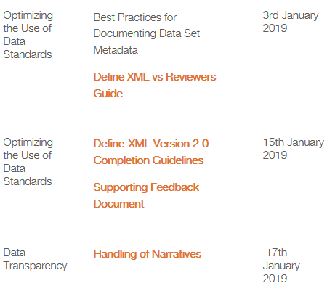
CDISC related PhUSE Working Groups Deliverables
Define-XML Completion Guidelines
newly found Define-XML Version 2.0 Completion Guidelines

Slide 9
CDISC related PhUSE Working Groups Deliverables
Define-XML Completion Guidelines
Provides clarifications and examples on metadata items to be represented in Define-XML version 2.0 documents, and how best to use the Define-XML 2.0 metadata items.
Applies when creating Define-XML 2.0 metadata for electronic submissions.
For Codelist and Value Level Metadata (VLM) more examples and use cases are included.
Notes:
Eher für Anfänger. Aber auch nützlich als referenz für Erfahrene.

Slide 10
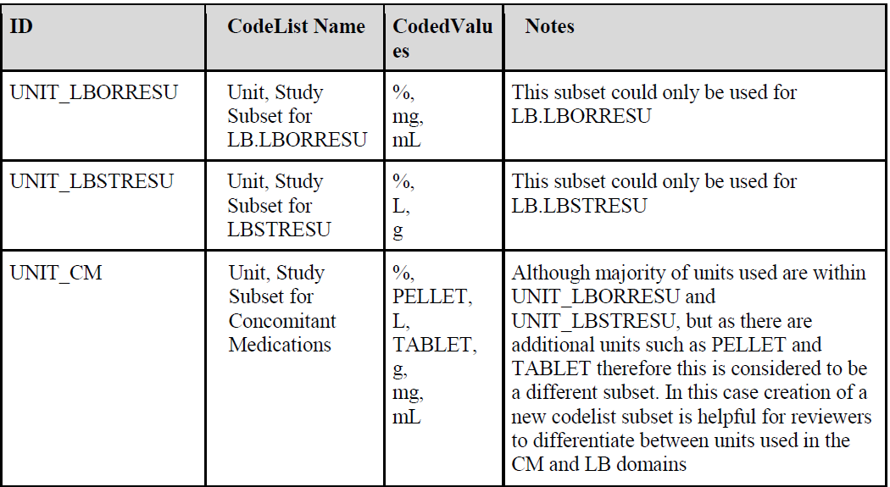
CDISC related PhUSE Working Groups Deliverables
Define-XML Completion Guidelines
Notes:
The UNIT codelist per the SDTM Implementation Guide is used across several unit variables such as --ORRESU and --STRESU. It is most likely that units used in the CM domain are different from those used in the LB domain. It is recommended to create a unique list of units (UNIT_CM) specific to the CM domain to distinguish it from the LB units. Also, in the LB domain (and many other domains where standard results are stored), the list of units used for LBORRESU may be different from those used in LBSTRESU. In those cases, it is recommended to create one subset for LBORRESU (UNIT_LBORRESU) and another subset for LBSTRESU (UNIT_LBSTRESU).

Slide 11
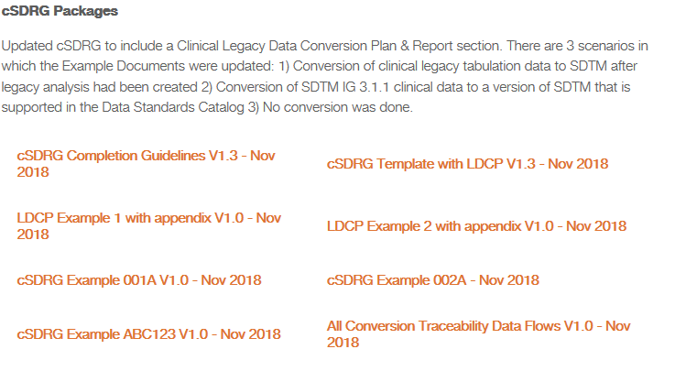
CDISC related PhUSE Working Groups Deliverables
Further new deliverables
New cSDRG package (final):

Slide 12
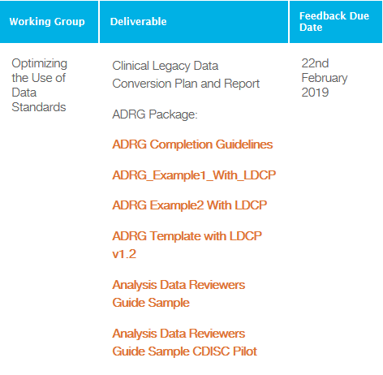
CDISC related PhUSE Working Groups Deliverables
Further new deliverables
New ADRG package (draft for review):

Slide 13
CDISC related PhUSE Working Groups Deliverables
Best Practices for Documenting Data Set Metadata - Define XML vs Reviewers Guide
Focused on
  study-level define.xml files
  Content: what to include, where to included (but not on technical aspects (e.g. XML syntax)
Specifies whether info belongs to DRG, define.xml or in both.
Provides examples how to complete.
Provides guidance and examples where to document (define.xml, DRG or both) additional info useful to help to understand data
Overview of DRG sections which can be used for info which does not fit into define.xml structure.
A table shows how topics are distributed between Define-XML and reviewers guide with highlighting differerences and commonalities

Slide 14
CDISC related PhUSE Working Groups Deliverables
Best Practices for Documenting Data Set Metadata - Define XML vs Reviewers Guide
Topic | Description | define.xml | cSDRG | ADRG
Protocol Information | Summary of protocol number, title, and design. | Y | Y | Y
Trial Design Information | Summary of Trial Design domains. | Y | Y | Y
Acronyms | List of sponsor-specific acronyms. | N | Y | Y
Standards Versions | Summary of standards used for data and metadata. | Y | Y | Y
Dictionary Versions | Summary of external dictionaries used. | Y | Y | Y
Annotated CRFs | Summary of annotation conventions. | N** | Y | N
Study Data Overview | A high level summary of the submitted data. | N | Y | Y
Traceability/Data Flow | Information which describes the various data sources and how the datasets were created. | Y | Y | Y
Dataset Metadata | Descriptions of dataset contents and structures. | Y | Y | Y
Variable Metadata | Descriptions of variables in each dataset. | Y | O | O
Value-Level Metadata | Description of each test within vertically structured datasets. | Y | O | O
Codelists/Controlled Terminology | Description of possible values within a variable or test. | Y | Y | Y
Computational Algorithms | Descriptions of derivations. | Y | O | O
Comments | Notes and explanations. | Y | O | O
Analysis Results Metadata | Describes linkage between datasets, programs, and results. | Y | N | N
Analysis Considerations | Summary of analysis rules and definitions. | Y | N | Y
Conformance / Compliance Findings | Summary of CDISC compliance checks and issues. | N | Y | Y
** define.xml links to the annotated CRFs
Notes:
Protocol Information
If different versions exist:
If inclusion/exclusion criteria were added, removed, or modified, how was this addressed in the IE and TI domains?
If there were changes to study design, how did they impact the TS domain?
If an assessment was added or removed and may not be present for all subjects/timepoints, please note this along with any conditions for its presence or absence.
If a form was modified and certain fields were only collected before or after the modification, please note this along with the timing of the implementation.
If there were no amendments, it is advisable to include a statement to that effect rather than simply listing the protocol number
Trial Design Information
ADRG: may be used to describe how the trial design affected the structure and design of the analysis datasets and how the treatments and study phases or elements are identified within those datasets. Additionally, trial inclusion/exclusion criteria should be fully documented within the cSDRG to include full text of all versions of criteria when there may be truncated or abbreviated text used in the TI (Trial Inclusion/Exclusion Criteria) domain or in cases where there were multiple versions and/or changes in criteria during the trial (note: per section 7.4 of SDTMIG v3.2, if criteria text is >200 characters, then the value of IETEST should be abbreviated with meaningful text and if the criteria is amended during the study, then additional IETESTCD values should be added to ti.xpt
Acronyms
It is recommended to include a comprehensive set of acronyms, even if they are available in other documents. Study documents such as the protocol, CRFs, and SAP should be referenced to identify acronyms that are used within the study. The list should also include acronyms used in the metadata, such as within variable labels (particularly for custom domains) or controlled terminology or in the define.xml. This list should include anything that is not commonly known within the industry, is sponsor-specific, or is specific to a therapeutic area or indication. When in doubt, it is advisable to include the acronym. When the same acronym is used across documents, the definition/description should be the same in each document.
Standards Versions
Dictionary Versions
Annotated CRFs
Study Data Overview
Traceability/Data Flow
Dataset Metadata
Variable Metadata
Value-Level Metadata
Codelists/Controlled Terminology
Computational Algorithms
Comments
Analysis Results Metadata
Analysis Considerations
Conformance / Compliance Findings

Slide 15
CDISC related PhUSE Working Groups Deliverables
Best Practices for Documenting Data Set Metadata - Define XML vs Reviewers Guide
Highlights some differences between authorities (FDA vs. PMDA) and divisions
  CDER vs. CBER in FDA
  BIMO
  SDSP
  Submission of programs
  Rejection criteria
Notes:
SDSP: Study Data Standardization Plan
BIMO: Bioresearch Monitoring Program
CDER: needs summary level clinical site dataset vs. CBER: needs SITEID variable in ALL DS → conflicting with SDTM rules where SITEID only to be in DM.

Slide 16
CDISC related PhUSE Working Groups Deliverables
Best Practices for Documenting Data Set Metadata - Define XML vs Reviewers Guide
QC
  Technical functionality
  Adherence to technical specifications
  Accuracy and completeness of content
  Consistency between documents
  Review
    By team members involved in the study
    By people unfamiliar with the study
    By people with different backgrounds (STAT, Medicine, etc.) whether all is clear and make sense

Slide 17
CDISC related PhUSE Working Groups Deliverables
Best Practices for Documenting Data Set Metadata - Define XML vs Reviewers Guide
Do not include extraneous information
Stick to the facts
Whenever doubts whether info is needfull → DRG
If info is too complex and/or does not fit into define.xml →DRG
DRG more flexible. Flowcharts, tables, figures, graphics etc. can be included to ease the understanding/work for the reviewer.
PhUSE templates not required to be used for submission but have been reviewed by the FDA and are referenced in the Technical Conformance Guide.
FDA presentations and the Technical Conformance Guide have stressed the importance of both documents and have encouraged sponsors to submit comprehensive metadata to help facilitate their reviews.
Future: DRG in XML. Current nothing final

Slide 18
CDISC related PhUSE Working Groups Deliverables
Hasan Kantarci
Senior Statistical Programmer
Hasan.kantarci@analytical-software.de
+49 6221 6051 186

