Slide 1

PhUSE CDISC Implementation Primer Project
German CDISC User Network Meeting
Parexel International GmbH, Berlin
06-Mar-2019
Beate Hientzsch
HMS Analytical Software GmbH
Otto-Volger-Straße 3c
65843 Sulzbach

Slide 2

PhUSE CDISC Implementation Primer – Project Background
Initiated during PhUSE CSS Conference in March 2018
Project of PhUSE Working Group:
“Optimizing the Use of Data Standards” (https://www.phuse.eu/optimizing-data-standards)
Current Team Structure
  PhUSE Leads: Yvonne Moores, Beate Hientzsch
  CDISC Lead: Bess Le Roy
  > 20 volunteers / sub-teams
Timelines: Deliverables ready for CSS June 2019

Slide 3
PhUSE CDISC Implementation Primer - Vision
“This project will identify needs of new CDISC implementers with an additional focus on academia and technology providers. A "CDISC Primer" (e.g. Wiki, White Paper, slide deck, quickstart, guides, etc.) will be developed that addresses these needs and made freely available to the public.”

Slide 4
PhUSE CDISC Implementation Primer – Topics of Interest (1 + 2)
What is meant with Traceability?
    Can we explain this through examples and visuals?
    …
How do the models link (or not)?
    which models are mandatory
    link to data standards catalogs
    which models have been developed in the past, what is their use, should you use them if regulatory does not require them?
    …

Slide 5
PhUSE CDISC Implementation Primer – Topics of Interest (3 + 4)
How to get started with CDISC?
  Where can you find training materials
  What are the training materials?
  Do we need to provide examples on getting started?
  How do the models link to clinical research processes?
  …
What does CDISC compliance mean?
  What are the steps to take to ensure CDISC compliance?
  …

Slide 6
PhUSE CDISC Implementation Primer – Your Thoughts
?

Slide 7
Back-Up

Slide 8
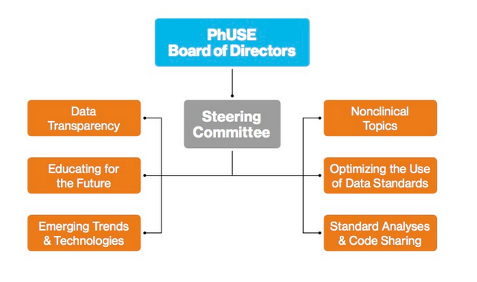
PhUSE Working Group Structure
https://www.phuse.eu/phuse-working-groups

