Slide 1
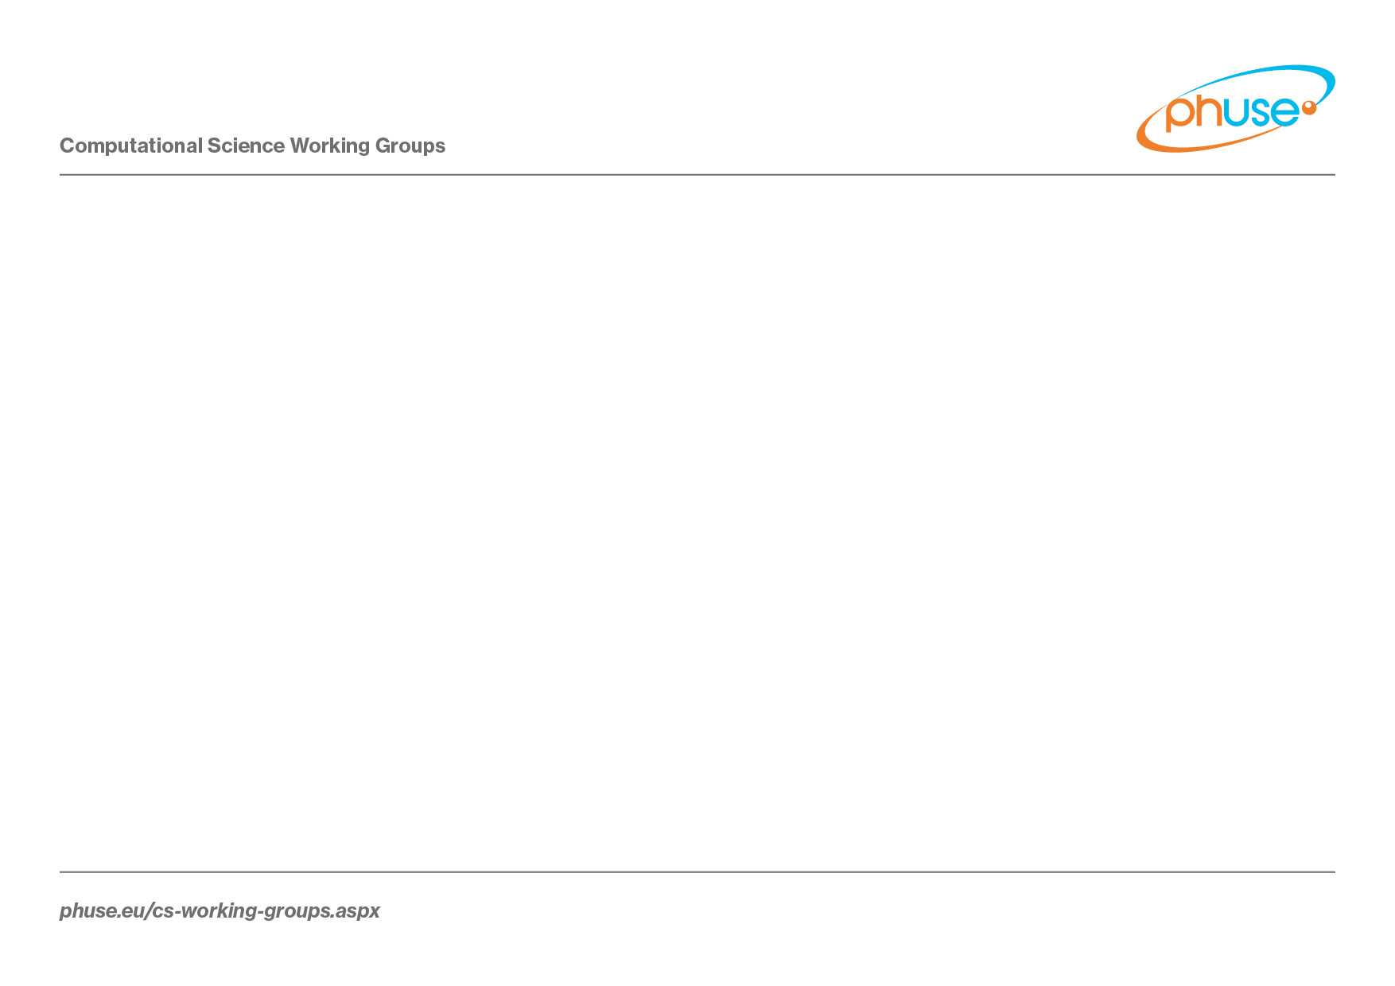
PhUSE Connect US 2019
A Linked Data Model and Hypermedia API for CDISC Library
Paper Authors:
Sam Hume, CDISC, State College, PA, USA
Frederik Malfait, Nurocor, Wolfenschiessen, Switzerland
Julie Chason, CDISC, Exton, PA, USA
Presented By:
Sam Hume shume@cdisc.org

Slide 2

Introducing CDISC Library

Slide 3
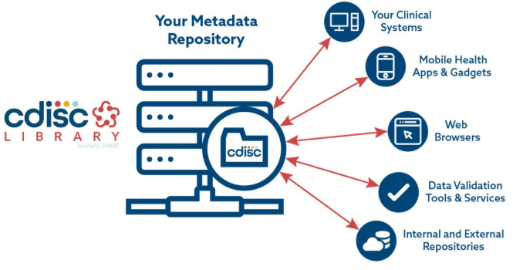

Slide 4
CDISC Library Launch
Formerly known as SHARE 2.0
Built on a new technology stack based on a linked data model
Includes an expanded hypermedia API
Includes new content not previously available
Broader membership access to the API
Launch includes lots of supporting activities

Slide 5
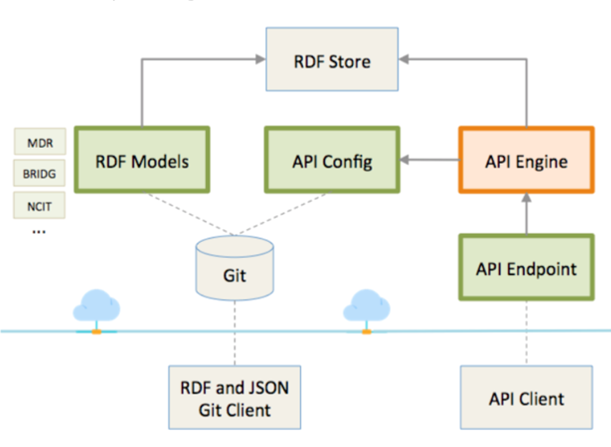
CDISC Library System Diagram

Slide 6
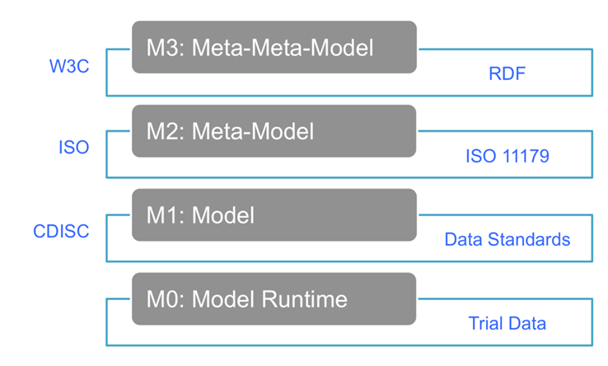
CDISC Library Model Layers

Slide 7
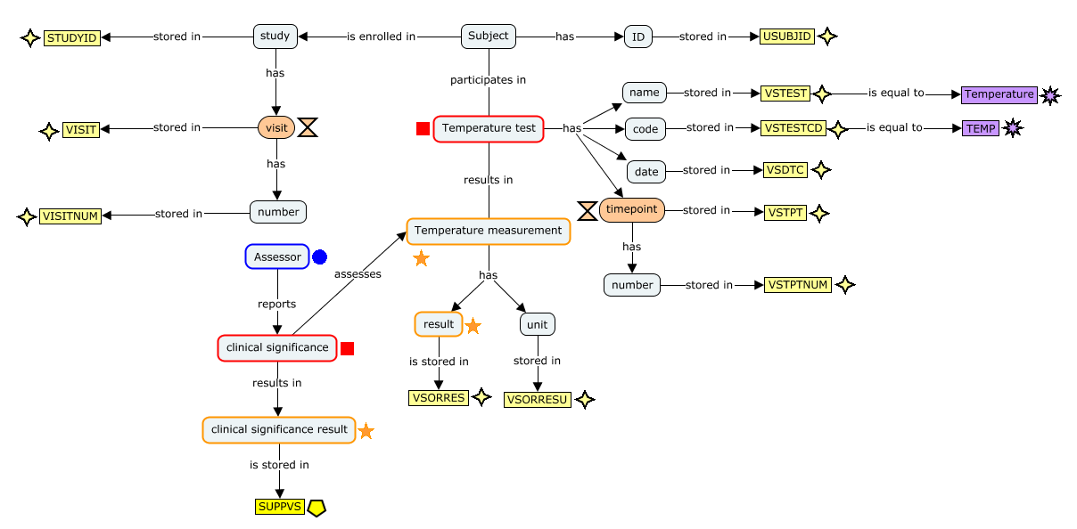
Standards Content Curation

Slide 8
Highlights of the metadata available in the CDISC Library
SDTM v1.2 | SDTMIG v3.2 | ADaM OCCDS v1.0
SDTM v1.3 | SDTMIG v3.3 | ADaM ADAE v1.0
SDTM v1.4 | SDTMIG-AP v1.0 | ADaM BDS for TTE v1.0
SDTM v1.5 | SENDIG v3.0 | CDASH Model v1.0
SDTM v1.6 | SENDIG v3.1 | CDASHIG v1.1.1
SDTM v1.7 | ADaM v2.1 | CDASHIG v2.0
SDTMIG v3.1.2 | ADaMIG v1.0 | Controlled Terminology Packages 2014Q3 - 2018Q4
SDTMIG v3.1.3 | ADaMIG v1.1

Slide 9
The CDISC Library Linked Data Model

Slide 10
Linked Data Principles
Linked data represents all kinds of conceptual things, and they have names that start with HTTP (URLs).
If one were to look up one of these URLs they would get back some useful data about that thing or event in a standard format.
The information returned includes not only facts, but also relationships. These relationships link content to other things that also have names represented as URLs.
Ref: Tim Berners-Lee, https://www.ted.com/talks/tim_berners_lee_on_the_next_web
Notes:
1… Names that start with HTTP are Uniform Resource Locators (URLs).
3… The ability to use these links to retrieve related content supports the follow your nose pattern.

Slide 11
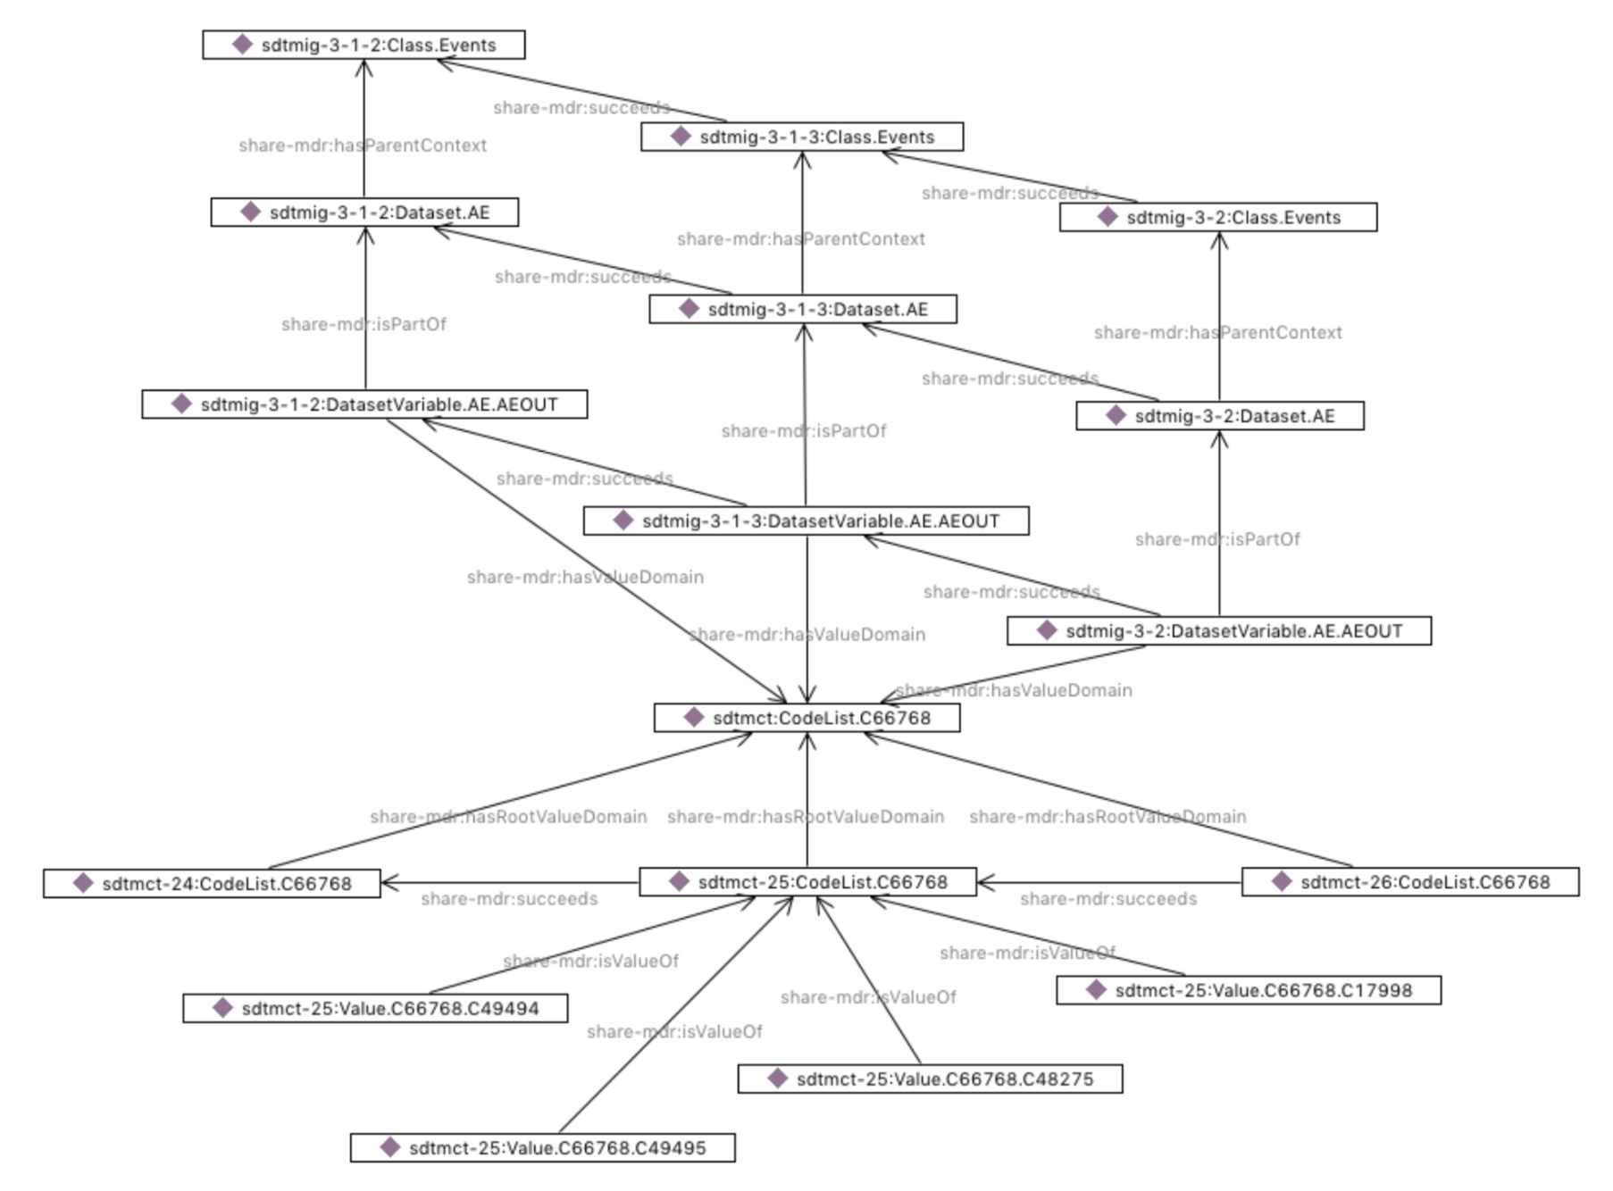
Example CDISC Library SDTM RDF Graph

Slide 12
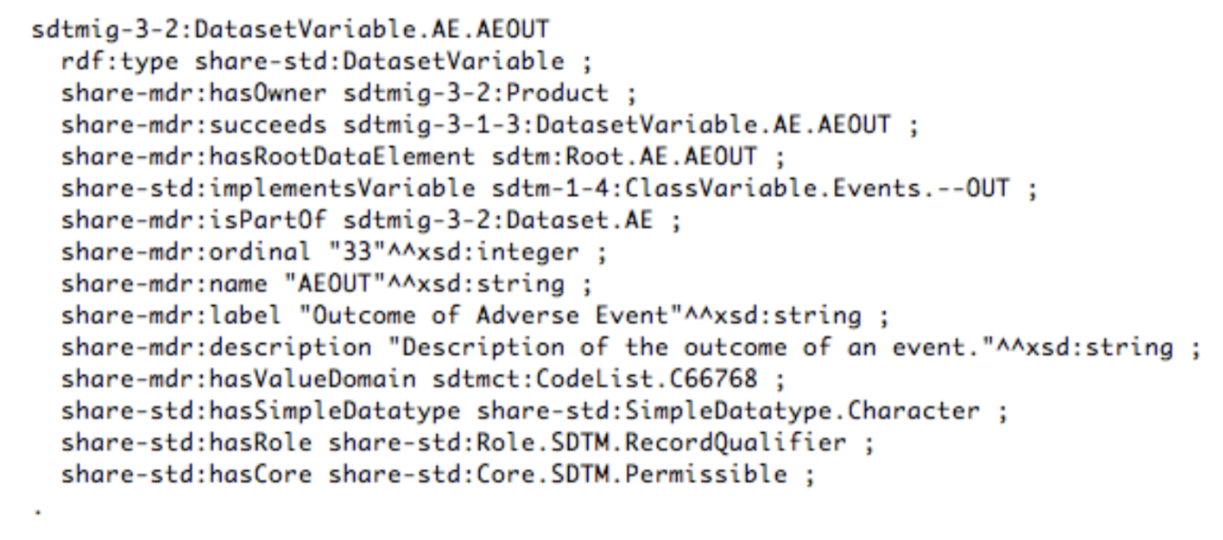
Example of Serialized RDF

Slide 13
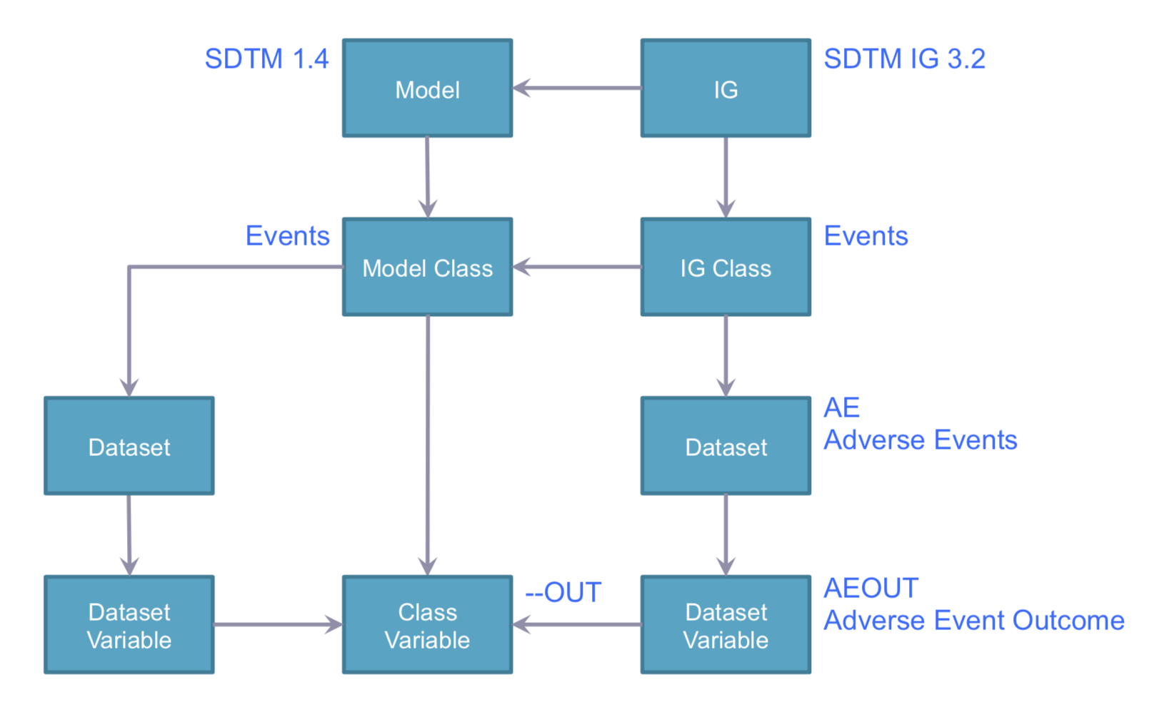
Conceptual Graph Showing the Relationships Model and IG elements

Slide 14
Conceptual Graph Showing Standards Versions
Model
IG
SDTM IG 3.1.2
Model
IG
SDTM IG 3.1.3
Model
IG
SDTM IG 3.2
Model Class
IG Class
Model Class
IG Class
Model Class
IG Class
Dataset
Dataset
Dataset
Dataset
Dataset
Dataset
Dataset Variable
Class
Variable
Dataset Variable
Dataset Variable
Class
Variable
Dataset Variable
Dataset Variable
Class
Variable
Dataset Variable

Slide 15
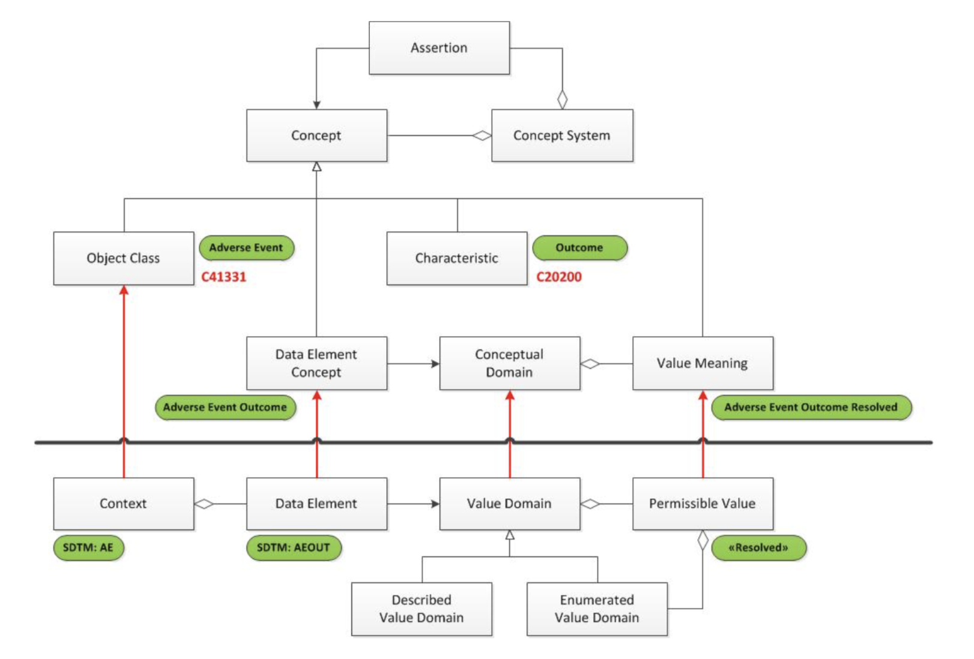
ISO 11179 with CDISC Library Content

Slide 16
The CDISC Library Hypermedia API

Slide 17
CDISC Library Applies REST Architecture Principles
A client server architectural style that implements a layered solution
Uses hypermedia as the engine of application state (HATEOAS)
Resources provide the source of specific information
Standard interfaces (e.g. HTTP) support the principle of generality
Stateless servers support the principles of visibility, reliability, and scalability
Responses should be cacheable to improve performance
Supports content negotiation - clients request specific content and media types

Slide 18
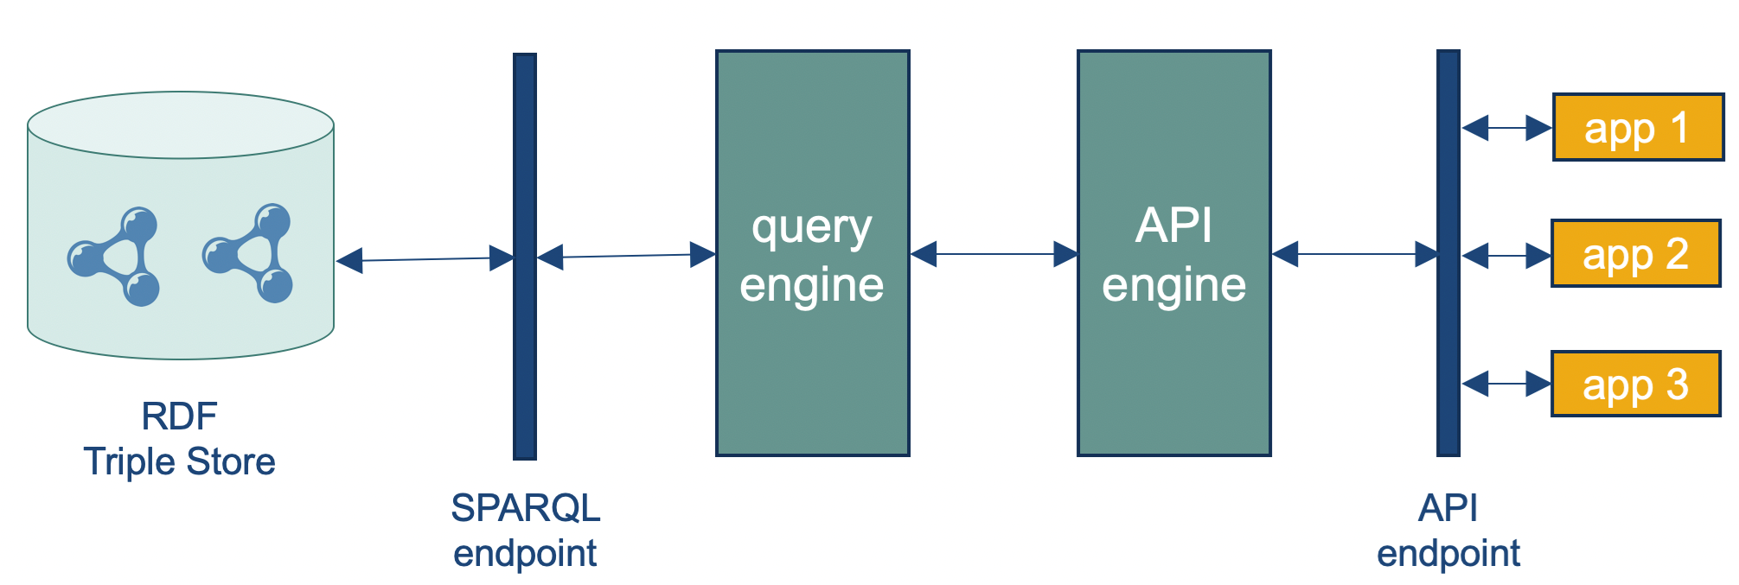
Mapping a REST API to a Linked Data Model

Slide 19
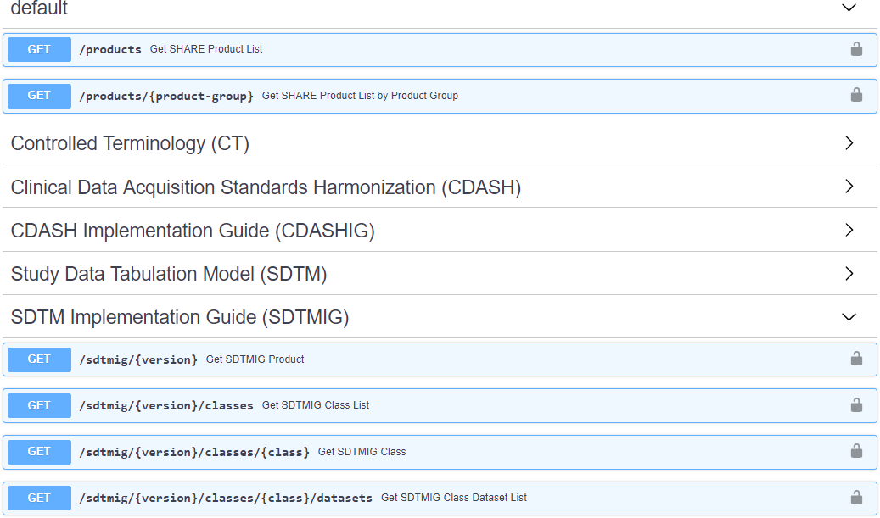
CDISC Library API Specification

Slide 20
CDISC Library REST API Example
SDTM API | Description
/sdtm/{version} | Get SDTM Product
/sdtm/{version}/classes | Get SDTM Class List
/sdtm/{version}/classes/{class} | Get SDTM Class
/sdtm/{version}/classes/{class}/variables | Get SDTM Class Variable List
/sdtm/{version}/classes/{class}/variables/{var} | Get SDTM Class Variable
/sdtm/{version}/classes/{class}/datasets | Get SDTM Class Dataset List
/sdtm/{version}/datasets | Get SDTM Dataset List
/sdtm/{version}/datasets/{dataset} | Get SDTM Dataset
/sdtm/{version}/datasets/{dataset}/variables | Get SDTM Dataset Variable List
/sdtm/{version}/datasets/{dataset}/variables/{var} | Get SDTM Dataset Variable
/root/sdtm/classes/{class}/variables/{var} | Get Root SDTM Class Variable
/root/sdtm/datasets/{dataset}/variables/{var} | Get Root SDTM Dataset Variable
/sdtm/{version}/corrigenda | Get SDTM Corrigenda

Slide 21
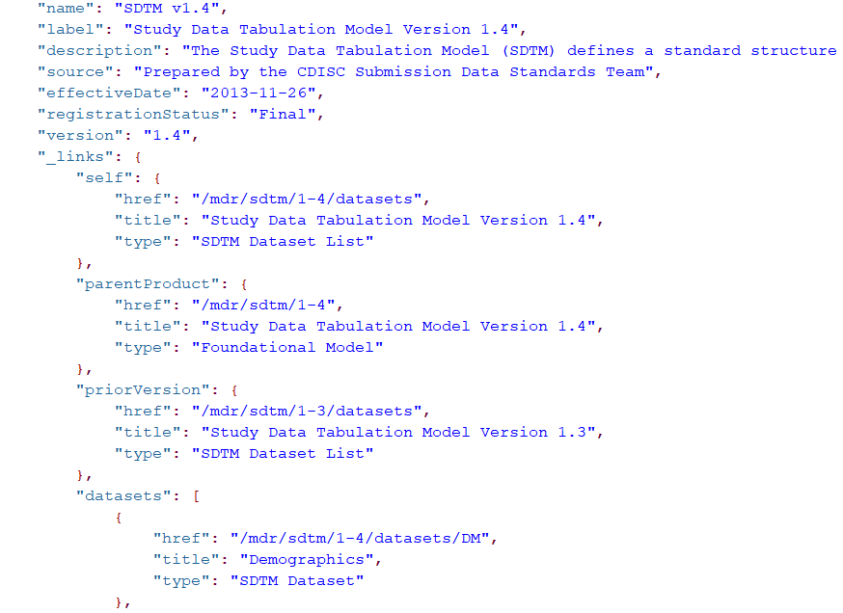
CDISC Library REST API Example – HATEOAS
Notes:
HATEOAS (Hypermedia as the Engine of Application State) is a constraint of the REST application architecture. A hypermedia-driven site provides information to navigate the site's REST interfaces dynamically by including hypermedia links with the responses.

Slide 22
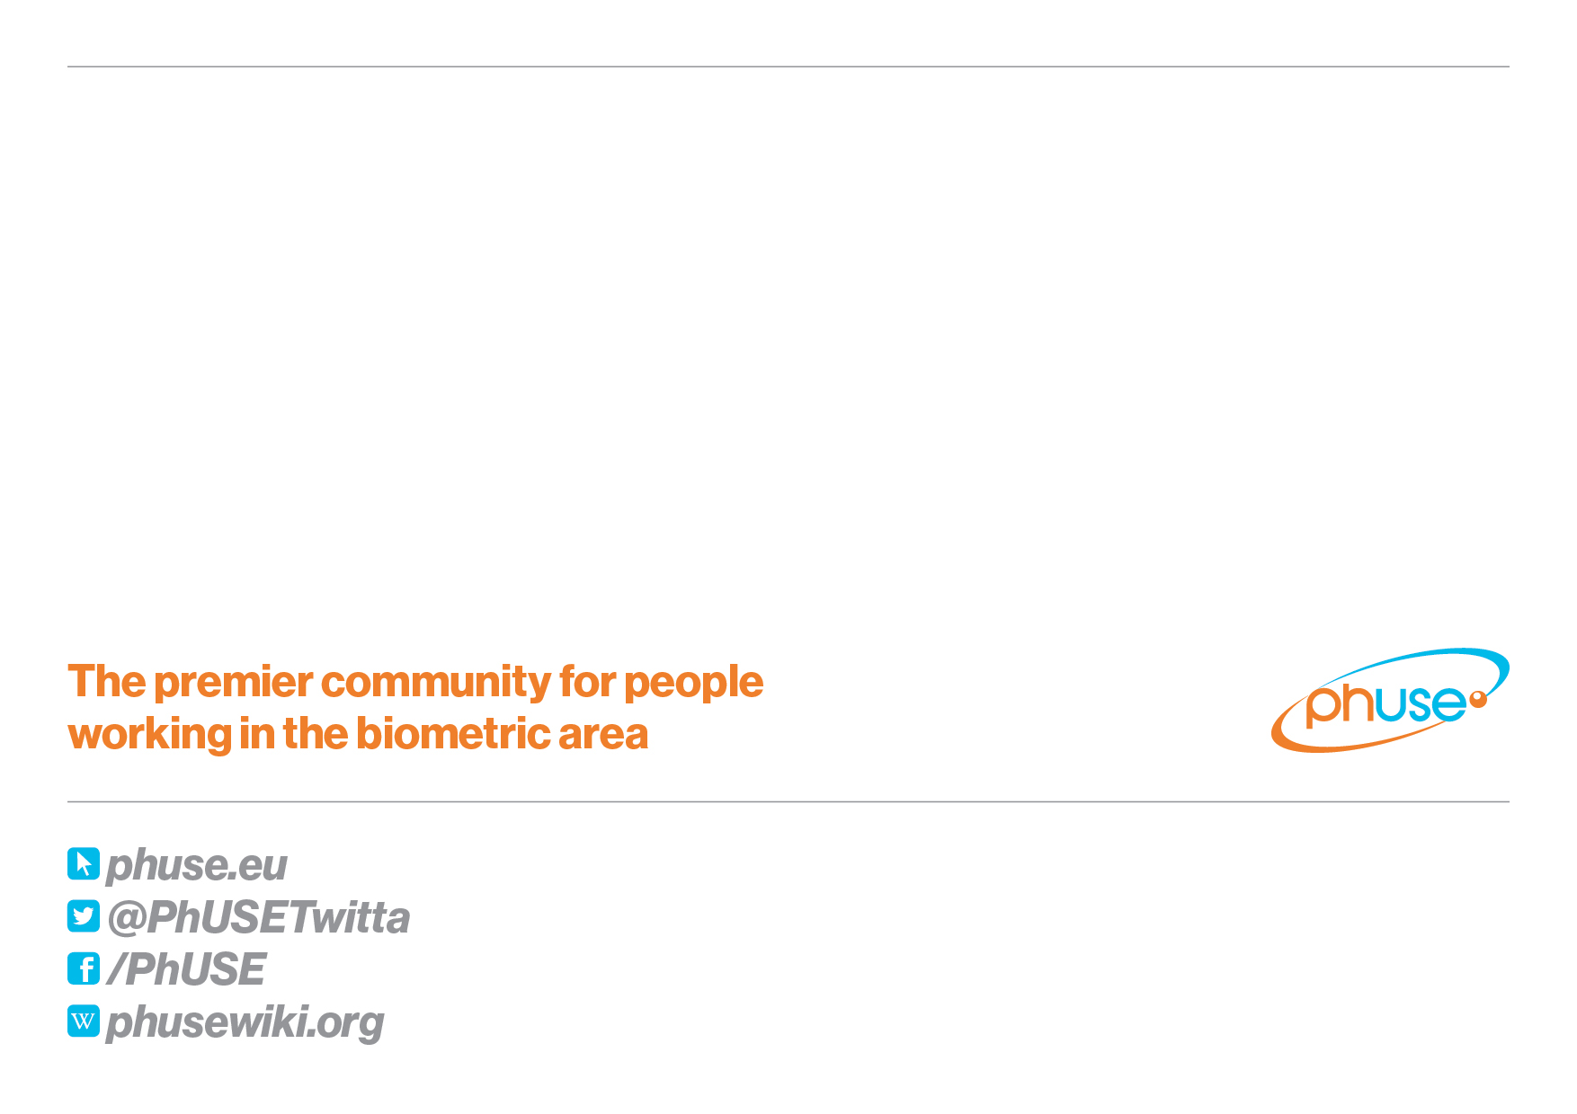
Interested in More Information?
Contact
Sam Hume shume@cdisc.org
Frederik Malfait frederik.malfait@nurocor.com
Thank You!

