Slide 1

Clinical Trial Process: Standardization End to End at CDISC German User Group 2019
Michael Walter, Head of Data Standards & Governance

Slide 2

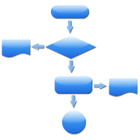










Clinical study process - data standardization built in
REGISTER
Intended
Use
Study
Plan
Study
Proposal
Study
Review
Study
Registration
Protocol
Approval
Data
Collection
Data
Tabulation
Data
Analysis
Regulatory
Submission
Master Data Standards
Protocol Standard
CDASH
SDTM
AdaM
*CDASH: Clinical Data Acquisition Standards Harmonization, **SDTM: Study Data Tabulation Model, ***AdaM: Analysis Data Model, CRF: Case Report Form

Slide 3
Doing now what patients need next

