Slide 1
CDISC 360:
Evolving our standards towards end to end automation
Peter van Reusel
Sam Hume
Barry Cohen

Slide 2
Agenda
Where are we today
Approach
Logistics
Relationship to Other Initiatives
Expected outcomes

Slide 3
1. Where are we today

Slide 4
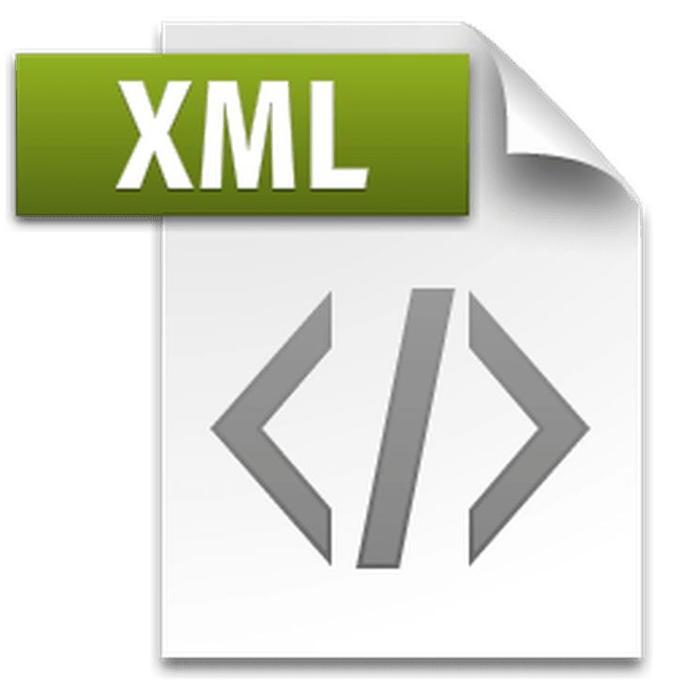







Today we are here
Define
Define
Protocol
eDC Build
Data Capture
Data Storage and Review
Analysis
Analysis Data and Results
Study Reports
CDASH
SDTM
ADaM
Define.xml
Controlled terminology
TAUGS
Collect
Aggregate
Analyze
ODM XML
SDM-XML
ODM XML
DATASET XML
DEFINE XML

Slide 5
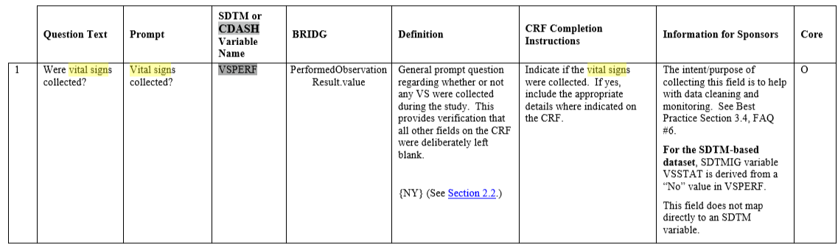
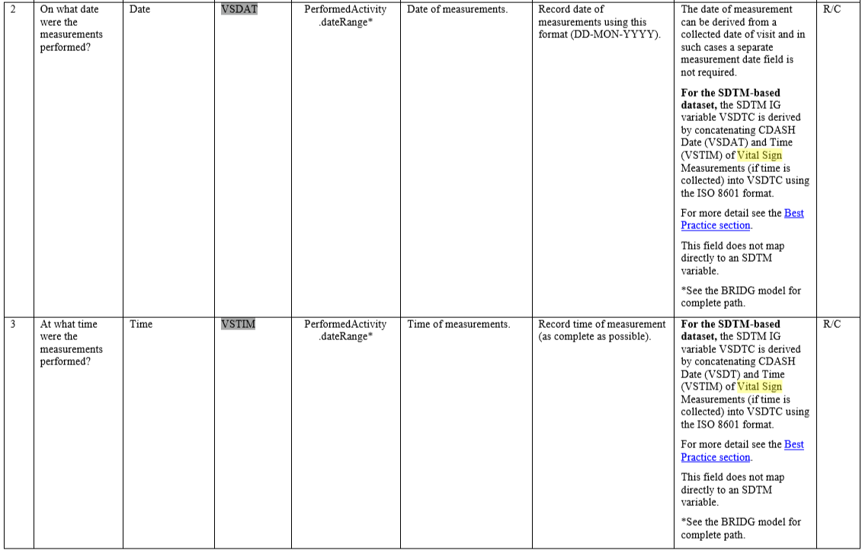
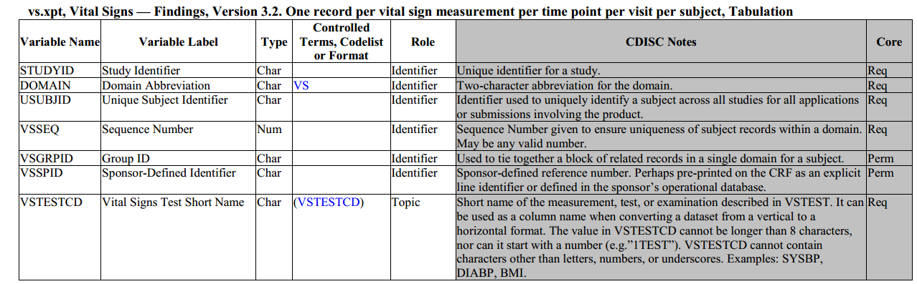
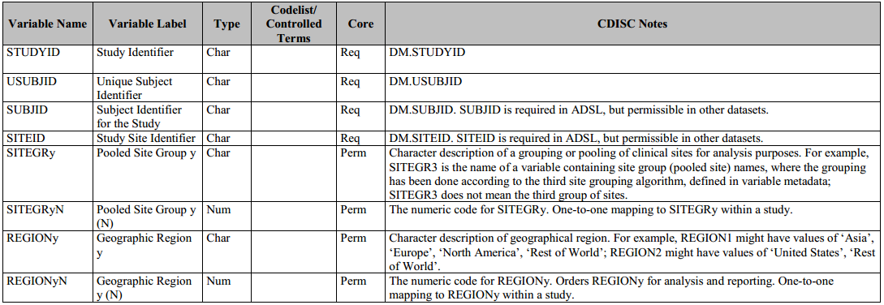
Defined structures
CDISC Foundational models
provide much needed structure
  Normative Content
  2 dimensional (tables, columns)
  Standard to represent data
The information itself is not defined
  We do not need new structures
  We need to define
    Entities
    Semantics (meaning)
    Relationships between information
    Rules in the data lifecycle

Slide 6
Why Change?
Industry needs are maturing
Machine-readable standards
Move beyond normative structural description of data
Provide semantic relations between data – add meaning
Add process metadata to enable end-to-end automation
We want non-standard experts to use our standards

Slide 7
2. Approach

Slide 8
What is the CDISC 360 Project?
Adding a conceptual layer to standards
Create and store standards as concepts which create meaning between data
A serious attempt to store and use data standards as linked metadata
Add computer readable process metadata which enables end to end automation
Evolve from normative to informative standards
CDISC 360 will develop concept-based standard definitions, and test and demonstrate end-to-end automation of study specification and data processing
  ➔ Test and demonstrate, but not building software

Slide 9
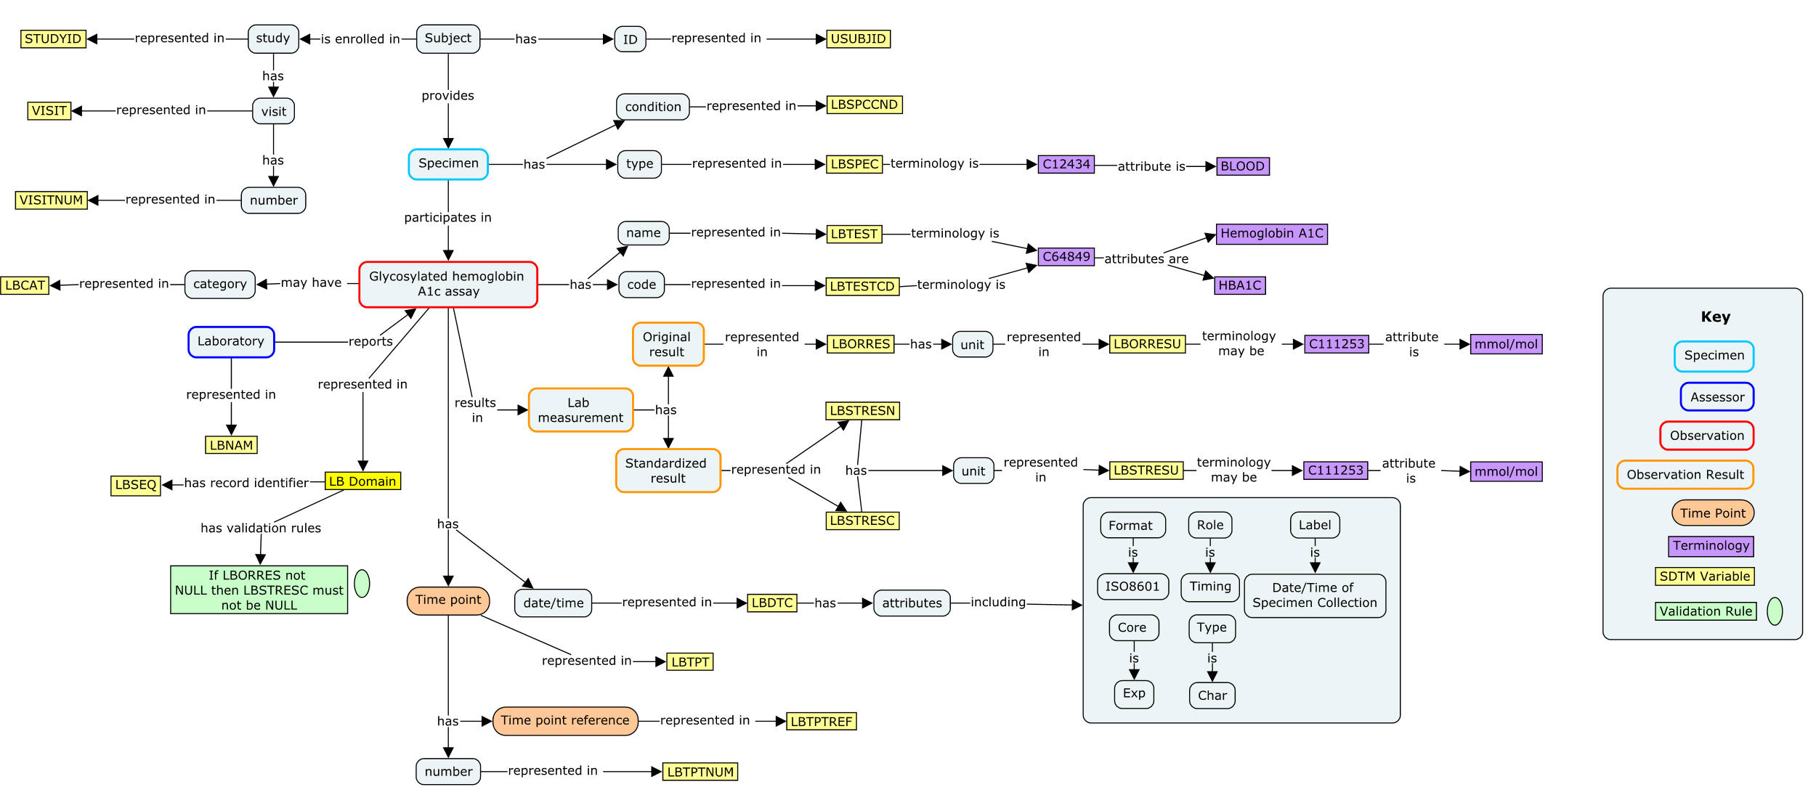
Biomedical Concept
Data is expressed through the CDISC Foundational Models
Can be mapped to BRIDG Reference Model

Slide 10
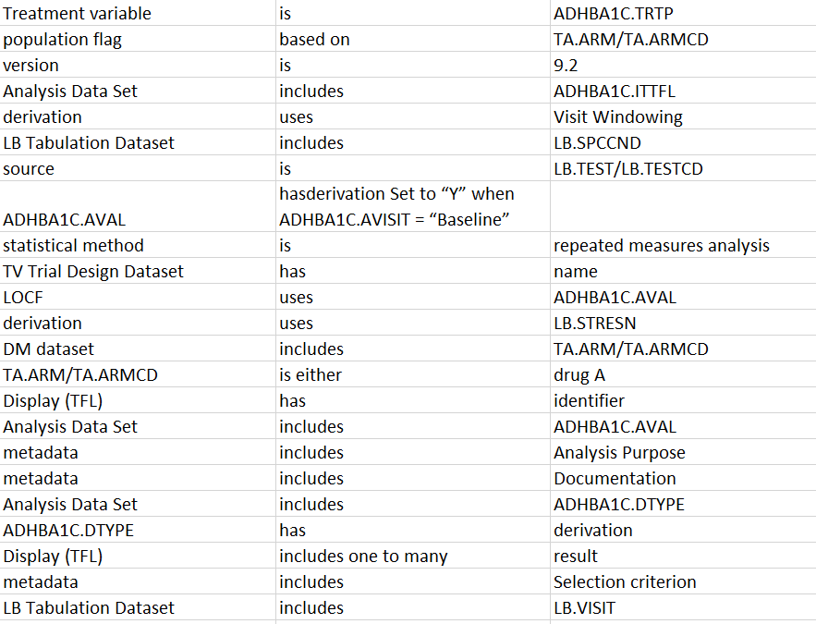
Biomedical Concept
Triple Store

Slide 11
Biomedical Concept
  Attributes are linked to the element

Slide 12
Biomedical Concept
c
  Linking controlled terminology to the variable

Slide 13
Biomedical Concept
  Standardize value level metadata

Slide 14
Biomedical Concept
40
  Machine readable
  definition of
  validation rules

Slide 15
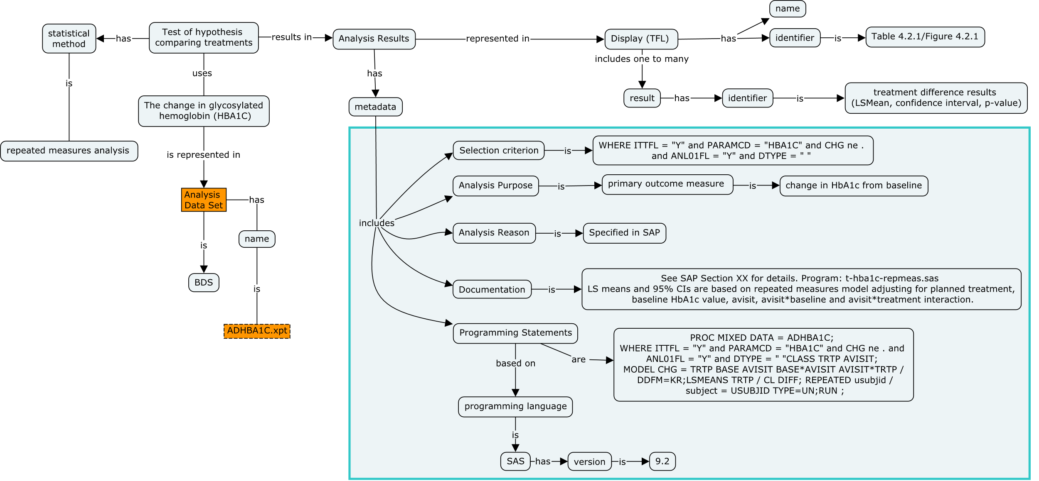
Analysis Result

Slide 16
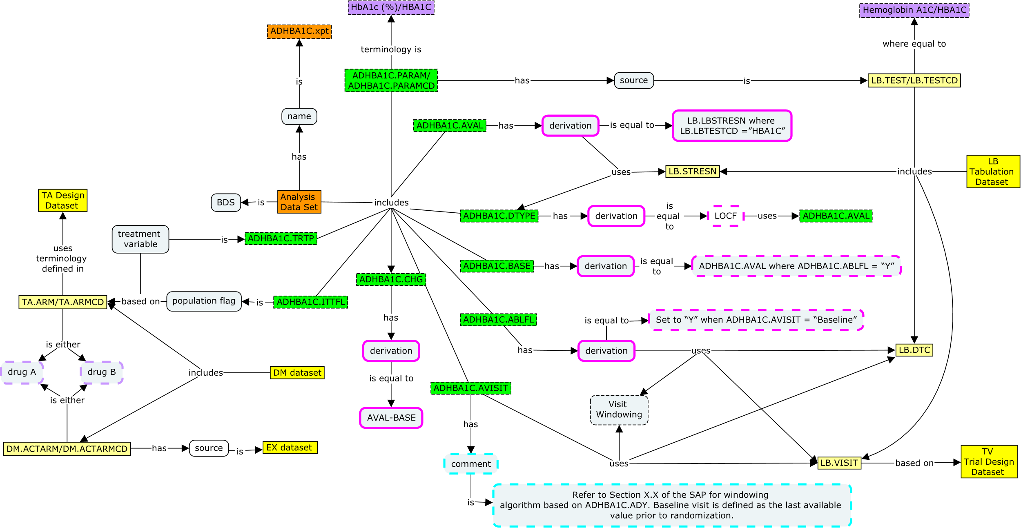

Analysis Concept

Slide 17
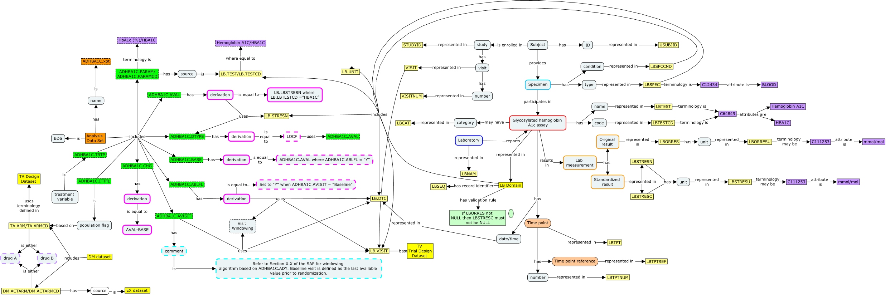
One Model
  Biomedical Concept Map
  Analysis Concept Map
→ The Biomedical Concept and Analysis Concept are ONE MODEL

Slide 18
The Power of a Conceptuel Model for Data Standards
Linking controlled terminology to the variable – standardize value level metadata
Machine readable definition of validation rules
Linking derivations and algorithms to variable(s)
  Include process metadata (ETL instructions)
Possibility to standardize Analysis outputs and Collection instruments
  Combining layout, variables, process information together
Link Analysis Concepts to Biomedical Concepts
  Choose an analysis and automatically obtain all related end-to-end metadata
→ All of the above: enables automation, increase confidence in results, true analysis traceability

Slide 19






Use Case 1 : End to Start Specification
Selecting standards concepts and linked metadata needed for a study
Data Standards
Biomedical Concepts
Analysis Concepts
Foundational Standards
Endpoints
TFL
Data
Collection
Modules
Collection Metadata
Retrieve
Collection Standards
Tabulation Metadata
Retrieve Tabulation
Standards
Analysis
Metadata
Retrieve
Analysis
Standards
Standards
Selection
TFL
Standards Metadata Selection
Protocol Outline (Hypothesis)

Slide 20

DISCLAIMER NOTE
The following is not a software demonstration
Sole purpose is to illustrate how data standards can enable tools

Slide 21


Welcome
Login:
CDarwin
Password:
************
SIGN IN >>

Slide 22


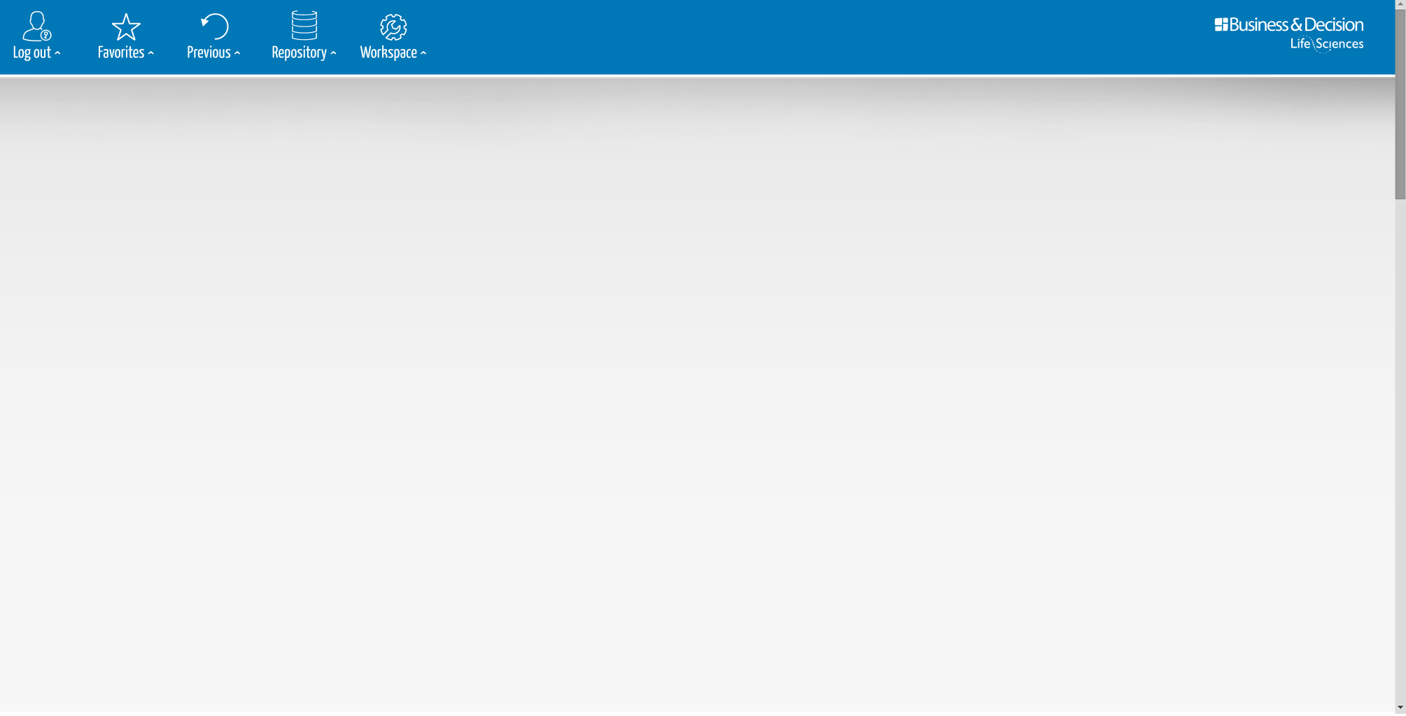








Selection
Enter your search here
CDASH
DOMAIN
CDASH Variable
Value Level Metadata
Controlled Terminology
SELECTION
DATA
COLLECTION
ANALYSIS
SDTM
DOMAIN
SDTM Variable
Value Level Metadata
Controlled Terminology
Computational algorithm
AE
EX
CM
MH
VS
LB
Adverse
Events
Exposure
Concomittant
Medication
Medical
History
Vital Signs
Laboratory
Test Results
ADaM
DOMAIN
ADaM Variable
ADaM Parameters
Controlled Terminology
Computational algorithm
Tables
Figures
Listings
End Points

Slide 23

Selection
Enter your search here
CDASH
DOMAIN
CDASH Variable
Value Level Metadata
Controlled Terminology
SELECTION
DATA
COLLECTION
ANALYSIS
Figures
Graphical Approaches to the Analysis of Safety Data from Clinical Trials”. Amit, et. al.
SDTM
DOMAIN
SDTM Variable
Value Level Metadata
Controlled Terminology
Computational algorithm
From “Graphical Approaches to the Analysis of Safety Data from Clinical Trials”. Amit, et. al.
Mean Change from Baseline in QTc by time and treatment.
Distribution of ASAT by time and treatment
Distribution of maximum LFT values by treatment.
Panel of LFT shift from baseline to maximum by treatment
ADaM
DOMAIN
ADaM Variable
ADaM Parameters
Controlled Terminology
Computational algorithm
LFT Patient profiles
Most Frequent On Therapy Adverse Events
Cumulative distribution (with SEs) of time to first AE of special interest
x

Slide 24
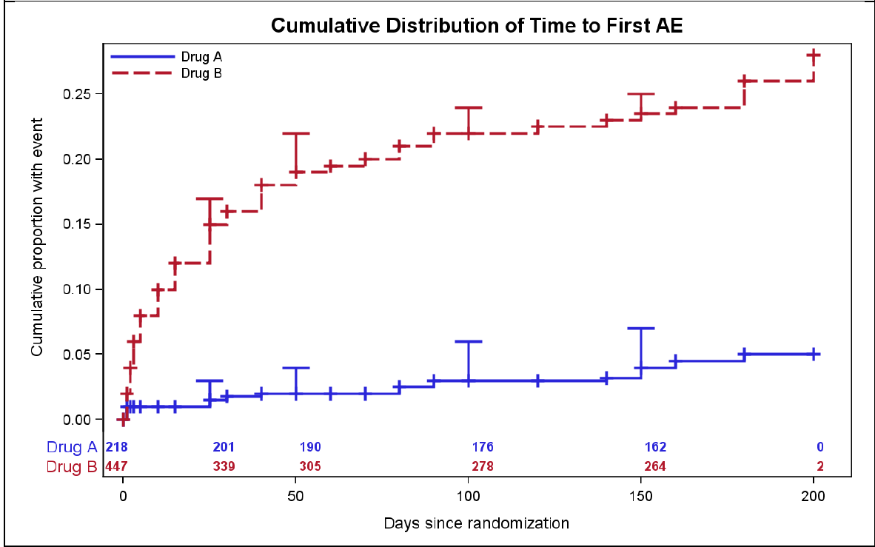
SAMPLE TEMPLATE

Slide 25

Selection
Enter your search here
CDASH
DOMAIN
CDASH Variable
Value Level Metadata
Controlled Terminology
SELECTION
DATA
COLLECTION
ANALYSIS
SDTM
DOMAIN
SDTM Variable
Value Level Metadata
Controlled Terminology
Computational algorithm
AE
EX
CM
MH
VS
LB
Adverse
Events
Exposure
Concomittant
Medication
Medical
History
Vital Signs
Laboratory
Test Results
ADaM
DOMAIN
ADaM Variable
ADaM Parameters
Controlled Terminology
Computational algorithm
Tables
Figures
Listings
End Points

Slide 26

Selection
Enter your search here
CDASH
DOMAIN
CDASH Variable
Value Level Metadata
Controlled Terminology
SELECTION
DATA
COLLECTION
ANALYSIS
Listings
Listing 2.4 Current Cancer History – All Treated Patients Experiencing Critical Events
SDTM
DOMAIN
SDTM Variable
Value Level Metadata
Controlled Terminology
Computational algorithm
Listing 2.5 Prior and Concomitant Medication – All Treated Patients Experiencing Critical Events
Listing 2.6 Physical Examination at Screening – All Treated Patients Experiencing Critical Events
Listing 3.1 Reference Chemotherapy and Concomitant Chemotherapies – All Treated Patients Experiencing ..
Listing 4.1 Adverse Event Listing. All Pre-Treatment Adverse Events – All Treated Patients Experiencing …
Listing 4.2 Adverse Event Listing. Treatment Emergent Adverse Events – All Treated Patients Experiencing …
ADaM
DOMAIN
ADaM Variable
ADaM Parameters
Controlled Terminology
Computational algorithm
Listing 4.3 Adverse Event Listing. Serious Treatment Emergent Adverse Events – All Treated Patients ..
Listing 4.4 Adverse Event Listing. Serious Treatment Emergent Adverse Events Related To Study Drug …
Listing 4.5 Adverse Event Listing. Serious Treatment Emergent Adverse Events Related To Treatment
x

Slide 27
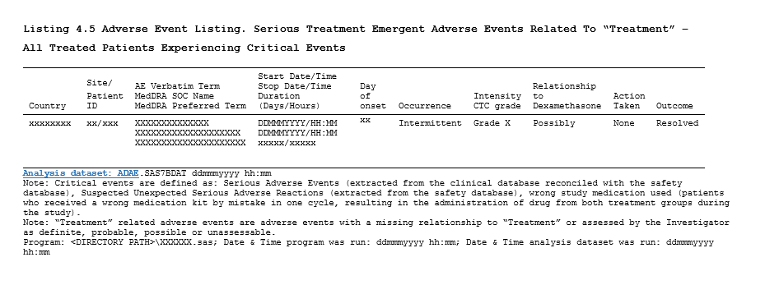
SAMPLE TEMPLATE
x
SELECT
Close

Slide 28



Selection
Filter active: ADAE Domain
CDASH
DOMAIN
CDASH Variable
Value Level Metadata
Controlled Terminology
ADaM
SELECTION
DATA
COLLECTION
ANALYSIS
Domain
Variables
Computational Algorithm
Dataset
Description
ADAE
One record per subject per adverse event, per date
x
SDTM
DOMAIN
SDTM Variable
Value Level Metadata
Controlled Terminology
Computational algorithm
ADaM
DOMAIN
ADaM Variable
ADaM Parameters
Controlled Terminology
Computational algorithm
Related metadata:
SDTM
Domain
Variables
Computational Algorithm
CDASH
Domain
Variables
DCM
Tables
Figures
Listings

Slide 29
Filter active: ADAE Domain
Selection
Filter active: ADAE Variables
CDASH
DOMAIN
CDASH Variable
Value Level Metadata
Controlled Terminology
ADaM
SELECTION
DATA
COLLECTION
ANALYSIS
Domain
Variables
Computational Algorithm
Domain
Name
Label
Computational Algorithm
ADAE
USUBJID
Unique Subject Identifier
SDTM
DOMAIN
SDTM Variable
Value Level Metadata
Controlled Terminology
Computational algorithm
ADAE
SUBJID
subject identifier for the study
ADAE
SITEID
Study Site identifier
ADAE
DOSEAONU
Study Drug Dose at AE Onset Units
ADAE.DOSEAEONU
ADAE
DOSEAEON
Study Drug Dose at AE Onset
ADAE.DOSEAEON
ADAE
COUNTRY
Country
ADAE
ASTTM
Analysis Start Time
ADAE.ASTTM
ADaM
DOMAIN
ADaM Variable
ADaM Parameters
Controlled Terminology
Computational algorithm
ADAE
ASTDT
Analysis Start Time
ADAE.ASTDT
ADAE
AETERM
Reported Term for the Adverse Events
x
Related metadata:
SDTM
Domain
Variables
Computational Algorithm
CDASH
Domain
Variables
DCM
Tables
Figures
Listings

Slide 30
Filter active: ADEA Computation..
Selection
Filter active: ADAE Variables
CDASH
DOMAIN
CDASH Variable
Value Level Metadata
Controlled Terminology
ADaM
SELECTION
DATA
COLLECTION
ANALYSIS
Domain
Variables
Computational Algorithm
Reference
Description
ADAE.AENDT
Equals to % SDTM_DATE_VARIABLE % transformed into %
DATE_NUMERIC_FORMAT% when length (%SDTM_DATE_VARIABLE%) > 9
SDTM
DOMAIN
SDTM Variable
Value Level Metadata
Controlled Terminology
Computational algorithm
ADAE.ADURN
Equals to ADAE.AENDT – ADAE.ASTDT + 1.
ADAE.DOSEAEON
Equals to EX.EXDOSE where the numeric version of EX.EXSTDTC
<= ASTDT <= the Numeric version of EX.EXENDTC.
ADAE.DOSEAEONU
Equals to EX.EXDOSU where the numeric version of EX.EXSTDTC
<= ASTDT <= the Numeric version of EX.EXENDTC.
ADAE.DOSEAEON
ADAE.DOSEAEON
Equals to ‘’DAYS’’
ADaM
DOMAIN
ADaM Variable
ADaM Parameters
Controlled Terminology
Computational algorithm
x
Related metadata:
SDTM
Domain
Variables
Computational Algorithm
CDASH
Domain
Variables
DCM
Tables
Figures
Listings

Slide 31
Selection
Filter active: DOSEAEON
CDASH
DOMAIN
CDASH Variable
Value Level Metadata
Controlled Terminology
ADaM
SELECTION
DATA
COLLECTION
ANALYSIS
Domain
Variables
Computational Algorithm
Reference
Description
ADAE.DOSEAEON
Equals to EX.EXDOSE where the numeric version of EX.EXSTDTC <= ASTDT <= the Numeric version of EX.EXENDTC.
SDTM
DOMAIN
SDTM Variable
Value Level Metadata
Controlled Terminology
Computational algorithm
x
Name
Label
Origin
Role
Core
AESTDTC
Start date/Time of Adverse Event
CRF
Timing
Exp
EXDOSE
Dose per administration
Derived
Record Qualifier
Exp
EXTDTC
Start date/Time of treatment
CRF
Timing
Exp
EXENDTC
End date/Time of treatment
CRF
Timing
Perm
x
ADaM
DOMAIN
ADaM Variable
ADaM Parameters
Controlled Terminology
Computational algorithm
Domain
Name
Question
AE
AESTDAT
Start Date
AE
AESTIM
Start Time
EX
EXAMONT
Dose
EX
EXAMONTU
Units
EX
EXENDAT
End Date
EX
EXENTIM
End Time
EX
EXSTDAT
Start Date
x
Related metadata:
SDTM
Domain
Variables
Computational Algorithm
CDASH
Domain
Variables
DCM
Tables
Figures
Listings

Slide 32

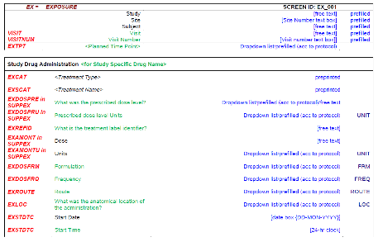
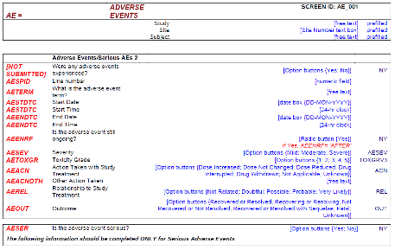
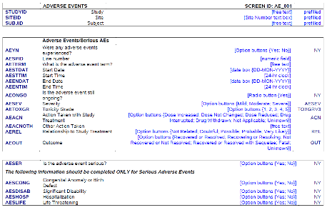
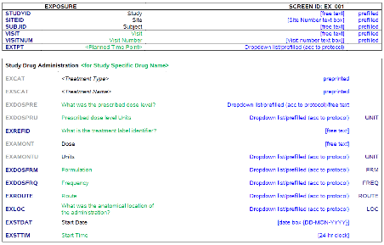
Selection
CDASH
DOMAIN
CDASH Variable
Value Level Metadata
Controlled Terminology
ADaM
SELECTION
DATA
COLLECTION
ANALYSIS
Domain
Variables
Computational Algorithm
DCM’s
SDTM
DOMAIN
SDTM Variable
Value Level Metadata
Controlled Terminology
Computational algorithm
ADaM
DOMAIN
ADaM Variable
ADaM Parameters
Controlled Terminology
Computational algorithm
<
<< >>
<
x
Related metadata:
SDTM
Domain
CDASH
Domain
Computational Algorithm
Variables
Computational Algorithm
Variables
Domain
Domain
Variables
Variables
DCM
Tables
Figures
Listings
DCM
Tables
Figures
Listings

Slide 33
Use Case 1 : End to Start specification
Selecting standards concepts and linked metadata needed for a study
Data Standards
Biomedical Concepts
Analysis Concepts Foundational Standards
Endpoints
TFL
Data
Collection
Modules
Collection Metadata
Retrieve
Collection Standards
Tabulation Metadata
Retrieve Tabulation
Standards
Analysis
Metadata
Retrieve
Analysis
Standards
Standards
Selection
TFL
Standards Metadata Selection
Protocol Outline (Hypothesis)

Slide 34
Use Case 2 : Start to End Study Metadata
Adding study design, concept configuration & generate artifacts
Endpoints
CDASH
SDTM
ADaM
Create Operational Database
Operational Database
Create Tabulation Datasets
Tabulation Datasets
Create ADaM Datasets
Analysis Datasets
Create Analysis
Results structures
& shells
Clinical
Study
Reports
TFL
Define
Define
Generate
Study artifacts
Study Build and configuration
Configured study metadata
Standards Metadata Selection

Slide 35




Use Case 3 : Start to End Data Processing
Automatic population of data into artifacts
Endpoints
CDASH
SDTM
ADaM
EDC
Operational Database
EDC Extract
Database
Tabulation Datasets
ADaM
Creation
Analysis Datasets
Analysis
Results
Creation
Clinical
Study
Reports
eDT
TFL
eHR
Configured study metadata
Process
Study
Data
ePRO

Slide 36

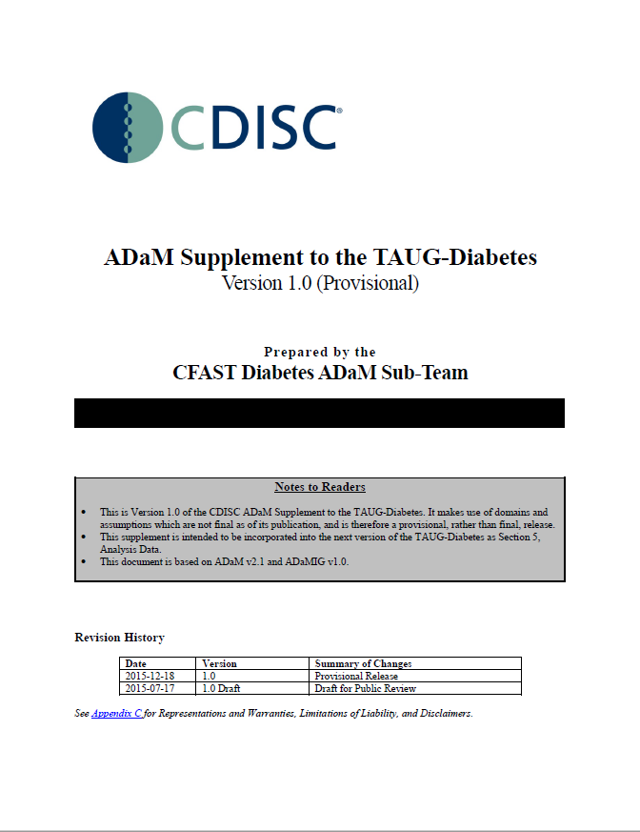
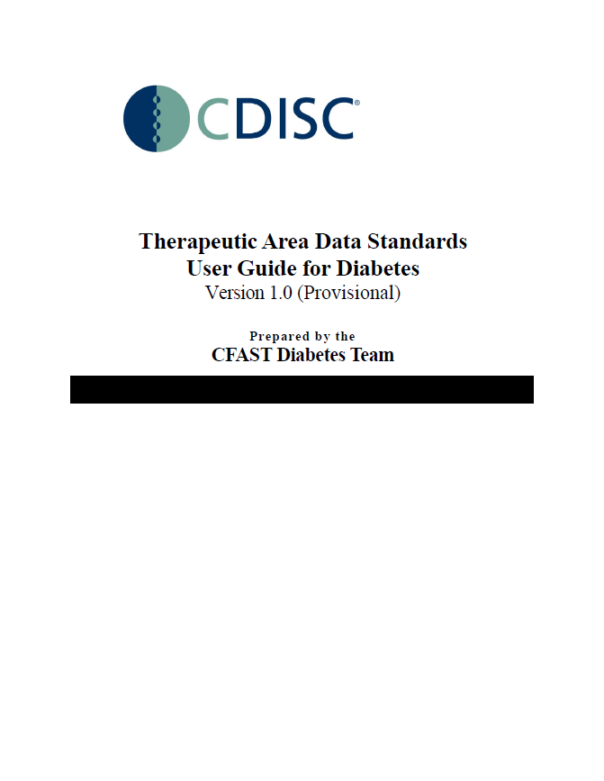
Project Standards Scope
Diabetes TAUG
  1 or 2 statistical endpoints
  3 to 4 ADaM datasets
  7 to 8 SDTM datasets
  15 Data Collection Modules
  → Reason for this scope: the Diabetes TAUG provides standardized artifacts from analysis outputs to data collection. This allows the project team to focus on innovation and not on establishing a new data standard.

Slide 37
3. Logistics

Slide 38
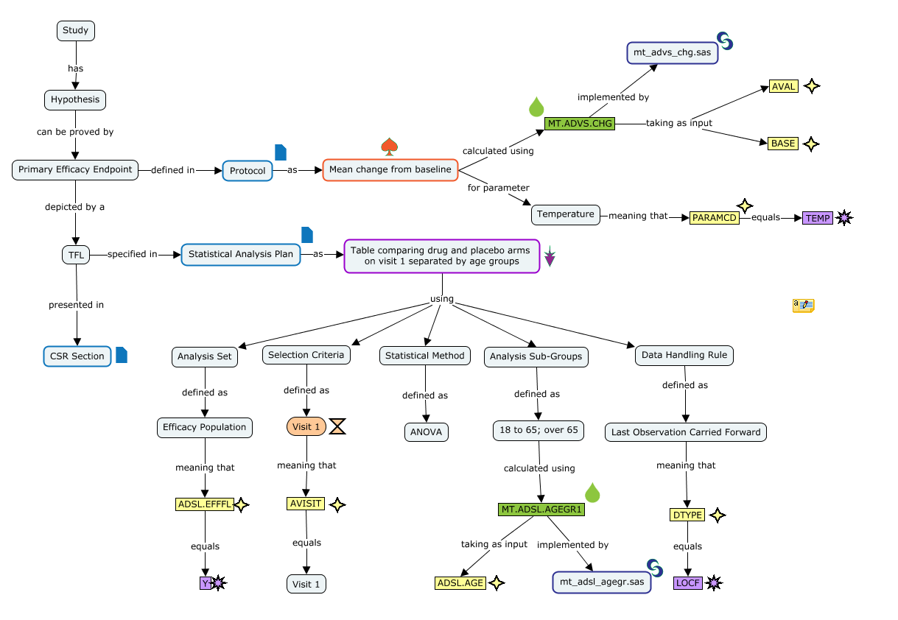

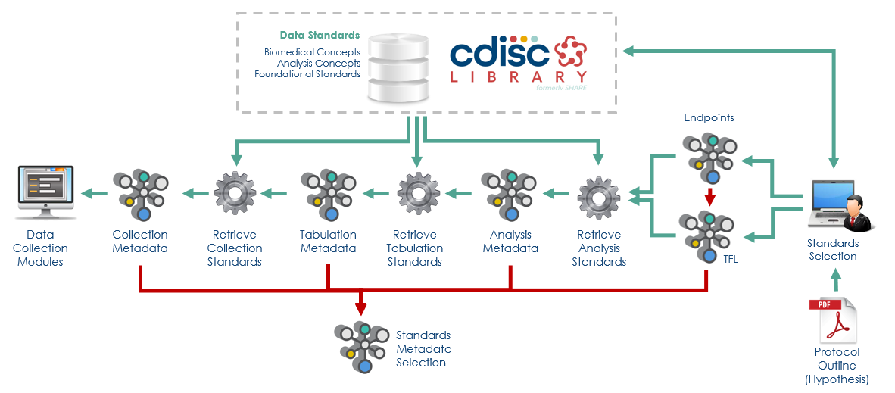
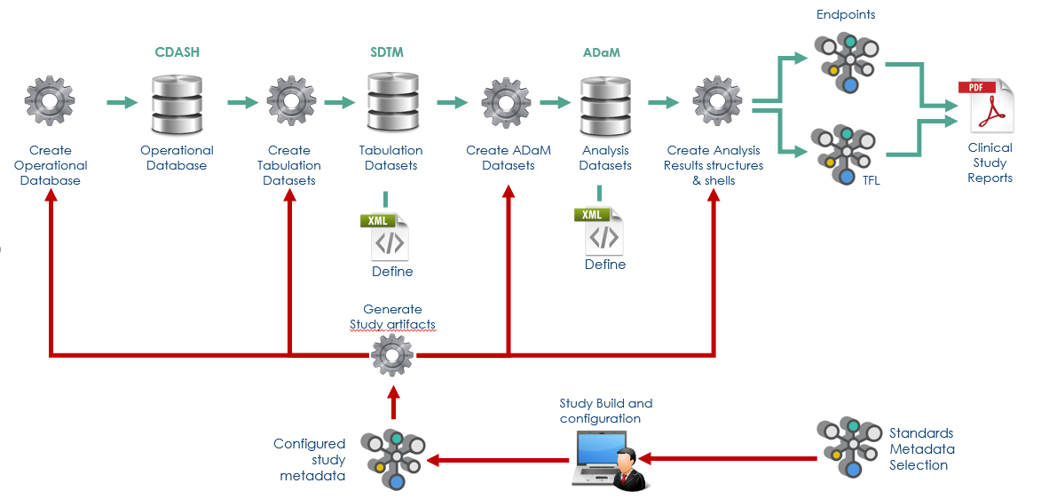
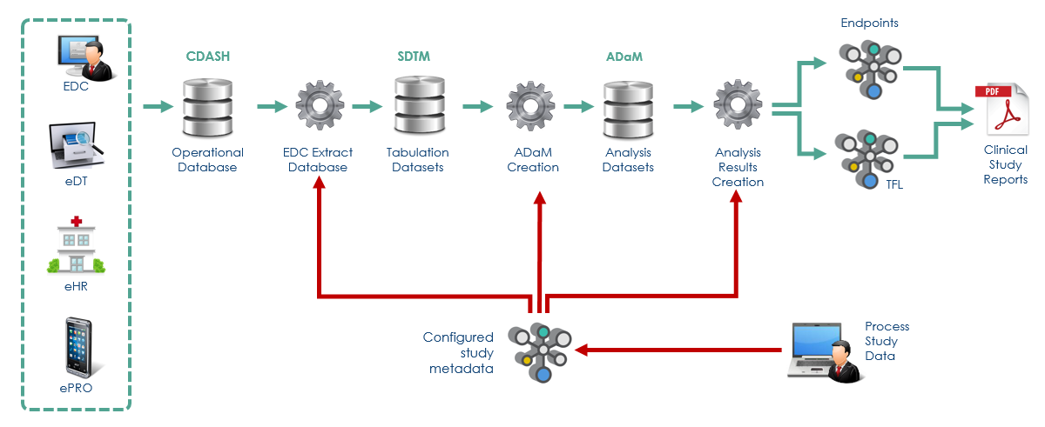
Transform concepts in machine readable form
WS 1
WS2
Biomedical Concepts
Analysis Concepts
Foundational Standards
Load into library
API
Extend API’s
Create concepts in knowledge graphs
WS3
WS 4
WS 5
WS 6
Add transformation
semantics
Configure study specification and
create artifacts (Use Case 2)
Identify and select standards specification (Use Case 1)
Automatically process and transform data (Use Case 3)

Slide 39
Workstream 1 & 2
Workstream 1 - End-to-end concept development
  Design concept maps
  Semantic end-to-end expression of concepts
  Final analysis output to data collection instruments
  Includes transformation information
  Combine Biomedical Concepts (BC) with Analysis Concepts (AC)
Workstream 2 - Machine-readable End-to-end concept development
  Transform concepts in machine readable form
  Load in to CDISC Library
  Extend API’s to extract multifunctional metadata

Slide 40
Workstream 3 & 4
Workstream 3 - Standard dataset definition extension to include transformation information
  Add semantics in the form of transformation information (ETL)
Workstream 4 - End-to-start standards specification development (Use Case 1)
  Demonstrate identify and select capability
  Ensure API output is complete
  Combine all metadata in specification pool

Slide 41
Workstream 5
Workstream 5 - Start-to-end study metadata development (Use Case 2)
  Study specific configuration of standards metadata
  Instantiate metadata on a study level
  Demonstrate study build process (includes trial design information)
  Create study artifacts
    Datasets
    Define xml
    Analysis shells

Slide 42
Workstream 6
Workstream 6 - Start-to-end auto process and transform (Use Case 3)
  Process data from collection to analysis
    Extract data from collection instruments
    Create operational database (ODM v2)
    Map and transform SDTM and ADaM data
    Auto generate analysis outputs
  Currently out of scope
    Creation of study Protocol, SAP, CSR
    Automated business rules (validation)

Slide 43
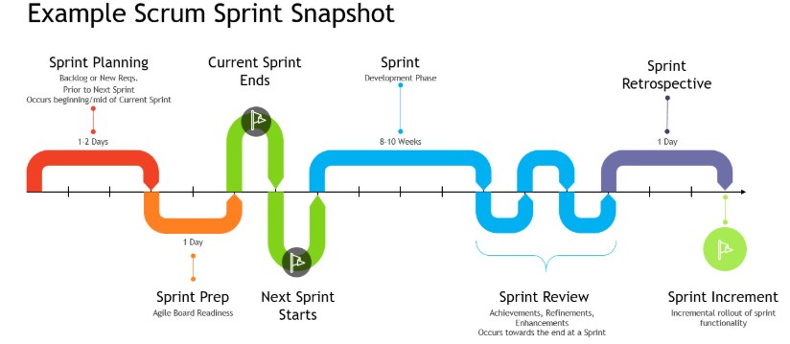
Agile Scrum Methodology and Timeframe
What is agile scrum methodology
  Continuous flexible development process: workstreams to be nimble, iterative, innovative, incremental, evolutionary, quality driven, adaptive, organized, and collaborative.
Why use agile scrum methodology
  Flexible mechanism to handle moments of change; e.g., technical limitations, requirements, or communication.
Project timeframe: 18 months
www.agilemanifesto.org

Slide 44
4. Relationship to other Initiatives

Slide 45
Relationship to other initiatives
Helmsley Transformational Grant
Blue Ribbon Commission
TransCelerate Digital Data Flow
CDISC Data Exchange Standards
  ODM v2
  SDM-XML
  → CDISC 360: a blueprint for the next generation data standards, aligned with key initiatives

Slide 46
5. Expected outcome

Slide 47

Expected Outcome
Learn
  What works and what doesn’t
Assessment
  Technology Gap Analysis
  Standards Gap Analysis
Building a base for the future
  Effort calculation
  Cost / Benefit Analysis
  Scale up to deliver the standards metadata needed
  Partnerships with vendors to ensure tools are made available

Slide 48
Thank You!
Peter Van Reusel
Sam Hume
Barry Cohen

