Slide 1
Europe CDISC Interchange
London 26-27 Apr 2017
Silvia Faini (CROS NT)

Slide 2
Content Disclaimer
All content included in this presentation is for informational purposes only.
These are from personal notes taken during the attendance of CDISC Europe Interchange.
Please refer to the original presentations available on CDISC website for the complete content.

Slide 3
Session 1: Opening Plenary
Future of CDISC - David Bobbitt, new president and CEO CDISC: “CDISC has the key asset in the people”
State of CDISC Union - Dr. Nicole Harmon, CDISC: “Passionate people working together to advance research” https://www.cdisc.org/news/cdisc-and-changing-landscape-standards-implementation - “Listening Tours Report”
The State of CDISC Standards - Barrie Nelson, CDISC
FDA and PMDA require CDISC standards
EMA and China FDA recommend CDISC standards

Slide 4
Session 2: Second Plenary
Real Life Experience on Data Review of Drug Submission in Japan - Dr. Yuki Ando, PMDA
  At the moment only 12 NDAs has been submitted as e-submission, but the gain in terms of time is already clear: before the first NDA meeting the statistician was always able to review demographics, primary analysis, subgroup analysis and pooled analyses.
EMA Update - Frank Petavy, EMA
  Clinical Trial Regulations (EU n° 536/2014) → EU portal and database
  Proactive Publication of Clinical Reports (Policy 0070) → technical anonymization group
  TA standards: not CDISC at the moment mainly because EMA does not review datasets
FDA Update - Ron Fitzmartin, FDA
  In 2016 FY (Fiscal Year) they received ~182.000 submissions (57% IND, 27% ANDA, 12% NDA, 4% BLA).
  eStudy guidance + eCTD guidance should be the references for submissions.

Slide 5
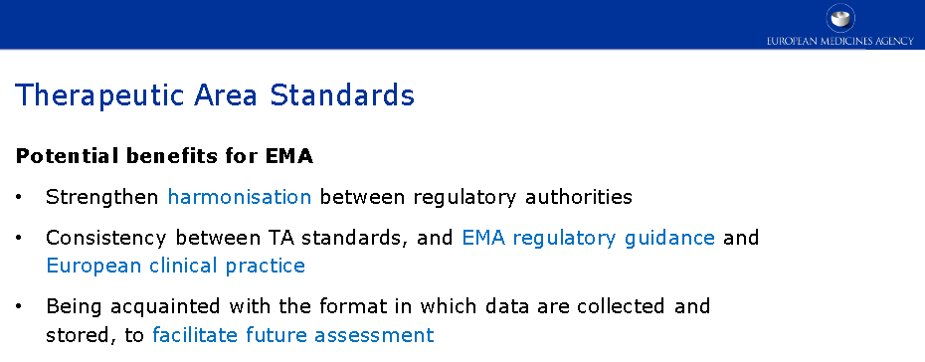
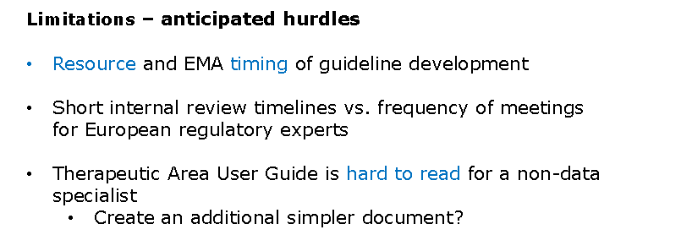
Session 2: Second Plenary - EMA 1/1

Slide 6
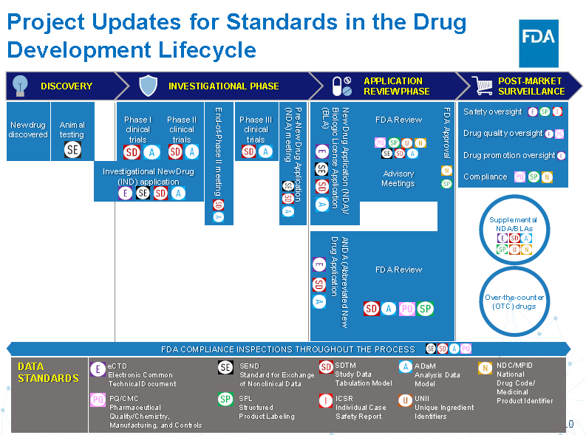
Session 2: Second Plenary - FDA 1/2

Slide 7
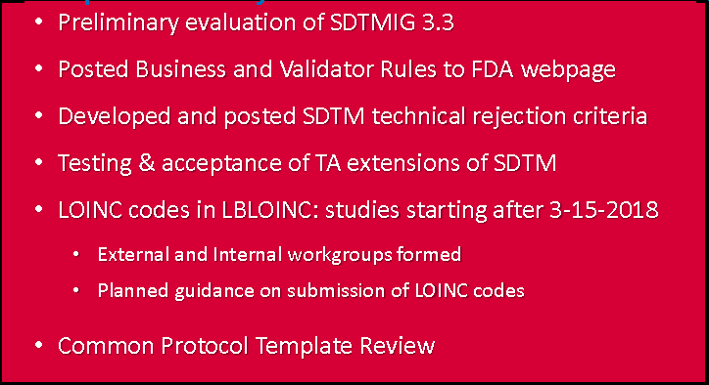
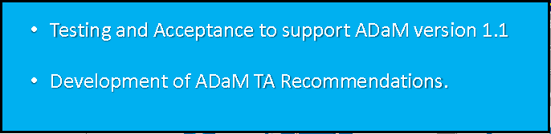
Session 2: Second Plenary - FDA 2/2
SDTM
ADaM

Slide 8
Session 3: Achieving Submission Quality 1/3
Good Data Validation Practice - Sergiy Sirichenko, Pinnacle21
According to FDA and PMDA guidance for regulatory submissions, sponsors are expected to perform study data validation and explain any issues that were not fixed. This is a new requirement introduced only a few years ago, which is why the industry is still struggling to achieve full implementation.
The lack of knowledge about data conformance, which is a requirement for the data quality, is at the base of wrong data validation.
Pinnacle21 use as sources of validation checks: CDISC guidelines (asap included Conformance Rules), FDA/PMDA business rules, others.

Slide 9
Session 3: Achieving Submission Quality 2/3
P21 Errorsare Checksbased on executable algorithm which produce issue reports with 100% confidence (e.g. Start Date is after End Date, New terms in Non-Extensible CT)
P21 Warningsare Reportsof potential data issues for manual review, which will decide if this is a real issue or not (e.g. New terms in Extensible CT, Missing Units on Results)
P21 Reports (only in Enterprise version) are additional diagnostics and a source of useful information (e.g. Death info reconciliation, Quality of MedDRA Coding, Content of SUPPQUALs)
Major implementation challenge
Data quality is defined by intended use and as absence of errors which matter.
All users are different: each user is interested only in data issues directly related to him/her, level of details and severity are also user-specific.

Slide 10
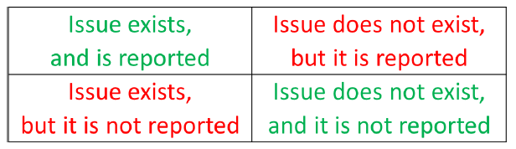
Session 3: Achieving Submission Quality 3/3
P21 Community is a personal desktop tool for SAS Programmers to QC their work for regulatory submissions
For everything else, there is P21E and other tools.
Minimizing False-Positives is desired when confirmatory diagnostics for Warnings is expensive
  for example, extra work for data vendors or missing planned timelines
Minimizing False-Negatives is critical when penalty for non-fixed errors is high
  for example, non-reported violations of Rejectionrules will delay in submission review
  Low quality data may compromise study results
False Positive
False Negative

Slide 11
Session 5: Standards in Practice
Extension Studies - CDISC Submission Challenges and Scenarios - Sachin Bharadia, Zifo RnD Solutions
Extension Study → Increased patient-years drug exposure → New perception of the main study → challenges: protocol review, CRF design, monitoring, data management, data submission and analysis
SDTM challenges, e.g.: demographics SUBJID and reference dates and age for extension study; adverse events main study AE= extension study MH?
ADaM/SDTM challenges: how identify baseline values?
Conclusions:
→ answer these questions at protocol stage
→ document each decision
→ proper traceability from EDC to CSR (including DefineXML, SDRG)

Slide 12
Session 9: Implementation Use Cases 1/5
Why End to End Standards Need to Begin with Statistics - Susan J. Kenny, PhD, Maximum Likelihood, Inc.
Challenging areas: parallel world of data, silos between sources of data, explosion of data, new sources of data (Genomics, Proteomics), statistical anonymization, combining real world evidence with other clinical data. More emphasis on early decision making → it is time for a Common Data Model (this was also an input from CDISC International Interchange 2016).
Having statisticians as active contributors to CDISC standards and processes is important → let’s see the statistician’s role in development of CDISC standards.

Slide 13
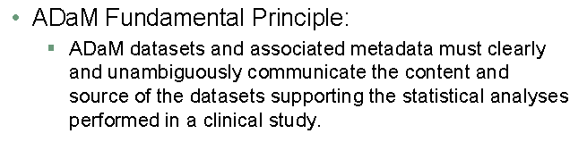
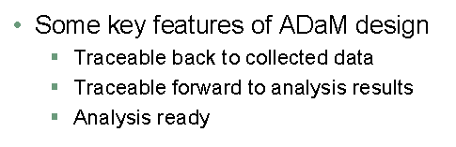
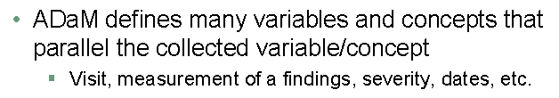
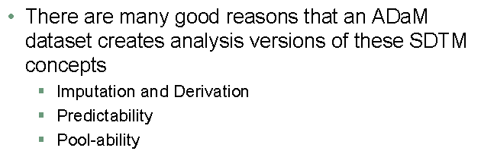
Session 9: Implementation Use Cases 2/5

Slide 14
Session 9: Implementation Use Cases 3/5
Some years ago in US National Review Council “The Prevention and Treatment of Missing Data in Clinical Trials” was issued, in this some important inputs were given. For example just to mention one about imputation: “imputation should not be used for primary objectives unless statistically justified”.
ADaM and Imputation
ADaM defines standard methodology for expressing imputation techniques such as LOCF, NRI, for missing data
Panel recommends these single imputation methods should not be used for primary analyses unless assumptions are scientifically justified
Better alternatives are available
Sensitivity analyses should be part of reporting

Slide 15
Session 9: Implementation Use Cases 4/5
Areas Where Statistical Expertise Is Needed
Development of Common Protocol Template
Creating common protocol template and standard content for Therapeutic Areas
Define and describe primary endpoints used in each TA → How is this reflected within analysis data?
ADaM supports efficient production of tables and figures
A compliant ADaM data set is ‘analysis ready’
How much of analysis ready concept is devoted to presentation?
Is there a better way to producing results?
PhUSE CSS Working Group – Analysis Results Model

Slide 16
Session 9: Implementation Use Cases 5/5
In Closing
We must be aware of the larger initiatives and goals that involve clinical trial data
Standards must evolve especially in areas where methodologies are rapidly changing
CDISC standards work for what they were designed to do but there will always be the need for improvements and maturation, especially for ADaM
Statisticians are needed on many fronts:
  Advisor
  Contributor
  Communicator
  Innovator

