Slide 1
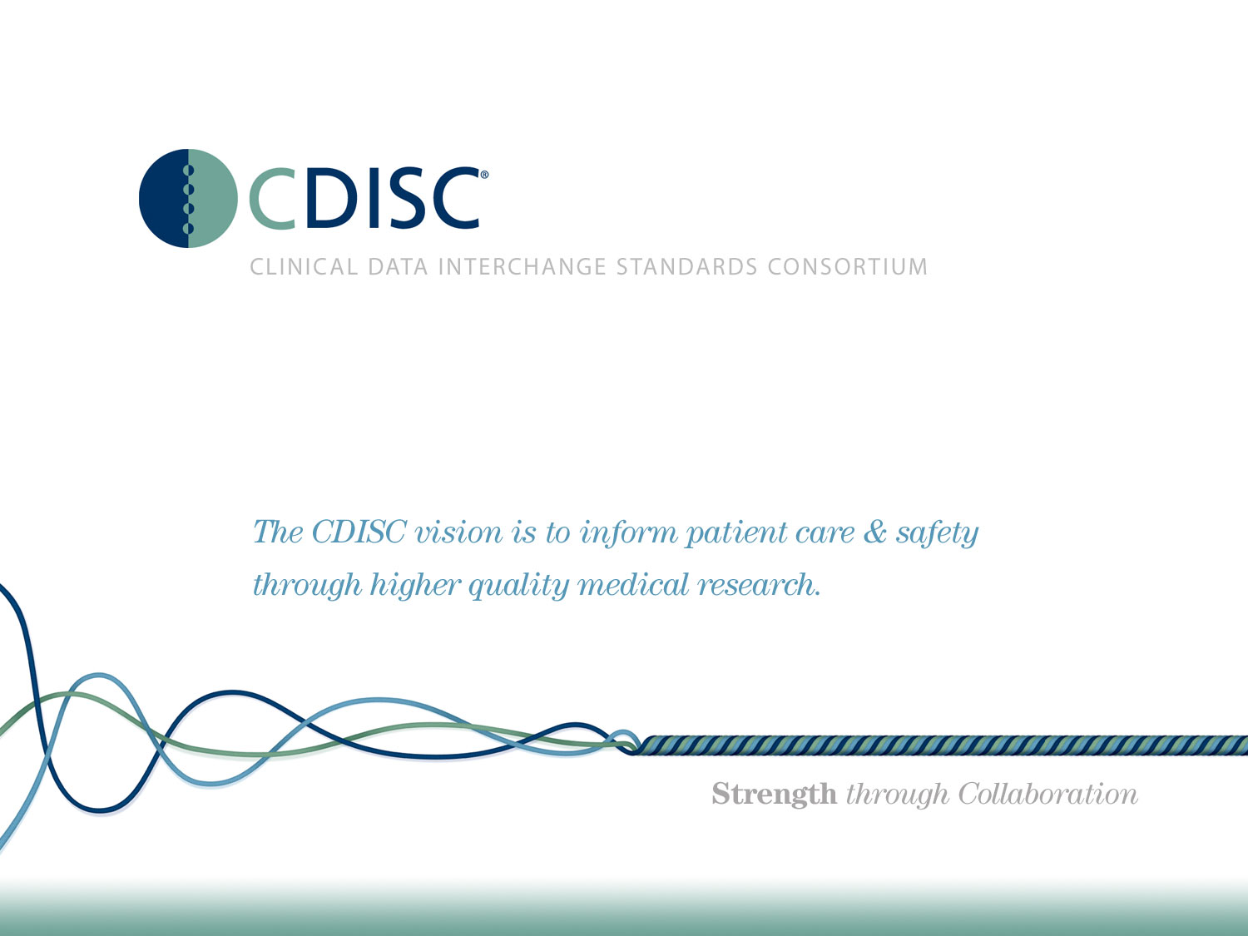

Slide 2
CDISC Italian User Network TC
22 Giugno 2016
Angelo Tinazzi (Cytel Inc. – CDISC E3C member)

Slide 3
Agenda
CDISC Europe Interchange Highlight
News dal Mondo (CDISC e non Solo)
Q&A Update
Varie ed Eventuali

Slide 4

CDISC Interchange Europe Highlight
Italiani al CDISC
Caterina Fiesoli e Cristina Rossi (Recordati) - Conference
Fabio Montanaro (Latis) - Training
Angelo Tinazzi (Cytel) - Conference

Slide 5
CDISC Interchange Europe Highlight
Regulatory Update
The FDA and PMDA are primarily focused on regulating data submission, thus accepting electronic data submission through CDISC standards
The EMA is adopting a top-down approach and as such, is more focused on topics such as data transparency. Nevertheless, topics such as data integration and interoperability form part of the EMA’s plans.

Slide 6
CDISC Interchange Europe Highlight
Regulatory Update (FDA)
The FDA will no longer accept non-CDISC data submission after December 2016 (for trials started after this date).
Currently 75% of submissions to the FDA are SDTM based. Within their presentation the FDA shared some key critical items / issues in the SDTM datasets they have received so far. These include (but are not limited to ): lack of, or incomplete documentation (i.e. define.xml and Reviewer's Guide); duplicated information; missing key information (such as seriousness criteria in the AE panel).

Slide 7
CDISC Interchange Europe Highlight
Regulatory Update (FDA)
They stressed the importance of having these issues fixed prior to submission. Not doing so will result in questions from the reviewer and delays in the approval process.

Slide 8
CDISC Interchange Europe Highlight
Regulatory Update (PMDA)
The PMDA is currently working in a pilot phase, but are already accepting eSubmissions - after Oct 2016 CDISC submissions will be mandatory
!!!!! CDASH is not required !!!!!

Slide 9
CDISC Interchange Europe Highlight
Standards Governance
The issue of standards governance is a hot topic in the industry. With the evolution of the standards available and their complexity, many large and medium size pharma companies have created dedicated teams for standards governance.
In the examples provided during the conference, such teams might have 4 to 6 people of which 75% are fully dedicated ( within a mid- size to large pharma company).

Slide 10
CDISC Interchange Europe Highlight
Standards Governance
This insight is one of the outcomes of a survey of a work stream of the Transcelerate initiative. This particular Transcelerate workstream is aiming to develop working practice to help pharma industries establishing Standards Governance Teams.
Leading pharmaceutical companies Janssen and Roche shared their own approaches to standards governance with the delegates.

Slide 11
CDISC Interchange Europe Highlight
Therapy specific implementation
There was a heavy focus on the implementation of CDISC within different TAs, such as diabetes ,with Anja Lundgreen and Mikkel Traun of Novo Nordisk presenting on challenges of adapting the user guide.
There was also focus on TAs that could be the object of new TA guidance such as vaccines and haemophilia.
A presentation from Philip Morris discussed how they apply CDISC standards in support of regulatory submissions for modified risk tobacco products.

Slide 12
CDISC Interchange Europe Highlight
Foundational Standards
This time the focus was given to the adoption of CDASH and how it could improve the process while saving time and money.
A case study on the use of Associated Person was also presented

Slide 13
CDISC Interchange Europe Highlight
CDISC Future Vision
Simplification of the use and adoption of standards
Therapeutic Area

Slide 14
CDISC Interchange Europe Highlight
« Lost » in Traceability, from SDTM to ADaM …. finally Analysis Results Metadata – A. Tinazzi
Presentazione disponibile

Slide 15
News dal mondo (CDISC e non Solo)
Nuovi Standard
Breast Cancer Therapeutic Area Data Standard User Guide v1.0 (2016-05-16)
Cardiovascular Imaging Therapeutic Area User Guide Draft v1 Now Available for Public Review – (Comments Due 29 June 2016)

Slide 16
News dal mondo (CDISC e non Solo)
Prossimi Webinars gratuiti o riservati ai membri di CDISC http://www.cdisc.org/webinars
11 Luglio: Applied Use of CDISC Standards: A Case Study Using REDCap (solo membri)
21 Luglio: Standards Updates and Additions
Notes:
REDCap (Research Electronic Data Capture) is a web-based software solution and tool set that allows biomedical researchers to create secure online forms for data capture, management and analysis with minimal effort and training.

Slide 17
News dal mondo (CDISC e non Solo)
Recenti webinars
ADaM IG 1.1
The Need for Human Intelligence in Assessing SDTM https://www.youtube.com/watch?v=ZSlAeGb13Z0&feature=youtu.be

Slide 18
Q&A Update
Gestione Questionari
Il questionario è previsto (QSCAT presente nella QRS terminology) ma protetto da copyright. A chi bisogna rivolgersi per avere l’elenco delle QSTEST-QSTESTCD da utilizzare, eventualmente pagando? All’autore o tramite CDISC? In che modo?
Se il questionario non è presente come procedere per richiedere un eventuale aggiornamento della QRS terminology. Eventuali tempi di attesa…
Il processo sarà piu’ trasparente in futuro e update/status potranno essere seguiti dagli utenti CDISC sul portale JIIRA di CDISC

Slide 19
Varie ed Eventuali
Potenziali Argomenti prossima TC
  ADaM Update
  Traceablility in CDISC
  Discussione di una TA in particolare
  Esperienze da Condividere
  Volontari?
BIAS
  Congresso Verona 30/6-1/7 DMC
  Giornata CDISC-SAS Milano Ottobre (seconda metà del mese)

