Slide 1
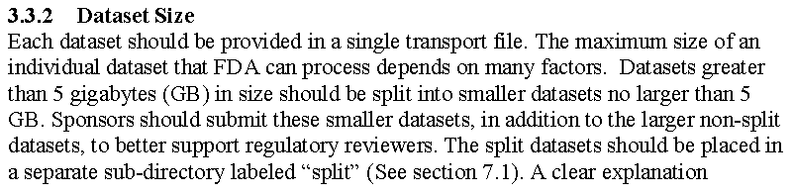
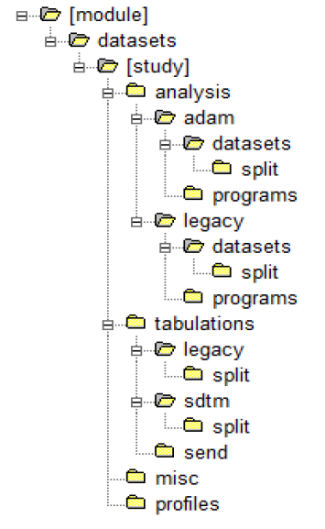
Q&A February-March
Q: Datasets Handling >1GB (from March 5GB)
A: From FDA Study Data Technical Conformance Guide
- Split based on–CAT and/or –SCAT, max 4-chars
Es. LBHM (hematology) e LBBC (chemistry)
Non-split datasets: both submitted
Non-split described in define.xml; split in RG (Assumptions no differences in attributes)

Slide 2
Q&A February-March
Q: Protocol Deviations handling
In ADaM (ADDV using OCCDS) or in SDTM (DV)?
In which panel they need to be collected? Is correct to create ADAM (i.e. ADDV) using OCCDS Structure?

Slide 3
Q&A February-March
Q: Protocol Deviations handling
From SDTM IG
The intent of the domain is to capture protocol violations and deviations during the course of the study and will store only those criteria violation by or deviated from by the subject and not a response to each violation or deviation
The DV domain is an Events model for collected protocol deviations and not for derived protocol deviations that are more likely to be part of analysis

Slide 4
Q&A February-March
Q: Handling of Questionnaires
The questionnaires is available (QSCAT available in QRS terminology) but copyright protected. Who we should contact to get QSTEST-QSTESTCD updated? How?
If the questionnaire is not present how to proceed to get QRS terminology updated? How long will take to get an answer?
A: CDISC Operational Procedure 017 “CDISC SDTMIG Questionnaire Supplements”

Slide 5
Q&A February-March
Q: Handling of Questionnaires (cont)
Q: The questionnaire is available (QSCAT available in QRS terminology) but copyright protected
A: Verify if the questionnaire is available or already ‘refused’
http://www.cdisc.org/system/files/members/standard/QRS/Reference/QRS%20Instrument%20Documentation%20Table%20Update%20Not%20Granted%202015-09-30.pdf
If not in the list follow the CDISC SOP and submit the request (QRS Standard Request Form)
http://www.cdisc.org/system/files/members/standard/QRS/Reference/QRS%20Standard%20Request%20Form.docx

Slide 6
Q&A February-March
Q: Handling of Questionnaires (cont)
Q: Who we should contact to get QSTEST-QSTESTCD updated? How?
A: Always CDISC CT update

Slide 7
Q&A February-March
Q: Handling of Questionnaires (cont)
Q: If the questionnaire is not present how to proceed to get QRS terminology updated? How long will take to get an answer?
A: QRS Standard Request Form. In any case if the questionnaire is not available in the list of Granted or Public Domain Questionnaires (http://www.cdisc.org/qrs) Follow the “CDISC Terminology Questionnaire Naming Rules”
How long will it take (??) to verify with CDISC

