Slide 1


Slide 2
CDISC Italian User Network TC
01 Febbraio 2017
Angelo Tinazzi (Cytel Inc. – CDISC E3C member)

Slide 3
Agenda
Italian CDISC UN Ottobre 2016
Agenda preliminare prossimo CDISC Europe Interchange, Londra (24-28 Aprile 2017)
News dal mondo CDISC
Creare ‘profili’ sul sito CDISC
FDA Study Data Standards Resources Update
  Technical Rejection Criteria for Study Data
  Study Data Technical Conformance Guide v3.2/v3.2.1
Varie ed Eventuali

Slide 4
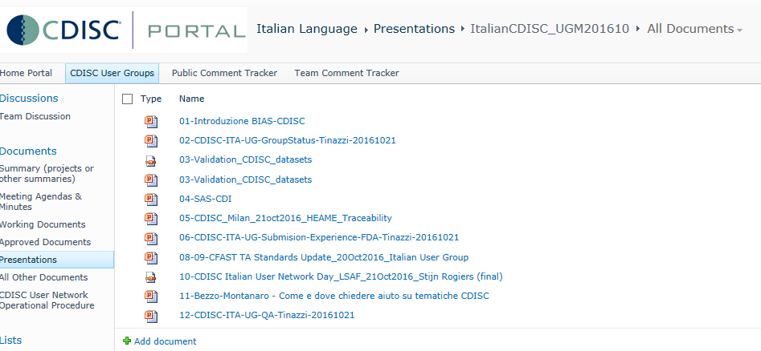
Italian CDISC UN Ottobre 2016
http://portal.cdisc.org/CDISC%20User%20Networks/Europe/Italian%20Language/Presentations/Forms/AllItems.aspx?RootFolder=%2FCDISC%20User%20Networks%2FEurope%2FItalian%20Language%2FPresentations%2FItalianCDISC%5FUGM201610&FolderCTID=0x012000CA3C65794BBA0A4A9D27D08C0E11DDE2&View={9D79E539-26FD-4DF0-AFFC-1965E00BE35F}

Slide 5
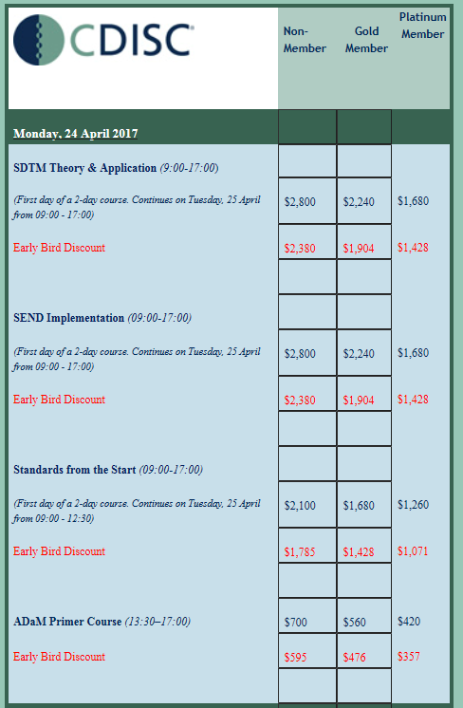
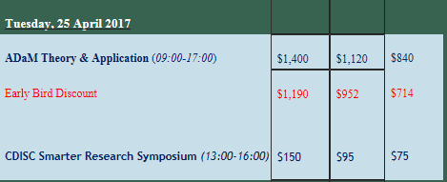
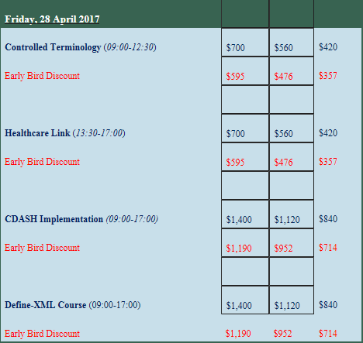
Agenda preliminare prossimo
CDISC Interchange Europe
Londra (24-28 Aprile 2017)
24, 25 e 28 Training
NEW
Notes:
Standards from the start: Explain the value of standardized research data
Understand the scope of CDISC standards
Identify the individual CDISC standards
Understand the value to the clinical research organization of implementing standards as early in the process as possible
Understand and apply the basic principles of individual CDISC standards using simple exercises
Understand the purpose and value of Therapeutic Area (TA) standards, and explain the contents of a TA User Guide
Understand the value of using a metadata repository (MDR) to implement standards
Healthcare Link:

Slide 6
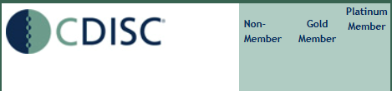
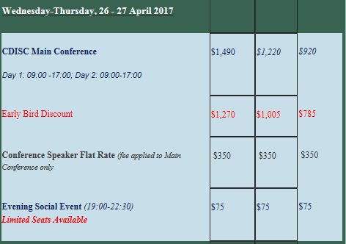
Agenda preliminare prossimo
CDISC Interchange Europe
Londra (24-28 Aprile 2017)
26 e 27 Conference

Slide 7
Agenda preliminare prossimo
CDISC Interchange Europe
Londra (24-28 Aprile 2017)
26 e 27 Conference - Agenda Preliminare
Non ancora in linea
Giorno 1
CDISC Update
Presentazione Agenzie Regolatorie (FDA, EMA, PMDA)
  Evolution of Standards in European regulatory submissions - EMA
  Update of regulatory review framework (among topics : rejection criteria) - FDA
  Our way to CDISC submissions - where are we - PMDA

Slide 8
Agenda preliminare prossimo
CDISC Interchange Europe
Londra (24-28 Aprile 2017)
26 e 27 Conference - Agenda Preliminare
Non ancora in linea
Giorno 1 e 2
Presentazioni nei seguenti ‘stream’:
  Achieving Submission Quality
  Standards in Practice
  Additional use cases of CDISC Standards
  Therapeutic Area User Guides
  From Protocol to Submission
  Implementation Use Cases
  Visualize your data
  CDISC in the Open World
  Moving forward
  Poster Session (?)
  Chiusura con CDISC e Agenzie Regolatorie
    Risposta a domande fatte dai partecipanti attraverso un questionario online

Slide 9
Agenda preliminare prossimo
CDISC Interchange Europe
Londra (24-28 Aprile 2017)
26 e 27 Conference - Agenda Preliminare
Non ancora in linea
Alcuni Esempi di Abstract «Accettati»
FDA/CBER CDISC Data Standardization Reviewer’s expectation
Validation of ADaM datasets based on CDISC ADaMIG 1.1: Pinnacle21 Community Conformance Findings and Explanations
Good Data Validation practice
Practical benefits of EC Exposure as Collected: building a comprehensive
Extension Studies - CDISC Submission Challenges and Scenarios
Clinical study oversight : different approaches and starter pack
Device Domains: Examples of their Use in Clinical Trials
Status update of the Vaccines Reactogenicity Therapeutic Area User Guide development
Mapping of Gastrointestinal Tolerance Data to SDTM
Achieving Submission Quality
Standards in Practice
Therapeutic Area User Guides
Notes:
CBER=Center for Biologics Evaluation and Research (CBER)

Slide 10
Agenda preliminare prossimo
CDISC Interchange Europe
Londra (24-28 Aprile 2017)
26 e 27 Conference - Agenda Preliminare
Non ancora in linea
Alcuni Esempi di Abstract «Accettati»
Analysis Results Metadata... are we there yet?
Why End to End Standards Need to Begin with Statistics
Create your own SDTM Mapping Framework
SDTM, graph databases and Biomedical Concepts
Big Data vs Smart Data in Clinical Trials
Solving Standards Governance Pain Points with MDR Visualizations
Bringing SDTM Alive for Monitoring and Review
Protocol Terminology - Advancing on The Holy Grail of CDISC Standards
How to ensure use of controlled terminology from protocol development to submission
CDISC XML Technology End-to-End Bench to Bedside
Healthcare Link
Implementation Use Cases
Visualize your data
From Protocol to Submission

Slide 11
News dal mondo CDISC
Prossimi Webinars gratuiti o riservati ai membri di CDISC http://www.cdisc.org/webinars
1 Febbraio: CDISC Public Webinar Series - Vaccines TA Public Review
16 Febbraio: Results Level Metadata: What, How and Why (solo membri)
9 Marzo: Some Considerations When Designing ADaM Datasets (solo membri)
16 Marzo: CDISC Tech Webinar Series - Making CDISC SHARE Metadata Operational

Slide 12
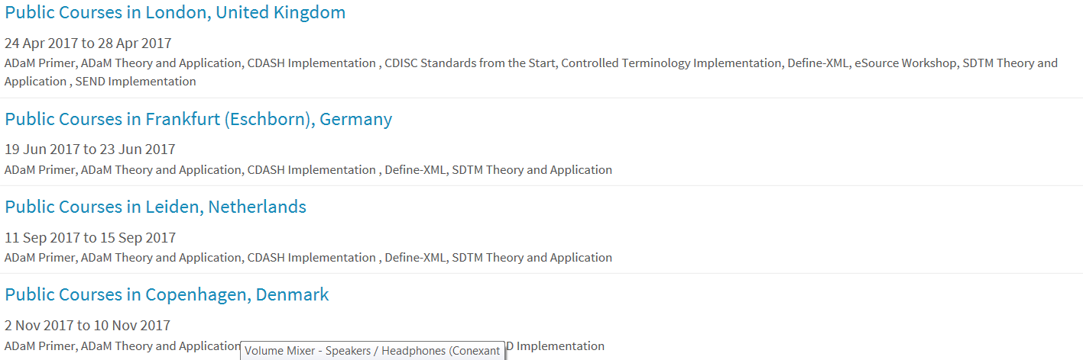
News dal mondo CDISC
Trainings

Slide 13
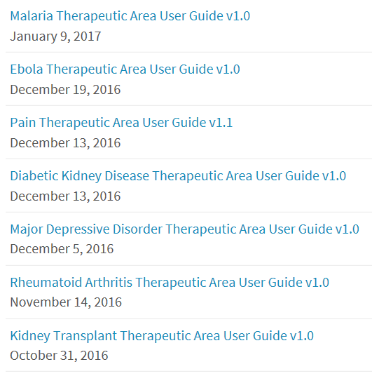
News dal mondo CDISC
Nuovi Standards

Slide 14
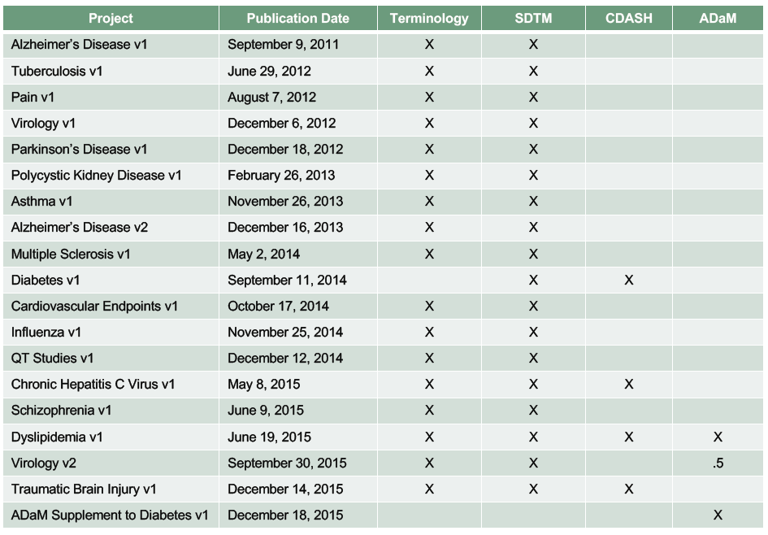
News dal mondo CDISC
Aree terapeutiche IG disponibili

Slide 15
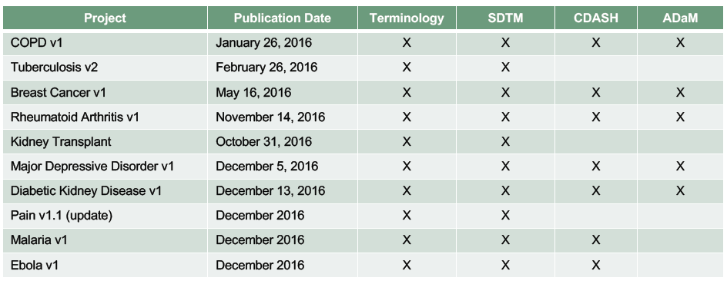
News dal mondo CDISC
Aree terapeutiche IG disponibili

Slide 16
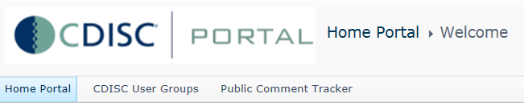
Creare ‘profili’ sul sito CDISC
http://portal.cdisc.org/Pages/Home.aspx
Accesso a materiale UserGroups incluso Italian UN http://portal.cdisc.org/CDISC%20User%20Networks/Europe/Italian%20Language/default.aspx
Public Comment Tracker per revisione draft standards (for public review) → Ora su JIRA, vedi slide 19

Slide 17
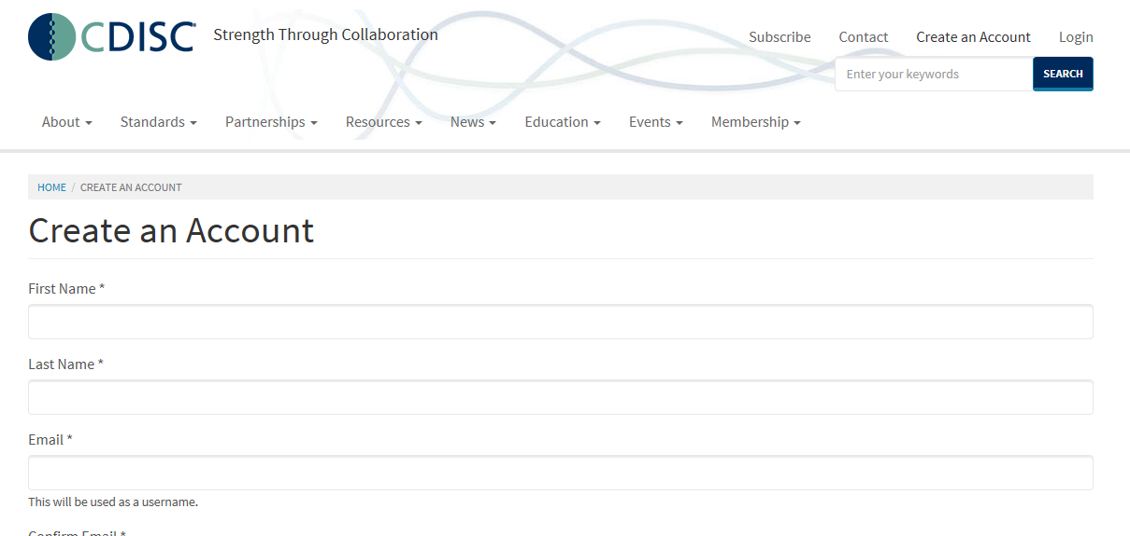
Creare ‘profili’ sul sito CDISC
https://www.cdisc.org/quick_access
Download materiale es. Standards
Accesso a ulteriori risorse solo per membri CDISC

Slide 18
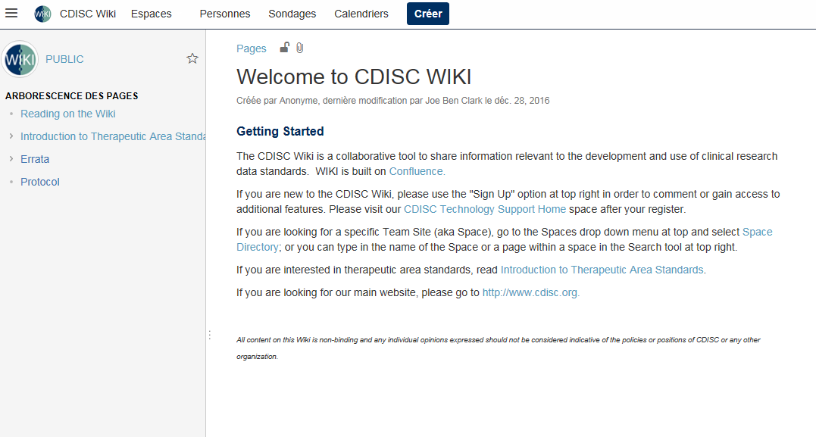
Creare ‘profili’ sul sito CDISC
http://wiki.cdisc.org/
Piattaforma di collaborazione
→Include Jira (vedi prossima slide)

Slide 19
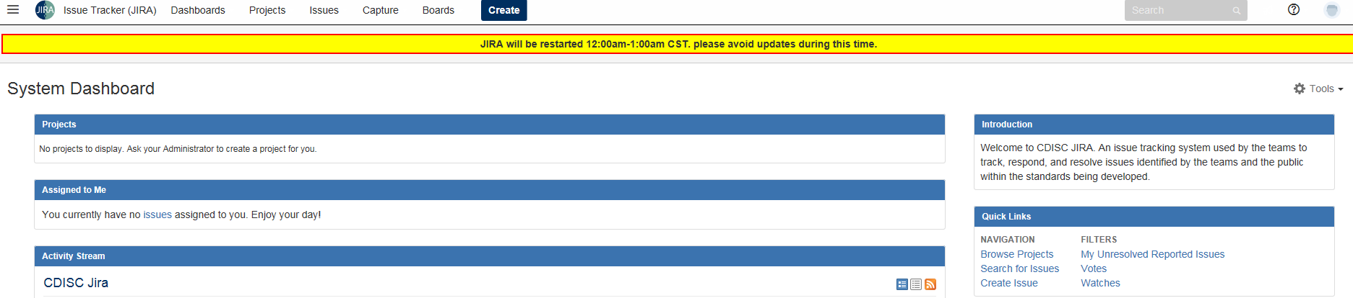
Creare ‘profili’ sul sito CDISC
http://jira.cdisc.org/secure/Dashboard.jspa
Issue tracking system utilizzato per riportare commenti a revisioni di nuovi standard, o suggerimenti per futuri cambi (es. CT)
Si accede con lo stesso account wiki

Slide 20
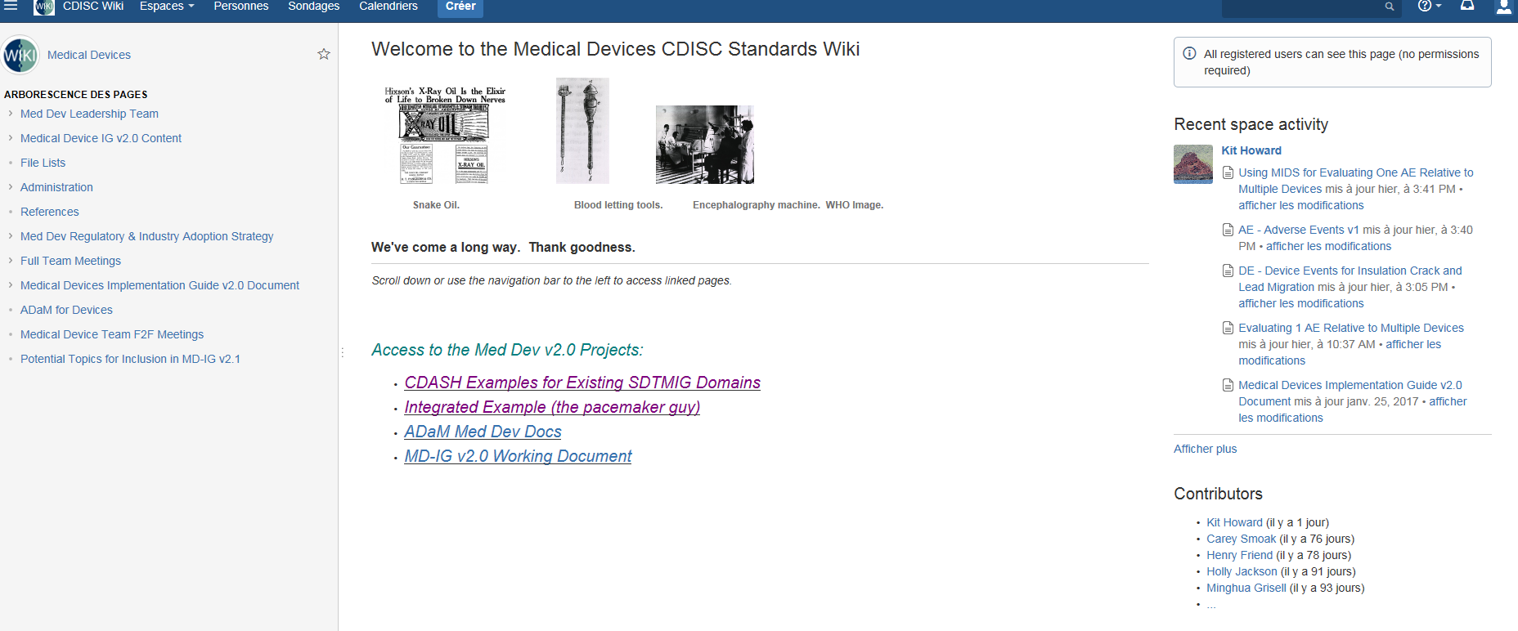
Creare ‘profili’ sul sito CDISC
http://jira.cdisc.org/secure/Dashboard.jspa
Esempio pagina gruppo di lavoro Device

Slide 21
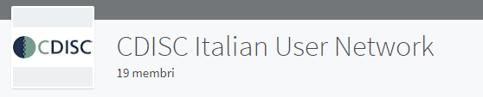
Linkedin Italian CDISC UN
https://www.linkedin.com/groups/12015458

Slide 22
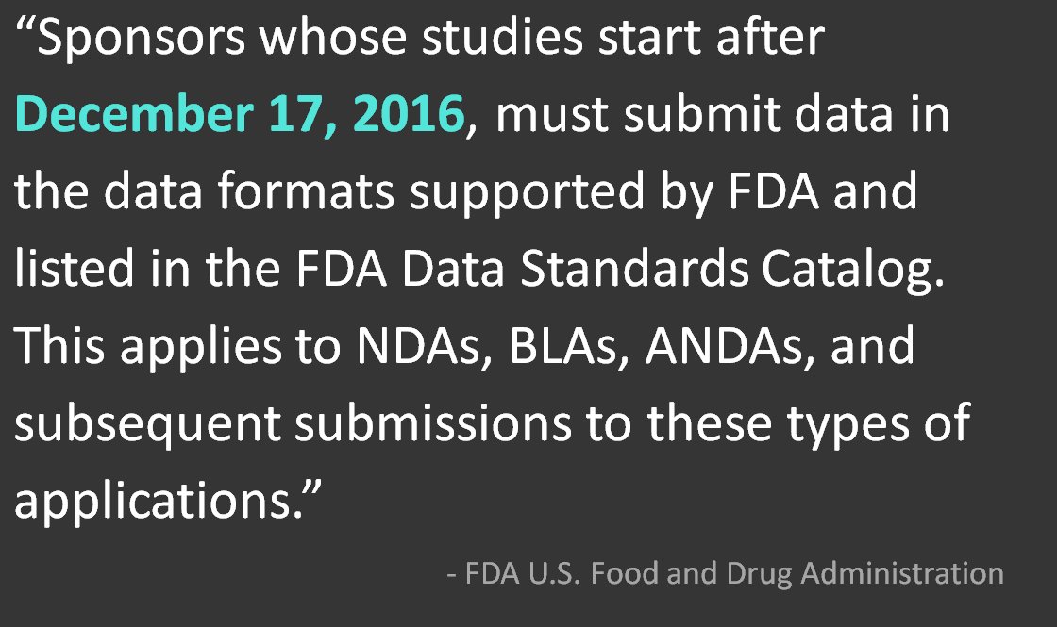
FDA Study Data Standards Resources Update

Slide 23
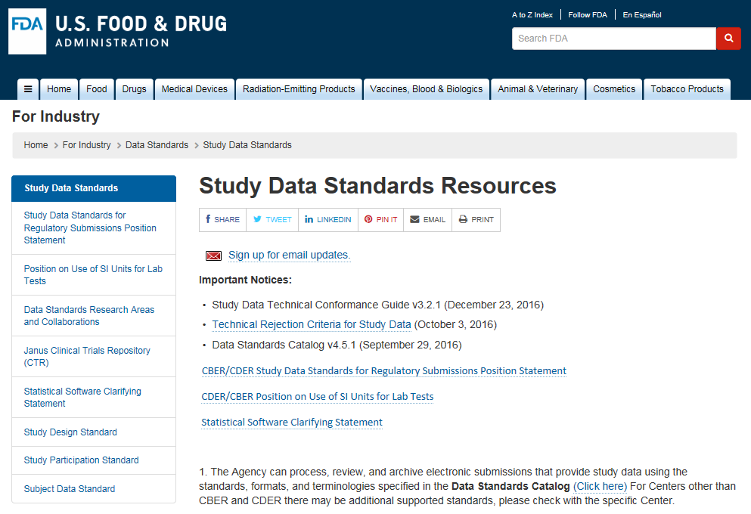
FDA Study Data Standards Resources Update http://www.fda.gov/ForIndustry/DataStandards/StudyDataStandards/

Slide 24
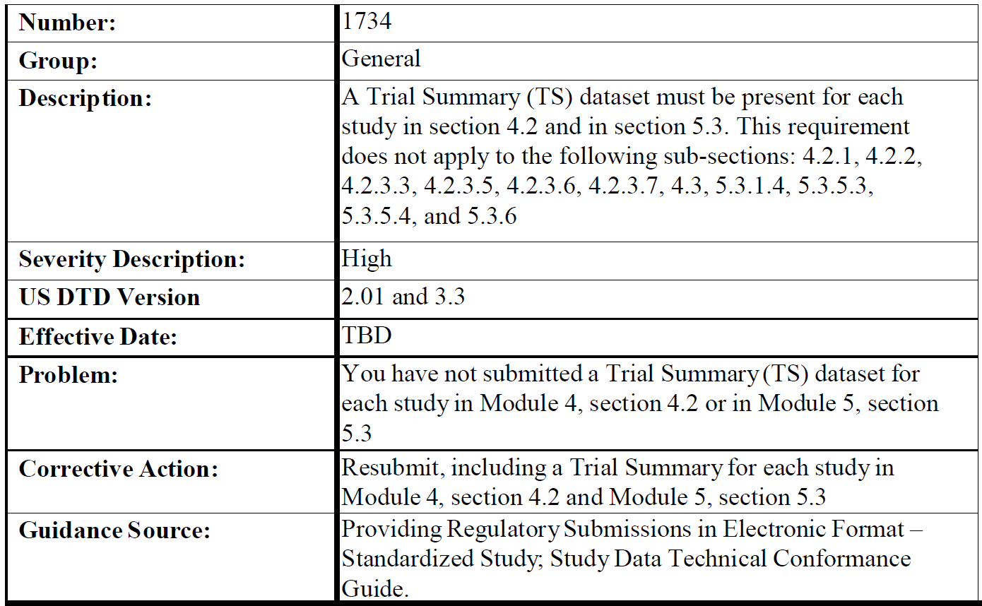
FDA Study Data Standards Resources Update
Technical Rejection Criteria for Study Data

Slide 25
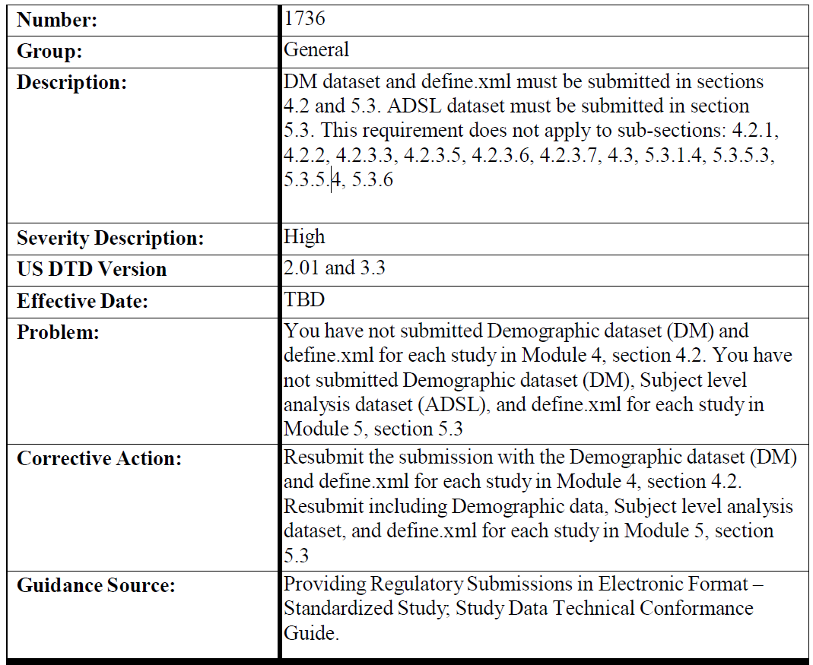
FDA Study Data Standards Resources Update
Technical Rejection Criteria for Study Data

Slide 26
FDA Study Data Standards Resources Update
Study Data Technical Conformance Guide v3.2/v3.2.1
(Update Ottobre/Novembre 2016)

Slide 27
FDA Study Data Standards Resources Update
Study Data Technical Conformance Guide v3.2/v3.2.1
(Update Ottobre/Novembre 2016)
This Study Data Technical Conformance Guide (Guide) provides specifications, recommendations, and general considerations on how to submit standardized study data using FDA-supported data standards located in the FDA Data Standards Catalog (Standards Catalog).

Slide 28
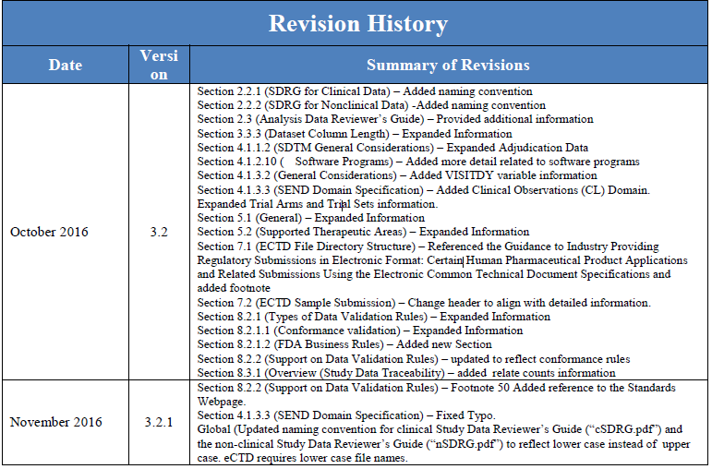
FDA Study Data Standards Resources Update
Study Data Technical Conformance Guide v3.2/v3.2.1
(Update Ottobre/Novembre 2016)

Slide 29
FDA Study Data Standards Resources Update
Study Data Technical Conformance Guide v3.2/v3.2.1
(Update Ottobre/Novembre 2016)
Section 2.2.1 / 2.2.2
cSDRG (Clinincal Study Data Reviewer Guide) vs nSDRG (Non Clinincal Study Data Reviewer Guide)
Attenzione in fase di submission (eCTD) i nomi dei file devono essere lowercase es. csdrg.pdf

Slide 30
FDA Study Data Standards Resources Update
Study Data Technical Conformance Guide v3.2/v3.2.1
(Update Ottobre/Novembre 2016)
Section 2.3
The preparation of an Analysis Data Reviewer’s Guide (ADRG) is recommended as an important part of a standards-compliant analysis data submission. The ADRG provides FDA reviewers with context for analysis datasets and terminology, received as part of a regulatory product submission, additional to what is presented within the data definition file (i.e., define.xml). The ADRG also provides a summary of ADaM conformance findings. The ADRG purposefully duplicates limited information found in other submission documentation (e.g., the protocol, statistical analysis plan [SAP], clinical study report, define.xml) in order to provide FDA reviewers with a single point of orientation to the analysis datasets. It should be noted that the submission of an ADRG does not eliminate the requirement to submit a complete and informative define.xml file corresponding to the analysis datasets.

Slide 31
FDA Study Data Standards Resources Update
Study Data Technical Conformance Guide v3.2/v3.2.1
(Update Ottobre/Novembre 2016)
Section 3.3
The allotted length for each column containing character (text) data should be set to the maximum length of the variable used across all datasets in the study except for suppqual datasets. For suppqual datasets, the allotted length for each column containing character (text) data should be set to the maximum length of the variable used in the individual dataset. This will significantly reduce file sizes. For example, if USUBJID has a maximum length of 18, the USUBJID’s column size should be set to 18, not 200.
???? Cosa fare con variabili comuni a diversi dataset ???? Esempio VISIT → diversi approcci, alcune aziende mantengono lo stesso LENGTH per tutti i dataset

Slide 32
FDA Study Data Standards Resources Update
Study Data Technical Conformance Guide v3.2/v3.2.1
(Update Ottobre/Novembre 2016)
Section 3.3 ‘Allotted length for each column’ Esempio
Le length della variable AETERM nel dataset ‘submitted’ sarà di 21 e non 200 (massima length per una variabile in SDTM/ADaM…..limite corrente determinato dall’uso di SAS .XPT)
USUBJID | AETERM | (AETERM length)
M0101-01-01 | NAUSEA | 6
M0101-01-01 | VOMIT | 5
M0101-01-02 | GASTROINTESTINAL PAIN | 21

Slide 33
FDA Study Data Standards Resources Update
Study Data Technical Conformance Guide v3.2/v3.2.1
(Update Ottobre/Novembre 2016)
Section 4.1.2.10
Sponsors should provide the software programs used to create all ADaM datasets along with the tables and figures associated with primary and secondary efficacy analyses in order to help reviewers to better understand how the datasets, tables and figures were created. The specific software utilized should be specified in the ADRG. The main purpose of requesting the submission of these programs is to understand the process by which the variables for the respective analyses were created and to confirm the analysis algorithms. Therefore, it is not necessary to submit the programs in a format or content that allows the FDA to directly run the program under its given environment. Sponsors should not submit software programs with executable file extensions. Sponsors should submit in ASCII text format. Any submitted programs (scripts) generated by an analysis tool should be provided as ASCII text files or PDF files, e.g., adsl.sas should be submitted as either adsl.txt or adsl.pdf.

Slide 34
FDA Study Data Standards Resources Update
Study Data Technical Conformance Guide v3.2/v3.2.1
(Update Ottobre/Novembre 2016)
Section 8.1.2.2 FDA Business Rules (NEW)
FDA business rules help to ensure that study data will support meaningful review and analysis. FDA’s list of business rules will grow and change with agency understanding and experience. The FDA may publish additional business rules preferring a particular option when multiple options are offered within a standard.
Questo puo’ comportare dei check in piu’ rispetto a quelli previsti dagli standard CDISC (anche per PMDA). Questi ulteriori checks dovrebbero essere già implementati in Pinnacle21 (former OpenCDISC)

Slide 35
FDA Study Data Standards Resources Update
Study Data Technical Conformance Guide v3.2/v3.2.1
(Update Ottobre/Novembre 2016)
Section 8.3.1 Traceability
An important component of a regulatory review is an understanding of the provenance of the data (i.e., traceability of the sponsor’s results back to the CRF data). Traceability permits an understanding of the relationships between the analysis results (tables, listings and figures in the study report), analysis datasets, tabulation datasets, and source data. Traceability enables the reviewer to accomplish the following:
- Understand the construction of analysis datasets
- Determine the observations and algorithm(s) used to derive variables
- Understand how the confidence interval or the p-value was calculated in a particular analysis
- Relate counts from tables, listings, and figures in a study report to the underlying data

Slide 36
Varie ed Eventuali
Potenziali Argomenti prossima TC
  1 Marzo h12-13
  Discussione di una TA in particolare?
  Topic SDTM o topic ADaM
  Esperienze da Condividere
    Area Terapeutica
    Derivazione EPOCH in SDTM
    Pooling
  Volontari?

