Slide 1
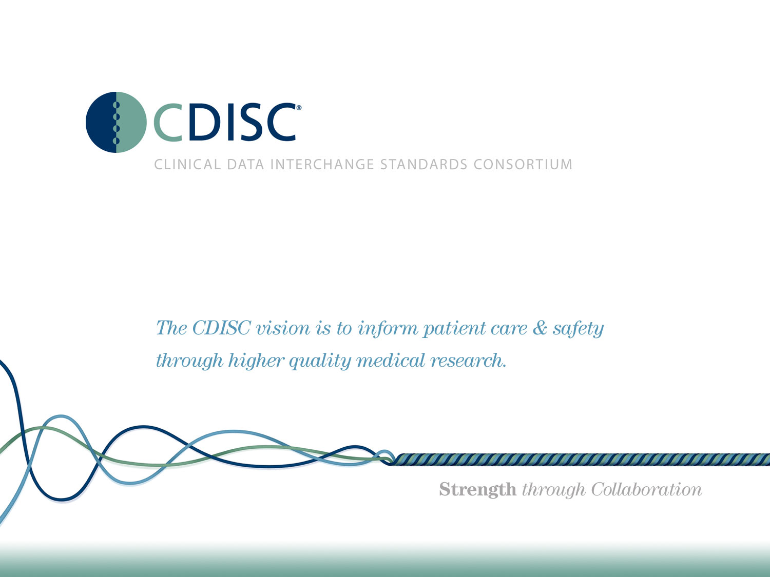

Slide 2
CDISC Italian User Network TC
20 Gennaio 2016
Angelo Tinazzi (Cytel Inc. – CDISC E3C member)

Slide 3
Agenda
Agenda preliminare prossimo CDISC Interchange Europe, Vienna (25-29 Aprile 2016)
Highlight CDISC Interchange, Chicago (Novembre 2015)
News dal mondo CDISC
Introduzione a Study Data Reviewer Guide e Analysis Reviewer Guide
Varie ed Eventuali

Slide 4
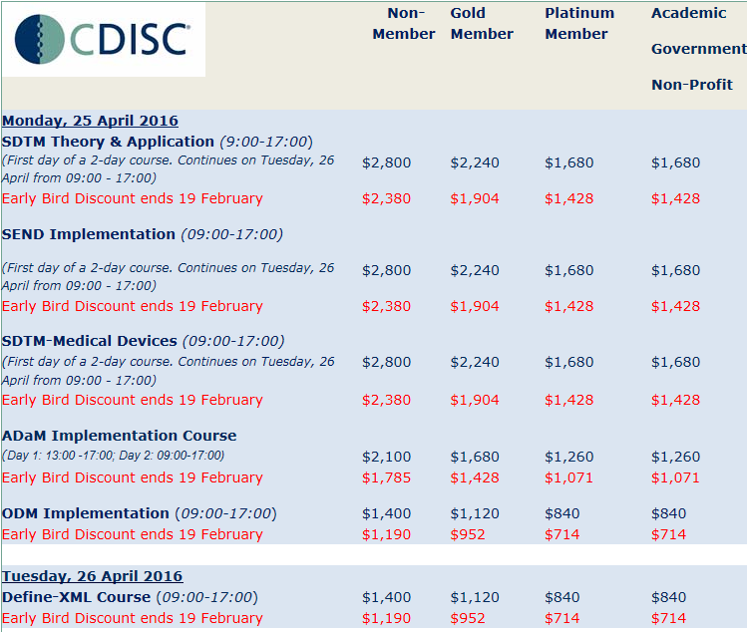
Agenda preliminare prossimo
CDISC Interchange Europe
Vienna (25-29 Aprile 2016)
25, 26 e 29 Training
NEW

Slide 5
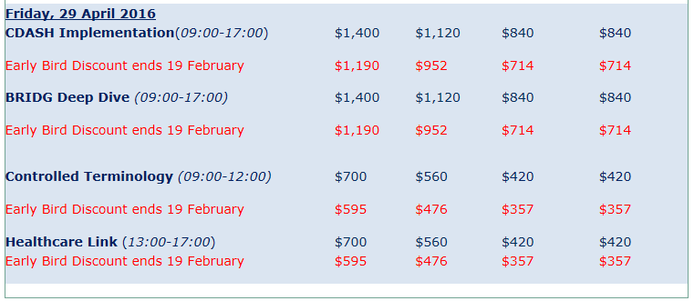
Agenda preliminare prossimo
CDISC Interchange Europe
Vienna (25-29 Aprile 2016)
25, 26 e 29 Training
http://www.cdisc.org/course-descriptions

Slide 6
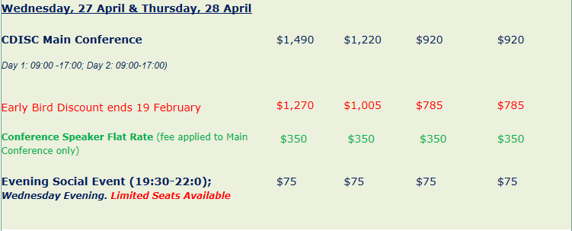
Agenda preliminare prossimo
CDISC Interchange Europe
Vienna (25-29 Aprile 2016)
27 e 28 Conference

Slide 7
Agenda preliminare prossimo
CDISC Interchange Europe
Vienna (25-29 Aprile 2016)
27 e 28 Conference - Agenda Preliminare
http://www.cdisc.org/interchange
Giorno 1
CDISC Update
Presentazione Agenzie Regolatorie (FDA, EMA, PMDA)
Presentazioni nei seguenti ‘stream’:
  Therapeutic Area (TA)
  CFAST & CPATH
  Share
  Governance

Slide 8
Agenda preliminare prossimo
CDISC Interchange Europe
Vienna (25-29 Aprile 2016)
27 e 28 Conference - Agenda Preliminare
http://www.cdisc.org/interchange
Possibili presentazioni
Presentazioni nei seguenti ‘stream’:
  Semantics & MDR & Automation
  Foundatational
  CDISC Success & Vision
  SEND
  Broaden CDISC and connect to the world
  Chiusura con CDISC e Agenzie Regolatorie
    Risposta a domande fatte dai partecipanti attraverso un questionario online

Slide 9
Highlight CDISC Interchange, Chicago (Novembre 2015)
http://www.cdisc.org/2015-international-interchange-presentations
Diverse presentazioni nella sezione TA con riferimenti ad ADaM
  Reflections on ADaM and TA User Guides
  Implementation of Diabetes ADaM Standards at Lilly
  Data Standards, Considerations & Conventions within TA User Guides
Stream SEND
Lessons Learned (CRO experience, metrics, etc.)
  Case Study: Impact of Implementing CDISC Standards in an Organization – Metrics Results (CRO experience)
  A Global CRO’s Journey to Innovation through CDISC Standards (CRO experience)

Slide 10
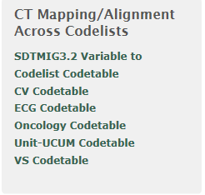
News dal mondo CDISC
Prossimi Webinars gratuiti o riservati ai membri di CDISC http://www.cdisc.org/webinars
28 Gennaio: Legacy Studies Submission Automation Using Metadata (solo membri)
11 Febbraio: Standards Updates and Additions
25 Febbraio: LOINC (solo membri)
Logical Observation Identifiers Names and Codes (LOINC) is a database and universal standard for identifying medical laboratory observations. First developed in 1994, it was created and is maintained by the Regenstrief Institute, a US nonprofit medical research organization. LOINC was created in response to the demand for an electronic database for clinical care and management and is publicly available at no cost (cfr Wikipedia)
http://www.cdisc.org/terminology

Slide 11
News dal mondo CDISC
Nuovi Standard
Diabetes Therapeutic Area Data Standard User Guide v1 - Supplement for ADaM (provisional)

Slide 12

Introduzione a Study Data Reviewer Guide e Analysis Reviewer Guide
http://www.phusewiki.org/wiki/index.php?title=Study_Data_Reviewer%27s_Guide
The Study Data Reviewer’s Guide (SDRG) provides FDA Reviewers with additional context for SDTM datasets received as part of a regulatory submission.
The SDRG is intended to describe SDTM data submitted for an individual study in the Module 5 clinical section of the eCTD.
The SDRG purposefully duplicates information found in other submission documentation (e.g. the protocol, clinical study report, define.xml, etc.) in order to provide FDA Reviewers with a single point of orientation to the SDTM datasets.

Slide 13
Introduzione a Study Data Reviewer Guide e Analysis Reviewer Guide
http://www.phusewiki.org/wiki/index.php?title=Study_Data_Reviewer%27s_Guide
The Analysis Data Reviewer’s Guide (ADRG) provides FDA Reviewers with additional context for analysis datasets (AD) received as part of a regulatory submission.
The ADRG is intended to describe analysis data submitted for an individual study in the Module 5 clinical section of the eCTD.
The ADRG purposefully duplicates limited information found in other submission documentation (e.g., the protocol, statistical analysis plan, clinical study report, define.xml) in order to provide FDA Reviewers with a single point of orientation to the analysis datasets.
The submission of a reviewer guide does not obviate the requirement to submit a complete and informative define.xml document to accompany the analysis datasets.

Slide 14
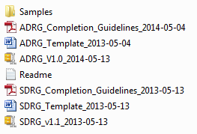
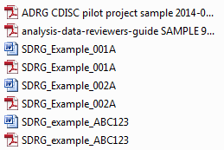
Introduzione a Study Data Reviewer Guide e Analysis Reviewer Guide

Slide 15
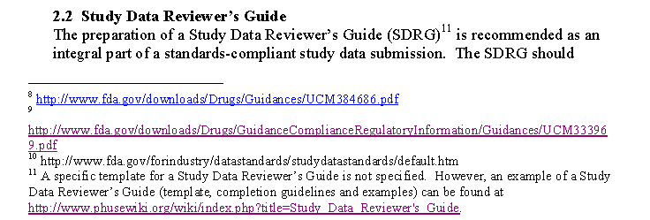
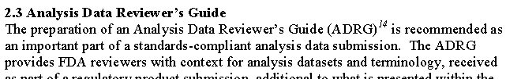
Introduzione a Study Data Reviewer Guide e Analysis Reviewer Guide
Utilizzo «Raccomandato» da FDA
STUDY DATA TECHNICAL CONFORMANCE GUIDE

Slide 16
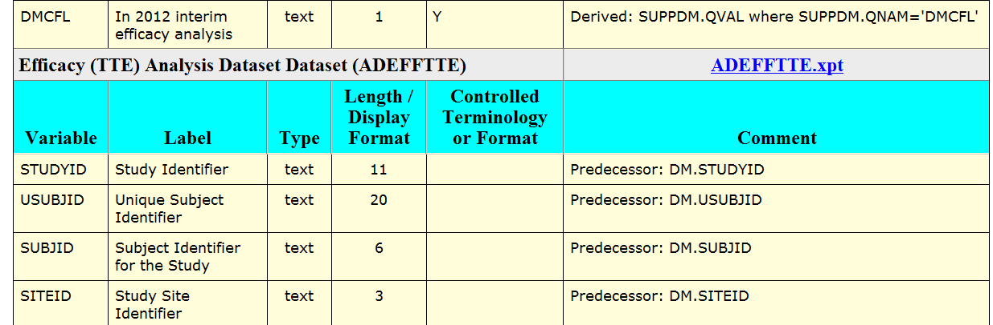
Introduzione a Study Data Reviewer Guide e Analysis Reviewer Guide
Define.xml e aCRF non sono sufficienti

Slide 17
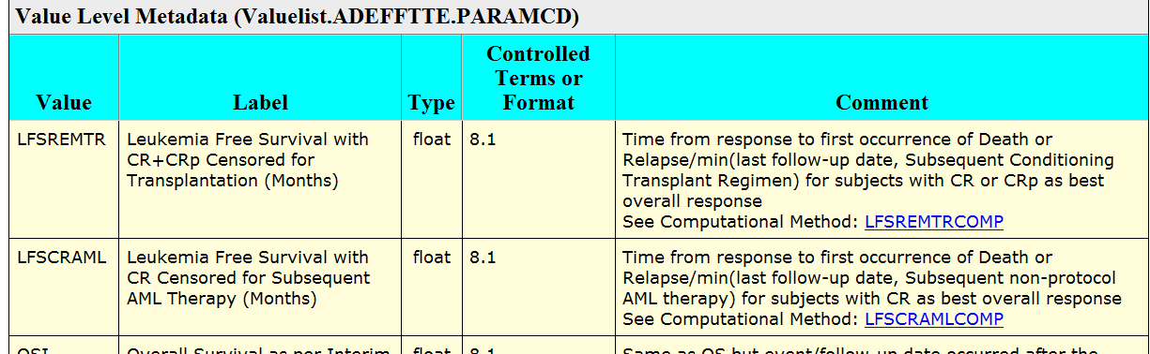
Introduzione a Study Data Reviewer Guide e Analysis Reviewer Guide
Define.xml e aCRF non sono sufficienti

Slide 18
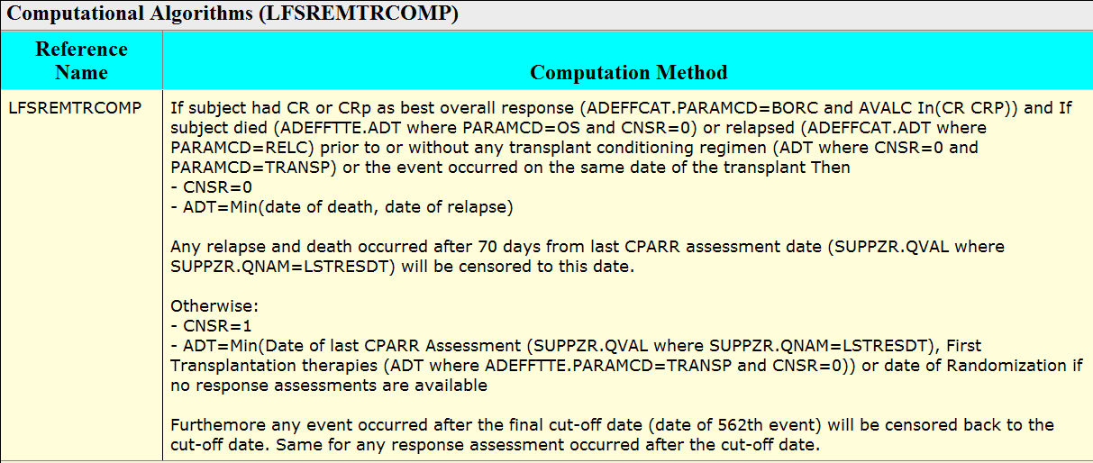
Introduzione a Study Data Reviewer Guide e Analysis Reviewer Guide
Define.xml e aCRF non sono sufficienti

Slide 19
Introduzione a Study Data Reviewer Guide e Analysis Reviewer Guide
Un caso complesso di studio con «Adaptive Design»

Slide 20
Introduzione a Study Data Reviewer Guide e Analysis Reviewer Guide
Study Data Reviewer Guide (SDRG)
Fornire al reviewer informazioni supplementari sul come identificare i pazienti analizzati durante l’analisi ad-interim
Subject Data Description
For the re-creation of the primary endpoint as per re-calculated interim analysis, patients included in 2012 interim analysis can be identified with SUPPDM where QNAM=‘DMCFL’ (Patient in 2012 efficacy analysis) and QVAL=‘Y’

Slide 21
Introduzione a Study Data Reviewer Guide e Analysis Reviewer Guide
Analysis Data Reviewer Guide (ADRG)
Fornire al reviewer informazioni supplementari su quale dataset ADaM utilizzare e quali record selezionare per il ri-calcolo della stima dell’endpoint primario utilizzando il cut-off dell’interim analysis e il cut-off dell’analisi finale.
Section 5: Analysis Dataset Descriptions
OSI / Overall Survival as per Interim analysis cut-off (Months) – This is the primary efficacy endpoint as per interim analysis cut-off. This is applicable only to the 382 patients part of the 2012 interim analysis (ADSL.DMCFL). It is re-calculated using data available at the time of final db lock but applying the cut-off date applied at the time of the interim analysis (15AUG2012)

Slide 22
Varie ed Eventuali
Potenziali Argomenti prossima TC
  ADaM Update
  Discussione di una TA in particolare
  Esperienze da Condividere
  Volontari?

