Slide 1


Slide 2
CDISC Italian User Network TC
16 Dicembre 2015
Angelo Tinazzi (Cytel Inc. – CDISC E3C member)

Slide 3
Agenda
Obiettivi del CDISC User Network e Modalità di Funzionamento
Chi siamo, quanti siamo e feedback iniziali su domande ricevute
News dal mondo CDISC
Varie ed Eventuali

Slide 4
Obiettivi del CDISC User Newtork e Modalità di Funzionamento
User Network Operational Procedure (COP-011)
http://www.cdisc.org/bylaws-and-policies
Definire i ruoli e aspettative tra User Network (UN) e CDISC
Scopo e Benefici
Condividere esperienze (implementazione CDISC)
  Discutere versioni finali e draft degli standard e fornire commmenti a CDISC
  Discutere nuove idee che potrebbero essere implementate in CDISC
  Networking e Condivisione
  Condividere ‘lessons learned’ in seguito a partecipazione congressi e/o corsi

Slide 5
Obiettivi del CDISC User Newtork e Modalità di Funzionamento
User Network Operational Procedure (COP-011)
http://www.cdisc.org/bylaws-and-policies
Ruolo dei CDISC UN
  Fornire feeedback sui seguenti aspetti
    Esempi di implementazione
    Principali ‘lesssons learned’
    Presentare le esperienze ai congressi CDISC (Interchange)
    ??? Qualcuno interessato a un F2F a Vienna al prossimo CDISC ???

Slide 6
Obiettivi del CDISC User Newtork e Modalità di Funzionamento
Advisory Boar
Europe CC (E3C)
Japan CC (J3C)
UGs
UGs
UGs
UGs
CDISC Coordinating Committes (3Cs)*
User Networks.
Attivi in Europa: UK, German, French and Nordic
* Ora attivi anche Asian Pacific (AP3C) e China (C3C)
Notes:
The CDISC Advisory Board (CAB) is composed of one member from each CDISC Platinum Member Organization. This group provides advice to CDISC through its Board representatives and representation on Board Committees
CDISC Coordinating Committees (3Cs)
In 2002, CDISC established CDISC Coordinating Committees (3Cs) in Europe and Japan to represent CDISC in those regions. The 3Cs also organize annual CDISC Interchanges in their respective regions. More recently, CDISC Coordinating Committees were established in China and Korea. Others may be established in more geographic regions in the future. CDISC leadership may organize a NA3C (North America CDISC Coordinating Committee) comprised of User Network Leaders.

Slide 7
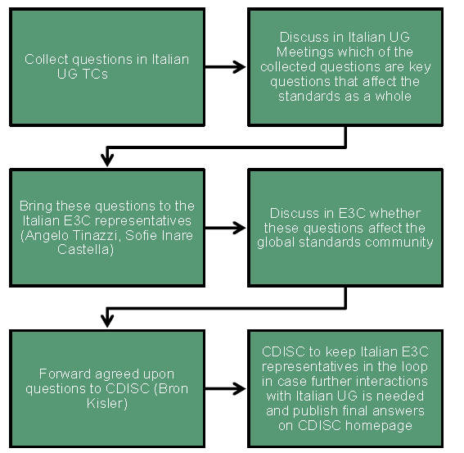
Obiettivi del CDISC User Newtork e Modalità di Funzionamento
Discusso durante il CDISC Italy Day in settembre a Milano a SAS Institute

Slide 8
Obiettivi del CDISC User Newtork e Modalità di Funzionamento
User Network Operational Procedure (COP-011)
http://www.cdisc.org/bylaws-and-policies
Il CDISC UN non puo’ competere con i CDISC Educational Courses
Il CDISC UN incoraggia ma non richiede la CDISC membership ai suoi membri.
Notes:
CDISC User Networks are prohibited from competing with CDISC Educational Courses. Specifically, CDISC Educational Course materials are branded and are CDISC intellectual property. These are only to be used by CDISC approved instructors performing CDISC-authorized training – [see COP-005.]
CDISC User Networks will encourage, but not require, CDISC membership from its members. (Per the list in the prior section, User Networks may collect fees from attendees to offset costs of meetings and these fees may differ depending upon whether or not a company is a CDISC member.)

Slide 9
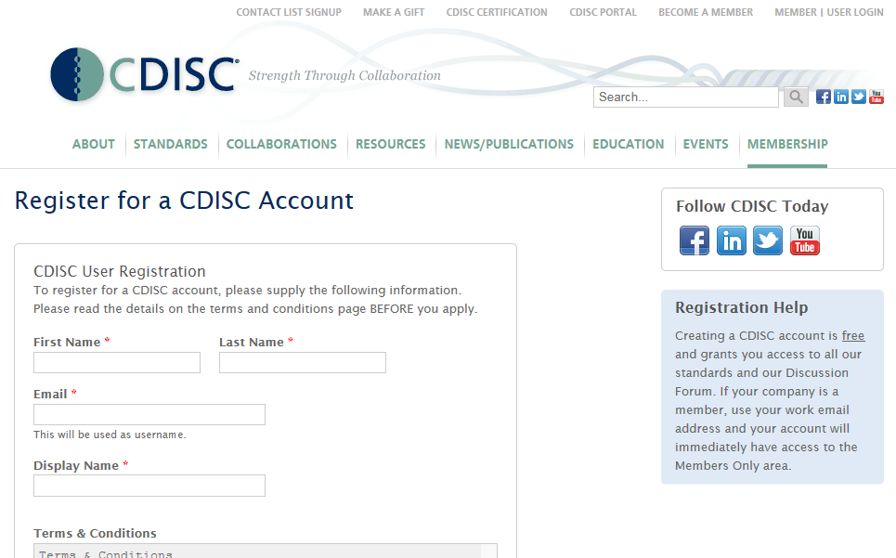
Obiettivi del CDISC User Newtork e Modalità di Funzionamento
http://www.cdisc.org/register/visitor

Slide 10
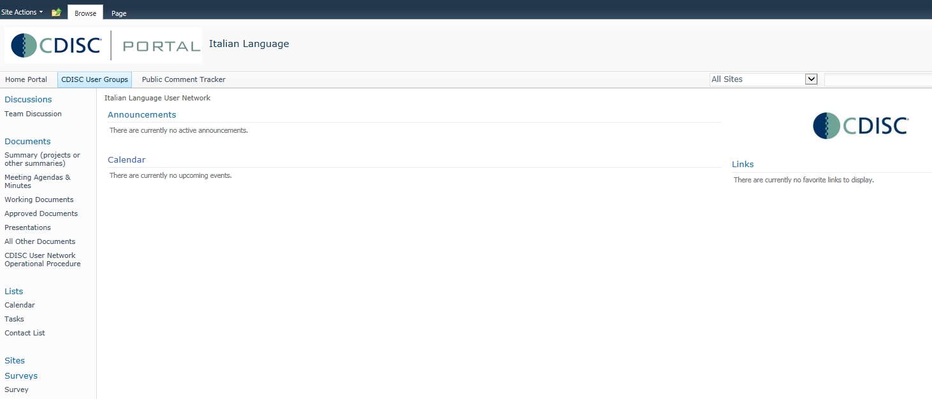
Obiettivi del CDISC User Newtork e Modalità di Funzionamento
http://portal.cdisc.org/CDISC%20User%20Networks/Europe/Italian%20Language/default.aspx
Notes:
CDISC User Networks are prohibited from competing with CDISC Educational Courses. Specifically, CDISC Educational Course materials are branded and are CDISC intellectual property. These are only to be used by CDISC approved instructors performing CDISC-authorized training – [see COP-005.]
CDISC User Networks will encourage, but not require, CDISC membership from its members. (Per the list in the prior section, User Networks may collect fees from attendees to offset costs of meetings and these fees may differ depending upon whether or not a company is a CDISC member.)

Slide 11
Chi siamo, quanti siamo e feedback iniziali su domande ricevute
35 adesioni
Provenienza
  Pharma: 11
  CRO: 20
  Accademia/Indipendente: 4
Ruolo*
  DM: 19
  Biostat: 16
  Stat Programmer: 9
  Altro: 2
??? Quanti membri CDISC ???
* Alcuni coprono piu’ funzioni/ruoli

Slide 12
Chi siamo, quanti siamo e feedback iniziali su domande ricevute
Tutte le info per standardizzare i database e la relazione tra CDASH e SDTM
Applicazione standard CDISC all’ematologia
Conversioni SDTM e ADAM
Membership, Rapporto con la clinica, figure professionali
Standardizzazione db in fase di progettazione

Slide 13
Chi siamo, quanti siamo e feedback iniziali su domande ricevute
Aspetti da Chiarire (con CDISC?)
Leads
Co-Leads
CDISC UK UN Model (?)

Slide 14

News dal mondo CDISC
CDISC Europe Interchange
Call for Abstracts
Link sulla homepage di CDISC (https://cdisc.wufoo.com/forms/p1tduyqi127qwy0)
Scadenza 4/1 probabilmente estesa al 12/1
Principali temi: End-To-End Implementation of Data Standards, End-To-End Governance & Change Management, CRO Governance, Metadata, Therapeutic Area CDISC Implementation

Slide 15
News dal mondo CDISC
Date prossimi training Europei
SDTM, ADaM, Define-XML Parigi 8-11 Marzo
SDTM, CDASH, and ADaM Brussels 6-9 Settembre
SEND, SDTM, ADaM, & Define-XML training in Copenhagen 3-11 Ottobre
SDTM, ADaM, and Define-XML training in Eschborn (Frankfurt), Germania 14-17 Giugno
+++ Online courses

Slide 16
News dal mondo CDISC
Prossimi Webinars gratuiti o riservati ai membri di CDISC
http://www.cdisc.org/webinars
14 Gennaio: Standards Updates and Additions
28 Gennaio: Legacy Studies Submission Automation Using Metadata (solo membri)
25 febbraio: LOINC (solo membri)

Slide 17
News dal mondo CDISC
Standards in fase di Sviluppo
SDTM IG 3.3
ADaM IG 1.2
Therapeutic Area User Guide (recenti update)
  Breast Cancer (draft public review settimana scorsa)
  Traumatic Brain Injury

Slide 18
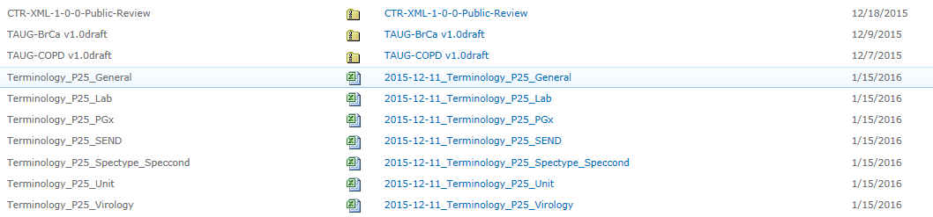
News dal mondo CDISC
Standards for Public Review

Slide 19
News dal mondo CDISC (e non)
FDA Technical Conformance Guide
(update ottobre 2015)
http://www.fda.gov/downloads/ForIndustry/DataStandards/StudyDataStandards/UCM384744.pdf
4.1.2.10 Software Programs
Sponsors should provide the software programs used to create all ADaM datasets along with the tables and figures associated with primary and secondary efficacy analyses in order to help reviewers to better understand how the datasets, tables and figures were created. The specific software utilized should be specified in the ADRG. The main purpose of requesting the submission of these programs is to understand the process by which the variables for the respective analyses were created and to confirm the analysis algorithms. Therefore, it is not necessary to submit the programs in a format or content that allows the FDA to directly run the program under its given environment. Any submitted programs (scripts) generated by an analysis tool should be provided as ASCII text files or PDF files, e.g., adsl.sas should be submitted as either adsl.txt or adsl.pdf.

Slide 20
Prossima TC
Mercoledi’ 20 Gennaio h 12-13

Slide 21
Varie ed Eventuali
Condivisione con CDISC lista indirizzi email / nominativi
Supporto TC, Webex (Cytel o a rotazione sistemi altre aziende), altri servizi es. FreeConferenceCall, TeamViewer
Potenziali Argomenti prossima TC
  Sommario CDISC Interchange (Chicago Novembre)
  ADaM Update
  SDTM Update
  Study Data Reviewer e Analysis Reviewer Guide
  Esperienze da Condividere
  Volontari?

