Slide 1
Japan Introduction
CJUG-SDTM Team

Slide 2
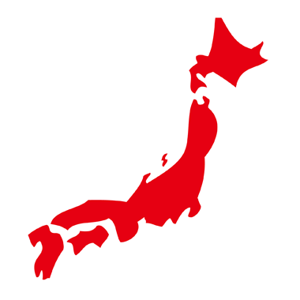
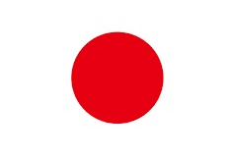
DATA
Population:126 million（10th）
Area:377,944 km² （62nd）
Pronunciation in Japanese:
“Nohon” or “Nippon”

Slide 3
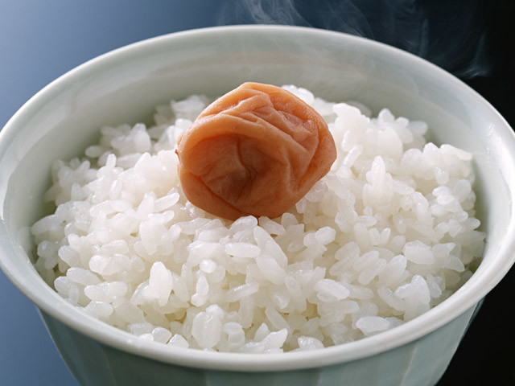
Foods and drinks
Rice
  The Japanese used to live on rice

Slide 4
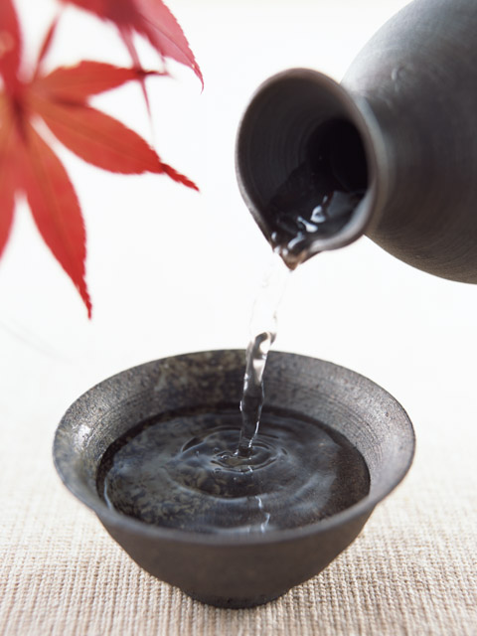
Foods and drinks
Japanese Sake
  It is Japanese traditional alcoholic drink.
  Rice is used as ingredient.

Slide 5
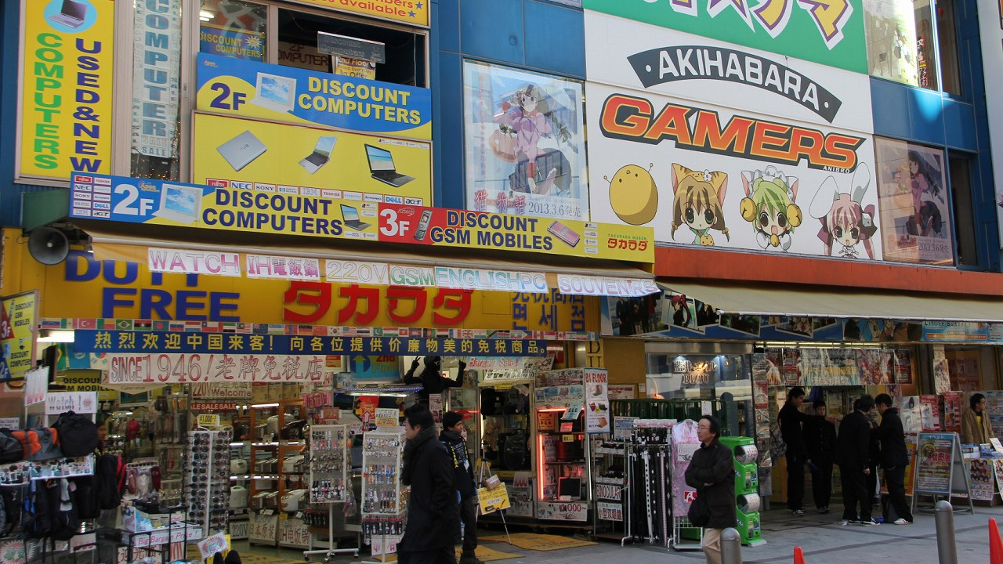
Local
Akihabara
  electronics quarter
  city of subculture

Slide 6
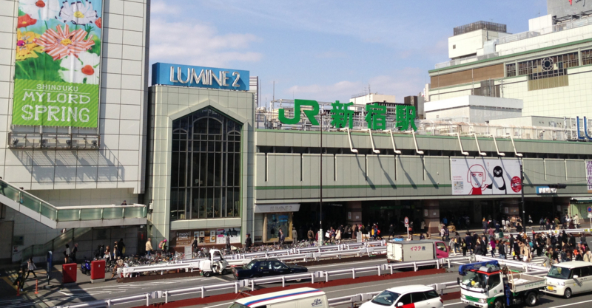
Local
Shinjuku
  The station was used by an average of 3.64 million people per day(Guinness World Records)

Slide 7
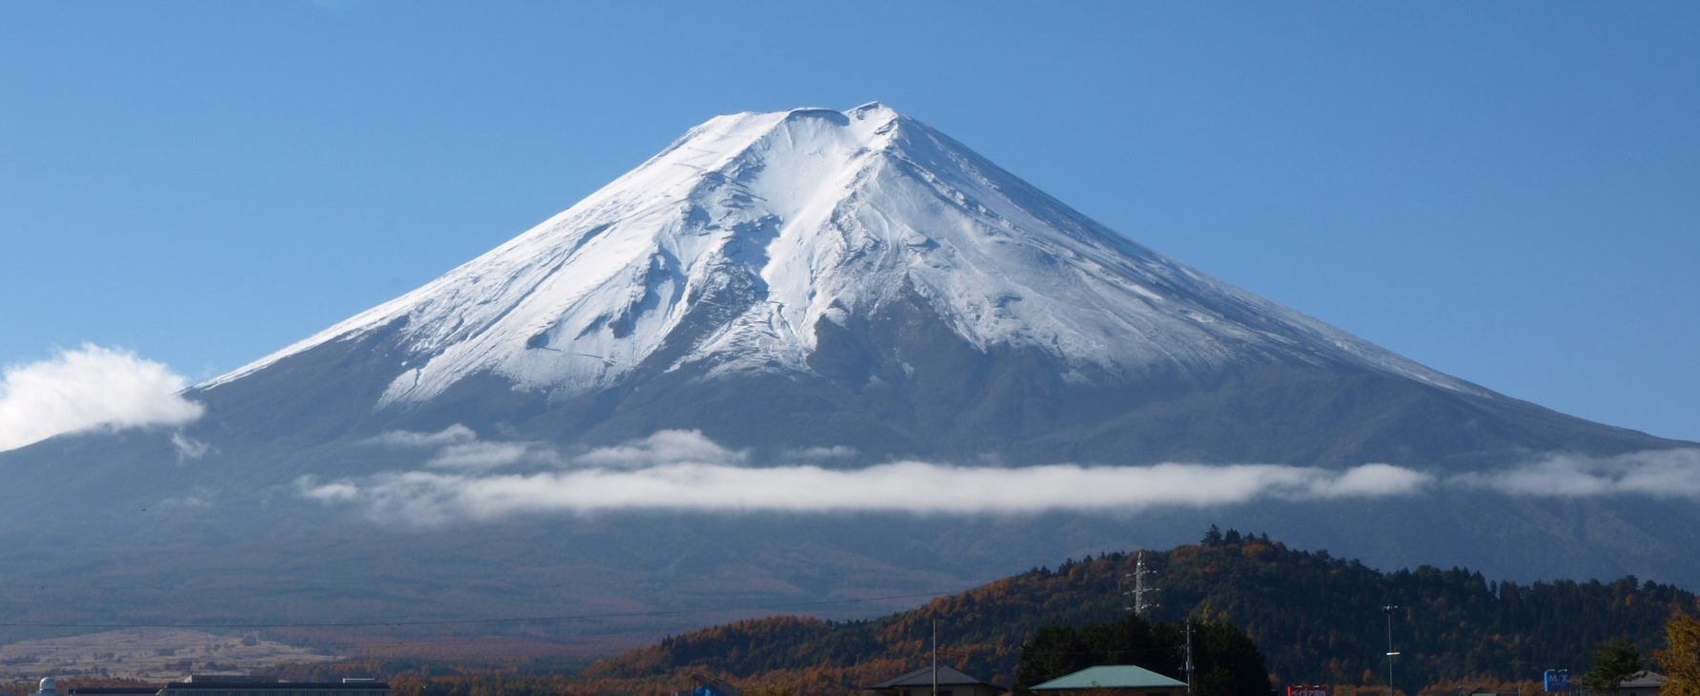
Japanese symbol
Mt.Fuji
  Height Above Sea Level:3,776m(Lower than 500th place)
  But, the charm of Mount Fuji is beauty.

Slide 8
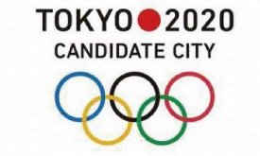
When will CDISC be required?
From April 1. 2020
  SDTM/ADaM and etc.
  SEND has not be required yet. But It will be necessary in the future.

