Slide 1
German CDISC User Group Intro
German speaking User Group
September 11, 2015

Slide 2
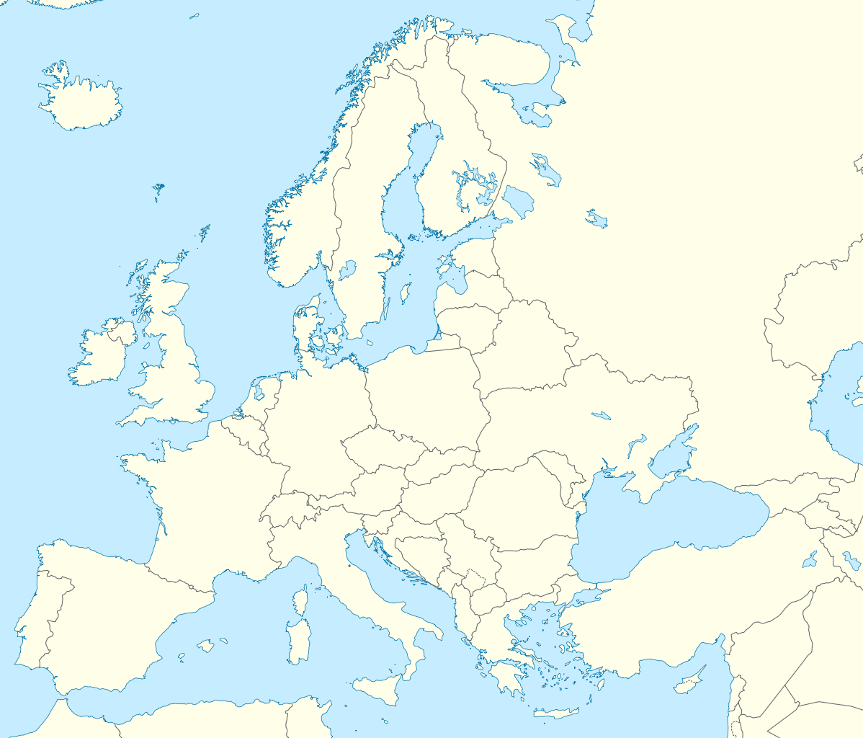
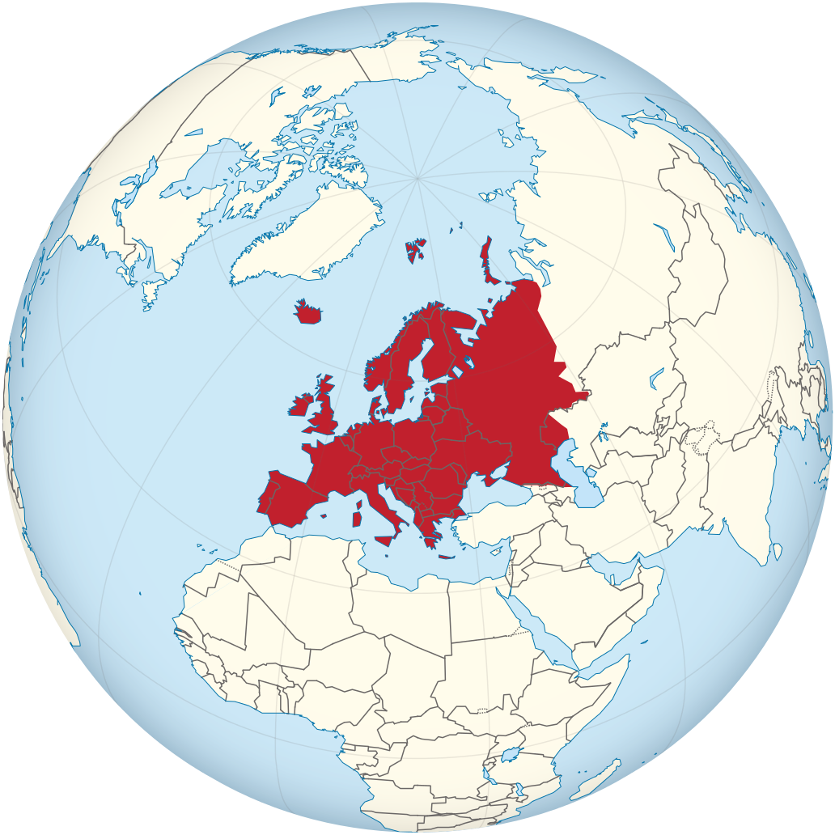
German speaking User Group origins...

Slide 3

Member State Austria
Republic of Austria (1918 / 1955)
constitution, covers area of ~84t km² (~32t mi²)
Population: 8,5 million, official language: German
Capital and largest city is Wien (~ 1.7 – 2.6 million)
Cultural goods:
Music: Mozart, Haydn, Liszt, Schubert, Strauss, Karajan
Art: Hundertwasser, F. G. Waldmüller, Hans Makart, Gustav Klimt
Famous: A. Schwarzenegger, Billy Wilder, C. Jürgens, C. Waltz, C.M. Brandauer
Literat.: Franz Grillparzer, Rainer Maria Rilke, Adalbert Stifter, ...
Others: Apfelstrudel, Kaiserschmarren, Stroh Rum, Sacher Torte, Tafelspitz, Mozartkugeln, Wiener Schnitzel
Science: F. Porsche, S. Freud, Paracelsus, Wittgenstein
Sports: All sorts of Skiing, Bobsleigh, Ski-Jumping, Luge, Skeleton

Slide 4

Member State Switzerland
Suisse Confederation (Confoederatio Helvetica: 1-Aug-1291 Swiss National Day)
Federal directional republic, includes 26 cantons, area of ~41t km² (~16t mi²)
Population: ~ 8 million (multi linguistic: French, Italian, German, Romansh)
capital city is Bern - largest city is Zürich – red cross, UN and CERN in Geneva
Cultural goods:
Artists: Arthur Cohn (8 Oscars), Ursula Andress, Rock Band Krokus
Literat.: Max Frisch, Friedrich Dürrenmatt, Gottfried Keller, Johanna Spyri (Heidi)
Other Goods: Premium Chocolate, Premium Cheese (Gruère, Emmentaler), Fondue, Raclette, Rösti, Edelweiss, Alphorn, Yodeling, all sorts of Financial Business (Banks)
Sports: Skiing, snowboarding and mountaineering are among the most popular sports in Switzerland, all sorts of alpine and winter sports, Bobsleigh, Luge, Skeleton, Tennis (e.g. Roger Federer, Stan Wawrinka)

Slide 5

Member State Germany
Federal Republic of Germany (1949, reunion East and West 1990)
includes 16 constituent states, covers area of ~357t km² (~138t mi²)
Population: 80.7 million (most populous member state in the European Union)
capital and largest city is Berlin (~ 3,5 million)
Cultural goods:
Folk festival traditions (Oktoberfest, Munich, Bavaria) and Christmas customs as Christmas markets, Christmas trees and Stollen cakes
Music: Beethoven, Bach, Haendel, Schumann, Wagner
Art: Albrecht Dürer, Paul Peter Rubens, C. David Friedrich, M. Liebermann
Literat.: Goethe, Schiller, Eschenbach, Fontane, Broths Grimm, Mann, Hesse ...
Other Goods: Beer, Weisswürste, Heidelberg, many, many Castles (e.g. Neu-Schwanstein, Sans Soussi), Timber Frame Houses, Roman monuments
☺ Soccer World Champion in 2014 ☺ (most popular sport)

