Slide 1

CDISC Italian User Network TC
Presented by Silvia Faini (LivaNova) Angelo Tinazzi (Cytel)
28.11.2018

Slide 2
Agenda
CDISC and Data Submission What’s New
CDISC and Data Submission topics from PhUSE 2019
CDISC and Machine Learning. “State of the Art” from CDISC EU Interchange and PhUSE 2019
How to handle ‘Multiple Enrolment’ and ‘Multiple screen Failure’ in SDTM e.g. USUBJID. “State of the Art” from CDISC, PhUSE Working Group and FDA Guidance
Other Topics
https://wiki.cdisc.org/display/ITAUG/Italian+User+Network+Home

Slide 3
CDISC e Data Submission What’s New
Upcoming Webinars, Trainings, New Standards and Working Progress

Slide 4
Upcoming webinars
CDISC Members-Only Mini-Training Series – What’s a disease milestone and why would I want one? – 13DEC2018 – D.Wold, CDISC
CDISC Public Webinar – Controlled Terminology Mapping/Alignment Across Codelists - 09JAN2019 – A.Chow (CDISC), E.Muhlbradt, D.Sattler

Slide 5
Public Trainings
Reading, UK 21 - 25 Jan 2019
  SDTM Theory and Application, CDASH Implementation, ADaM Primer, ADaM Theory and Application, Define-XML
Madrid, Spain 11 - 15 Feb 2019
  SDTM Theory and Application, CDASH Implementation , ADaM Primer, ADaM Theory and Application, Define-XML
Amsterdam, Nederlands 6 - 10 May 2019 → EU CDISC Interchange week
  CDISC for Newcomers, ADaM Primer, ADaM Theory and Application, SDTM Theory and Application, SDTM Theory and Application for Medical Devices, SEND Implementation , CDASH Implementation, ODM implementation, Controlled Terminology, Define-XML

Slide 6
CDISC Events
Italian CDISC UN - in (22?) Febbraio 2019 a Milano, tema della giornata «What’s New a 360 gradi»
  Si accettano volontari per le presentazioni
EU CDISC Interchange 8-9 Mag 2019 ad Amsterdam
  Fino a 11 Gennaio è aperta la «Call for Abstract» https://www.cdisc.org/2019-cdisc-europe-interchange-call-abstracts
    LINKING TO OTHER STANDARDS, DICTIONARIES AND FRAMEWORKS
    IMPLEMENTATION
    TOWARDS END TO END AUTOMATION
    DATA STANDARDS GOVERNANCE
    TOWARDS PROTOCOL STANDARDS

Slide 7
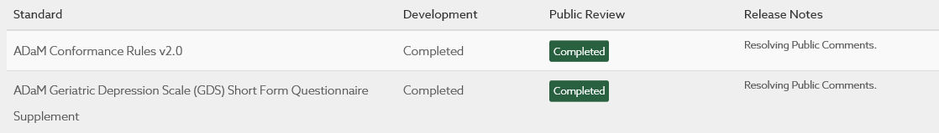
CDISC Update
Nuova veste grafica del sito... e nuova organizzazione dei contenuti.
Prossime pubblicazioni:
https://www.cdisc.org/standards/in-development
Standard e Data Exchange

Slide 8
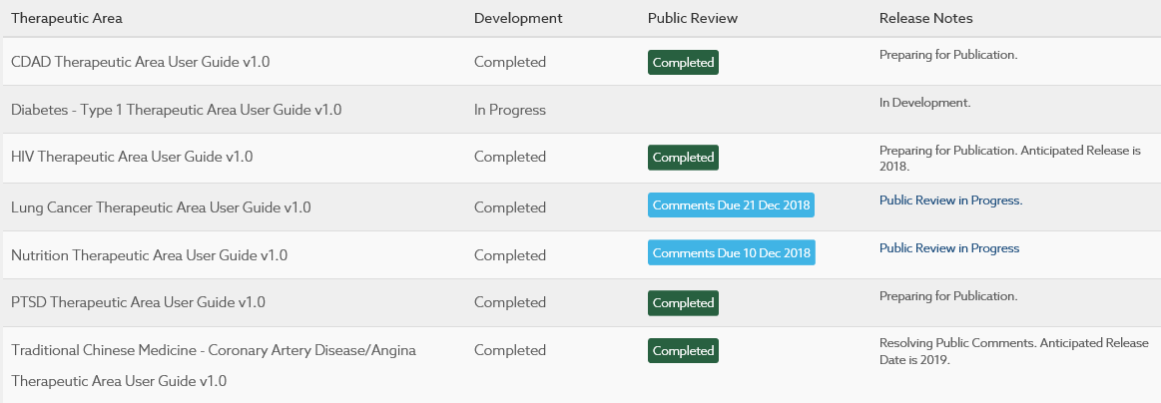
CDISC Update
Therapeutic Area

Slide 9
CDISC and Data Standards Update
CDISC SDTM Ig 3.3 / SDTM Model 1.7
ADaM Ig 1.2 ... November or before end of the year
WHODrug B3 (C3) ... Mandatory for FDA for study starting 15-MAR-2019
See Wiki Page Italian UN
FDA Study Data Technical Conformance Guide – v October 2018
See Angelo email (FDA_TCG_Memo.pdf)
FDA Planning of Bioresearch Monitoring (BIMO) Inspections for CDER Submissions
Guidance and Technical Conformance Guide available in the wiki Italian UN page

Slide 10
CDISC and Data Standards Update
FDA BIMO Requirements
Clinical Study-Level Information
Subject-Level Data Line Listings by Clinical Site
Summary Level Clinical Site Dataset

Slide 11
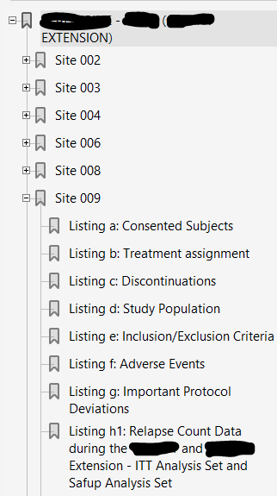
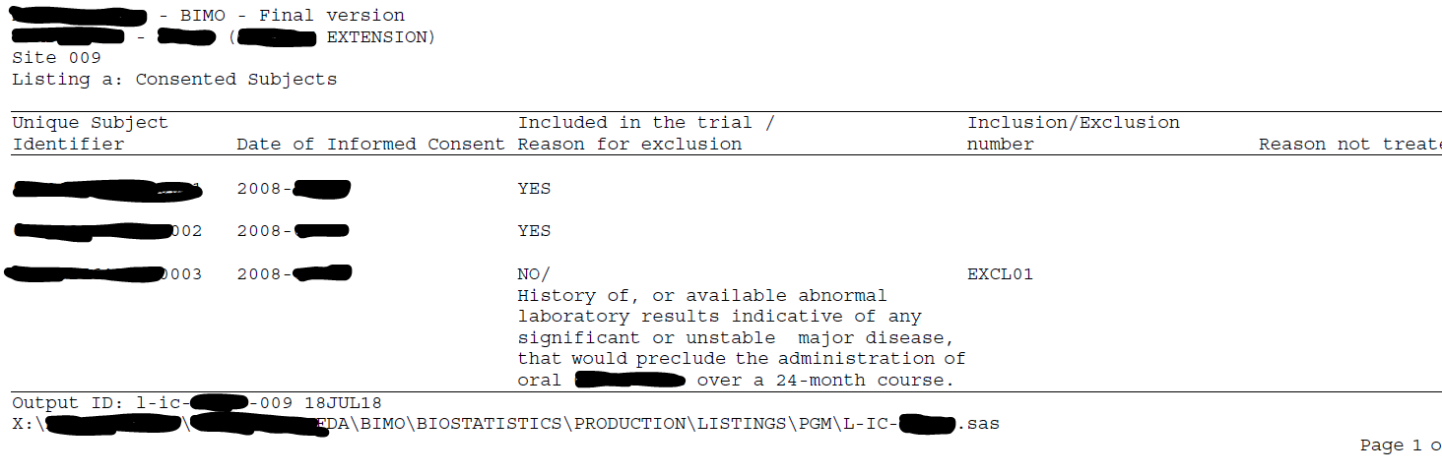
CDISC and Data Standards Update
FDA BIMO Requirements (cont)
Clinical Study-Level Information
Subject-Level Data Line Listings by Clinical Site

Slide 12
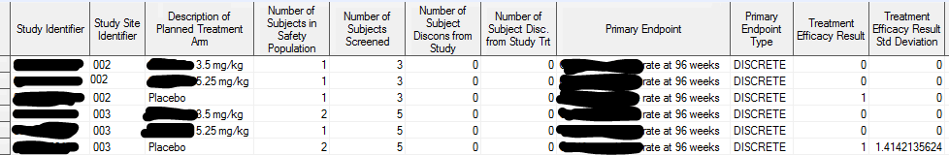
CDISC and Data Standards Update
FDA BIMO Requirements (cont)
Clinical Study-Level Information
Summary Level Clinical Site Dataset

Slide 13
CDISC and Data Submission
Topics from PhUSE 2019
https://www.phuse.eu/euconnect18-presentations

Slide 14
CDISC and Data Submission
Topics from PhUSE 2019
Paper | Author | Content
Do's and Don'ts of Define.xml (SA04) | David Roulstone / Pinnacle 21 | Best practices for creating define.xml that is clear and useful in a regulatory review
From Machine-readable CDISC Standard Specifications to the e-Protocol (SI09) | Jozef Aerts / University of Applied Sciences FH Joanneum | He presented projects where he is currently involved; all these projects have the objectives of improving the way we use standards and how by better using standards and available technology we can have may be one day Alexia for SDTM. Ongoing project at PhUSE such as sdrg in .xml

Slide 15
CDISC and Data Submission
Topics from PhUSE 2019 (cont)
Paper | Author | Content
Into the Fire Linking CDISC & FHIR (SI12) | Dave Iberson-Hurst / Assero | Dave is also a very well-known CDISC and standards in general guru. In his presentation Dave showed, by taking the example of LOINC that will be soon required by the FDA, how it is possible to integrate Electronic Health Record (HER) into SDTM via Fast Healthcare Interoperability Resources (FHIR)
Easing Your Pain with Biomedical Concepts (SI13) | Kirsten Walther Langendorf / S-CUBED & A3 Informatics | Biomedical concepts provides a detailed metadata definition that allows a clear definition and links of all elements defining the concept e.g. the example of blood pressure, a concept defined by type of pressure e.g. diastolic, a results with its unit, measurement position, etc.

Slide 16
CDISC and Data Submission
Topics from PhUSE 2019 (cont)
Paper | Author | Content
Guideline for submission ready aCRF (PP02) | Christina Paul / Grunenthal, Stefanie Sturm / HMS | The poster was a preview of an industry guideline that will be soon published by the CDISC German User Network. The guideline is about how to best create acrf submission ready
SDTM and ADaM Implementation FAQ (Workshop) | Amy Palmer & Peter Van Reusel / CDISC | SDTM and ADaM Implementation FAQ is a PhUSE working group led by Peter and Amy from CDISC. The aim of this working group is to collect questions from data standards implemented, mainly SDTM and ADaM, and provide answers to these questions from a pool of expert belonging to the working group. The FAQs are currently maintained and made public available at the following address: https://www.phusewiki.org/wiki/index.php?title=SDTM_ADaM_Implementation_FAQ Also introduced new CDISC 2.0 (new era) and a new proof of concept from data collection to TFLs

Slide 17
Machine Learning and CDISC
“State of the Art” from CDISC EU Interchange and PhUSE 2019

Slide 18
Machine Learning (ML) and CDISC Focus
L’interesse per il Machine Learning sta aumentando anche nel campo della ricerca clinica, quest’anno sia al CDISC Interchange che al PhUSE ci sono stati delle sessioni dedicate. Di seguito un focus su queste tematiche.

Slide 19
ML from EU CDISC Interchange
“Machine Learning Applications for Clinical Data Scientists” - Mike Collinson, Oracle → inquadra cosa è il ML all’interno del vasto campo dell’Artificial Intenlligence e il ruolo del Data Scientist.
“Data Mapping Using Machine Learning” - Nathan Asselstine, SAS → Esempio di data mapping tramite linguaggio SAS: software tipicamente usati per ML sono Python, R, SAS.

Slide 20
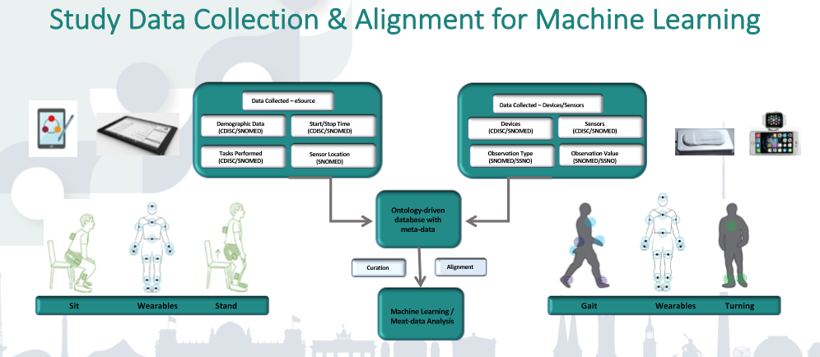
ML from EU CDISC Interchange
“How Machine Learning can be Empowered by Using Data Standards in Digital Biomarker Space” - Farhan Hameed, Pfizer → descrive l’approccio del ML nella soluzione di alcuni problemi, tra cui Study Data Collection & Alignment for ML.

Slide 21
ML from EU CDISC Interchange
“CDISC Standards in the Age of Artificial Intelligence” - Jozef Aerts, University of Applied Sciences FH Joanneum → cosa è necessario per poter avere supporto da AI/ML nell’implementazione degli standard CDISC?
  input machine-readable: protocolli e specifiche degli standard CDISC;
  regole chiare che siano machine-readable e machine-executable.
  Iniziative spontanee XML4PHarma e università, ma servirebbe una visione comune per fare passi in avanti, verso «Alexa for SDTM».

Slide 22
ML from EU PHUSE
ML01 - Introduction to Machine Learning
“THE ECOSYSTEMS”
There are several ecosystems to implement ML, open source or commercials. Here are 4 interesting ones:
  The Python programing language and the Scikit-Learn library have become the most popular solution for ML implementation. Many books or MOOCs available for Python. Scikit-learn has plenty algorithms available: Classification, Regression, SVM, Clustering, Dimensionality Reduction, Decision Trees, Random Forests. It’s usually the starting point when learning ML.

Slide 23
ML from EU PHUSE
ML01 - Introduction to Machine Learning (cont)
  The R programming language also offers some libraries for ML implementation. It seems that R is more used for data manipulation and wrapping Python libraries.
  TensorFlow is an open source Python framework developed by Google. It offers more recent and powerful techniques, especially neural networks.
  SAS has a module called “SAS Visual Data Mining and Machine Learning”. It’s not free and therefore has limited players. It offers several algorithms for regression and classification.

Slide 24
ML from EU PHUSE
ML01 - Introduction to Machine Learning (cont)
“CONCRETE APPLICATIONS”
ML is a transformative technology in many fields. The number of applications is exploding.
  - Handwriting recognition, like reading cheques
  - Interface with humans: chatbots, Siri, Alexa etc.
  - SPAM detection
  - Customers recommendation: Amazon, Netflix, Spotify etc.
  - Sentiment analysis using Natural Language Processing: Amazon, Facebook
  - Alpha Go was the first AI program to have beaten a Go world champion. There’s an interesting movie about this story which I recommend

Slide 25
ML from EU PHUSE
ML01 - Introduction to Machine Learning (cont)
More and more in the pharmaceutical industry:
  - Drug discovery and candidate selection
  - Medical image recognition (Scan, MRI etc.)
  - Medical diagnosis, sometimes saving lives where doctors couldn’t reach a diagnosis
  - Optimum site selection and recruitment
  - Data anomality detection
  - Personalized medicine
  - Operational data about clinical trials
  - And maybe one day soon, SDTM, ADaM and TFL?

Slide 26
ML from EU PHUSE
ML01 - Introduction to Machine Learning (cont)
The adoption is slow in Pharma compared to other industries. It’s probably due to regulatory constraints. ML operates as a black box and we need to prove and validate models to explain the outcome. There are big investments in Healthcare and more and more AI startups are coming the Pharma industry.

Slide 27
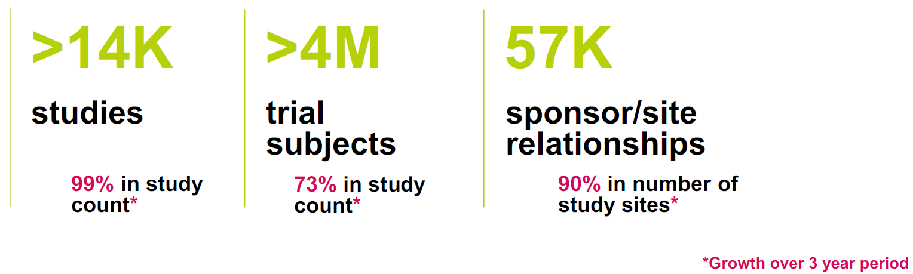
ML from EU PHUSE
ML04 - Automate Data Standardization in Clinical Trials
Medidata Enterprise Data Store (MEDS) One of the Industry’s Largest Give to Get Clinical and Operational Data

Slide 28
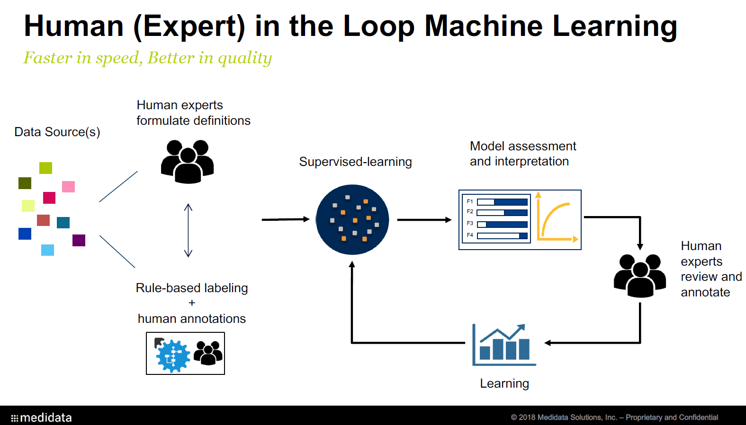
ML from EU PHUSE
ML04 - Automate Data Standardization in Clinical Trials (Cont)

Slide 29
How to handle ‘Multiple Enrolment’ and ‘Multiple screen Failure’ in SDTM
e.g. USUBJID. “State of the Art” from CDISC, PhUSE Working Group and FDA Guidance

Slide 30
How to handle ‘Multiple Enrolment’ and ‘Multiple screen Failure’ in SDTM
Possible Scenario Within Study
Multiple Screen Failures
Screen Failures / Re-screen Successfull
Multiple Enrolments
Possible Scenario Across Studies
Multiple Enrolments / Participation in different studies
Extension Studies

Slide 31
How to handle ‘Multiple Enrolment’ and ‘Multiple screen Failure’ in SDTM
SDTM Ig >v=3.2 Discuss Subject (same) Enrolled in Multiple Studies
FDA SDTCG (v October 2018) Discuss Multiple Enrolment within the same study and re-screening and multiple failures
«Decomissioned» PhUSE WG
  CDISC / PhUSE Webinar 12FEB2015

Slide 32
How to handle ‘Multiple Enrolment’ and ‘Multiple screen Failure’ in SDTM
SDTM Ig Requirement
The unique subject identifier (USUBJID) is required in all datasets containing subject-level data. USUBJID values must be unique for each trial participant (subject) across all trials in the submission. This means that no two (or more) subjects, across all trials in the submission, may have the same USUBJID. Additionally, the same person who participates in multiple clinical trials (when this is known) must be assigned the same USUBJID value in all trials

Slide 33
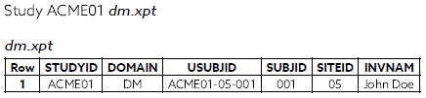
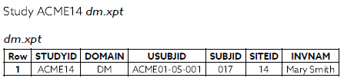
How to handle ‘Multiple Enrolment’ and ‘Multiple screen Failure’ in SDTM
SDTM Ig Requirement (cont)
Many sponsors concatenate values for the Study, Site and Subject into USUBJID, but this is not a requirement. It is acceptable to use any format for USUBJID, as long as the values are unique across all subjects per FDA guidance

Slide 34
How to handle ‘Multiple Enrolment’ and ‘Multiple screen Failure’ in SDTM
FDA SDTCG
For subjects with multiple enrollments within a single study, the primary enrollment should be submitted in DM. Additional enrollments should be included in a custom domain with a similar structure to DM. Clarifying statements in the RG would be helpful
For subjects with multiple screenings and no subsequent enrollment, include the primary screening in DM with additional screenings in a custom domain with a structure similar to DM.
For subjects with multiple screenings and subsequent enrollment, include the enrollment in DM with screenings in a custom domain with a structure similar to DM.

Slide 35
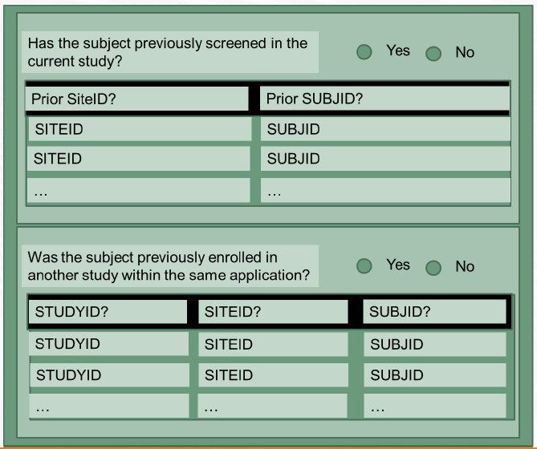
How to handle ‘Multiple Enrolment’ and ‘Multiple screen Failure’ in SDTM
PhUSE WG / CDISC Webinar
Good Recommendations on prospectic multiple enrolment / screen failures data collection

Slide 36
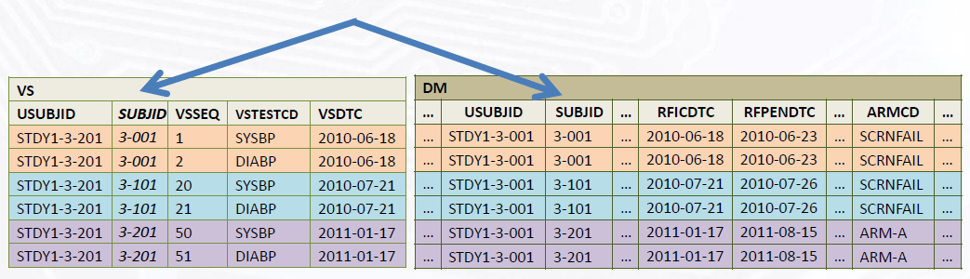
How to handle ‘Multiple Enrolment’ and ‘Multiple screen Failure’ in SDTM
PhUSE WG / CDISC Webinar (cont)
Recommend to make DM one record per USUBJD per SUBJID
SDTM Ig 3.3 just released is still one record per USUBJID

Slide 37
How to handle ‘Multiple Enrolment’ and ‘Multiple screen Failure’ in SDTM
Conclusions
No clear how to handle situations when multiple failures / enrolments within same study occur
Even the recent released SDTM Ig 3.3 doesn’t cover this scenario
What to do in ADaM when pooling from different studies subject with multiple participations? Waiting for any indication from the ADaM Integration Sub-team
It does seem (Angelo opinion) any solution will require changes in the models, both SDTM and ADaM

Slide 38
How to handle ‘Multiple Enrolment’ and ‘Multiple screen Failure’ in SDTM
Conclusions (cont)
Extension Studies e.g. open-label extension study of a double blind study, seems the only scenario of easy solution in pooled ADaM when pooling is done from individual SDTM
ADSL
STUDYID | USUBJID
STUDY1 | STUDY1-001-001
ADLB
STUDYID | ASTUDY | USUBJID | ADT | AVAL
STUDY1 | STUDY1 | STUDY1-001-001 | 20DEC2017 | 10.1
STUDY1 | STUDY2 | STUDY1-001-001 | 30JAN2018 | 15.5
Observation occurred during STUDY1 participation
Observation occurred during STUDY2 participation

Slide 39
Thank You!
Silvia Faini
silvia.Faini@livanova.com
Angelo Tinazzi
angelo.tinazzi@Cytel.com

