Slide 1
Protocol Representation Model (PRM) in the Real World
Richard Young | Director, EMEA
Monday, 17th December, 2012

Slide 2
Per Patient Costs – USD ($)
Pharmalot, reporting data from Cutting Edge Informatics, 26 Jul 2011

Slide 3
Challenges of Clinical Development
Explosion of analytics and data related to trials
Increasing difficulty recruiting patients
Low visibility for performance management
Increasingly complex trials and trial design
High risks, delayed approvals, delayed revenue
Many processes continue to be siloed, manual or inefficient
Growing importance of emerging markets
Struggle to adapt to emerging world of genomic-based drugs
Notes:
Add examples of systems utilised......100-160 in DM, Clinical and Stats

Slide 4
From Data to Intelligence
Confidence in DECISION
OPTIMISE
Best Outcome ?
PREDICT
What Will Happen ?
EXPLORE
Why ?
What Happened ?
RAW Data
Standard Reports
Time / Resource
CLEAN Data
Ad hoc Reports
DATA
INFORMATION
KNOWLEDGE
INTELLIGENCE
Notes:
Adaptive Trials
- might increase the “information value” per $$ investment (in a resource constrained environment)
- are an “enabler” for
a) team-building (discovery, clinical, biostatistics, IT, regulatory, project management, clinical operations, marketing) and
b) earlier and better planning, decision-making
c) simulation guided clinical drug development

Slide 5
Protocol Representation Model
CDISC has a standard model for the protocol
  Protocol Representation Model (PRM)
The PRM was developed to
  Support the generation of a protocol document,
  Support research study (clinical trial) registration and tracking,
  Support regulatory needs,
  Facilitate single-sourced, downstream electronic consumption of the protocol content
In SIMPLE terms, PRM enables us to
  Define the core clinical components
  Define the relationship between the components

Slide 7
Protocol Representation Model
Summary of Study Design (EXAMPLE)
  This is a prospective, randomized, double-blind, double-dummy, placebo controlled, forced-titration, multicenter, parallel group trial. Stage I or II hypertensive patients, age 18 years of age or older, who meet all other inclusion and exclusion criteria and successfully complete the placebo run-in period will be randomized at the site level.
Notes:
As researchers know, the protocol, in terms of a clinical research study, is the plan, or blueprint, that describes the study’s objectives, methodology, statistical considerations, and the organization of the study. Much in the way that an effective business plan lays out the foundation for what is expected in beginning a successful enterprise, a well-designed protocol is the map that is vital to the overall success of a clinical trial or study. Everyone involved in the research study needs the protocol; this includes but is not limited to the investigator, the site personnel, the clinical project managers and monitors, the data managers, and the statisticians. Additionally, the protocol is a requirement by regulatory authorities for regulated clinical research studies. A fully developed clinical protocol is essential for regulatory purposes including Investigational New Drug (IND) applications, Institutional Review Boards (IRB) and Ethics Committees.

Slide 8
Protocol Representation Model
Summary of Study Design (EXAMPLE)
  This is a prospective, randomized, double-blind, double-dummy, placebo controlled, forced-titration, multicenter, parallel group trial. Stage I or II hypertensive patients, age 18 years of age or older, who meet all other inclusion and exclusion criteria and successfully complete the placebo run-in period will be randomized at the site level.
Degree of blind
Population disease description
Configuration
Subject age description
Notes:
STANDARD CONCEPTS

Slide 9
Protocol Representation Model
“Meta” Information about Content | Content
Subject age description | Age 18 years of age or older
Configuration | Parallel group trial
Population disease description | Stage I or II hypertensive patients
Degree of blind | Double-blind
Notes:
STRUCTURED CONCEPTS

Slide 10
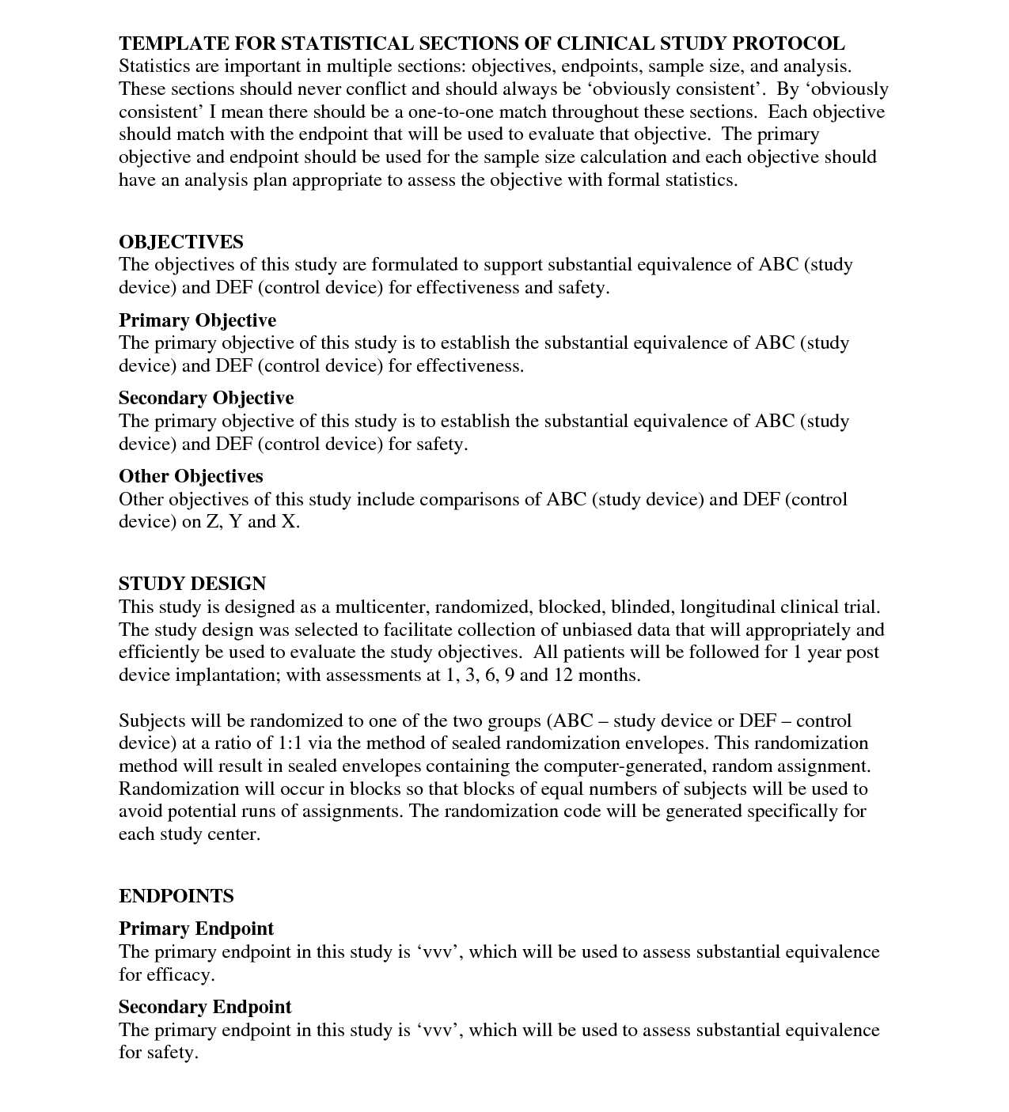
Protocol Representation Model

Slide 11
Protocol Representation Model
Objective #1
Endpoint #1
Procedure #1
Procedure #2
Objective #2
Variable #1
Variable #3
Variable #2
Variable #4
Endpoint #2
Procedure #3
Variable #5
Variable #6

Slide 12
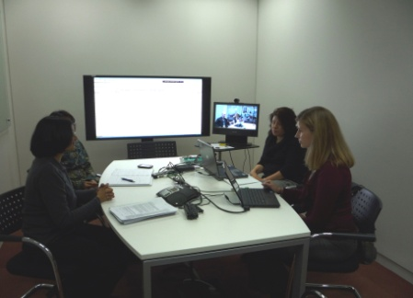
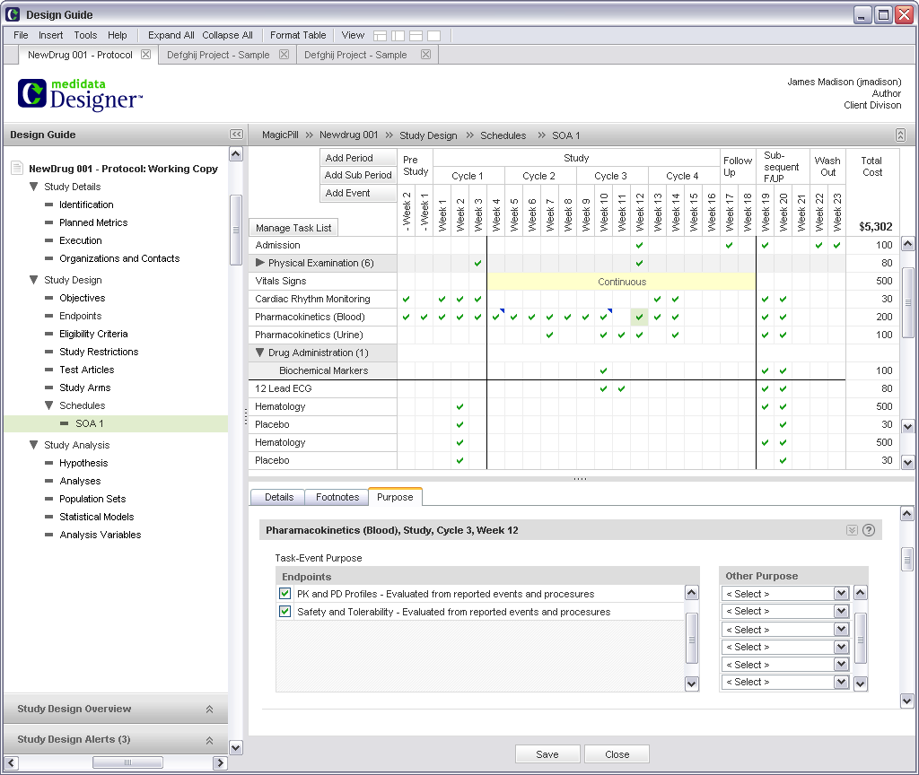
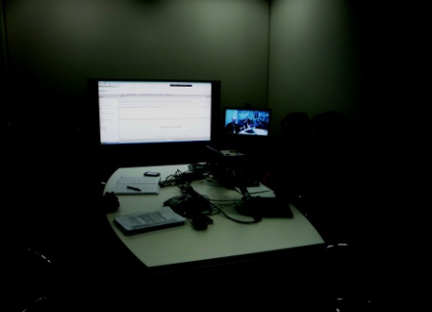
A New World..........
Strategy/Goal:
Shift from clinical document management to information management
Increase the quality and consistency of clinical information
Align objectives, endpoints and procedures
Demonstrate traceability from strategy to plan to study design
Support parallel development of Protocol, RAP, eCRF and CSR
Leverage industry benchmarks
People/Behaviours:
Process:
Technology:
More disciplined approach
Willingness to seek peer feedback
Business acumen - ability to assess trade-offs bertween time cost value & risk
Focus on outcomes & audience (start with the end in mind, consider consumers)
Shift from study level to project level planning
Plan -> Design -> Document
Leverage project level information
Apply study specific information
Generate clinical deliverables
Streamline review & approval
Electronic study design tool (inc. content management capabilities and publishing templates)
Integration with
  upstream planning and study registration solutions
  downstream data collection solutions
  benchmarking data and clinical standards
Results:
Simplify protocols
Reduce number of procedures and cost per patient
Reduce effort setting up downstream systems
Eliminate effort associated with cleaning and analyzing ’excess’ data
Avoid amendments/rework
Reduce cycle time (creation and review of clincial deliverables)
Reduce duplicate data entry, reformatting and rewriting of information
Notes:
69% of all protocols have at least one amendment
46% of all amendments occur BEFORE first patient first dose
37% are considered “somewhat” or “completely’” avoidable
Adds 61-days and cost $450,000+ to implement each amendment

Slide 13
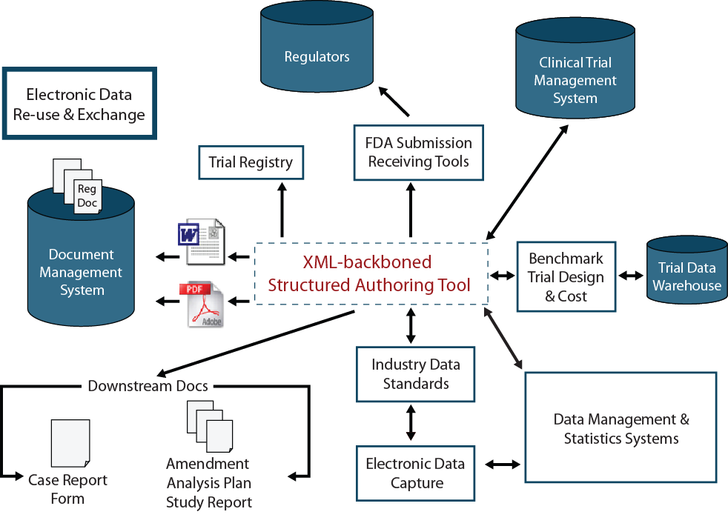
A New World Realised
PRM

Slide 14
The Typical Protocol in 2012
Average of 13 endpoints – 1 primary and 5 ‘key’ secondary
Median of 170 total procedures
    85 procedures support primary and key secondary endpoints
Median 50 inclusion and exclusion criteria and 180+ case report form pages
Requires study volunteers to make 11 visits over an average of 175 days
Source: Tufts CSDD, 2012

Slide 15
Mean Number of Data Points
Collected per Study
Source: Medidata Solutions Worldwide, 2012

Slide 16
Rising Protocol Complexity and Burden
(All TAs, All Phases)
 | 00 – 03 | 04-07 | 08-11
Unique procedures per protocol (median) | 20.5 | 28.2 | 30.4
Total procedures per protocol (median) | 105.9 | 158.1 | 166.6
Total investigative site work burden (median units) | 28.9 | 44.6 | 47.5
Total eligibility criteria | 31 | 49 | N/A
Median study duration in days | 140 | 154 | 175
Median number of CRF pages per protocol | 55 | 180 | N/A
Getz, Campo, Kaitin. Variability in Protocol Design Complexity by Phase and Therapeutic Area. DIJ 2011 45(4); 413-420.
Source: Tufts CSDD

Slide 17
Primary Drivers of Protocol Complexity
Ongoing shift from acute to chronic diseases
Pipeline composition shift from traditional NCEs to biologics
Focus on doing more in earlier development phases
Phase IV becoming more robust and sophisticated
Growing requirements from purchasers and payers
Habit and legacy protocol templates and authoring practices
Risk mitigation/risk avoidance
Notes:
17

Slide 18
IMPACT: Trial Performance
(All TAs, Phases II-III)
 | Less Complex | More Complex | Difference
Study volunteer screen to completion rate | 52% | 23% | Half as Effective
Time from Protocol Ready to FPFV (median) | 115 days | 129 days | +12%
Time from Protocol Ready to LPLV (median) | 413 days | 714 days | +73%
Number of Amendments | 1.9 | 3.2 | +68%
Getz, Wenger, Campo et al. Assessing the Impact of Protocol Design Change on Clinical Trial Performance. AJT 2008 15(5); 450 - 457
Source: Tufts CSDD

Slide 19
IMPACT: Amendment Prevalence
Protocol Phase | Number of Amendments* | Number of Changes per Amendment
Phase I | 2.0 | 5.6
Phase II | 2.6 | 6.8
Phase III | 3.6 | 8.5
Phase IIIb/IV | 2.3 | 8.3
ALL PROTOCOLS | 2.4 | 6.9
46% of all amendments occur BEFORE first patient first dose
37% of all amendments are considered ‘avoidable’
Note: All values are means
*Analysis excludes protocols without any amendments
Source: Tufts CSDD, 2012

Slide 20
IMPACT: Extraneous Protocol Data
Two primary areas of ‘protocol waste’ – (1) Essential procedures performed excessively (2) Extraneous and unused procedures
New 2012 Tufts CSDD study among 15 participating pharmaceutical and biotechnology companies to assess cost of ‘non-core’ procedures
  Study sponsored by Medidata Solutions
  N = 117 PII/III protocols; N= 22,143 procedures analyzed; cost data N=16,607 procedures
    Global, multiple therapeutic areas, No pediatric, devices, orphan diseases and No extensions

Slide 21
Procedure Classifications
Core
Non-Core
Required - GCP Compliance
Standard Procedures
Procedures supporting primary and/or secondary objectives
Procedures supporting primary, *key* secondary and safety endpoints
Procedures supporting tertiary and exploratory objectives and endpoints
Procedures supporting *supportive* secondary and exploratory endpoints
Safety and efficacy procedures that are not included as an endpoint or objective
Screening requirements
Drug dispensing (compliance)
Procedures not tied to an endpoint or objective
Informed Consent
Performed in all trials: concommitant medications, demographics, adverse event assessment etc...

Slide 22
One-out-of-Four Phase II/III Protocol Procedures are ‘Non-Core’
Source: Tufts CSDD, 2012

Slide 23
$1 Million in Direct Procedure Costs per Protocol is Paying for Non-Core Activity
 | Overall $000 | Phase II $000 | Phase III $000
All | $6,001 | $2,068 | $9,174
Core | $3,133 (52%) | $1,316 (64%) | $4,599 (50%)
Non-Core | $1,051 (18%) | $262 (13%) | $1,688 (18%)
Required | $1,372 (23%) | $329 (16%) | $2,214 (24%)
Standard | $474 (7%) | $161 (8%) | $673 (7%)
* All values are means; Aggregate of costs for all patients receiving the procedures scheduled per visit per protocol
Source: Tufts CSDD, 2012

Slide 24
Conservative Impact of Extraneous Protocol Data Costs
The total direct cost to industry to perform ‘Non-Core procedures is an estimated $3.7 billion annually
  Only counts an investigational drug in clinical development once although it may be in active clinical trials for multiple indications.
  Counts only one clinical trial per active compound per phase when multiple trials are likely conducted simultaneously.
This study only examined direct procedure cost and does not include the indirect cost of personnel time to capture, monitor, clean, analyze, manage and store tertiary and exploratory procedure data.
The ethical cost of exposing study volunteers to the risk of performing less essential, and unnecessary, procedures has also not been considered in this analysis.

Slide 25
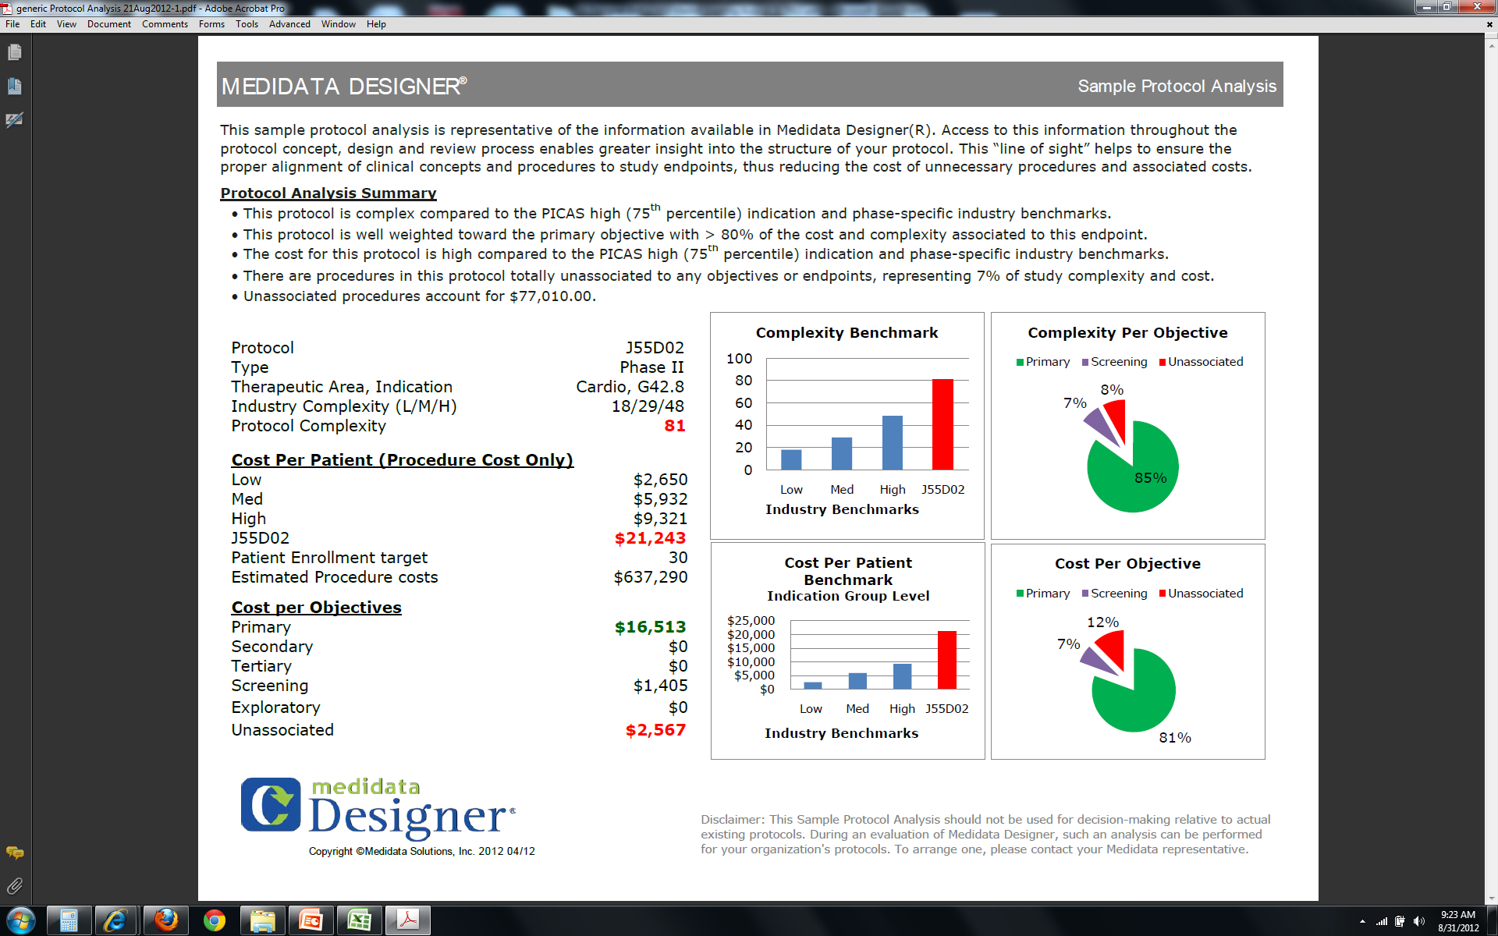

Slide 26
Potential Financial Impact
Measured over implementation stage
Reduce effort
Focus on Study Design
Improve Quality and Consistency
Integration
Eliminate costs
30-50% efficiency gain in protocol development process (authoring and review cycles)
Sponsor experience and Medidata best practice
$150k/late phase study decrease in study costs through linking exercise
Sponsor experience
$453k/per controllable amendment reduction
Ken Getz, Tufts Center for Study of Drug Development study results on cost
Medidata best practice
30-50% EDC study start-up time and effort reduction
Medidata best practice
50% time saving exporting to ClinicalTrial.gov
Sponsor and Medidata expected results
Decrease costs of collecting/storing/validating/managing unnecessary patient data
$3,354/per day for 100% SDV per PICAS

Slide 27
Rising Complexity and Cost

Slide 28
Protocol Amendment Prevalence
69% of all protocols have at least one amendment
46% of all amendments occur BEFORE first patient first dose
37% are considered “somewhat” or “completely’” avoidable
Adds 61-days and cost $450,000+ to implement each amendment
*Analysis of those protocols with at least one amendment
Note: All values are means
Getz, Zuckerman, Cropp, Hindle , Krauss. Measuring the Incidence, Causes and Repercussions of Protocol Amendments. Drug information Journal. 2011 45(3); 265 - 275

Slide 29
Conclusions
Adopting PRM, ENABLES
  Significant process change involved in adoption
  Real business value can be demonstrated
  Opportunity to
    Influence trial cost and complexity
    Drive reuse and efficiency
    Interface with other standards
  Application of standards will enable organizations to build BI and analytic capability never possible before
Adopting PRM, WILL
  Drive significant operational, clinical, ethical and technical savings/benefits

