Slide 1
Implementation of Oncology specific
SDTM domains
Jacintha Eben
Clinical Data Manager Coordinator Oncology
18/Dec/2013

Slide 2
Agenda
Oncology in General and Experience within SGS
Endpoints in Oncology
Standardized Response Criteria
Cheson 2007
Oncology Specific Domains: TU, TR, RS
Conclusion

Slide 3
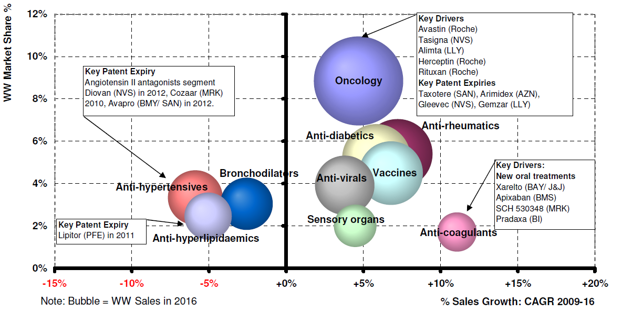
Oncology in General
Analysis on Top 10 Therapy Areas in 2016, Market Share & Sales Growth (2009-16)
Source: EvaluatePharma® (30APR2010)

Slide 4
experience within SGS
Number of trials in Oncology (number of patients)
  14 trials in InformTM, 7 in Rave® and 8 paper oncology trials
  Solid tumors, Ovarian Cancer, Prostate Cancer, Smoldering Multiple Myeloma, Multiple Myeloma, Multicentric Castleman’s Disease, Myelodysplastic Syndrome, non-Hodgkin Lymphoma, Mantle Cell Lymphoma, Follicular Lymphoma...
SDTM format
Phase/Patients | < 100 | >100/400< | >400 | Total
I | 11 |  |  | 11
II | 6 | 5 |  | 11
III |  | 1 | 6 | 7
Total | 17 | 6 | 6 | 29

Slide 5
Endpoints in oncology
Assessment of the change in tumor burden: both tumor shrinkage and disease progression
Endpoints
Endpoint | Clarification
Overall Survival (OS) | Time from randomization/1st drug administration to date of death
Progression Free survival (PFS) | Time from randomization/1st drug administration until objective tumor progression or death due to any cause
Time to Progression (TTP) | Time from randomization/1st drug administration until objective tumor progression or death as a result of cancer
Duration of Response (DR) | Time from first CR/PR (whichever is first) until the first recurrent disease or PD
Duration of Stable Disease | Time from the start of the treatment until criteria for progression is met
Time to Treatment Failure (TTF) | Time from randomization/1st drug administration to treatment discontinuation for any reason (e.g., PD, AEs, death, etc.).
...

Slide 6

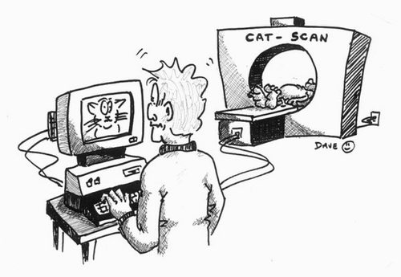
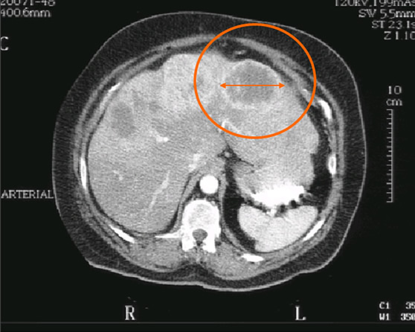
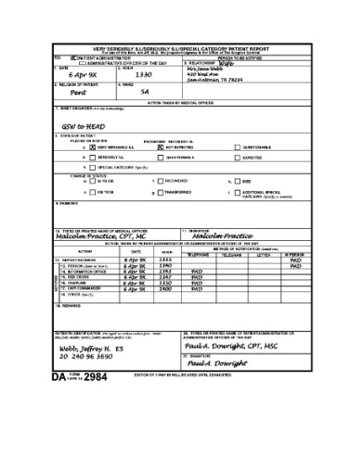
-Independent assessor(s)
-Adjudication
Method of assessment:
CT
MRI
PET
Endoscopy
Bone Marrow Biopsy
...
a) Assessment:
Target lesion (measurable lesion)
Non-target (assessable lesion)
b) Evaluation of Response(s)
Source notes
eCRF
Lesions followed up and re-assessed on subsequent time points

Slide 7
Standardized Response criteria
Uniform set of criteria for assessing response in Clinical trials
Allow comparison among trials
Aiding the review and approval process of new agents
Different Standardized Response Criteria
RECIST – Solid Tumor
Cheson – Malignant Lymphoma
...

Slide 8
Cheson 2007
Lesions
Measurable (max. 6)
Non- Measurable (Assessable)
Measurable lesions not selected as target
Target
Followed quantitatively
Non- Target
Followed qualitatively
Revised Response Criteria for Maligant Lymphoma – Bruce D. Cheson et al.

Slide 9
Cheson 2007
Techniques
  CT/MRI
  PET (PET/CT)
  Bone marrow assessment
  Immunohistochemistry
Measurements/assesments
  Longest perpendicular diameters
  SPD: Sum of product in diameters
  Visually assess non-target lesions
  Determine new lesions
Evaluation of Response
Revised Response Criteria for Maligant Lymphoma – Bruce D. Cheson et al.

Slide 10
CHESON 2007
 | Response Criteria
Complete Response (CR) | Nodes returned to normal (if GTD >15 mm before therapy, GTD now ≤15 mm; if GTD 11-15 and SA >10 mm before therapy, SA now ≤10 mm) All (non-nodal) target lesions completely resolved and all non-target lymph nodes returned to normal size. All extranodal lesions have completely resolved Liver and spleen have returned to normal size (if enlarged at BL)
Partial Response (PR) | SPD of target lesions decreased ≥50% from baseline Spleen and liver nodules regress by 50% in SPD or single lesion in GTD
Stable Disease (SD) | Not enough shrinkage for PR Not enough growth for PD
Progressive Disease (PD)/ Relapse | SPD increase ≥50% from nadir in nodal target lesions overall or in any single nodal target lesion - A node with SA <10 mm must grow ≥50% and to ≥15 x 15 mm or >15 mm GTD - A node with SA >10 mm must increase ≥ 50% in GTD or in non-nodal target lesions overall (e.g. liver/spleen nodules selected as target lesions)
Revised Response Criteria for Maligant Lymphoma – Bruce D. Cheson et al.

Slide 11
Oncology SPECIFIC domains
3 SDTM Findings Class domains
  SDTMIG 3.1.3
Related to each other
Distinct purpose
  TU: Tumor Identification
  TR: Tumor Results
    Quantitative measurements
    Qualitative assessments
  RS: Disease Response

Slide 12
-Independent assessor(s)
-Adjudication
Method of assessment:
CT
MRI
PET
Endoscopy
Bone Marrow Biopsy
...
a) Assessment:
Target lesion (measurable lesion)
Non-target (assessable lesion)
New lesion (+ TU)
b) Evaluation of Response(s)
TR
Source notes
eCRF
TU
RS

Slide 13
Tumor Identification (TU) DOMAIN
TUGRPID | TULNKID | TUTESTCD | TUTEST | TUORRES | TULOC | TUMETHOD | VISIT | TUDTC
A1 | A1 | TUMIDENT | Tumor Identification | ASSESSABLE TUMOR LESION | ADENOPATHY CERVICAL | SPIRAL CT | SCREENING | 2012-11-01
M1 | M1 | TUMIDENT | Tumor Identification | MEASURABLE TUMOR LESION | ADENOPATHY INGUINAL | SPIRAL CT | SCREENING | 2012-11-01
M2 | M2 | TUMIDENT | Tumor Identification | MEASURABLE TUMOR LESION | ADENOPATHY PARATRACHEAL | SPIRAL CT | SCREENING | 2012-11-01
N1 | N1 | TUMIDENT | Tumor Identification | NEW | ADENOPATHY MESENTERIC | SPIRAL CT | VISIT 3 | 2013-06-11

Slide 14
Tumor Identification (TU) DOMAIN: SPLIT LESION
Split lesions: if a tumor identified at baseline subsequently splits into separate distinct tumors
TULNKID reflects the split by adding 0.1; 0.2, ... to the original TULNKID value
TUGRPID | TULNKID | TUTESTCD | TUTEST | TUORRES | TULOC | TUMETHOD | VISIT | TUDTC
M2 | M2 | TUMIDENT | Tumor Identification | MEASURABLE TUMOR LESION | ADENOPATHY PARATRACHEAL | SPIRAL CT | SCREENING | 2012-11-01
M2 | M2.1 | TUMIDENT | Tumor Identification | MEASURABLE TUMOR LESION | ADENOPATHY PARATRACHEAL | SPIRAL CT | VISIT 2 | 2013-04-15
M2 | M2.2 | TUMIDENT | Tumor Identification | MEASURABLE TUMOR LESION | ADENOPATHY PARATRACHEAL | SPIRAL CT | VISIT 2 | 2013-04-15

Slide 15
Tumor Results (TR) DOMAIN: Assessable
TUGRPID | TULNKID | TUTESTCD | TUTEST | TUORRES | TULOC | TUMETHOD | VISIT | TUDTC
A1 | A1 | TUMIDENT | Tumor Identification | ASSESSABLE TUMOR LESION | ADENOPATHY CERVICAL | SPIRAL CT | SCREENING | 2012-11-01
TRLNKID | TRTESTCD | TRTEST | TRORRES | TRMETHOD | VISIT | TRDTC
A1 | LESSTAT | Lesion Status | DECREASED | SPIRAL CT | VISIT 1 | 2013-01-25
A1 | LESSTAT | Lesion Status | NOT EVALUABLE | SPIRAL CT | VISIT 2 | 2013-03-26
A1 | LESSTAT | Lesion Status | NO CHANGE | SPIRAL CT | VISIT 3 | 2013-05-13

Slide 16
Tumor Results (TR) DOMAIN: Measurable
TUGRPID | TULNKID | TUTESTCD | TUTEST | TUORRES | TULOC | TUMETHOD | VISIT | TUDTC
M2 | M2 | TUMIDENT | Tumor Identification | MEASURABLE TUMOR LESION | ADENOPATHY PARATRACHEAL | SPIRAL CT | SCREENING | 2012-11-01
M2 | M2.1 | TUMIDENT | Tumor Identification | MEASURABLE TUMOR LESION | ADENOPATHY PARATRACHEAL | SPIRAL CT | VISIT 2
M2 | M2.2 | TUMIDENT | Tumor Identification | MEASURABLE TUMOR LESION | ADENOPATHY PARATRACHEAL | SPIRAL CT | VISIT 2 | 2013-04-15
TRLNKID | TRTESTCD | TRTEST | TRORRES | TRORRESU | TRMETHOD | VISIT | TRDTC
M2 | BIDMEAS1 | Bidimensional Measurement 1 | 55.0 | mm | SPIRAL CT | SCREENING | 2012-10-11
M2 | BIDMEAS2 | Bidimensional Measurement 2 | 27.0 | mm | SPIRAL CT | SCREENING | 2012-10-11
M2 | BIDMEAS1 | Bidimensional Measurement 1 | 53.0 | mm | SPIRAL CT | VISIT 1 | 2013-01-16
M2 | BIDMEAS2 | Bidimensional Measurement 2 | 24.0 | mm | SPIRAL CT | VISIT 1 | 2013-01-16
M2.1 | BIDMEAS1 | Bidimensional Measurement 1 | 30.0 | mm | SPIRAL CT | VISIT 2 | 2013-04-15
M2.1 | BIDMEAS2 | Bidimensional Measurement 2 | 7.0 | mm | SPIRAL CT | VISIT 2 | 2013-04-15
M2.2 | BIDMEAS1 | Bidimensional Measurement 1 | 12.0 | mm | SPIRAL CT | VISIT 2 | 2013-04-15
M2.2 | BIDMEAS2 | Bidimensional Measurement 2 | 6.0 | mm | SPIRAL CT | VISIT 2 | 2013-04-15

Slide 17
Tumor results (TR) DOMAIN: New LESION
TUGRPID | TULNKID | TUTESTCD | TUTEST | TUORRES | TULOC | TUMETHOD | VISIT | TUDTC
N1 | N1 | TUMIDENT | Tumor Identification | NEW | ADENOPATHY MESENTERIC | SPIRAL CT | VISIT 3 | 2013-06-11
TRLNKID | TRTESTCD | TRTEST | TRORRES | TRORRESU | TRMETHOD | VISIT | TRDTC
N1 | BIDMEAS1 | Bidimensional Measurement 1 | 17.0 | mm | SPIRAL CT | VISIT 3 | 2013-06-11
N1 | BIDMEAS2 | Bidimensional Measurement 2 | 10.0 | mm | SPIRAL CT | VISIT 3 | 2013-06-11

Slide 18
Combined Results
Data from eCRF
=
+
TU
TR
RS
Data from Independent Assessor
TUGRPID | TULNKID | TUTESTCD | TUTEST | TUORRES | TULOC | TUMETHOD | TUEVAL | VISIT
A1 | A1 | TUMIDENT | Tumor Identification | ASSESSABLE TUMOR LESION | ADENOPATHY CERVICAL | SPIRAL CT | INVESTIGATOR | SCREENING
M2 | M2 | TUMIDENT | Tumor Identification | MEASURABLE TUMOR LESION | ADENOPATHY PARATRACHEAL | SPIRAL CT | INVESTIGATOR | SCREENING
R1-101 | R1-101 | TUMIDENT | Tumor Identification | MEASURABLE TUMOR LESION | ADENOPATHY INGUINAL | PET | RADIOLOGIST | SCREENING
R1-501 | R1-501 | TUMIDENT | Tumor Identification | ASSESSABLE TUMOR LESION | ADENOPATHY INGUINAL | PET | RADIOLOGIST | SCREENING

Slide 19
TUMOr Identification (TU) DOMAIN - independent assessor
TUREFID | TULNKID | TUTESTCD | TUORRES | TULOC | TUMETHOD | TUEVAL | TUEVALID | TU ACPTFL | VISIT
27595 | R1-101 | TUMIDENT | MEASURABLE TUMOR LESION | ADENOPATHY INGUINAL | PET | RADIOLOGIST | RADIOLOGIST 1 | N | SCREENING
27595 | R1-102 | TUMIDENT | MEASURABLE TUMOR LESION | ADENOPATHY ABDOMINAL | PET | RADIOLOGIST | RADIOLOGIST 1 | N | SCREENING
27595 | R1-501 | TUMIDENT | ASSESSABLE TUMOR LESION | ADENOPATHY INGUINAL | PET | RADIOLOGIST | RADIOLOGIST 1 | N | SCREENING
27595 | R1-502 | TUMIDENT | ASSESSABLE TUMOR LESION | ADENOPATHY COMMON ILIAC | PET | RADIOLOGIST | RADIOLOGIST 1 | N | SCREENING
31436 | R1-801 | TUMIDENT | NEW | OTHER | SPIRAL CT | RADIOLOGIST | RADIOLOGIST 1 | N | VISIT 2
27595 | R2-101 | TUMIDENT | MEASURABLE TUMOR LESION | ADENOPATHY ABDOMINAL | PET | RADIOLOGIST | RADIOLOGIST 2 | Y | SCREENING
27595 | R2-102 | TUMIDENT | MEASURABLE TUMOR LESION | ADENOPATHY MEDIASTINAL | PET | RADIOLOGIST | RADIOLOGIST 2 | Y | SCREENING
27595 | R2-501 | TUMIDENT | ASSESSABLE TUMOR LESION | ADENOPATHY MEDIASTINAL | PET | RADIOLOGIST | RADIOLOGIST 2 | Y | SCREENING
32693 | R2-801 | TUMIDENT | NEW | SUBCUTANEOUS MASS | SPIRAL CT | RADIOLOGIST | RADIOLOGIST 2 | Y | VISIT 1

Slide 20
TUMOR RESULTS (TR) & Disease Response (RS) DOMAIN - INDEPENDENT ASSESSOR
TRLNKGRP | TRLNKID | TRTESTCD | TRTEST | TRORRES | TRORRESU | TRMETHOD | TRACPTFL | VISIT
R2-V1 | R2-101 | LDIAM | Longest Diameter | 104.49 | mm | PET | Y | SCREENING
R2-V1 | R2-101 | PPD | Product Perpendicular Diameters | 7245.34 | mm2 | PET | Y | SCREENING
R2-V2 | R2-101 | LDIAM | Longest Diameter | 77.75 | mm | SPIRAL CT | Y | VISIT 1
R2-V2 | R2-101 | PPD | Product Perpendicular Diameters | 2506.66 | mm2 | SPIRAL CT | Y | VISIT 1
R2-V2 | R2-501 | TUMSTATE | Tumor State | PRESENT |  | SPIRAL CT | Y | VISIT 1
R2-V2 | R2-801 | TUMSTATE | Tumor State | PRESENT |  | SPIRAL CT | Y | VISIT 1
M
A
N
RSLNKGRP | RSTEST | RSCAT | RSORRES | RSEVAL | RSEVALID | RSACPTFL | VISIT
R1-V2 | Overall Response | CHESON 2007 | SD | RADIOLOGIST | RADIOLOGIST 1 | N | VISIT 1
R2-V2 | Overall Response | CHESON 2007 | PD | RADIOLOGIST | RADIOLOGIST 2 | Y | VISIT 1

Slide 21
Disease Response (RS) DOMAIN
RSLNKGRP | RSTEST | RSCAT | RSORRES | RSSTAT | RSREASND | RSEVAL | VISIT
 | Assessable Lesion Response | CHESON 2007 | SD |  |  | RADIOLOGIST | VISIT 1
 | Measurable Lesion Response | CHESON 2007 | PR |  |  | RADIOLOGIST | VISIT 1
 | Liver Response | CHESON 2007 | CR |  |  | RADIOLOGIST | VISIT 1
 | Spleen Response | CHESON 2007 | CR |  |  | RADIOLOGIST | VISIT 1
 | Best Overall Response | CHESON 2007 | PR |  |  | RADIOLOGIST
 | Measurable Lesion Response | CHESON 2007 | PR |  |  | INVESTIGATOR | VISIT 1
 | Assessable Lesion Response | CHESON 2007 | PR |  |  | INVESTIGATOR | VISIT 1
 | Overall Response | CHESON 2007 | PR |  |  | INVESTIGATOR | VISIT 1

Slide 22

Conclusion
TA specific SDTM domains
More oncology specific standards (CFAST)

Slide 23

Questions?
E-mail:
jacintha.eben@sgs.com
Internet:
www.sgs.com/cro

