Slide 1

Board Chair’s Update 2013 and Vision for CDISC 2014-2015
Pierre-Yves Lastic, PhD
Chair-Elect, CDISC Board of Directors
Chief Privacy Officer, Sanofi

Slide 2
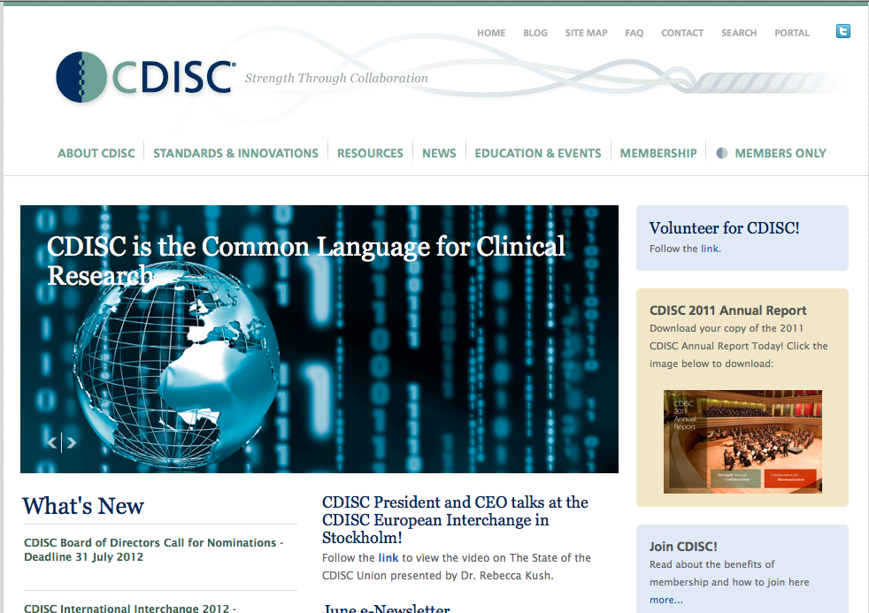
Clinical Data Interchange Standards Consortium (CDISC)
Global, open, multi-disciplinary, vendor-neutral, non-profit (charitable) standards developing organization (SDO)
Founded 1997, incorporated 2000
Member-supported (> 300 member organizations: academia, biopharma, service and technology providers, etc)
Liaison A Status with ISO TC 215 (healthcare standards)
Active Coordinating Committees (3C)
  Europe, Japan, China, Asia-Pacific
~ 20 User Networks worldwide
> 90 countries (>18,000 participants)
CDISC Standards are freely
available via the website
www.cdisc.org
Notes:
That is what CDISC was created to do. Break down barriers, build collaborations, and in doing so create an environment in which medical research can accelerate and improve at the same time.

Slide 3



CDISC Operations
Technical
Operations
Membership
CAC
Global
Operations
Education
Fundraising
TA Projects
Strategic
Initiatives & Alliances
Foundational
Standards
TLC, SRC
Communications
Public Relations
Events
Semantics
SHARE,
BRIDG, CT
Finance
IT

Slide 4

CDISC
CDISC
Board of
Directors
CDISC
Coordinating Committees
CDISC
Advisory
Council
CDISC
Operations
CDISC
Teams
CDISC
User Networks
Members, Supporters,
Volunteers, Stakeholders,
Adopters

Slide 5
‘Scientific/Operational’ Highlights - 2013
Inaugural CDISC Asia-Pacific Interchange (CAPI), AP3C
Launch of Learning Health System (LHS) Standards Initiative and other Healthcare Link Activities
Endorsements from Regulatory Authorities
CFAST Progress and Formation of Scientific Advisory Committee (SAC) for CFAST
New and Continuing Alliances and Collaborations
CDISC Communications Initiatives
Record Attendance at International Interchange and SHARE Launch

Slide 6
CDISC Inaugural Asia-Pacific Interchange

Slide 7
CDISC in the Asia-Pacific
CAPI Program Committee
  Dr. Kiyoteru Takenouchi (Japan), co-chair
  Dr. Ken Toyoda (Japan), co-chair
  Dr. Colleen Brooks (Australia, Singapore)
  Partha Chakraborty (India)
  Dr. Yao Chen (China)
  Dr. Richard Day (Australia)
  Dr. Jaranit Kaewkungwal (Thailand)
  Dr. Greg Koski (USA)
  Dr. Zibao Zhang (China)
Initiated Entity in Asia – CDISC Europe Foundation, Hong Kong Branch
Meeting of AP3C on 9 December in Hong Kong, Leader: Dr. Kiyoteru Takenouchi

Slide 8










Learning Health System
BioPharma
State Public Health
Patient-centered Groups
Federal
Agencies
Beacon Community
Governance
Patient Engagement
Trust
Analysis
Dissemination
Integrated
Delivery System
Health Information Organization
8
Health Center
Network
Source: Dr. C. P. Friedman
CDISC Leading ESTEL =
Essential Standards to Enable Learning
Notes:
8
Exchange of electronic health information to:
improve the quality / efficiency of health care
empower the individual patient
support public health, emergency preparedness, and research
Requires common elements:
minimum set of detailed standards - a shared network “dial tone”
support for consumer / inter-organizational trust
value of exchanging data exceeds the cost

Slide 9
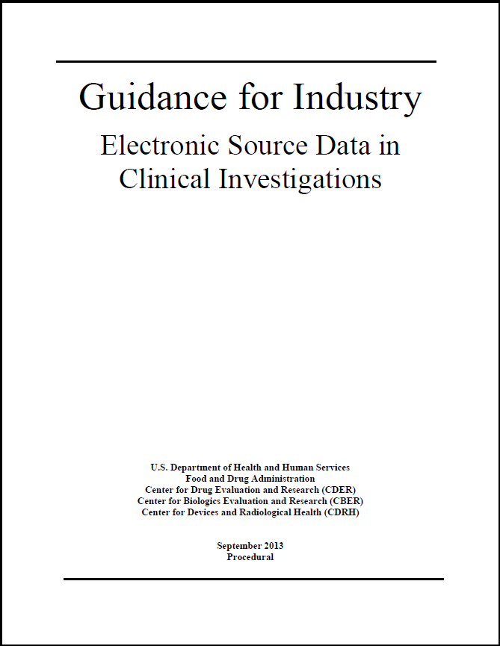
“…promotes capturing source data in electronic form…,”
[assists] “in ensuring the reliability, quality, integrity, and traceability of electronic source data.”
Source: Dr. Ron Fitzmartin, FDA
  http://www.fda.gov/downloads/Drugs/GuidanceComplianceRegulatoryInformation/Guidances/UCM328691.pdf
Notes:
Final Guidance Released September 2013
Previous 2 Draft Versions (December 2010 & November 2013) Obsolete

Slide 10

Standards and Initiatives at the Intersection of Healthcare and Research
Biomedical Research Integrated Domain Group Model (BRIDG)
  Collaboratively developed with four key stakeholders: NCI, CDISC, HL7, FDA
  www.bridgmodel.org
IHE Profiles for Clinical Research – L. Bain
  Developed through the Quality, Research and Public Health (QRPH) Group with CDISC Leadership
  Include Retrieve Form for Data Capture (RFD), Research Matching (RM), Retrieve Process (Protocol) for Execution (RPE), Data Exchange (DEX) and others
U.S. Health and Human Services (HHS/ONC) Structured Data Capture (SDC) Initiative
EU Innovative Medicines Initiative

Slide 11

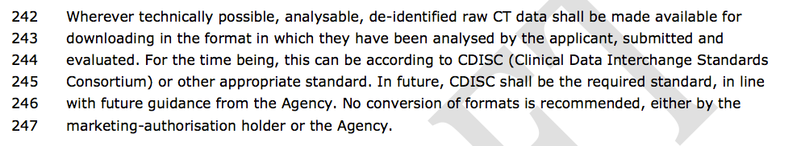
In late 2012, EU informed European Medicines Agency:
“Clinical trial data is not commercial confidential information.”
DRAFT Document for Public Comment

Slide 12
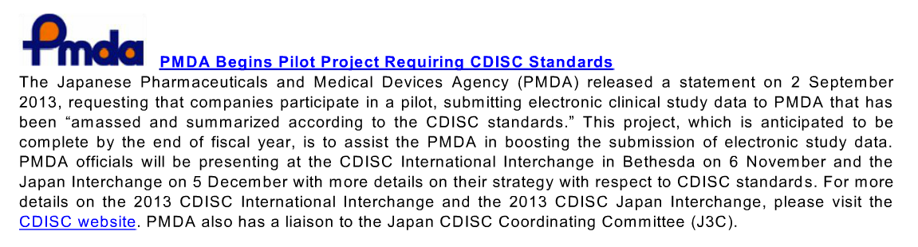

Slide 13
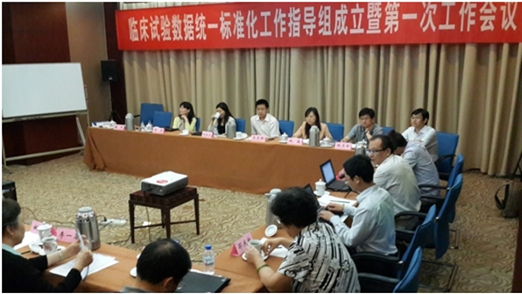

Update on the Center of Drug Evaluations (CDE), China FDA (CFDA) and CDISC (C3C)
2012 -mid-2013 China CDISC Coordinating Committee 3C - CSTAR) validated translations of CDISC standards into Chinese and launched Traditional Chinese Medicine (TCM) Team
June 2013 - Established China Clinical Trial Data Standards Steering Committee
(临床试验数据标准化工作指导组)
Co-led by C3C Chair with CFDA
July and August: Issued China Clinical Data Plan (CCDP)
and formed working groups (CTDS-WG) around CDISC Standards
September through 2014: Pilot project (CDISC standards in Chinese)
Many thanks to Zibao Zhang, leader of C3C, and to the C3C teams.

Slide 14

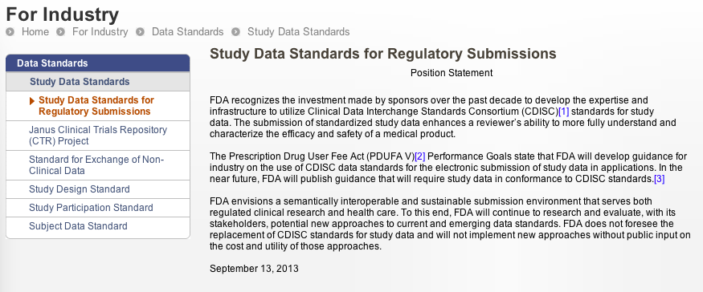
http://www.fda.gov/ForIndustry/DataStandards/StudyDataStandards/ucm368613.htm

Slide 15


Coalition for Accelerating Standards & Therapies
In response to CDISC member value surveys and PDUFA V (with the FDA's statement of need for therapeutic area data standards), C-Path and CDISC established CFAST
CFAST is an initiative to accelerate clinical research and medical product development by creating and maintaining data standards, tools and methods for conducting research in therapeutic areas that are important to public health
Now contributing to CFAST: FDA, TransCelerate Biopharma, NCI EVS, ACRO and IMI
15
Notes:
15

Slide 16













Therapeutic Area Standards Governance
CFAST SAC
Scientific Advisory Committee
CFAST TAPSC
Therapeutic Area Program
Steering Committee
Ongoing
Maintenance
&
Enhancement
of Foundational CDISC Standards
Provides Scientific Advice to TAPSC
Identifies Risks and Opportunities
Identifies/Engages Relevant Partners
Prioritizes/Approves Proposals
Approves Projects & Charters
Resources & Oversees Projects
CDISC TA Standards Project Teams
Project Leader +
Clinical leads (SMEs), BRIDG Modeler, Concept Creators, Terminologists, Metadata Analysts, Stats Consultants, Writers, Communications
Research Community
Research Community

Slide 17
Scientific Advisory Committee
Dr. Lynn Hudson
Dr. Rebecca Kush
Dr. David Jordan
CFAST SAC
Scientific Advisory Committee
Dr. Ronald Fitzmartin
Dr. Eileen Navarro
Dr. Nathalie Seigneuret
Dr. Malcolm Burgess
Roles
Activities to Date
Provides Scientific Advice to CFAST TAPSC
Identifies Risks and Opportunities
Identifies/Engages Relevant Partners
Advice on Oncology Projects/Priorities
Advised on Partners for CV Endpoints
Convened Imaging Stds Collaborators

Slide 18

TransCelerate BioPharma Inc. Launches Second Year Initiatives, Expands Membership and Achieves Milestones for Original Projects
PHILADELPHIA, Nov. 7, 2013 /PRNewswire/ -- TransCelerate BioPharma Inc. ("TransCelerate") is launching three new global initiatives to further advance efficiency in clinical trials and accelerate the development of new medicines: creation of common clinical trial protocol templates, development of clinical trial networks for pediatric and minority populations, and establishment of a global investigator registry.

Slide 19
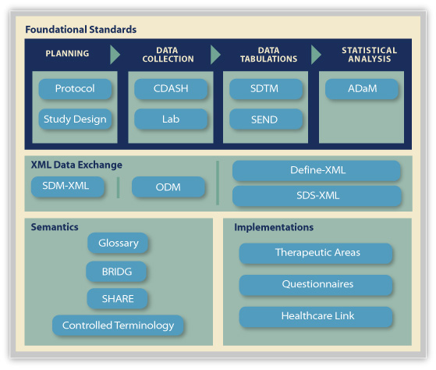
Looking Back: 2013 Products Delivered
2013 New Foundational Standards:
Define-XML v2
SDTMIG 3.2/SDTM 1.4 (11 new domains)
SDTMIG-AP (Associated Persons)
CDASH SAE Supplement
Quarterly Terminology and Periodic QS Supplements
New Drafts for Comment:
Study Dataset-XML
ADaM General/Hierarchical Occurrence Data Structure
Notes:
Mention Posters

Slide 20
Data and Metadata in Submissions Today
SDTM Data
SDTM Metadata
SAS V5 XPT
Define-XML

Slide 21
SDS-XML as an Alternative to SAS XPT
SDTM Data
SDTM Metadata
SDS-XML
Define-XML
ODM-based Standards

Slide 22
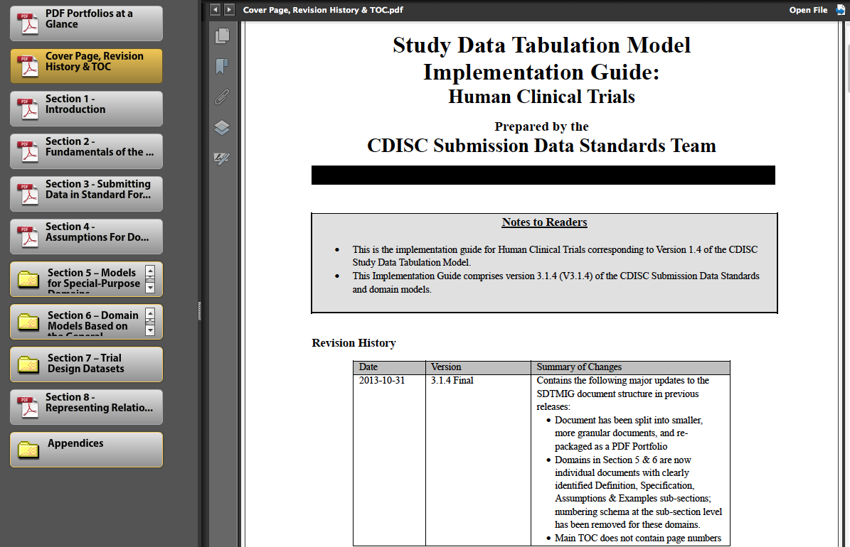
Re-engineering the SDTMIG – v. 3.1.4
New Domains:
  Death Details (DD)
  Exposure as Collected (EC) and EX enhancements
  Healthcare Encounters (HO)
  Immunogenicity domains (IS/SR)
  Microscopic Findings (MI)
  Morphology (MO)
  Procedures (PR)
  Reproductive Details (RD)
  Subject Status (SS)
  Trial Disease Assessments (TD)

Slide 23
Governing the SDTM Product Family
SDTMIG-PGx
Pharmacogenomics
SDTMIG QS
Supplements
SDTMIG-AP
Associated Persons
SEND IG
Non-Clinical
SDTMIG
Human Clinical
SDTMIG-MD
Medical Devices
Study Data Tabulation Model (SDTM)
CDISC Therapeutic Area User Guides

Slide 24
Looking Forward: Products Soon to Come
2013 CDISC Technical Plan – Foundational Standards
Coming Attractions through 2014:
Quarterly Terminology and Periodic QS Supplements
SDTM PGxIG for Pharmacogenomics Data
ADaM IG Update and other documents
Additional CFAST TA UGs
SDTM Device IG v1.1 (Components)
SEND IG v3.1
SDTMIG 3.3 Batch 1 Updates
Protocol Templates, IG and XML Schema
Define-XML and SDS-XML IGs, Validation Rules
CDASH v2.0
BRIDG 4.0 and ISO approval
Healthcare Link UG
SHARE Metadata in Excel, ODM, Define-XML, RDF

Slide 25
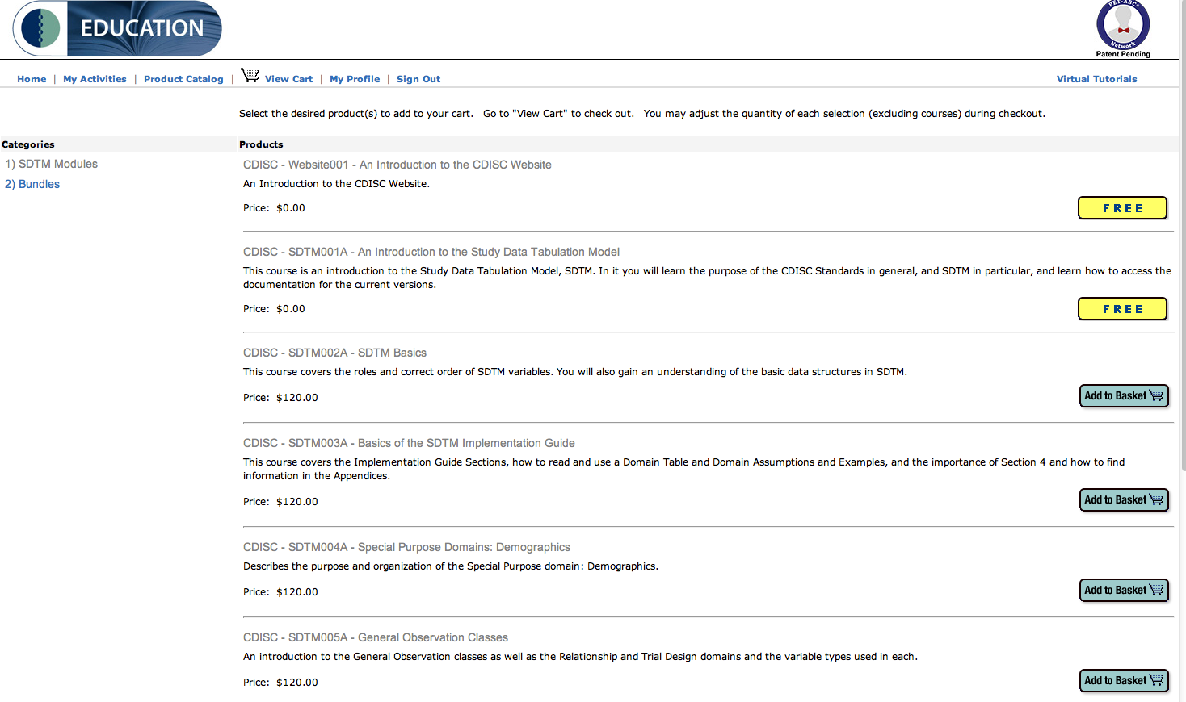
Reaching the World with CDISC Online Education ç

Slide 26

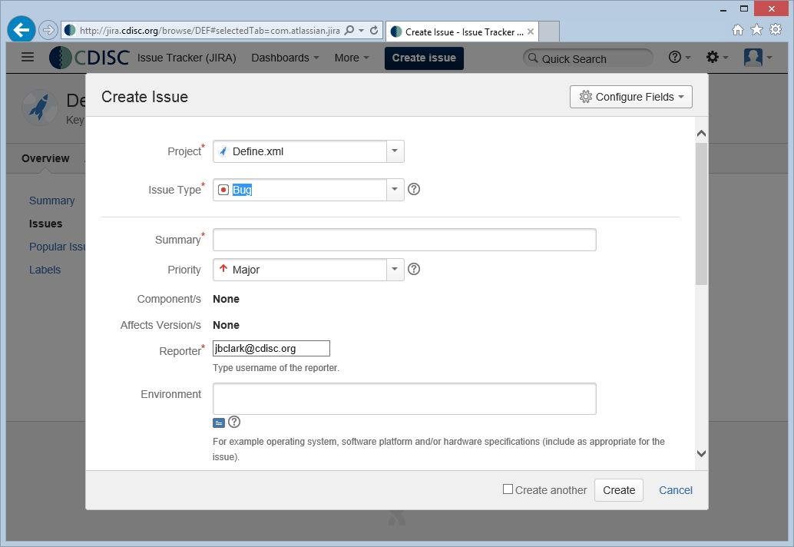
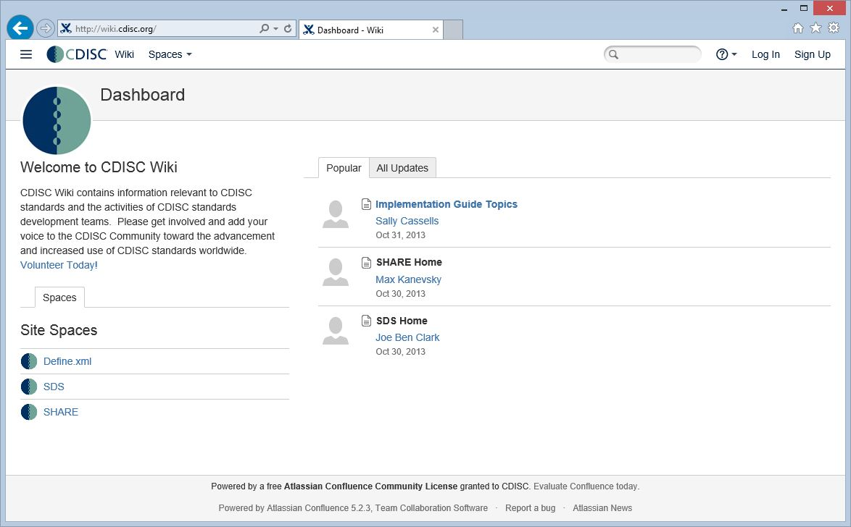
Tools to Make Teams More Productive:
Style Guide, Checklists, Website

Slide 27


Driving with the CDISC Technical Roadmap
Foundational Standards
SDTM v4
Data Exchange Layer
XML, OWL, JSON…
SDS Product Family
CDASH Product Family
SEND
PROTOCOL
Semantic Layer
BRIDG/SHARE
ADAM
XML Technologies
Functional Layer
SDTM, SEND, ADaM, CDASH
Others
Semantics
CDISC Technical Itinerary
Destination 2016
SHARE
Implementation Layer
Therapeutic Area Guides, Healthcare Interoperability Kits
BRIDG
Glossary
Controlled Terminology
Therapeutic Areas
Track 1
Track 2
Track 3
Health Care Interoperability
IHE
ONC/Euro-rec
CRProcess/SHARE
Notes:
Use of ODM as a transition path from SAS XPT is also a way to leverage the CDISC technical roadmap to a next generation set of semantically consistent standards for research, allowing FDA to selectively benefit from new capabilities in an incremental manner over time.

Slide 28
CDISC SHARE Library Contents
Metadata
  CDISC Therapeutic Area and Foundational Standards (Protocol, Trial Design, CDASH, SEND, SDTM, ADaM)
  BRIDG mappings, associations and relationships
  Value Level Metadata
  Definitions and annotations
  Datatypes (ISO 21090 and simple)
  Rules (conformance, implementation)
  Controlled Terminology
Implementation instructions
Links to analysis concepts, healthcare concepts, etc.
http://www.youtube.com/watch?v=gCyVdvgVpY8
28
Notes:
CDISC Metadata standards, extensions to those in the future

Slide 29
SHARE Road Map: Incremental Implementation
R1
Q1 2014
R2
Q4 2014
R3
Q4 2015
R4
Q4 2016
Major Versions: Releases 1 - 4

Slide 30
R1: Machine-Readable Standards
R1
Q1 2014
Initial load of CDISC standards into SHARE
  SDTM 1.2 (IG 3.1.2) and 1.3 (IG 3.1.3)
  CDASH 1.1
  BRIDG 3.2 and ISO21090
  All CDISC Terminologies
  New versions (e.g. SDTM 3.1.4) will be added after the R1 release
Export machine-readable standards (e.g. ODM, Define-XML)
Initial Value Level Metadata
Workflows (e.g. new requests, metadata governance)
Version control & impact analysis
Reporting (e.g. governance metrics)

Slide 31
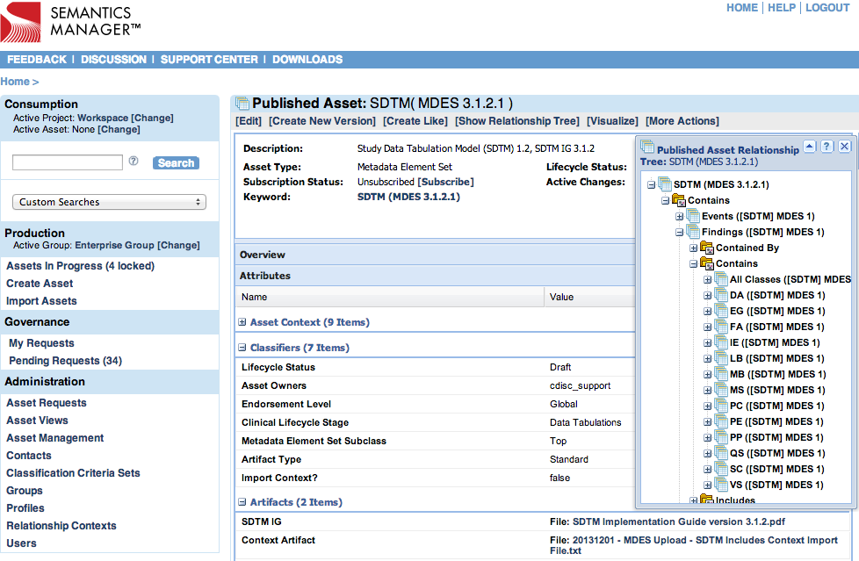
Using SHARE

Slide 32
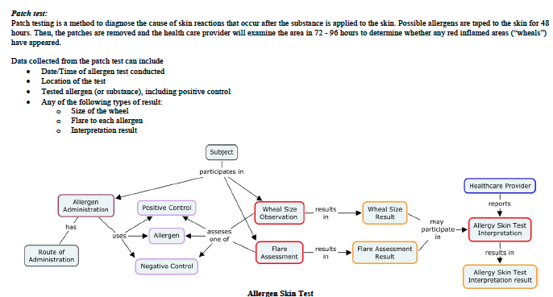

Asthma User Guide Example

Slide 33
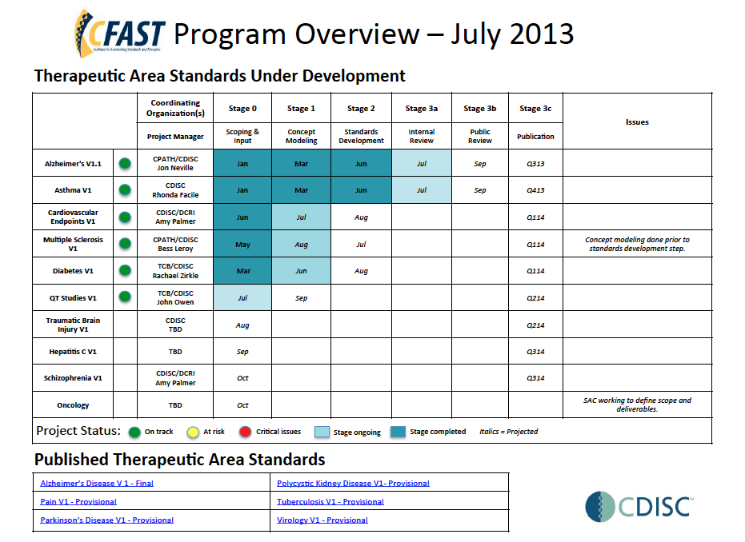

Slide 34

October eNews (new format)
Update on Global Regulatory
Agencies with respect to CDISC
Monthly News
Technical Updates
Success Stories
Press Releases & Blogs
on Hot Topics
Membership Updates
3Cs and User Networks
Events
Educational Courses

Slide 35



Communication is Essential
Website (www.cdisc.org)
You Tube Videos (e.g. SHARE)
eJournal, Success Stories
Press Releases
Announcements
eNewsletter
CDISC Annual Report

Slide 36
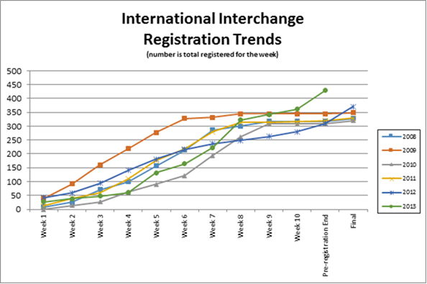
CDISC Europe Interchange 2014
  Paris, France, 7-11 April 2014
450

Slide 37
Questions
?
What lays ahead of CDISC in the next two years?
  Main Activity Drivers
  Main Challenges and opportunities
  Organizational Changes
Where and what will CDISC be in two years?

Slide 38




Main Activity Drivers
Regulatory Requirements
  USA
    Mandatory submission of clinical data in CDISC standard
    Comparative Effectiveness Research using CDISC Therapeutic Area standards
  EU
    EMA Clinical Trials Data Transparency
  Japan
    PMDA Clinical Data Submissions using SDTM, ADaM & Define.xml
  Korea
    KFDA CDISC Pilot submission

Slide 39




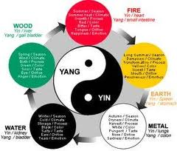
Main Activity Drivers (cont.)
Collaborative Research & Translational Medicine
  US FDA Critical Path Projects:
  CPTR (Critical Path to TB Regimen), CAMD (Coalition Against Major Diseases), …
  EU Innovative Medicine Initiative (IMI) Projects:
  Predict-TB, BioVaccSafe, …
eHealth Development & personalized Medicine
  US Healthcare Reform, EU Digital Agenda, etc.:
  Content-rich, shared Electronic Health Records enabling more personalized treatment and better drug safety
New Users
  Academic Clinical Research,
  Traditional Chinese Medicine
  More users outside the traditional Pharma/CRO community

Slide 40

Main Challenges & Opportunities
Challenges:
  Maintaining Standards
  Consistency
  Facing the Demand
  & Managing Growth
  Funding
  Users Satisfaction
Opportunities
  Becoming THE Regulatory Standard
  Becoming THE Academic Research Standard
  THE Seamless Link between Care & Research

Slide 41

  Maintaining Standards Consistency

Slide 42

  Facing the Demand & Managing Growth
New, increasing demand requires new skills and more manpower
  Knowledge in many different therapeutic areas
  Knowledge of regulatory processes and medical practices in different countries and regions
  Higher staff numbers
  Stronger Management, larger,
  more professionnal organization

Slide 43
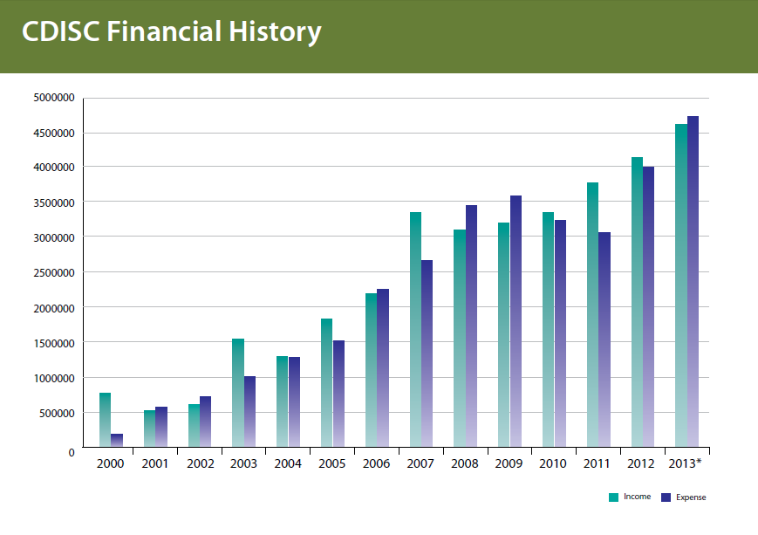
Funding

Slide 44

Users Satisfaction
More different users (Pharma, Regulatory, Academia, Healthcare, US, EU, Asia, etc.)
More different needs
More different skills to satisfy them

Slide 45
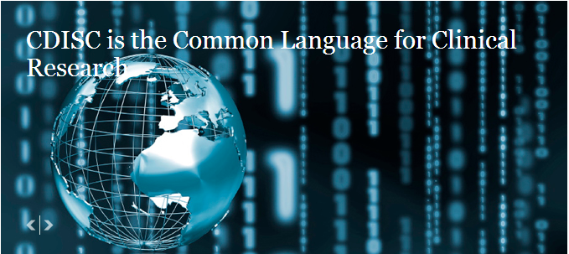
Opportunities
CDISC is already
THE data standard
for Clinical Research!
It is recognized by several major regulatory agencies : it could be used by ALL agencies!
It is being proposed for data transparency & collaborative research: this opens the way for academic recognition!
It is used in several major US, EU and Japanese eHealth projects: the best starting position to become THE seamless link between Care and Research!

Slide 46


Need for Change
S =>XL
CDISC need to become
  Larger
  More diverse and
  more specialized
  Funded for the future

Slide 47
Vision : in 2016, CDISC standards
- are used by the 3 major Drug Regulatory Agencies FDA, EMA, PMDA
- are used by all major drug companies for making their study data public
- are used by major public research institutions in more than 10 different countries
THANK YOU !
pierre-yves.lastic@sanofi.com

