Slide 1
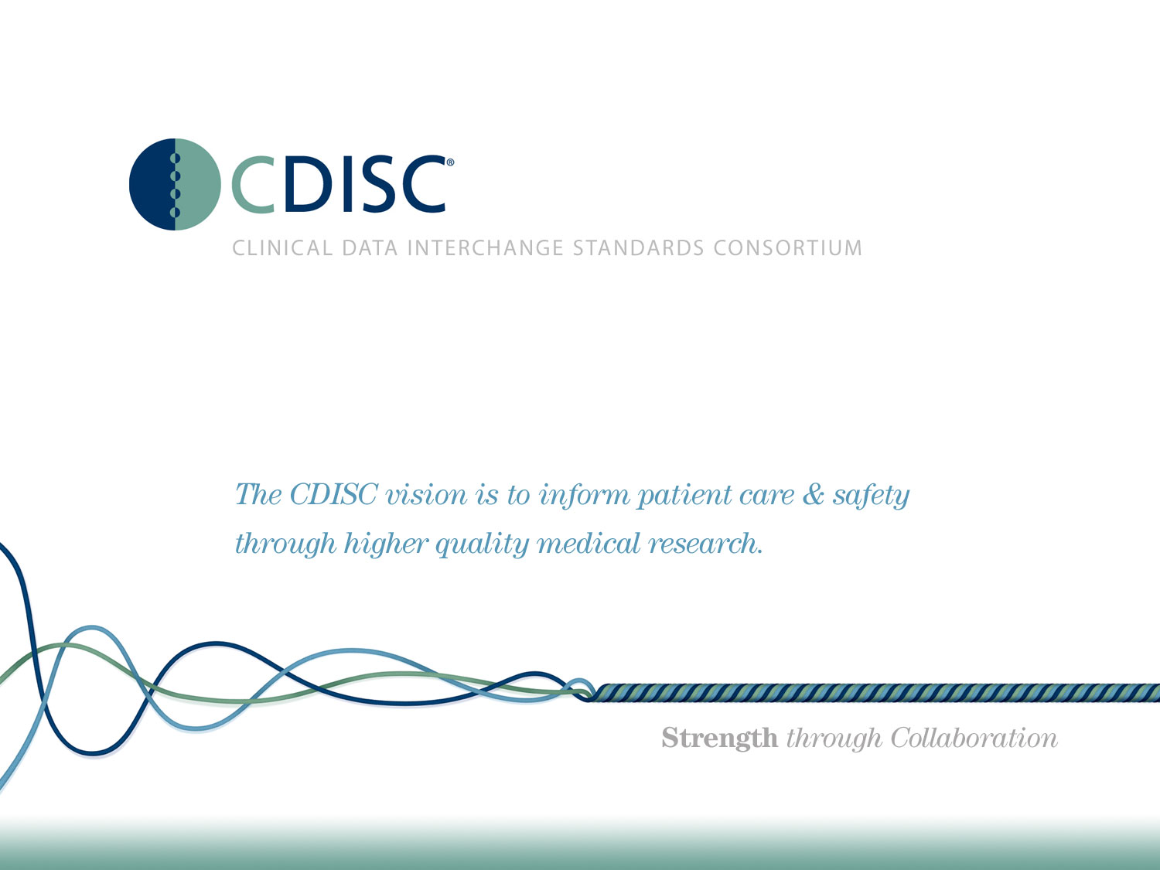

Slide 2
CDISC Italian User Network TC
20 Giugno 2018
Angelo Tinazzi (Cytel)
Silvia Faini (CROS NT)

Slide 3
Last useful webinars
Preparing ADaMDatasets and Related Files for FDA Submission - CDISC Members-Only Mini-Training Series - 14 JUN 2018
Categorization of Data in ADaM - CDISC Members-Only Mini-Training Series - 28 Nov 2017

Slide 4
Upcoming webinars
CDISC Public Webinar - CDISC Newcomers Informational Webinar - THU, 28 JUN 2018 - Peter Van Reusel, Chief Standards Officer, CDISC → During the last EU CDISC Interchange a Newcomers track was introduced, a new successful track for CDISC newbies.
CDISC Members-Only Mini-Training Series - ODM v2 Overview - TUE, 31 JUL 2018 - Sam Hume, DSc., VP, Data Science, CDISC

Slide 5
Public Trainings
Link
Leiden, The Netherlands 25 - 29 Jun 2018
  ADaM Primer, ADaM Theory and Application, CDASH Implementation , Define-XML, SDTM Theory and Application
Paris, France 10 - 14 Sep 2018
  ADaM Primer, ADaM Theory and Application, CDASH Implementation , Controlled Terminology, Define-XML, SDTM Theory and Application
Copenhagen, Denmark 8 - 16 Nov 2018
  ADaM Primer, ADaM Theory and Application, Define-XML, SDTM Theory and Application , SEND Implementation

Slide 6
EU CDISC Interchange 1/7
Berlin, 25-26 April 2018
From the regulatory session:
  Dr. Lin, from FDA, explained the new validation process established at the end of 2017 mentioning the development of Study Data Standardization Plan Completion Guidelines (https://www.phuse.eu/css-deliverables) by a PhUSE working group.
  Dr. Ando, from PMDA, gave feedback on the most frequent issues in eSubmission and underlined that Analysis Results Metadata (ARM) is recommended.
  Dr. Cave of the EMA presented the challenges of submitting a marketing authorization and how to speed up the process. She pointed out that even if a Common Data Model is one of the “enablers” of a quicker process, the EMA still does not require CDISC standards.

Slide 7
EU CDISC Interchange 2/7
Berlin, 25-26 April 2018
Global Submission Experience: interesting case studies from pharma companies.
  Basically today, CDISC submission packages must be prepared separately for the FDA and PMDA because the requirements differ between regulatory agencies. The benefit of using CDISC standards was not under discussion, but handling a global submission needs a good plan for all aspects including: submission deliverables, regulatory agencies’ recommendations, meetings with the authorities.
ADaM session
  The unveiled secret of ADaM - Tinazzi-Faini
  ADaM 2018: What's New and What's Coming, Monika Kawohl
  Introducing The ADaM Implementation Guide v1.2, Terek Peterson

Slide 8
EU CDISC Interchange 3/7
Berlin, 25-26 April 2018
Process implementation and optimization session
  Another noteworthy “Cost Benefit Analysis of Using Standards” where the costs and benefits achieved with different levels of standardization were shown. It was a thought-provoking presentation that showed the significant impact in setting up a trial from no standardization to some level of standardization and that the time for setting up a trial from a high level of standardization to a fully standardized trial rapidly decreases. Once more, CDISC standards implementation is a highly recommended choice.

Slide 9
EU CDISC Interchange 4/7
Berlin, 25-26 April 2018
DefineXML session, all three presentations were valuable:
  a real life experience in big pharma for define.xml version 2.0 creation and related processes,
  one about some good tips on the usage of Value Level Metadata (VLM)
  and the most technical “Define-XML – What You See Isn’t Always What You Get” about stylesheet modification/improvement.

Slide 10
EU CDISC Interchange 5/7
Berlin, 25-26 April 2018
Challenges and doing better session
  Collection of Race and Ethnicity Data, Pharmacokinetic Parameters (PP) Domain, Standardized Units, Event Adjudication Results, Associated Person (AP) Domains were all discussed as “Top 5 Challenges for Complying with CDISC Standards”.
  The task of creating SDTM compliant databases was discussed also in presentation “SDTM: It is Not all Black and White”, where the discrepancies between SDTM/SDTM IG and Pinnacle 21 or FDA highlighted the issues to be handled at programming level. What solution was recommended? Agreeing a uniform approach during and between studies.

Slide 11
EU CDISC Interchange 6/7
Berlin, 25-26 April 2018
Poster Session
  Mind the gap: Pinnacle 21 Community version vs Pinnacle 21 Enterprise version, Angelo Tinazzi
  → PDF copy can be provided if interested

Slide 12
EU CDISC Interchange 7/7
Berlin, 25-26 April 2018
Key Conference Takeaways
  Sharing knowledge and experience allows for a better application of standards
  From a technical point of view CDISC standards implementation can continue to improve
  If the FDA and PMDA are the end users, then their requirements must be the basis of our plan
  PhUSE working groups are important in supporting CDISC standards implementation

Slide 13
PhUSE US Connect 1/3
Raleigh, 3-6 June 2018 https://www.phuse.eu/raleigh-presentations
Data Standards and Governance
  Making PK Analysis Easier: The New ADaM Data Standard ADNCA
  Comparing and Contrasting Differences between the PhUSE SDSP and CBER Checklist
  Best Practices for Explaining Validation Results in the Study Data Reviewer's Guide

Slide 14
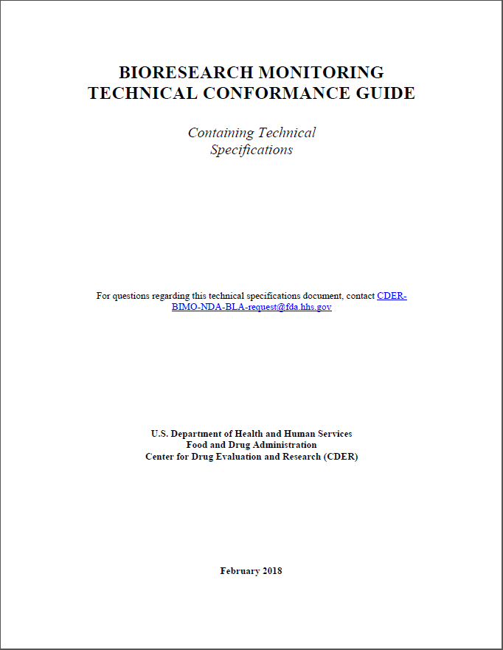
PhUSE US Connect 2/3
Raleigh, 3-6 June 2018 https://www.phuse.eu/raleigh-presentations
Regulatory
  BIMO Listings - Check That Off Your NDA To-Do List
  Confusing Data Validation Rules Explained

Slide 15
PhUSE US Connect 3/3
Raleigh, 3-6 June 2018 https://www.phuse.eu/raleigh-presentations
Standards Implementations
  Automated CRF Annotations – A shift from Manual
  ADaM Intermediate Dataset: How to Improve Your Analysis Traceability

Slide 16
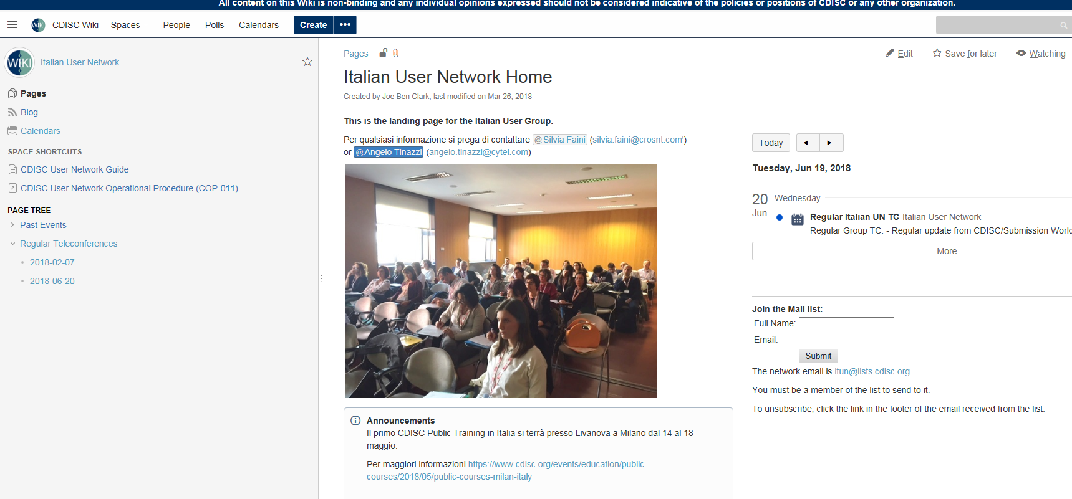
New Italian CDISC UN Wiki Page
https://wiki.cdisc.org/display/ITAUG/Italian+User+Network+Home
TC material
Slides presented at Italian CDISC UN Meeting
Announcements

