Slide 1


Slide 2
Riepilogo e Spazio Q&A
CDISC Italian User Network Day
27 Ottobre 2017
Angelo Tinazzi (Cytel) - Silvia Faini (CROS NT)
E3C members

Slide 3
Agenda
ADaM key list
Bad & Good ADaM
....More.....
Spazio Q&A

Slide 4
ADaM Key List

Slide 5
ADaM Key List
ADaM Key Principles
Traceability
Be analysis-ready
Have metadata
Be usable with common available tool

Slide 6
ADaM Key List
ADaM is not ADaM without define.xml
ADSL is the only mandatory ADaM datasets, all the rest is analysis driven i.e. no need to create ADIE (inclusion/exclusion criteria), no need to create ADMH if there is no specific MH analysis
Create a second by-subject ADaM if ADSL is not enough
  i.e. do not try to “squeeze” all baseline variables in ADSL. For example create something called ADBASE
ADxxx if it’s ADaM compliant ADxxx otherwise

Slide 7
ADaM Key List
Respect naming conventions for standards variables or use ADaM fragments when deriving new variables
Fragment | Meaning
CHG | Change
BL | Baseline
FU | Follow-up
OT | On treatment
RU | Run-in
SC | Screening
TA | Taper
TI | Titer
WA | Washout
Format:
Sponsor defined content fragment + Period (i.e., xx) + ADaM timing fragment + Date/Time Suffix or Grouping Suffix
Examples:
SBP01BL
WEIGHTSC
WT01SC
RUSDT
WA01SDT
BMIBLGR1

Slide 8
ADaM Key List
ADaM can be derived from the following source
  one SDTM dataset
  multiple SDTM datasets
  one ADaM dataset
  multiple ADaM datasets
  a combination of SDTM and ADaM datasets
The only allowed non-SDTM/non-ADaM datasets are look-up datasets
  i.e. a dataset containing SMQ mapping

Slide 9
ADaM Key List
Traceability (cont)
Hypertension event (HYPEREVT) is defined as the earliest occurrence of hospital admission, DBP > 90 or SBP >140

Slide 10
ADaM Key List
Traceability
ADaM is always derived from SDTM
No need to copy over all source datasets records from (but for ADAE/OCCDS.......)
  i.e. not all laboratory parameters needs to be mapped to ADLB if they are not all analyzed
  i.e. if Urinalysis are only described in listings
However make sure you copy all relevant variables to make the ADaM analysis-ready
  i.e. study population flags and subgroups/covariates from ADSL
It has to be traceable back to source
  make use of --SEQ i.e. AESEQ when deriving ADAE
  make use of SRCDOM/SRCVAR/SRCSEQ when an ADaM dataset make use of several datasets as source

Slide 11
ADaM Key List
Traceability (cont)
Make use of flags to specify which records are not used for which analysis
  i.e. ANLxxFL
Use of Intermediate ADaM Datasets
Validate against SDTM
  in the P21 validation include DM, EX and AE

Slide 12
ADaM Key List
Derivations/Imputations
If an SDTM variable appears in an ADaM dataset, then ALL attributes must remain the same
“same name, same meaning, same values” with few exceptions i.e. DS.DSDECOD
  Variable name, label, format, content
  With the exception that lengths can be shortened to the maximum length needed for the variable
Imputations for missing information not in SDTM but in ADaM. Be transparent do not override original variables and make use of
  date –DTFL
  new record i.e. when a missing time-point is derived from other time-points, for example LOCF or WOCF methods

Slide 13
ADaM Key List
BDS – The six « good » rules
All rules except one require the creation of new records
Rule 1: A parameter-invariant function of AVAL and BASE on the same row that does not involve a transform of BASE should be added as a new column.
Rule 2: A transformation of AVAL that does not meet the conditions of Rule 1 should be added as a new parameter, and AVAL should contain the transformed value.
Rule 3: A function of one or more rows within the same parameter for the purpose of creating an analysis timepoint should be added as a new row for the same parameter.
Rule 4: A function of multiple rows within a parameter should be added as a new parameter.
Rule 5: A function of more than one parameter should be added as a new parameter.
Rule 6: When there is more than one definition of baseline, each additional definition of baseline requires the creation of its own set of rows.

Slide 14
Bad & Good ADaM

Slide 15
Bad and Good
PARCATy can be not used as PARAM Qualifier
Misuse of flag and criteria variables
BDS Deriving Rows or adding columns

Slide 16
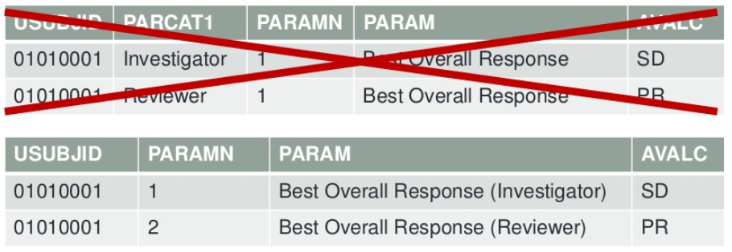
Bad & Good ADaM
PARCATy can be not used as PARAM Qualifier
Provisional PARQUAL

Slide 17
Bad & Good ADaM
BDS Deriving Rows or adding columns
Section 4.2 of IG illustrates the 6 rules for the creation of rows vs columns
All rules except one require the creation of new records
  «A parameter invariant function of AVAL and BASE on the same row that does not involve a transformation of BASE should be added as a new column»
  Adding a new column is restricted to available BDS variables
e.g. CHG=AVAL-BASE
Designing and Tuning ADaM Datasets; PharmaSUG 2013
Common Misunderstanding about ADaM Implementation; PharmaSUG 2012
Adding new Rows in the ADaM Basic Data Structure. When and How; SAS Global Forum 2013
Derived observations and associated variables in ADaM datasets; PharmaSUG 2013

Slide 18
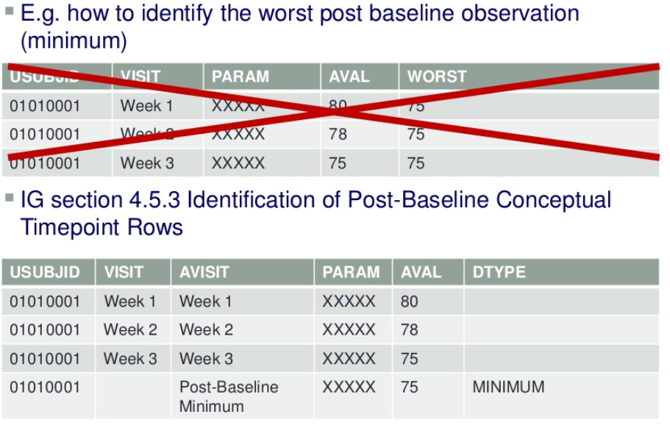
Bad & Good ADaM
BDS Deriving Rows or adding column (Cont)

Slide 19
….More….

Slide 20
Analysis Datasets vs ADaM
Date Imputation
Data Imputation
AVAL vs AVALC
Analysis Ready
Use of Analysis Flags

Slide 21
….More….
Analysis Datasets vs ADaM
Analysis Datasets
ADaM Datasets
Non-ADaM Analysis Datasets
ADSL
BDS
OCCDS
OTHER
ADSL
ADLB*
ADAE*
ADMV*
PATP**
ADEFF*
AXEVT**
ADTTE*
Datasets not in one of the defined ADaM structures can still be ADaM datasets
They must follow the ADaM Fundamental Principles and naming conventions
* Example name of ADaM dataset
** Example name of dataset developed without following ADaM fundamental principles

Slide 22
….More….
Date Imputation
A subject can’t remember the day of a knee injury
SDTM MH.MHSTDTC = “2013-05”
ADaM Imputation, per SAP specifications:
  ADMH.ASTDT = May 1, 2013 (numeric date) and ASTDTF = “D”
A subject can’t remember the month of a knee injury
SDTM MH. MHSTDTC = “2013---15”
ADaM Imputation, per SAP specifications:
  ADMH. ASTDT = January 1, 2013 and ASTDTF = “M”
A subject can’t remember the month or day …
SDTM MH. MHSTDTC = “2013”
ADaM Imputation, per SAP specifications:
  ADMH. ASTDT = January 1, 2013 and ASTDTF = “M”

Slide 23
….More….
Data Imputation
AEREL | RELGR1
NOT RELATED | Not Related
NOT RELATED | Not Related
NOT RELATED | Not Related
POSSIBLY RELATED | Related
PROBABLY RELATED | Related
PROBABLY RELATED | Related
DEFINITELY RELATED | Related
DEFINITELY RELATED | Related
 | Related
DEFINITELY RELATED | Related
Original value of AEREL copied from SDTM
New variable RELGR1 created to group into
  Related
  Not Related
Follows the ADaM general naming conventions, like BDS
Mixed case content makes table production easier

Slide 24
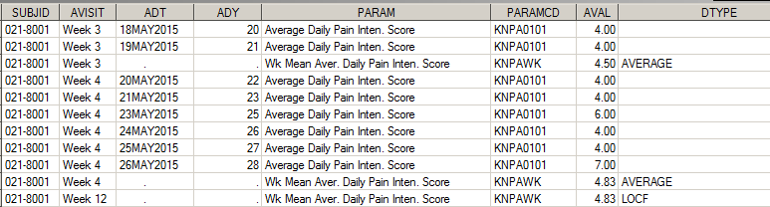
….More….
Data Imputation (cont)
Derivation of study endpoint when early drop-out
Primary endpoint was «Weekly Mean Daily Pain Intensity Score at 12 weeks »
For early drop-out prior to week-12 the Last Observation Carry forward imputation method was used

Slide 25
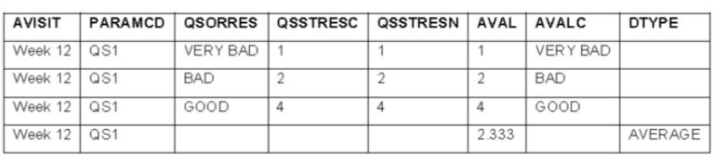
….More….
AVAL vs AVALC
When both AVAL and AVALC are non-missing on any record of a parameter, then AVALC must be 1:1 with AVAL on all records for that parameter

Slide 26
….More….
Analysis Ready
As per ADaM IG “Analysis datasets have a structure and content that allows statistical analysis to be performed with minimal programming”
“Analysis ready" - Considerations, Implementations, and Real World Applications; PharmaSUG 2012
Laboratory Analysis Dataset (ADLB): a real-life experience; CDISC Europe Interchange 2013
Linkedin ADaM Group Discussion http://www.linkedin.com/groupItem?view=&gid=3092582&type=member&item=245409684&qid=379c7b1b-df19-4772-acf1-3d279ef5b245&trk=group_most_popular-0-b-ttl&goback=%2Egmp_3092582&_mSplash=1
One-proc-away
Output programs should only focus on selecting (and extracting) the statistical models and «eventually» improving the standard statistical outputs template
It is preferable to have complex derivation in the derived (and fully validated) analysis datasets

Slide 27
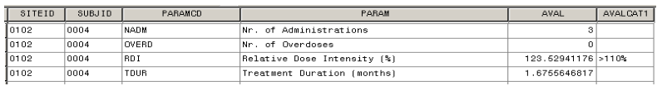
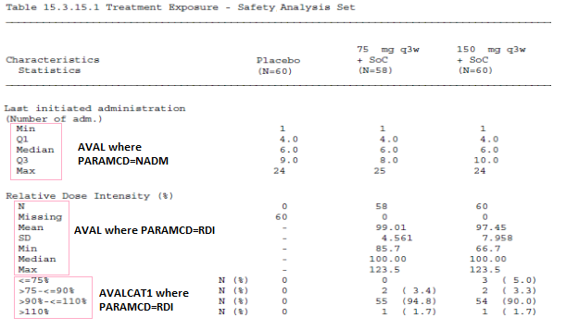
….More….
Analysis Ready (cont)
Complex derivations for exposure
ADEXSUM derived from ADEX

Slide 28
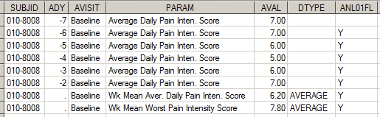
….More….
Use of Analysis Flag
Derivation of Weekly Mean Daily Pain Intensity Score by excluding observations occurred during the wash-out period

Slide 29
Spazio Q&A

