Slide 1

ADaM in Oncology
5th Italian CDISC User Network
Milano – 27/10/2017
Angelo Tinazzi
Cytel Inc.
Geneva – Switzerland
angelo.tinazzi@cytel.com

Slide 2
Agenda
What’s special in oncology
Best Overall Tumor Response (BOR) & Progression Free Survival (PFS) Definitions
Best Overall Tumor Response SDTM Representation
Analysis and ADaM Preparation

Slide 3
What’s special in Oncology

Slide 4
What’s special in oncology….some examples
Efficacy Endpoint i.e. tumor response
Composite time to event endpoints
i.e. Progression Free Survival
Derivation of NCI-CTCAE Grade for Laboratory Data
Exposure i.e chemotherapy
  Concept of Cyles and count
  Dose Intensity (and relative dose-intensity)
  Count of Modifications, delyas, reductions

Slide 5
Best Overall Tumor Response (BOR) & Progression Free Survival (PFS)
Definitions

Slide 6
BOR & PFS - Definitions
Assessing tumor response in solid tumors
Change in Tumor Mass (lesions) compared to baseline (i.e. prior to start the treatment or randomization)
  Shrinkage (Response)
  Growth (Progression)
Instrumental Evaluation / Radiological Evaluation (e.g. CT-Scan)
Periodic and Regular Assessment

Slide 7
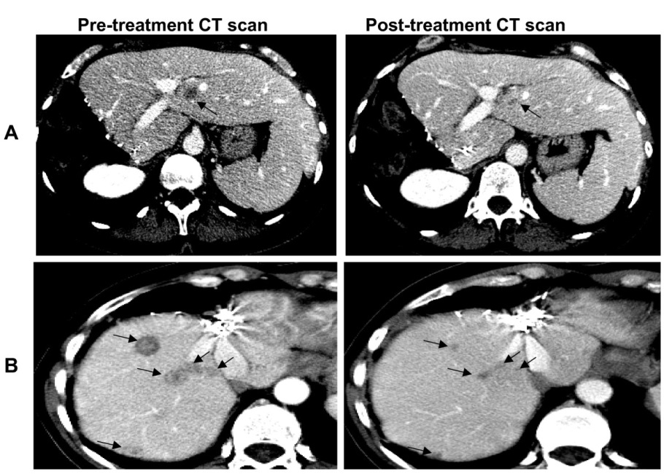
BOR & PFS - Definitions
Assessing tumor response in solid tumors (cont)
Source: Gonçalves et al. BMC Cancer 2008 8:169 doi:10.1186/1471-2407-8-169

Slide 8
BOR & PFS - Definitions
Assessing tumor response in solid tumors (cont)
Standard set of criteria to assess tumor response (RECIST)
Measurable (Target) vs non-Measurable lesions (non-Target)
Response to Treatment at each regular assessment defined as (« objective criteria »)
  CR – Complete Response
    disappearance of all lesions and no new lesions
  PR – Partial Response
    decrease of 30% change from BL and no PD in non-target lesions no new lesions
  SD – Stable Response
    no PD in non-target lesions no new lesions
  PD – Progressive Disease
    increase of 20% change from BL or PD in non-target lesions or new lesions
  NE – Not Evaluable

Slide 9
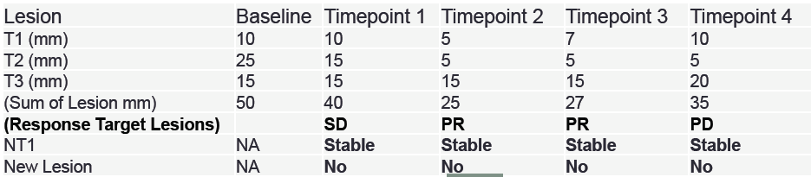


BOR & PFS - Definitions
Assessing tumor response in solid tumors (cont)
The Best Overall Response (BOR) is the best tumor response assessed since the subject is on-study (on-treatment)
- In some studies a confirmation of the response for CR and PR might be required
Tumor Response - SD PR PR PD
% Change from BL - -20% -46% -50% -30%

Slide 10
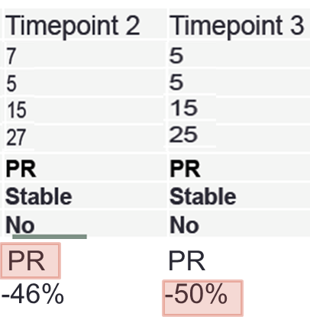
BOR & PFS - Definitions
Assessing tumor response in solid tumors (cont)
Partial Response (PR) at timepoint 2 is the best overall response observed and it is confirmed by the assessment at timepoint 3
Timepoint 3 had the best change from baseline (decrease/shrinkage)

Slide 11
BOR & PFS - Definitions
Other endpoints related to BOR
Objective Response Rate (ORR) or Overall Response
Proportion of patients with BOR either CR or PR
Duration of Response (DOR)
Time from first assessment of CR or PR until date of
progression or last tumor assessment. Applicable to only patient with BOR either CR or PR (ORR)
Disease Control Rate
Proportion of patients with BOR either CR or PR or SD
Clinical Benefit Response Rate
Proportion of patients with BOR either CR or PR or Durable SD (i.e. observed not before 6 weeks from baseline)

Slide 12
BOR & PFS - Definitions
Other endpoints related to BOR (cont)
Progression Free Survival (PFS)
Time from randomization/1st treatment to first Progression or death whichever come first (event)
Time from randomization/1st treatment to last radiological tumor response (censor)

Slide 13
BOR & PFS - Definitions
Progression Free Survival (PFS)
Off TRT
Death /
Alive
RAN
SD
SD
PR
CR
PD
ORR
PFS
DOR
OS
Overall Survival (time to death or last seen alive)

Slide 14
BOR & PFS - Definitions
Other derivation options to consider
The assessment of the response is usually done by the investigator. In some studies an independent assessment might be needed (adjudication processs)
A radiological tumor response assessment might be not considered after the occurrence of an « event » i.e. start of new treatment in the BOR and PFS derivation
A death occurred after ‘xx’ weeks from last tumor response assessment might be censored and not considered as an event in the PFS derivation

Slide 15
BOR & PFS - Definitions
Progression Free Survival (PFS) with additional censoring
Off TRT
Death /
Alive
RAN
SD
SD
PR
CR
PD
New Trtt
ORR
PFS censored at start of new Treatment
PFS
DOR
OS
Overall Survival (time to death or last seen alive)

Slide 16
Best Overall Tumor Response
SDTM representation

Slide 17
Best Overall Tumor Response - SDTM
SDTM Standard Oncology Domains – TU/TR/RS
Tumor Identification
Unique identification of tumors for that patient
Tumor Results
Quantitative measurements and/or qualitative
assessments of the tumors identified in the TU
Disease Response
Clinical response evaluations determined from the TR
data and other SDTM domains
TU
TR
RS

Slide 18
Best Overall Tumor Response - SDTM
SDTM Standard Oncology Domains – TU/TR/RS (cont)
TR at BASELINE
USUBJID | TRGRID | TRLINKID | TRTESTCD | TRORRES | VISIT | TRDTC
01-001001 | Target | TR01 | LDIAM | 10 | BASELINE | 07JAN13
01-001001 | Target | TR02 | LDIAM | 25 | BASELINE | 07JAN13
01-001001 | Target | TR01 | LDIAM | 15 | BASELINE | 07JAN13
01-001001 | Non-Target | NT01 | TUMSTATE | PRESENT | BASELINE | 07JAN13

Slide 19
Best Overall Tumor Response - SDTM
SDTM Standard Oncology Domains – TU/TR/RS (cont)
TR at TIMEPOINT 2 (BOR)
USUBJID | TRGRID | TRLINKID | TRTESTCD | TRORRES | VISIT | TRDTC
01-001001 | Target | TR01 | LDIAM | 7 | TIMEPOINT 1 | 12MAY13
01-001001 | Target | TR02 | LDIAM | 5 | TIMEPOINT 1 | 12MAY13
01-001001 | Target | TR01 | LDIAM | 15 | TIMEPOINT 1 | 12MAY13
01-001001 | Non-Target | NT01 | TUMSTATE | PRESENT | TIMEPOINT 1 | 12MAY13

Slide 20
Best Overall Tumor Response - SDTM
SDTM Standard Oncology Domains – TU/TR/RS (cont)
Investigator vs Independent Assessment
Different « opinion » on TR03 lesion size and therefore response might be different i.e. PR vs PD in the above example
USUBJID | TRGRID | TRLINKID | TRTESTCD | TRORRES | TREVAL | VISIT
01-001001 | Target | TR01 | LDIAM | 7 | INVESTIGATOR | TIMEPOINT 2
01-001001 | Target | TR02 | LDIAM | 5 | INVESTIGATOR | TIMEPOINT 2
01-001001 | Target | TR03 | LDIAM | 15 | INVESTIGATOR | TIMEPOINT 2
01-001001 | Target | TR01 | LDIAM | 7 | INDEPENDENT ASSESSOR | TIMEPOINT 2
01-001001 | Target | TR02 | LDIAM | 5 | INDEPENDENT ASSESSOR | TIMEPOINT 2
01-001001 | Target | TR03 | LDIAM | 60 | INDEPENDENT ASSESSOR | TIMEPOINT 2

Slide 21
Best Overall Tumor Response - SDTM
SDTM Standard Oncology Domains – TU/TR/RS (cont)
RS at TIMEPOINT 1
USUBJID | RSTESCD | RSTEST | RSCAT | RSORRES | VISIT | RSDTC
01-001001 | TRGRESP | Target Response | RECIST 1.1 | SD | TIMEPOINT 1 | 11MAR13
01-001001 | TRGRESP | Non-target Response | RECIST 1.1 | NonCR/NonPD | TIMEPOINT 1 | 11MAR13
01-001001 | NEWLPROG | New Lesion Progression | RECIST 1.1 | N | TIMEPOINT 1 | 11MAR13
01-001001 | OVRLRESP | Overall Response | RECIST 1.1 | SD | TIMEPOINT 1 | 11MAR13
Tumor Response - SD PR PR PD
% Change from BL - -20% -46% -50% -30%

Slide 22
Best Overall Tumor Response - SDTM
SDTM Standard Oncology Domains – TU/TR/RS (cont)
RS at TIMEPOINT 2 (BOR)
USUBJID | RSTESCD | RSTEST | RSCAT | RSORRES | VISIT | RSDTC
01-001001 | .... | .... | .... | .... | TIMEPOINT 1 | 11MAR13
01-001001 | OVRLRESP | Overall Response | RECIST 1.1 | PR | TIMEPOINT 1 | 11MAR13
01-001001 | TRGRESP | Target Response | RECIST 1.1 | SD | TIMEPOINT 2 | 12MAY13
01-001001 | TRGRESP | Non-target Response | RECIST 1.1 | NonCR/NonPD | TIMEPOINT 2 | 12MAY13
01-001001 | NEWLPROG | New Lesion Progression | RECIST 1.1 | N | TIMEPOINT 2 | 12MAY13
01-001001 | OVRLRESP | Overall Response | RECIST 1.1 | PR | TIMEPOINT 2 | 12MAY13

Slide 23
Analysis and ADaM Preparation

Slide 24
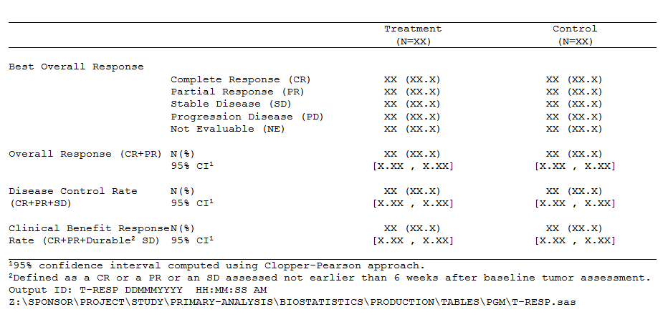
Analysis & ADaM Preparation
How is it usually analyzed/reported (summary table)?
Table 1.01 Summary of Best Overall Tumor Response by the <Investigator or Central Imaging center> (ITT Population)

Slide 25
Analysis & ADaM Preparation
How is it usually analyzed/reported (summary table)?
Which derived information we need to create (derived)
Identify « evaluable » Tumor Response
Identifiy Confirmed Tumor Responses
Identify and create Best Overall Response
Derive addition BOR endpoints
It should be fully traceable i.e. we should keep all tumor responses from SDTM.RS

Slide 26
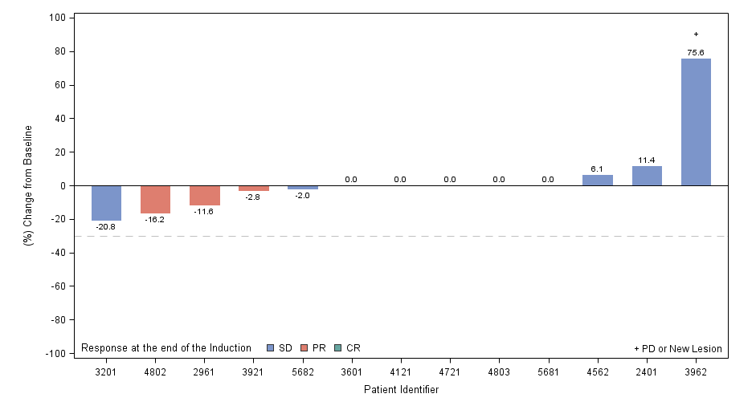
Analysis & ADaM Preparation
How is it usually analyzed/reported (figure)?
Figure 1.01 Best Tumor Shrinkage (ITT Population)

Slide 27
Analysis & ADaM Preparation
How is it usually analyzed/reported (figure)?
Figure 1.01 Best Tumor Shrinkage (ITT Population)
Calculate sum of target lesions at each assessment
Calculate absolute change and % change from baseline
Identify best change from baseline
Flag time-point where a PD occurred

Slide 28
Analysis & ADaM Preparation
Planning the ADaM derivation
Dataset | Description | Class | Structure | Purpose | Keys | Location | Documentation
ADEVENT | Events AD | BASIC DATA STRUCTURE | One record per subject per assessor per parameter per time-point | Analysis | STUDYID, USUBJID, PARQUAL, PARAMCD, ASTDT | adevent.xpt | See referenced dataset creation program adevent.sas
ADRESP | Best Overall Response AD | BASIC DATA STRUCTURE | One record per subject per assessor per parameter | Analysis | STUDYID, USUBJID, PARQUAL, PARAMCD | adresp.xpt | See referenced dataset creation program adresp.sas
ADTUMD | Tumor Diameter AD | BASIC DATA STRUCTURE | One record per subject per assessor per parameter per time-point | Analysis | STUDYID, USUBJID, PARQUAL, PARAMCD, AVISITN | adtumd.xpt | See referenced dataset creation program adtumd.sas
ADTTEPFS | Progression Free Survival TTE AD | BASIC DATA STRUCTURE | One record per subject parameter per time-point | Analysis | STUDYID, USUBJID, PARAMCD | adttepfs.xpt | See referenced dataset creation program adttepfs.sas

Slide 29
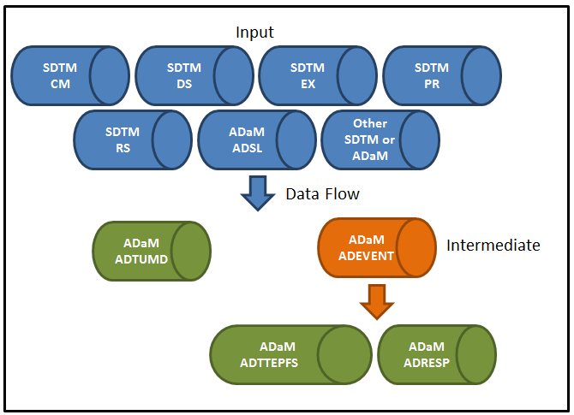
Analysis & ADaM Preparation
Planning the ADaM derivation

Slide 30
Analysis & ADaM Preparation
Intermediate Dataset
An intermediate dataset is one that is created as a step towards the creation of a final analysis dataset
Intermediate datasets usually do not directly support statistical summaries
When might an interim dataset be needed?
  Complex derivations
  Multiple input SDTM domains with complex relationships
  A large and cumbersome interim dataset kept for traceability
TAUGs include examples of intermediate datasets that are BDS or ADaM other class datasets

Slide 31
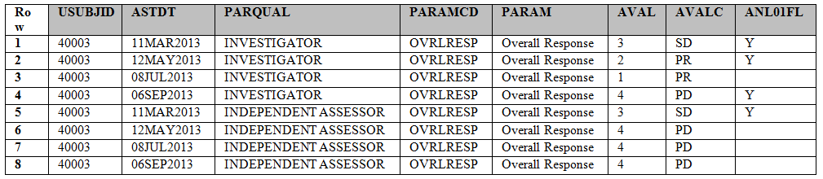
Analysis & ADaM Preparation
ADEVENT (Intermediate Dataset)
Rows nr 2 shows an example where the ‘Partial Response’ tumor response assessed the 12MAY2013 is confirmed (ANL01FL=Y) by the next assessment when assessed by the investigator (row nr 3)
By default a PD is confirmed

Slide 32
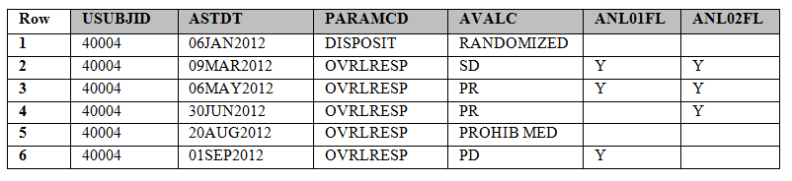
Analysis & ADaM Preparation
ADEVENT (Intermediate Dataset) - cont
ANL02FL identify tumor assessments “eligible” for the derivation of PFS “sensitivity” analysis where assessment occurred after “events” such as start of “prohibited“ medications are not considered
Row nr. 6 shows a PD occurred after prohibited medications that will be not considered in the derivation of PFS that will be censored at last evaluable tumor assessment (30JUN2012)

Slide 33
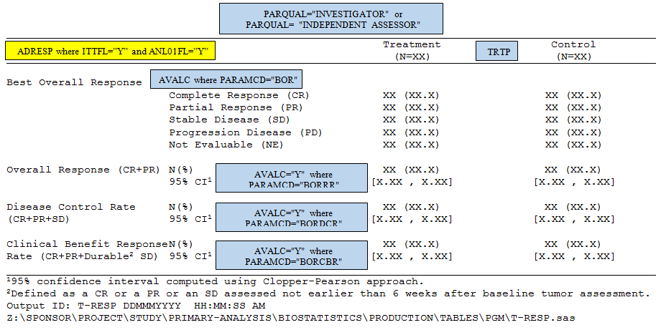
Analysis & ADaM Preparation
Planning the ADaM derivation - ADRESP

Slide 34
Analysis & ADaM Preparation
Planning the ADaM derivation – ADRESP (cont)
DISPLAY IDENTIFIER | Table 1.01
DISPLAY NAME | Summary of Best Overall Tumor Response by the <Investigator or Central Imaging center> (ITT Population)
RESULT IDENTIFIER | Analysis of Best Overall Tumor Response
PARAM | Best Overall Response Response Rate Disease Control Rate Clinical Benefit Response Rate
PARAMCD | BOR BORRR BORDCR BORCBR
ANALYSIS VARIABLE | AVALC. When PARAMCD=”BOR” values of VALUEC have to be presented in the order indicated by AVAL
REASON | Specified in SAP
DATASET | ADRESP
SELECTION CRITERIA | ADRESP where ITTFL=’Y’ and PARQUAL=”INVESTIGATOR” ¦ “INDEPENDENT ASSESSOR”
DOCUMENTATION | Summary of Best Overall Tumor Response. N represents the number of subjects in the ITT population
PROGRAMMING STATEMENTS | SAS programming statement for the estimation of the 95% C.I. PROC FREQ Data = ADRESP (Where = (TRT01P = “EXP” and PARAMCD=‘<…>’); Tables AVALC / Binomial (ac wilson exact) alpha = .05 Missing; Ods Output BinomialCLs = CP1; RUN;

Slide 35
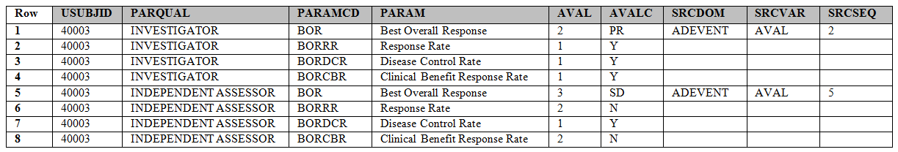
Analysis & ADaM Preparation
ADRESP
Rows nr 1 and 5 are “copied” from ADVENT i.e. AVAL/AVALC where Min(AVAL) by Subject
Rows nr 2, 3, 4, 6, 7 and 8 are derived from rows nr 1 and 2

Slide 36
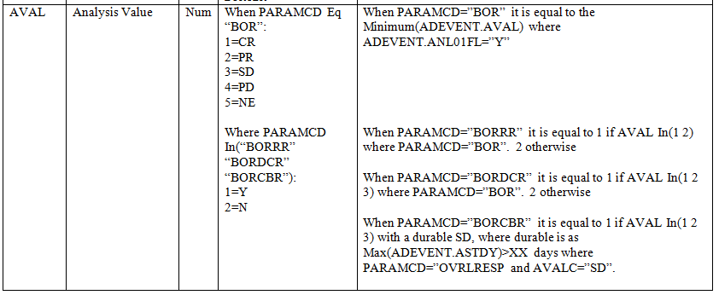
Analysis & ADaM Preparation
ADRESP (cont) – Describing the derivation methods

Slide 37
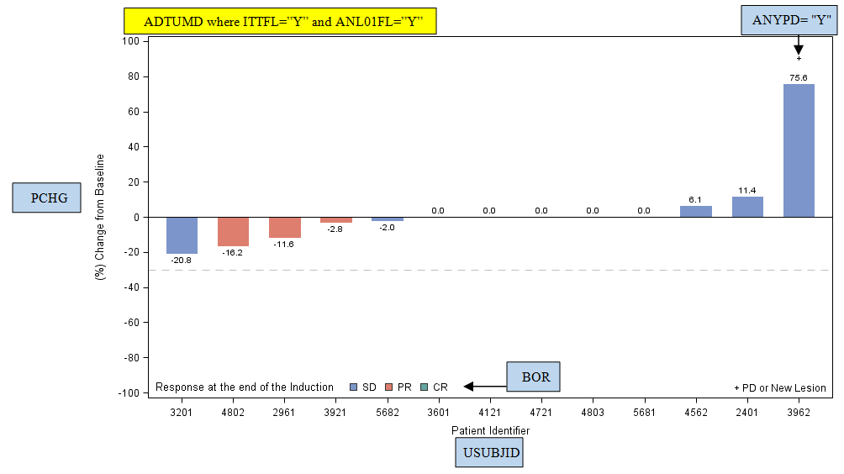
Analysis & ADaM Preparation
Planning the ADaM derivation - ADTUMD

Slide 38
Analysis & ADaM Preparation
Planning the ADaM derivation – ADTUMD (cont)
DISPLAY IDENTIFIER | Figure 1.01
DISPLAY NAME | Best Tumor Shrinkage (ITT Population)
RESULT IDENTIFIER | Analysis of Best Tumor Shrinkage
PARAM | Sum of Longest Diameter (mm)
PARAMCD | SUMLDIAM
ANALYSIS VARIABLE | AVAL, BOR, ANYPROG
REASON | Specified in SAP
DATASET | ADTUMD
SELECTION CRITERIA | ADTUMD where ITTFL=’Y’ and ANL01FL=’Y’
DOCUMENTATION | Histogram presenting the best tumor shrinkage for each patient. Applicable to only patients with at least one measurable (target) lesion at baseline. Each histogram represents the best % change from baseline (PCHG where ANL01FL=”Y”) in sum of lesions with color indicating the best overall response (BOR where ANL01FL=”Y”) obtained by the patient throughout the study. Also patients going into progression are flagged with ‘+’ (ANYPROG=’Y’)
PROGRAMMING STATEMENTS | …….

Slide 39
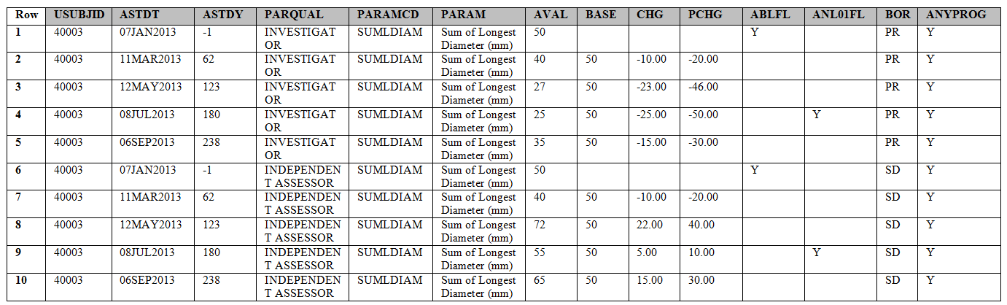
Analysis & ADaM Preparation
ADTUMD
ANYPD variable derived from ADEVENT
BOR copied from ADRESP
ANL01FL identify best tumor shrinkage (best % change from baseline)

Slide 40
Analysis & ADaM Preparation
ADTTEPFS
ADaM TTE = ADaM BDS with special TTE variables
Recommendation:
  Store time-to-event data separate from non-time-to-event data
  Create multiple ADaM TTE if needed for clarity
Intermediate analysis dataset might be useful
→ See slides 30-32

Slide 41
Analysis & ADaM Preparation
ADTTEPFS (cont)
Description of time-to-event (PARAMCD/PARAM)
  i.e. PFS/Progression Free Survival (months)
Date Origin (STARTDT)
  i.e. Randomization Date
Censor (CNSR) 0=Event 1…n=Censor
Analysis date of event or censoring (ADT)
  i.e. E.g. PD or Death Date / Last valid tumor assessment
Elapsed time to the event of interest from the origin (AVAL)
  i.e. (ADT-STARTDT)+1 (days)

Slide 42
Analysis & ADaM Preparation
ADTTEPFS (cont)
Event or Censoring Description (EVNTDESC)
    i.e. DEATH
Censor Date Description (CNSDTDSC)
    i.e. LAST TUMOR ASSESSMENT DATE
Imputation Date Flag (ADTF)
    E.g. D/M/Y

Slide 43
Analysis & ADaM Preparation
ADTTEPFS (cont)
SUBJ ID | PARAMCD | PARAM | AVAL | START DT | ADT | CNSR | EVNTDESC | CNSDTDSC
001001 | PFS | Progression Free Survival (Months) | 16.8 | 15AUG11 | 07JAN13 | 0 | RADIOLOGICAL PROGRESSION
001002 | PFS | Progression Free Survival (Months) | 8.4 | 12SEP11 | 25MAY12 | 1 | STUDY COMPLETED | LAST RADIOLOGICAL ASSESSMENT
001003 | PFS | Progression Free Survival (Months) | 7.2 | 02SEP13 | 08APR14 | 2 | NO BASELINE ASSESSMENT | RANDOMIZATION
001004 | PFS | Progression Free Survival (Months) | 8.4 | 12SEP11 | 25MAY12 | 0 | DEATH
Event/Censor Description
Time to Event Parameter
Start Date Randomisation
Event/Censor Date
Time part of the TTE event
(ADT-STARTDT+1)/30.42
*30.42 Standard for nr. of days in a month
0=Event
1..n=Censor

Slide 44
References
CDISC, “Therapeutic Area User Guide for Prostate Cancer”, 2017
CDISC, “Therapeutic Area Data Standards User Guide for Breast Cancer”, 2016
Tinazzi A, “Efficacy endpoints in Oncology“, PhUSE 2013
Almond S, Deconstructing ADRS: Tumor Response Analysis Data Set, PharmaSUG 2016

Slide 45

Angelo Tinazzi
Director – Standards, Systems, CDISC Consulting (CDISC E3C Member)
angelo.tinazzi@cytel.com
Cytel, Shaping the Future of Drug Development

