Slide 1
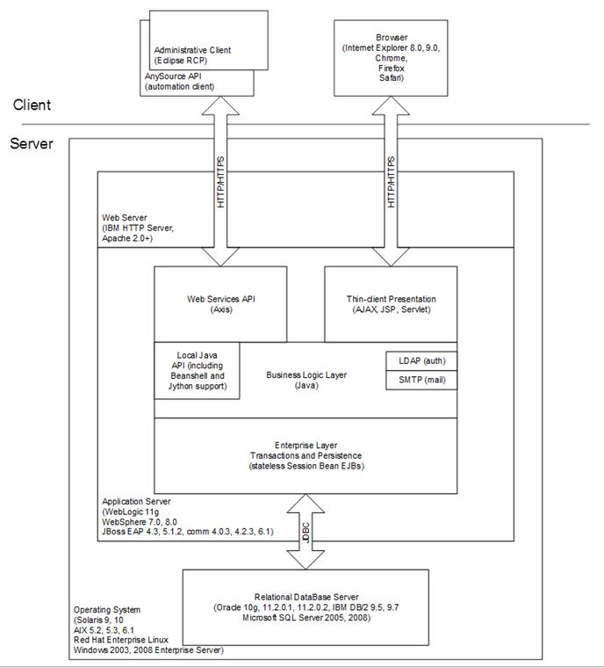

Slide 2
F5
APP
DB
Sub-Project Name, v
Date
Your Name
Description of build and architecture goes here.
Ports: 443, 80
Proxies:
Dependencies:
Location: ETDC BCM IT
VM Mgt OS: Vmware 3
VM OS: RHEL 5.0
Middleware: JBoss 7
Software: JEE6/Seam 3, NAME.war
Ports: 9443, 8080
Dependencies:
Physical OS: RHEL 5.0
RDBMS: Oracle 11g
Ports: 1521
Dependencies:
Location:
IP:
DNS:
Location:
IP:
DNS:
SID:
User:
DEV
HTTPS
BCM only
JDBC
Public IP:
FQDN:
IP:
DNS:
Location:
IP:
DNS:
SID:
User:
STG
HTTPS
HTTPS
JDBC
SSL
SSL
Public IP:
FQDN
IP:
DNS:
Location:
IP:
DNS:
SID:
User:
PROD
HTTPS
HTTPS
JDBC
SSL
SSL
Notes:
Some projects will have multiple sub-project detail pages & will require an overall context diagram

Slide 3
Concerning direct addressability of each server node (share1 & share2 bypassing the load balancer), I’ve assigned each an Amazon Elastic IP (which won’t change with EC2 instance restarts).
Node1 (share1) will be exposed via direct URL:
https://ec2-52-32-7-50.us-west-2.compute.amazonaws.com/sm (this is currently available)
https://share1.cdisc.org/sm (once DNS is changed)
Node2 (share2) will be exposed via direct URL:
https://ec2-52-32-194-32.us-west-2.compute.amazonaws.com/sm (this is currently available)
https://share2.cdisc.org/sm (once DNS is changed)
So, here’s the revised (complete) list of DNS changes for Joe Ben to implement (including the previously absent in my task list share1.cdisc.org and share2.cdisc.org records):
share.cdisc.org CNAME CDSIC-512993267.us-west-2.elb.amazonaws.com
share-training.cdisc.org CNAME CDISCTRAINING-1912407174.us-west-2.elb.amazonaws.com
share1.cdisc.org CNAME ec2-52-32-7-50.us-west-2.compute.amazonaws.com
share2.cdisc.org CNAME ec2-52-32-194-32.us-west-2.compute.amazonaws.com

Slide 4
To recap, this is what we need:
So, here’s the revised 11/4/15 (complete) list of DNS changes for Joe Ben to implement (including the previously absent in my task list share1.cdisc.org and share2.cdisc.org records):
share.cdisc.org CNAME CDSIC-512993267.us-west-2.elb.amazonaws.com
share-training.cdisc.org CNAME CDISCTRAINING-1912407174.us-west-2.elb.amazonaws.com
share1.cdisc.org CNAME ec2-52-32-7-50.us-west-2.compute.amazonaws.com
share2.cdisc.org CNAME ec2-52-32-194-32.us-west-2.compute.amazonaws.com
Share.cdisc.org, and share-training.cdisc.org look fine:
[root@cslxc-host ~]# dig @208.109.255.10 +noall +answer share.cdisc.org
share.cdisc.org. 600 IN CNAME cdsic-512993267.us-west-2.elb.amazonaws.com.
[root@cslxc-host ~]# dig @216.69.185.10 +noall +answer share.cdisc.org
share.cdisc.org. 600 IN CNAME cdsic-512993267.us-west-2.elb.amazonaws.com.
[root@cslxc-host ~]# dig @208.109.255.10 +noall +answer share-training.cdisc.org
share-training.cdisc.org. 600 IN CNAME cdisctraining-1912407174.us-west-2.elb.amazonaws.com.
[root@cslxc-host ~]# dig @216.69.185.10 +noall +answer share-training.cdisc.org
share-training.cdisc.org. 600 IN CNAME cdisctraining-1912407174.us-west-2.elb.amazonaws.com.
share-training 54.68.101.218
share1 52.32.7.50
share2 52.32.194.32

Slide 5
The most likely culprit is that the internal target IPs of the tunnels had also changed (I neglected to mention that).
The internal IP of the Oracle server that you’ll need to update is: 10.0.0.114
The internal IP of the share1 server (for LDAP) is: 10.0.0.200
Please note that the IP address/hostname required to establish the SSH tunnel to share-training (to facilitate the DB connectivity) has changed to:
ec2-54-68-101-218.us-west-2.compute.amazonaws.com
or IP 54.68.101.218
As I stated, the DB internal IP is now 10.0.0.114, and share1 is now 10.0.0.200.
So you’d want:
L1389=10.0.0.200:389 (for LDAP on share1)
L389=10.0.0.235:389 (for LDAP on share-training)
L1521=10.0.0.114:1521 (for Oracle on db)

Slide 6
Perhaps that SPF record hadn't been updated with the move to the new AWS servers?
Here's the current SPF record:
{code}
[root@cslxc-host ~]# dig +noall +answer -t txt cdisc.org
cdisc.org. 3583 IN TXT "v=spf1 ip4:207.235.63.0/24 ip4:207.235.62.48/28 ip4:50.249.48.192/27 ip4:204.239.0.224/27 ip4:198.207.147.224/27 ip4:54.68.101.218 ip4:52.32.7.50 ip4:52.32.194.32 include:cvent-planner.com include:spf.protection.outlook.com mx include:_spf.acquia.com incl" "ude:simplelists.com include:mailsenders.netsuite.com -all"
{code}
Here are the share environment hostnames (for the ELBs) and IP's for the specific nodes:
{code}
CDISC ELB: CDSIC-512993267.us-west-2.elb.amazonaws.com (A Record)
share1: 52.32.7.50
share2: 52.32.194.32
CDISCTRAINING ELB: CDISCTRAINING-1912407174.us-west-2.elb.amazonaws.com (A Record)
share-training: 54.68.101.218
{code}

Slide 7
The POC systems are running JBOSS EAP 6.4 and the DB is Oracle 11gR2 (11.2.0.1.0).
Both systems are para-virtualized containers on a host server. There are no CPU allocation limits and both JVMs were configured similarly with regards to max heap.
The synchronization between the two systems was set to have the artifacts of type file to remain on POC2. The connection is only made back to POC2 when the individual artifact is retrieved. However, the configured synchronization can set up to cache artifacts on the target system as well. With regards to the exports, I don’t believe we access artifacts of type file directly.
General health of the POC3 system is good.
If you have further questions, please let me know.
Shannon Wenzel

Slide 8
Sub-Project Name, v
Date
Your Name
Description of build and architecture goes here.
F5
APP
DBs
Ports: 443, 80
Proxies:
Dependencies
Location:
VM Mgt OS: Vmware 3
VM OS: RHEL 5.0
Middleware: JBoss 7
Software: JEE 6, Seam 3
Ports: 9443, 8080
Dependencies:
Physical OS: RHEL 5.0
RDBMS: Oracle 11g
Ports: 1521
Dependencies:
Location:
VM OS: RHEL 5.0
DBMS: MongoDB
Ports: xx
Dependencies:
Location:
Oracle IP:
DNS:
SID:
User:
IP:
DNS:
Location:
JDBC
DEV
HTTPS
BCM only
Mongo IP:
DNS: User:
Oracle IP:
DNS:
SID:
User:
Public IP:
FQDN:
IP:
DNS:
Location:
STG
HTTPS
HTTPS
JDBC
SSL
SSL
Mongo IP:
DNS:
User:
OracleIP:
DNS:
SID:
User:
Public IP:
FQDN
IP:
DNS:
Location:
JDBC
PROD
HTTPS
HTTPS
Mongo IP:
DNS: User:
SSL
SSL
Notes:
An example with multiple back-end databases. Some projects will have multiple sub-project detail pages & will require an overall context diagram

Slide 9
Sub-Project Name, v
Date
Your Name
Description of build and architecture goes here.
F5
APP
DBs
Ports: 443, 80
Proxies:
Dependencies
Location:
VM Mgt OS: Vmware 3
VM OS: RHEL 5.0
Middleware: JBoss 7
Software: JEE 6, Seam 3
Ports: 9443, 8080
Dependencies:
Physical OS: RHEL 5.0
RDBMS: Oracle 11g
Ports: 1521
Dependencies:
Location:
BCM LDAP
Ports: xx
Dependencies:
Location:
Oracle IP:
DNS: SID:
User:
IP:
DNS:
Location:
JDBC
DEV
HTTPS
BCM only
LDAP IP:
DNS:
Oracle IP:
DNS:
SID:
User:
Public IP:
FQDN:
IP:
DNS:
Location:
STG
HTTPS
HTTPS
JDBC
SSL
SSL
LDAP IP:
DNS:
OracleIP:
DNS:
SID:
User:
Public IP:
FQDN
IP:
DNS:
Location:
JDBC
PROD
HTTPS
HTTPS
LDAP IP:
DNS:
SSL
SSL
Notes:
An example with a local back-end database and BCM AD . Some projects will have multiple sub-project detail pages & will require an overall context diagram

Slide 10
Project Objectives & Rationale
Objectives | Rationale
The purpose of the software is to:
Architectural Details
Performance Requirements
Configuration Management Details
Will connections/requests to the application be session based (i.e. stateful versus stateless)? If so, is there any reason why application would not support “sticky session” load balancing?
Will the application be caching data? If so, what is being cached and how much data will be cached? (NOTE: Seam 3 default is last 512 objects cached)
What data files will be created (if any)? How much data will be saved on an on going basis? How will data go into the system?
Will this application need a database schema(s) created on the DLDCC/LSSBC infrastructure? If so, what is the maximum number of objects to be stored?
Are there any external/non-BCM data sources that will be accessed by the application?
  Total number of users for this application?
  Peak number of concurrent users?
  Peak number of requests/minute?
  Acceptable down time when recovering from major systems disaster (SLA)?
  -Impact assessment criteria: select Critical, High, Medium, or Low
    -Security definition criteria: select High, Medium, or Low
    -Service Level Determination & Response: select SLA level 1,2,3, or 4
What DLDCC SVN repository name is requested?
Indicate whether you will require DLDCC/LSSBCM support migrating your source code to the SVN repository and provide the repository’s location.

Slide 11
Major Deployment Milestones
Milestone | Date
Storage
Load Balancing/Fault Tolerance
Development, Staging, and Production:
-Expected file server disk storage (in MB):
-Expected initial database storage (in MB):
-Expected ftp storage (in MB):
-Expected media/image storage (in MB):
-NFS Mount Points:
Does the application support load balancing?
Implement load balancing?
Load balancing requirements:
Fault tolerance solution suggested:

Slide 12
Below is a list of activities that need to take place (from Jake):
The ~4hr maintenance window activities would consist of:
· (CDISC needs to do) share.cdisc.org will need it’s CNAME record adjusted to point to CDSIC-512993267.us-west-2.elb.amazonaws.com
· (CDISC needs to do) share-training.cdisc.org will need it’s A record changed to a CNAME record pointing to CDISCTRAINING-1912407174.us-west-2.elb.amazonaws.com
· (Akana) current OLD environment share and share-training DB schemas exported
· (Akana) those schema exports transferred to the NEW environment DB server
· (Akana) those schema exports imported into the NEW DB environment (this process could take a couple of hours itself to process the Oracle statistics)
· (Akana) current OLD environment share and share-training LDAP ldif exports created
· (Akana) those ldif exports transferred to the NEW environment (share1 and share-training instances)
· (Akana) delete the existing LDAP DB’s and import the new LDAP ldif’s into the NEW environment (share1 and share-training instances)
· (Akana) upgrade share.cdisc.org from 6.6 -> 6.7
· (Akana) upgrade share.cdisc.org from 6.7 -> 7.0
· (Akana) upgrade share-training.cdisc.org from 6.7 -> 7.0

