Slide 1
Semantics Manager V6.5
CDISC Amazon Connections
March 2014
Tools & Connections for
For CDISC SHARE

Slide 2
Covered Topics
Connection Information
Tool Summary
Tool Connection Setup & Use

Slide 3
SHARE Server & Library Information
Production
  https://share.cdisc.org/sm
  Note: this server has two nodes
    For the UI login, use https://share.cdisc.org/sm
    For checking logs and uploading configuration, use both nodes:
      https://share1.cdisc.org/sm
      https://share2.cdisc.org/sm
  Libraries:
    SHARE (ID:5)
    SHARE-Testing (ID:4)
Training
  https://share-training.cdisc.org/sm
  Libraries:
    SHARE-Training (ID:5)
    SHARE-Sandbox (ID:4)

Slide 4
SHARE Database Connection Information
Production
  IP address: 10.0.0.114
  Port: 1521
  SID: db1
  Username: CDISC_ADMIN
  Password: noi$yEnd65
  View Schema Owner: CDISC
Training
  IP address: 10.0.0.199
  Port: 1521
  SID: db1
  Username: CDISC_ADMIN
  Password: noi$yEnd65
  View Schema Owner: CDISC_TRAINING

Slide 5
Tool Summary
Repository Client – used to manage SM configuration
Eclipse for BIRT – used to manage SM reports
PuTTY Configuration – needed to tunnel in to the Oracle and OpenLDAP servers to connect to them
SQL Developer – used (or other tools like SQLPlus or TOAD) to connect to the Oracle views
Apache Directory Studio – used (or other tools) to connect to LDAP to be able to delete or edit user accounts (should never delete unless the account has not been used or was created inadvertently)

Slide 6
Repository client
Installation & Configuration of Repository Client

Slide 7
Installing Repository Client (RC)
Login to assigned library
Go to Downloads link in library
  Click on Installation Instructions under Repository Client
  Click the Click here to start the install link
  Follow the instructions for installation
Add gdt and capture template editors
  Open RC and go to Help menu
  Choose Find and Install Updates
  Search for New Features to Install and then New Remote Site
    Remote site link to add can be found under Downloads >> Repository Client Installation Instructions >> Upgrade Instructions
  Expand link and check off Template enablement and Template Editors, then click Next
  Accept terms and click Next, and then Finish
  Choose Install All and then Yes to restart the RC

Slide 8
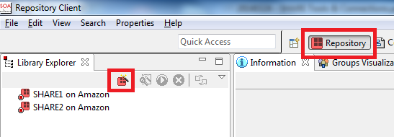
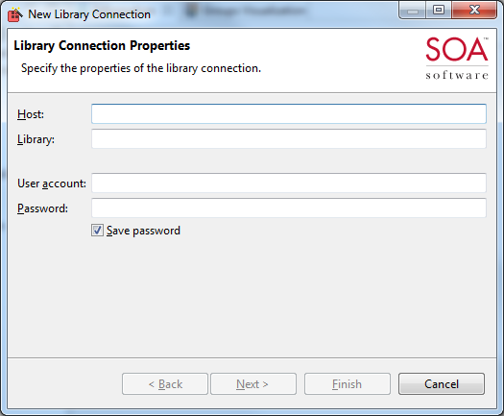
Add Connections for SHARE in Repository Client
From the Connections perspective, create a connection for each library per server per user account you will be using (requires at least usage controller role)
Connections to create for SHARE
  SHARE1 on Amazon
    Host: https://share1.cdisc.org/sm
    Library: SHARE
    Username: your account/password
  SHARE2 on Amazon
    Host: https://share2cdisc.org/sm
    Library: SHARE
    Username: your account/password
  SHARE1-Testing on Amazon
    Host: https://share1.cdisc.org/sm
    Library: SHARE-Testing
    Username: your account/password
  SHARE2-Testing on Amazon
    Host: https://share2.cdisc.org/sm
    Library: SHARE-Testing
    Username: your account/password

Slide 9
Add Connections for SHARE in Repository Client
Connections to create for SHARE (continued)
  SHARE-Training on Amazon
    Host: https://share-training.cdisc.org/sm
    Library: SHARE-Training
    Username: your account/password
  SHARE-Sandbox on Amazon
    Host: https://share-training.cdisc.org/sm
    Library: SHARE-Sandbox
    Username: your account/password

Slide 10
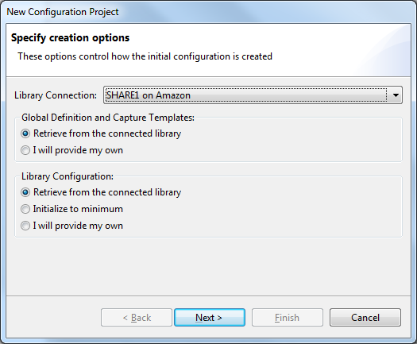
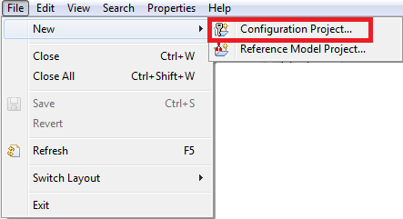
Add Projects for SHARE in Repository Client
From the Configuration Perspective ( ), create a Project for each SHARE library
  SHARE
  SHARE-Testing
  SHARE-Training
  SHARE-Sandbox

Slide 11
BIRT
Installation & Configuration of Eclipse for BIRT

Slide 12
Install & Configure BIRT
Install Eclipse for BIRT - http://www.eclipse.org/downloads/download.php?file=/birt/downloads/drops/R-R1-2_6_2-201102191842/birt-report-designer-all-in-one-2_6_2.zip
Open Eclipse for BIRT (eclipse.exe) and set up your workspace to use the same workspace you had set up for Repository Client

Slide 13
Putty configuration
PuTTY Installation, Configuration, and Startup

Slide 14
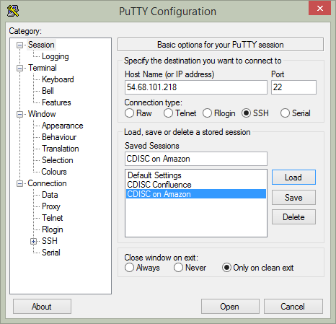
PuTTY Installation/Configuration
Install PuTTY Configuration (http://www.chiark.greenend.org.uk/~sgtatham/putty/download.html)
Open PuTTY Configuration
Click on Session and add a session for cdisc-amazon with host name 54.68.101.218
Save the session

Slide 15
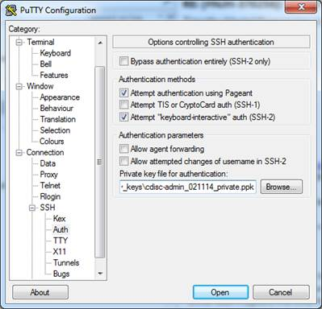
PuTTY Configuration
Save the .PPK file provided to your computer (to a place you plan to store it permanently)
Under Connection in PuTTY expand SSH and click on Auth
Click on the Browse button and navigate to your .PPK file, then click Open

Slide 16
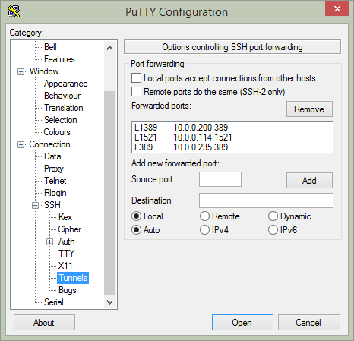
PuTTY Configuration
Now move to the Tunnels Category under SSH
Add a tunnel for each of the following servers/ports as shown in the picture:
  L1389=10.0.0.200:389 (for LDAP on share1)
  L389=10.0.0.235:389 (for LDAP on share-training)
  L1521=10.0.0.114:1521 (for Oracle on db)
Go back to the Session Category and Save the session
Note: the source port (e.g., L389) is the local port running PuTTY that will be the local end point port for the remote service, where as the port in the Destination at the end of the IP address is the remote port (e.g., 389). Each local port must be unique.

Slide 17
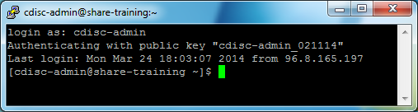
Tunneling in with PuTTY
Needed to connect to LDAP or Oracle (e.g., SQL Developer, TOAD, SQLPlus, etc.)
Once PuTTY is configured
  Open it
  Load your saved session
  Click Open
Login as: cdisc-admin (no password)
You are now tunneled in and can use other tools to connect to Oracle/LDAP

Slide 18
SQL Developer
Installation, Configuration, and Connecting to the SHARE Oracle databases with SQL Developer

Slide 19
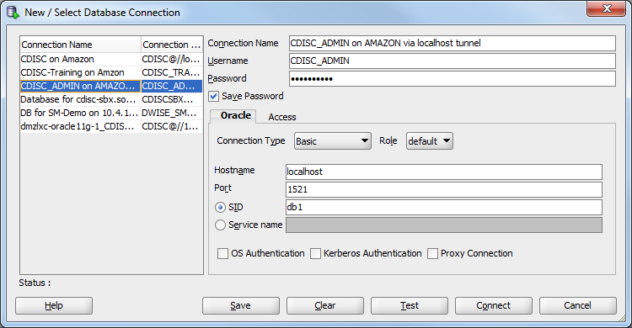
SQL Developer Installation/Configuration
Install SQLDeveloper (http://www.oracle.com/technetwork/developer-tools/sql-developer/overview/index-097090.html)
Add a new connection using the following (pwd: noi$yEnd65)
Test (must be tunneled in with PuTTY) and Save the connection

Slide 20
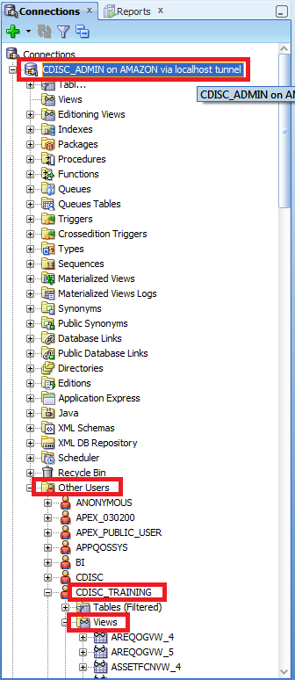
Accessing the Reporting Views
Once logged in with the connection, expand it by clicking on the plus sign (+)
Then expand the Other Users folder
Expand CDISC schema for production or CDISC_Training for the training server
Under each schema you should be able to expand the Views folder and see all of the reporting views

Slide 21
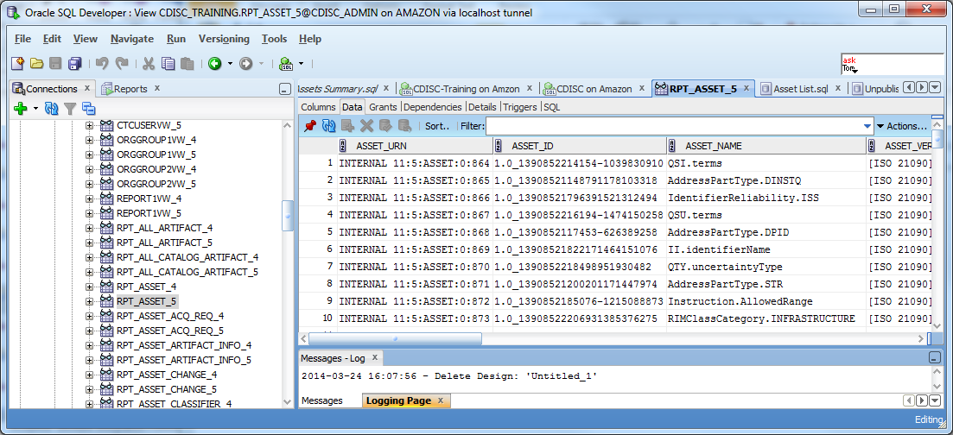
Using the Reporting Views
Double click on any view to see its structure, data, grants, etc.
You can filter, sort, and export the output

Slide 22
Open ldAP
Installation, Configuration, and use of OpenLDAP for CDISC SHARE Servers

Slide 23
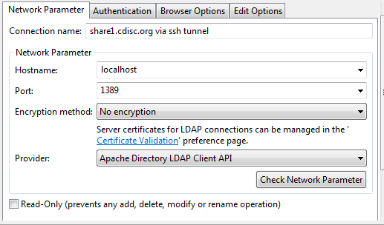
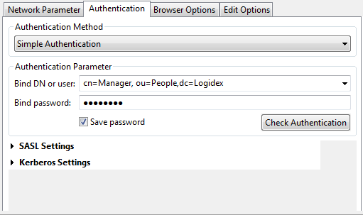
Apache Directory Studio Install/Configuration
Install Apache Directory Studio (http://directory.apache.org/studio/)
Run PuTTY and tunnel in to your server
Add a new connection for the share1 node for the production server using the following (use defaults unless specified in graphic below – bind password = 0ink0ink)
Click OK to save the connection

Slide 24
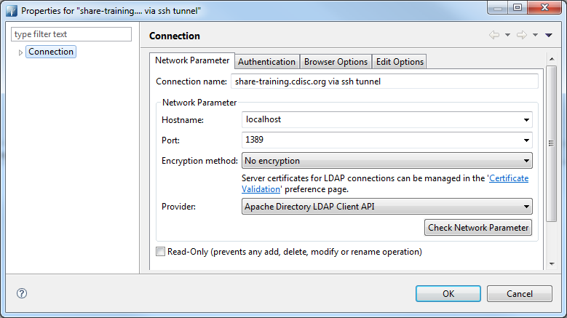
ADS Add New Connection
Repeat steps from previous slide to add a connection for the training server (all info same other than name and port [uses local port from PuTTY])

Slide 25
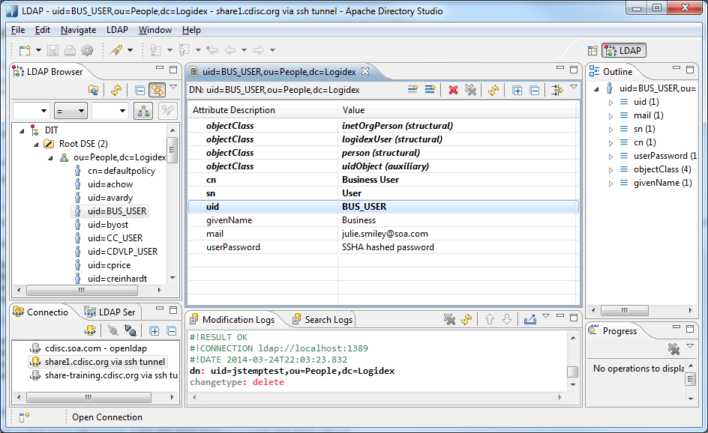
Using the OpenLDAP Connection
Double click your connection to connect to the OpenLDAP server
Under the LDAP Browser pane, expand the ou=People… folder
Click on any user to see/modify its properties
Right click on any user to delete/rename
Note: you should never delete an LDAP account if it has ever been used in SM.

Slide 26
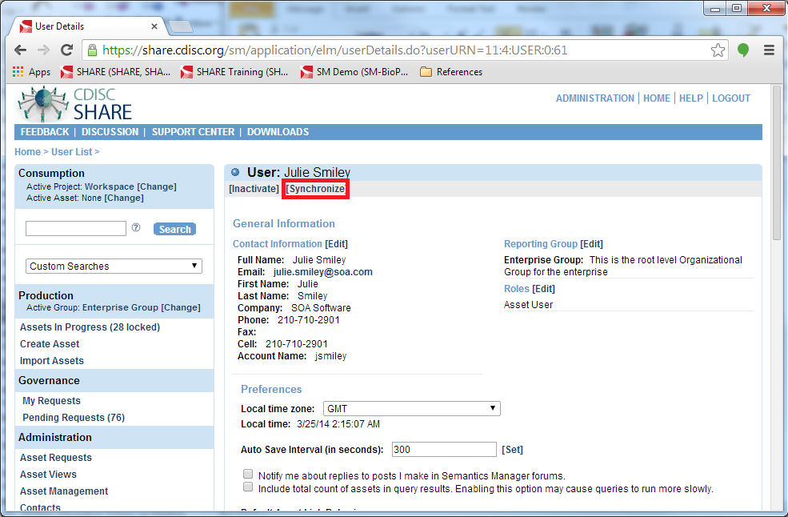
Synchronize User Changes in SM
Login to the SM library that user changes were made to on LDAP
Click on Users under Administration section on the left nav bar
[Select] the user that needs updating
[Synchronize] the user account

