Slide 1
ICH M11 Clinical electronic Structure Harmonized Protocol (CeSHarP) and CDISC: Making the Electronic Protocol a reality
PHUSE US Connect 2024
Peter Van Reusel, Chief Standards Officer, CDISC

Slide 2
Agenda
ICH M11 Introduction
CDISC and ICH M11 Engagement
  Content model
  Controlled terminology
  Define Trial Design mappings
  Conformance rules for M11 model
  Partner with Vulcan FHIR: exchange standard for ICH M11
Conclusion

Slide 3
ICH M11
Clinical Electronic Structured Harmonized Protocol

Slide 4

ICH M11 Expert Working Group
Regulatory Members​
  ANVISA, Brazil​
  CDSCO, India
  EC, Europe​
  FDA, United States​
  Health Canada, Canada
  HSA, Singapore​
  MHLW / PMDA, Japan​
  National Center, Kazakhstan
  NMPA, China​
  SFDA, Saudi Arabia
  TFDA, Chinese Taipei ​
Industry Members​
  BIO​
  EFPIA​
  IFPMA
  IGBA​
  JPMA​
  PhRMA​
Source: https://ich.org/page/multidisciplinary-guidelines

Slide 5
Topics and Codes
International Council for Harmonisation (ICH) Guidelines
Quality Guidelines
Safety Guidelines
Harmonisation achievements in the Quality area include pivotal milestones such as the conduct of stability studies, defining relevant thresholds for impurities testing and a more flexible approach to pharmaceutical quality based on Good Manufacturing Practice (GMP) risk management.
ICH has produced a comprehensive set of safety Guidelines to uncover potential risks like carcinogenicity, genotoxicity and reprotoxicity. A recent breakthrough has been a non-clinical testing strategy for assessing the QT interval prolongation liability: the single most important cause of drug withdrawals in recent years.
Q
S
Efficacy Guidelines
The work carried out by ICH under the Efficacy heading is concerned with the design, conduct, safety and reporting of clinical trials. It also covers novel types of medicines derived from biotechnological processes and the use of pharmacogenetics/genomics techniques to produce better targeted medicines.
E
Multidisciplinary Guidelines
M
Those are the cross-cutting topics which do not fit uniquely into one of the Quality, Safety and Efficacy categories. It includes the ICH medical terminology (MedDRA), the Common Technical Document (CTD) and the development of Electronic Standards for the Transfer of Regulatory Information (ESTRI).
M11, M2
E3, E6, E9…

Slide 6
Why Clinical electronic Structured Harmonized Protocol (CeSHarP)?
01
No internationally harmonized standard template for the format and content to support consistency across sponsors and exchange of protocol information.
02
Lack of harmonization contributes to inefficiencies and difficulties in reviewing and assessing clinical protocols by regulators, sponsors, ethical oversight bodies, investigators, and other stakeholders

Slide 7
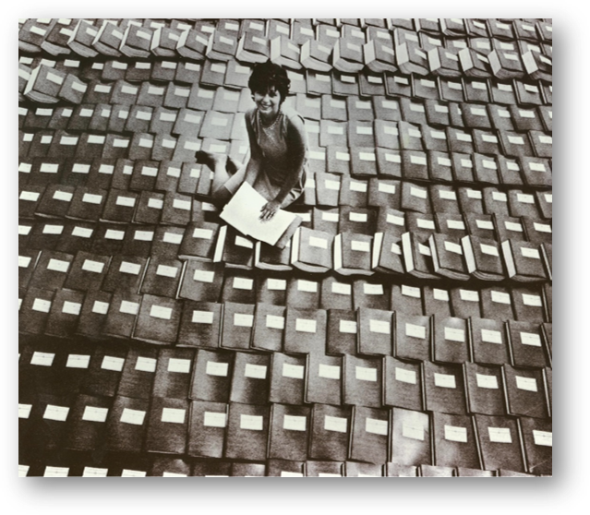

Why Clinical electronic Structured Harmonized Protocol (CeSHarP)?
Paper Submissions…
Not like this anymore…
…but this isn’t much better!

Slide 8
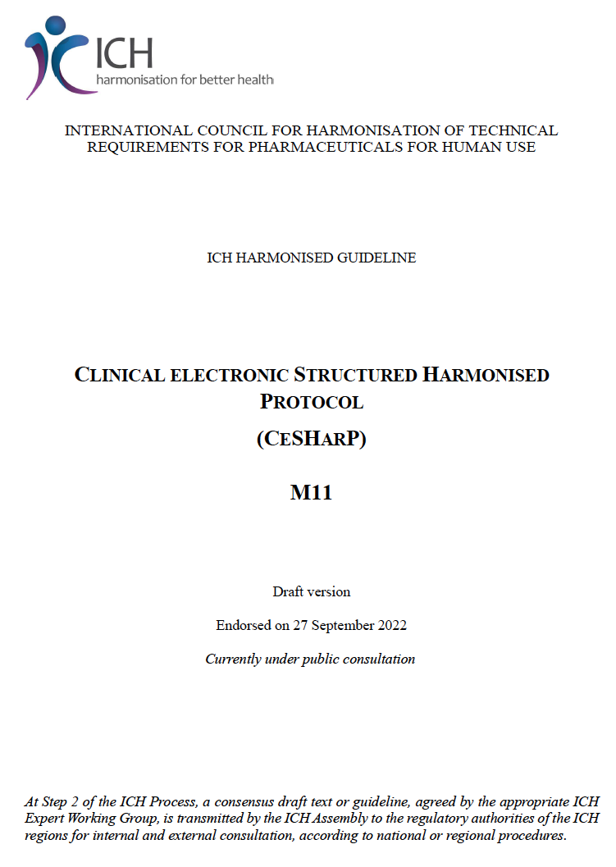
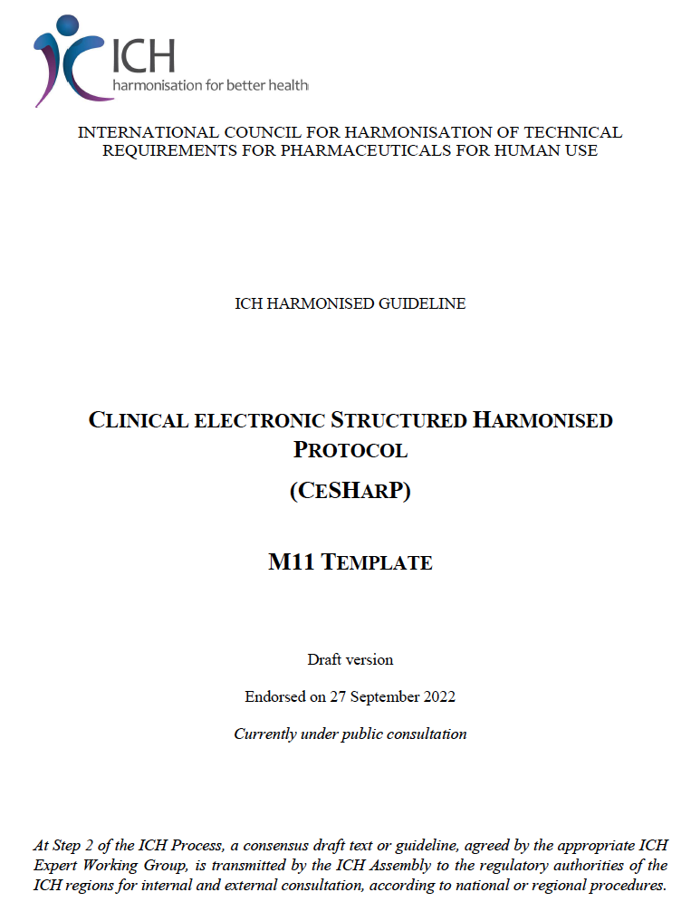
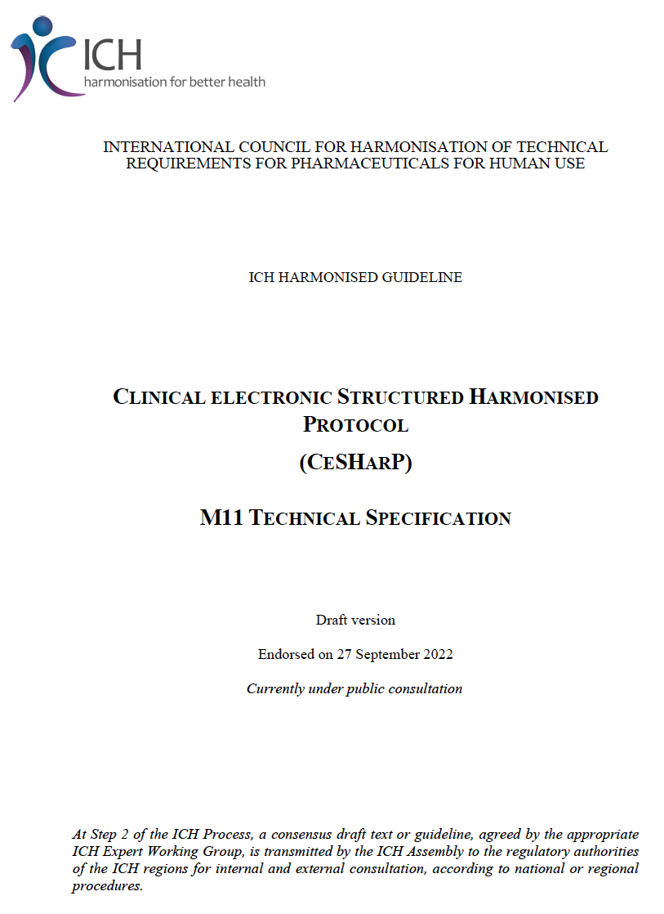
M11 Is …
ICH CLINICAL ELECTRONIC STRUCTURED HARMONISED PROTOCOL (CeSHarP)
https://www.ich.org/page/multidisciplinary-guidelines
Provides background, purpose, and
scope as a guideline
Provides the written format for the
Interventional Clinical Trial Protocol
Template
Provides the technical representation
aligned with the guideline and protocol
template

Slide 9
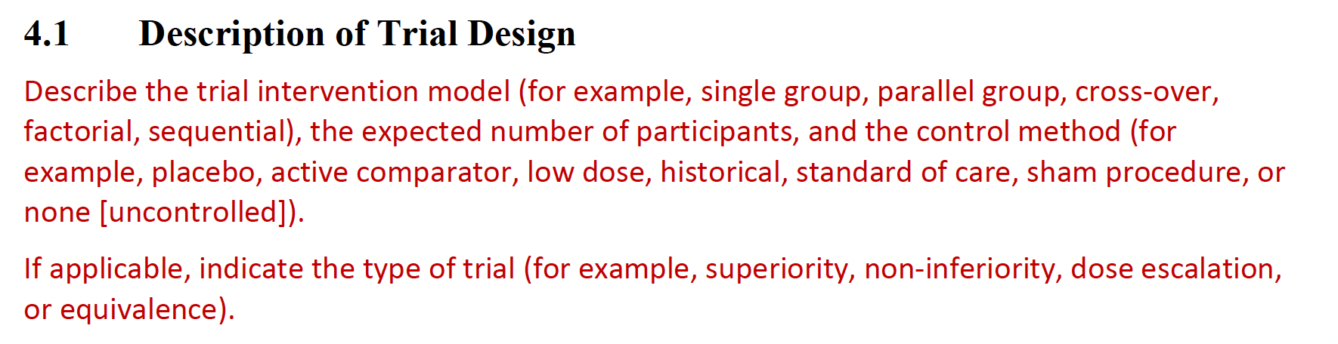
Template for Description of Trial Design

Slide 10
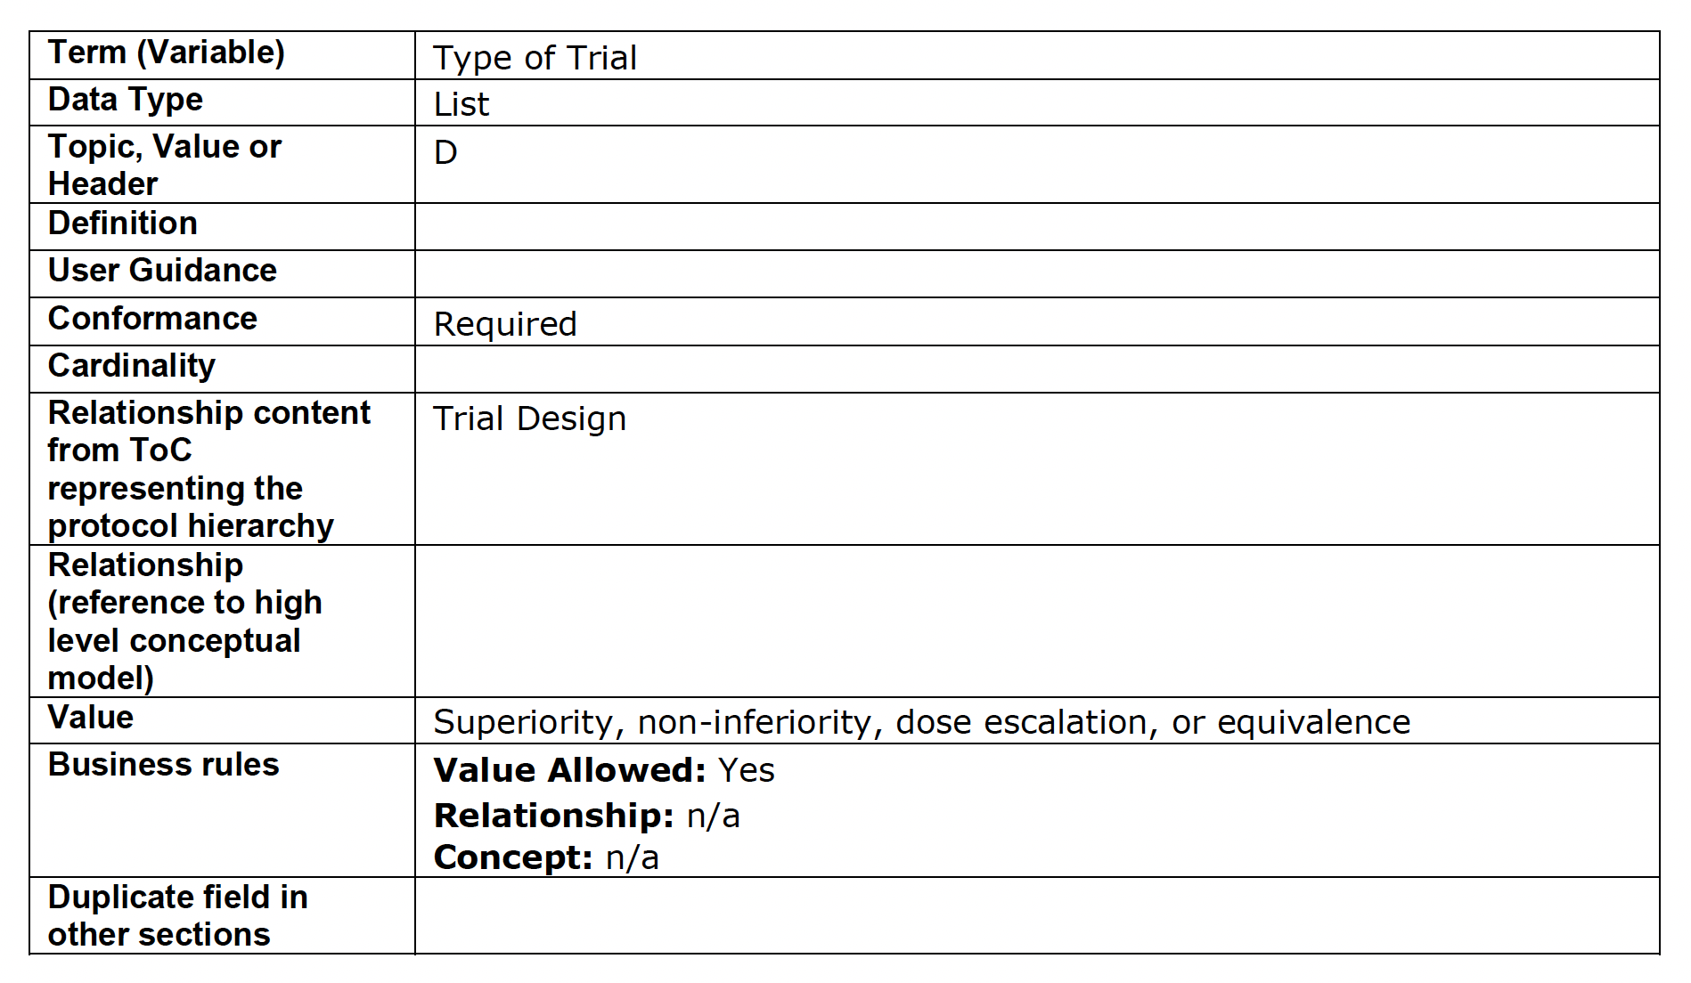
Technical Specification for Description of Trial Design
Variables
Concept/Terminology
Code lists
Conformance

Slide 11


CDISC M2/M11 Engagement
01
Controlled terminology, code lists, content nomenclature.
02
Define Content model to represent content agnostic of exchange standard.
03
Determine conformance rules for M11 model.
04
Collaborate with ICH M2/M11 on defining mappings between M11 model and CDISC Standards and Artifacts.
05
Joint project with Vulcan FHIR accelerator to deliver an electronic exchange standard for the ICH M11.
Notes:
For (2), there are elements of the protocol that are required for the authoring/medical writing community which are covered in a content model but not needed in the exchange standard.

Slide 12
CDISC M2/M11 Engagement
Define Content model to represent content agnostic of exchange standard

Slide 13












TransCelerate Digital Data Flow (DDF) Ambition
https://www.transceleratebiopharmainc.com/assets/digital-data-flow-solutions/
Write Once, Read Many
TODAY: Document-based paradigm for protocol creation, interpretation, and transcription into consuming systems
TOMORROW: Digital paradigm for protocol creation, with fully automated data flow and interoperability between systems
Digital Flow
Study Definitions Repository (SDR)
Reference Implementation
Unified Study Definitions Model (USDM)
API Specs
Controlled Terminology
Automation
Study Team
Design & Protocol Authoring
EDC
CTMS
DCT
IRT
EHR
EDC
CTMS
DCT
IRT
EHR
Protocol
13
Notes:
[2-Click Animation]

Slide 14
DDF 3 USDM Scope
Represent ICH M11 in USDM
Clinical Trial Registry Population
Complex Studies/Cohorts
Model Enhancements
SDTM Trial Design Population
Conformance Rules

Slide 15
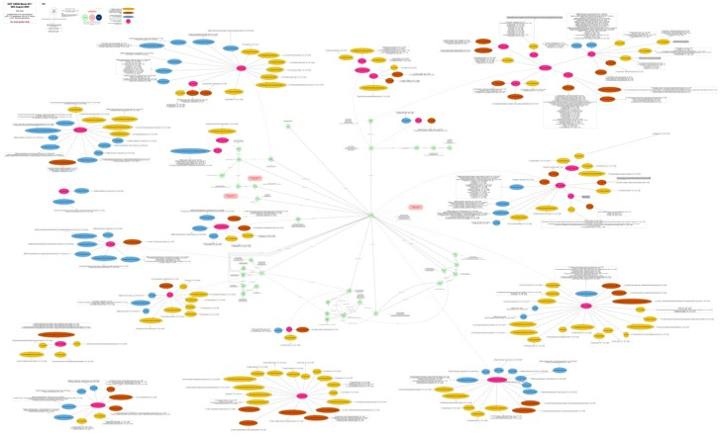
USDM Meets M11

Slide 16

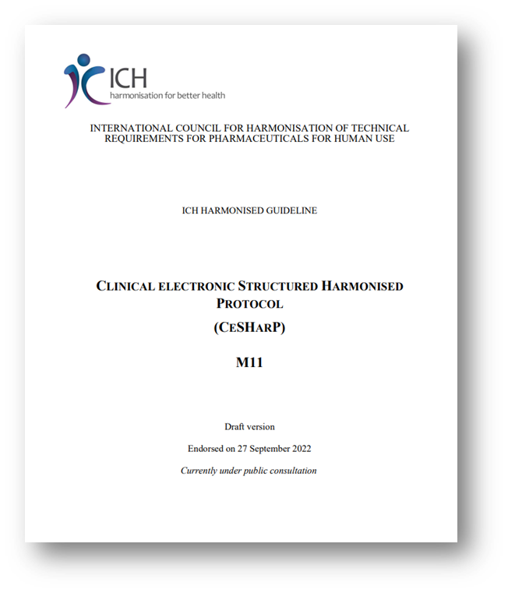
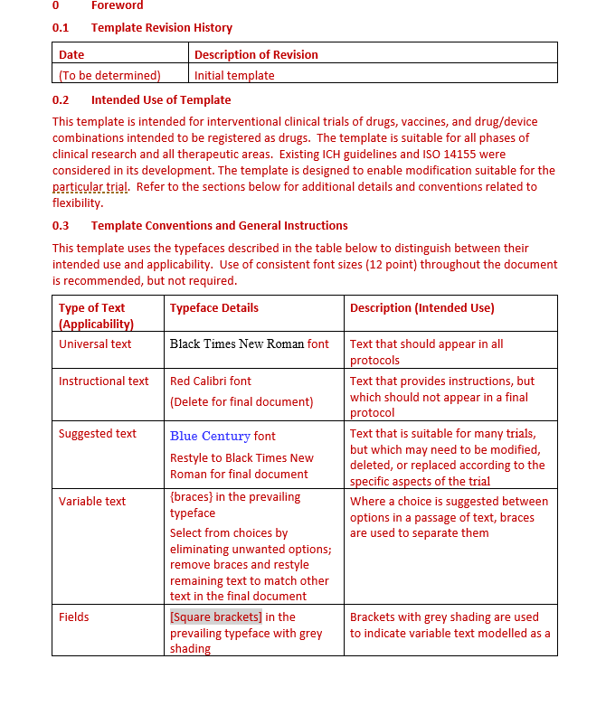
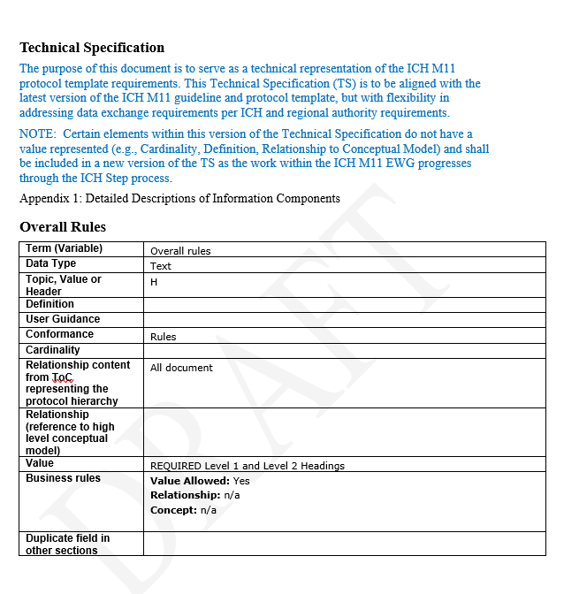


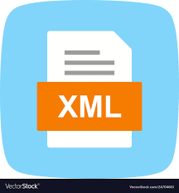


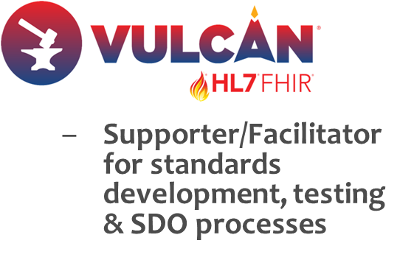

M2/M11 Technical Development Process
Guideline & Template
Tech Spec
Electronic Document
Human Readable Form
Machine- Readable Form
...
Standard Message Exchange Formats

Slide 17
CDISC M2/M11 Engagement
Controlled terminology, code lists, content nomenclature

Slide 18
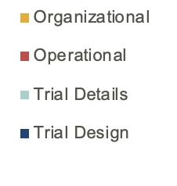
M11 Document Controlled Terminology Categories
Analysis of CT in M11 Data Element Spreadsheet (n=223)
Organizational provides information on sponsors and committees
Operational provides details on tasks required (e.g., how to mix drug or handle the drug)
Trial Details provides explanatory text that would be required for human comprehension
Trial Design aligns with concepts found discretely in a protocol
Percentage of Data Elements from M11 Concepts
Notes:
Trial Design means the terms provide specificity related the trial in specific terms concisely (e.g., trial phase).
Trial Details means the term provides explanatory information for the trial implementation by study sites following the protocol.
Operational means the explanation provides how to perform specific tasks required for the study (such as mixing the study drug).
Organizational means the information is about the specific organizations involved in the research study (monitoring, sponsoring, adjudicating committees, etc.).
Total Data Elements in the M11 document identified by CT (n=287)
Excluded headers (n=37): Trial Protocol Version Details Trial Protocol Amendment History Reason For Protocol Amendment Summary of Protocol Changes Clinical Trial Study Identifier Trial Design Study Intervention Intervention Model Study Population Country Criterion Schedule of Activities Clinical Trial Objective End Point Outcome Measure Type Estimand Compound Name Sponsor Name and Address Manufacturer Name and Address Protocol Synopsis Study Population Protocol Introduction Section Trial Design Study Population Trial Intervention and Concomitant Therapy Concomitant Therapy Discontinuation of Trial Intervention and Participant Withdrawal from Trial Trial Assessment and Procedures General Statistical Consideration Regulatory, Ethical and Trial Oversight Considerations Trial Data Protection Risk Management and Quality Assurance ADVERSE EVENTS AND SERIOUS ADVERSE EVENTS – DEFINITIONS, SEVERITY, AND CAUSALITY DEFINITIONS AND SUPPORTING OPERATIONAL DETAILS Glossary Reference List
Excluded terms for generic concepts (n=10): Year Month Day Year Month Day Abbreviations and Definitions Abbreviation Definition Reference List
Excluded duplicate concepts (n=35) – (there were 66 with duplicates and 31 removed (1 with 3 alike, 1 with 5 alike): Approximate Indicator Clinical Trial Objective Concomitant Therapy Day Detailed Changes in Protocol Amendment Emergency Consent Process End Point General Statistical Consideration Interim Analysis Intervention Model Month Primary Endpoint Protocol Approval by Sponsor Date Reason for Trial Duration Variation Reference List Schedule of Activities Secondary Endpoint Study Identifier Study Population Study Protocol Amendment Effective Date Study Protocol Version Acronym Study Protocol Version Number Trial Design Trial Intervention Assignment Method Trial Primary Objective Trial Protocol Version Details Trial Protocol Version Geographic Scope Trial Secondary Objective Trial Specific Definition of Adverse Event Trial Specific Definition of Serious Adverse Event Year

Slide 19
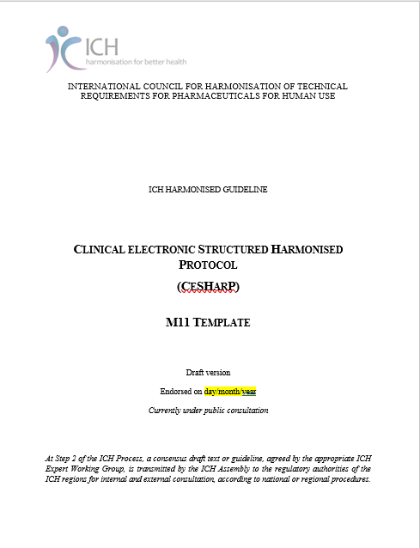
ICH M11 Terminology
CDISC is working with the ICH M11 working group to create draft semantics for the ICH M11 Protocol Template
  257 Data Elements
  22 Valid Value Sets comprising 112 terms
Aligns with/harmonizes to CDISC terminology where appropriate
  SDTM, DDF, Protocol, Glossary
Stored with CDISC terminology in the NCI Thesaurus
Will be undergoing CDISC public review and regulatory review in the next couple of months.

Slide 20
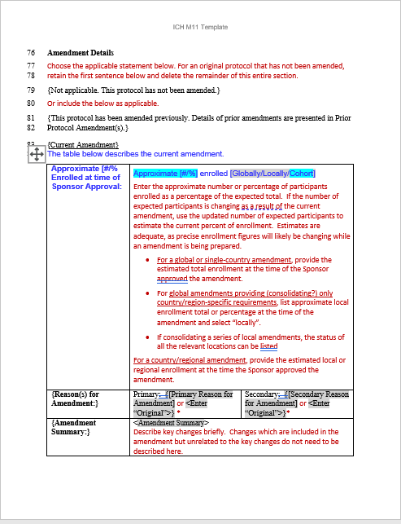
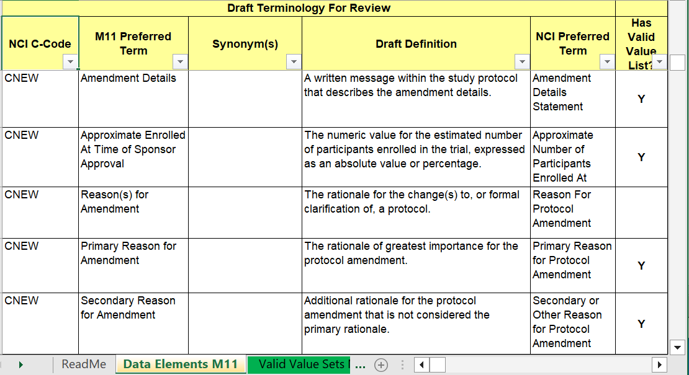
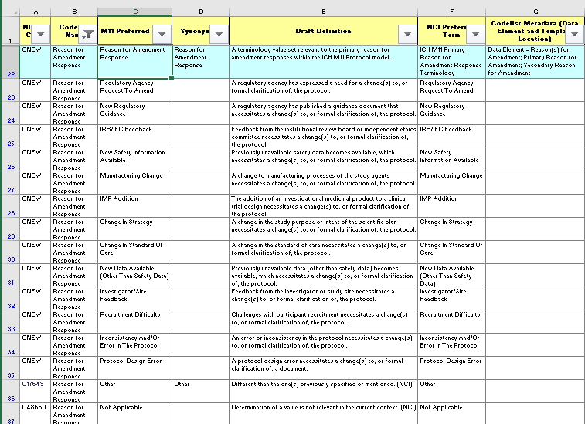
Notes:
This slide is animated. It start with the same screenshot of the M11 Protocol front page. On click 1, a page in the template will appear showing part of the Protocol amendment section. On click 2, the draft semantics for the data elements associated with this page will appear. On click 3, the draft semantics for one of the valid value sets associated with two of the data elements (Reason for Protocol Amendment Response) will appear.

Slide 21
CDISC M2/M11 Engagement
Defining Trial Design mappings for M11 model

Slide 22
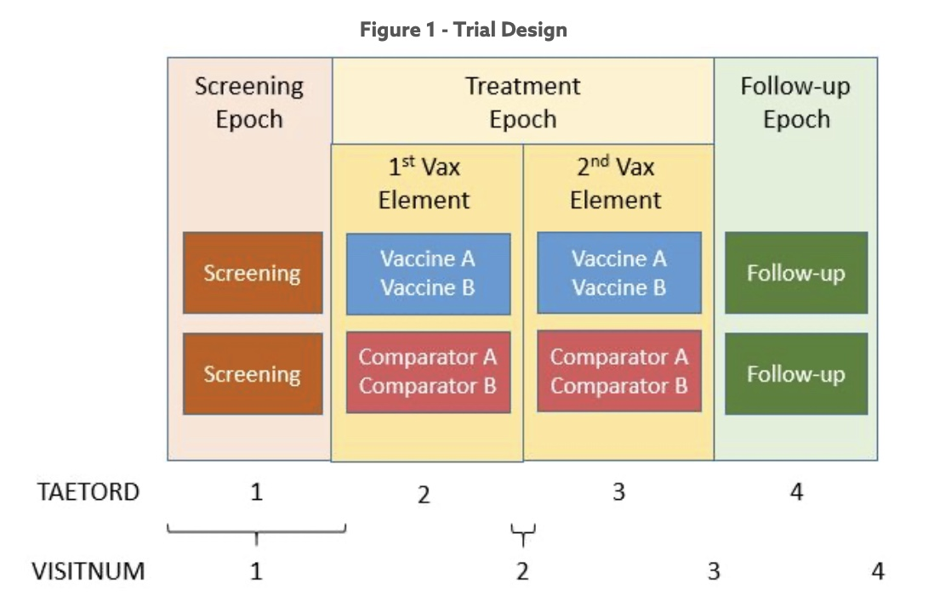
Generate SDTM Trial Design Datasets
Demonstrate how an M11 protocol represented in USDM will be used to generate SDTM Trial Design datasets
For Trial Arms, Trial Elements, Trial Visits, Trial Inclusion
  Domain specifications supplemented with sources in USDM
For Trial Summary
  Assessed whether and how FDA-required parameters could be generated

Slide 23
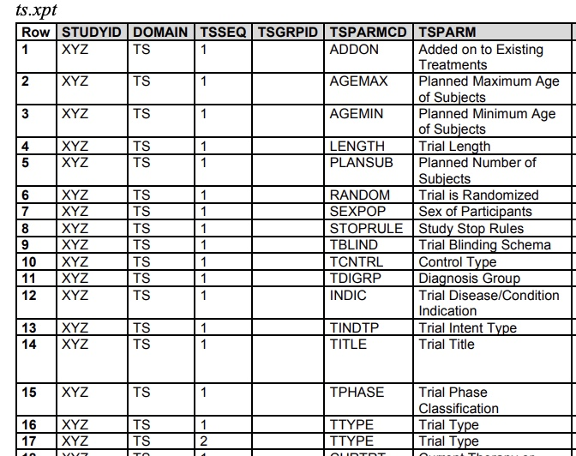
Identify new Trial Summary Parameters from M11
M11 terminology is evolving, so a definitive list is not yet possible
Examples of possible new trial summary parameters
  A set of parameters to describe top-level characteristics of each amendment
  Parameters to represent compound names and numbers
  Parameter(s) to represent various committees overseeing aspects of study conduct

Slide 24
Possible Future Modifications to SDTM Trial Design
Trial Visits
  Add planned contact mode and include other than in-person visits
  Add planned visit windows
New Trial Timepoints
  Fill gap in representing schedule of activities
  Structure similar to Trial Visits
Trial Interventions
  Separate duration of treatment from duration of elements (assessment of trial effects)
  Based on study interventions, allows denormalized representation of dosing data currently in normalized form in Trial Summary
  Enhance Trial Elements by linking Trial Interventions to treatment elements
Trial Inclusion/Exclusion
  Link tests/biomedical concepts to criteria
New Trial Organizations
  Represent roles and contact information

Slide 25
CDISC M2/M11 Engagement
  Determine conformance rules for M11 model

Slide 26
The Conformance Rule Challenge
A single source of truth for all conformance rules
Consistency across conformance rule implementations
Central management and governance of rule specifications, regardless of source:
CDISC – rules in the foundational standards
FDA Validator Rules
Community – proposed new/updated rules
Development, central management and governance of machine-executable rules from specifications
Efficient and transparent process for the community to
Access specifications
Propose new/updated rules
Access executable rules
PMDA Validation Rules

Slide 27










End User
4
3rd Party
application
End User
SDR
CORE in COSA*
Engine
API
3
API
API
Report
5
5
Rule Development/Governance
USDM Development/Governance
2
2
Executable
Load
Load
1
Specification
Rule Developer
Conformance rules
Data Standards
& rules
* CDISC Open-Source Alliance API

Slide 28
CDISC M2/M11 Engagement
Joint project with Vulcan FHIR accelerator to deliver an electronic exchange standard for the ICH M11

Slide 29
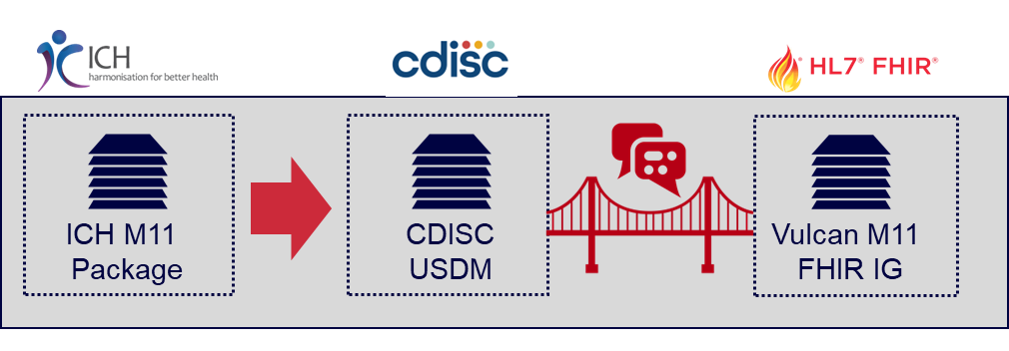
CDISC and HL7 FHIR Vulcan Collaboration

Slide 30
M2/M11 Technical Development Process
Guideline & Template
Tech Spec
Electronic Document
Human Readable Form
Machine- Readable Form
...
Standard Message Exchange Formats

Slide 31
Conclusion
Next steps

Slide 32
What to expect
It’s time to start paying attention
Transcelerate and CDISC will accelerate the operationalization of the digital protocol
We expect to engage in industry and regulatory pilots soon

Slide 33
Thank You!

