Slide 1
The TransCelerate / CDISC Digital Data Flow Project:
Practical Electronic Study Designs
PHUSE US Connect 2024 (DS02)
Dave Iberson-Hurst, CDISC Product Owner
26th February 2024

Slide 2


Meet the Speaker
Dave Iberson-Hurst
Title: Partner
Organization: d4k, Copenhagen
Dave has over 40 years’ experience across several industries with the last 20 years spent in the pharmaceutical industry combining his technology and software development experience with clinical data standards.
During this time, he has served as the CDISC CTO, worked on, and led, several CDISC teams, presented in many forums in Europe, the US, and elsewhere across the globe. He has worked closely with the FDA, EMA, HL7, ISO, and other standards organizations and was was a member of CDISC's Blue Ribbon commission. He is currently the CDISC Product Owner for the Digital Data Flow project.
He is a partner at data4knowledge in Copenhagen and is focused on getting greater value and utility from clinical trial data.

Slide 3
Disclaimer and Disclosures
The views and opinions expressed in this presentation are those of the author(s) and do not necessarily reflect the official policy or position of CDISC.
On contract to CDISC for the DDF work

Slide 4
Abstract
Over the last two years CDISC, in collaboration with Transcelerate, have been working on the Digital Data Flow (DDF) initiative. This initiative aims to “modernize clinical trials by enabling a digital workflow to allow for the automated creation of study assets and configuration of study systems to support clinical trial execution.”. The work is focused on the protocol and associated study designs and manifests itself in a new CDISC standard, the Unified Study Definitions Model (USDM), and an open-source implementation of the USDM known as the Study Definitions Repository (SDR).
Now coming to the end of the second phase, with the third phase about to commence, the DDF project delivers a new standard that allows for the digitization of study designs and the foundation of the digital protocol.
This presentation will detail:
The work performed in phases one and two.
The work planned as part of phase three.
The use cases supported by the model.
How the model/standard can enable protocol creation, automated data flow and interoperability between systems.
How the model/standard can be deployed and implemented today.

Slide 5
Agenda
Introduction
Digital Data Flow – The Project
Use Cases and Adoption
Phase Three: USDM Meets M11
Summary

Slide 6
Introduction

Slide 7
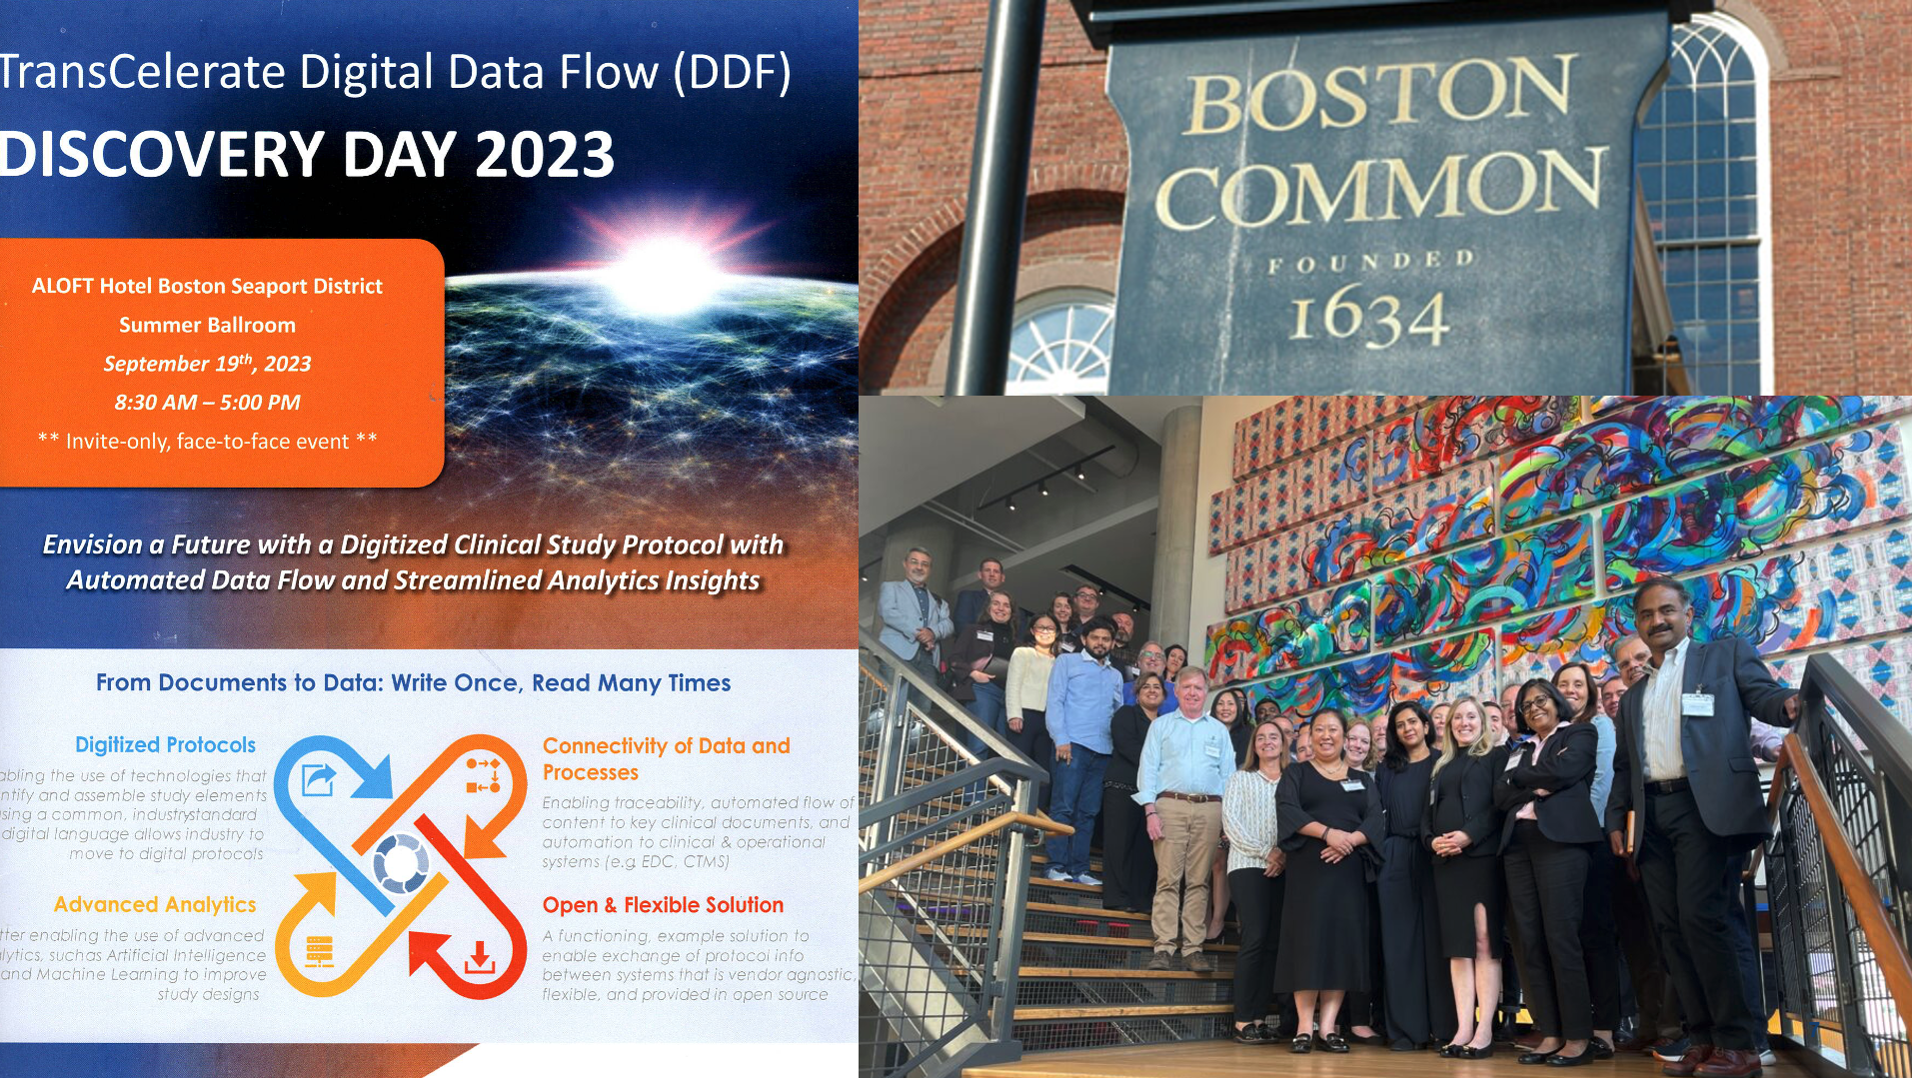
“Art of the Possible”

Slide 8
Digital Data Flow - The Project

Slide 9











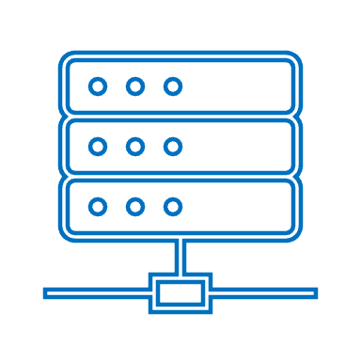
TransCelerate Digital Data Flow (DDF) Ambition
https://www.transceleratebiopharmainc.com/assets/digital-data-flow-solutions/
Write Once, Read Many
TODAY: Document-based paradigm for protocol creation, interpretation, and transcription into consuming systems
TOMORROW: Digital paradigm for protocol creation, with fully automated data flow and interoperability between systems
Digital Flow
Study Definitions Repository (SDR)
Reference Implementation
Unified Study Definitions Model (USDM)
API Specs
Controlled Terminology
Automation
Study Team
Design & Protocol Authoring
EDC
CTMS
DCT
IRT
EHR
EDC
CTMS
DCT
IRT
EHR
Protocol
9

Slide 10
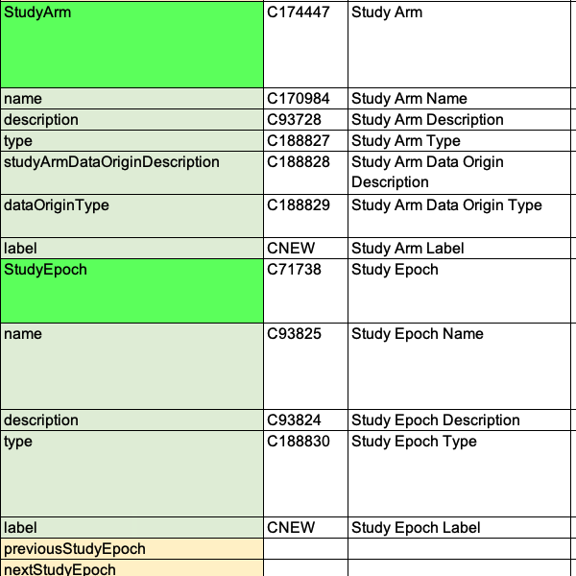
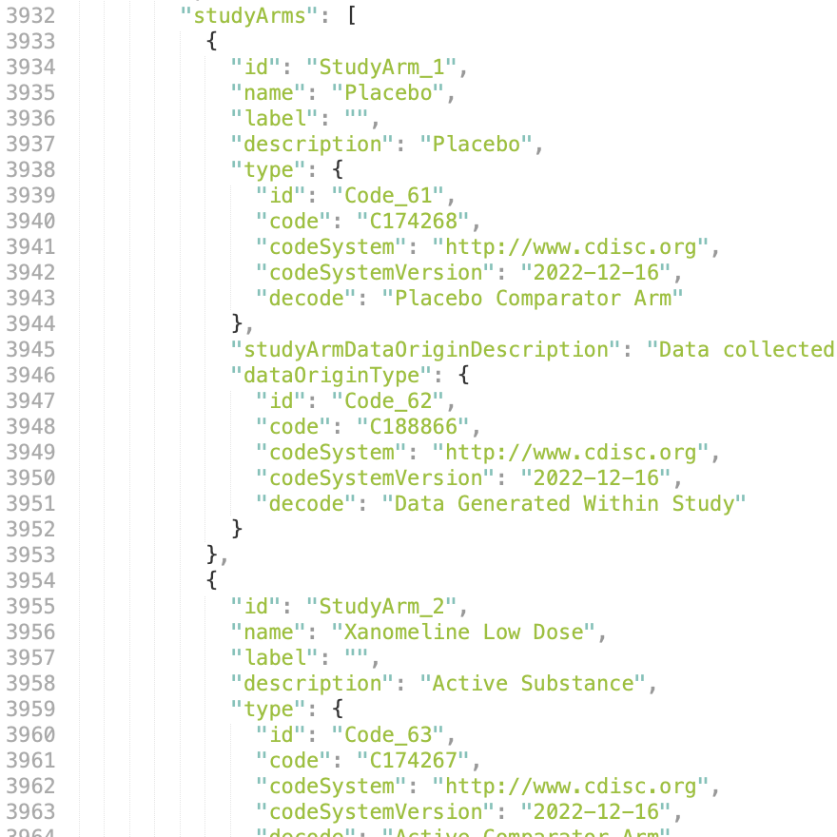
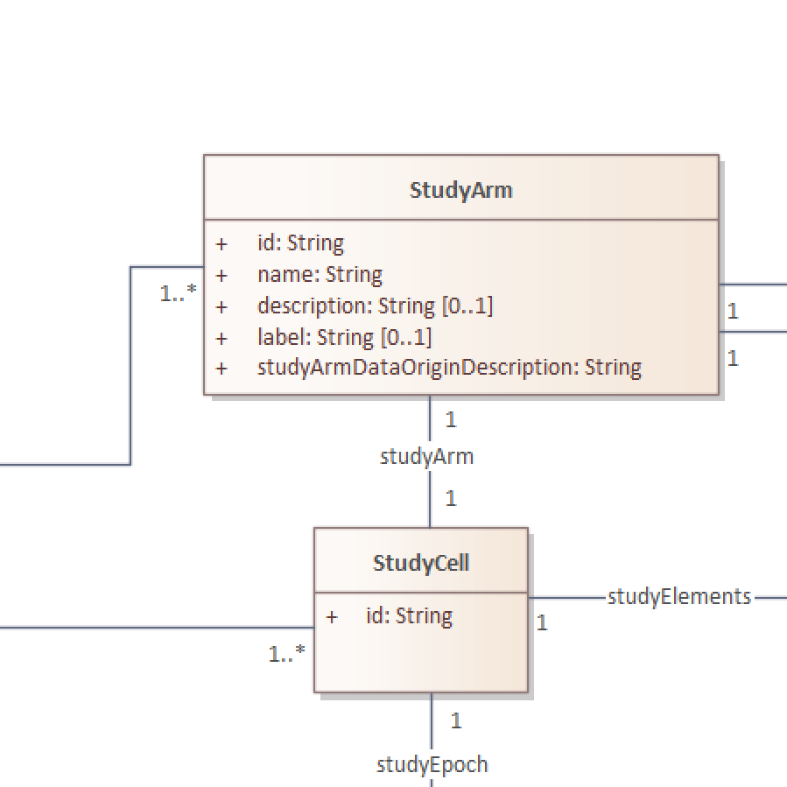
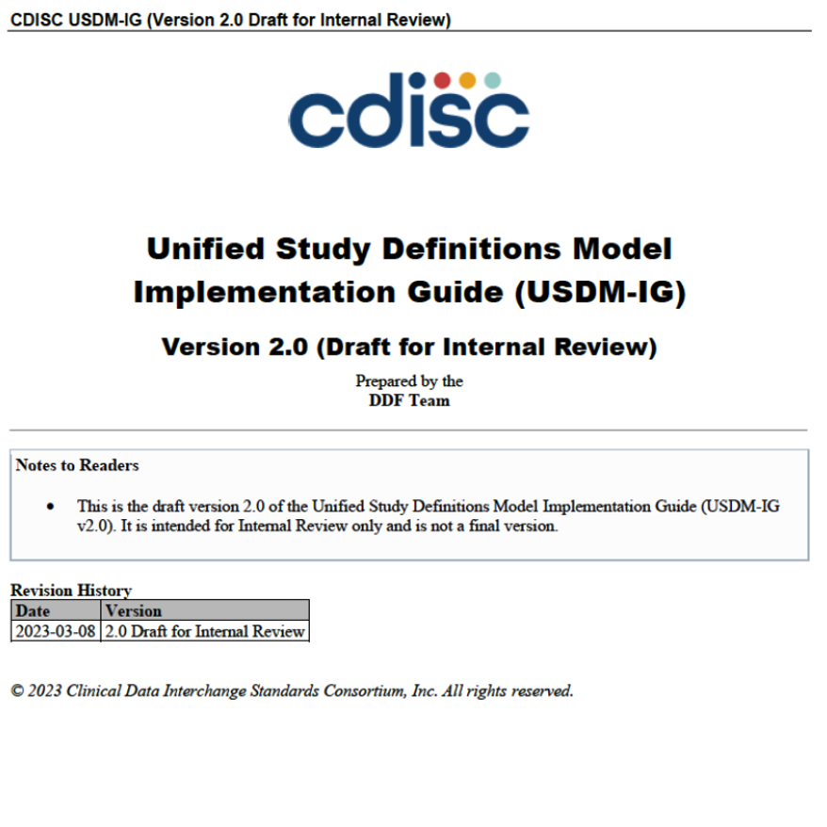
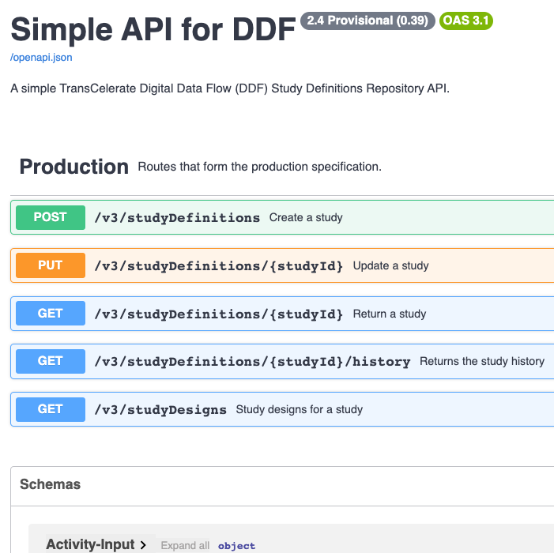
The USDM Standard
CDISC Controlled Terminology
Provides further semantics, complementing the UML model. Includes the definition of classes and attributes along with the definition of value sets
Logical Model
The UML logical model (a class diagram) that provides the basis for the USDM standard.
Examples
Example protocols implemented in the USDM with associated JSON files and visualisations
Implementation Guide
API Specification
Guidance on using the USDM model and ensuring conformance with the standard
Provides the means to exchange a single study between machines using a JSON API

Slide 11














USDM Status
PUBLIC REVIEW
PHASE ONE
PHASE TWO
PHASE THREE
July 2021 – July 2022
Oct 2022 – June 2023
July 2023 – Apr 2024
Unified Study Definitions Model (USDM)
Application Programming Interface (API) Specification
CDISC Controlled Terminology
Reference Architecture Conformance Tests
Being replaced by CDISC CORE rules
Essential Users Stories
Architecture Principles
Still applicable
Still applicable
Test Files
Implementation Guide

Slide 12
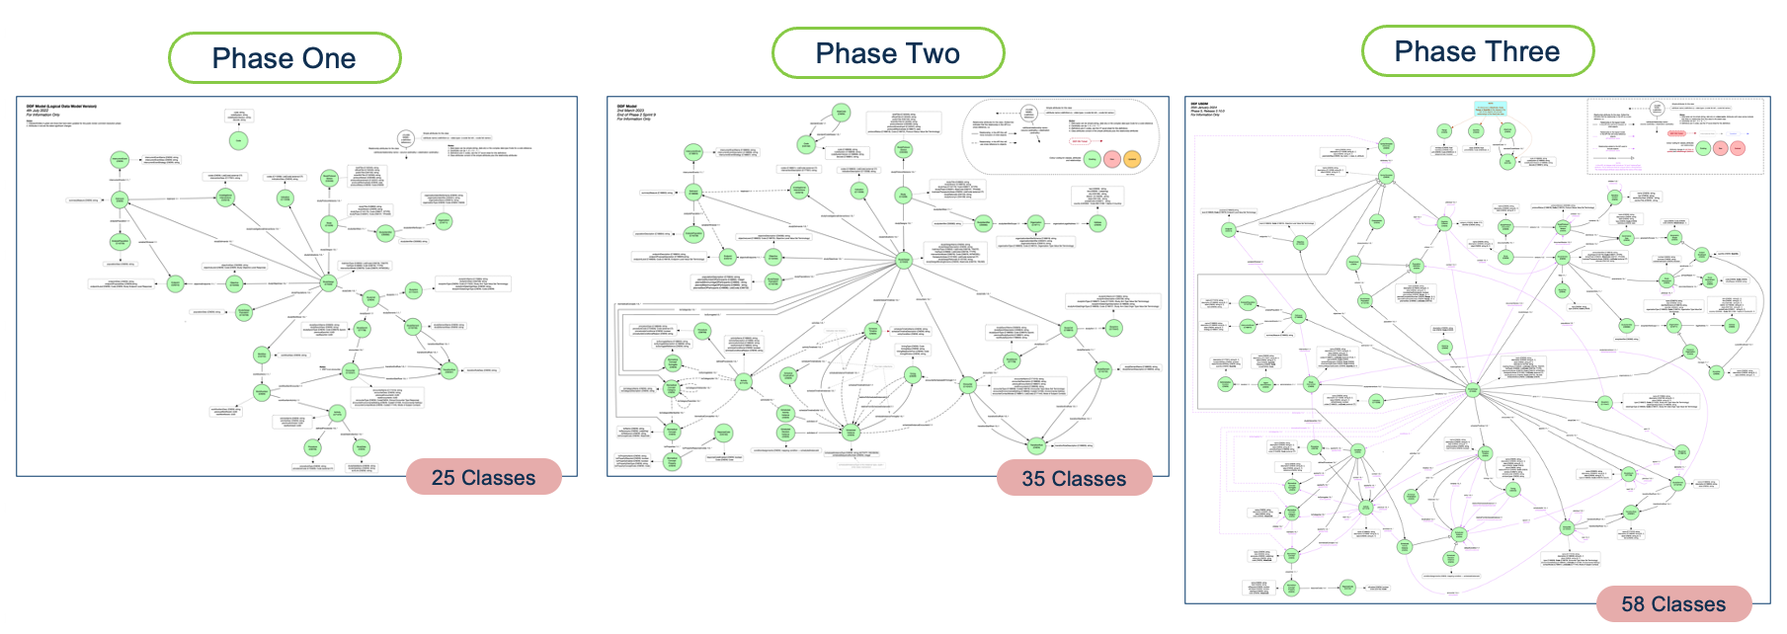
CDISC DDF / USDM: Phases One, Two and Three
  Solid foundation
  The protocol document was an external entity into which the structured content could be exported
  Focused on the structured elements of the protocol, e.g. the Schedule of Activities (SoA) & Biomedical Concepts (BCs)
  The protocol document still an external entity
  Now contains structured and unstructured elements
  The entire protocol document can be held within the USDM
  Allows for the protocol document to be generated from the model

Slide 13
CDISC DDF / USDM: Phases One, Two and Three
CT
Extend, Detail, Precision
Document & M11
Timing
BCs
  Solid foundation
  The protocol document was an external entity into which the structured content could be exported
  Focused on the structured elements of the protocol, e.g. the Schedule of Activities (SoA) & Biomedical Concepts (BCs)
  The protocol document still an external entity
  Now contains structured and unstructured elements
  The entire protocol document can be held within the USDM
  Allows for the protocol document to be generated from the model

Slide 14
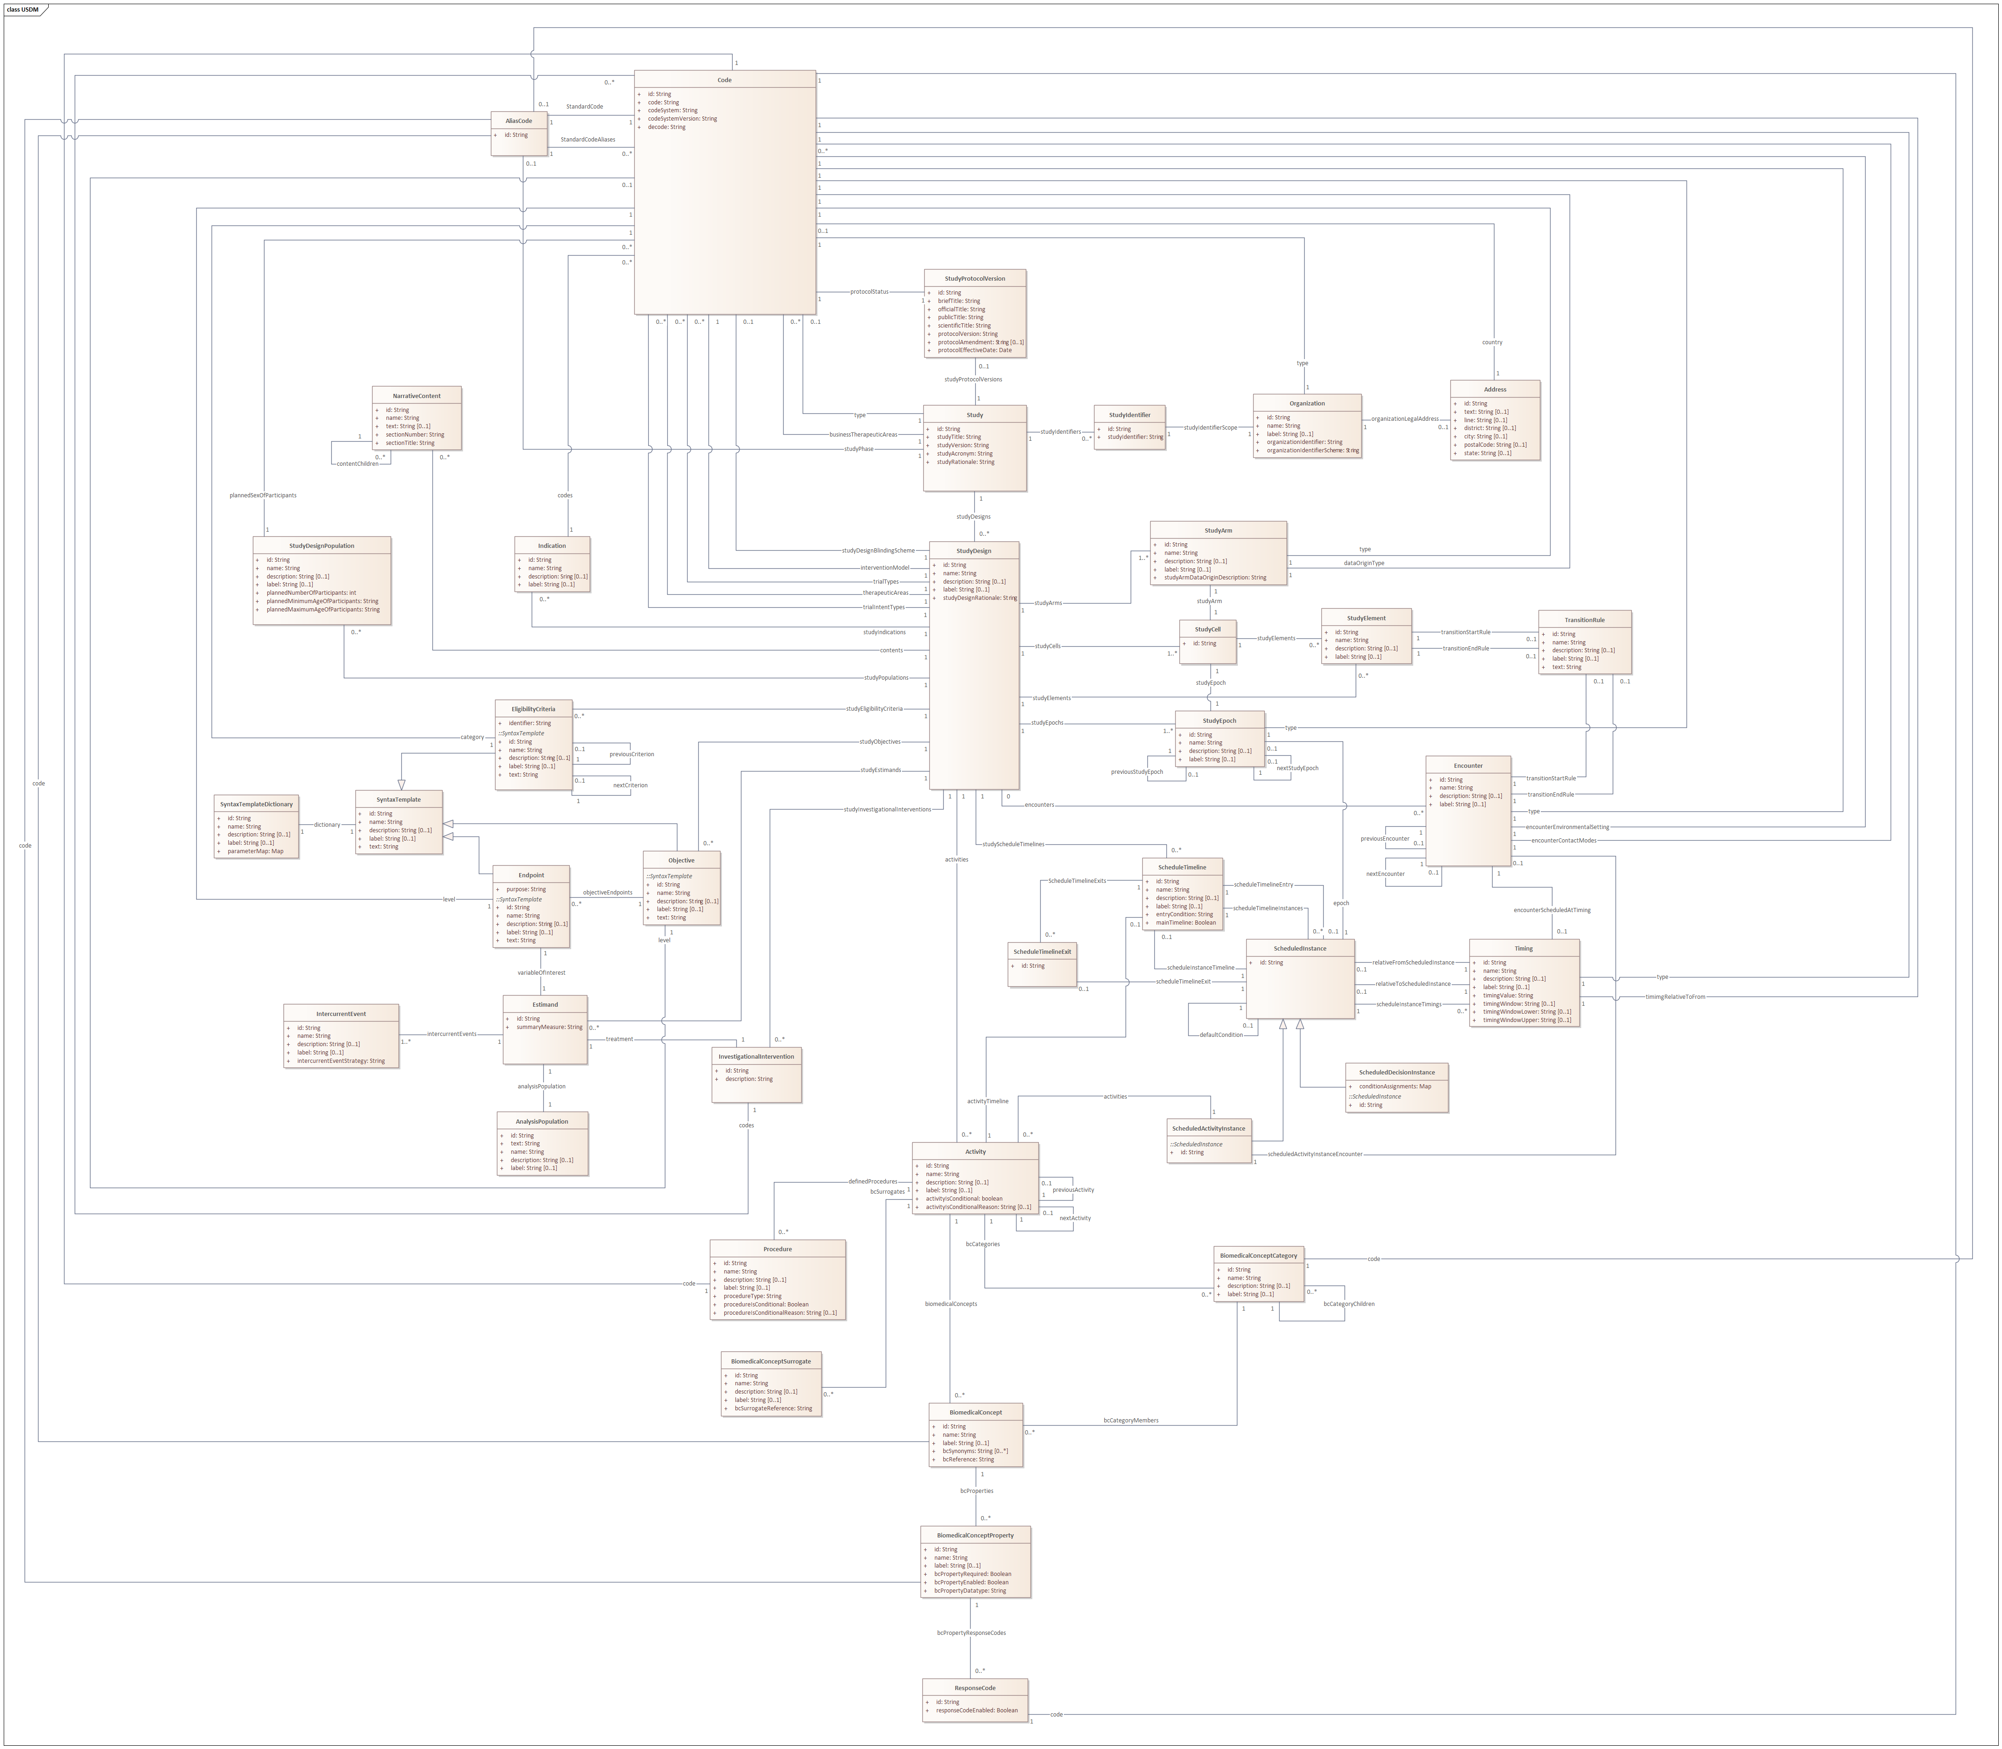
USDM Content
Controlled Terms
Study, Identifiers, Amendments
Unstructured Content
Estimands
Populations
Inclusion & Exclusion
Interventions & Indications
Objectives & Endpoints
Study Designs, Arms, Epochs
Detailed Study Logic, Encounters
Procedures, Biomedical Concepts

Slide 15
Use Cases and Adoption

Slide 16


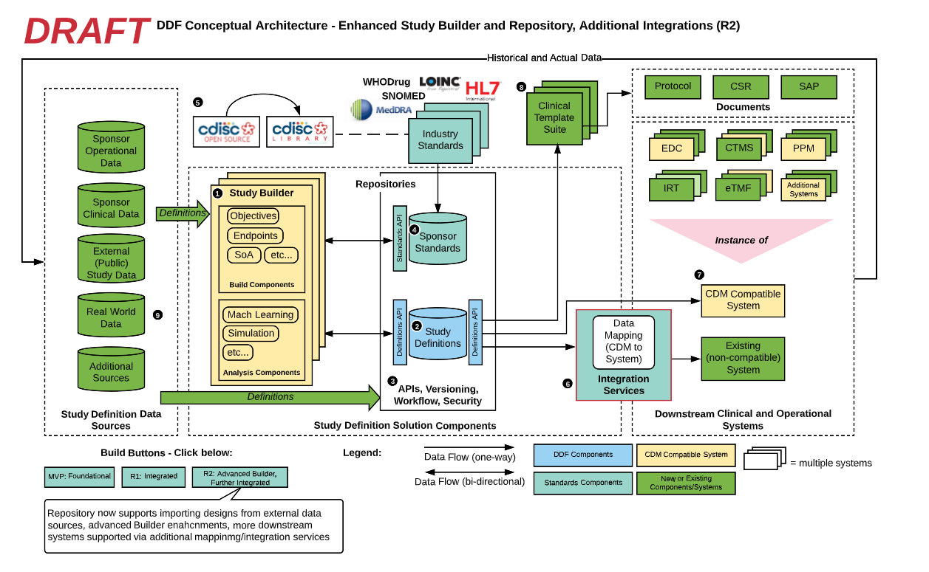
Use Cases
Data Capture
Automate the setup of data capture systems, incl. RWE, and capture the data.
CTMS, TMF …
The provision of protocol information to downstream systems needing “study” information.
SoA
Use the study design to build the FHIR SoA message.
Query
Having multiple studies that have a common structure allows for data export and query across the set of studies.
Data Import
Import data from a variety of sources. Can be re-exported thus allowing for conversion across versions.
SDTM
Automate the generation of SDTM datasets using the study design and BCs, including the “T” Domains.
Common Protocol Template (CPT)
Generation of the CPT from a study design.
Data Decay
Re-import data using the USDM as a framework to rebuild a study design & data using the SDTM Trial Design Domains.
Scoring
The “scoring” of a study for such purposes as site impact, subject impact, environmental impact etc.
Feasibility
The use of the design to determine study feasibility including subject recruitment. A study data template.
CT Registry
The provision of study information to a CT registry.
FAIR Data
The use of the design to aid Findability, Accessibility, Interoperability, and Reusability.
Any time we read some portion of a protocol … is a use case

Slide 17
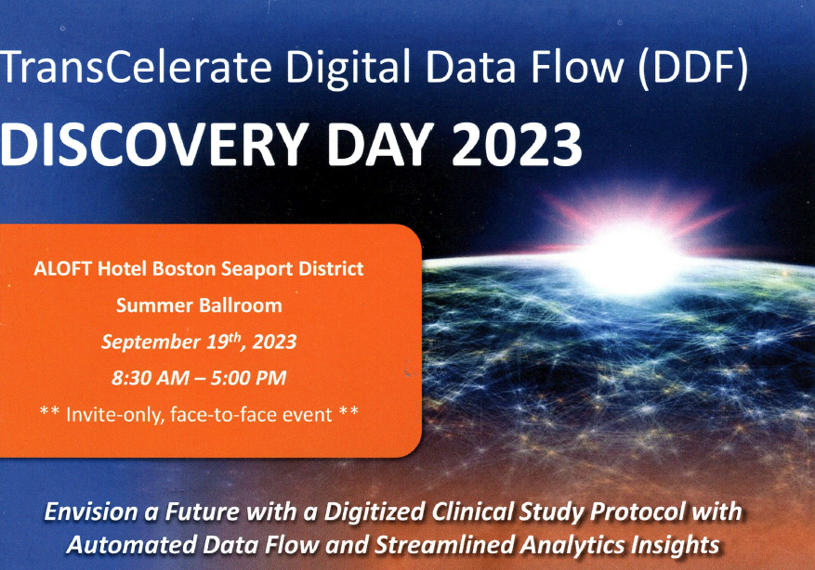


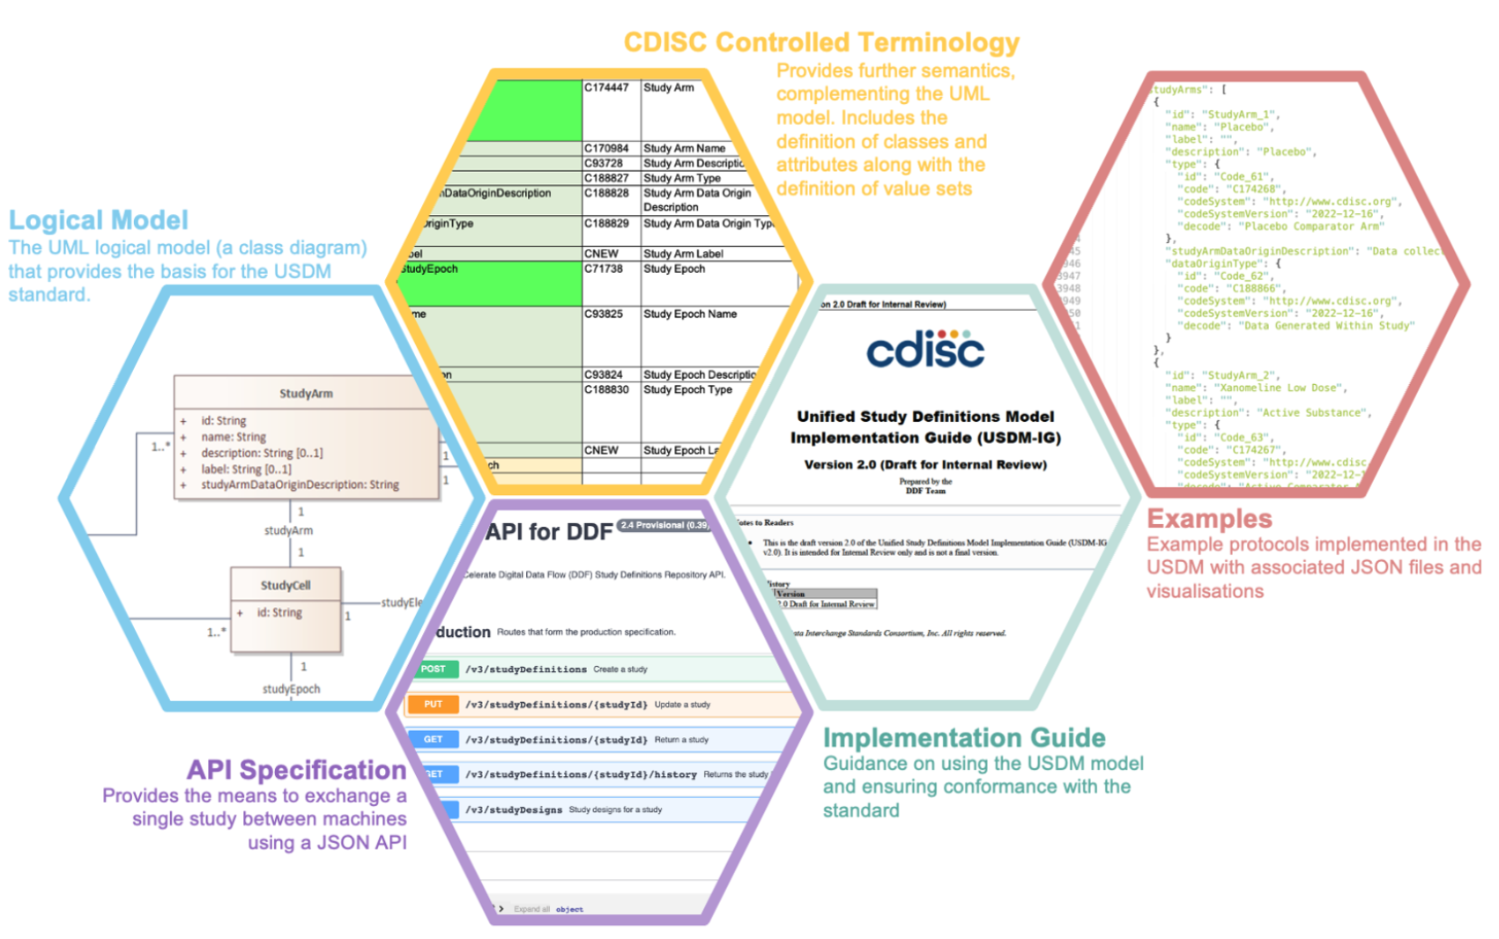

USDM Adoption
USDM Data Mining Application
Sponsor working with CDISC to develop a retrospective use case
Study Build Application
Sponsor is using the model for retrospective data ingestion
Study Build & EDC Configuration
Retrospective has a lower risk as a first point of entry into using USDM
Retrospective Studies
Prospective Studies
The “footnote conundrum”
Retrospective study re-creation brings a few challenges
We are not constrained by the “2D” paper world. USDM enables an “improved” reconstruction
Sponsors need to consider their “philosophy”, their approach to “reconstruction” of protocols
Study Build Application
Population of USDM from old protocols
Open Study Builder
Study Build Application
Academic institution using the model as a component of a data import application

Slide 18
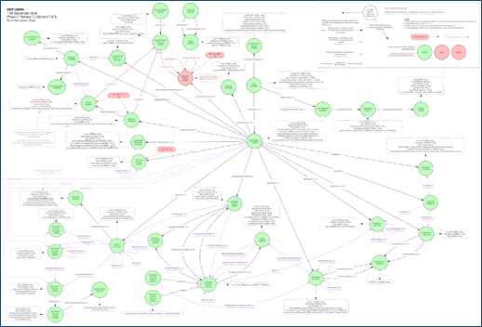

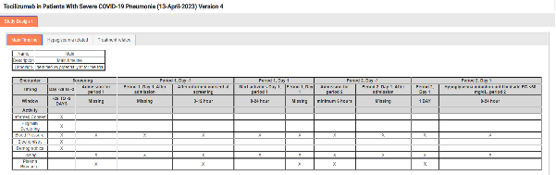

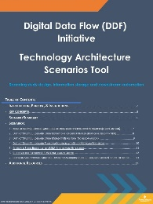
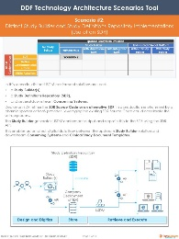
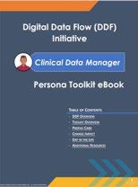
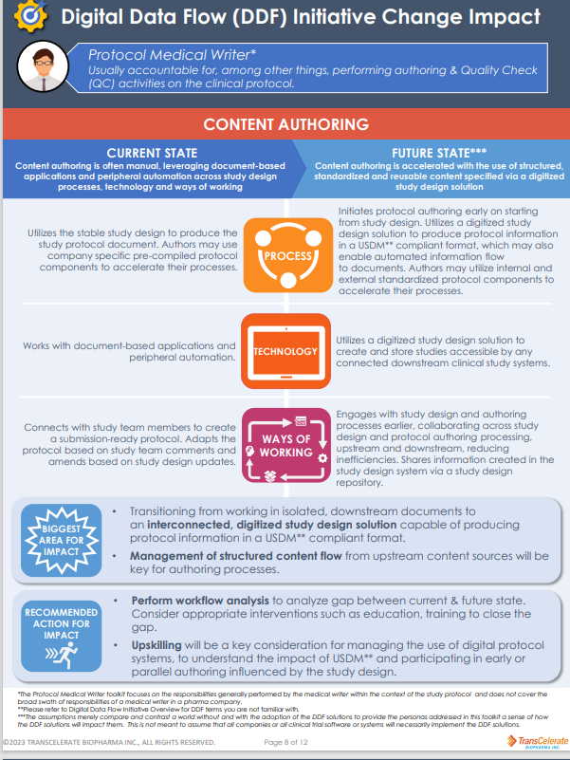
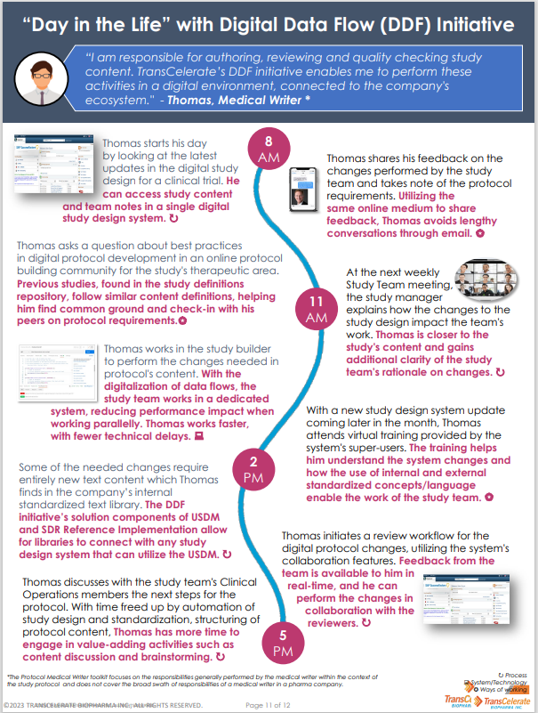
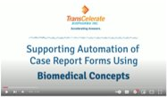
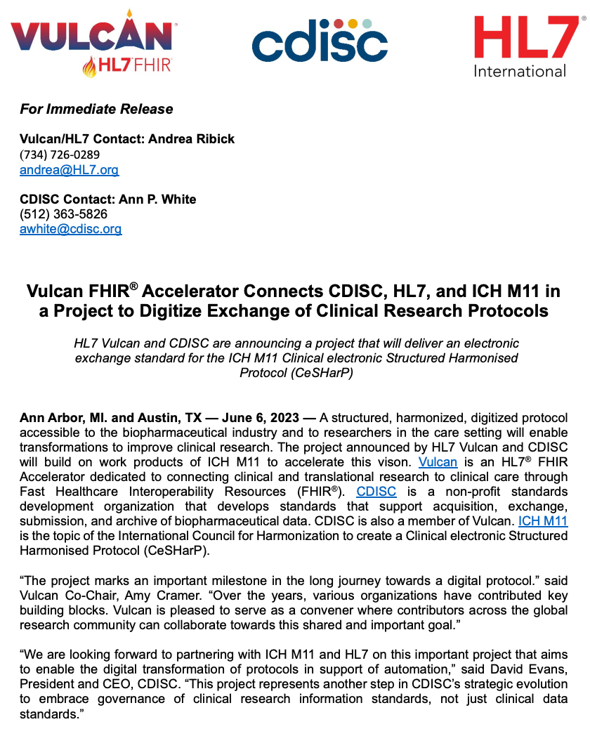
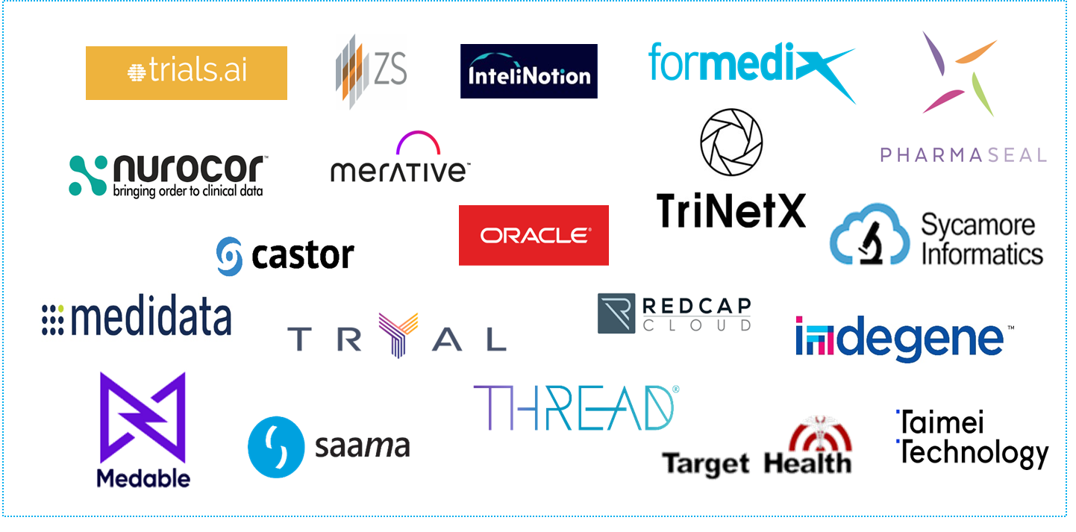


DDF Initiative encompasses technical delivery, change management, and industry engagement
TransCelerate’s Study Definitions Repository (SDR)
Unified Study Definitions Model (USDM) Reference Architecture
Digital Data Flow Initiative
Suite of DDF Adoption Resources, Videos & Change Management Tools
Continued Industry Collaboration between TransCelerate, CDISC ICH, and HL7
Growing Solution Collaboration Forum (SCF)*
*Company logos illustrate current involvement and are not used to imply endorsement of specific vendors for DDF or to identify a comprehensive list of all actual or potential future participants in DDF.

Slide 19
Phase Three: USDM Meets M11

Slide 20
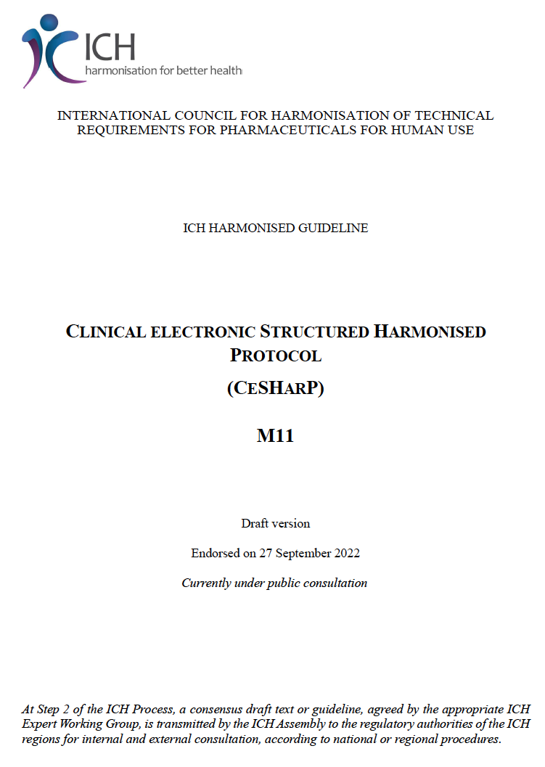
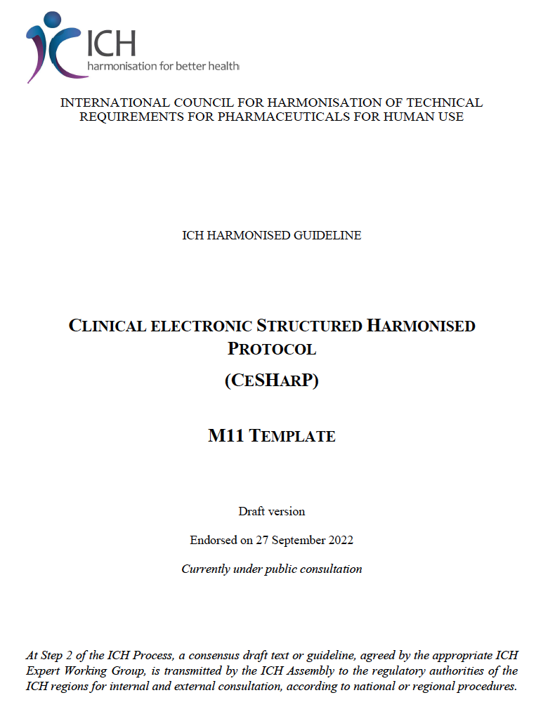
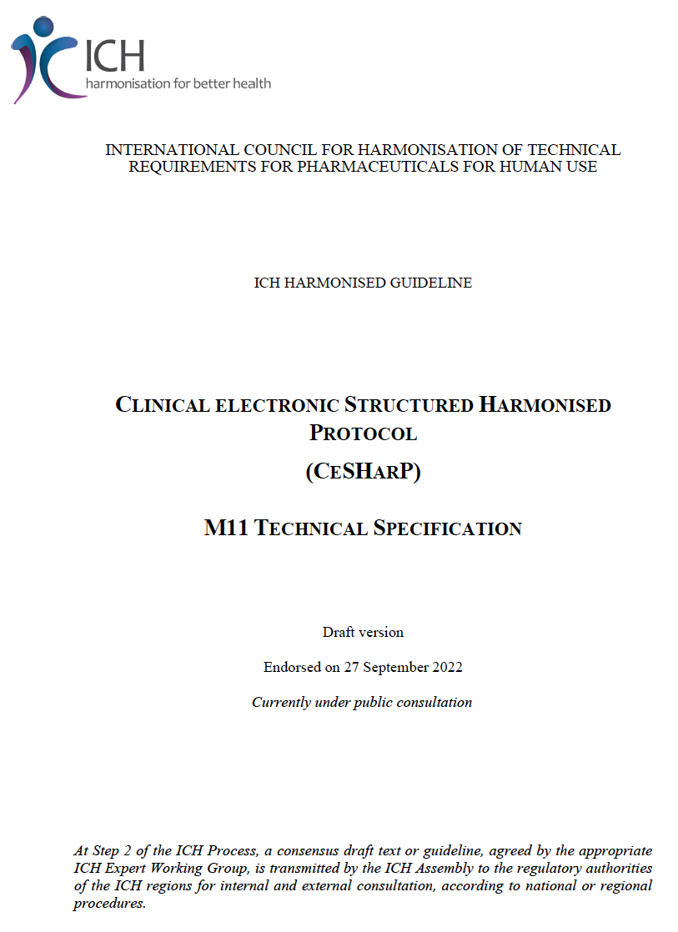
M11 Is …
ICH CLINICAL ELECTRONIC STRUCTURED HARMONISED PROTOCOL (CeSHarP)
https://www.ich.org/page/multidisciplinary-guidelines
Provides background, purpose, and
scope as a guideline
Provides the written format for the
‘Interventional Clinical Trial Protocol
Template’
Provides the technical representation
aligned with the guideline and protocol
template
Idea for slide layout from Rebecca Baker

Slide 21
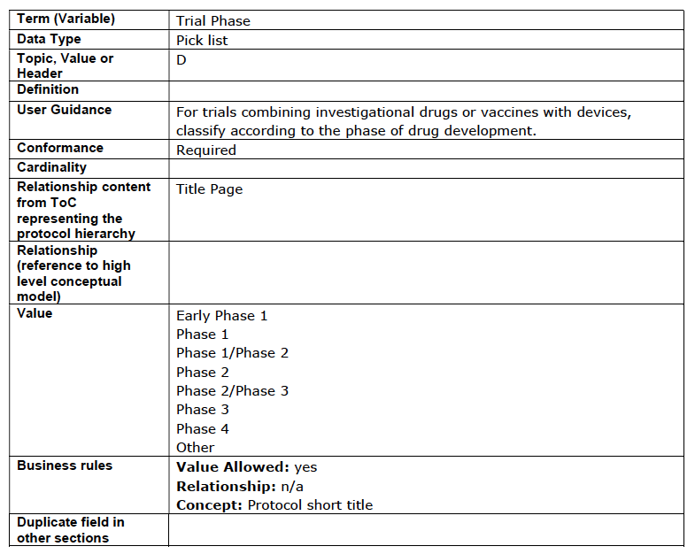
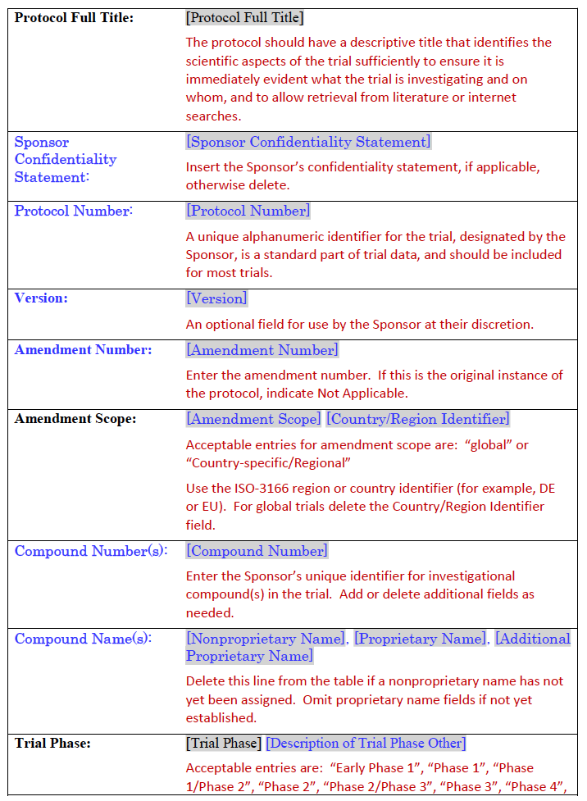
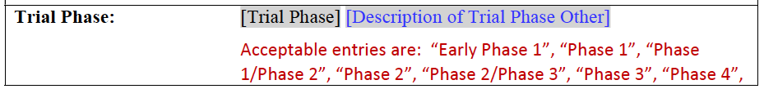
M11 Simple Example
Technical Specification
Template Specification

Slide 22
Controlled Terms
Technical Specification
Template Specification
CDISC CT
Trial Phase Response
(C66737)
NOT APPLICABLE
PHASE 0 TRIAL
PHASE I TRIAL
PHASE I/II TRIAL
PHASE II TRIAL
PHASE II/III TRIAL
PHASE IIA TRIAL
PHASE IIB TRIAL
PHASE III TRIAL
PHASE IIIA TRIAL
PHASE IIIB TRIAL
PHASE IV TRIAL
PHASE V TRIAL

Slide 23
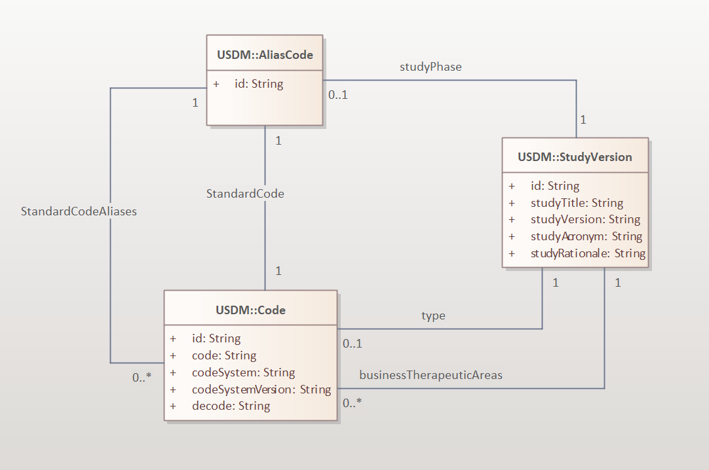
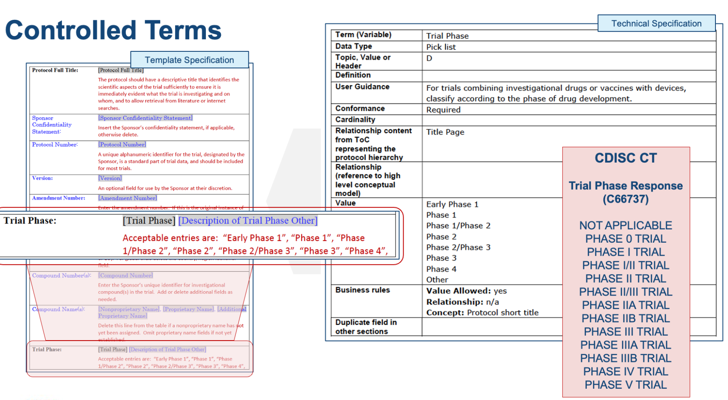
Put Into Context … the USDM
Walkthrough
A StudyVersion has a studyPhase
Linked to the AliasCode class via the relationship studyPhase
AliasCode can store:
  a single standard code (CDISC Trial Phase Response, C66737) using the Code class
  And zero or more other alias codes (e.g. a sponsor phase code) using the Code class to provide flexibility
Machine Perspective
USDM V3 accommodates ICH M11
Human Perspective

Slide 24
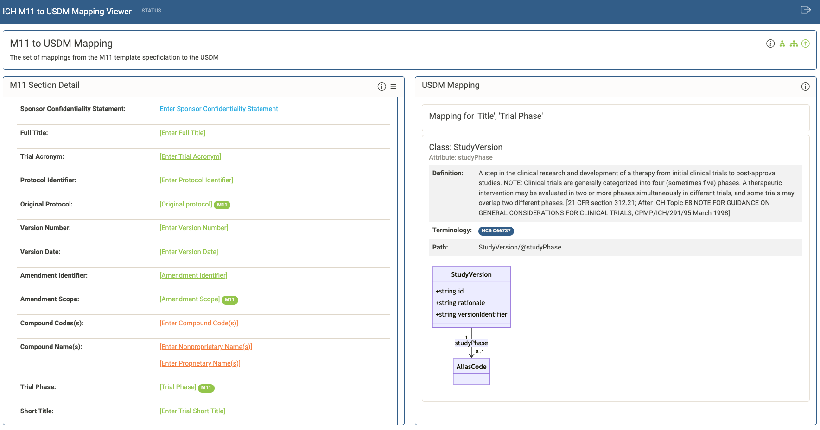
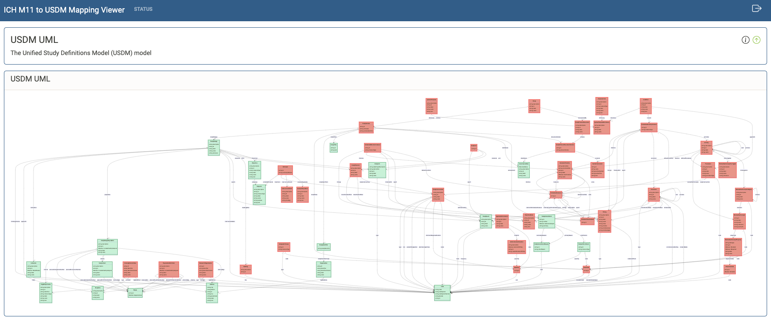
ICH M11 Protocol Specifications
Original plan was to release USDM V3 at a similar time to the first issue of the ICH M11 specification
ICH M11 Delivery timelines are currently being amended
USDM V3 accommodates the latest available ICH M11 information
ICH, HL7 Vulcan and CDISC now working together on the ICH Technical Implementation Guide (TIG) that will be part of the ICH release

Slide 25
Summary

Slide 26
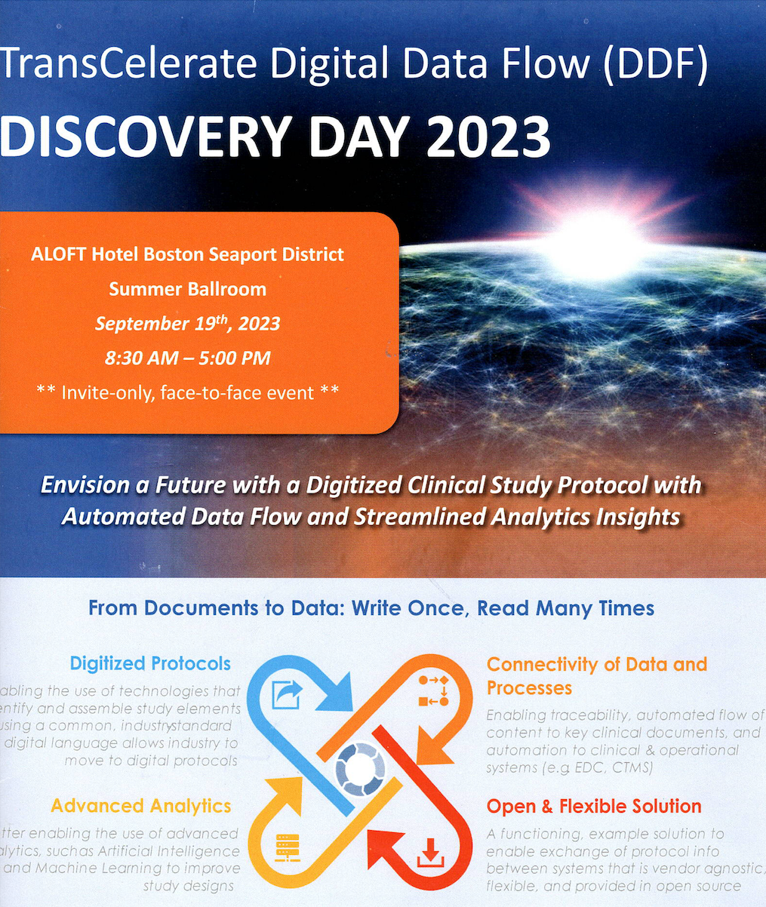
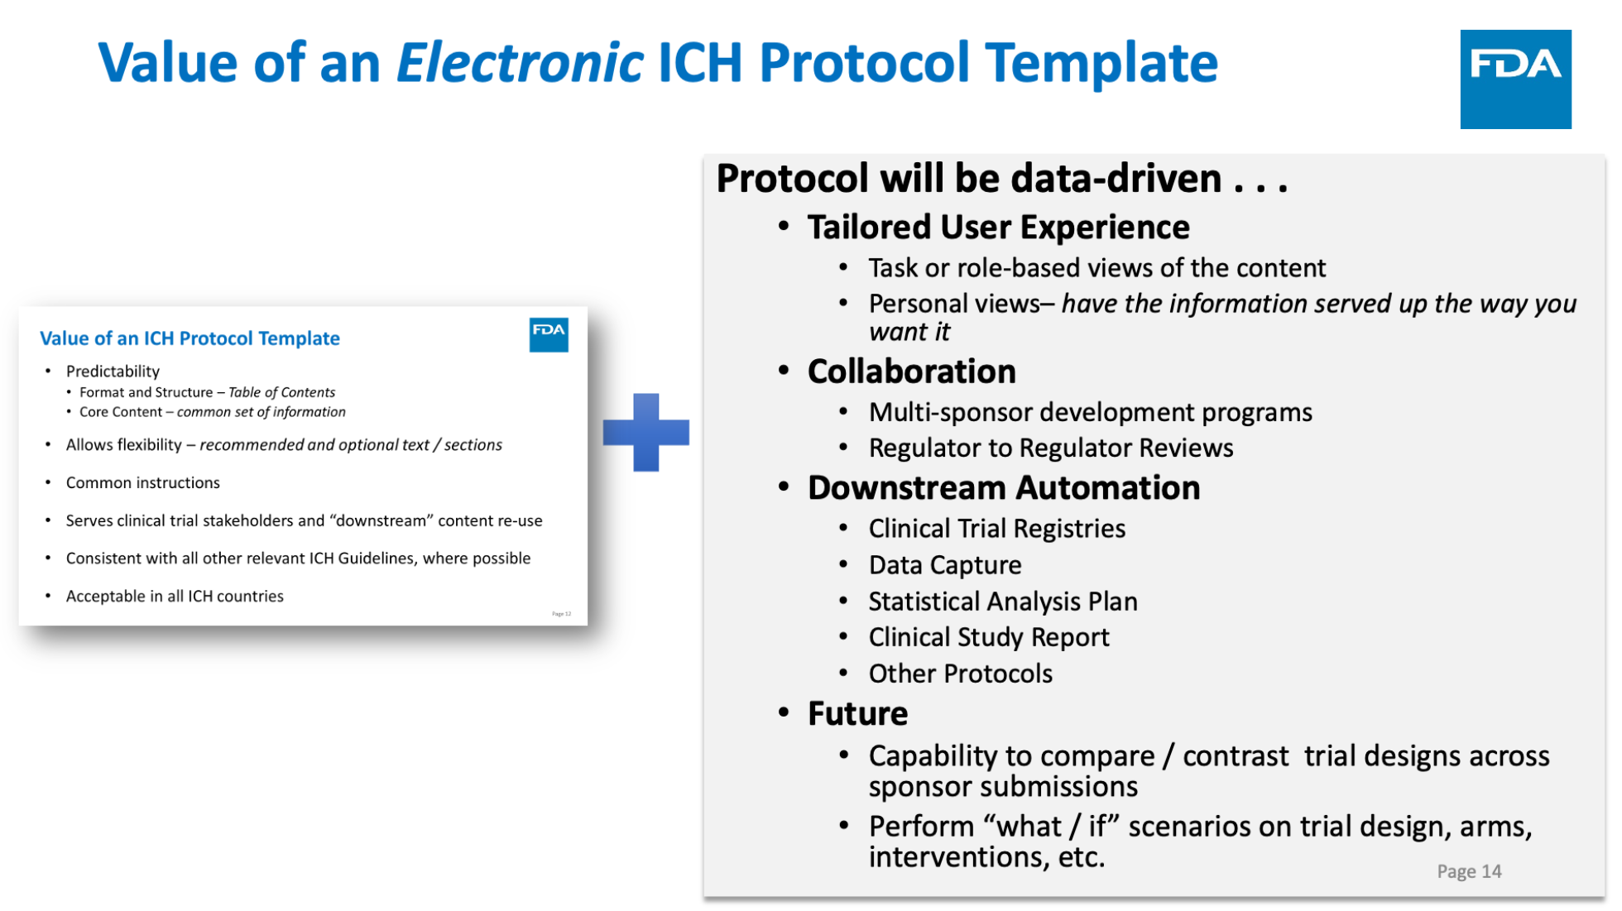
The Art Of The Possible
Tailored User Experience
Slide taken from CDISC US Interchange 2023 Presentation
“ICH M11 Clinical Electronic Structured Harmonized Protocol”
Ron Fitzmartin, PhD, MBA
Center for Biologics Evaluation and Research
Food and Drug Administration

Slide 27
Summary
Digital Data Flow / Unified Study Definitions Model (DDF/USDM) fills an important gap
USDM is but one building block, but an important one
USDM accommodation of ICH M11 will be an important step forward
Can support various use cases, the prospective versus the retrospective
We are only limited by our imagination, the art of the possible
27

Slide 28
Thank You
Contacts:
Dave IH: diberson-hurst.external@cdisc.org
John Owen: jowen@cdisc.org
Links:
Public Review: https://wiki.cdisc.org/display/PUB/DDF+Phase+3+Public+Review+Dashboard
Github: https://github.com/cdisc-org/DDF-RA
CDISC Team:
Gerry Campion
Drew Mills
Erin Muhlbradt
John Owen
Berber Snoeijer
Craig Zwickl

