Slide 1
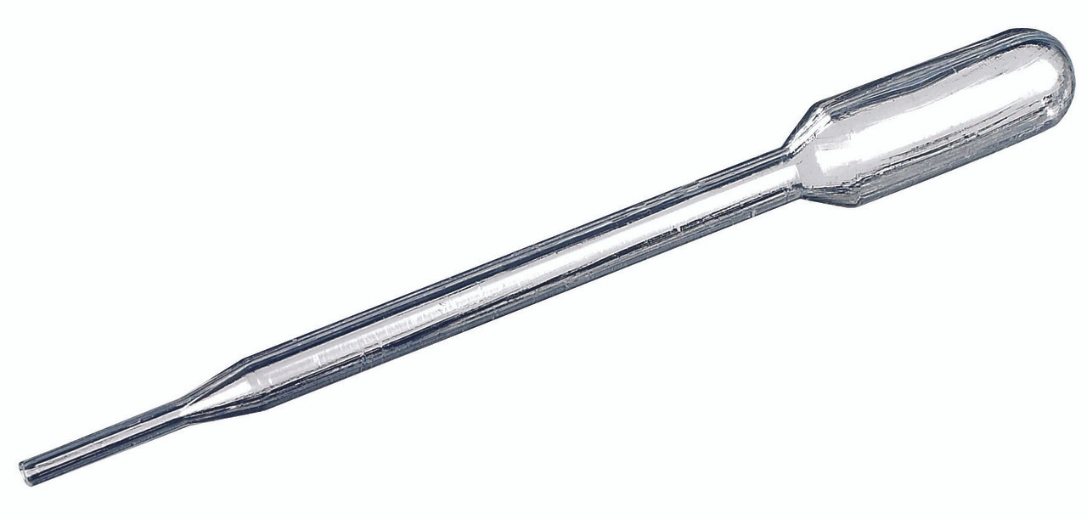
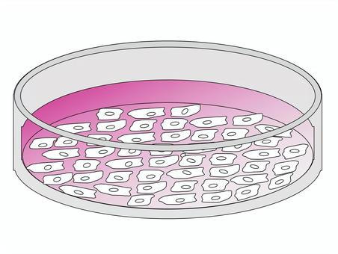
Specimen-based, in vitro Testing & Induced Responses – Commonality in the Collected Data
Cells, Microbes
(from a subject, grow in culture)
  Stimulating,
  Activating
  Response;
  Up-regulation
Added Agent
Concentration
Dosing Unit
  Inhibitory,
  Deactivating
  Response;
  Down-regulation
Added Agent Types (we have seen):
  Study/control drugs (e.g. antibiotics).
  Vaccines (e.g. vaccine viral component).
  Gene therapy (e.g. vector, theraptucis transgene product).
  Diagnostic or stimulating agents (e.g. TB antigens, Macrophage inflammatory protein).
Measured output:
Genetic profile: Changes in gene expression, mutation. – GF
Biomarker expression changes:
  Cell phenotyping – CP
  Microscopic findings, staining – MI
Immune responses: immune cell expansion & production of cytokines. - IS
Microbial Resistance: susceptibility/resistance of a microbe to antibiotics. - MS

Slide 2
Specimen-based, in vitro Testing & Induced Responses – Commonality in the Collected Data
Cells, Microbes
(from a subject, grow in culture)
  Stimulating,
  Activating
  Response;
  Up-regulation
Agent (Name) : CNDAGT (CP, LB, IS), AGENT (MS only)
Concentration: CONC (MS only)
Dosing Unit: CONCU (MS only)
  Inhibitory,
  Deactivating
  Response;
  Down-regulation
Added Agent Types (we have seen):
  Study/control drugs (e.g. antibiotics).
  Vaccines (e.g. vaccine viral component).
  Gene therapy (e.g. vector, theraptucis transgene product).
  Diagnostic or stimulating agents (e.g. TB antigens, Macrophage inflammatory protein).
Measured output in SDTM --TEST Examples:
Genetic profile: GFTEST = Gene Expression? (not sure)
Biomarker expression changes:
  CPTEST+CPMRKSTR = CD45+CD3+CD19- T-Lymphocytes
  MITEST = Human Epidermal Growth Factor Receptor 2
Immune responses: ISTEST = Cytokine-secreting Cells
Microbial Resistance: MSTEST = Diameter of the Zone of Inhibition, or Microbial Susceptibility

Slide 3
Specimen-based, in vitro Testing & Induced Responses – Commonality in the Collected Data
Cells, Microbes
(from a subject, grow in culture)
  Stimulating,
  Activating
  Response;
  Up-regulation
Agent (Name) : CNDAGT (CP, LB, IS), AGENT (MS only)
Concentration: CONC (MS only)
Dosing Unit: CONCU (MS only)
  Inhibitory,
  Deactivating
  Response;
  Down-regulation
** I think these should be the same 3 variables regardless of domains.
Problems/Thoughts:
We need a variable to map the added agent: drug, diagnostic agents, other substances (used to induce a in vitro response). Sometimes this is all people need, and the dataset stops here.
  There are two variables now serving the same function: CNDAGT and AGENT.
    Can we merge them? One less variable people have to worry about.
  We need a variable for the agent concentration. MSCONC works but this is limited to MS.
    Expand it to other specimen-domains, no need to create new variable.
  We need a variable for the agent dosing unit. MSCONCU works but this is limited to MS.
    Expand it to other specimen-domains, no need to create new variable.

Slide 4
Final Recommendations
MB-IS Team/ISMT Decisions:
We need a variable to map the added agent: drug, diagnostic agents, other substances (used to induce a in vitro response). Sometimes this is all we need, and the dataset stops here.
  There are two variables now serving the same function: CNDAGT and AGENT. – Yes true, but that ship had sailed, we can't do much at this point without causing significant changes.
  Can we merge them? One less variable people have to worry about. – No to this one because the kind of changes required to replace AGENT (MS) is too large and not worth people going back to fix their data. The –TSTCND (test condition) and –CNDAGT (test condition agent) variables can be available for all the other specimen-based domains when needed, EXCEPT, --CNDAGT (test condition agent) should NOT be used in MS (until use-cases arise that require both AGENT and CNDAGT to be needed for MS). We need to update their scopes in the newest SDTM Model.
We need a variable for the agent concentration.
  MSCONC works but this is limited to MS.
  Pro: already a standard variable, expand it to other specimen-domains, no need to create new variable. – Yes, we agree to extend --CONC to other domains. Meanwhile people can use it as a NSV for their respective domains. We may aim for IG4.0 for this change. If ISMT/GGG agrees, we need to update the variable Role, Notes and Definition so that it qualifies --CNDAGT as well.
We need a variable for the agent dosing unit.
  MSCONCU works but this is limited to MS.
  Pro: already a standard variable, expand it to other specimen-domains, no need to create new variable. – Yes, we agree to extend --CONCU to other domains. Meanwhile people can use it as a NSV for their respective domains. We may aim for IG4.0 for this change. If ISMT/GGG agrees, we need to update the variable Role, Notes and Definition so that it qualifies --CNDAGT as well.
Notes:
Jordan to go to SDTM and GGG for approval for the variable scope change. Jon to talk to Dianne about getting into IG4.0 scope and timeline and see if this is doable for 4.0.

