Slide 1
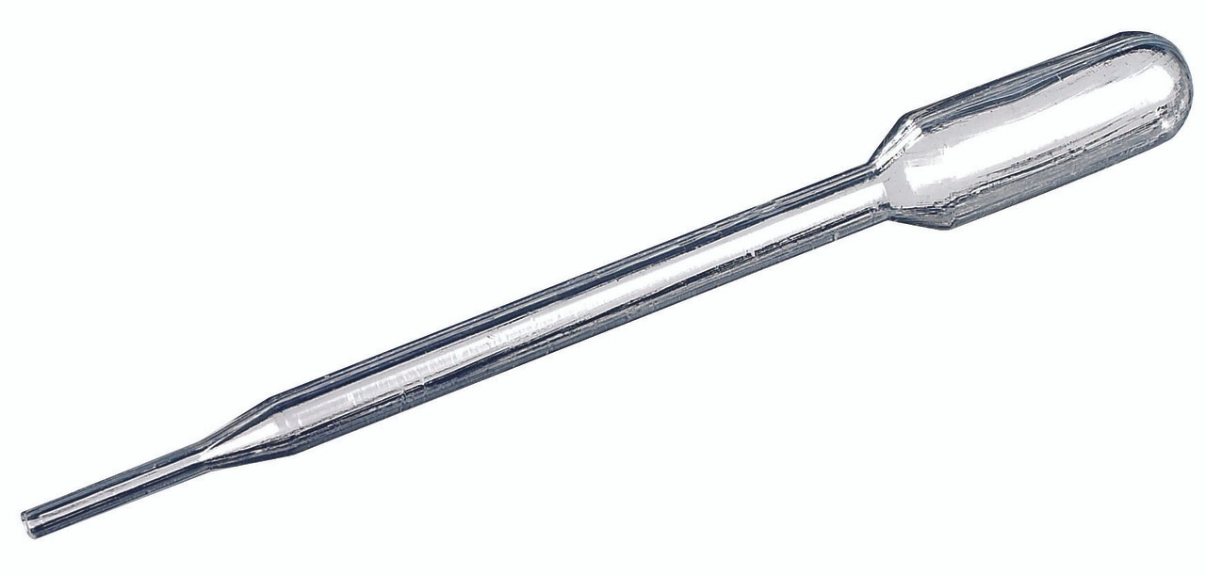
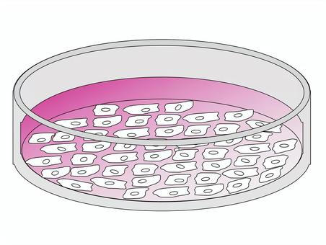
in vitro Testing & Induced Responses – Commonality in Collected Data
Cells,
Microbes,
Enzymes??
  Stimulating
  Response;
  Up-regulation
Added Agent
Concentration
Dosing Unit
  Inhibitory
  Response;
  Down-regulation
Added Agent Types (we have seen):
  Study/control drugs (e.g. antibiotics).
  Vaccines (e.g. vaccine viral component).
  Gene therapy (e.g. vector, theraptucis transgene product).
  Diagnostic or stimulating agents (e.g. TB antigens, Macrophage inflammatory protein).
  Other substances (e.g. a substrate for the enzymatic reaction)
Measured output:
Genetic profile: Changes in gene expression, mutation. – GF
Biomarker (e.g. protein) expression changes:
  Cell phenotyping – CP
  Microscopic findings, staining – MI
Immune responses: immune cell expansion & production of cytokines. - IS
Microbial Resistance: susceptibility/resistance of a microbe to antibiotics. - MS

Slide 2
in vitro Testing & Induced Responses – Commonality in Collected Data
Cells,
Microbes,
Enzymes??
  Stimulating
  Response;
  Up-regulation
Agent (Name) : CNDAGT (CP, IS), AGENT (MS only)
Concentration: CONC (MS only)
Dosing Unit: CONCU (MS only)
  Inhibitory
  Response;
  Down-regulation
Added Agent Types (we have seen):
  Study/control drugs (e.g. antibiotics).
  Vaccines (e.g. vaccine viral component).
  Gene therapy (e.g. vector, theraptucis transgene product).
  Diagnostic or stimulating agents (e.g. TB antigens, Macrophage inflammatory protein).
  Other substances (e.g. a substrate for the enzymatic reaction)
Measured output SDTM --TEST Examples:
Genetic profile: GFTEST = Gene Expression? (not sure)
Biomarker expression changes:
  CPTEST+CPMRKSTR = CD45+CD3+CD19+ T-Lymphocytes
  MITEST = Human Epidermal Growth Factor Receptor 2
Immune responses: ISTEST = Cytokine-secreting Cells
Microbial Resistance: MSTEST = Diameter of the Zone of Inhibition, or Microbial Susceptibility

Slide 3
in vitro Testing & Induced Responses – Commonality in Collected Data
Cells,
Microbes,
Enzymes??
  Stimulating
  Response;
  Up-regulation
Agent (Name) : CNDAGT (CP, IS), AGENT (MS only)
Concentration: CONC (MS only)
Dosing Unit: CONCU (MS only)
  Inhibitory
  Response;
  Down-regulation
Problems/Thoughts:
We need a variable to map the added agent: drug, diagnostic agents, other substances (used to induce a in vitro response). Sometimes this is all we need, and the dataset stops here.
  There are two variables now serving the same function: CNDAGT and AGENT.
  Can we merge them? One less variable people have to worry about.
We need a variable for the agent concentration.
  MSCONC works but this is limited to MS.
  Expand it to other specimen-domains, no need to create new variable.
We need a variable for the agent dosing unit.
  MSCONCU works but this is limited to MS.
  Expand it to other specimen-domains, no need to create new variable.
These variables function similarly for mapping exposure data like those in EX/EC, but EX/EC are used for live patients, in vivo studies, ONLY. Diane W confirmed it.

