Slide 1
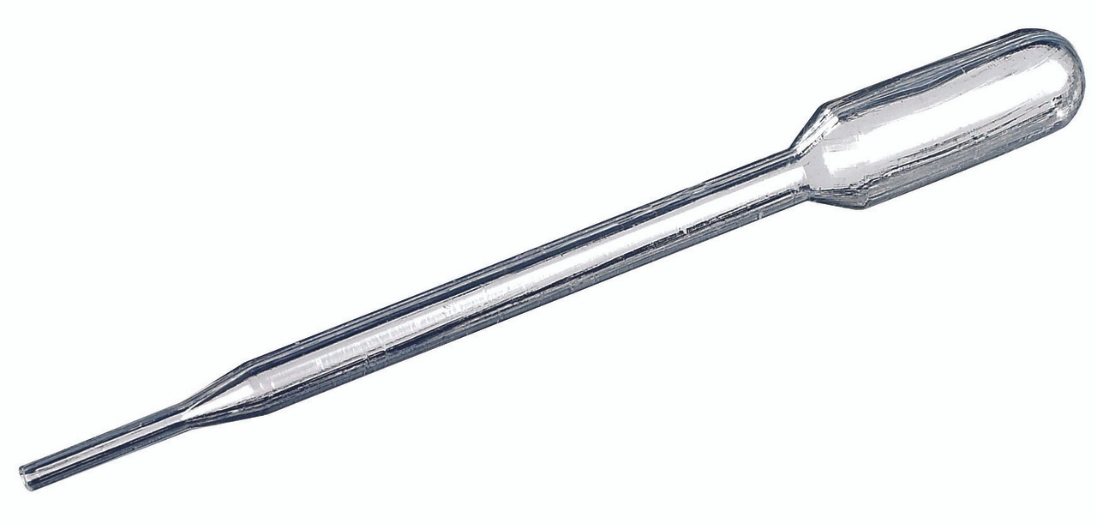
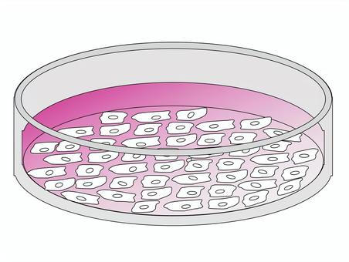
in vitro Testing & Induced Responses – Commonality in the Collected Data
Cells,
Microbes,
Enzymes??
  Stimulating
  Response;
  Up-regulation
Added Agent
Concentration
Dosing Unit
  Inhibitory
  Response;
  Down-regulation
Added Agent Types (we have seen):
  Study/control drugs (e.g. antibiotics).
  Vaccines (e.g. vaccine viral component).
  Gene therapy (e.g. vector, theraptucis transgene product).
  Diagnostic or stimulating agents (e.g. TB antigens, Macrophage inflammatory protein).
  Other substances (e.g. a substrate for the enzymatic reaction)
Measured output:
Genetic profile: Changes in gene expression, mutation. – GF
Biomarker expression changes:
  Cell phenotyping – CP
  Microscopic findings, staining – MI
Immune responses: immune cell expansion & production of cytokines. - IS
Microbial Resistance: susceptibility/resistance of a microbe to antibiotics. - MS

Slide 2
in vitro Testing & Induced Responses – Commonality in the Collected Data
Cells,
Microbes,
Enzymes??
  Stimulating
  Response;
  Up-regulation
Agent (Name) : CNDAGT (CP, LB, IS), AGENT (MS only)
Concentration: CONC (MS only)
Dosing Unit: CONCU (MS only)
  Inhibitory
  Response;
  Down-regulation
Added Agent Types (we have seen):
  Study/control drugs (e.g. antibiotics).
  Vaccines (e.g. vaccine viral component).
  Gene therapy (e.g. vector, theraptucis transgene product).
  Diagnostic or stimulating agents (e.g. TB antigens, Macrophage inflammatory protein).
  Other substances (e.g. a substrate for the enzymatic reaction)
Measured output in SDTM --TEST Examples:
Genetic profile: GFTEST = Gene Expression? (not sure)
Biomarker expression changes:
  CPTEST+CPMRKSTR = CD45+CD3+CD19+ T-Lymphocytes
  MITEST = Human Epidermal Growth Factor Receptor 2
Immune responses: ISTEST = Cytokine-secreting Cells
Microbial Resistance: MSTEST = Diameter of the Zone of Inhibition, or Microbial Susceptibility

Slide 3
in vitro Testing & Induced Responses – Commonality in the Collected Data
Cells,
Microbes,
Enzymes??
  Stimulating
  Response;
  Up-regulation
Agent (Name) : CNDAGT (CP, LB, IS), AGENT (MS only)
Concentration: CONC (MS only)
Dosing Unit: CONCU (MS only)
  Inhibitory
  Response;
  Down-regulation
** I think these should be the same 3 variables regardless of domains.
Problems/Thoughts:
We need a variable to map the added agent: drug, diagnostic agents, other substances (used to induce a in vitro response). Sometimes this is all people need, and the dataset stops here.
  There are two variables now serving the same function: CNDAGT and AGENT.
    Can we merge them? One less variable people have to worry about.
  We need a variable for the agent concentration. MSCONC works but this is limited to MS.
    Expand it to other specimen-domains, no need to create new variable.
  We need a variable for the agent dosing unit. MSCONCU works but this is limited to MS.
    Expand it to other specimen-domains, no need to create new variable.

Slide 4
in vitro Testing & Induced Responses – Commonality in the Collected Data
Team Decisions:
We need a variable to map the added agent: drug, diagnostic agents, other substances (used to induce a in vitro response). Sometimes this is all we need, and the dataset stops here.
  There are two variables now serving the same function: CNDAGT and AGENT. – Yes true, but that ship had sailed, we can't do much at this point without causing significant changes.
  Can we merge them? One less variable people have to worry about. – No to this one because the kind of changes required to replace AGENT (MS) is too large and not worth people going back to fix their data. The --CNDAGT variable can be available for all the other specimen-based domains when needed, we will add --CNDAGT to domains that require it when use-cases arise. --CNDAGT (per SDTM2.0) is limited to IS, LB and CP for now. We also need to add an assumption to the MS domain (for IG4.0) to say that because we will keep AGENT in MS, people should not use CNDAGT in MS. They serve the same purpose so using both will create a contradiction.
We need a variable for the agent concentration.
  MSCONC works but this is limited to MS.
  Pro: already a standard variable, expand it to other specimen-domains, no need to create new variable. – Yes, we agree to extend --CONC to other domains. Meanwhile people can use it as a NSV for their respective domains. We may aim for IG4.0 for this change. If ISMT/GGG agrees, we need to update the variable Role, Notes and Definition so that it qualifies --CNDAGT as well.
We need a variable for the agent dosing unit.
  MSCONCU works but this is limited to MS.
  Pro: already a standard variable, expand it to other specimen-domains, no need to create new variable. – Yes, we agree to extend --CONCU to other domains. Meanwhile people can use it as a NSV for their respective domains. We may aim for IG4.0 for this change. If ISMT/GGG agrees, we need to update the variable Role, Notes and Definition so that it qualifies --CNDAGT as well.

