Slide 1
The State of the RS Domain: Overloaded and Missing Data

Slide 2
Evolution of the RS Domain Scope from the SDTMIG v3.2 to v3.4
Instruments that are considered as Clinical Classifications
(For all disease types/therapeutic area CC data)
Tumor Disease Response to Treatment
(For Oncology Data ONLY)
SDTMIG v3.2 Scope
SDTMIG v3.3/3.4 Scope
Tumor Disease Response to Treatment
(For Oncology Data ONLY)
Onc-RS
RS
CC-RS
IG3.2 RS: A findings domain for the assessment of disease response to therapy.
IG3.3-3.4 RS: A findings domain for the assessment of disease response to therapy, or clinical classification based on published criteria.
Notes:
The Disease Response to Treatment RS domain was introduced in the SDTMIG v3.2. This domain was specifically a part of the oncology three-domains structure. Together with the TU and TR domains, these three oncology domains are used to represent information about the identification of tumor lesions, the quantitative/qualitative measurements/characteristics of the identified lesions, and also for mapping data related to the changes in tumor burden, specifically, the assessment of both tumor shrinkage and disease progression.
Around the same time, the CDISC QRS team was also working on a new domain called clinical classification. The domain was initially created in order to properly model and represent information collected from the composite score type of instruments such as the APACHE. In fact, APACHE was the first modeled use-case in the then-nascent CC domain. The plan at the time was to publish the CC domain in the SDTMIG v3.3, under the QRS umbrella. Together with the QS and FT domains, the QRS domain trio should be used to map information collected from questionnaires, functional tests and clinical classifications.
However, it was determined that the data collected for both CC and RS are very similar in structure, and therefore, it was not necessary to maintain a separate CC domain. Ultimately the decision was to combine and incorporate the CC domain into the RS domain scope in the SDTMIG 3.3. This is the reason why in the current RS domain scope, there are now two types of data: the tumor response to treatment data (which off course only concerns cancer study data), and also the clinical classifications which cover all types of diseases (it is not limited to oncology).

Slide 3
Oncology-RS and CC Differences: Codelists
Clinical Classifications
Tumor Disease Response to Treatment
RS
RS-Oncology Only
CC-All Disease Types
RSCAT - supported by 1 CAT codelist: ONCRSCAT (Category of Oncology Response Assessment) codelist.
  Examples: RECIST 1.1, AJCC V4-V8, WHO BREAST CANCER 2006, etc.
RSTEST-CD - supported by 2 TEST-CD codelists: ONCRTS-CD (Oncology Response Assessment Test Name/Code).
RSSTRESC - supported by 1 standard result codelist: ONCRSR (Oncology Response Assessment Result).
RSCAT - supported by 1 CAT codelist: CCCAT (Category of Clinical Classifications).
  Examples: AJCC V7, APACHE II, CANADIAN CV SOCIETY GRADING ANGINA, etc.
RSTEST-CD - supported by 160 instrument-specific CCTEST-CD codelists
RSORRES - supported by 55 instrument-specific original result CC codelists.
RSSTRESC - supported by 55 instrument-specific standardized result CC codelists.
(Variables) | RSCAT | RSTEST-CD | RSORRES | RSSTRESC
Oncology | ONCRSCAT | ONCRTS-CD |  | ONCRSR
Clinical Classification | CCCAT | KDPI01TC-TC | HBI0104OR | HBI0101STR
 |  | AIMS01TC-TN | KFSS101OR | KPSS0101STR
 |  | APCH1TC-TN | APCH102OR | APCH103STR
 |  | HAMA1TC-TN | AIMS0101T07OR | AIMS0101T07STR
 |  | … ... | … … | … …
 |  | 160 CC TC-TN codelists | 55 CCORRES codelists | 55 CCSTRESC codelists
Total # of Codelists | 2 | 162 | 55 | 56
(As of 2023 December publication)
Notes:
As of December 2023, there are a total of 275 codelists in the RS domain, to support the various RS variables.

Slide 4
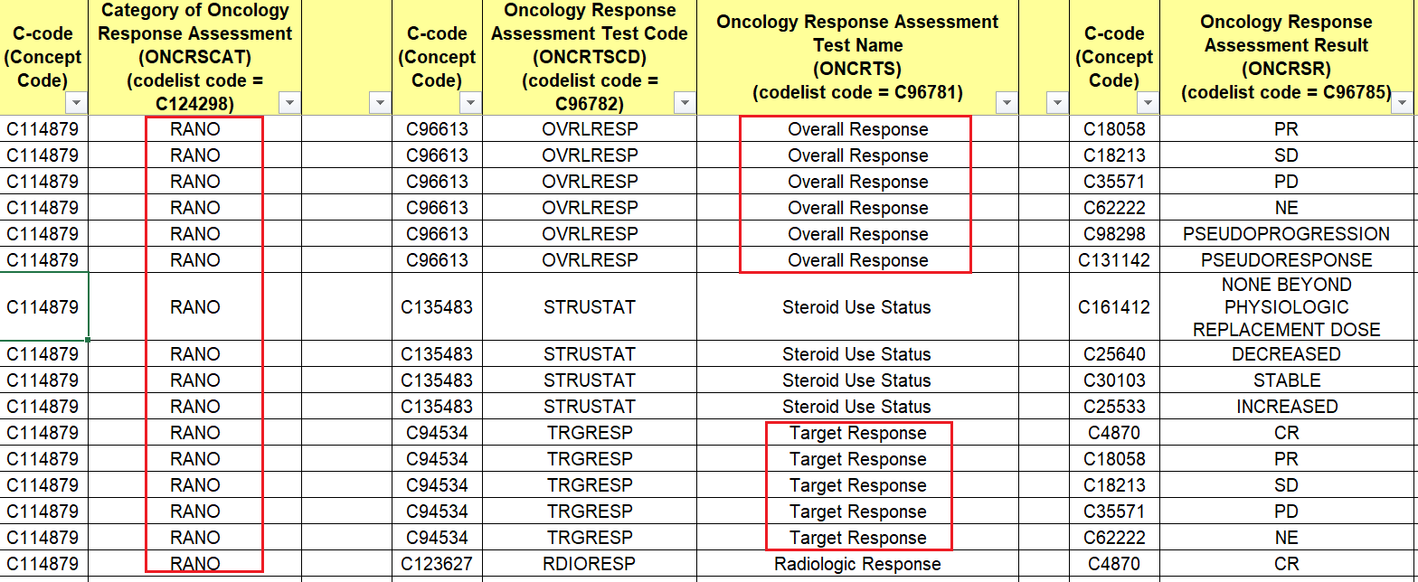
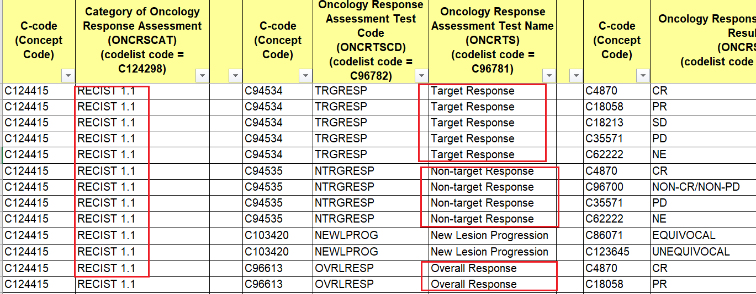
Oncology-RS and CC Differences: Terminology and Data Mapping
RS
RS-Oncology
Clinical Classifications
Tumor Disease Response to Treatment
“Generic” oncology assessments from ONCRTS-CD to be used with, and grouped by a “specific” oncology criterion value in ONCRSCAT.
Onc-Tests and Onc-Results can be “recycled, reused” for mapping but ultimately they mean different tumor responses to treatment depending on the specific criterion you are using to make the evaluation.
RANO Criterion Mapping
RECIST Criterion Mapping
For TEST = Target (lesion) Response/C94534,
the result of CR (Complete Response) per RANO is defined as: complete disappearance of all enhancing measurable and non-measurable disease sustained for at least 4 weeks; no new lesions; stable or improved lesions; patients must be off corticosteroids (or on physiologic replacement doses only); and stable or improved clinically.
For TEST = Target (lesion) Response/C94534,
the result of CR (Complete Response) per RECIST 1.1 is defined as: disappearance of all target lesions. Any pathological lymph nodes (whether target or non-target) must have reduction in short axis to <10mm.
Notes:
The left picture here is the tumor response data mapping for the RANO criterion (Response assessment in neuro-oncology criteria); and on the right, this is the tumor response assessment mapping for the RCICIST 1.1. As highlighted by the red boxes, the oncology tests and standardized results for both criteria have the same values; the tests and results are re-used between the two criteria data mapping sets. However, if you look at the oncology CAT column, it specifies which tumor response criterion you are using to make that evaluation. What this means is that a result of complete response for the target lesion per the RANO criterion is very different from the complete response defined by RECIST. Because RANO and RECIST have different definitions on what’s considered as a complete response for the target or non-target lesions. So this way, even though the oncology tests and results are re-used between to two data mappings sets, the CR per RANO has a different set of clinical definitions than the CR per RECIST, you will have to look up and rely on the criterion name indicated by the Oncology CAT, to truly understand the meaning of that clinical output of CR.

Slide 5
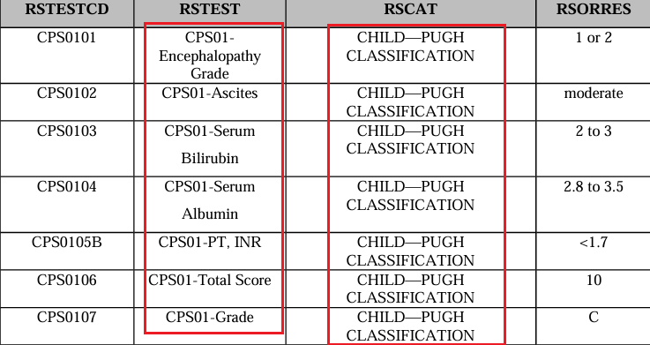
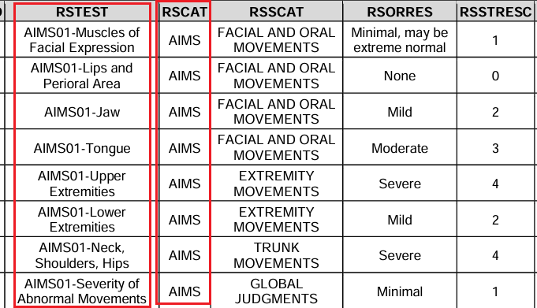
Oncology-RS and CC Differences: Terminology and Data Mapping
Clinical Classifications
Tumor Disease Response to Treatment
RS
RS-Clinical Classification
“Specific” Clinical Classification TEST-CD assessments to be used with, and grouped by a “specific” Clinical Classification value in CCCAT.
CC-Tests and CC-Results are always instrument-specific. You HAVE to use the named CCTEST-CD tests with the same named CCCAT. There is no reusability for the CCTEST-CDs, that’s why there are 160 CCTEST-CD codelists, each is unique and was created for a single clinical classification.
“CPS01” is the Synonym to the Child-Pugh CAT submission value, and indicates these tests are specifically associated with the Child-Pugh.
“AIMS01” in RSTEST indicates these tests are associated with AIMS (Abnormal Involuntary Movement Scale ).
Notes:
Clinical classification standards and terminology development are overseen by the QRS teams. Our business rules dictate that we create instrument-specific Clinical Classification tests and results. There is absolutely NO re-usability of tests and results between different instruments. This is also why we have 160 CCTEST-CD codelists and over 100 original and standardized results codelists, because each set of terminology is unique to the instrument it supports.
The QRS team is able to create instrument-specific TESTs by incorporating a stem value, which is the synonym of the instrument CAT submission value; that stem value is uniquely associated with a single clinical classification. In the examples here, the CPS01 and AIMS01 values are the unique instrument stems that we build into the TESTs and they clearly indicate that these tests can only be used for the Child-Pugh classification and AIMS. Also, both Child-Pugh and AIMS are controlled as CCCATs under the RSCAT variable, and these CATs should be used with their corresponding instrument-specific CCTESTs.

Slide 6
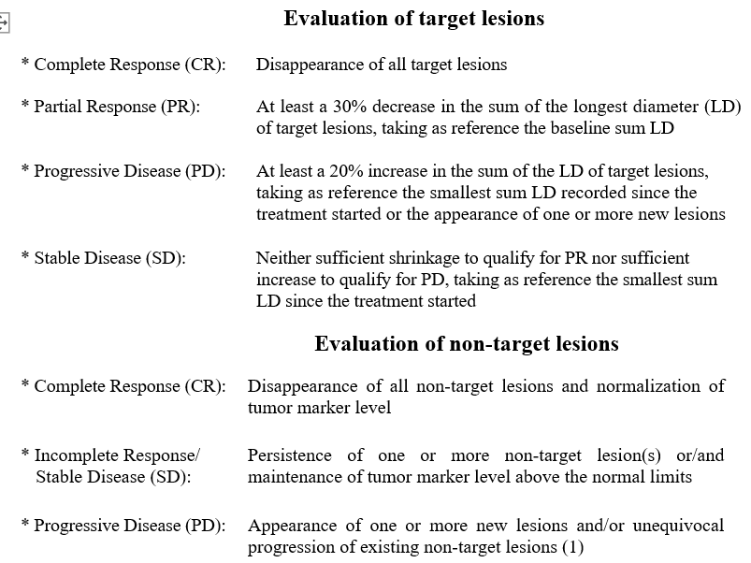
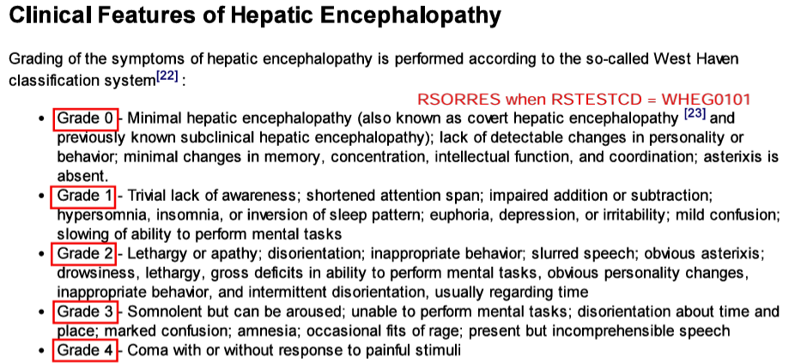
Oncology-RS and CC Differences: Nature of the Data
Clinical Classifi-cations
Tumor Disease Response to Treatment
RS-CC
RS-Oncology
RS
Clinical classifications are named instruments whose output is an ordinal or categorical score that serves as a surrogate for, or ranking of, disease status, or other physiological or biological status.
Often, CC instruments are about measuring the severity of a disease, in the form of clinical grading, staging, ranking or scoring, from clinician’s reported outcomes and observations.
How BAD is the disease? How sick are you?
Oncology response criteria assess the change in tumor burden (i.e., target/non-target lesions):
Tumor Shrinkage (tumor/lesion got smaller; Disappeared; Less number of existing lesions).
Disease Progression (lesion got bigger; New lesions; New metastasis).
How well/bad is the tumor responding to treatment?
RECIST 1.1
West Haven Hepatic Encephalopathy Grade
Notes:
There are also significant differences in the nature and purpose of the data collected between oncology RS and clinical classification.
The tumor response to treatment assessments typically address questions around the changes in tumor burden. These are objective observations on tumor shrinkage or disease progression. The kind of clinical observations you will see in a tumor response criterion are: the tumor got smaller; there are less lesions identified after treatment as compared to baseline, or the lesions have completely disappeared. Or, the tumor becomes bigger; there are more lesions, and there are new metastatic lesions that weren’t previously identified. Or it could be about stable disease as in there are no changes to the size or number of lesions after treatment. These changes in tumor burden observations are classified into different disease response categories (like complete response, partial response, stable disease, etc.) and the question to be answered with this type of data is: how well/bad does the tumor respond to a treatment? This is the type of data you would map to oncology RS.
In contrast, clinical classifications are standalone, validated and named instruments that serves as a surrogate for, or ranking of, disease status, or other physiological or biological status. They are not patient reported, and they are also objective clinical observations made by a clinician or the investigator. I want to say that in the past decade, the majority of what we consider as clinical classifications are usually about the severity evaluation of a particular disease. They often appear as staging, grading or scoring of sets of symptoms, signs, lab results, imagining results, etc., that are related to a specific disease. The example on the right here is the West Haven Hepatic Encephalopathy Grade. The symptoms showing worsening hepatic disease are classified and ranked into a grading system of Grade 1 to 4, where 4 means the most severe form of the hepatic Encephalopathy disease.
While oncology-RS and clinical classifications are similar in the structuring and presentation of their data, they serve very different purposes and provide different clinical outputs.

Slide 7
Q 1: How do we model “non-tumor” disease response to treatment data? Which set of rules/principles do we follow? Need to fill in the GAP
Clinical Classifications
(All disease types/therapeutic area)
271 Codelists
Non-Tumor Disease Response to Treatment (All disease types excluding cancer)
Tumor Disease Response to Treatment
(Oncology)
4 Codelists
Proposal: model “non-tumor” disease response data in the RS domain, but, follow QRS rules.
Pros:
There are active QRS domain and CT teams with expertise and resources to develop and maintain the standards, supplements and controlled terminology.
Each Disease Response to Treatment Criterion will be modeled separately with instrument-specific QRS supplement and terminology.
Faster turn-around for internal, public reviews and publication for the supplements.
Cons:
Need to undergo lengthy copyright/public domain verification process for the instruments which can be time-consuming. (Risk: copyright denied and unable to develop standards.)
Lots of codelists/CT because terminology is instrument-specific. Also inconsistent modeling strategy from how the oncology SDS team is handling tumor-RS data.
More work for the QRS teams in the future.
Onc-RS
CC-RS

Slide 8
Q 2: Clinical classifications and disease responses, do they really belong in the same domain?
Clinical Classifications
(All disease types/therapeutic area)
Tumor Disease Response to Treatment
(Oncology)
RS-Oncology and CC have:
  Different types of data.
  Different business rules and SOPs for standards and controlled terminology development.
  Two independent, separate domain/CT teams governing content development:
    Oncology SDS-Domain/CT team.
    QRS Subteam/CT team.
  A single instrument may contain both disease response criteria and clinical classifications data. Both parts are modeled in the RS domain but they follow completely different business rules – lots of confusions.
    Case Study: AJCC 7
  Request to split CC from RS: https://jira.cdisc.org/browse/SDS-2786
RS

Slide 9
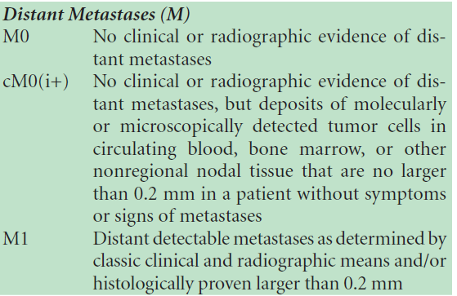
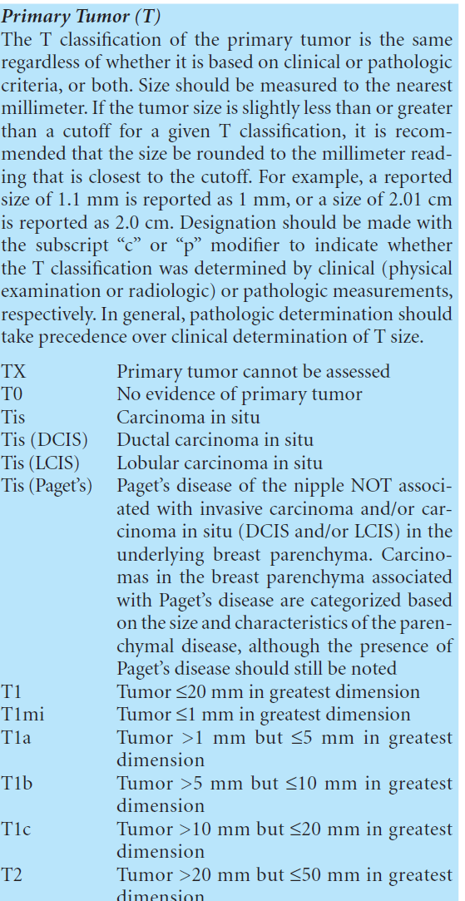
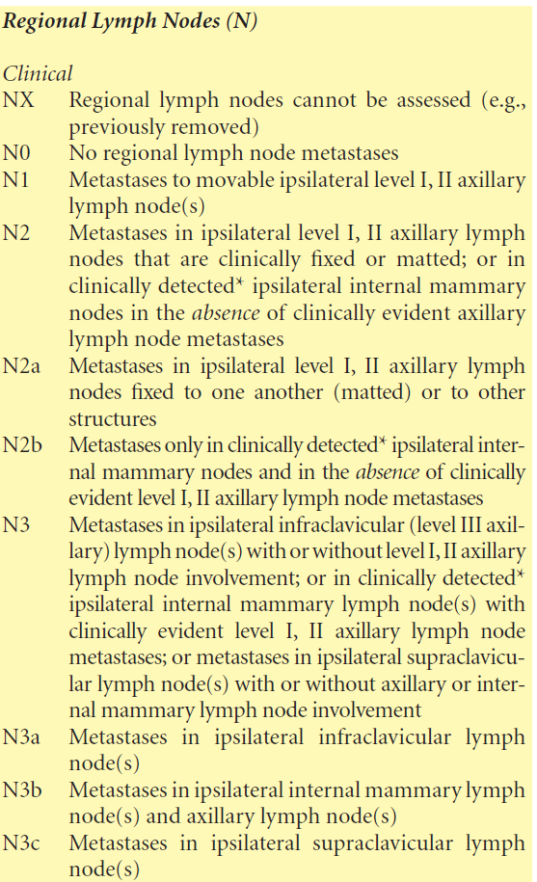
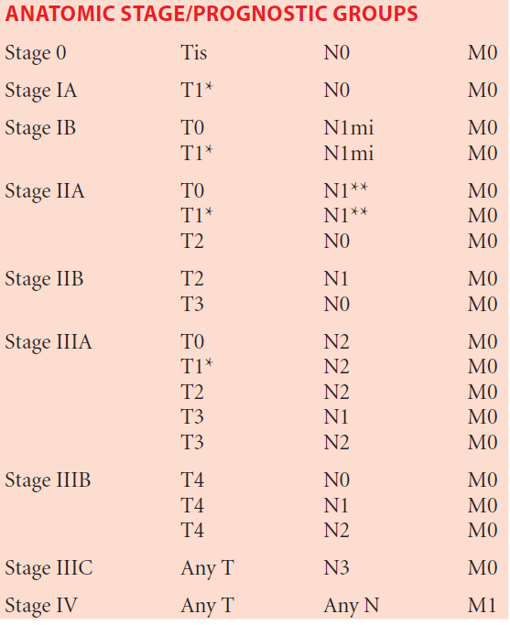
AJCC 7 - A Case Study: Is it RS-Oncology or CC? It is both!
AJCC 7, Breast Cancer TNM Staging:
TNM staging is used for the classification of tumor malignancy. (surrogate for the evaluation of how bad is the cancer? How severe is the disease?)
***This is considered as a clinical classification (CC) and has been modeled as such. (all AJCC cancer staging has been and will be molded as CC)
Notes:
https://aboutcancer.com/AJCC_stage.htm

Slide 10
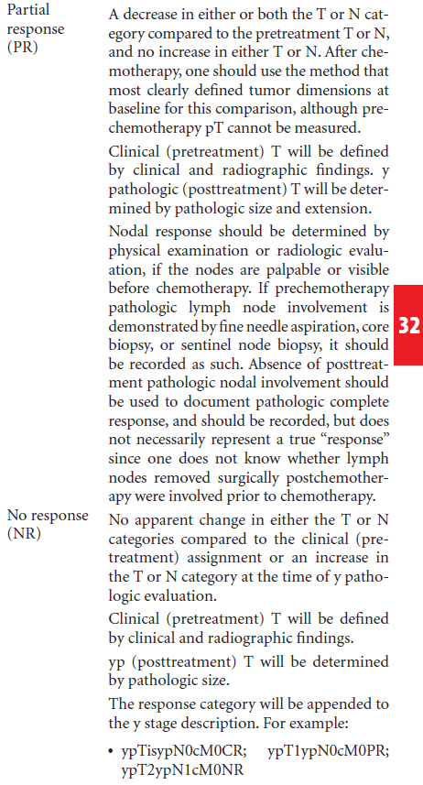
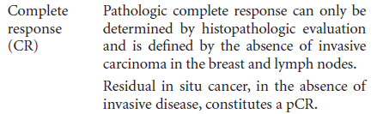
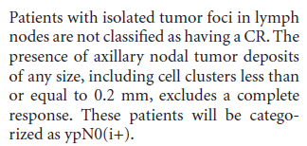
AJCC 7 - A Case Study: Is it RS-Oncology or CC? It is both!
AJCC 7, Response Criteria for Neoadjuvant Chemotherapy in Breast Cancer:
Complete Response (CR): absence of invasive carcinoma in the breast and node.
Partial Response (PR): decrease in either or both T or N stage.
No Response (NR): no change or increase in either or both T or N stage.
***This is considered as oncology disease response to treatment (RS) data and has been modeled following the oncology standards and CT development rules.
Notes:
AJCC 7, breast cancer response criteria:
(1) Complete response is defined as the absence of
invasive carcinoma in the breast and lymph nodes. Residual
in situ cancer, in the absence of invasive disease,
constitutes a CR. Patients with isolated tumor foci in LN
are not classified as having a CR.
(2) Partial response is defined as a decrease in either or
both yT or yN stage compared with the pretreatment T or
N, and no increase in either yT or yN. After chemotherapy,
one should use the method that most clearly defined tumor
dimensions at the baseline for this comparison, although
prechemotherapy pT cannot be measured.
(3) No response is defined as no apparent change in
either the yT or yN categories compared to the clinical
staging or increase in the T or N categories at the time of y
pathological evaluation

Slide 11
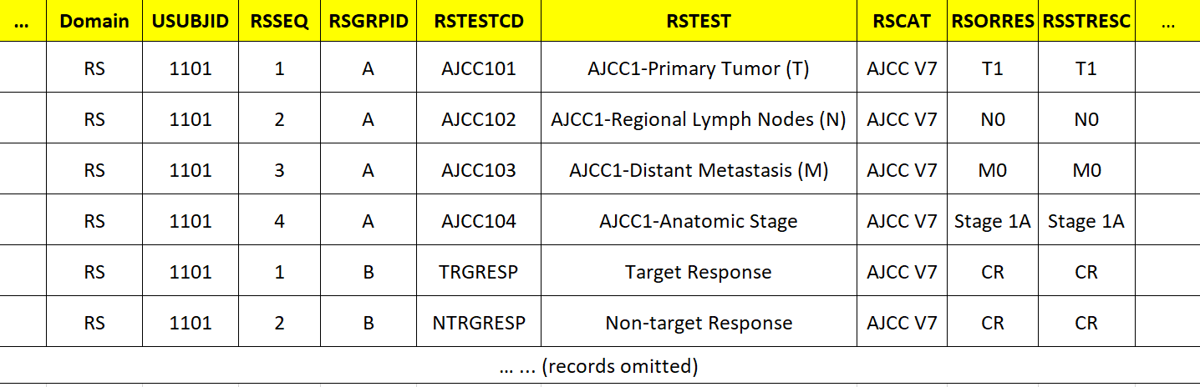
AJCC 7 - A Case Study: Tumor Malignancy Staging + Response to Treatment Data all mapped to the RS domain, however…
AJCC1TC-TN Codelists (AJCC1 = AJCC Version 7)
CCCAT Codelist
Follow Clinical Classification Rules
Initial Staging at Screening
Follow Oncology
RS Rules
After Treatment Visit
ONCRTS-CD Codelists
ONCRSCAT Codelist
*AJCC V7 = C125755, same C-code in the two CAT codelists above.
Notes:
The number of times people have asked me about why AJCC 7 appears in both CCCAT and ONCRSCAT codelsits. If it is a CC, how can it be a disease response criteria. The answer is that the AJCC 7 manual contains both tumor malignancy staging and tumor response criteria, so AJCC 7 is both oncology-RS and CC. However the modeling of tumor staging and tumor response data is completely different.

Slide 12
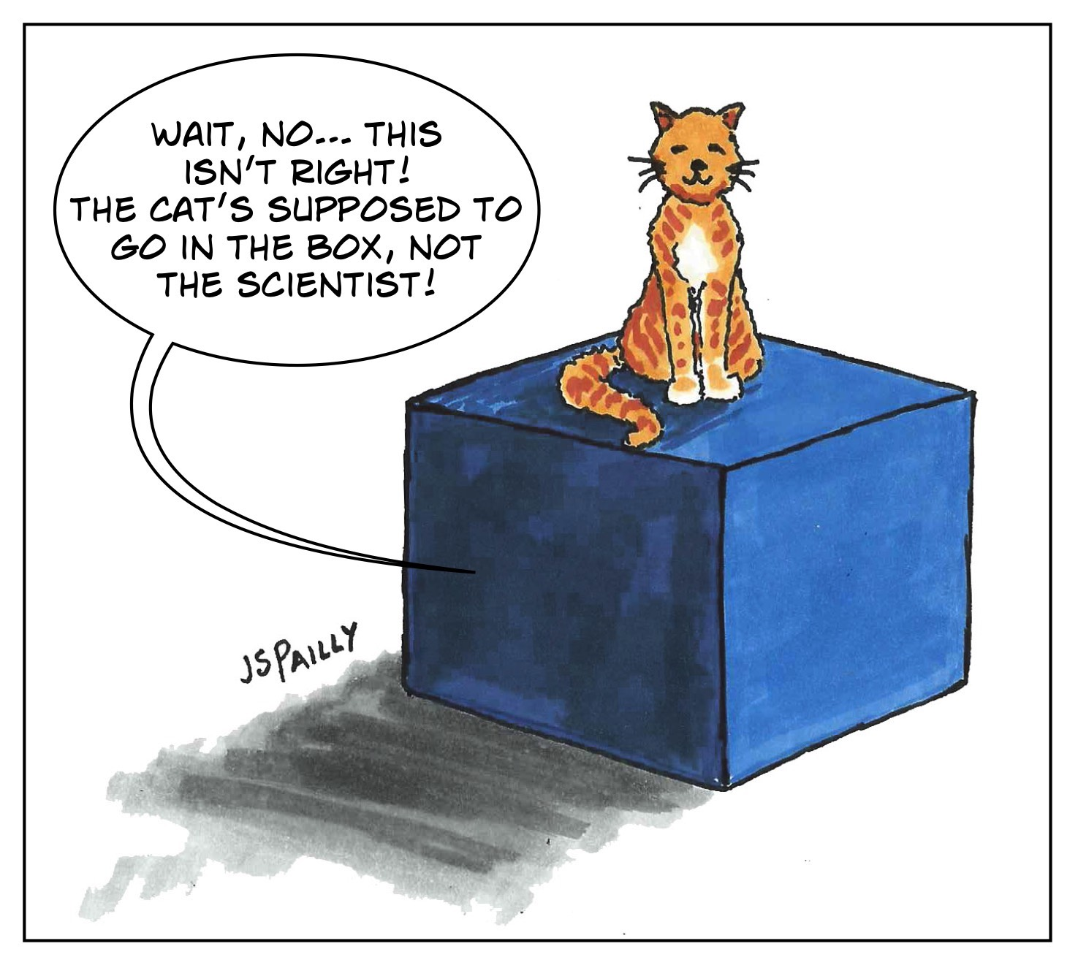
State of the RS Domain: Both Overladed and Missing Data
RS
Clinical Classifications
(All disease types/therapeutic area)
271 Codelists
Non-Tumor Disease Response to Treatment (All disease types excluding cancer)
Tumor Disease Response to Treatment
(Oncology)
4 Codelists
Schrödinger’s Scientist
Notes:
AJCC 7, breast cancer response criteria:
(1) Complete response is defined as the absence of
invasive carcinoma in the breast and lymph nodes. Residual
in situ cancer, in the absence of invasive disease,
constitutes a CR. Patients with isolated tumor foci in LN
are not classified as having a CR.
(2) Partial response is defined as a decrease in either or
both yT or yN stage compared with the pretreatment T or
N, and no increase in either yT or yN. After chemotherapy,
one should use the method that most clearly defined tumor
dimensions at the baseline for this comparison, although
prechemotherapy pT cannot be measured.
(3) No response is defined as no apparent change in
either the yT or yN categories compared to the clinical
staging or increase in the T or N categories at the time of y
pathological evaluation

Slide 13
Place holder for additional content from other co-leads…
Anything to add?
Notes:
AJCC 7, breast cancer response criteria:
(1) Complete response is defined as the absence of
invasive carcinoma in the breast and lymph nodes. Residual
in situ cancer, in the absence of invasive disease,
constitutes a CR. Patients with isolated tumor foci in LN
are not classified as having a CR.
(2) Partial response is defined as a decrease in either or
both yT or yN stage compared with the pretreatment T or
N, and no increase in either yT or yN. After chemotherapy,
one should use the method that most clearly defined tumor
dimensions at the baseline for this comparison, although
prechemotherapy pT cannot be measured.
(3) No response is defined as no apparent change in
either the yT or yN categories compared to the clinical
staging or increase in the T or N categories at the time of y
pathological evaluation

