Slide 1
The State of the RS Domain: Overloaded and Missing Data

Slide 2
Evolution of the RS Domain Scope from the SDTMIG v3.2 to v3.4
Instruments that are considered as Clinical Classifications
(For all disease types/therapeutic area CC data)
Tumor Disease Response to Treatment
(For Oncology Data ONLY)
SDTMIG v3.2 Scope
SDTMIG v3.3/3.4 Scope
Tumor Disease Response to Treatment
(For Oncology Data ONLY)
Onc-RS
RS
CC-RS
IG3.2 RS: A findings domain for the assessment of disease response to therapy.
IG3.3-3.4 RS: A findings domain for the assessment of disease response to therapy, or clinical classification based on published criteria.

Slide 3
Oncology-RS and CC Differences: Codelists
Clinical Classifications
Tumor Disease Response to Treatment
RS
RS-Oncology Only
CC-All Disease Types
RSCAT - supported by 1 CAT codelist: ONCRSCAT (Category of Oncology Response Assessment) codelist.
  Examples: RECIST 1.1, AJCC V4-V8, WHO BREAST CANCER 2006, etc.
RSTEST-CD - supported by 2 TEST-CD codelists: ONCRTS-CD (Oncology Response Assessment Test Name/Code).
RSSTRESC - supported by 1 standard result codelist: ONCRSR (Oncology Response Assessment Result).
RSCAT - supported by 1 CAT codelist: CCCAT (Category of Clinical Classifications).
  Examples: AJCC V7, APACHE II, CANADIAN CV SOCIETY GRADING ANGINA, etc.
RSTEST-CD - supported by 160 instrument-specific CCTEST-CD codelists
RSORRES - supported by 55 instrument-specific original result CC codelists.
RSSTRESC - supported by 55 instrument-specific standardized result CC codelists.
(Variables) | RSCAT | RSTEST-CD | RSORRES | RSSTRESC
Oncology | ONCRSCAT | ONCRTS-CD |  | ONCRSR
Clinical Classification | CCCAT | KDPI01TC-TC | HBI0104OR | HBI0101STR
 |  | AIMS01TC-TN | KFSS101OR | KPSS0101STR
 |  | APCH1TC-TN | APCH102OR | APCH103STR
 |  | HAMA1TC-TN | AIMS0101T07OR | AIMS0101T07STR
 |  | … ... | … … | … …
 |  | 160 CC TC-TN codelists | 55 CCORRES codelists | 55 CCSTRESC codelists
Total # of Codelists | 2 | 162 | 55 | 56
(As of 2023 December publication)

Slide 4
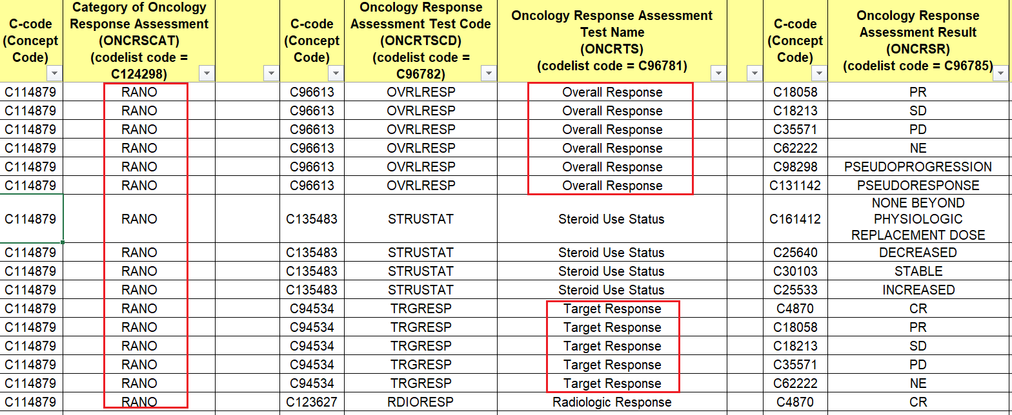
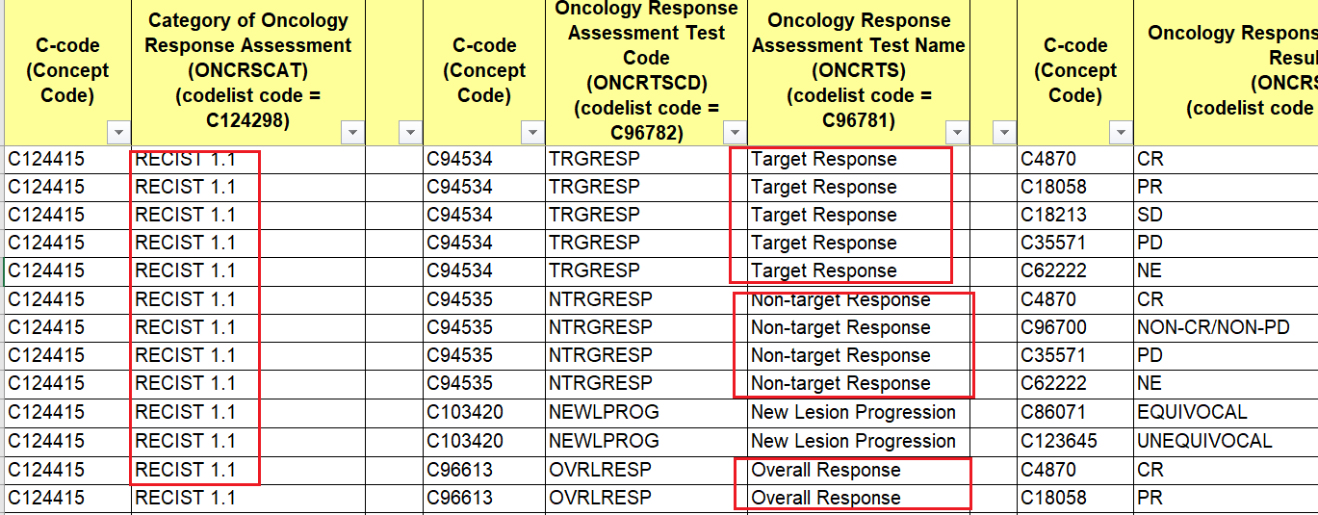
Oncology-RS and CC Differences: Terminology and Data Mapping
RS
Clinical Classifications
Tumor Disease Response to Treatment
RS-Oncology
“Generic” oncology assessments from ONCRTS-CD to be used with, and grouped by a “specific” oncology criterion value in ONCRSCAT.
While Onc-Tests and Onc-Results can be “recycled, reused” for mapping but ultimately they mean different tumor responses to treatment depending on the specific criterion you are using to make the evaluation.
For TEST = Target (lesion) Response/C94534,
the result of CR (Complete Response) per RANO is defined as: complete disappearance of all enhancing measurable and non-measurable disease sustained for at least 4 weeks; no new lesions; stable or improved non-enhancing (T2/FLAIR) lesions; patients must be off corticosteroids (or on physiologic replacement doses only); and stable or improved clinically.
For TEST = Target (lesion) Response/C94534,
the result of CR (Complete Response) per RECIST 1.1 is defined as: disappearance of all target lesions. Any pathological lymph nodes (whether target or non-target) must have reduction in short axis to <10mm.

Slide 5
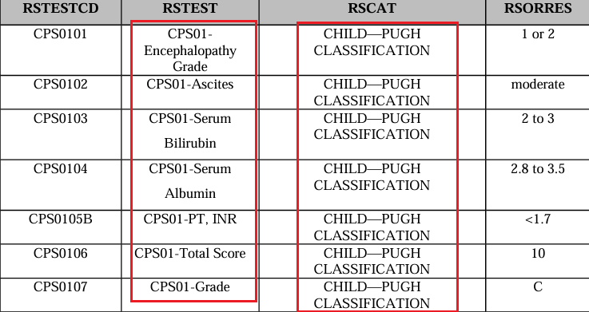
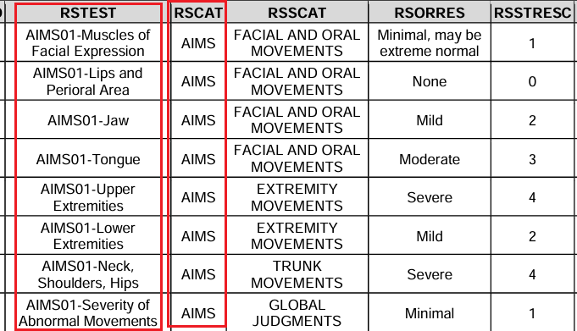
Oncology-RS and CC Differences: Terminology and Data Mapping
Clinical Classifications
Tumor Disease Response to Treatment
RS
RS-Clinical Classification
“Specific” Clinical Classification TEST-CD assessments to be used with, and grouped by a “specific” Clinical Classification value in CCCAT.
CC-Tests and CC-Results are always instrument-specific. You HAVE to use the named CCTEST-CD tests with the same named CCCAT. There is no reusability for the CCTEST-CDs, that’s why there are 160 CCTEST-CD codelists, each is unique and was created for a single clinical classification.
CPS01 in RSTEST indicates these tests are associated with Child-Pugh.
AIMS01 in RSTEST indicates these tests are associated with AIMS (Abnormal Involuntary Movement Scale ).

Slide 6
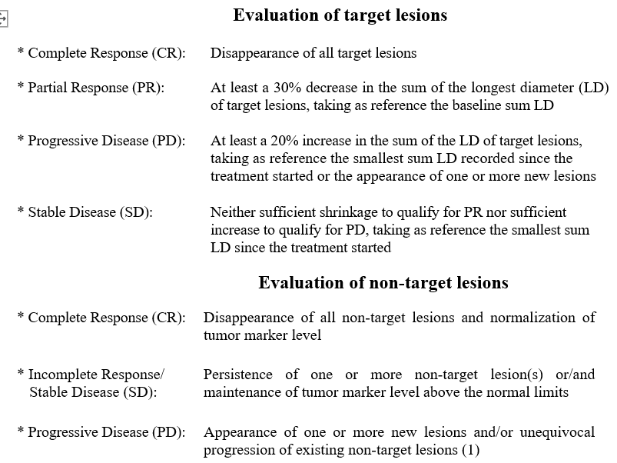
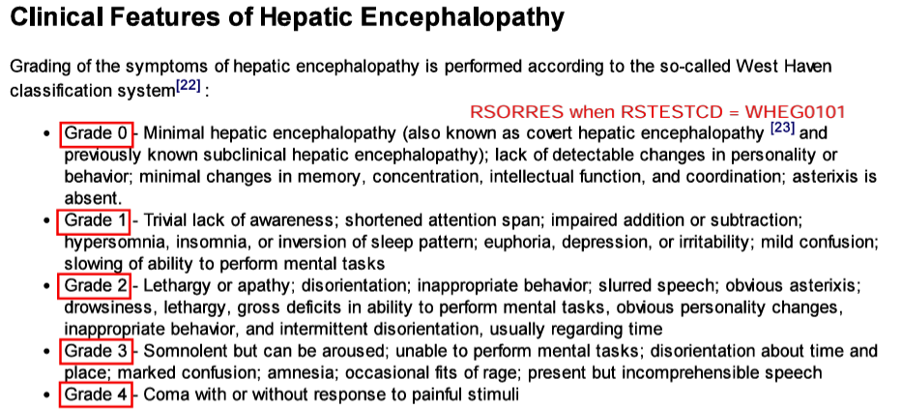
Oncology-RS and CC Differences: Nature of the Data
RS-Oncology
Clinical Classifications
Tumor Disease Response to Treatment
RS-CC
RS
Clinical classifications are named instruments whose output is an ordinal or categorical score that serves as a surrogate for, or ranking of, disease status, or other physiological or biological status.
Often, CC instruments are about measuring the severity of a disease, in the form of clinical grading, staging, ranking or scoring, from clinician’s reported outcomes and observations.
How BAD is the disease? How sick are you?
Oncology response criteria assess the change in tumor burden (i.e., target/non-target lesions):
Tumor Shrinkage (tumor/lesion got smaller? Disappeared? Less number of existing lesions?)
Disease Progression (lesion got bigger? Appearance of one or more new lesions?)
RECIST 1.1
West Haven Hepatic Encephalopathy Grade
Notes:
Other CCs that are for severity assessment:

Slide 7
Q 1: How do we model “non-tumor” disease response to treatment data? Which set of rules/principles do we follow? Need to fill in the GAP
Clinical Classifications
(All disease types/therapeutic area)
271 Codelists
Non-Tumor Disease Response to Treatment (All disease types excluding cancer)
Tumor Disease Response to Treatment
(Oncology)
4 Codelists
Proposal: model “non-tumor” disease response data in the RS domain, but, follow QRS rules.
Pros:
There are active QRS domain and CT teams with expertise and resources to develop and maintain the standards, supplements and controlled terminology.
Each Disease Response to Treatment Criterion will be modeled separately with instrument-specific QRS supplement and terminology.
Faster turn-around for internal, public reviews and publication for the supplements.
Cons:
Need to undergo lengthy copyright/public domain verification process for the instruments which can be time-consuming. (Risk: copyright denied and unable to develop standards.)
Lots of codelists/CT because terminology is instrument-specific. Also inconsistent modeling strategy from how the oncology SDS team is handling tumor-RS data.
More work for the QRS teams in the future.
Onc-RS
CC-RS

Slide 8
Q 2: Clinical classifications and disease responses, do they really belong in the same domain?
Clinical Classifications
(All disease types/therapeutic area)
Tumor Disease Response to Treatment
(Oncology)
RS-Oncology and CC have:
  Different types of data.
  Different business rules and SOPs for standards development.
  Different business rules and SOPs for controlled terminology development.
  Two independent, separate domain/CT teams governing content development:
    Oncology SDS-Domain/CT team.
    QRS Subteam/CT team.
  A single instrument may contain both disease response criteria and clinical classifications data. Both parts are modeled in the RS domain but they follow completely different business rules – lots of confusions.
    Case Study: AJCC 7
  Request to split CC from RS: https://jira.cdisc.org/browse/SDS-2786
RS

Slide 9
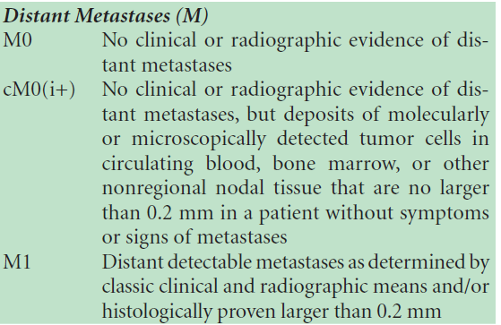
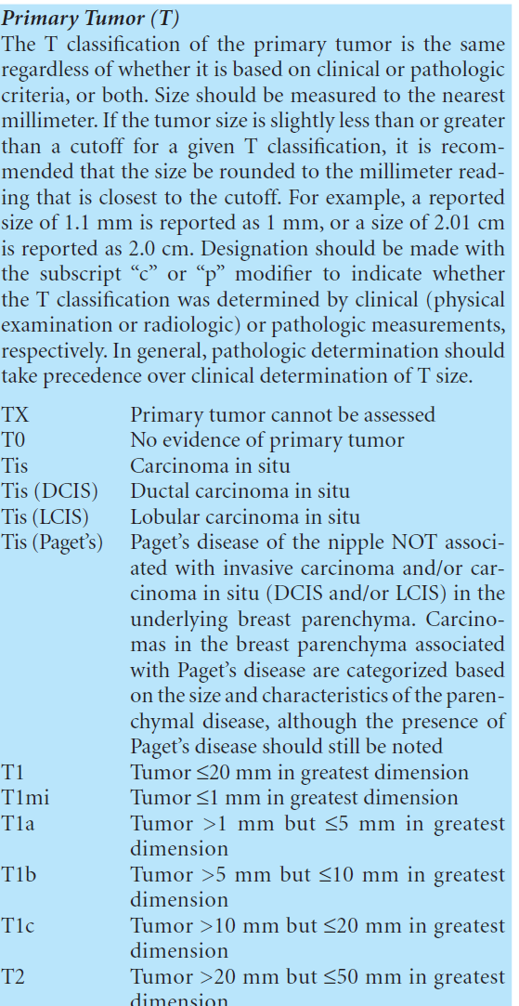
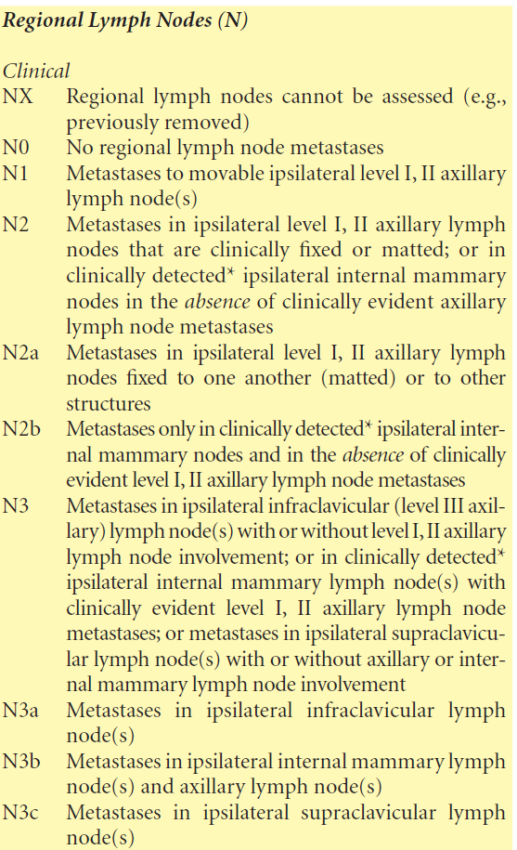
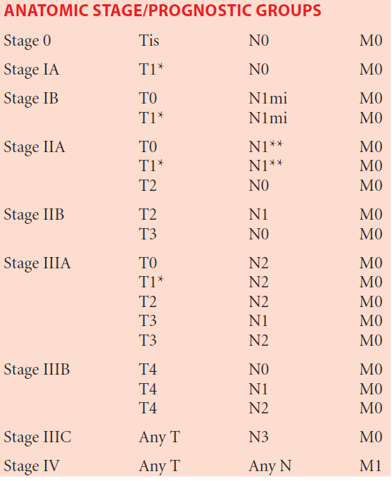
AJCC 7 - A Case Study: Is it RS-Oncology or CC? It is both!
AJCC 7, Breast Cancer TNM Staging:
TNM staging is used for the classification of tumor malignancy. (surrogate for the evaluation of how bad is the cancer? How severe is the disease?)
***This is considered as a clinical classification (CC) and has been modeled as such. (all AJCC cancer staging has been and will be molded as CC)
Notes:
https://aboutcancer.com/AJCC_stage.htm

Slide 10
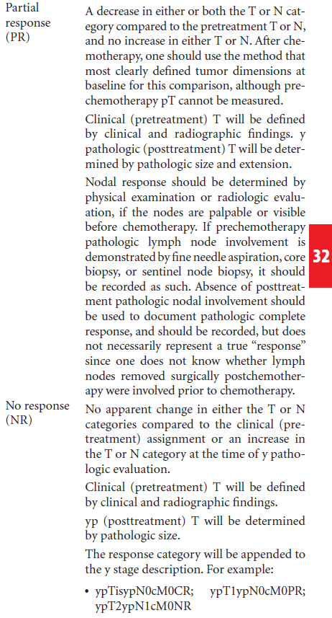
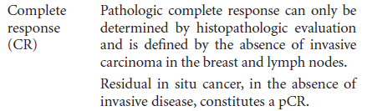
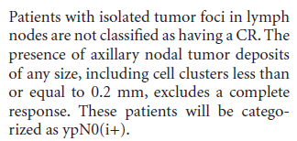
AJCC 7 - A Case Study: Is it RS-Oncology or CC? It is both!
AJCC 7, Response Criteria for Neoadjuvant Chemotherapy in Breast Cancer:
Complete Response (CR): absence of invasive carcinoma in the breast and node.
Partial Response (PR): decrease in either or both T or N stage.
No Response (NR): no change or increase in either or both T or N stage.
***This is considered as oncology disease response to treatment (RS) data and has been modeled following the oncology standards and CT development rules.
Notes:
AJCC 7, breast cancer response criteria:
(1) Complete response is defined as the absence of
invasive carcinoma in the breast and lymph nodes. Residual
in situ cancer, in the absence of invasive disease,
constitutes a CR. Patients with isolated tumor foci in LN
are not classified as having a CR.
(2) Partial response is defined as a decrease in either or
both yT or yN stage compared with the pretreatment T or
N, and no increase in either yT or yN. After chemotherapy,
one should use the method that most clearly defined tumor
dimensions at the baseline for this comparison, although
prechemotherapy pT cannot be measured.
(3) No response is defined as no apparent change in
either the yT or yN categories compared to the clinical
staging or increase in the T or N categories at the time of y
pathological evaluation

Slide 11
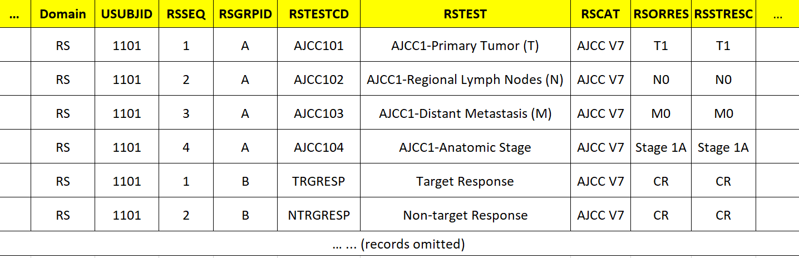
AJCC 7 - A Case Study: Tumor Malignancy Staging + Response to Treatment Data all mapped to the RS domain, however…
AJCC1TC-TN Codelists (AJCC1 = AJCC Version 7)
CCCAT Codelist
Follow Clinical Classification Rules
Initial Staging at Screening
Follow Oncology
RS Rules
After Treatment Visit
ONCRTS-CD Codelists
ONCRSCAT Codelist
*AJCC V7 = C125755, same C-code in the two CAT codelists above.
Notes:
AJCC 7, breast cancer response criteria:
(1) Complete response is defined as the absence of
invasive carcinoma in the breast and lymph nodes. Residual
in situ cancer, in the absence of invasive disease,
constitutes a CR. Patients with isolated tumor foci in LN
are not classified as having a CR.
(2) Partial response is defined as a decrease in either or
both yT or yN stage compared with the pretreatment T or
N, and no increase in either yT or yN. After chemotherapy,
one should use the method that most clearly defined tumor
dimensions at the baseline for this comparison, although
prechemotherapy pT cannot be measured.
(3) No response is defined as no apparent change in
either the yT or yN categories compared to the clinical
staging or increase in the T or N categories at the time of y
pathological evaluation

Slide 12
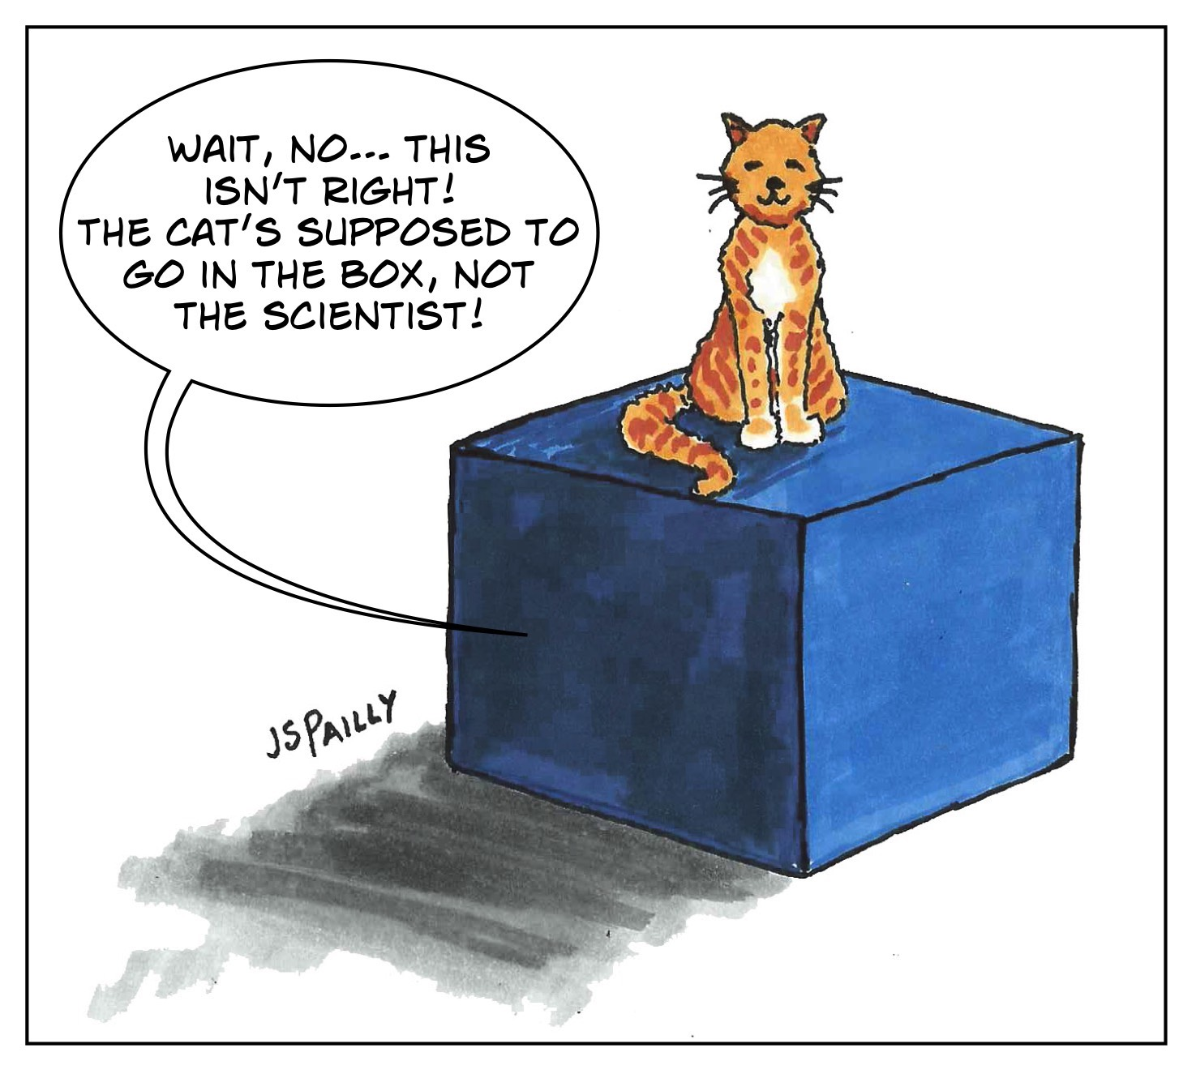
State of the RS Domain: Both Overladed and Missing Data
RS
Clinical Classifications
(All disease types/therapeutic area)
271 Codelists
Non-Tumor Disease Response to Treatment (All disease types excluding cancer)
Tumor Disease Response to Treatment
(Oncology)
4 Codelists
Schrödinger's Cat
Notes:
AJCC 7, breast cancer response criteria:
(1) Complete response is defined as the absence of
invasive carcinoma in the breast and lymph nodes. Residual
in situ cancer, in the absence of invasive disease,
constitutes a CR. Patients with isolated tumor foci in LN
are not classified as having a CR.
(2) Partial response is defined as a decrease in either or
both yT or yN stage compared with the pretreatment T or
N, and no increase in either yT or yN. After chemotherapy,
one should use the method that most clearly defined tumor
dimensions at the baseline for this comparison, although
prechemotherapy pT cannot be measured.
(3) No response is defined as no apparent change in
either the yT or yN categories compared to the clinical
staging or increase in the T or N categories at the time of y
pathological evaluation

Slide 13
Place holder for additional content from other co-leads…
Anything to add?
Notes:
AJCC 7, breast cancer response criteria:
(1) Complete response is defined as the absence of
invasive carcinoma in the breast and lymph nodes. Residual
in situ cancer, in the absence of invasive disease,
constitutes a CR. Patients with isolated tumor foci in LN
are not classified as having a CR.
(2) Partial response is defined as a decrease in either or
both yT or yN stage compared with the pretreatment T or
N, and no increase in either yT or yN. After chemotherapy,
one should use the method that most clearly defined tumor
dimensions at the baseline for this comparison, although
prechemotherapy pT cannot be measured.
(3) No response is defined as no apparent change in
either the yT or yN categories compared to the clinical
staging or increase in the T or N categories at the time of y
pathological evaluation

