Slide 1
The State of the RS Domain and Gap (Data) Mapping – A Proposal

Slide 2
The Evolution of the RS domain scope from the SDTMIG v3.2 to v3.4
Instruments that are considered as Clinical Classifications
(For all disease types/therapeutic area CC data)
Tumor Disease Response to Treatment
(For Oncology Data ONLY)
SDTMIG v3.2 Scope
SDTMIG v3.3/3.4 Scope
Tumor Disease Response to Treatment
(For Oncology Data ONLY)
RS
RS
CC
IG3.2 RS: A findings domain for the assessment of disease response to therapy.
IG3.3-3.4 RS: A findings domain for the assessment of disease response to therapy, or clinical classification based on published criteria.
Notes:
Jordan to go to SDTM and GGG for approval for the variable scope change. Jon to talk to Dianne about getting into IG4.0 scope and timeline and see if this is doable for 4.0.

Slide 3
Differences between Oncology-RS and CC: (Too Many) Codelists
Clinical Classifications
Tumor Disease Response to Treatment
RS
RS-Oncology Only
CC-All Disease Types
RSCAT - supported by 1 CAT codelist: ONCRSCAT (Category of Oncology Response Assessment) codelist.
  Examples: RECIST 1.1, AJCC V4-V8, WHO BREAST CANCER 2006, etc.
RSTEST-CD - supported by 2 TEST-CD codelists: ONCRTS-CD (Oncology Response Assessment Test Name/Code).
RSSTRESC - supported by 1 standard result codelist: ONCRSR (Oncology Response Assessment Result).
RSCAT - supported by 1 CAT codelist: CCCAT (Category of Clinical Classifications).
  Examples: AJCC V7, APACHE II, CANADIAN CV SOCIETY GRADING ANGINA, etc.
RSTEST-CD - supported by 160 instrument-specific CCTEST-CD codelists
RSORRES - supported by 55 instrument-specific original result CC codelists.
RSSTRESC - supported by 55 instrument-specific standardized result CC codelists.
(Variables) | RSCAT | RSTEST-CD | RSORRES | RSSTRESC
Oncology | ONCRSCAT | ONCRTS-CD |  | ONCRSR
Clinical Classification | CCCAT | KDPI01TC-TC | HBI0104OR | HBI0101STR
 |  | AIMS01TC-TN | KFSS101OR | KPSS0101STR
 |  | APCH1TC-TN | APCH102OR | APCH103STR
 |  | HAMA1TC-TN | AIMS0101T07OR | AIMS0101T07STR
 |  | … ... | … … | … …
 |  | 160 CC TC-TN codelists | 55 CCORRES codelists | 55 CCSTRESC codelists
Total # of Codelists | 2 | 162 | 55 | 56
(As of 2023 December publication)
Notes:
Jordan to go to SDTM and GGG for approval for the variable scope change. Jon to talk to Dianne about getting into IG4.0 scope and timeline and see if this is doable for 4.0.

Slide 4
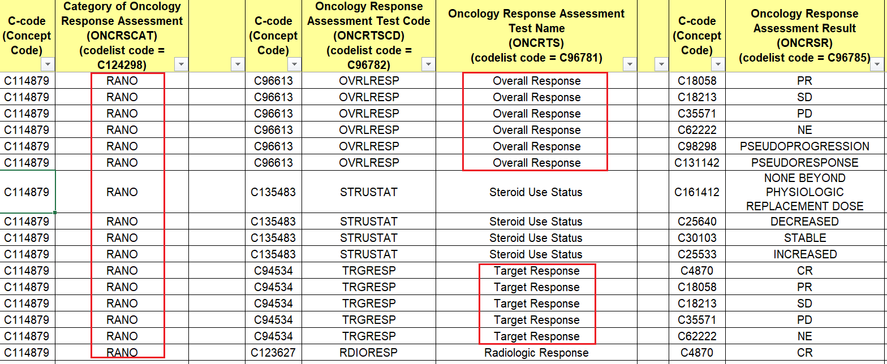
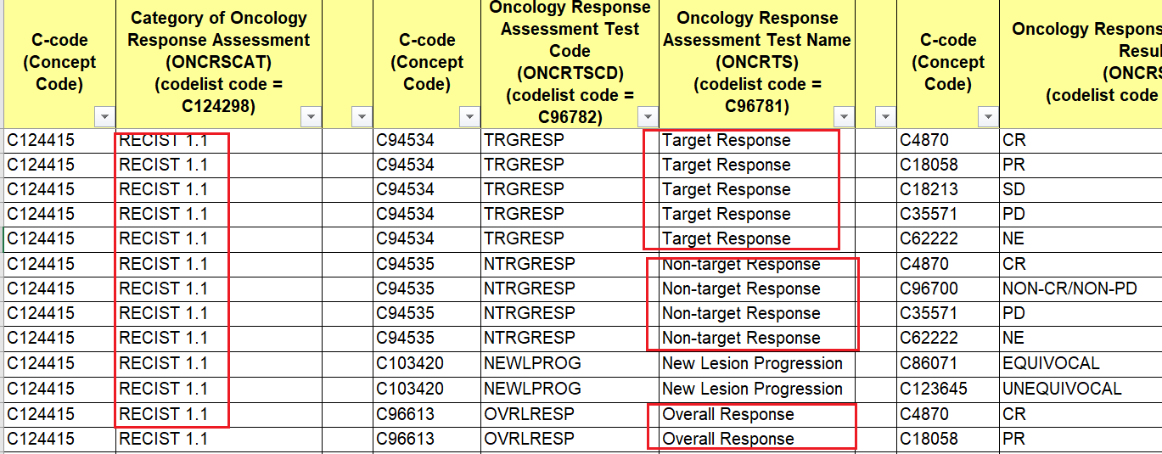
Differences between Oncology-RS and CC: CT and Data Mapping Strategy
RS
Clinical Classifications
Tumor Disease Response to Treatment
RS-Oncology
“Generic” oncology assessments from ONCRTS-CD to be used with, and grouped by a “specific” oncology criterion value in ONCRSCAT.
While Onc-Tests and Onc-Results can be “recycled, reused” for mapping but ultimately they mean different tumor responses to treatment depending on the specific criterion you are using to make the evaluation.
For ONC TEST = Target (lesion) Response/C94534,
the result of CR (Complete Response) per RANO is defined as: complete disappearance of all enhancing measurable and non-measurable disease sustained for at least 4 weeks; no new lesions; stable or improved non-enhancing (T2/FLAIR) lesions; patients must be off corticosteroids (or on physiologic replacement doses only); and stable or improved clinically.
For ONC TEST = Target (lesion) Response/C94534,
the result of CR (Complete Response) per RECIST 1.1 is defined as: disappearance of all target lesions. Any pathological lymph nodes (whether target or non-target) must have reduction in short axis to <10mm.
Notes:
Jordan to go to SDTM and GGG for approval for the variable scope change. Jon to talk to Dianne about getting into IG4.0 scope and timeline and see if this is doable for 4.0.

Slide 5
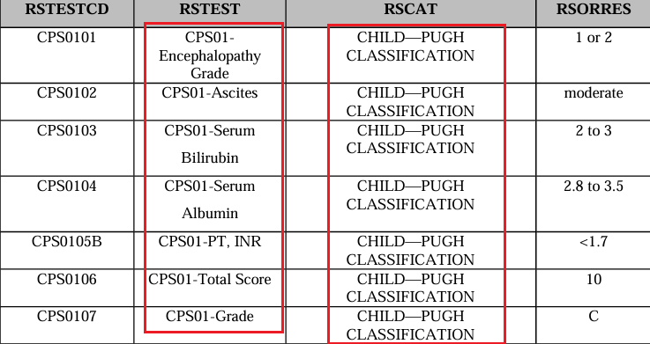
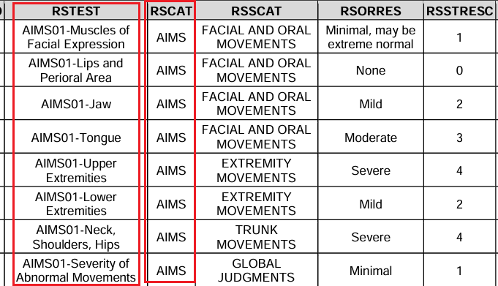
Differences between Oncology-RS and CC: Terminology and Data Mapping Strategy
RS
Clinical Classifications
Tumor Disease Response to Treatment
RS-Clinical Classification
“Specific” Clinical Classification TEST-CD assessments to be used with, and grouped by a “specific” Clinical Classification value in CCCAT.
CC-Tests and CC-Results are always instrument-specific. You HAVE to use the named CCTEST-CD tests with the same named CCCAT. There is no reusability for the CCTEST-CDs, that’s why there are 160 CCTEST-CD codelists, each is unique and was created for a single clinical classification.
CPS01 in RSTEST indicates these tests are associated with Child-Pugh.
AIMS01 in RSTEST indicates these tests are associated with AIMS (Abnormal Involuntary Movement Scale ).
Notes:
Jordan to go to SDTM and GGG for approval for the variable scope change. Jon to talk to Dianne about getting into IG4.0 scope and timeline and see if this is doable for 4.0.

Slide 6
Differences between Oncology-RS and CC: Nature of the Data
Clinical Classifications
Tumor Disease Response to Treatment
RS
RS-Oncology
RS-CC
Oncology response criteria assess the change in tumor burden:
  Tumor Shrinkage
  Disease Progression
Clinical classifications are named instruments whose output is an ordinal or categorical score that serves as a surrogate for, or ranking of, disease status/(severity) or other physiological or biological status.
Notes:
Jordan to go to SDTM and GGG for approval for the variable scope change. Jon to talk to Dianne about getting into IG4.0 scope and timeline and see if this is doable for 4.0.

Slide 7
Modeling and CT Differences between Oncology-RS and CC, CT Development Conventions
RS
Clinical Classifications
Tumor Disease Response to Treatment
RS-Oncology Only
CC-All Disease Types
RSCAT:
  supported by 1 ONCRSCAT codelist
  Examples: RECIST 1.1…
RSTEST-CD:
  Supported by 2 oncology codelists: ONCRTS; ONCRTSCD
RSCAT:
  supported by 3 codelists: QSCAT, FTCAT, and CCCAT codelists.
  Examples:
RSTEST-CD:
  Supported by XXX instrument-specific QSTEST-CD, FTTEST-CD, CCTEST-CD codelists (as of 2023 December publication)
Notes:
Jordan to go to SDTM and GGG for approval for the variable scope change. Jon to talk to Dianne about getting into IG4.0 scope and timeline and see if this is doable for 4.0.

Slide 8
The Evolution of the RS domain scope from the SDTMIG v3.2 to v3.4
Instruments that are considered as Clinical Classifications
(For all disease types/therapeutic area CC data)
Where and how do we model Disease Response to Treatment data for any diseases outside of the oncology realm?
Tumor Disease Response to Treatment
(For Oncology Data ONLY)
RS domain Scope in SDTMIG 3.3+3.4
RS
CC
Notes:
Jordan to go to SDTM and GGG for approval for the variable scope change. Jon to talk to Dianne about getting into IG4.0 scope and timeline and see if this is doable for 4.0.

