Slide 1
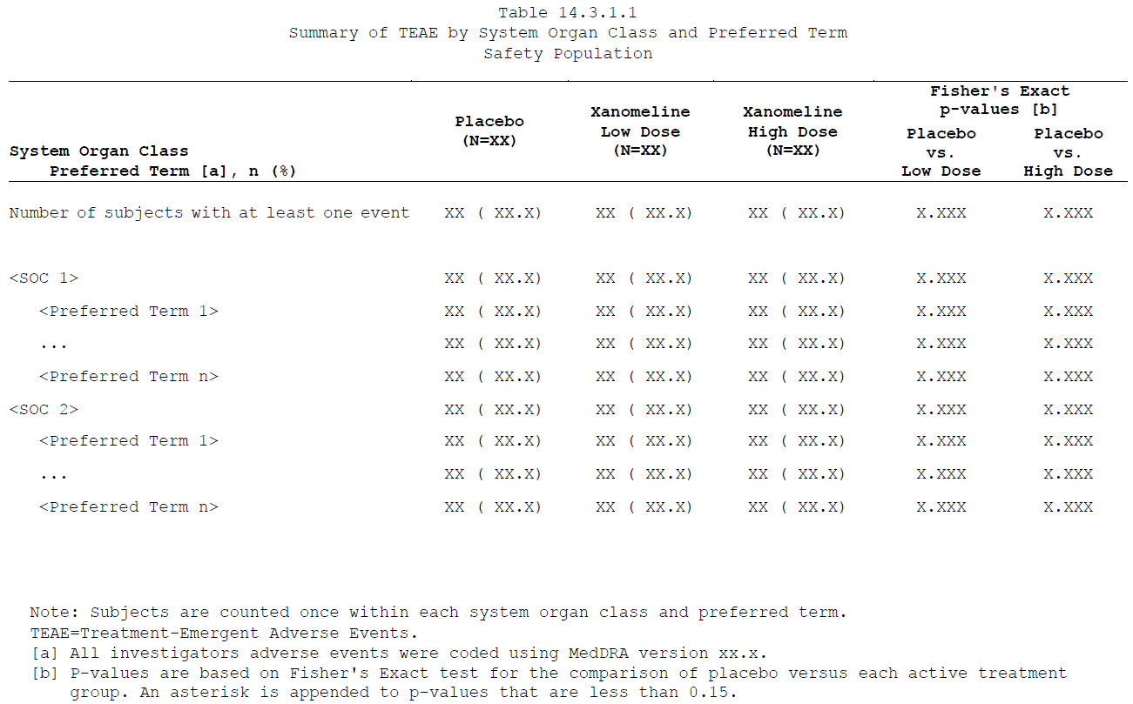
Title
Rowlabel
Header
Legend
Abbreviation
Footnote

