Slide 1
An Overview of the NCI EVS Services and Its Collaboration with CDISC
Presented by Dr. Jordan Li;
Clinical/Biomedical Information Specialist,
National Cancer Institute’s Enterprise Vocabulary Services

Slide 2

Meet the Speaker
Jordan Li. Ph.D.
Title: Clinical/Biomedical Information Specialist
Organization: Guidehouse; NCI-EVS
Subject matter and terminology expert from the National Cancer Institute’s Enterprise Vocabulary Services (NCI EVS).
Over 10 years of experience creating and publishing CDISC terminology.
Directs delivery of multiple CDISC controlled terminology teams .
Leads the CDISC Microbiology and Immunogenicity Submission Data Standards Development (SDS) subteam.
CDaSH and SDTM standards experts and developed standards for several CDISC disease therapeutic area projects, including Cardiovascular Imaging, Kidney Transplant, Type 1 Diabetes and multiple Traditional Chinese Medicine projects.
Jordan holds a PhD in Pharmacology and Physiology from Georgetown University.
Notes:
The Session Chair will introduce you based on the information you provide on this slide.
Instructions:
1. Select one of the two ‘Meet the Speaker’ templates based upon how many presenters you have.
2. Insert a medium or high resolution professional bio photo of yourself and format it to the dimensions of the placeholder image(s).
3. Place bio photo(s) over the placeholder(s) and delete the placeholder image(s).
4. Fill in your name, title and organization in the text boxes provided.
5. Insert short bio’s in the text box provided. If the quantity of presenters does not allow adequate space for bios on the slide, delete this text and replace it with short bios of all presenters.

Slide 3
Disclaimer and Disclosures
The views and opinions expressed in this presentation are those of the author(s) and do not necessarily reflect the official policy or position of CDISC.

Slide 4
National Cancer Institute - Enterprise Vocabulary Services (NCI - EVS)
- What We Do

Slide 5
  Mission: Development of services and resources that
  address the needs of NCI and many national and
  international partners for controlled vocabularies.
Subject Matter Expertise
Definition Writing and Analysis
Terminology Coding, Tagging and Subset bundling
Publish, Maintain and Version Terminology
Terminology Content Expansion & Facilitation of Terminology Requests
Produce and Maintain Two Public Browsers - NCIt & NCIm
Links to Other Controlled Terminologies
EVS provides an array of technology products and services to support the semantic infrastructure of NCI and our collaborating organizations.
Source: NCI-EVS

Slide 6
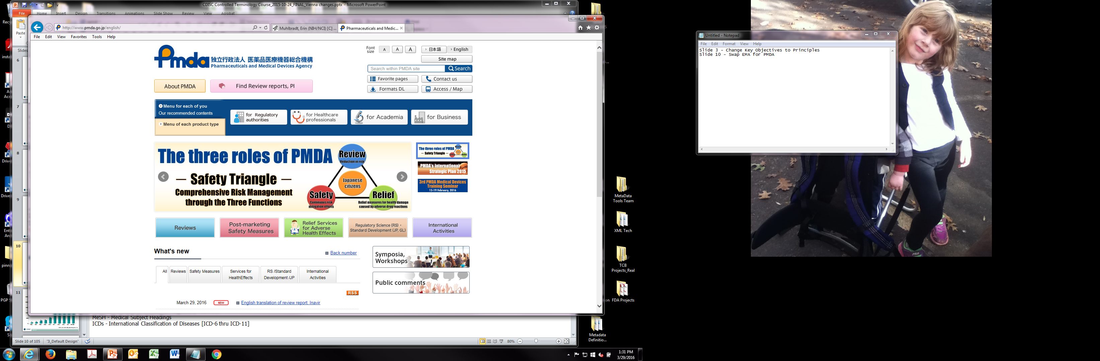

















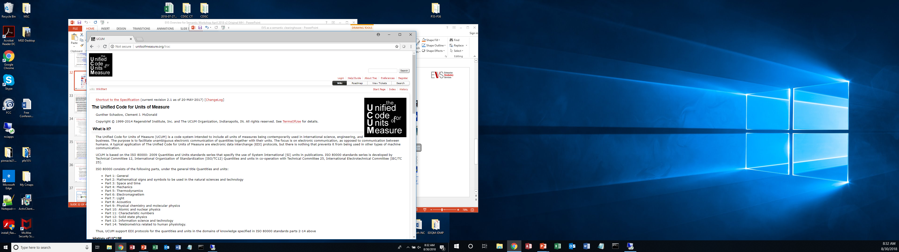
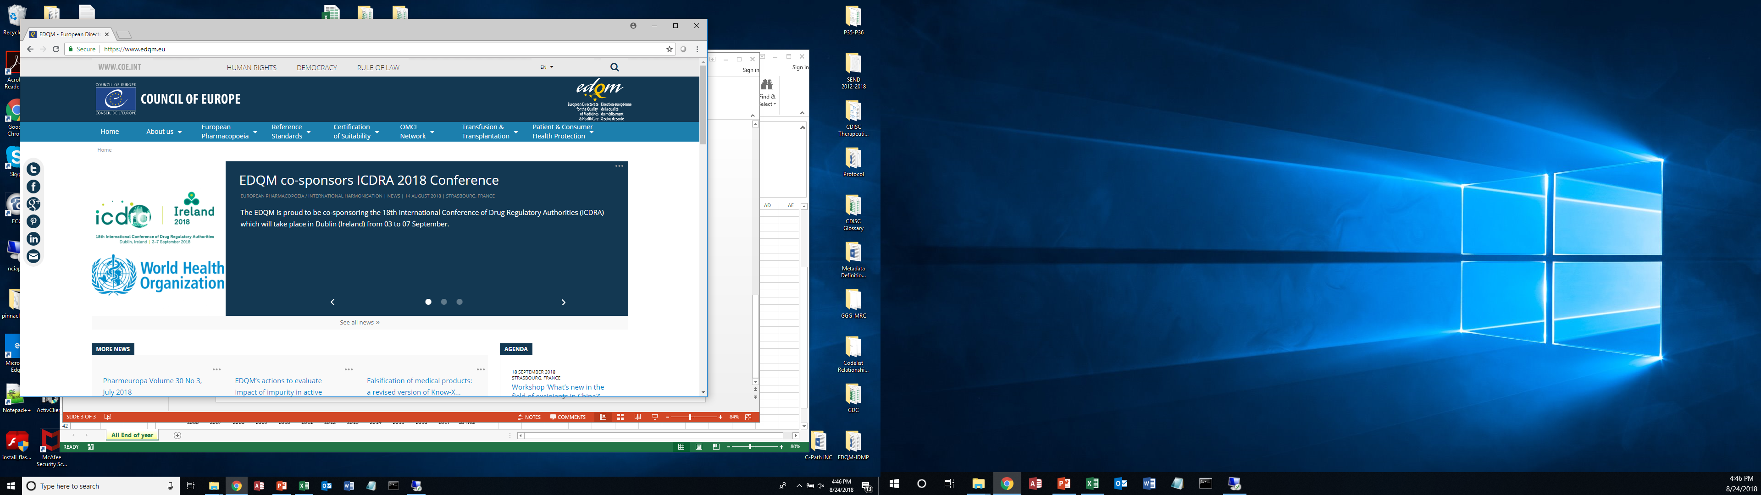

NCI EVS:
Unified Terminology Services and Standards
ICD9
ICD10
ICDO
FedMed
100+ biomedical controlled
vocabularies
SNOMED CT®
LexEVS
APIs
EVS
FTP
Files
Cancer & Biomedical Community
NCI-EVS works with many national and international partners to develop, license and publish terminology, and also jointly develop software tools to support harmonization and shared standards.
Source: NCI-EVS

Slide 7
NCI EVS Production Engine: NCI Thesaurus (NCIt) Term Browser
- Free, Open Access 24/7

Slide 8
  NCI Thesaurus (NCIt) Overview
NCI's core reference terminology. It is a free, non-license restricted biomedical coding ontology system.
  Main function of NCIt is to establish data semantics.
Adopted by FDA, CDISC and other partners as a shared standards development and coding environment.
Allows participants to compare and harmonize with each other's content while taking advantage of full-text definitions, codes, and other features.
User-driven concept expansion from NCI, NIH and other term source partners. It is also open to public request via the EVS term request system.
  Anyone can suggest an addition or a change to existing concepts within the NCIt.
Currently there are 50 source contributors tagged in NCIt concepts.
As of April 2023, over 178,000 coded concepts stored in NCIt, including basic and translational research, clinical care, public information, healthcare and administrative activities.
400,000 relationships modeled between concepts.
Source: NCI-EVS

Slide 9
  NCIt is used to build and enrich semantics for a concept
All concepts in the NCIt are given:
  NCIt concept code (C-code): a unique identifier assigned to each concept by EVS to permanently track a specific meaning.
  Preferred Name: the term chosen by EVS as most unambiguous and widely used in the biomedical community.
  Synonyms: additional term(s) chosen by NCI with meaning equivalent to the Preferred Term, this helps with mapping to other terminologies.
  Definition: a text statement of the what the concept is. This ensures that humans and systems have a common understanding of the concept and can therefore use it accurately, precisely and consistently across users and systems.
  Hierarchical arrangement: concepts are modeled using a parent-child "is-a" relationships in the NCIt ontology environment.
Source: NCI-EVS

Slide 10
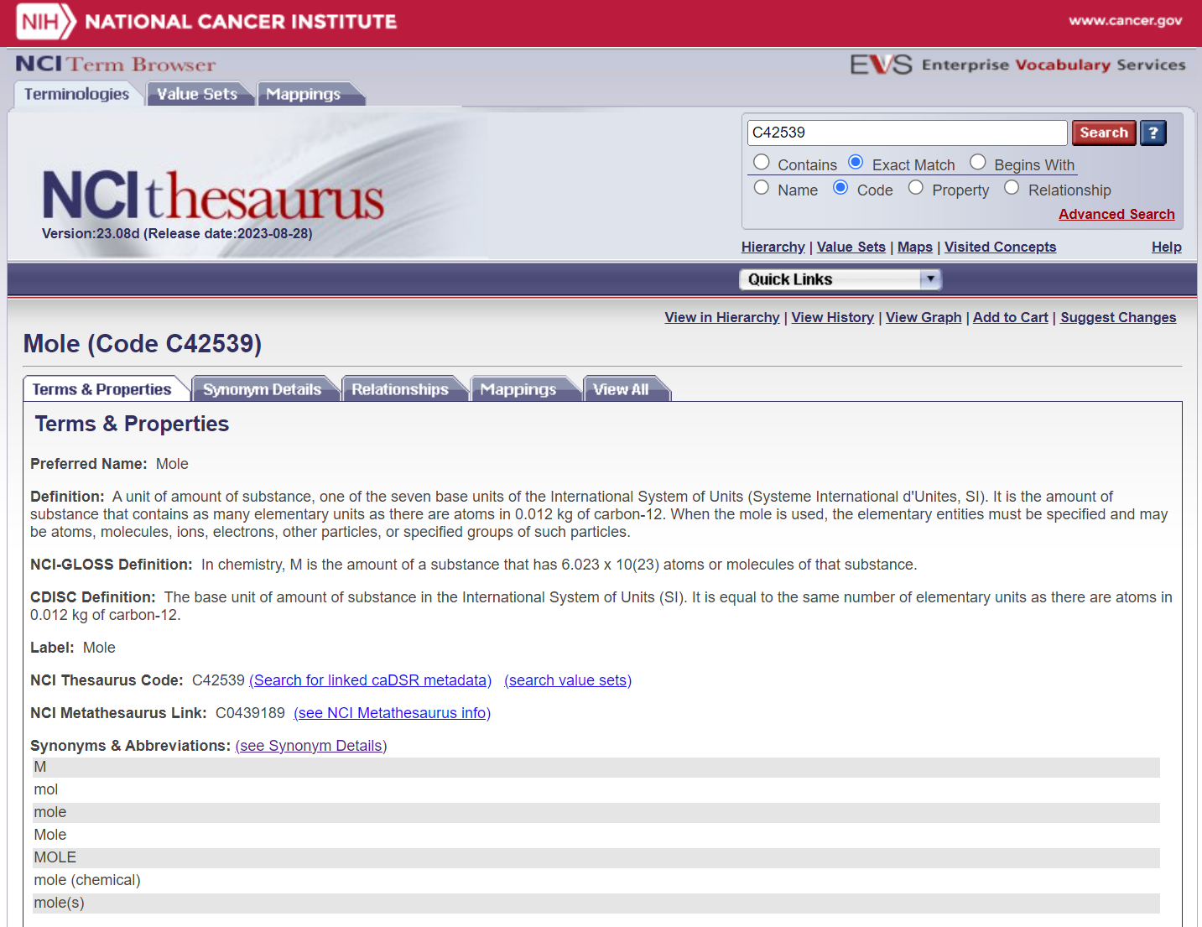
Searching for a concept in the NCIt Term Browser
Search Box
Unique Concept Code
NCI Definition
Source-Specific Definition from CDISC
Common Synonyms
Source: NCI-EVS
Notes:
This is an example of a CDISC concept which was found by typing ‘mole' in the text box and choosing 'contains' and the default 'name/codes' within the search parameters. I'd like to point out the concept code which is the unique identifier assigned to every concept within NCIt. Here is the CDISC definition and to the right is the 'view in hierarchy' link that enables the user to view the concept within the hierarchy or the thesaurus.

Slide 11
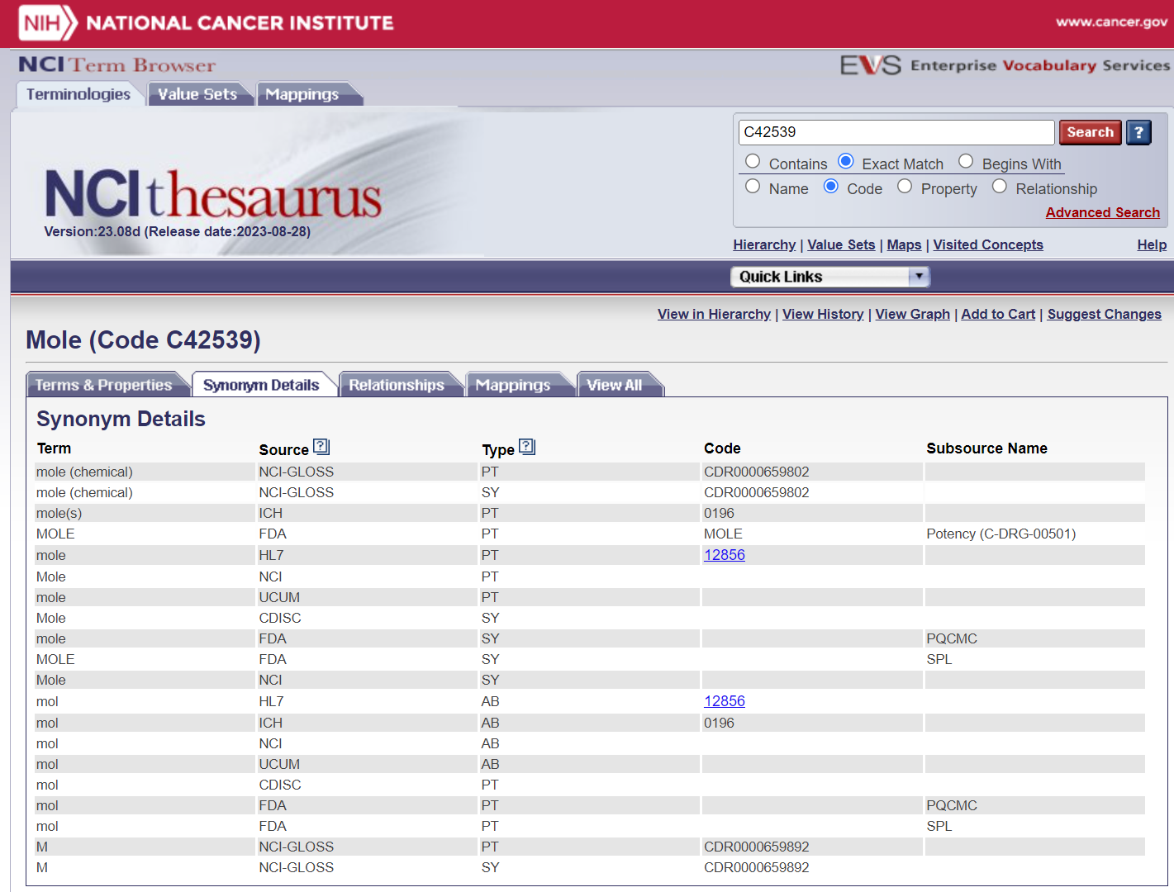


The Importance of a Concept Code – Mole (the Unit)
Unique Concept Code
Additional Source Data
Terms from Other Sources
Term Source
Source: NCI-EVS
Notes:
The concept code located next to the NCI preferred term is important because it ensure that all sources are referring to the same meaning of their term. For example, this mole concept is referring to the chemistry mole as opposed to the mammal, the spy, the food, or the skin condition.

Slide 12
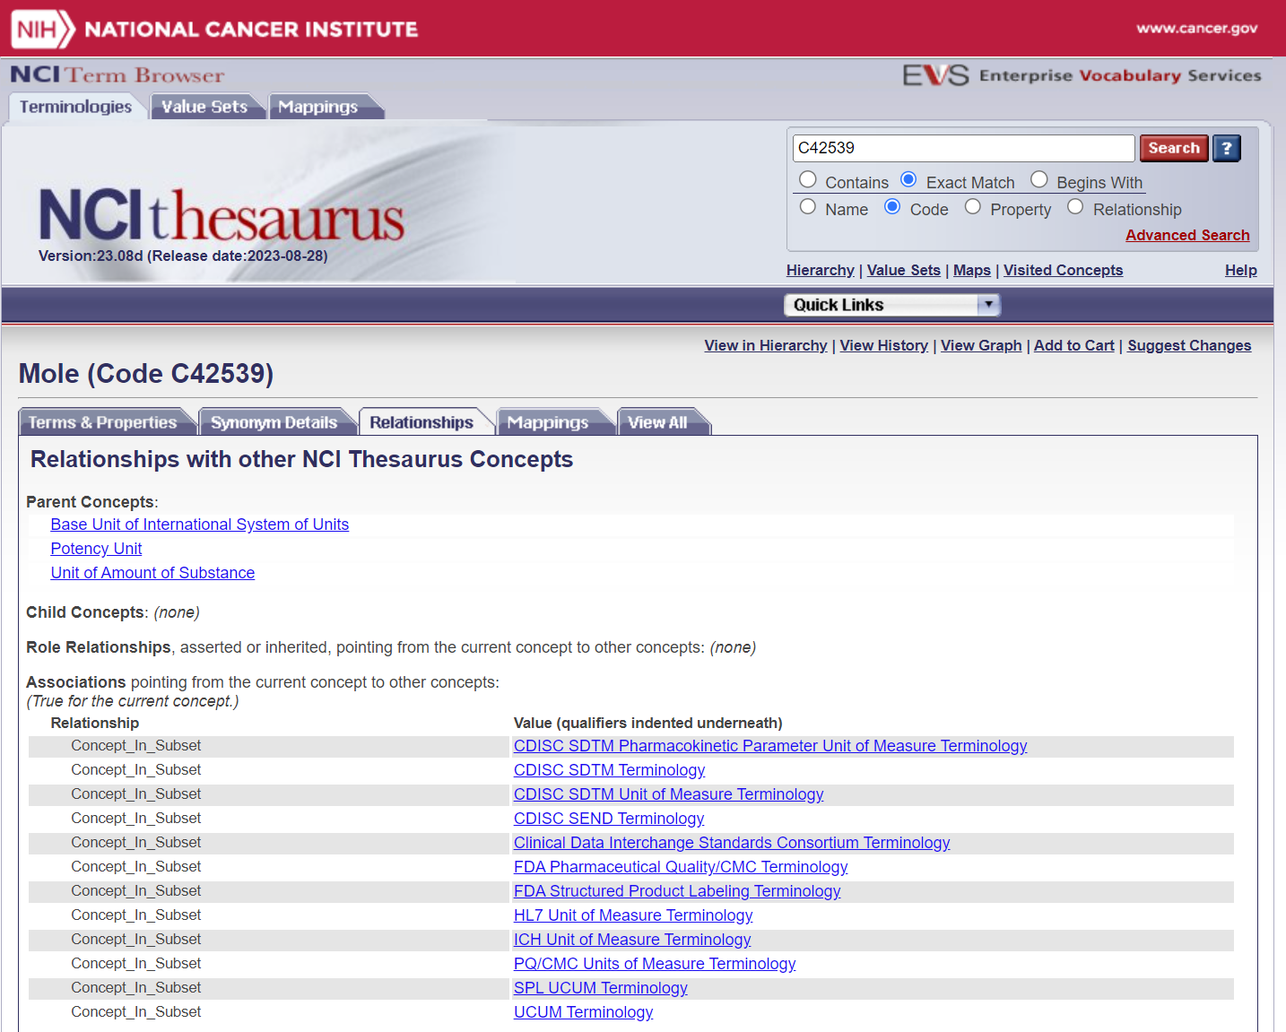
Relationships – Where else is “Mole” used? Association to Other Vocabularies and Codelist Bundling
NCIt Hierarchy
The “Concept_In_Subset” property indicates what other terminology source this concept is associated with. It also allows the bundling of concepts into supersets and value sets (codelists). Currently EVS maintains over 1500 value sets for 26 organizational entities.
Source: NCI-EVS

Slide 13
NCI-EVS and CDISC Terminology Program

Slide 14
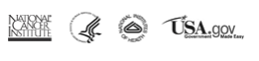
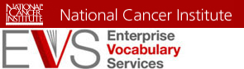
NCI EVS Partnership
CDISC and EVS have been working closely together for more than 20 years.
EVS provides dedicated terminology experts, subject matter experts.
Provides established terminology infrastructure and standard operating procedures.
Required and preferred by global regulatory agencies.
>54,000 CDISC terms are coded and tagged in NCI Thesaurus (NCIt)
CDISC terminology standards average 35,000 downloads/month in more than 60 countries.
All CDISC-tagged concepts contain a CDISC definition to ensure that all users understand and use the concept in the same way.
Responsible for CDISC controlled terminology development, harmonization, publication and maintenance.
Required by FDA and PMDA.
Preferred NMPA and Recommended by EMA.
Over 1300 published codelists associated with CDISC terminology in NCIt.
8 subsets of CDISC terminology, each with one-to-many codelists.
Support both general clinical and non-clinical data submission.
Notes:
The Enterprise Vocabulary Services of the National Cancer Institute has committed dedicated resources and is making a significant investment in the CDISC Terminology Program. This is of tremendous value to CDISC, as it allows us to leverage EVS’s rich knowledge and expertise in the area of Terminology Development, Production and Maintenance as well as their mature terminology infrastructure. CDISC terms are coded in NCI Thesaurus for ease of retrieval by the user community. Also important to CDISC, is the fact that NCI EVS is supporting key FDA Vocabulary projects in the same manner.

Slide 15
CDISC Terminology Objectives and Development Principles
Adopt-Adapt-Develop
Global
Sustainable and Open Source
Develop CDISC submission values with clear definitions; Create codelists and concept coding; define relationships between and among CT and CDISC model elements.
Two-Way process:
- Use CDISC models to guide and drive terminology decisions.
- Terminology analysis influences domain modeling and structuring.
Consider the impact of changes.
Communicate early and often with stakeholders.
Focus on re-use of existing terminology.
Commit to consistent decision-making; follow best terminology practice rules.
Support CDISC foundational and therapeutic area standards and CDISC teams. Fulfill CDISC user requests and support the user community.
Notes:
Address international needs for global projects and organizations
Ensure a sustainable “open source” environment and infrastructure for production terminology supporting terminology evolution

Slide 16
CDISC CT Are Made by Their Users
Currently 16 active CDISC controlled terminology teams that develop CT to support various CDISC standards and to fulfill CDISC user requests.
  New volunteers welcome! (Join us)
Led and overseen by NCI-EVS, industry subject matter- and data standards experts with rich experience and extensive knowledge in cardiovascular medicine, pharmacokinetics/pharmacogenomics, oncology, laboratory sciences, human physiology, and immunology studies, etc.
  CDISC terminology covers a wide variety of scientific and medical disciplines.
  Used by and support both clinical and non-clinical studies.
Made and consumed by their users: clear, consistent, practical, user-friendly.
Notes:
https://www.cdisc.org/standards/terminology

Slide 17
  Controlled Terminology to Support TMF Standards
- Artifacts for TMF-RM
- Metadata Standards for eTMF-EM

Slide 18
Terminology Organization and Bundling Basics
The development and organization of controlled terminology are driven by the model structure it serves.
  how do we organize the controlled terminology so it can best support the “overall structure” of the model and be the most user friendly?
For example, some of the CDISC Terminology is grouped by CDISC Domains.
  CDISC has what they call physiology/body system domains such as: Cardiovascular Domain/CV (for collection of heart assessment data), GI domain (for collection of GI assessment data), Respiratory/RE Domain (for collection of lung function test data).
  Assessment Codelists are created for EACH domain.
    Cardiac Output, belong in the CV codelist.
    Number of Polyps is in the GI codelist.
  If you are running a study on treating a heart disease, you are more likely to collect data related to heart findings:
    Superset: weed through the GI and RE tests just to find the heart assessment you need?
    Domain-specific Valuesets: Much easier to find what you need in the CV codelist for heart related tests. (CDISC CT approach)
Notes:
@ TMF folks:
Discuss how you would like the terminology bundled. Our last conversation left with a preference to creating multiple codelists organized/bundled by Artifact Zone Names.
Discuss “subartifacts”: are these valid values related to a specific artifact name? We could create codelists for subartifacts as well and bundle/organize by the Artifact Name these subartifacts are related to.
During the 6-month development period, what is the process to pass the changes to existing terms to me so I can include them into the Public Review Terminology File for the TMF subset? For public review purposes, both new terms and changes to existing terms are sent out for review.

Slide 19
Organization of TMF CT – Initial Plan for Artifacts in RM
Trial Management
Trial Oversight
Operational Procedure Manual
List of SOPs Current During Trial
Zone Name Level
Section Name Level
Artifact Name Level
Sub-Artifact Level
List of SOPs Current During Trial
SOP Waivers
SOP Deviations
Three-level Value Control: Provide coding and semantics to the values from Zone, Section, and Artifacts. Each concept in these 3 levels will be given unique C-codes for permanent tracking as well as clear and consistent definitions.
  Plans to also control sub-artifacts in the future.
Two-level Grouping:
  All Artifacts related to a Zone.
  Artifacts related to a Section.
11
48
250
Notes:
@ TMF folks:
Discuss how you would like the terminology bundled. Our last conversation left with a preference to creating multiple codelists organized/bundled by Artifact Zone Names.
Discuss “subartifacts”: are these valid values related to a specific artifact name? We could create codelists for subartifacts as well and bundle/organize by the Artifact Name these subartifacts are related to.
During the 6-month development period, what is the process to pass the changes to existing terms to me so I can include them into the Public Review Terminology File for the TMF subset? For public review purposes, both new terms and changes to existing terms are sent out for review.

Slide 20
Zone C-code
Trial Management
Trial Oversight
Operational Procedure Manual
List of SOPs Current During Trial
List of SOPs Current During Trial
SOP Waivers
SOP Deviations
Trial Committee
Committee Member Curriculum Vitae
Group artifacts into their related Zone
Codelist Name: Trail Management Zone Related Artifacts
  Unique C-code and definition for this codelist.
All 37 related artifacts across 5 sections from this Zone will be grouped into this codelist.
  Unique C-code and definition for each artifact.
C-code for each Artifact
Notes:
@ TMF folks:
Discuss how you would like the terminology bundled. Our last conversation left with a preference to creating multiple codelists organized/bundled by Artifact Zone Names.
Discuss “subartifacts”: are these valid values related to a specific artifact name? We could create codelists for subartifacts as well and bundle/organize by the Artifact Name these subartifacts are related to.
During the 6-month development period, what is the process to pass the changes to existing terms to me so I can include them into the Public Review Terminology File for the TMF subset? For public review purposes, both new terms and changes to existing terms are sent out for review.

Slide 21
Trial Management
Trial Oversight
Operational Procedure Manual
List of SOPs Current During Trial
List of SOPs Current During Trial
SOP Waivers
SOP Deviations
Trial Committee
Committee Member Curriculum Vitae
Section C-code
Section C-code.
Group artifacts into their related Sections
Codelists Names:
Trial management Zone - Trail Oversight Section Related Artifacts
  Unique C-code and definition for this Section as a codelist.
  20 related artifacts mapped to this codelist with unique C-code and definitions.
Trial management Zone - Trail Committee Section Related Artifacts
  Unique C-code and definition for this Section as a codelist.
  7 related artifacts mapped to this codelist with unique C-codes and definitions.
C-code for each Artifact
Notes:
@ TMF folks:
Discuss how you would like the terminology bundled. Our last conversation left with a preference to creating multiple codelists organized/bundled by Artifact Zone Names.
Discuss “subartifacts”: are these valid values related to a specific artifact name? We could create codelists for subartifacts as well and bundle/organize by the Artifact Name these subartifacts are related to.
During the 6-month development period, what is the process to pass the changes to existing terms to me so I can include them into the Public Review Terminology File for the TMF subset? For public review purposes, both new terms and changes to existing terms are sent out for review.

Slide 22
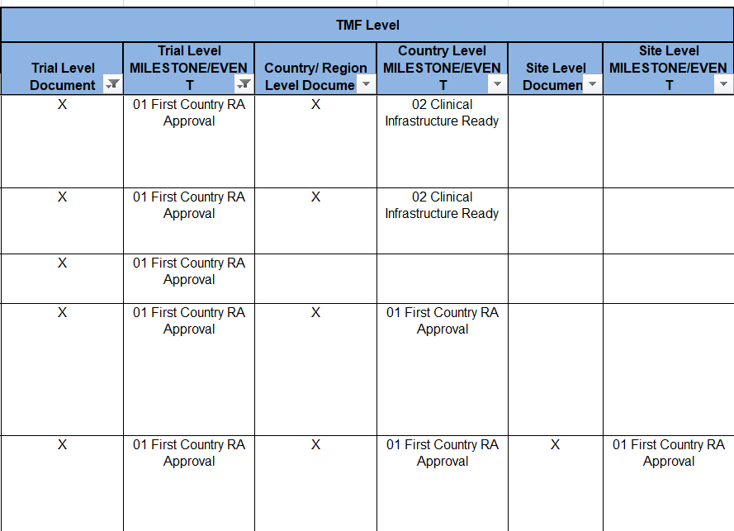
Future Plans – Additional Valuesets to Support the TMF RM
Grouping by artifacts needed and included at the Trail, Country, Site Levels.
Grouping by artifacts needed and included at the Trail Level Milestone, Country Level Milestone and Site Level milestone.
Value-set organization of the artifacts are driven by the model and how TMF users consume and use this data.
Ability to retrieve artifacts and standards metadata only relevant to, and needed by a specific purpose(s), e.g. TMF documents included only at the trial and site levels.
Customized (artifact) terminology to support the RM in the way you need.
Notes:
@ TMF folks:
Discuss how you would like the terminology bundled. Our last conversation left with a preference to creating multiple codelists organized/bundled by Artifact Zone Names.
Discuss “subartifacts”: are these valid values related to a specific artifact name? We could create codelists for subartifacts as well and bundle/organize by the Artifact Name these subartifacts are related to.
During the 6-month development period, what is the process to pass the changes to existing terms to me so I can include them into the Public Review Terminology File for the TMF subset? For public review purposes, both new terms and changes to existing terms are sent out for review.

Slide 23
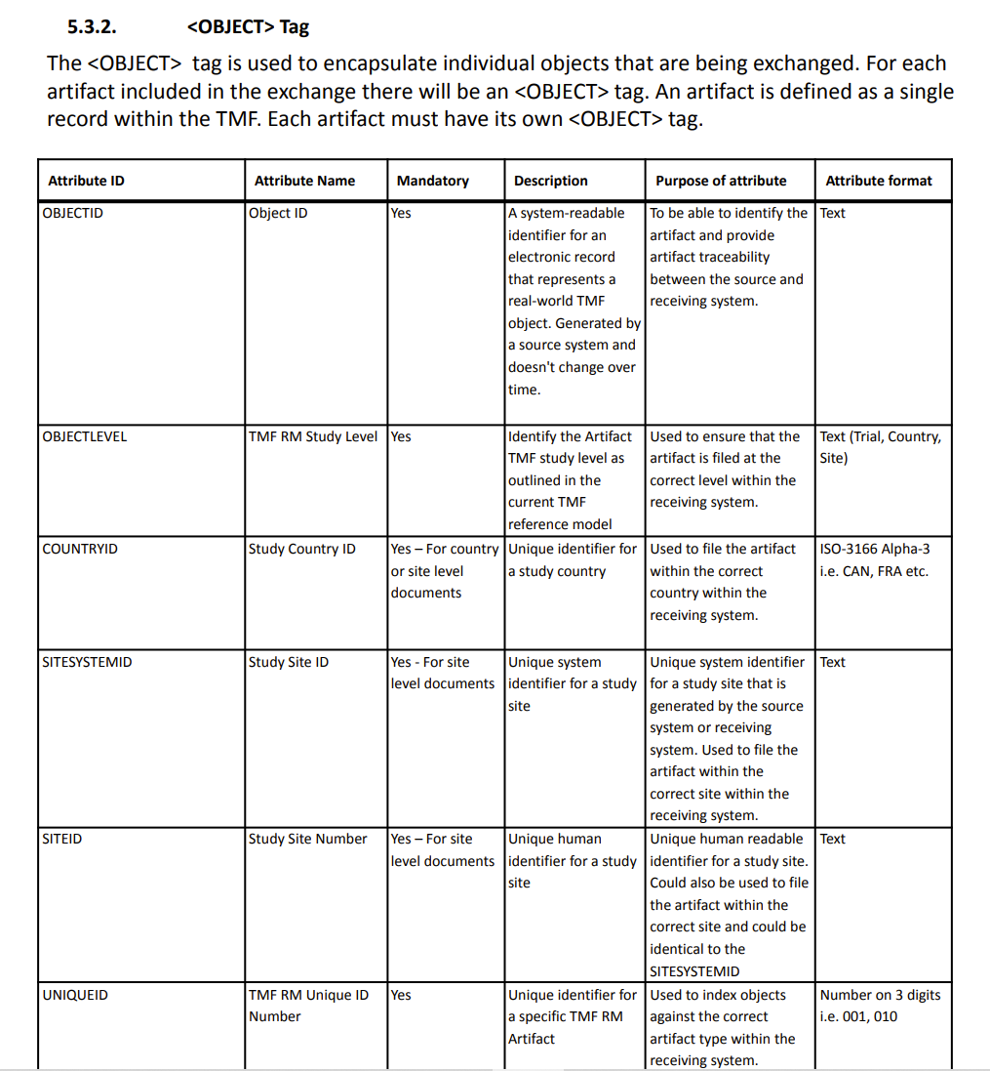
Future Plans – Codify the Metadata Standards in “Exchange.XML”
Provide unique identifier codes and semantics for the metadata standards used by the eTMF-Exchange Mechanism.
Specifically, we will control the attributes under the 6 tags in the Exchange.xml:
<BATCH>Tag
<OBJECT>Tag
<FILE>Tag
<SIGNATURE>Tag
<AUDITRECORD>Tag
<METADATA>Tag
Notes:
@ TMF folks:
Discuss how you would like the terminology bundled. Our last conversation left with a preference to creating multiple codelists organized/bundled by Artifact Zone Names.
Discuss “subartifacts”: are these valid values related to a specific artifact name? We could create codelists for subartifacts as well and bundle/organize by the Artifact Name these subartifacts are related to.
During the 6-month development period, what is the process to pass the changes to existing terms to me so I can include them into the Public Review Terminology File for the TMF subset? For public review purposes, both new terms and changes to existing terms are sent out for review.

Slide 24
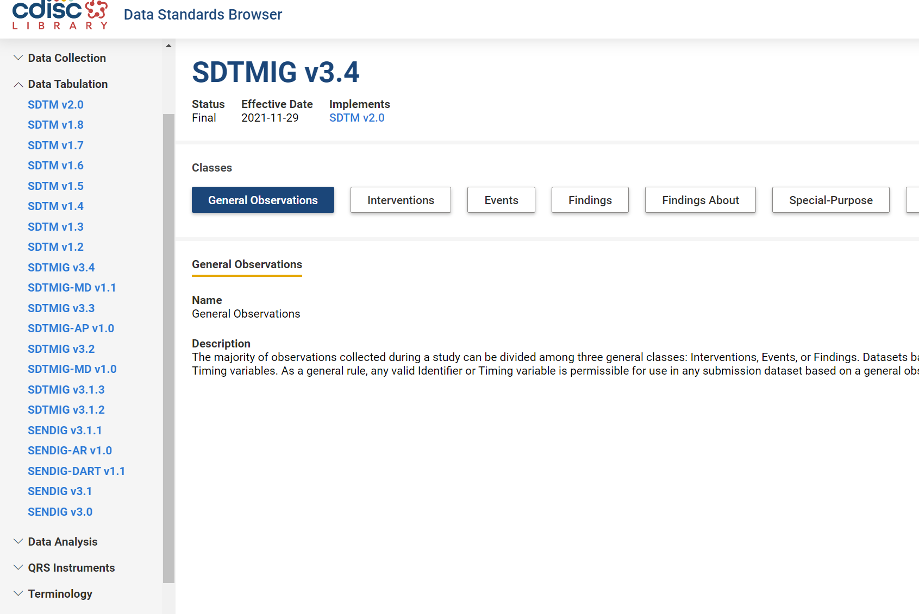
Both the TMF Reference Model and Terminology will be stored in the CDISC Library
CDISC models and controlled terminology are stored in the CDISC library. You can:
Access and easily browse multiple versions of the CDISC Foundational Standards' metadata and Controlled Terminology.
Retrieve machine-readable standards metadata using multiple media-types: JSON, XML, ODM, CSV, Excel (moving away from spreadsheet for metadata consumption and simplify automation).
Create Diff Reports, which deliver machine-readable (JSON, Excel) metadata comparisons that compute and display differences between the content in two versions of a standard.
Model relationships between and within variable- and value- level metadata.
Check conformance against standards metadata.
To learn more - Past Webinars:
CDISC Library: Ideas for using the CDISC Library: https://www.cdisc.org/events/webinar/cdisc-library-ideas-using-cdisc-library-and-look-whats-coming-next
CDISC Library Virtual Workshop: https://www.cdisc.org/events/webinar/cdisc-library-virtual-workshop
Source: NCI-EVS

Slide 25
Controlled Terminology Better Support the RM and the Exchange of TMF Content
Maintain community engagement
To the end: user community governance and quality assurance through public outreach, review and commenting.
Create Clear Standards and Formalize the model with regulatory authorities
Imported into the CDISC Library
Searching for specific artifacts, mapping relationships between artifacts.
Create views of content and metadata for various types of trials.
Concept coding at Zone, Section and Artifact levels – unique and permanent tracking for each TMF concept at each level.
Definition proofing: clearly, consistently and meaningfully defined individual concepts (instead of plain language description now used by the reference model).
From the start: controlled terminology is made by their users: need to be clear, consistent, practical and useful.
Enhance the Trial Master File Exchange Mechanism Standard
Codified artifacts and metadata standards will be used in the “exchange.xml” to support the automatic transfer of TMF content between sponsors, CROs and other stakeholders in the eTMF-EMS.
Enhance communication among sponsors, partners, and CROs.
Standardized TMF concepts will help to better support the Refence Model itself, which will further help to formalize the TMF-RM with regulatory agencies.
Retrieve versioned reference model and TMF terminology from the library.
Terminology analysis and placement influences RM modeling and structuring – users will have a better understanding of where to add and place a new or existing artifact.
Control changes and version history.

Slide 26


Slide 27
  Additional Slides – More Info

Slide 28
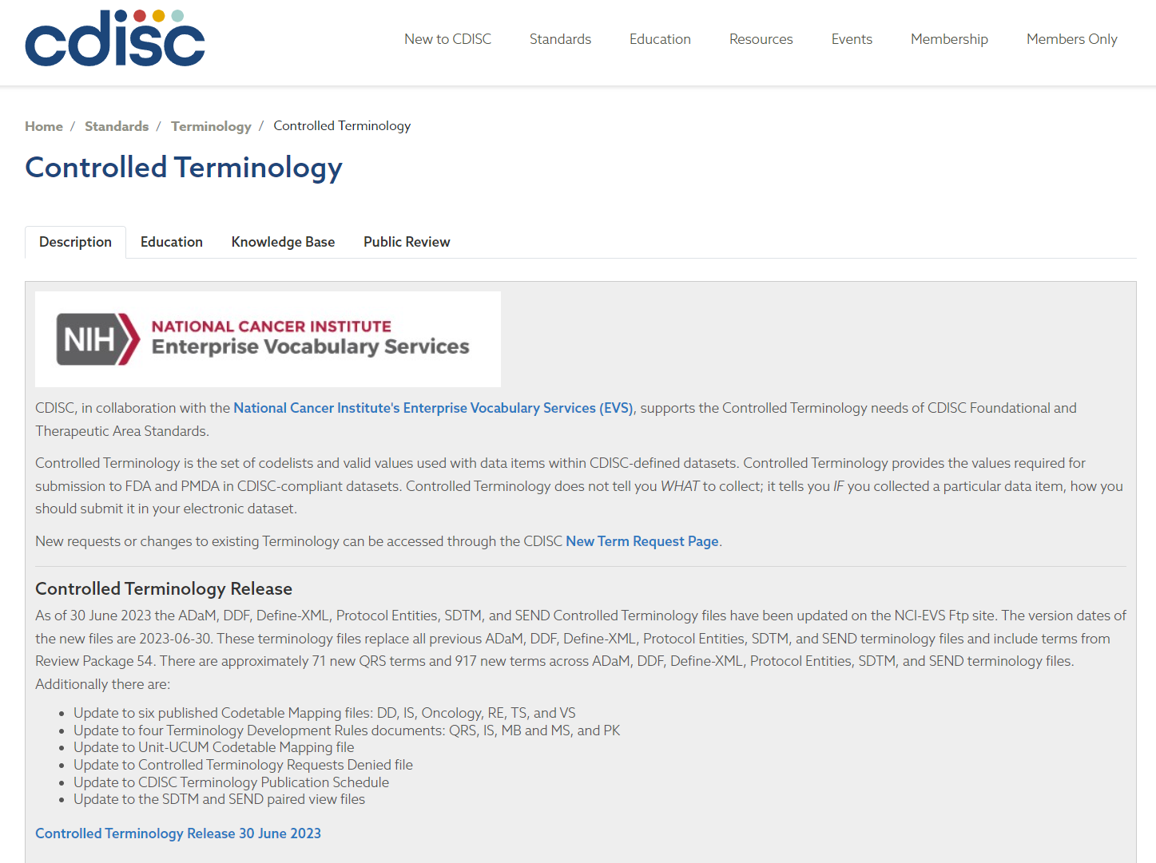
CDISC Controlled Terminology Page
CDISC CT Landing Page - https://www.cdisc.org/standards/terminology/controlled-terminology
Public announcement will be made about the new CT public review and publication (email blast from CDISC)
High-level summary will be provided on updates made to specific CDISC terminology subsets.
Link to the NIH CDISC Terminology Homepage for download.
Other supporting documents (CT rules, etc.) will be published and hosted on this page.

Slide 29
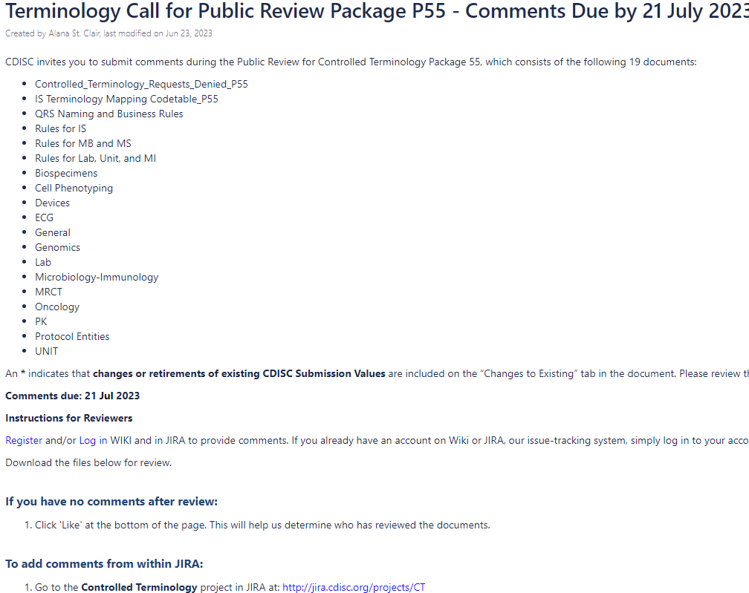
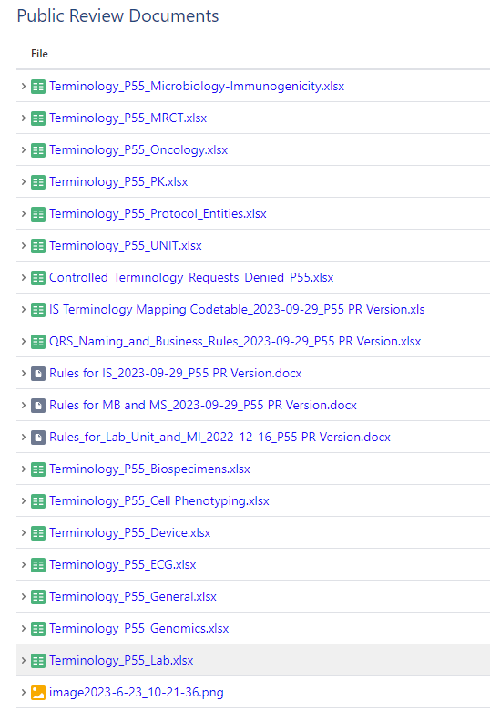
Terminology Public Review and Comment Resolution – CDISC WIKI
Instructions on how to enter comments through CDISC JIRA – CT Project.
> Terminology_P58_TMF-RM.xlsx

Slide 30
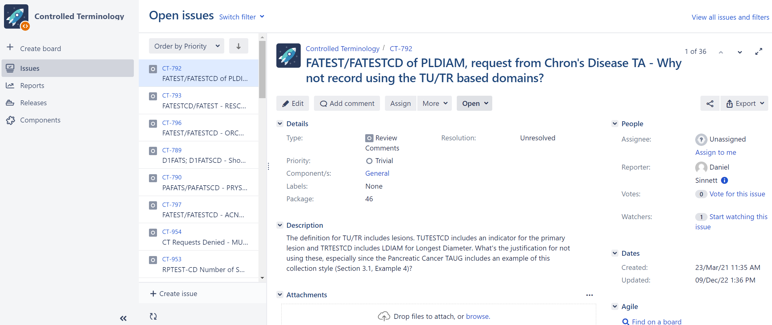
Terminology Public Review and Comment Resolution – CDISC JIRA CT Project
TMF-RM
58
http://jira.cdisc.org/projects/CT

Slide 31
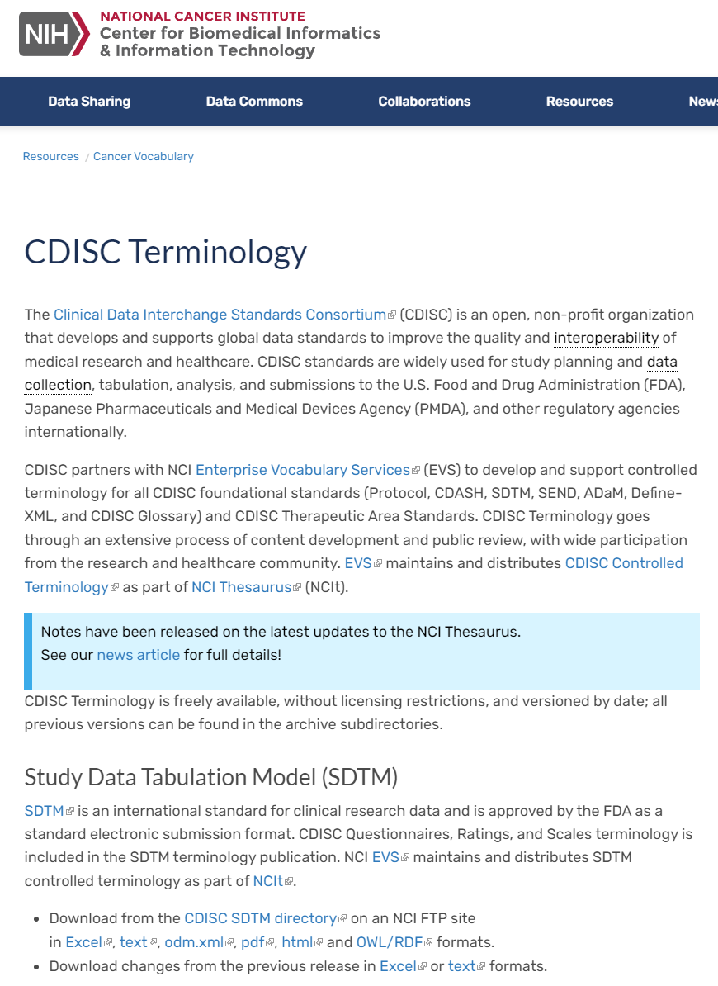
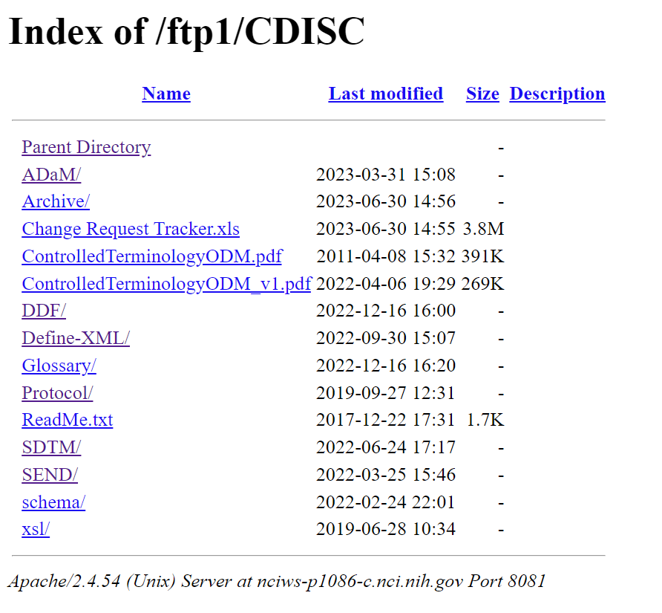
CDISC and TMF Terminologies are published on the NCI-FTP Site
Plan to publish twice a year for TMF terminology; aiming for 2024 publication.
6 formats can be directly downloaded from this page: .xls, .txt, .html, .odm-xml, .OWL/RDF, .pdf
CT Changes files (from previous release) + Changes Program
All files are stored on the NCI Ftp: https://evs.nci.nih.gov/ftp1/CDISC/
  Including older published files that are stored in subset terminology Archives.
Imported into the CDISC Library.
https://www.cancer.gov/research/resources/terminology/cdisc
Source: NCI-EVS

Slide 32
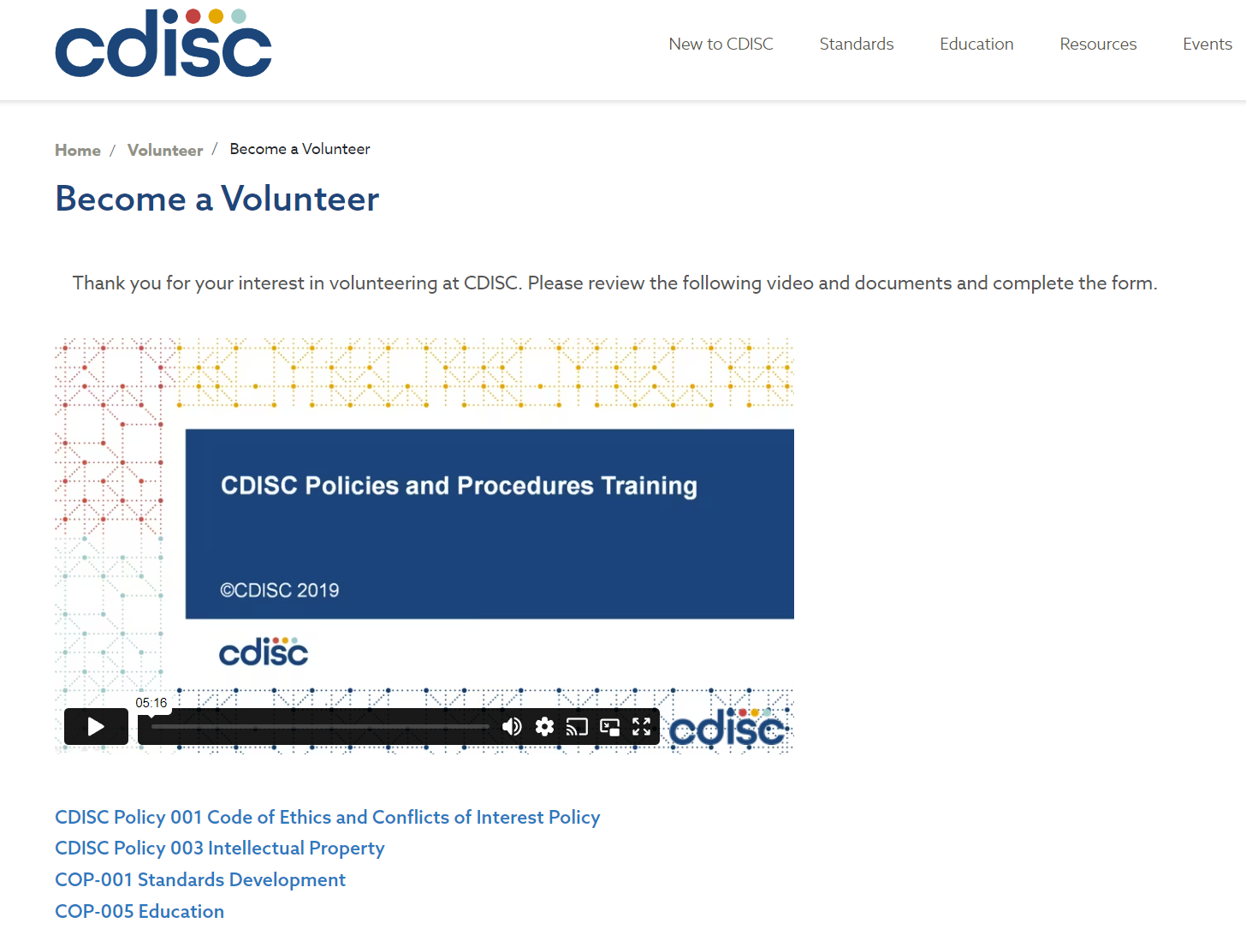
Join and Volunteer for a CDISC CT Team
https://www.cdisc.org/volunteer/form
Receive trainings.
Fill out a form and indicate which standards and CT teams you’d like to join.
Register and create accounts in CDISC WIKI and JIRA.
Participate in public reviews/commenting for CDISC standards products.
Join a team and talk to us directly.

