Slide 1
Changes in FDA technical Conformance Guide v4.7.1 & v4.7.2
Marion Friebel, Parexel
21 January 2022, CDISC DACH UG Meeting,

Slide 2

Revision History
FDA Study Data Technical Conformance Guide 4.7.1 & 4.7.2
Study Data Technical Conformance Guide - Technical Specifications Document (fda.gov)

Slide 3
Definition
This Study Data Technical Conformance Guide provides specification, recommendations and general considerations on how to submit standardized study data using FDA–support
The guide is separated in the same sections as before:
FDA SDTCG v. 4.7.2

Slide 4
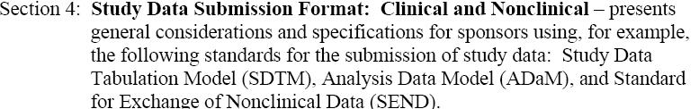


Definition- Continue
FDA SDTCG v. 4.7.2

Slide 5
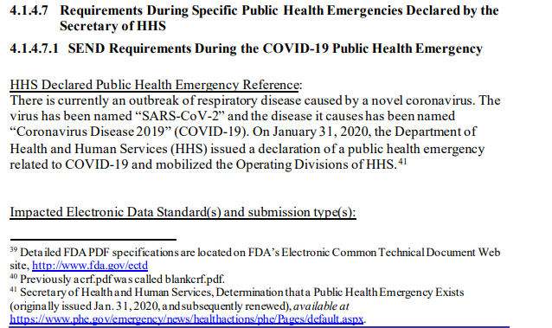
Changes from Guide v4.7 to Guide v4.7.1 , Section 4.1.4.7
    Type of change: added text
FDA SDTCG v. 4.7.2 page 24

Slide 6
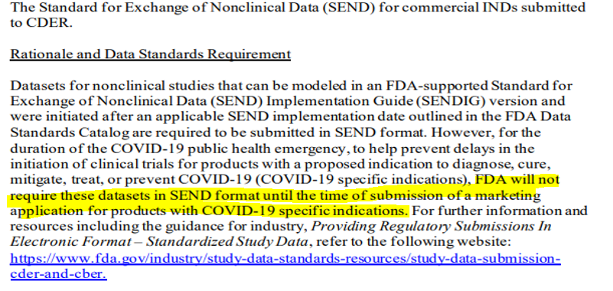
Changes from Guide v4.7 to Guide v4.7.1 , Section 4.1.4.7
Continue
  Type of change: added text
FDA SDTCG v. 4.7.2 page 25
Notes:
To spead up the process

Slide 7
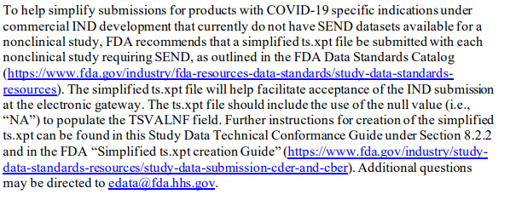
Changes from Guide v4.7 to Guide v4.7.1 , Section 4.1.4.7
Continue
  Type of change: added text
FFDA SDTCG v. 4.7.2 page 21

Slide 8
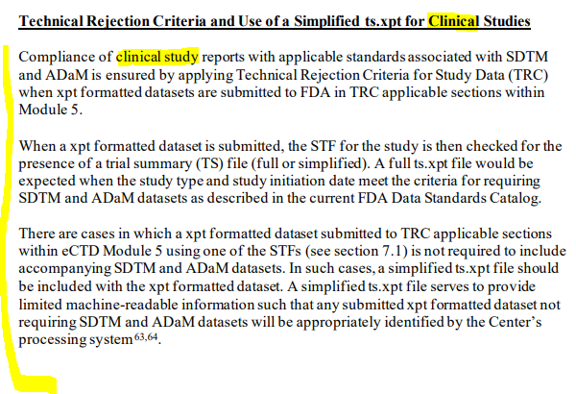
Changes from Guide v4.7 to Guide v4.7.2 , Section 8.2.2
  Type of change: added text
FDA SDTCG v. 4.7.2 page 40
Notes:
STF – study tagging file

Slide 9
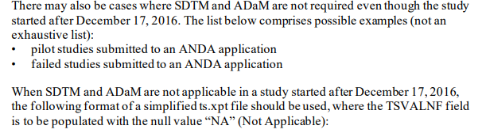

Changes from Guide v4.7 to Guide v4.7.2 , Section 8.2.2 Continue
Type of change: added text
FDA SDTCG v. 4.7.2 page 40

Slide 10
Thank you

