Slide 1
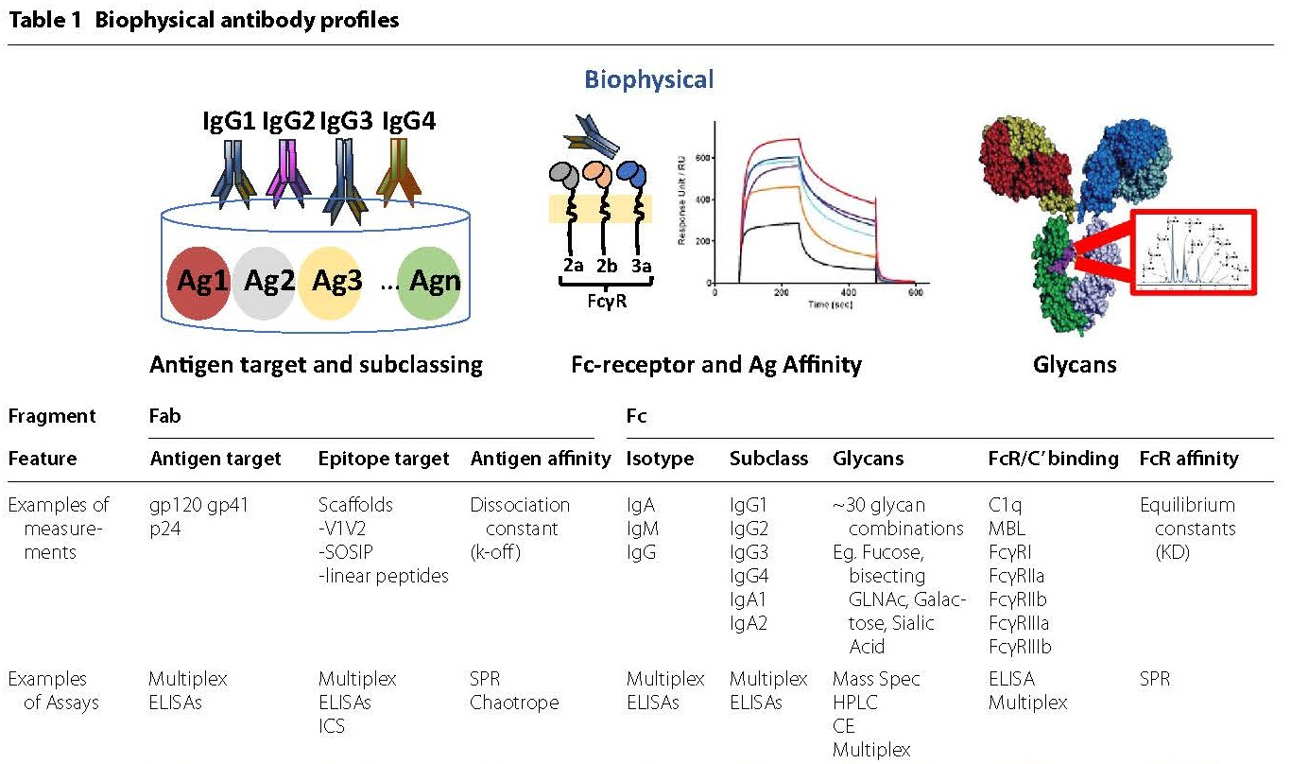
Not well modeled in current IS

Slide 2
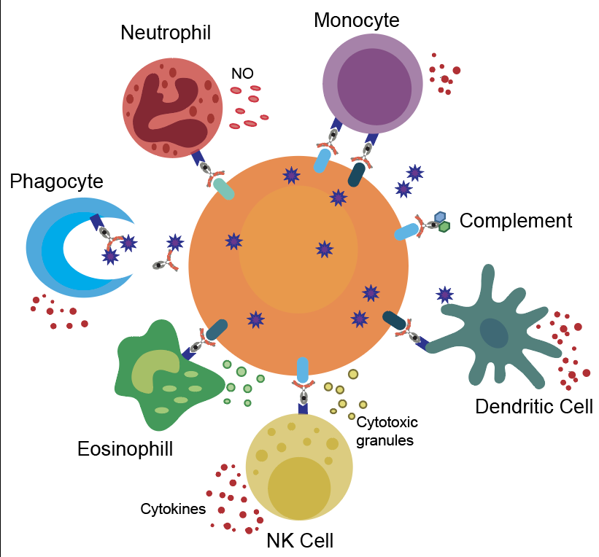
Antibodies drive more than just phagocytosis…

Slide 3
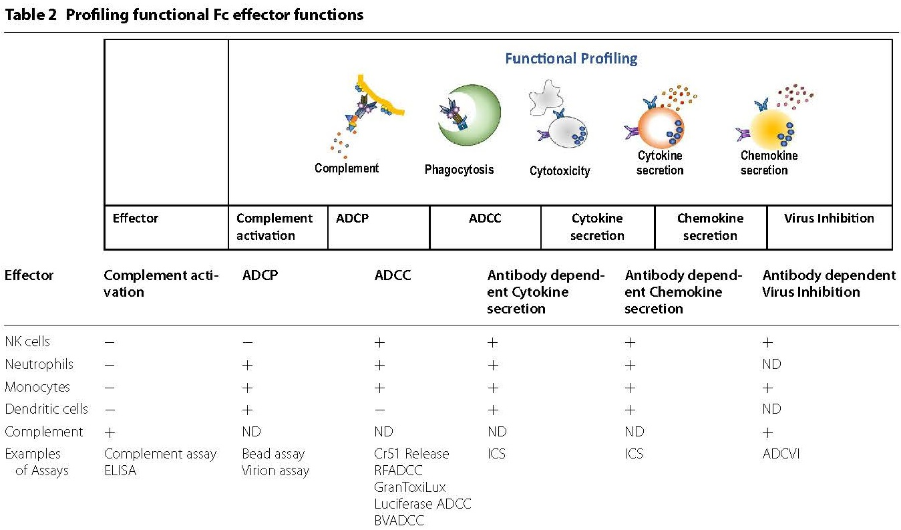
Not well modeled in current IS

Slide 4
Manuscripts for reference

