Slide 1
Percutaneous Vascular Intervention (PVI)
Peripheral vascular intervention is used to treat peripheral artery disease, the following first two bullets are the mostly commonly performed PVIs:
  Angioplasty with Stents
    Opens up occluded blood vessel by using a catheter with a stent at its tip
  Atherectomy
    removes plaque using a catheter with either a sharp blade or small drill on its tip
  3. A bunch of other procedures: percutaneous transluminal balloon angioplasty, thrombectomy,
  embolectomy, dissection repair, aneurysm exclusion, etc.
For the published SDTM examples, PVI is the bucket/categorical term that describes 3 (or more) procedures:
  CT angiography:
    for pre-op lesion diagnostic and identification process.
    during operation it guides the catheter insertion and its movement within the vessel that’s under treatment.
  2. Cardiac Catheterization
    injects contrast dye into the affected vessel to help visualize the vessel and the lesion.
    carries the stent (or the blade/drill)
  3. Stent implantation (or lesion removal with blade/drill).

Slide 2
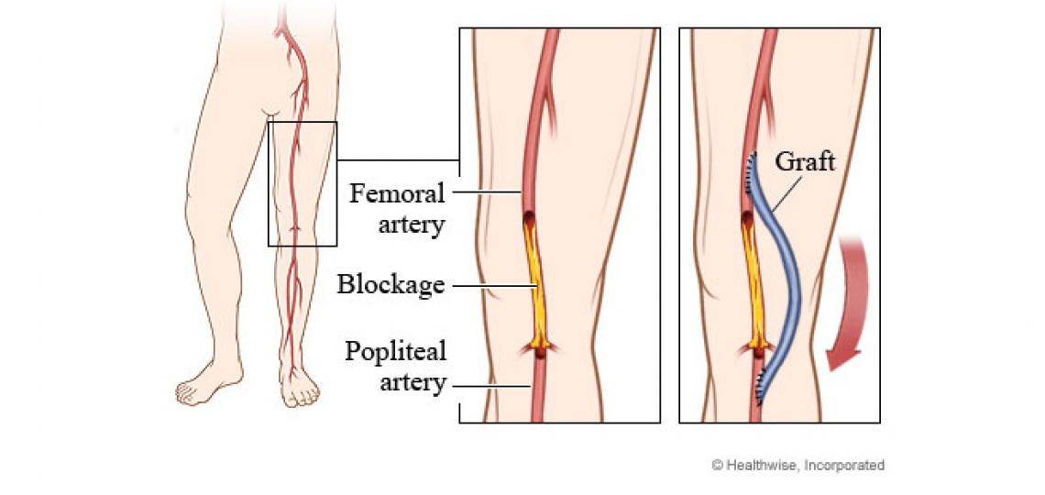
Peripheral Artery Bypass Graft Surgery
This surgery is performed when the patient is not a good candidate for PVI, and when the lesion is too severe and extensive. The femoral-popliteal graft surgery is the most commonly performed (and is the example that was created for the CV-endpoint TAUG, also in the SDTMIG) but technically, lesion can develop anywhere within the peripheral vasculature, and you could build grafts at different locations accordingly.
With bypass grafts, you’d typically want to know the following information:
Where is the graft? On which native vessel system is the graft built?
What is the material/type of the graft?
  From the patient himself (arterial or venous)
  From a dead/cadaveric donor (arterial or venous)
  Synthetic
The connection points/locations to the native vessel, this is called graft anastomosis.

Slide 3
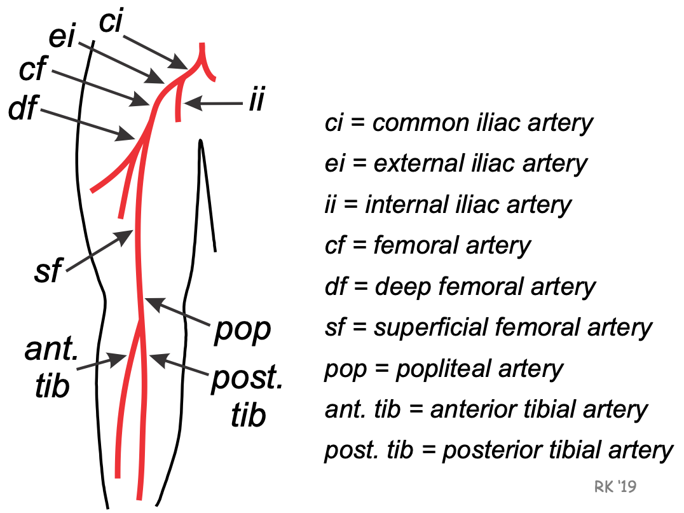
Complex anatomy of lesion location identification
How do you represent the complex anatomy of a lesion’s location, such as : “A lesion is in the segment of the popliteal artery above the knee, in the femoral-popliteal major arterial vessel system, of the left leg.”
Take femoral artery for example, it is divided into: common, deep, superficial femoral artery segments.
Popliteal artery is divided into: above the knee, below the knee segments.

Slide 4
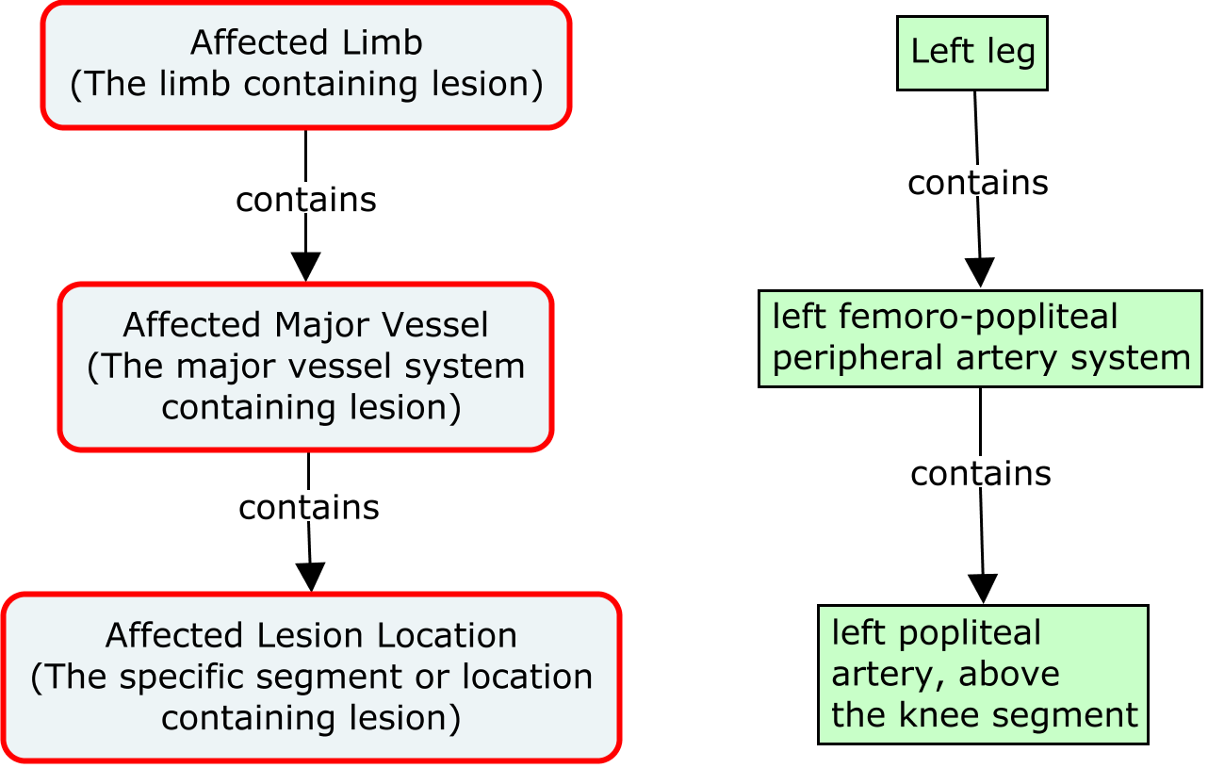
Complex anatomy of lesion location identification
There aren’t enough location variables to properly represent this level of anatomical granularities. We can tackle this issue with a combination of location-related TESTs and the use of location variables.

