Slide 1
Changes in FDA technical Conformance Guide v4.7
Marion Friebel, Parexel
16 April 2021, CDISC DACH UG Meeting,

Slide 2
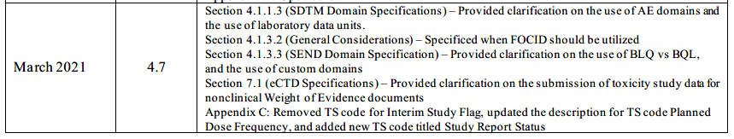
Revision History
FDA Study Data Technical Conformance Guide 4.7 (March 2021)
Study Data Technical Conformance Guide - Technical Specifications Document (fda.gov)

Slide 3
Definition
This Study Data Technical Conformance Guide provides specification, recommendations and general considerations on how to submit standardized study data using FDA–support
The guide is separated in the same sections as before:
FDA SDTCG v. 4.7 page 2

Slide 4
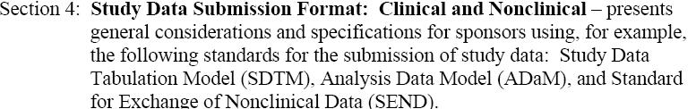


Definition- Continue
FDA SDTCG v. 4.7 page 3

Slide 5
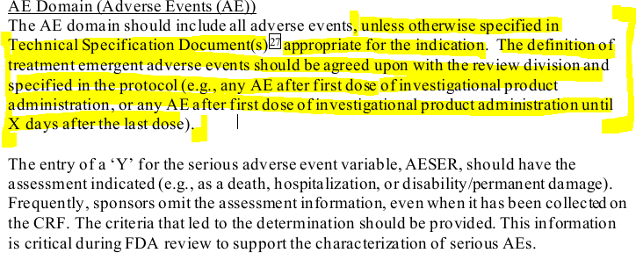
Changes from Guide v4.6 to Guide v4.7 , Section 4.1.1.3
SDTM Domain Specifications
    Type of change: added text
FDA SDTCG v. 4.7 page 11

Slide 6
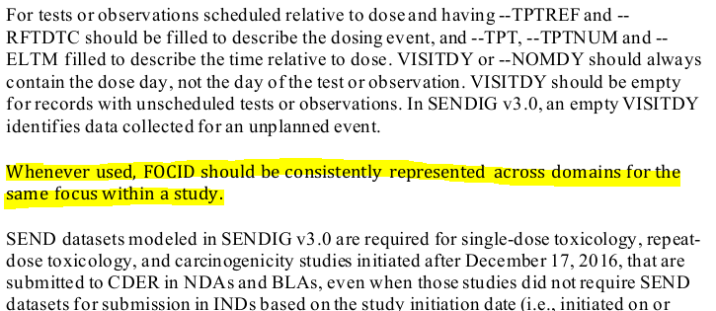
Changes from Guide v4.6 to Guide v4.7 , Section 4.1.3.2
General Considerations
  Type of change: added text
FDA SDTCG v. 4.7 page 18
Notes:
SDTM IG 3.3 has variable FOCID - Focus of Study-Specific Interest / Definition : Identification of a focus of study-specific interest on or within a subject or specimen as called out in the protocol for which a measurement, test, or examination was performed. The value in this variable should have inherent semantic meaning.
Variable FOCID found in new domains OE, MB, NV but can used as group identifier in other domains as well

Slide 7

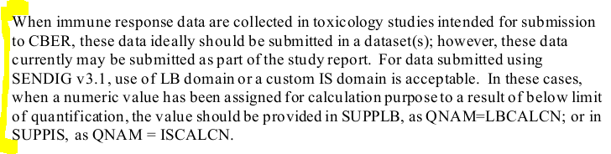
Changes from Guide v4.6 to Guide v4.7 , Section 4.1.3.3
SEND Domain Specification - Custom Domains
  Type of change: added clarifying text
FFDA SDTCG v. 4.7 page 21

Slide 8
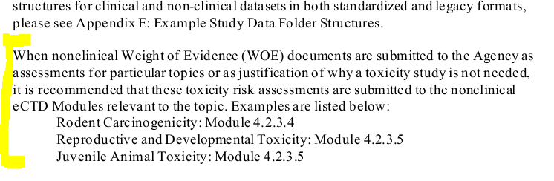
Changes from Guide v4.6 to Guide v4.7, Section 7.1
eCTD Specifications
  Type of change: added clarifying text
FDA SDTCG v. 4.7 page 35

Slide 9
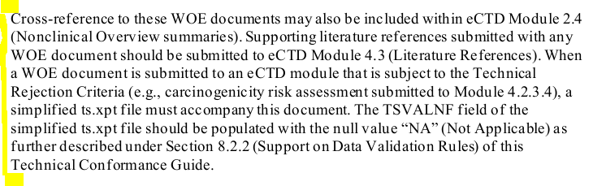
Changes from Guide v4.6 to Guide v4.7, Section 7.1 Continue
Type of change: added clarifying text
FDA SDTCG v. 4.7 page 36

Slide 10


Changes from Guide v4.6 to Guide v4.7, Appendix C
Trial Summary (TS) Parameters for Submission – Nonclinical
Flag in v4.7 removed
v4.6
v4.7
Flag in v4.7 added
  Type of change: updated
FFDA SDTCG v. 4.7 page 50-51

Slide 11
Thank you

