Slide 1
Representation of Questionnaires, Ratings, and Scales (QRS) items in SDTM -
Logically Skipped Items
03.08.2021

Slide 2
Definition
Logically skipped items (e.g., questions) on a QRS instrument are items which may be skipped due to a specific response to a previous item on the instrument or when the item does not apply to the subject.

Slide 3
Suggested representation of CDISC QRS expected logically skipped items
CDISC QRS supplements will have a record in qs.xpt with
  original results of null (QSORRES is missing).
  standardized results (QSSTRESC and QSSTRESN) populated with values from the instrument’s manual if instructions on scoring missing items are provided; otherwise, the values are missing.
  a status of NOT DONE (QSSTAT=“NOT DONE”).
  reason not done equal “LOGICALLY SKIPPED ITEM” (QSREASND=“LOGICALLY SKIPPED ITEM”).

Slide 4
Some History...

Slide 5
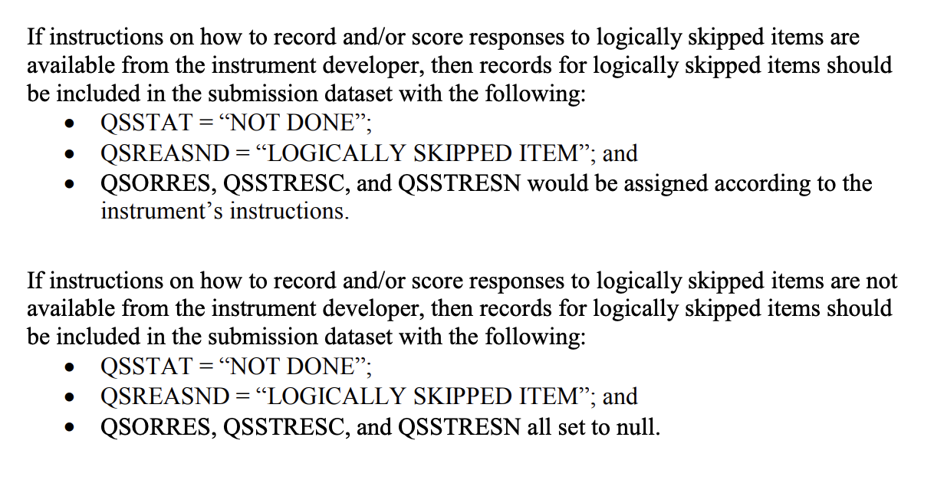
FDA Technical Conformance Guide

Slide 6
Tree Diagram for Determining –REASND
(from August 27, 2019)
QRS Instrument Missing Responses
Logically Skipped Items
Other Missing Responses – Reason Collected on Instrument
Other Missing Responses – Reason Not Collected on Instrument
--STAT=“NOT DONE”
--STAT=“NOT DONE”
--STAT=“NOT DONE”
--REASND=“LOGICALLY SKIPPED ITEM”
--REASND=<collected reason> (e.g., “PREFER NOT TO ANSWER”)
--REASND=“NO RESPONSE COLLECTED”
The 1st time this chart appeared, Aug 27, 2019
*Note: --ORRES, --STRESC, --STRESN are missing in all of these instances.

Slide 7
Tree Diagram for Determining –REASND
(Presented January 21, 2020)
QRS Instrument Missing Responses
Logically Skipped Items
Other Missing Responses – Reason Not Collected on Instrument
--STAT=“NOT DONE”
--STAT=“NOT DONE”
(--REASND missing)
--REASND=“LOGICALLY SKIPPED ITEM”
Presented Jan 21, 2020, this is what we PREVIOUSLY proposed. Please see the slide 9 for our new proposal.
*Note: --ORRES, --STRESC, --STRESN are missing in all of these instances.

Slide 8
Representation of standardized results in CDISC standards
Sometimes standardized results are known to exist for a QRS instrument, but not stated on the CRF. When this occurs, the standardized values will be represented in SDTM. As per CDISC QRS Best Practices and SDTMIG v3.4: “...This is only done when the numeric standardized responses are documented in the QRS CRF instructions, a user manual, a website specific to the QRS instrument, or another reference document that provides a clear explanation and rationale for providing them in the SDTMIG QRS dataset.”

Slide 9
An updated recommendation...

Slide 10
Tree Diagram for Determining --REASND
QRS Instrument Missing Responses (Expected and Not Expected)
Logically Skipped Items (with scoring information)
Logically Skipped Items (no additional information)
--STAT=“NOT DONE”
--STAT=“NOT DONE”
--REASND=“LOGICALLY SKIPPED ITEM”
Unexpected Missing Responses - Reason Not Collected on Instrument
--STAT="NOT DONE”
(--REASND missing)
--STRESC/--STRESN = score from manual
--ORRES missing since the item was skipped
--ORRES, --STRESC, and --STRESN all missing
--ORRES, --STRESC, and --STRESN all missing
--REASND="LOGICALLY SKIPPED ITEM"

Slide 11
Requested Change to the FDA TCG
In order to be consistent with the SDTMIG, and the representation of other standardized values in QRS, CDISC is requesting that the requirement for QSORRES to be assigned with the value from a manual when available be replaced with “QSORRES = null” :
Instead of:
  QSORRES, QSSTRESC, and QSSTRESN would be assigned according to the instrument’s instructions
We are requesting the following be considered:
  QSORRES = null
  QSSTRESC and QSSTRESN would be assigned according to the instrument’s instructions

Slide 12
Requested Change to the FDA TCG
If this request is implemented, the TCG would read:
  If instructions on how to record and/or score responses to logically skipped items are available from the instrument developer, then records for logically skipped items should be included in the submission dataset with the following:
  QSSTAT = “NOT DONE”,
  QSREASND = “LOGICALLY SKIPPED ITEM”,
  QSORRES = null; and
  QSSTRESC and QSSTRESN would be assigned according to the instrument’s instructions
  If instructions on how to record and/or score responses to logically skipped items are not available from the instrument developer, then records for logically skipped items should be included in the submission dataset with the following:
  QSSTAT = “NOT DONE”,
  QSREASND = “LOGICALLY SKIPPED ITEM”; and
  QSORRES, QSSTRESC, and QSSTRESN all set to null.

Slide 13
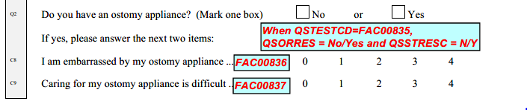
Example of logically skipped items – FACT-C
FAC00835 leads to two possibly skipped items:
FAC00836 and
FAC00837

Slide 14
Representing logically skipped items – FACT-C
qs.xpt* - with no ostomy appliance
Row | USUBJID | QSTESTCD | QSORRES | QSSTRESC | QSSTRESN
1 | P0001 | FAC00835 | No | N
2 | P0001 | FAC00836
3 | P0001 | FAC00837
qs.xpt (cont.)
Row | QSSTAT | QSREASND
1 (cont.)
2 (cont.) | NOT DONE | LOGICALLY SKIPPED ITEM
3 (cont.) | NOT DONE | LOGICALLY SKIPPED ITEM
*Note:
Due to space constraints, some variables are not shown in the qs.xpt table.
Logically skipped items are not scored for the FACT-C. If standardized values for logically skipped items had been provided, then QSSTRESC and QSSTRESN would have been populated with those values in Rows 2 and 3.

Slide 15
Representing logically skipped items – FACT-C (cont.)
qs.xpt* - with an ostomy appliance, answering all questions
Row | USUBJID | QSTESTCD | QSORRES | QSSTRESC | QSSTRESN | QSSTAT
1 | P0001 | FAC00835 | Yes | Y
2 | P0001 | FAC00836 | Somewhat | 2 | 2
3 | P0001 | FAC00837 | Quite a bit | 3 | 3
*Note: Due to space constraints, some variables are not shown in the qs.xpt table.

Slide 16
Representing logically skipped items – FACT-C (cont.)
qs.xpt* - with an ostomy appliance, but missing a response
Row | USUBJID | QSTESTCD | QSORRES | QSSTRESC | QSSTRESN | QSSTAT
1 | P0001 | FAC00835 | Yes | Y
2 | P0001 | FAC00836 |  |  |  | NOT DONE
3 | P0001 | FAC00837 | Quite a bit | 3 | 3
*Note: Due to space constraints, some variables are not shown in the qs.xpt table. QSREASND is not
included as the reason there was no response is not known.

Slide 17
Representing logically skipped items – FACT-C (cont.)
qs.xpt* - missing all responses at the end of the FACT-C
Row | USUBJID | QSTESTCD | QSORRES | QSSTRESC | QSSTRESN | QSSTAT
1 | P0001 | FAC00835 |  |  |  | NOT DONE
2 | P0001 | FAC00836 |  |  |  | NOT DONE
3 | P0001 | FAC00837 |  |  |  | NOT DONE
*Note: Due to space constraints, some variables are not shown in the qs.xpt table. QSREASND is not
included as the reason there was no response is not known.

Slide 18
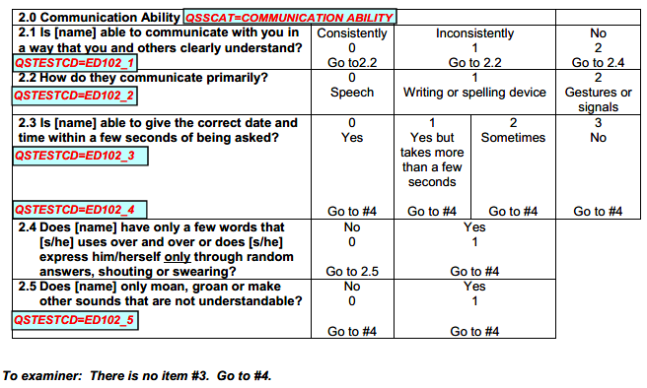
Example of logically skipped items –
Expanded DRS-PI Caregiver Version, Section 2
When EDR102_1 is “Consistently” or “Inconsistently”, then items ED102_4 and ED102_5 are skipped.
When EDR102_1 is “No”, then items ED102_2 and ED102_3 are skipped.
When ED102_4 is “Yes”, then item ED102_5 is skipped.

Slide 19
Representing logically skipped items –
Expanded DRS-PI Caregiver Version, Section 2 (cont.)
qs.xpt* (with ED102_1 = “Consistently”)
Row | USUBJID | QSTESTCD | QSORRES | QSSTRESC | QSSTRESN
1 | P0001 | ED102_1 | Consistently | 0 | 0
2 | P0001 | ED102_2 | Speech | 0 | 0
3 | P0001 | ED102_3 | Yes, but takes more than a few seconds | 1 | 1
4 | P0001 | ED102_4
5 | P0001 | ED102_5
qs.xpt (cont.)
*Note:
Logically skipped items are not scored for the Expanded DRS-PI. If standardized values for logically skipped items had been provided, then QSSTRESC and QSSTRESN would have been populated with those values in Rows 4 and 5.
Row | QSSTAT | QSREASND
1 (cont.)
2 (cont.)
3 (cont.)
4 (cont.) | NOT DONE | LOGICALLY SKIPPED ITEM
5 (cont.) | NOT DONE | LOGICALLY SKIPPED ITEM
*Note: Due to space constraints, some variables are not shown in the qs.xpt table.

Slide 20
Representing logically skipped items –
Expanded DRS-PI Caregiver Version, Section 2 (cont.)
qs.xpt* (with ED102_1 = “No”)
Row | USUBJID | QSTESTCD | QSORRES | QSSTRESC | QSSTRESN
1 | P0001 | ED102_1 | No | 2 | 2
2 | P0001 | ED102_2
3 | P0001 | ED102_3
4 | P0001 | ED102_4 | Yes | 1 | 1
5 | P0001 | ED102_5
qs.xpt (cont.)
Row | QSSTAT | QSREASND
1 (cont.)
2 (cont.) | NOT DONE | LOGICALLY SKIPPED ITEM
3 (cont.) | NOT DONE | LOGICALLY SKIPPED ITEM
4 (cont.)
5 (cont.) | NOT DONE | LOGICALLY SKIPPED ITEM
*Note:
Logically skipped items are not scored for the Expanded DRS-PI. If standardized values for logically skipped items had been provided, then QSSTRESC and QSSTRESN would have been populated with those values in Rows 2, 3, and 5.
* Note: Due to space constraints, some variables are not shown in the qs.xpt table.

Slide 21
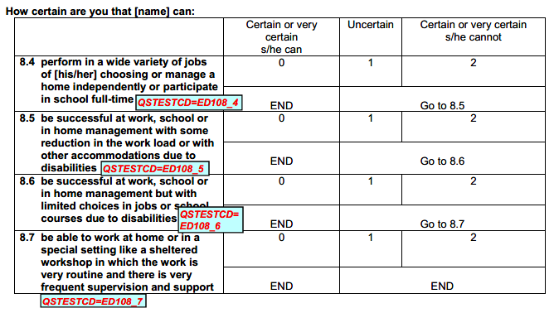
Example of logically skipped items –
Expanded DRS-PI Caregiver Version, Section 8
ED108_4, ED108_5, and ED108_6 can each lead to items being skipped when the response is “Certain or very certain s/he can”.

Slide 22
Representing logically skipped items –
Expanded DRS-PI Caregiver Version, Section 8
qs.xpt*
Row | USUBJID | QSTESTCD | QSORRES | QSSTRESC | QSSTRESN
1 | P0001 | ED108_4 | Uncertain | 1 | 1
2 | P0001 | ED108_5 | Certain or very certain s/he can | 0 | 0
3 | P0001 | ED108_6
4 | P0001 | ED108_7
qs.xpt (cont.)
*Note:
Logically skipped items are not scored for the Expanded DRS-PI. If standardized values for logically skipped items had been provided, then QSSTRESC and QSSTRESN would have been populated with those values in Rows 3 and 4.
Row | QSSTAT | QSREASND
1 (cont.)
2 (cont.)
3 (cont.) | NOT DONE | LOGICALLY SKIPPED ITEM
4 (cont.) | NOT DONE | LOGICALLY SKIPPED ITEM
* Note: Due to space constraints, some variables are not shown in the qs.xpt table.

Slide 23
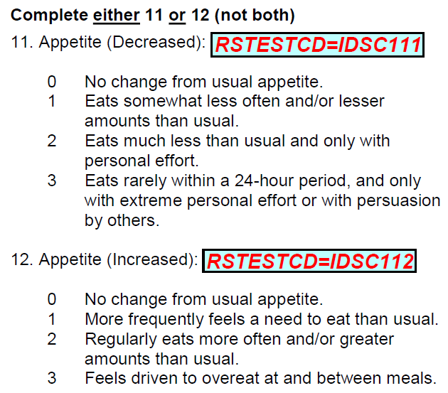
Example of logically skipped items – IDS-C
Data needs cleaning if IDSC111/IDSC112 conflict
A record is created for both items.
The item that does not apply is considered to be logically skipped.

Slide 24
Representing logically skipped items – IDS-C
rs.xpt
Row | USUBJID | RSTESTCD | RSORRES | RSSTRESC | RSSTRESN
11 | P0001 | IDSC111 | No change from usual appetite. | 0 | 0
12 | P0001 | IDSC112
rs.xpt (cont.)
*Note:
Logically skipped items are not scored for the IDS-C. If standardized values for logically skipped items had been provided, then RSSTRESC and RSSTRESN would have been populated with those values in Row 12.
Row | RSSTAT | RSREASND
11 (cont.)
12 (cont.) | NOT DONE | LOGICALLY SKIPPED ITEM
* Note: Due to space constraints, some variables are not shown in the rs.xpt table

Slide 25
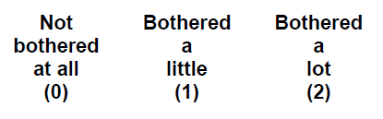
Example of logically skipped items– PHQ-15
Data needs cleaning if PHQ0204 is answered for “Male” subjects.
If the item does not apply, it is considered to be logically skipped.

Slide 26
Representing logically skipped items – PHQ-15
qs.xpt* (female respondent for which this applies)
Row | USUBJID | QSTESTCD | QSORRES | QSSTRESC | QSSTRESN | QSSTAT
1 | P0001 | PHQ0204 | Not bothered at all | 0 | 0
qs.xpt (male respondent, menopausal woman, someone that does not use traditional gender identification, etc.)
Row | USUBJID | QSTESTCD | QSORRES | QSSTRESC | QSSTRESN
4 | P0004 | PHQ0204
qs.xpt (cont.)
Row | QSSTAT | QSREASND
4 (cont.) | NOT DONE | LOGICALLY SKIPPED ITEM
*Note:
Due to space constraints, some variables are not shown in the qs.xpt table.
Logically skipped items are not scored for the PHQ-15. If standardized values for logically skipped items had been provided, then QSSTRESC and QSSTRESN would have been populated with those values in Row 4.

Slide 27
Final notes regarding representing missing data in QS/RS/FT
Providing records for items with no response will be unique to QRS domains (QS, RS, and FT).
We are working to revise the SDTMIG to reflect the representation of missing data for QRS instruments.

Slide 28
Thank You!
Dana Booth
dbooth@cdisc.org
Steve Kopko
skopko.external@cdisc.org

