Slide 1
Representation of Questionnaires, Ratings, and Scales (QRS) items in SDTM -
Logically Skipped Items & Conditional Branching
11.30.2023

Slide 2
Topics
Some History
Conditional Branching
An updated recommendation for sdTCG language on logically skipped items
Examples

Slide 3
Some History...

Slide 4
The definition for logically skipped items was…
Logically skipped items (e.g., questions) on a QRS instrument are items which may be skipped due to a specific response to a previous item on the instrument or when the item does not apply to the subject.

Slide 5
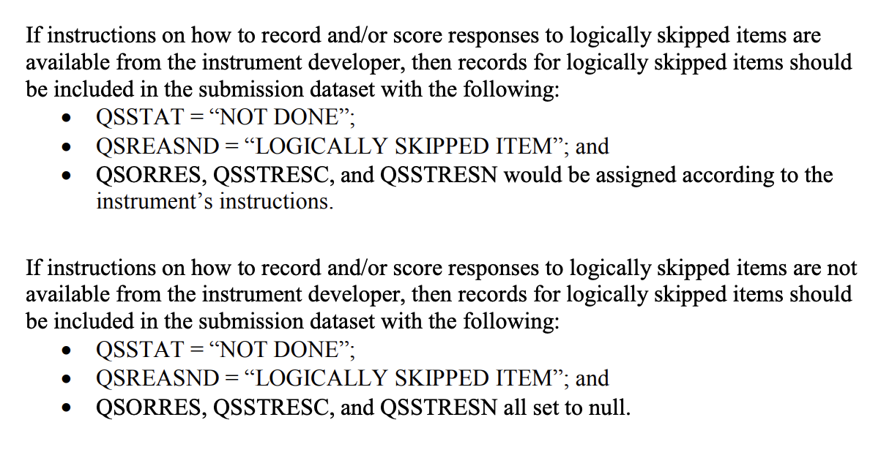
FDA Study Data Technical Conformance Guide

Slide 6
Tree Diagram for Determining –REASND
(from August 27, 2019)
QRS Instrument Missing Responses
Logically Skipped Items
Other Missing Responses – Reason Collected on Instrument
Other Missing Responses – Reason Not Collected on Instrument
--STAT=“NOT DONE”
--STAT=“NOT DONE”
--STAT=“NOT DONE”
--REASND=“LOGICALLY SKIPPED ITEM”
--REASND=<collected reason> (e.g., “PREFER NOT TO ANSWER”)
--REASND=“NO RESPONSE COLLECTED”
The 1st time this chart appeared, Aug 27, 2019
*Note: --ORRES, --STRESC, --STRESN are missing in all of these instances.

Slide 7
Tree Diagram for Determining –REASND
(Presented January 21, 2020)
QRS Instrument Missing Responses
Logically Skipped Items
Other Missing Responses – Reason Not Collected on Instrument
--STAT=“NOT DONE”
--STAT=“NOT DONE”
(--REASND missing)
--REASND=“LOGICALLY SKIPPED ITEM”
Presented Jan 21, 2020, this is another PREVIOUSLY proposed.
*Note: --ORRES, --STRESC, --STRESN are missing in all of these instances.

Slide 8
Tree Diagram for Determining --REASND
QRS Instrument Missing Responses (Expected and Not Expected)
Logically Skipped Items (with scoring information)
Logically Skipped Items (no additional information)
--STAT=“NOT DONE”
--STAT=“NOT DONE”
--REASND=“LOGICALLY SKIPPED ITEM”
Unexpected Missing Responses - Reason Not Collected on Instrument
--STAT="NOT DONE”
(--REASND missing)
--STRESC/--STRESN = score from manual
--ORRES missing since the item was skipped
--ORRES, --STRESC, and --STRESN all missing
--ORRES, --STRESC, and --STRESN all missing
--REASND="LOGICALLY SKIPPED ITEM"
Presented Mar 8, 2021, this is another PREVIOUS proposal.

Slide 9
With 2022 Came Conditional Branching…

Slide 10
Conditional Branching and the PRO-CTCAE
PRO-CTCAE logic branches from frequency to severity to interference. PRO-CTCAE uses conditional branching to determine if items need to be presented to a subject.
For example, if a PRO-CTCAE item never occurs (frequency item response is QSORRES = Never), then the severity and interference items are never presented to the subject, but they are provided a score of 0.
According to the PRO-CTCAE expert CDISC has spoke with, NIH does not consider these items to be skipped because a score is assigned to the item or items that were not presented to the subject.

Slide 11
Conditional Branching
According to PC Mag, conditional branching is “A programming instruction that directs the computer to another part of the program based on the results of a compare.”
In questionnaires, ratings, and scales (QRS) this might be written: Conditional branching on a QRS instrument is when the instrument, or the electronic data entry of the instrument, directs the subject to another part of the instrument based on a given condition.

Slide 12
Conditional Branching and Logically Skipped Items
Conditional branching is very similar to what we have been calling “logically skipped items”.
The only difference between PRO-CTCAE items that have not been presented to a subject and logically skipped items is that CDISC hasn’t had a use case in which the items were skipped and a score assigned to the items.
So while PRO-CTCAE items are not “skipped”, they are not presented to the subject based on a given condition, i.e., due to a specific response to a previous item on the instrument, which is a significant part of the definition of logically skipped item.

Slide 13
Conditional Branching and Logically Skipped Items
The other part of the definition is, “…or when the item does not apply to the subject.” such as when an item is used if something happened (e.g., weight decreased) or a different item is used if something else happened (e.g., weight increased). These items that do not apply are ones that the instrument directs the subject to answer or not based on a given condition (e.g., weight).
Looking at the earlier definition of conditional branching as applied to questionnaires, ratings, and scales: Conditional branching on a QRS instrument is when the instrument directs the subject to another part of the instrument based on a given condition.

Slide 14

Conditional Branching and Logically Skipped Items
Conditionally branching and logically skipped items have the same logic and are essentially the same thing!

Slide 15
Representation of standardized results in CDISC standards
Sometimes standardized results are known to exist for a QRS instrument, but not stated on the CRF. When this occurs, the standardized values will be represented in SDTM. As per CDISC QRS Best Practices and SDTMIG v3.4: “...This is only done when the numeric standardized responses are documented in the QRS CRF instructions, a user manual, a website specific to the QRS instrument, or another reference document that provides a clear explanation and rationale for providing them in the SDTMIG QRS dataset.”

Slide 16
Recap of CDISC representation of QRS logically skipped items to this point
QSORRES, QSSTRESC, and QSSTRESN have been null because CDISC did not have a use case where standardized values were provided for items that were not done
QSSTAT and QSREASND have been “NOT DONE” and “LOGICALLY SKIPPED ITEM”, respectively
  Dilemma though because the sdTCG and CDISC standards were still out of sync
  The standards provided no other solid way to represent that an item was conditionally branched

Slide 17
An updated recommendation...

Slide 18
A new variable
The CDISC SDS QRS Subteam is requested a new variable which has been approved by the CDISC Global Governance Group (GGG) for SDTMIG v4.0; meanwhile a non-standard variable (supplemental qualifier) has been approved:
Name: QSCBRFL
Label: Conditionally Branched Item Flag
Possible values of “Y” and null
This will allow for indicating if an item was not done due to conditional branching
The new standard variable will be released in SDTMIG v4.0 and the corresponding model, SDTM v2.x/3.0.
Meanwhile, the CDISC SDS QRS Subteam will use QSCBRFL as a non-standard variable.

Slide 19
A new approach for items that are not done due to conditional branching:
When there are assigned values
Use the non-standard variable QSCBRFL (represented as suppqual until SDTMIG v4.0 is approved)
Do not use --STAT and --REASND
Do not use the derived flag, --DRVFL, as this is no longer needed given ADaM and Define-XML.

Slide 20
A new approach for items that are not done due to conditional branching:
When there are NOT assigned values
Use QSCBRFL and do not use –DRVFL (same as when there are assigned values)
Use --STAT and optionally use --REASND
For REASND:
If there is a collected reason not done, use that
If there is no collected reason, either leave missing, or use the sponsor-defined reason not done per the sponsor’s data management best practices (e.g., QSREASND = “LOGICALLY SKIPPED ITEM”)

Slide 21
Requested Change to the FDA sdTCG
  If instructions on how to record and/or score responses to items not done due to conditional branching are available from the instrument developer, then records for items with conditional branching should be included in the submission dataset with the following:
  QSCBRFL = “Y”
  QSORRES, QSSTRESC, and QSSTRESN would be assigned according to the instrument’s instructions

Slide 22
Requested Change to the FDA sdTCG (cont.)
  If instructions on how to record and/or score responses to items not done due to conditional branching are not available from the instrument developer, then records for items with conditional branching should be included in the submission dataset with the following:
  QSSTAT = “NOT DONE”,
  QSCBRFL = “Y” and,
  QSORRES, QSSTRESC, and QSSTRESN all set to null.
  QSREASND = missing or the sponsor-provided reason (e.g., “LOGICALLY SKIPPED ITEM”)

Slide 23
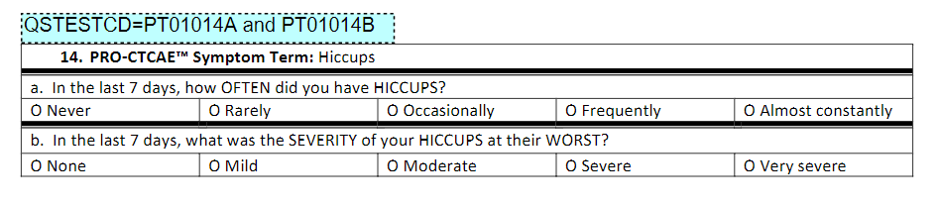
Example of items with conditional branching – PRO-CTCAE®
When the PRO-CTCAE® is administered electronically, if the subject answers “Never” for PT01014A, then PT01014B is assigned “None”.

Slide 24
Representing items with conditional branching - PRO-CTCAE®
qs.xpt* - subject never having hiccups
Row | USUBJID | QSTESTCD | QSORRES | QSSTRESC | QSSTRESN | QSCBRFL
1 | P0001 | PT01014A | Never | 0 | 0
2 | P0001 | PT01014B | None | 0 | 0 | Y
Currently QSCBRFL would be represented as a non-standard variable (suppqual); in the future (SDTMIG v4.0; SDTM v2.x/3.0) it is anticipated to become a new standard variable.
When the PRO-CTCAE is administered electronically, items not done due to conditional branching are assigned values of “None” or “Not at all” for QSORRES; QSSTRESC and QSSTRESN are assigned 0.
*Note: Due to space constraints, some variables are not shown in the qs.xpt table.

Slide 25
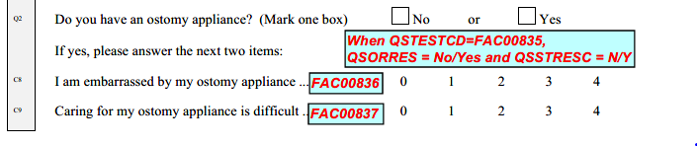
Example of items with conditional branching – FACT-C
FAC00835 leads to two possible items not done due to conditional branching:
FAC00836 and
FAC00837

Slide 26
Representing items with conditional branching – FACT-C
qs.xpt* - with no ostomy appliance
Row | USUBJID | QSTESTCD | QSORRES | QSSTRESC | QSSTRESN
1 | P0001 | FAC00835 | No | N
2 | P0001 | FAC00836
3 | P0001 | FAC00837
qs.xpt (cont.)
Row | QSSTAT | QSREASND | QSCBRFL
1 (cont.)
2 (cont.) | NOT DONE | LOGICALLY SKIPPED ITEM | Y
3 (cont.) | NOT DONE | LOGICALLY SKIPPED ITEM | Y
*Note:
Due to space constraints, some variables are not shown in the qs.xpt table.
Items skipped due to conditional branching are not scored for the FACT-C. QSREASND was not collected; however, the sponsor chose to use it to represent the data as “LOGICALLY SKIPPED ITEM” per data management best practices. (If standardized values for items with conditional branching had been provided, then they would have been represented in QSORRES, QSSTRESC, and QSSTRESN in Rows 2 and 3 and QSSTAT and QSREASND would not have been used.)

Slide 27
Representing items with conditional branching – FACT-C (cont.)
qs.xpt* - with an ostomy appliance, answering all questions
Row | USUBJID | QSTESTCD | QSORRES | QSSTRESC | QSSTRESN | QSSTAT
1 | P0001 | FAC00835 | Yes | Y
2 | P0001 | FAC00836 | Somewhat | 2 | 2
3 | P0001 | FAC00837 | Quite a bit | 3 | 3
*Note: Due to space constraints, some variables are not shown in the qs.xpt table.

Slide 28
Representing items with conditional branching – FACT-C (cont.)
qs.xpt* - with an ostomy appliance, but missing a response
Row | USUBJID | QSTESTCD | QSORRES | QSSTRESC | QSSTRESN | QSSTAT
1 | P0001 | FAC00835 | Yes | Y
2 | P0001 | FAC00836 |  |  |  | NOT DONE
3 | P0001 | FAC00837 | Quite a bit | 3 | 3
*Note: Due to space constraints, some variables are not shown in the qs.xpt table. QSREASND is not
included as the reason there was no response is not known.

Slide 29
Representing items with conditional branching – FACT-C (cont.)
qs.xpt* - missing all responses at the end of the FACT-C
Row | USUBJID | QSTESTCD | QSORRES | QSSTRESC | QSSTRESN | QSSTAT
1 | P0001 | FAC00835 |  |  |  | NOT DONE
2 | P0001 | FAC00836 |  |  |  | NOT DONE
3 | P0001 | FAC00837 |  |  |  | NOT DONE
*Note: Due to space constraints, some variables are not shown in the qs.xpt table. QSREASND is not
included as the reason there was no response is not known. All items, including the item that could lead to conditional branching, were left blank.

Slide 30
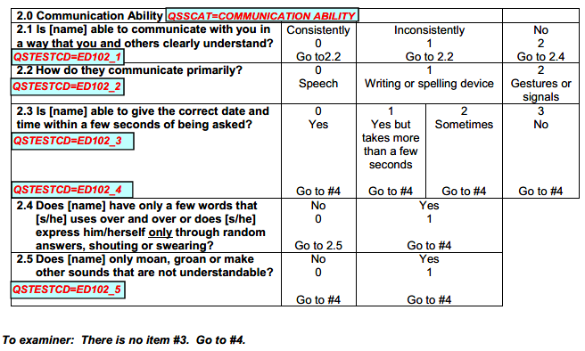
Example of items skipped due to conditional branching -
Expanded DRS-PI Caregiver Version, Section 2
When EDR102_1 is “Consistently” or “Inconsistently”, then items ED102_4 and ED102_5 are skipped.
When EDR102_1 is “No”, then items ED102_2 and ED102_3 are skipped.
When ED102_4 is “Yes”, then item ED102_5 is skipped.

Slide 31
Representing items with conditional branching –
Expanded DRS-PI Caregiver Version, Section 2 (cont.)
qs.xpt* (with ED102_1 = “Consistently”)
Row | USUBJID | QSTESTCD | QSORRES | QSSTRESC | QSSTRESN
1 | P0001 | ED102_1 | Consistently | 0 | 0
2 | P0001 | ED102_2 | Speech | 0 | 0
3 | P0001 | ED102_3 | Yes, but takes more than a few seconds | 1 | 1
4 | P0001 | ED102_4
5 | P0001 | ED102_5
qs.xpt (cont.)
*Note:
Items not done due to conditional branching are not scored for the Expanded DRS-PI. The sponsor chose not to use QSREASND since QSCBRFL shows there was conditional branching. (If standardized values for items with conditional branching had been provided, then they would have been represented in QSORRES, QSSTRESC, and QSSTRESN in Rows 4 and 5 and QSSTAT would not have been used.)
Row | QSSTAT | QSCBRFL
1 (cont.)
2 (cont.)
3 (cont.)
4 (cont.) | NOT DONE | Y
5 (cont.) | NOT DONE | Y
*Note: Due to space constraints, some variables are not shown in the qs.xpt table.

Slide 32
Representing items with conditional branching –
Expanded DRS-PI Caregiver Version, Section 2 (cont.)
qs.xpt* (with ED102_1 = “No”)
Row | USUBJID | QSTESTCD | QSORRES | QSSTRESC | QSSTRESN
1 | P0001 | ED102_1 | No | 2 | 2
2 | P0001 | ED102_2
3 | P0001 | ED102_3
4 | P0001 | ED102_4 | Yes | 1 | 1
5 | P0001 | ED102_5
qs.xpt (cont.)
*Note:
Items not done due to conditional branching are not scored for the Expanded DRS-PI. The sponsor chose not to use QSREASND since QSCBRFL shows there was conditional branching. (If standardized values for items with conditional branching had been provided, then they would have been represented in QSORRES, QSSTRESC, and QSSTRESN in Rows 2, 3, and 5 and QSSTAT would not have been used.)
Row | QSSTAT | QSCBRFL
1 (cont.)
2 (cont.) | NOT DONE | Y
3 (cont.) | NOT DONE | Y
4 (cont.)
5 (cont.) | NOT DONE | Y
* Note: Due to space constraints, some variables are not shown in the qs.xpt table.

Slide 33
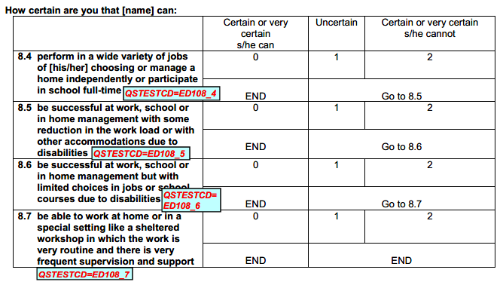
Example of items with conditional branching –
Expanded DRS-PI Caregiver Version, Section 8
ED108_4, ED108_5, and ED108_6 can each lead to items being skipped due to conditional branching when the response is “Certain or very certain s/he can”.

Slide 34
Representing items with conditional branching –
Expanded DRS-PI Caregiver Version, Section 8
qs.xpt*
Row | USUBJID | QSTESTCD | QSORRES | QSSTRESC | QSSTRESN
1 | P0001 | ED108_4 | Uncertain | 1 | 1
2 | P0001 | ED108_5 | Certain or very certain s/he can | 0 | 0
3 | P0001 | ED108_6
4 | P0001 | ED108_7
qs.xpt (cont.)
*Note:
Items not done due to conditional branching are not scored for the Expanded DRS-PI. The sponsor chose not to use QSREASND since QSCBRFL shows there was conditional branching. (If standardized values for items with conditional branching had been provided, then they would have been represented in QSORRES, QSSTRESC, and QSSTRESN in Rows 3 and 4 and QSSTAT would not have been used.)
Row | QSSTAT | QSCBRFL
1 (cont.)
2 (cont.)
3 (cont.) | NOT DONE | Y
4 (cont.) | NOT DONE | Y
* Note: Due to space constraints, some variables are not shown in the qs.xpt table.

Slide 35
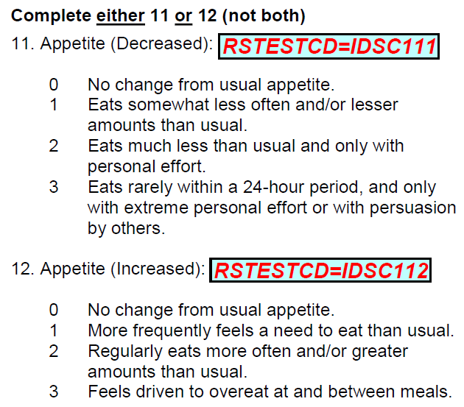
Example of items with conditional branching – IDS-C
Data needs cleaning if IDSC111/IDSC112 conflict
A record is created for both items.
The item that does not apply is considered to be not done due to conditional branching.

Slide 36
Representing items with conditional branching – IDS-C
rs.xpt
Row | USUBJID | RSTESTCD | RSORRES | RSSTRESC | RSSTRESN
11 | P0001 | IDSC111 | No change from usual appetite. | 0 | 0
12 | P0001 | IDSC112
rs.xpt (cont.)
*Note:
Items not done due to conditional branching are not scored for the IDS-C. The sponsor chose not to use RSREASND since RSCBRFL shows there was conditional branching. (If standardized values for the item with conditional branching had been provided, then they would have been represented in RSORRES, RSSTRESC, and RSSTRESN in Row 12 and RSSTAT would not have been used.)
Row | RSSTAT | RSCBRFL
11 (cont.)
12 (cont.) | NOT DONE | Y
* Note: Due to space constraints, some variables are not shown in the rs.xpt table

Slide 37
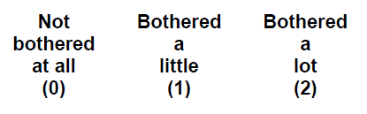
Example of items with conditional branching – PHQ-15
Data needs cleaning if PHQ0204 is answered for “Male” subjects.
If the item does not apply, it is considered to be not done due to conditional branching.

Slide 38
Representing items with conditional branching – PHQ-15
qs.xpt* (female respondent for which this applies)
Row | USUBJID | QSTESTCD | QSORRES | QSSTRESC | QSSTRESN | QSSTAT
1 | P0001 | PHQ0204 | Not bothered at all | 0 | 0
qs.xpt (male respondent, menopausal woman, someone that does not use traditional gender identification, etc.)
Row | USUBJID | QSTESTCD | QSORRES | QSSTRESC | QSSTRESN
4 | P0004 | PHQ0204
qs.xpt (cont.)
Row | QSSTAT | QSCBRFL | QSREASND
4 (cont.) | NOT DONE | Y | CONDITIONAL BRANCHING
*Note:
Due to space constraints, some variables are not shown in the qs.xpt table.
Items not done due to conditional branching are not scored for the PHQ-15. The sponsor chose to represent the reason not done as “CONDITIONAL BRANCHING” per their data management best practices. (If standardized values for the item with conditional branching had been provided, then they would have been represented in
QSORRES, QSSTRESC, and QSSTRESN in Row 4 and QSSTAT would not have been used.)

Slide 39
Final notes regarding representing missing data in QS/RS/FT
Providing records for items with no response is unique to QRS domains (QS, RS, and FT).
The SDS QRS Subteam is working to revise the SDTMIG to reflect the representation of missing data for QRS instruments.

Slide 40
Thank You!
Dana Booth
dana.booth@merck.com
Steve Kopko
skopko.external@cdisc.org

