Slide 1
Representation of Questionnaires, Ratings, and Scales (QRS) items in SDTM
11.03.2020

Slide 2
Definition
Logically skipped items (e.g., questions) on a QRS instrument are items which may be skipped due to a specific response to a previous item on the instrument or when the item does not apply to the subject.

Slide 3
Suggested representation of CDISC QRS expected logically skipped items
(revised 2020-10-06)
CDISC QRS supplements will have a record in qs.xpt with
  original results are null (QSORRES is missing).
  standardized results (QSSTRESC and QSSTRESN) are populated with values from the instrument’s manual if instructions on scoring missing items are provided; otherwise the values are missing.
  a status of NOT DONE (QSSTAT=“NOT DONE”).
  reason not done equal “LOGICALLY SKIPPED ITEM” (QSREASND=“LOGICALLY SKIPPED ITEM”).

Slide 4
Some History...

Slide 5
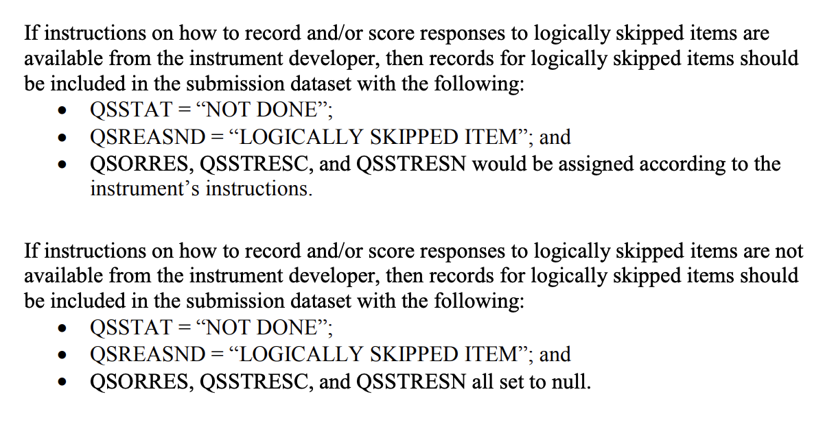
FDA Technical Conformance Guide

Slide 6
Tree Diagram for Determining –REASND
(from August 27, 2019)
QRS Instrument Missing Responses
Logically Skipped Items
Other Missing Responses – Reason Collected on Instrument
Other Missing Responses – Reason Not Collected on Instrument
--STAT=“NOT DONE”
--STAT=“NOT DONE”
--STAT=“NOT DONE”
--REASND=“LOGICALLY SKIPPED ITEM”
--REASND=<collected reason> (e.g., “PREFER NOT TO ANSWER”)
--REASND=“NO RESPONSE COLLECTED”
The 1st time this chart appeared, Aug 27, 2019
*Note: --ORRES, --STRESC, --STRESN are missing in all of these instances.

Slide 7
Tree Diagram for Determining –REASND
(Presented January 21, 2020)
QRS Instrument Missing Responses
Logically Skipped Items
Other Missing Responses – Reason Not Collected on Instrument
--STAT=“NOT DONE”
--STAT=“NOT DONE”
(--REASND missing)
--REASND=“LOGICALLY SKIPPED ITEM”
Presented Jan 21, 2020, this is what we PREVIOUSLY proposed. Please see the slide 9 for our new proposal.
*Note: --ORRES, --STRESC, --STRESN are missing in all of these instances.

Slide 8
An updated recommendation...

Slide 9
Tree Diagram for Determining --REASND
QRS Instrument Missing Responses (Expected and Not Expected)
Logically Skipped Items (with scoring information)
Logically Skipped Items (no additional information)
--STAT=“NOT DONE”
--STAT=“NOT DONE”
--REASND=“LOGICALLY SKIPPED ITEM”
Unexpected Missing Responses - Reason Not Collected on Instrument
--STAT="NOT DONE”
(--REASND missing)
--STRESC/--STRESN = score from manual
--ORRES missing since the item was skipped
--ORRES, --STRESC, and --STRESN all missing
--ORRES, --STRESC, and --STRESN all missing
--REASND="LOGICALLY SKIPPED ITEM"

Slide 10
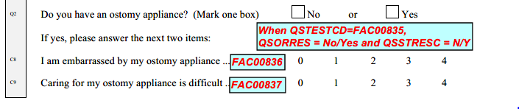
Example of logically skipped items – FACT-C
FAC00835 leads to two possibly skipped items:
FAC00836 and
FAC00837

Slide 11
Representing logically skipped items – FACT-C
qs.xpt* - with no ostomy appliance
Row | USUBJID | QSTESTCD | QSORRES | QSSTRESC | QSSTRESN
1 | P0001 | FAC00835 | No | N
2 | P0001 | FAC00836
3 | P0001 | FAC00837
qs.xpt (cont.)
Row | QSSTAT | QSREASND
1 (cont.)
2 (cont.) | NOT DONE | LOGICALLY SKIPPED ITEM
3 (cont.) | NOT DONE | LOGICALLY SKIPPED ITEM
*Note:
Due to space constraints, some variables are not shown in the qs.xpt table.
Logically skipped items are not scored for the FACT-C. If standardized values for logically skipped items had been provided, then QSSTRESC and QSSTRESN would have been populated with those values in Rows 2 and 3.

Slide 12
Representing logically skipped items – FACT-C (cont.)
qs.xpt* - with an ostomy appliance, answering all questions
Row | USUBJID | QSTESTCD | QSORRES | QSSTRESC | QSSTRESN | QSSTAT
1 | P0001 | FAC00835 | Yes | Y
2 | P0001 | FAC00836 | Somewhat | 2 | 2
3 | P0001 | FAC00837 | Quite a bit | 3 | 3
*Note: Due to space constraints, some variables are not shown in the qs.xpt table.

Slide 13
Representing logically skipped items – FACT-C (cont.)
qs.xpt* - with an ostomy appliance, but missing a response
Row | USUBJID | QSTESTCD | QSORRES | QSSTRESC | QSSTRESN | QSSTAT
1 | P0001 | FAC00835 | Yes | Y
2 | P0001 | FAC00836 |  |  |  | NOT DONE
3 | P0001 | FAC00837 | Quite a bit | 3 | 3
*Note: Due to space constraints, some variables are not shown in the qs.xpt table. QSREASND is not
included as the reason there was no response is not known.

Slide 14
Representing logically skipped items – FACT-C (cont.)
qs.xpt* - missing all responses at the end of the FACT-C
Row | USUBJID | QSTESTCD | QSORRES | QSSTRESC | QSSTRESN | QSSTAT
1 | P0001 | FAC00835 |  |  |  | NOT DONE
2 | P0001 | FAC00836 |  |  |  | NOT DONE
3 | P0001 | FAC00837 |  |  |  | NOT DONE
*Note: Due to space constraints, some variables are not shown in the qs.xpt table. QSREASND is not
included as the reason there was no response is not known.

Slide 15
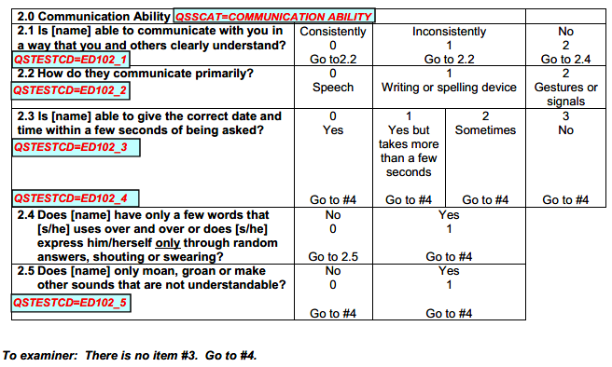
Example of logically skipped items –
Expanded DRS-PI Caregiver Version, Section 2
When EDR102_1 is “Consistently” or “Inconsistently”, then items ED102_4 and ED102_5 are skipped.
When EDR102_1 is “No”, then items ED102_2 and ED102_3 are skipped.
When ED102_4 is “Yes”, then item ED102_5 is skipped.

Slide 16
Representing logically skipped items –
Expanded DRS-PI Caregiver Version, Section 2 (cont.)
qs.xpt* (with ED102_1 = “Consistently”)
Row | USUBJID | QSTESTCD | QSORRES | QSSTRESC | QSSTRESN
1 | P0001 | ED102_1 | Consistently | 0 | 0
2 | P0001 | ED102_2 | Speech | 0 | 0
3 | P0001 | ED102_3 | Yes, but takes more than a few seconds | 1 | 1
4 | P0001 | ED102_4
5 | P0001 | ED102_5
qs.xpt (cont.)
*Note:
Logically skipped items are not scored for the Expanded DRS-PI. If standardized values for logically skipped items had been provided, then QSSTRESC and QSSTRESN would have been populated with those values in Rows 4 and 5.
Row | QSSTAT | QSREASND
1 (cont.)
2 (cont.)
3 (cont.)
4 (cont.) | NOT DONE | LOGICALLY SKIPPED ITEM
5 (cont.) | NOT DONE | LOGICALLY SKIPPED ITEM
*Note: Due to space constraints, some variables are not shown in the qs.xpt table.

Slide 17
Representing logically skipped items –
Expanded DRS-PI Caregiver Version, Section 2 (cont.)
qs.xpt* (with ED102_1 = “No”)
Row | USUBJID | QSTESTCD | QSORRES | QSSTRESC | QSSTRESN
1 | P0001 | ED102_1 | No | 2 | 2
2 | P0001 | ED102_2
3 | P0001 | ED102_3
4 | P0001 | ED102_4 | Yes | 1 | 1
5 | P0001 | ED102_5
qs.xpt (cont.)
Row | QSSTAT | QSREASND
1 (cont.)
2 (cont.) | NOT DONE | LOGICALLY SKIPPED ITEM
3 (cont.) | NOT DONE | LOGICALLY SKIPPED ITEM
4 (cont.)
5 (cont.) | NOT DONE | LOGICALLY SKIPPED ITEM
*Note:
Logically skipped items are not scored for the Expanded DRS-PI. If standardized values for logically skipped items had been provided, then QSSTRESC and QSSTRESN would have been populated with those values in Rows 2, 3, and 5.
* Note: Due to space constraints, some variables are not shown in the qs.xpt table.

Slide 18
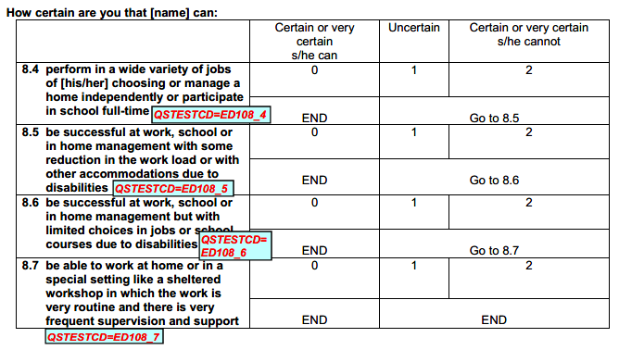
Example of logically skipped items –
Expanded DRS-PI Caregiver Version, Section 8
ED108_4, ED108_5, and ED108_6 can each lead to items being skipped when the response is “Certain or very certain s/he can”.

Slide 19
Representing logically skipped items –
Expanded DRS-PI Caregiver Version, Section 8
qs.xpt*
Row | USUBJID | QSTESTCD | QSORRES | QSSTRESC | QSSTRESN
1 | P0001 | ED108_4 | Uncertain | 1 | 1
2 | P0001 | ED108_5 | Certain or very certain s/he can | 0 | 0
3 | P0001 | ED108_6
4 | P0001 | ED108_7
qs.xpt (cont.)
*Note:
Logically skipped items are not scored for the Expanded DRS-PI. If standardized values for logically skipped items had been provided, then QSSTRESC and QSSTRESN would have been populated with those values in Rows 3 and 4.
Row | QSSTAT | QSREASND
1 (cont.)
2 (cont.)
3 (cont.) | NOT DONE | LOGICALLY SKIPPED ITEM
4 (cont.) | NOT DONE | LOGICALLY SKIPPED ITEM
* Note: Due to space constraints, some variables are not shown in the qs.xpt table.

Slide 20
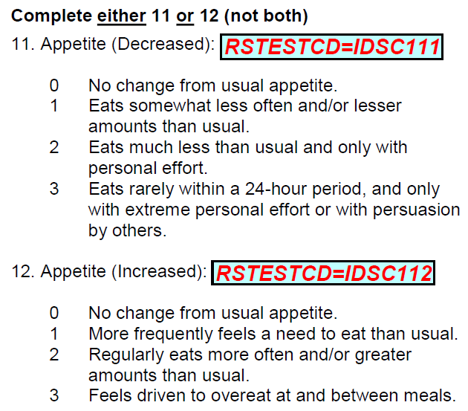
Example of logically skipped items – IDS-C
Data needs cleaning if IDSC111/IDSC112 conflict
A record is created for both items.
The item that does not apply is considered to be logically skipped.

Slide 21
Representing logically skipped items – IDS-C
rs.xpt
Row | USUBJID | RSTESTCD | RSORRES | RSSTRESC | RSSTRESN
11 | P0001 | IDSC111 | No change from usual appetite. | 0 | 0
12 | P0001 | IDSC112
rs.xpt (cont.)
*Note:
Logically skipped items are not scored for the IDS-C. If standardized values for logically skipped items had been provided, then RSSTRESC and RSSTRESN would have been populated with those values in Row 12.
Row | RSSTAT | RSREASND
11 (cont.)
12 (cont.) | NOT DONE | LOGICALLY SKIPPED ITEM
* Note: Due to space constraints, some variables are not shown in the rs.xpt table

Slide 22
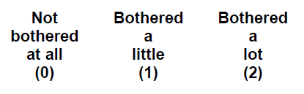
Example of logically skipped items– PHQ-15
Data needs cleaning if PHQ0204 is answered for “Male” subjects.
If the item does not apply, it is considered to be logically skipped.

Slide 23
Representing logically skipped items – PHQ-15
qs.xpt* (female respondent for which this applies)
Row | USUBJID | QSTESTCD | QSORRES | QSSTRESC | QSSTRESN | QSSTAT
1 | P0001 | PHQ0204 | Not bothered at all | 0 | 0
qs.xpt (male respondent, menopausal woman, someone that does not use traditional gender identification, etc.)
Row | USUBJID | QSTESTCD | QSORRES | QSSTRESC | QSSTRESN
4 | P0004 | PHQ0204
qs.xpt (cont.)
Row | QSSTAT | QSREASND
4 (cont.) | NOT DONE | LOGICALLY SKIPPED ITEM
*Note:
Due to space constraints, some variables are not shown in the qs.xpt table.
Logically skipped items are not scored for the PHQ-15. If standardized values for logically skipped items had been provided, then QSSTRESC and QSSTRESN would have been populated with those values in Row 4.

Slide 24
Which kinds of QS items are NOT considered logically skipped items?
Another item does not instruct that the item be skipped
Presence of data styles of items
    ∙ “Other, Specify:” text responses
  ∙ “Check all that apply” type questions
  Items that indicate a specific response when an item does not apply
  Items the subject skips for some unknown reason

Slide 25
How are other items represented in QS?
A record is created in qs.xpt for all items.
If an instrument is not done, then a record will be created for all items on the instrument.
Items with responses are represented as per usual.
For those in which the subject checks all that apply, if an item is not checked, there is still a response recorded of “NOT CHECKED” so QSSTAT is not used.
For other missing data, including for items the subject skips (e.g., when the item does not apply or no response was provided), no assumption is made as to the reason (e.g., QSSTAT=“NOT DONE” and QSREASND is not needed for that record).

Slide 26
How are other items represented in QS? (cont.)
If an original result is indicated on a QRS instrument for an item that does not apply, then that item is not considered to be logically skipped (e.g., In the Expanded DRS-PI, Sections 4-6, it states to mark 0 if an item does not apply and move to the next item. The item marked 0 has an original result of QSORRES=0 and is not logically skipped.).

Slide 27
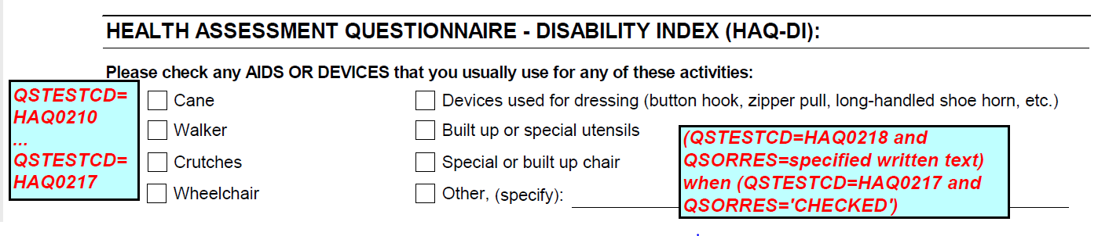
Example of presence of data with “other, specify” – HAQ-DI
HAQ0218 (the specify part of the last checkbox above) is only responded to when HAQ0217 (the checkbox for “Other, (specify)”) is “CHECKED”
Data needs cleaning if HAQ0217/HAQ0218 conflict.
Records are created for all checkboxes and HAQ0218.
HAQ0218 is not considered to be logically skipped because the subject checks all that apply; it is a “presence of data” style of item.
If HAQ0217 is not checked, then HAQ0218 has QSSTAT=“NOT DONE”

Slide 28
Representing presence of data – HAQ-DI
qs.xpt
Row | USUBJID | QSTESTCD | QSORRES | QSSTRESC | QSSTAT
10 | P0001 | HAQ0210 | CHECKED | CHECKED
11 | P0001 | HAQ0211 | NOT CHECKED | NOT CHECKED
12 | P0001 | HAQ0212 | NOT CHECKED | NOT CHECKED
13 | P0001 | HAQ0213 | NOT CHECKED | NOT CHECKED
14 | P0001 | HAQ0214 | NOT CHECKED | NOT CHECKED
15 | P0001 | HAQ0215 | NOT CHECKED | NOT CHECKED
16 | P0001 | HAQ0216 | NOT CHECKED | NOT CHECKED
17 | P0001 | HAQ0217 | NOT CHECKED | NOT CHECKED
18 | P0001 | HAQ0218 |  |  | NOT DONE
* Note: Due to space constraints, some variables are not shown in the qs.xpt table. QSREASND is not
included as the reason there was no response is not known.

Slide 29
Representation of standardized results in CDISC standards
Sometimes standardized results are known to exist for a QRS instrument, but not stated on the CRF. When this occurs, the standardized values will be represented in SDTM. As per CDISC QRS Best Practices: “...This is only done when the numeric standardized responses are documented in the QRS CRF instructions, a user manual, website specific to the QRS instrument, or other reference document that provides a clear explanation and rationale for providing them in the SDTMIG QRS dataset.”

Slide 30
Representation of subtotal and total scores in CDISC standards
Subtotal and total scores provided directly on the CRF will be represented in SDTM as captured data.
Sometimes subtotal and total scores are indicated in a manual for a QRS instrument, but not shown on the CRF. Vendors and sponsors do sometimes submit these electronically to SDTM so these scores will be represented in SDTM as captured data.

Slide 31
Final notes regarding representing missing data in QS/RS/FT
Providing records for items with no response will be unique to QRS domains (QS, RS, and FT).
We are working to revise the SDTMIG to reflect the representation of missing data for QRS instruments.

Slide 32
Thank You!
Dana Booth
dbooth@cdisc.org
Steve Kopko
skopko.external@cdisc.org

