Slide 1
Changes in FDA technical Conformance Guide v4.6
18.Dec2020, German User Group Meeting, Marion Friebel

Slide 2
Definition
This Study Data Technical Conformance Guide provides specification, recommendations and general considerations on how to submit standardized study data using FDA–support
The guide is separated in the same sections as before:

Slide 3
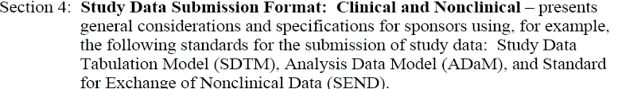

Definition - continue

Slide 4
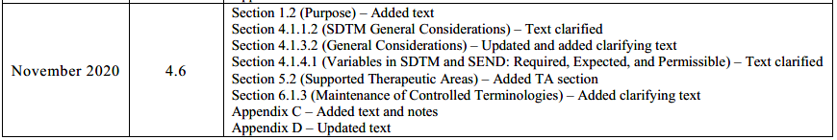
Updates 4.6

Slide 5
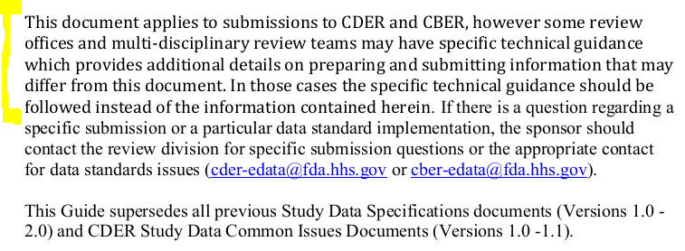
Changes from guide v4.5.1 to Guide v4.6 (released November 2020) –Updates in section 1.2
V4.6:
Added Text
Notes:
More specific that some review team can have specific technical guidiance including additional details-→ early as much contact to review team

Slide 6
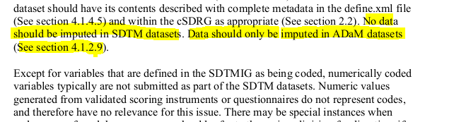
Changes from guide v4.5.1 to Guide v4.6 (released November 2020) –Updates in section 4.1.1.2 v4.5.1:
V4.6: yellow marked passage is removed in v4.6

Slide 7
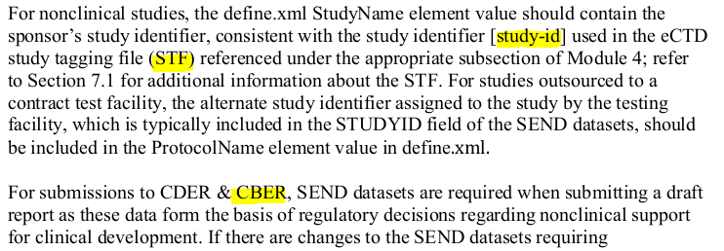
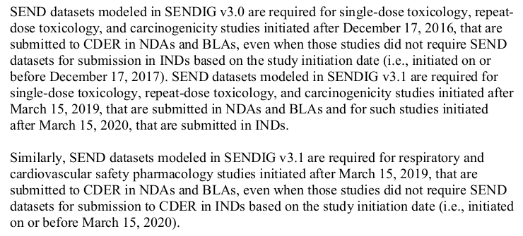
Changes from guide v4.5.1 to Guide v4.6 (released November 2020) –Updates in section 4.1.3.2 v4.6:
New text:
Notes:
Center for Drug Evaluation and Research (CDER) and Center for Biologics Evaluation and Research (CBER).

Slide 8
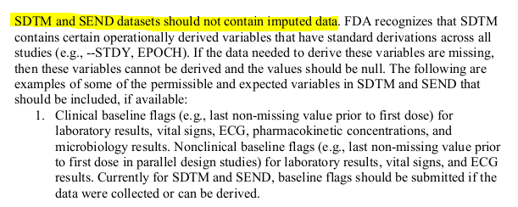
Changes from guide v4.5.1 to Guide v4.6 (released November 2020) –Updates in section 4.1.4.1
V4.5.1:
Notes:
Yellow test deleted

Slide 9

Changes from guide v4.5.1 to Guide v4.6 (released November 2020) –Updates in section 5.2
New Taug:

Slide 10
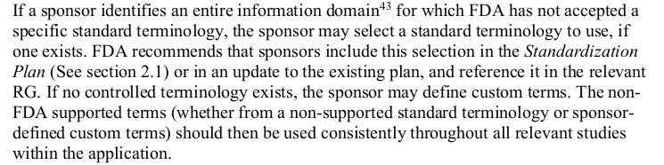
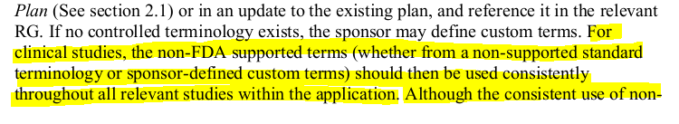

Changes from guide v4.5.1 to Guide v4.6 (released November 2020) –Updates in section 6.1.3
V4.5.1:
V4.6:

Slide 11
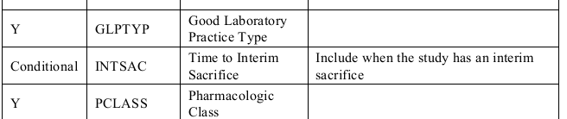
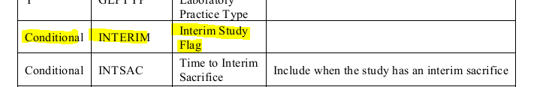
Changes from guide v4.1 to Guide v4.2 (released November 2020) –Appendix c
V4.5.1:
V4.6:

Slide 12
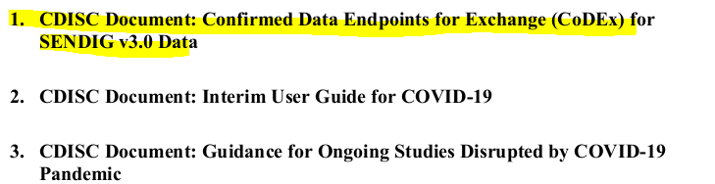
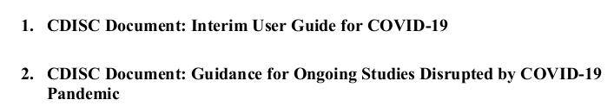
Changes from guide v4.1 to Guide v4.2 (released November 2020) –Appendix D
V4.5.1:
V4.6:

Slide 13
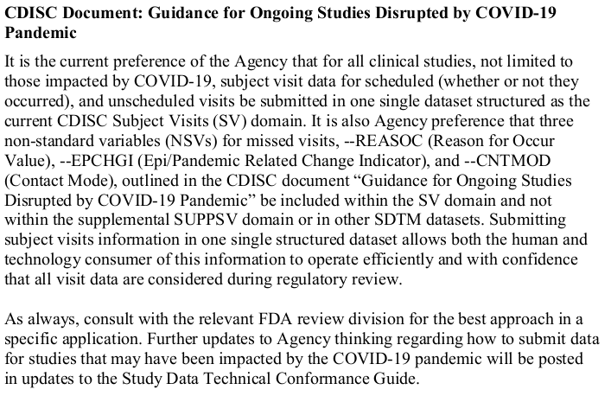
Question : mapping Covid impact SV versa VE ?
:
Notes:
Any experiences , feedback from FDA on mapping SV domain, discrepany to the CDISC guidiances , In French GUG - Peter van Reusel Presentation- question come up and answer was that CDISC will have discussion with FDA regarding the discrepancy-maybe update is available

