Slide 1
Advancing SDTM annotation through automation
Anja Kreis
Wolfgang Rohnert
Gerald Leahy
Nov 2020

Slide 2
DISCLOSURE
The support of this presentation was provided by AbbVie. AbbVie participated in the review and approval of the content.
Anja Kreis is an employee AbbVie and may own AbbVie stock.
Wolfgang Rohnert is an employee AbbVie and may own AbbVie stock.
Gerald Leahy works for AbbVie as a contractor and may own AbbVie stock.
Advancing SDTM annotation through automation | Nov 2020| Company Confidential © 2020 AbbVie |

Slide 3
AGENDA
Introduction aCRF
Challenges of manual process
Why not buy a commercial tool?
aCRF creator – Requirements and Guidelines
aCRF creator – Overview
Manual vs automated process
Challenges and Business Impact
Advancing SDTM annotation through automation | Nov 2020| Company Confidential © 2020 AbbVie |

Slide 4
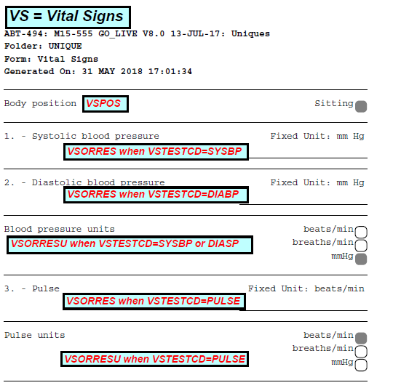
Annotated Case Report Forms (aCRF)
Annotated Case Report Forms (aCRF) - Key CDISC submission deliverable.
Importance of the aCRF for regulatory agencies.
Support FDA reviewer to find the origin of data variables.
Importance of the aCRF for study teams
SDTM annotation performed per study at least two times:
beginning of study for study team
end of study for SDTM submission package
Use by Data Management/Data Science
Use for creating ADaM datasets
Advancing SDTM annotation through automation | Nov 2020| Company Confidential © 2020 AbbVie |

Slide 5
Challenges of manual process
Manual annotation takes a week or more per study.
Manual aCRF bookmark creation usually takes several hours.
The work is done by highly qualified personal. Annotation is a complex Process.
Knowledge needed in different tools. Each tool is providing partial information which needs to be combined manually.
Maintaining consistency across annotations regarding size, color, font type.
Validating annotations against submission datasets are error prone activities.
Advancing SDTM annotation through automation | Nov 2020| Company Confidential © 2020 AbbVie |

Slide 6
Why not buy a commercial tool?
Tools on the market
Use blank Case Report Form (CRF) document from Electronic Data Capture (EDC) system
aCRF Creator
Automated creation of SDTM annotated CRF
Often require pre-annotation of the form
Cannot be linked to in-house systems
Cannot handle complex pages
Entail updates of created annotation
CRF creation based on EDC system metadata instead of using blank CRF from EDC system
Use of Metadata stored and maintained in Metadata Repository, no pre-annotation is needed
Annotation based on study specific metadata from Clinical Data Repository (CDR)
Complete annotation process is automated
6
6
Advancing SDTM annotation through automation | Nov 2020| Company Confidential © 2020 AbbVie |

Slide 7
aCRF creator – Regulatory Requirements
Regulatory Requirement documents
  Technical Conformance Guide
Inlude treatment assignment forms, when applicable and map each variable on the CRF to corresponding variables in dataset
Include variable names and coding for each CRF item
Items not submitted should be annotated with text
‚NOT SUBMITTED‘
    FDA‘s portable document PDF Specifications
Advancing SDTM annotation through automation | Nov 2020| Company Confidential © 2020 AbbVie |

Slide 8
aCRF creator – CDISC Guidelines
Metadata Submission Guidelines v1.0 – CDISC SDS Metadata Team
aCRF should be bookmarked by form and by visit.
aCRF should not have database annotations on it.
aCRF must contain all final unique CRF pages/modules. It should not contain blank pages.
Domain should have its annotation with 2-letter domain code and domain name.
If more than one domain exists on a page, each domain , and all of its variables should be color-coded.
All text in the annotation that represent variable and domain names should be capitalized.
Advancing SDTM annotation through automation | Nov 2020 | Company Confidential © 2020 AbbVie |

Slide 9

aCRF creator – Additional Guidelines
Appearance recommendations (font, color)
Additional Guidelines
Domains [Domain Short Name] = [Domain Long Name]
  Supplemental Qualifiers SUPPXX.QVAL when QNAM = VARNAME
  Test Codes e.g. VSORRES when VSTESTCD= “WEIGHT”, VSORRESU when VSTESTCD=“WEIGHT”
Advancing SDTM annotation through automation | Nov 2020 | Company Confidential © 2020 AbbVie |

Slide 10
aCRF Creator Overview – CRF creation
Tool is a combination of shell scripts and SAS programs (SAS 9.4 on HP-UX)
SAS webservice calls to receive study metadata from EDC System
SAS AUTOMAP attempted to generate XMLMAP ->
too many unneeded elements were defined
New Strategy: map only needed elements
HTML tagging from EDC Tool had to be stripped out
PDF format of each question label and response field based on length of annotation
Final conversion to PDF by PS2PDF
Advancing SDTM annotation through automation | Nov 2020 | Company Confidential © 2020 AbbVie |

Slide 11
aCRF Creator Overview – Access Metadata
Metadata (CDASH, SDTM, mappings, lookups) stored and maintained in MDR
Study specific metadata extracted to Clinical Data Repository (CDR)
FDF file containing annotations feeding from study specific metadata from Clinical Data Repository (CDR)
Advancing SDTM annotation through automation | Nov 2020 | Company Confidential © 2020 AbbVie |

Slide 12
aCRF Creator Overview – Creation of Annotation
CRF label and response field coordinates based on annotation box width and height.
Programming of annotation placement by trial and error until perfect coordinates found.
.
SAS macro reads through metadata received from EDC system and brings over all matching SDTM annotations from study specific metadata.
SAS used to generate all layers, the document layer produced by DATA _NULL_ in postscript format, so the bookmark layer (pdfmark) and annotation layer (FDF) can easily be appended. Script allows to automatically import FDF file to pdf File.
For annotation text field following
information needs to be defined:
Box color, CRF page, Box width and height
Annotation text font and size, alignment, color
Advancing SDTM annotation through automation | Nov 2020 | Company Confidential © 2020 AbbVie |

Slide 13
aCRF Creator - Bookmarking
Tool creates automated bookmarking of domains
Bookmark hierarchy is two tiered with SDTM domain above form name, sorted by SDTM domain prefix
Compiling SDTM domains within a form, identifying the page, reversing the sort to present the bookmarks in the desired order
Advancing SDTM annotation through automation | Nov 2020 | Company Confidential © 2020 AbbVie |

Slide 14

aCRF Creator – System Architecture Diagram
Metadata Repository
Study Metadata
Source-to-Target
Mappings & Rules
Global & Standards
Library Metadata
Source
System
MDR Integration Framework
Target Study Metadata
& Mappings
EDC System
Metadata Load Utility
PL/SQL
Clinical Data Repository
Global Lookup Table
Webservices
EDC System Metadata as XML file
Study Specific Metadata in Business Area (BA) Prod/QC
Pull Study Metadata & Create SAS Datasets
Extract Study Metadata and create/load SAS datasets via XMLMAP
aCRF Creator
eCRF PDF
FDF annotation File
eMail with Link to aCRF
Annotated CRF
Advancing SDTM annotation through automation | Nov 2020 | Company Confidential © 2020 AbbVie |
14

Slide 15
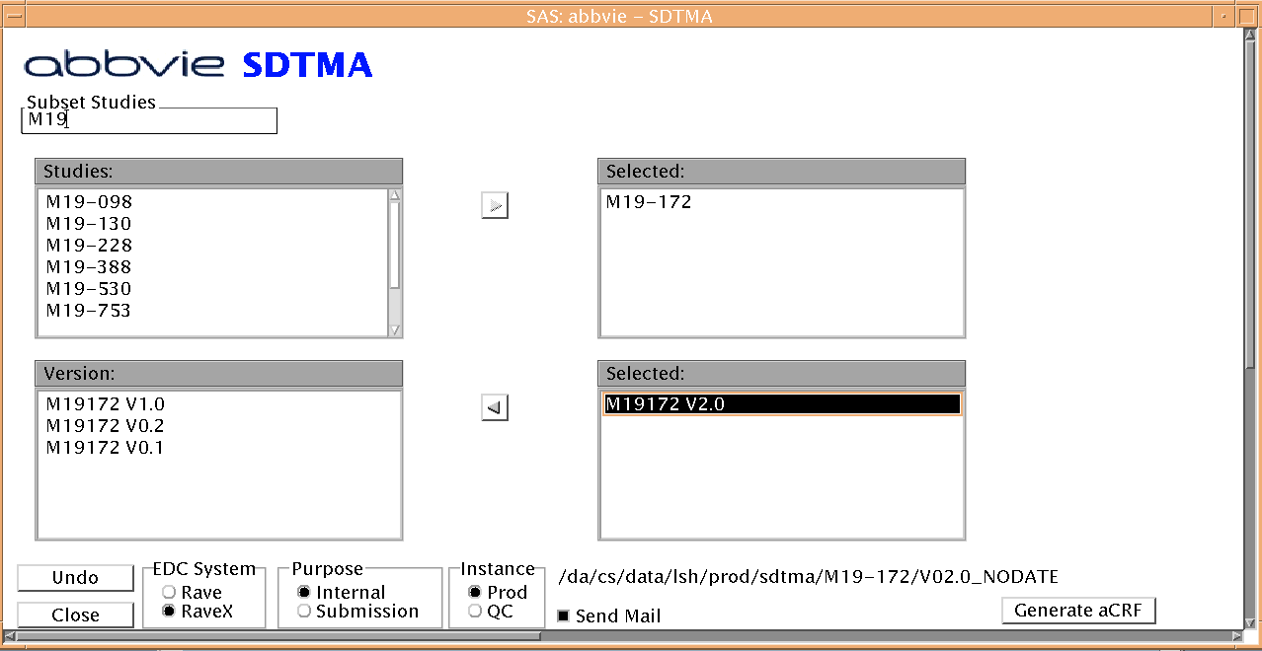
aCRF Creator - UI overview
General overview of user interface
Enter study or prefix of study number
Select Study
Select Production or QC environment
Select CRF version
Select Study and press Generate aCRF
Select Undo to revert last step
Select EDC System dependent on study location
Select Internal for Test Review and Submission for Final Submission
Tick to receive email with link to aCRF
Advancing SDTM annotation through automation | Nov 2020 | Company Confidential © 2020 AbbVie |

Slide 16
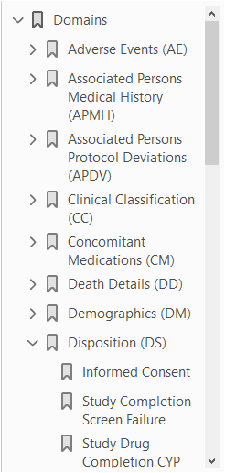
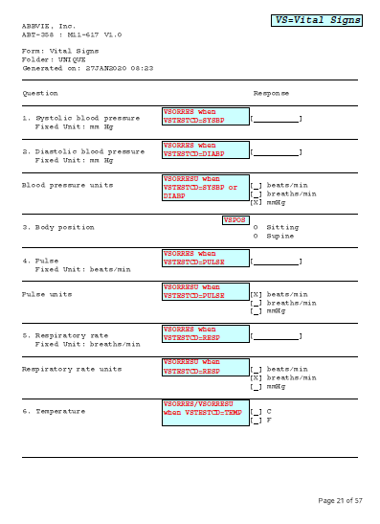
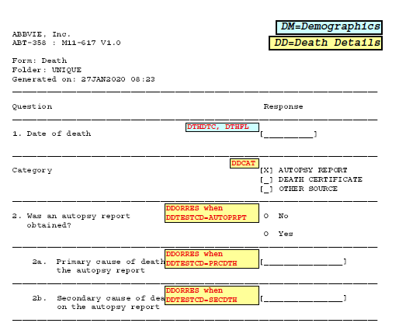
aCRF Creator Output
Advancing SDTM annotation through automation | Nov 2020 | Company Confidential © 2020 AbbVie |

Slide 17
Process manual vs automated SDTM annotation
Create PDF from EDC system
Identify annotations for form, question, test etc.
Set attributes like color and font
Create annotation and place on pdf page
Create domain/visit bookmarks
In case of any EDC setup changes, update annotations and redo bookmarks
Finalize aCRF
Manual
Process
Open automated annotation tool
Select attributs: EDC System, Study, CRF version, Internal Review vs. Submission, Test vs Production Setup, Receive aCRF via email
Click email link to open final aCRF
Automated
Process
Advancing SDTM annotation through automation | Nov 2020 | Company Confidential © 2020 AbbVie |

Slide 18
aCRF creator – Challenges
Interpret XML file from EDC System
Build SAS datasets based on Metadata
Handle characters outside extended ASCII char set
Challenges
Build CRF based on metadata
Create annotations without overlapping the CRF labels
Annotate forms with more than one domain
Study specific deviations
Advancing SDTM annotation through automation | Nov 2020 | Company Confidential © 2020 AbbVie |

Slide 19
aCRF creator – Business Impact
Gain in efficiency – annotation done in several minutes
Users can create annotated CRFs ad hoc without waiting time
More user-friendly way to provide higher quality feedback
Better use of highly qualified personnel
Bookmarking automation reduces the processing time,
prevents transcription errors and inconsistency
Better quality annotated CRFs
Advancing SDTM annotation through automation | Nov 2020 | Company Confidential © 2020 AbbVie |

Slide 20
Thank you!
Questions?
anja.kreis@abbvie.com
Advancing SDTM annotation through automation | Nov 2020 | Company Confidential © 2020 AbbVie |

